Slide 1

Directed Acyclic Graphs – Part I
Epidemiology 207 - Epidemiology Methods II
Rebecca E. Graff, ScD
Assistant Professor, Department of Epidemiology & Biostatistics
Based on Slides from Maria Glymour and Miguel Hernán

Slide 2
Learning Objectives (Weeks 2 & 3)
Overview of DAGs
Research Design Interlude
DAGs for Common Problems in Epidemiology
  Confounding
  Bias in RCTs
  Selection Bias
  Measurement Bias
Limitations of DAGs
2

Slide 3
Overview of DAGs

Slide 4
Why Causal Diagrams?
Conceptualize research questions
Show your assumptions about relationships among variables
Identify and classify sources of bias
Identify issues in study design and analysis
4
Notes:
DAGs help to conceptualize research questions. They offer a framework for summarizing your knowledge and assumptions about the problem you’re trying to solve
Because causal inference generally requires expert knowledge and untestable assumptions about relationships among exposure, outcome, and other variables, DAGs are important for making choices explicit.
They also help to identify and classify sources of bias that could affect your ability to validly answer your research question.
When you represent your study design and analysis in a DAG, you might see issues that you hadn’t otherwise identified

Slide 5
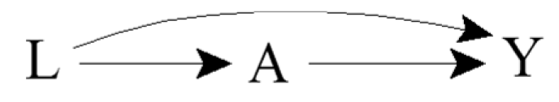
Terminology
Directed: Edges imply a direction
Acyclic: No cycles; a variable cannot cause itself
Edge: Arrow
Node: Random variable
Causal DAG: Common causes of any pair of variables are also in the graph
5
Notes:
Directed refers to the edges, or arrows, having an implied direction
For example, the arrow from L is into A, meaning that L may cause A, but not the other way around
Acyclic refers to the lack of cycles. A variable cannot cause itself
The arrows are referred to as edges
The random variables in a DAG are referred to as nodes
A DAG is considered to be causal when the common causes of any pair of variables in the graph are also in the graph
Causal DAGs need not include variables that are not of interest for the analysis and that are not common causes of other variables in the DAG

Slide 6

Ideal Randomized Experiments
What does the DAG look like for a marginally randomized experiment?
What does the DAG look like for a conditionally randomized experiment?
6
Notes:
E.g., effect of aspirin on the risk of stroke?
An ideal randomized experiment is not affected by any sources of bias, so the only relevant variables are aspirin and stroke.
E.g., effect of aspirin on the risk of stroke conditional on a history of heart disease?
In a conditionally randomized ideal experiment, a history of heart disease affects the probability of randomization to aspirin as well as the probability of stroke → edges from L into A and Y

Slide 7
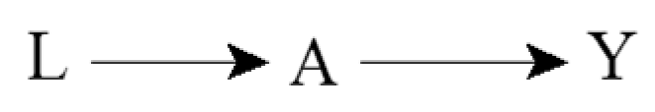
Incorporating Expert Knowledge
Complete DAGs do not exclude any possible causal effect
Incomplete DAGs encode expert knowledge in the form of missing arrows
7
Notes:
When incorporating expert knowledge into DAGs, the information is in the missing arrows.
What is termed a complete DAG does not exclude any possible causal effect
E.g., conditionally randomized experiment that randomized aspirin according to a history of heart disease
What is termed an incomplete DAG, which is to say a DAG that doesn’t have all possible arrows, encodes expert knowledge in the form of missing arrows.
This second DAG, for example, encodes the knowledge that the variable L does not affect the variable Y
E.g., conditionally randomized experiment that randomized according to day of the week? Then day of the week would affect exposure, but we would encode our expert knowledge that day of the week doesn’t affect stroke risk by omitting an arrow from L to Y

Slide 8
Causal Effects and Association
For example:
  A: Cigarette smoking
  Y: Lung cancer
  Pr(Y^{a=1} = 1) ≠ Pr(Y^{a=0} = 1)
  Pr(Y = 1 | A = 1) ≠ Pr(Y = 1 | A = 0)
8
Notes:
DAG that represents a true causal effect.
E.g., smoking has a harmful causal effect on the risk of lung cancer
What should the graph look like that represents an experiment in which cigarette smoking is randomly, and unconditionally, assigned?
Essentially back to our marginally randomized ideal experiment.
In general, when one knows that A has a causal effect on Y, then one should also generally expect A and Y to be associated
Consistent with the fact that in an ideal randomized experiment with unconditional exchangeability, causation implies association and vice versa

Slide 9
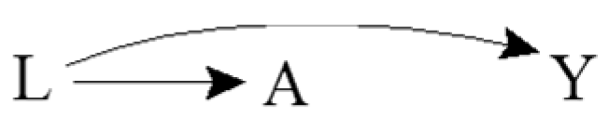
Common Causes and Association
For example:
  A: Yellow fingers
  Y: Lung cancer
  L: Cigarette smoking
  Pr(Y^{a=1} = 1) = Pr(Y^{a=0} = 1)
  Pr(Y = 1 | A = 1) ≠ Pr(Y = 1 | A = 0)
Confounding!
Results in lack of unconditional exchangeability
9
Notes:
DAG showing a common cause of two other variables.
Outcome remains lung cancer, exposure of interest is yellow fingers.
Yellow fingers has no causal effect on lung cancer, as reflected by the lacking arrow between A and Y
There is no causal effect of A and Y
Cigarette smoking, as represented by L, has a causal effect on both having yellow fingers and the risk of lung cancer. It is a common cause of A and Y.
In the observational setting
An investigator asks to see the fingers of a large number of people and records if they are diagnosed with lung cancer during the next five years.
Someone who has yellow fingers is more likely to be a smoker, and therefore is more likely to develop lung cancer.
A and Y are thus expected to be associated because the cancer risk in those with yellow fingers is different from the cancer risk in those without yellow fingers.
Having information about A improves our ability to predict Y, even though A does not cause Y
Are individuals with A = 1 exchangeable with the individuals for whom A = 0? No. There is a lack of exchangeability, and thus confounding of relationship between A and Y by L
That’s reflected in the DAG by a pathway from A to L to Y

Slide 10
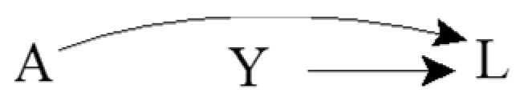
Common Effects
For example:
  A: Genetic factor
  Y: Environmental factor
  L: Lung cancer
  Pr(Y^{a=1} = 1) = Pr(Y^{a=0} = 1)
  Pr(Y = 1 | A = 1) = Pr(Y = 1 | A = 0)
Collider
10
Notes:
Common effects represented by DAGs
Assume that a genetic and environmental risk factor for lung cancer have no bearing on each other.
There is no causal effect of A on Y
The common effect L is referred to as a collider on the path A → L ← Y because the two arrowheads collide on this node
What about the associational relationship?
An investigator decides to study the effect of the genetic risk factor on the risk of the environmental risk factor. She determines whether or not each individual has the genetic risk factor and records whether the same individual has the environmental risk factor. For a person without the genetic risk factor, is the environmental risk factor more or less likely to be present than for any other individual? Learning about the genetic risk factor not improve our ability to predict the outcome Y because the risk of the environmental factor in persons with or without the genetic risk factor is the same. In other words, we would intuitively conclude that A and Y are not associated. The knowledge that both A and Y cause lung cancer is irrelevant when considering the association between A and Y.
Causal graph theory again confirms our intuition because it says that colliders, unlike other variables, block the flow of association along the path on which they lie.
Thus A and Y are independent because the only path between them is blocked by the L.

Slide 11
Conditioning on Mediators
For example:
  A: Cigarette smoking
  Y: Lung cancer
  B: DNA damage to lung cells
  Pr(Y^{a=1} = 1) ≠ Pr(Y^{a=0} = 1)
  Pr(Y = 1 | A = 1) ≠ Pr(Y = 1 | A = 0)
  Pr(Y = 1 | A = 1, B = b) = Pr(Y = 1 | A = 0, B = b)
A
B
Y
11
Notes:
Suppose the only mechanism through which smoking affects lung cancer risk is DNA damage to lung cells
The effect of A on Y runs through B
Is there a causal effect of A on Y?
All of the arrows on the path from A to Y are pointing in the same direction, so A still causes Y.
Association, unlike causation, is a symmetric relationship between two variables; thus, when present, association flows between two variables regardless of the direction of the causal arrows. In this DAG, one could equivalently say that the association flows from A to Y or from Y to A. For causation, however, the arrows must all flow in the same direction. Both A and B cause Y according to this DAG, but Y does not cause either.
Are A and Y unconditionally associated?
We know that A has an effect on Y, so that should indicate to use that there is an association between A and Y
But what if we only look at individuals who do (or do not) have DNA damage?
Represented by a box around B. We’ve conditioned on the variable B.
Is there an association between A and Y within levels of B or conditional on B? When we already have information on B, does information on A improve our ability to predict Y?
Suppose we restrict the analysis to the subset of individuals with no DNA damage (B=0), as indicated by the box placed around B.
Individuals with no DNA damage (B = 0) have a lower than average risk of lung cancer. Regardless of whether an individual with no DNA damage was treated (A = 1) or untreated (A = 0), we already know that he has a lower than average risk because he doesn’t have DNA damage.
Because smoking affects lung cancer risk only through DNA damage, learning smoking status doesn’t contribute any additional information about lung cancer risk
In the subset of individuals with low DNA damage, smoking and lung cancer are not associated, and it’s the same argument for those DNA damage.
Graphically, we say that a box placed around variable B blocks the flow of association through the path A → B → Y .

Slide 12
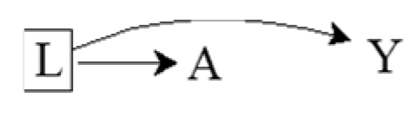
Conditioning on Common Causes
For example:
  A: Yellow fingers
  Y: Lung cancer
  L: Cigarette smoking
  Pr(Y^{a=1} = 1) = Pr(Y^{a=0} = 1)
  Pr(Y = 1 | A = 1) ≠ Pr(Y = 1 | A = 0)
  Pr(Y = 1 | A = 1, L = l) = Pr(Y = 1 | A = 0, L = l)
12
Notes:
Is A associated with Y conditional on L?
Represented by the box around L.
Suppose the investigator restricts the study to nonsmokers (L = 0).
Learning that an individual has yellow fingers (A = 1) does not help predict his risk of lung cancer (Y = 1) because the entire argument for better prediction relied on the fact that people with yellow fingers are more likely to be smokers.
This argument is irrelevant when the study is restricted to nonsmokers or, more generally, to people who smoke with a particular intensity.
Even though A and Y are marginally associated, A and Y are conditionally independent given L because the risk of lung cancer is the same in the treated and the untreated within levels of L
The flow between A and Y is interrupted because the path A ← L → Y is blocked by the box around L.

Slide 13
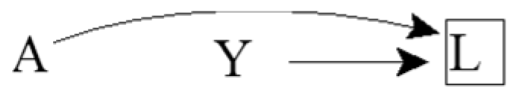
Conditioning on Common Effects
For example:
  A: Genetic risk factor
  Y: Environmental risk factor
  L: Lung cancer
  Pr(Y^{a=1} = 1) = Pr(Y^{a=0} = 1)
  Pr(Y = 1 | A = 1) = Pr(Y = 1 | A = 0)
  Pr(Y = 1 | A = 1, L = l) ≠ Pr(Y = 1 | A = 0, L = l)
Selection Bias!
Results in lack of conditional exchangeability
13
Notes:
What happens to the relationship between A and Y if we condition on their common effect L?
Suppose that the investigators, who are interested in estimating the effect of genetics on environment, restricted the study population to individuals with lung cancer (L = 1).
The square around L indicates that they are conditioning on a particular value of L.
Knowing that an individual with lung cancer does not have the genetic risk factor provides some information about the environmental risk factor because, in the absence of the genetic risk factor, it is more likely that another cause of lung cancer is present.
Among individuals with lung cancer, the proportion of individuals with the environmental risk factor is increased among individuals without the genetic risk factor.
Therefore, A and Y are inversely associated conditional on L = 1.
The investigator will make a mistake if he concludes that A has a causal effect on Y just because A and Y are associated within levels of L.
In the extreme, if the genetic and environmental factors were the only causes of lung cancer, then among individuals with lung cancer, the absence of one risk factor would perfectly predict the presence of the other.
Causal graphs theory shows that indeed conditioning on a collider like L opens the path A → L ← Y, which was blocked when the collider was not conditioned on.
Intuitively, whether two variables (the causes) are associated cannot be influenced by an event in the future (their effect), but two causes of a given effect generally become associated once we stratify on the common effect.
Premise of selection bias under the null.

Slide 14
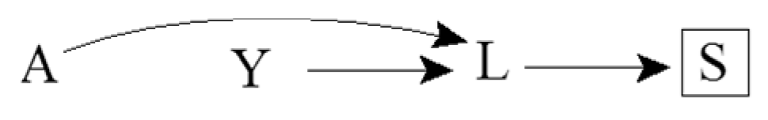
Consequences of Colliders
For example:
  A: Genetic risk factor
  Y: Environmental risk factor
  L: Lung cancer
  S: Death from lung cancer
  Pr(Y = 1 | A = 1, S = s) ≠ Pr(Y = 1 | A = 0, S = s)
14
Notes:
This causal diagram adds a consequence of the lung cancer, namely death from lung cancer.
A and Y are also associated within levels of S because S is a common effect of A and Y.
Causal graphs theory shows that conditioning on a variable S affected by a collider L also opens the path A → L ← Y
This path is blocked in the absence of conditioning on either the collider L or its consequence S.

Slide 15
Sources of Association
Statistical association between two variables A and Y may be due to:
Random fluctuation
A causing Y
Y causing A
A and Y sharing a common cause
Conditioning on a common effect of A and Y
15
Notes:
Two variables may be associated by chance, but that’s not a structural source of association
Increase the sample size and chance associations disappear, whereas structural associations will remain
We don’t address chance since we’re focusing our discussion on bias. We’re essentially assuming a very large population.

Slide 16
How we can use this
Eliminating four of these explanations is usually the goal of an analysis
Knowing these five sources of statistical association helps identify the (set of) causal structure(s) that could have generated the observed statistical associations
16

Slide 17
D-separation
Set of graphical rules to decide whether two variables are
  D-separated: independent
  D-connected: associated (in general)
If two variables are d-separated
  Without conditioning on any other variables in the DAG, then they are marginally independent
  After conditioning on a set of other variables, then they are conditionally independent
17

Slide 18
More Terminology
Ancestors / Descendants
  Parents / Children
Path: a route that connects two variables by following a sequence of edges such that the route visits no variable more than once
  A causal path consists entirely of edges with their arrows pointing in the same direction
Paths can be either blocked or open according to the following graphical rules
18
Notes:
V2 is a descendant of V1 (and V1 is an ancestor of V2) if there is a sequence of nodes connected by edges between V1 and V2 such that following the direction indicated by the arrows, one can reach V2 by starting at V1.
Parents: the set of nodes with direct arrow into the variable of interest

Slide 19
Rule 1
If there are no variables being conditioned on, a path is blocked if and only if two arrowheads on the path collide at some variable on the path
Open path
Blocked path
19

Slide 20

Rule 2
Any path that contains a noncollider that has been conditioned on is blocked
We use a box around a variable to indicate that we are conditioning on it
Blocked path
20

Slide 21

Rule 3
A collider that has been conditioned on does not block a path
Open path
21

Slide 22
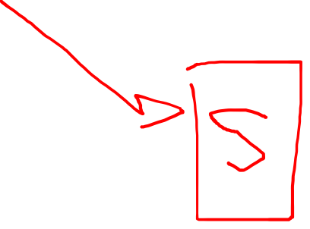
Rule 4
A collider that has a descendant (e.g., child) that has been conditioned on does not block a path
Open path
22

Slide 23
Directed Acyclic Graphs – Part II
Epidemiology 207 - Epidemiology Methods II
Rebecca E. Graff, ScD
Assistant Professor, Department of Epidemiology & Biostatistics
Based on Slides from Maria Glymour and Miguel Hernán

Slide 24
Learning Objectives (Weeks 2 & 3)
Overview of DAGs
Research Design Interlude
DAGs for Common Problems in Epidemiology
  Confounding
  Bias in RCTs
  Selection Bias
  Measurement Bias
Limitations of DAGs
24

Slide 25
Review of DAG Intuition

Slide 26
Review of D-separation
Notes:
Note that “d” connotes “directional”

Slide 27
Questions from the Recorded Lecture?

Slide 28
Exercises

Slide 29
Causation
What causal statement represents the relationship between A and Y?
L
A
B
Y
C

Slide 30
Causation – Solution
What causal statement represents the relationship between A and Y?
L
A
B
Y
C
  Pr(Y^{a=1} = 1) ≠ Pr(Y^{a=0} = 1)

Slide 31
Association I
What marginal associational statement represents the relationship between A and Y?
L
A
B
Y
C

Slide 32
Association I – Solution
What marginal associational statement represents the relationship between A and Y?
L
A
B
Y
C
  Pr(Y = 1 | A = 1) ≠ Pr(Y = 1 | A = 0)

Slide 33
Association II
What marginal associational statement represents the relationship between L and C?
L
A
B
Y
C

Slide 34
Association II – Solution
What marginal associational statement represents the relationship between L and C?
L
A
B
Y
C
  Pr(C = 1 | L = 1) ≠ Pr(C = 1 | L = 0)

Slide 35
Association III
What associational statement represents the relationship between L and Y, conditional on A?
L
A
B
Y
C

Slide 36
Association III – Solution
What associational statement represents the relationship between L and Y, conditional on A?
L
A
B
Y
C
  Pr(Y = 1 | L = 1, A = a) ≠ Pr(Y = 1 | L = 0 , A = a)

Slide 37
Association IV
What associational statement represents the relationship between L and B, conditional on A?
L
A
B
Y
C

Slide 38
Association IV – Solution
What associational statement represents the relationship between L and B, conditional on A?
L
A
B
Y
C
  Pr(B = 1 | L = 1, A = a) ≠ Pr(B = 1 | L = 0 , A = a)

Slide 39
Research Design Interlude

Slide 40
Research Design
You are interested in estimating the effect of A on Y
Imagine the most plausible the ways the world might work
If the world worked like this or like that, would your analysis plan successfully identify the effect of A on Y?
What assumptions do you have to make to interpret your statistical association as a causal effect?
40

Slide 41
Quizlet: Can you test which DAG is correct if you have data on these variables?
X₁
X₁
X₂
X₃
X₂
X₃
X₄
X₄
X₅
X₅
If you know that one of these two causal structures generated the data, and you have perfect measures of all 5 variables, can you tell which one is correct?
41

Slide 42
Quizlet
X₁
X₁
X₂
X₃
X₂
X₃
X₄
X₄
X₅
X₅
X₁, X₂, and X₃ are independent of X₅, unless you condition on X_{4,} when they become associated with X₅
Hint: We’re looking for something like this for the answers to HW Q10
X₁, X₂, and X₃ predict X₅, but are independent of X₅ conditional on X₄.
42
Notes:
there are several statistical considerations that are DIFFERENT between these two DAGS.
If you condition on X4, you can check your data and see which correlations fit your data better.
if you condition on X4 in the first DAG, then X2 and X5 are not correlated, or are independent
If you condition on X4 in the 2nd DAG, they become correlated

Slide 43
Quizlet: Can you test which DAG is correct if you have data on these variables?
X₁
X₁
X₁
X₁
X₂
X₃
X₂
X₃
X₂
X₃
X₄
X₄
U
X₄
X₅
X₅
X₅
If you know that one of these three causal structures generated the data, and you have perfect measures of all 5 variables, can you tell which one is correct?
43

Slide 44
Quizlet
X₁
X₁
X₁
X₂
X₃
X₂
X₃
X₂
X₃
X₄
X₄
U
X₄
X₅
X₅
X₅
X₁, X₂, and X₃ are independent of X₅, unless you condition on X_{4,} when they become associated with X₅
X₁ and X₃ are independent of X₅, unless you condition on X₂ or X_{4,} when they become associated with X₅
X₁, X₂, and X₃ predict X₅, but are independent of X₅ conditional on X₄.
44
Notes:
- if you condition on X4, it has the same effect as conditioning on X2, which is a collider, bc X4 is a descendent of a collider

Slide 45
DAGs for Common Problems in Epidemiology
Confounding

Slide 46
Confounding is When…
Exposure and outcome have common causes
The exposed are not exchangeable with the unexposed
Association is not causation
All equivalent characterizations!
46

Slide 47
Identifiability of Causal Effects
Two components of an unconditional association between exposure and outcome:
  Effect of exposure on outcome
  Result of common causes
Can we identify the former component?
47
Notes:
A causal effect can be identified when there are no common causes or there are common causes but we have enough information to block what all are called backdoor paths
Here, the path A ← L → Y is an example of a backdoor path
A backdoor path is a path between A and Y that includes an arrow into A
To identify the former component we need expert knowledge
Statistical criteria are insufficient

Slide 48
The Backdoor Criterion
A set of variables L satisfies the backdoor criterion relative to A and Y in a DAG if:
  No variable in L is a descendant of A
  All backdoor paths between A and Y are blocked by conditioning on L
If a set of variables L satisfies the backdoor criterion, then the causal effect of A on Y is identifiable
48
Notes:
Conditional exchangeability on L holds if and only if L satisfies the backdoor criterion

Slide 49
Healthy Worker Bias
For example:
  A: Working as a firefighter
  Y: Death
  L: Physical fitness
49
Notes:
The effect of working as a firefighter A on the risk of death Y will be confounded if “being physically fit” L is a cause of both being an active firefighter and having a lower mortality risk.
Does L satisfy the backdoor criterion?
Yes

Slide 50
Exercise
How might you draw a DAG representing confounding by indication?
  A: Aspirin
  Y: Stroke
  L: Heart disease
  U: Atherosclerosis
50

Slide 51
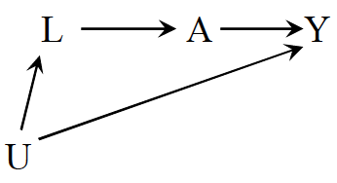
Exercise – Solution
How might you draw a DAG representing confounding by indication?
  A: Aspirin
  Y: Stroke
  L: Heart disease
  U: Atherosclerosis
51
Notes:
The effect of aspirin on the risk of stroke will be confounded if the drug is more likely to be prescribed to individuals with a condition (heart disease) that is both an indication for treatment and a risk factor for the disease.
Does L satisfy the backdoor criterion?
Yes
What if heart disease is only a risk factor for stroke because both heart disease and stroke are caused by atherosclerosis?
Does L satisfy the backdoor criterion?
Still yes

Slide 52
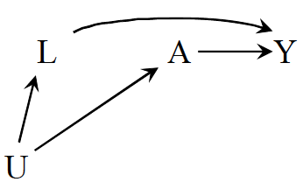
Confounding by Lifestyle
For example:
  A: Exercise
  Y: Death
  L: Cigarette smoking
  U: Personality or social factors
52
Notes:
The effect of behavior exercise on the risk of death will be confounded if the behavior is associated with another factor like cigarette smoking that has a causal effect on Y and tends to co-occur with exercise.
Does L satisfy the backdoor criterion?
Yes

Slide 53
Confounding by Early Life Factors
L₂
1
For example:
  A: Depression
  Y: Death
  L₁: Education
  L₂: Income
53
Notes:
Does education satisfy the backdoor criterion?
Yes
Does income satisfy the backdoor criterion?
Yes
One can adjust for either education or income to identify the effect of depression on mortality

Slide 54
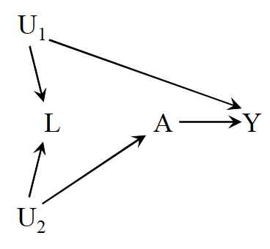
Be Careful with Adjustment!
For example:
  A: Physical activity
  Y: Cervical cancer
  L: Pap smear
  U₁: Pre-cancer lesion
  U₂: Health-conscious personality
54
Notes:
Do A and Y have any common causes in this scenario?
No!
L does not confound the effect of A on Y!
In fact, adjusting for it would open up a non-causal path between A and Y
Does L satisfy the backdoor criterion?
No!
This is our first example of a scenario in which unconditional exchangeability holds, but conditional exchangeability does not
Some people would call this selection bias since one is conditioning on a collider and others would still call it confounding since the bias results from an open backdoor path from A to Y
The definition is just a matter of preference
The conclusions are the same regarding identifiability of the causal effect

Slide 55
Is L a “confounder”?
Is L associated with A?
Is L associated with Y conditional on A?
Is L on the causal pathway from A to Y?
Yes
Yes
No
55
Notes:
L fulfills the traditional definition of a confounder, but adjusting for it would introduce bias in this case

Slide 56
Is L a “confounder”?
Is the conditional (within levels of L) association between A and Y different from the unconditional association measure?
  E.g., the adjusted odds ratio changes by >10% compared to the unadjusted odds ratio
Differences between conditional and unconditional association measures may exist in the absence of common causes when
  Using non-collapsible measures
  Conditioning on common effects
56

Slide 57
Is L a “confounder”?
Be careful with the “standard” definitions!
We need expert knowledge to determine if we should adjust for a variable
*But* if our expert knowledge reduces the number of possible causal structures, then consider the methods on the prior two slides to decide whether a variable is a confounder (Ahem, HW Q9!)
57

Slide 58
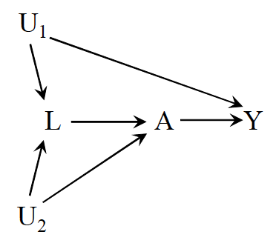
Intractable Confounding
Open backdoor path A ← L ← U₁ → Y
But what happens if we adjust for L?
  Open the path A ← U₂ → L ← U₁ → Y
58
Notes:
Does L satisfy the backdoor criterion?
No!
To deal with the bias, we’d have to find a way to measure a variable between U1 and A or Y or a variable between U2 and either A or L

Slide 59
Until Next Time…
Finish Homework #1
Get Started on Homework #2
Read Chapters 8.1-8.3 and 9.1-9.3 in Hernán & Robins
Watch “Directed Acyclic Graphs – Part III”
Office Hours: Tuesday @ 1:10pm on Zoom
Class 1/20 will be virtual

Slide 60
Directed Acyclic Graphs – Part III
Epidemiology 207 - Epidemiology Methods II
Rebecca E. Graff, ScD
Assistant Professor, Department of Epidemiology & Biostatistics
Based on Slides from Maria Glymour and Miguel Hernán

Slide 61
Learning Objectives (Weeks 2 & 3)
Overview of DAGs
Research Design Interlude
DAGs for Common Problems in Epidemiology
  Confounding
  Bias in RCTs
  Selection Bias
  Measurement Bias
Limitations of DAGs
61

Slide 62
DAGs for Common Problems in Epidemiology
Bias in RCTs

Slide 63
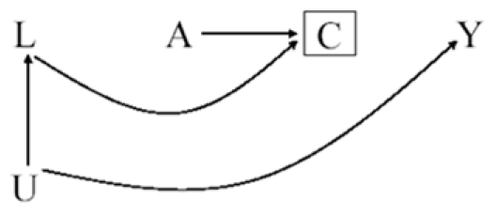
Example RCT
A: ART Treatment Arm
Y: 3-year Risk of Death
U: Level of Immunosuppression
L: Symptoms, CD4 Count, etc.
C: Loss to Follow-up
63

Slide 64
Confounding & Selection Bias
Can confounding occur in this marginally randomized RCT?
  No
Can selection bias occur in this marginally randomized RCT?
  Yes
64
Notes:
There are no common causes of A and any other variable on account of treatment being randomly assigned
Individuals in both randomized experiments and observational studies may be lost to follow-up or drop out of the study before their outcome is ascertained.

Slide 65
More on Selection Bias in RCTs
⛔️ Pr(Y = 1 | A = a)
✅ Pr(Y = 1 | A = a, C = 0)
Randomization protects against confounding, but not necessarily against selection bias
65
Notes:
When individuals are lost to follow-up the risk of the outcome among those assigned to antiretrovirals and among those assigned to no therapy cannot be computed because the value of the outcome Y is unknown for the censored individuals (C = 1).
Only the risks among the uncensored Pr[Y= 1|A = a, C = 0] can be computed.
Unfortunately, this restriction of the analysis to the uncensored individuals induces selection bias.
Uncensored individuals who remained through the end of the study (C = 0) are not exchangeable with individuals that were lost (C = 1); conditioning on the collider C induces an association between A and Y

Slide 66
Selection Before Randomization
A: ART Treatment Arm
Y: 3-year Risk of Death
U: Level of Immunosuppression
L: Symptoms, CD4 Count, etc.
C: Volunteer Status
C
A
Y
L
U
66
Notes:
No bias arises in randomized experiments from selection into the study before treatment is assigned.
Even though only volunteers are included in RCTs, they are not affected by volunteer bias because participants are randomly assigned to treatment only after agreeing to participate (C = 0).
Generalizability or external validity will be affected, but the results from the randomized trial will be internally valid

Slide 67
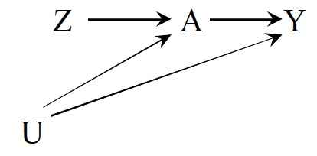
Noncompliance
For example:
  Z: Exposure assignment
  A: Exposure
  Y: Outcome
  U: Factors affecting adherence and the outcome
What kind of analysis looks at the effect of A on Y?
What kind of analysis looks at the effect of Z on Y?
→ as-treated
→ intention-to-treat
67
Notes:
intention to treat is generally favored in randomized experiments to preserve the lack of confounding that is guaranteed by randomization in large enough samples

Slide 68
Unblinding
How might you draw a DAG representing unblinding?
  Z: Exposure assignment
  A: Exposure
  Y: Outcome
  U: Blinded status
68

Slide 69
Unblinding
How might you draw a DAG representing unblinding?
  Z: Exposure assignment
  A: Exposure
  Y: Outcome
  U: Blinded status
69

Slide 70
Directed Acyclic Graphs – Part IV
Epidemiology 207 - Epidemiology Methods II
Rebecca E. Graff, ScD
Assistant Professor, Department of Epidemiology & Biostatistics
Based on Slides from Maria Glymour and Miguel Hernán

Slide 71
Learning Objectives (Weeks 2 & 3)
Overview of DAGs
Research Design Interlude
DAGs for Common Problems in Epidemiology
  Confounding
  Bias in RCTs
  Selection Bias
  Measurement Bias
Limitations of DAGs
71

Slide 72
Questions from the Recorded Lecture?

Slide 73
DAGs for Common Problems in Epidemiology
Selection Bias

Slide 74
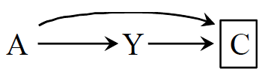
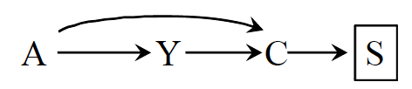
What is Selection Bias?
Bias due to the process used to select subjects into the study or into the analysis
Consequence of conditioning on a common effect of exposure and outcome
  Or on a common effect of a cause of the exposure and a cause of the outcome
74
Notes:
Two sources of association:
the causal effect of A on Y
The open path between A and Y resulting from conditioning on a common effect
The examples DAGs herein just that – examples
Even within types of bias, there isn’t only one structure that represents the bias in all its forms
Depends on the causal questions, the nodes and relationships among them can change.
Selection bias can also be a common effect of a cause of exposure and the outcome itself or a common effect of the exposure itself and a cause of the outcome

Slide 75
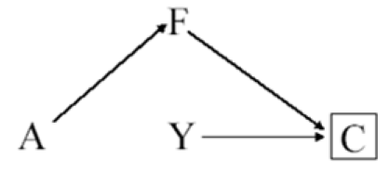
Inappropriate Selection of Controls
For example:
  A: Postmenopausal hormones
  Y: Coronary heart disease
  F: Hip fracture
  C: Selection into study
75
Notes:
The arrow from disease status Y to selection C indicates that cases in the population are more likely to be selected than non-cases, which is the defining feature of a case-control study.
In this particular case-control study, the investigator decided to select controls (C = 0) preferentially among women with a hip fracture.
Because treatment A has a protective causal effect on hip fracture, the selection of controls with hip fracture implies that treatment A now has a causal effect on selection C.
In a case-control study, the odds ratio is by definition conditional on having been selected into the study (C = 0). If individuals with hip fracture are oversampled as controls, then the probability of control selection depends on a consequence of treatment A (as represented by the path from A to C) and “inappropriate control selection” bias will occur.
Again, this bias arises because we are conditioning on a common effect C of treatment and outcome.
A heuristic explanation of this bias :
Among individuals selected for the study (C = 0), controls are more likely than cases to have had a hip fracture.
Therefore, because estrogens lower the incidence of hip fractures, a control is less likely to be on estrogens than a case, and hence the A-Y odds ratio conditional on C = 0 would be greater than the causal odds ratio in the population.

Slide 76
Differential Loss to Follow-up
For example:
  A: Antiretroviral therapy
  Y: AIDS
  C: Censoring
  L: Symptoms, CD4, viral load
  U: Immunologic status
76
Notes:
DAG from DAGs for RCT lecture
Example of what the structure of differential loss to follow-up (i.e., informative censoring) can look like
Differential loss to follow-up can take on many forms
In addition, other types of bias can take on the same form

Slide 77
Non-response / Missing Data Bias
For example:
  A: Antiretroviral therapy
  Y: AIDS
  C: Reluctance to answer questions
  L: Symptoms, CD4, viral load
  U: Immunologic status
77
Notes:
The variable C can represent missing data on the outcome for any reason, not just as a result of loss to follow up.
For example, individuals could have missing data because they are reluctant to provide information or because they miss study visits.
Regardless of the reasons why data on Y are missing, restricting the analysis to individuals with complete data (C = 0) may result in bias.

Slide 78
Exercise
How might you draw a DAG representing volunteer (self-selection) bias?
  A: Smoking
  Y: Coronary heart disease
  C: Volunteered to participate
  L: Heart disease awareness
  U: Family history of heart disease
78

Slide 79
Exercise – Solution
How might you draw a DAG representing volunteer (self-selection) bias?
  A: Smoking
  Y: Coronary heart disease
  C: Volunteered to
  participate
  L: Heart disease awareness
  U: Family history of heart disease
79

Slide 80
Another Healthy Worker Bias
For example:
  A: Chemical exposure
  Y: Death
  C: Being at work
  L: Physical exam
  U: Health status
80
Notes:
The study is restricted to individuals who are at work (C = 0) at the time of outcome ascertainment.
Being exposed to the chemical reduces the probability of being at work in the near future (e.g., exposure can cause disabling asthma)

Slide 81
Prevalent User Bias
A
Y₋₁
C
Y₁
L
For example:
  A: Aspirin use
  Y₋₁: Death before time 0
  Y₁: Death after time 0
  C: Selection into study
  L: Exercise
81
Notes:
This creates a potential collider bias because exposed individuals who do not have the event prior to T₀ may have other characteristics (L) that protected them from an early event and also bias associations with later event rates.

Slide 82
Adjusting for Selection Bias
Design
  E.g., sampling controls that represent the exposure distribution in the population
Analysis
  Stratification
82
Notes:
Stratification boxes nodes
In this DAG representing differential loss to follow-up, we can stratify on L to deal with the selection bias

Slide 83
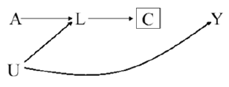
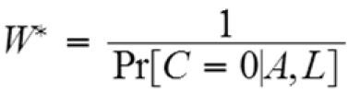
Adjusting for Selection Bias
But what about this DAG?
  Stratification doesn’t work!
Inverse Probability Censoring Weighting
    Same concept as IPW
    But treat censoring as the “exposure”
    Everyone in the pseudo-population is uncensored
83
Notes:
Differential loss to follow-up can also take on this structure
C is a descendant of L, so we already have an open pathway between A and Y
To close the pathway, we can remove any arrows into C via inverse probability censoring weighting
Inverse probability weighting appropriately adjusts for selection bias in this situation because this approach is not based on estimating effect measures conditional on the covariates L, but rather on estimating unconditional effect measures after reweighting the subjects according to their exposure and their values of L.
Stratification boxes nodes, whereas IPW removes arrows

Slide 84
DAGs for Common Problems in Epidemiology
Measurement Bias
Notes:
Also called information bias

Slide 85
What is Measurement Bias?
Bias due measurement of study variables with error, such that the observed associational measure does not equal the causal measure
No single structure describing measurement bias
85

Slide 86
Relevant Variables
For example:
  A: Exposure
  A*: Exposure measurement
  U_{A}: Factors other than A that determine the value of A* (i.e., measurement error)
  Y: Outcome
  Y*: Outcome measurement
  U_{Y}: Factors other than Y that determine the value of Y* (i.e., measurement error)
86

Slide 87
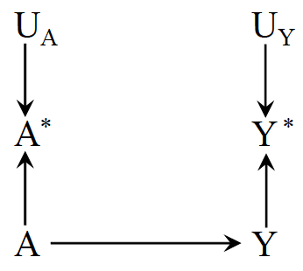
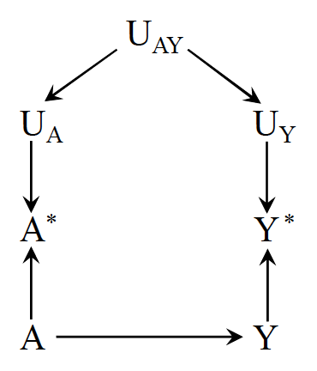
Nondifferential Measurement Error
Independent nondifferential measurement error
Dependent nondifferential measurement error
87
Notes:
E.g., A = cholesterol-lowering drugs, Y = liver disease
According to the rules of d-separation, the measurement errors Ua and Uy are independent because the path between them is blocked by colliders (either A* or Y*)
E.g., haphazard data entry errors
In other settings, however, the measurement errors for exposure and outcome may be dependent, as depicted in the second figure
For example, dependent measurement errors will occur if the information were obtained retrospectively by phone interview and an individual’s ability to recall her medical history (Uay) affected the measurement of both A and Y.
Both Figures represent settings in which the error for treatment Ua is independent of the true value of the outcome Y, and the error for the outcome Uy is independent of the true value of treatment A.
We then say that the measurement error for treatment is nondifferential with respect to the outcome and that the measurement error for the outcome is nondifferential with respect to the treatment.
Note that the mismeasured variables are NOT boxed
We aren’t conditioning on mismeasurement

Slide 88
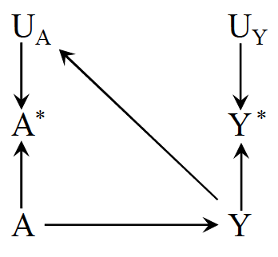
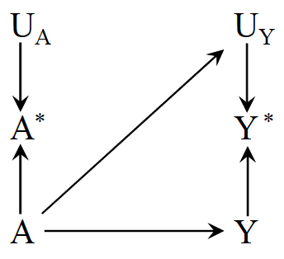
Independent Differential Measurement Error
Independent differential measurement error of exposure
Independent differential measurement error of outcome
88
Notes:
In the first figure, measurement errors of treatment and outcome are independent but differential, such that the true value of the outcome affects the measurement of the treatment
E.g., A = drug use, Y = dementia
A ascertained by interviewing demented study participants
The second figure, shows an example of independent but differential measurement error in which the true value of the treatment affects the measurement of the outcome (i.e., an arrow from A to Uy).
E.g., A differential measurement error of the outcome will occur if physicians, suspecting that drug use A causes liver toxicity Y, monitored patients receiving drug more closely than other patients.
Note that the mismeasured variables are NOT boxed
We aren’t conditioning on mismeasurement

Slide 89
Exercise
How might you draw a DAG representing recall bias?
  A: Alcohol use
  A*: Recalled alcohol use
  U_{A}: Factors other than A that determine the value of A* (i.e., measurement error)
  Y: Birth defects
  U_{Y}: Factors other than Y that determine the value of Y* (i.e., measurement error)
89

Slide 90
Exercise – Solution
How might you draw a DAG
representing recall bias?
  A: Alcohol use
  A*: Recalled alcohol use
  U_{A}: Factors other than A that determine the value of A* (i.e., measurement error)
  Y: Birth defects
  U_{Y}: Factors other than Y that determine the value of Y* (i.e., measurement error)
90
Notes:
One would expect an arrow from Y to Ua in a study to compute the effect of alcohol use during pregnancy A on birth defects Y if alcohol intake is ascertained by recall after delivery–because recall may be affected by the outcome of the pregnancy.
The resulting measurement bias is often referred to as recall bias

Slide 91
Reverse Causation Bias
For example:
  A: Drug A
  A*: Blood levels of drug A
  Y: Liver toxicity
91
Notes:
A bias with the same structure might arise if blood levels of drug A* are used in place of actual drug use A, and blood levels are measured after liver toxicity Y is present–because liver toxicity affects the measured blood levels of the drug.
The resulting measurement bias is often referred to as reverse causation bias

Slide 92
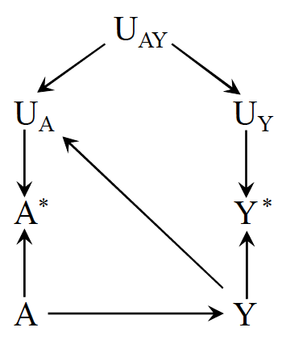
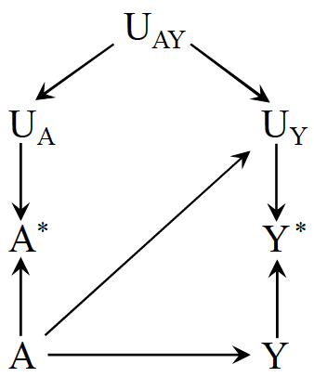
Dependent Differential Measurement Error
Dependent differential measurement error of exposure
Dependent differential measurement error of outcome
92
Notes:
These figures depict measurement errors that are both dependent and differential, which may result from a combination of the settings described above.

Slide 93
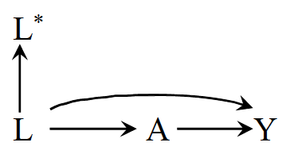
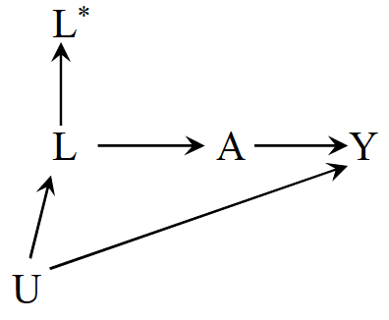
Mismeasured Confounders
Conditioning on L* does not block the backdoor path between A and Y in either scenario
93

Slide 94
Limitations of DAGs

Slide 95
Some Objections to DAGs
DAGs do not display effect modification
  If Z modifies the effect of X on Y, then Z must itself affect Y.
  Effect modification is scale dependent, so showing an effect modifier implies a scale and DAGs do not represent any scale
  Some progress on this: e.g., VanderWeele’s sufficient cause framework
  If Z and X both affect Y, then there is some scale on which Z modifies the effect of X and vice versa
95

Slide 96
Some Objections to DAGs
DAGs do not represent the magnitude of bias
  Major limitation
  Lots of work now on (a) signing the bias and (b) estimating the magnitude
  Simulations and bias bounding formulas
96

Slide 97
Some Objections to DAGs
DAGs do not match the complex, dynamic feedback loops in the real world
  DAGs can represent feedback between two variables
  DAGs can represent complex interventions (e.g., deliver this set of 4 treatments vs only 2 of these)
  DAGs match (one of the) things you want to know: will intervening in a specific way elicit a change in health?
  To say “it’s all very complicated and impossible to specify which variables come first” is to abdicate any hope of guiding clinical or policy decisions
  DAGs do not tell you everything, and complex systems simulations are often useful as a next step to predict spillovers and interactions with variables you do not have in your DAG; the simulation will presumably rely on causal parameter inputs.
97

Slide 98
Some Objections to DAGs
I’m not sure about which causal structure is right
  Do you know enough to rule some DAGs out?
  What are the commonalities across all plausible DAGs?
  Useful to state: under these assumptions, we can draw these inferences; need evidence on the assumptions from other sources
I don’t know anything about the causal structure
  This is not an objection to DAGs, this is an objection to ever drawing causal inferences
98

Slide 99






Acknowledgements
June Chan
Shelley DeVost
Maria Glymour
Miguel Hernán
Francois Rerolle
Carolyn Smith
Hughes
99

Slide 100
Until Next Time…
Finish Homework #2
Read Chapter 6 and skim Chapter 7 in Rothman, Greenland, and Lash 2008
Watch the recorded Target Trials lectures
Office Hours: Monday@ 4:10pm on Zoom

Slide 101
Questions?

