Slide 1
RCT – Brief Summary
Acknowledgement: Deb Grady, MD MPH
This work is licensed under a Creative Commons Attribution-NonCommercial-NoDerivatives 4.0 International License.
Notes:
This next set of slides is NOT RECORDED and is considered a review of aspects of RCT design. Please review on your own, as needed.
We thank Dr. Deb Grady for developing and sharing these slides.

Slide 2
Concept of RCT’s or experimental studies guide other study designs
⚐ “Trial” → there is an intervention, distinct from “Observational” studies
Randomized experiments → paradigm for causal inference
Randomized trials provide helpful idealized framework in which to think about other types of study designs
Counterfactual framework → Randomized Experiments → Target Trial → Observational Study Designs
Notes:
EPI 205 focuses on clinical trial design/conduct
Be deliberate when you use the word “trial”; this means a study with an intervention.
Previously, we introduced the idea of counterfactuals – i.e., what if we could observe the outcomes for everyone under assignment to an exposure/intervention, as well as under assignment to no exposure/intervention (e.g., the Greek god example where we could observe what happened if assigned to heart transplant and not assigned to heart transplant). If we knew the counterfactual outcomes, then one can compute causal effects.
However, we never know all the counterfactuals for a given research question and population in real life. However, the “ideal randomized experiment” is the next best thing we can conceptualize, which allows us to compute average causal effects or contrast average counterfactual outcomes under different treatment conditions.
For each causal effect we are trying to estimate, there’s a hypothetical randomized experiment one can imagine to quantify it.
This hypothetical randomized experiment is the “target trial” for a given causal question. When we cannot actually carry out the target trial due to reasons of ethics, practicality, etc… then we use observational data, and try to design/analyze observational studies that emulate the target trial.
(ref: section 3.6 What If, Hernan & Robins)

Slide 3
Basic Trial Design
Population
Intervention
Outcome
Sample
Randomization
+ Blinding
Placebo
Control
Outcome
Notes:
An example of a basic trial - select persons with memory loss, treat with daily mathematics and memory exercises and see if this improves score on MMSE (mini-mental state exam) and reduces risk of developing dementia.
Note – there is such thing as an uncontrolled trial or time series design. These have no concurrent control group and can produce the wrong answer due to learning, regression to the mean, secular trends and the placebo effect. Note, for example, that it is common to have a 30-50% improvement in depression scores, pain scores, hot flash scores, over time or based on receipt of placebo.
There can also be a controlled trial without randomization. This addresses problems noted above but may make the treatment look good simply because the groups are different to begin with. For example, if you put all the older people in the control group because it’s too hard to teach them mathematics, the rate of developing dementia may be higher in this group simply because they are older. This design is really no different from a double cohort study. Randomization fixes this - for both known (measured) and unknown (unmeasured) potential confounders - I.e., age will be balanced in both groups, as will education, etc. And potential confounders we don’t know about.
There can also be a randomized controlled trial without blinding (e.g., no placebo pill). This could bias outcome ascertainment.
Also note that these three elements - treatment, randomization, and blinding result in the major ethical concerns regarding randomized trials.

Slide 4
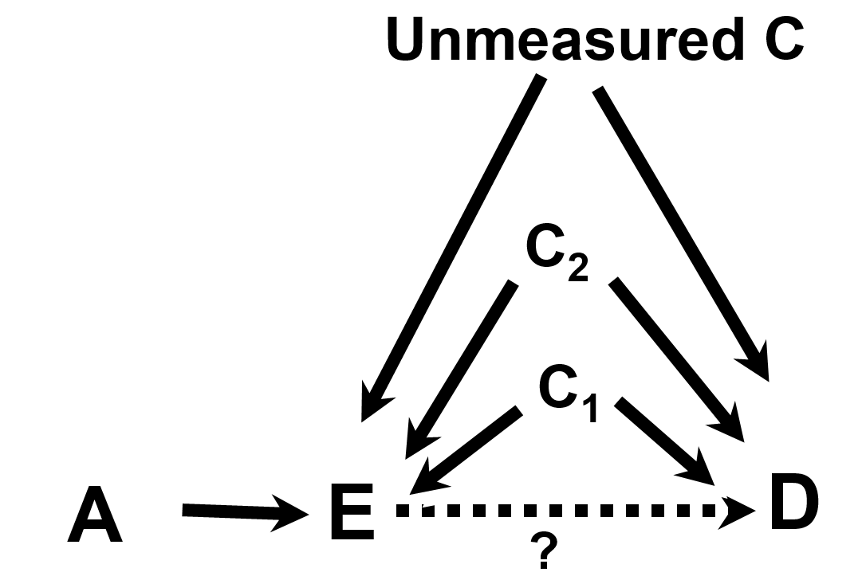
EPI203, Confounding & Interaction
Variable A is referred to as an instrumental variable (IV) or “instrument”
IV: a factor related to exposure but nothing else

Slide 5
EPI203, Confounding & Interaction
Randomization
Here, let A (the IV) be randomization in a RCT.
Randomization is related to the Exposure and nothing else.
In a RCT, we focus on the IV→D relationship (randomized assignment and disease outcomes) in Intent-to-Treat analyses
Notes:
Variable A is referred to as an instrumental variable or “instrument”. An instrument is defined to as a factor related to exposure but to nothing else.

Slide 6
Randomized Controlled Trial attributes:
  Randomization to Exposure (e.g., drug) or a Control (e.g., placebo)
    Addresses known & unknown confounding factors
  Intention to Treat (ITT): “once randomized, always analyzed”
    Maintains randomization
  Blinding minimizes bias in assessments/self-report
Notes:
Randomized Clinical Trial attributes:
Randomization to Exposure (e.g., drug) or a Control (e.g., placebo) addresses known/unknown confounding factors
Intention to Treat (ITT): “once randomized, always analyzed”, maintains randomization
Blinding minimizes bias in assessments
Co-Intervention – additional diagnostic or therapeutic tests or procedures applied to either the intervention or control group in a RCT. Such additions that are not pre-specified by the protocol could introduce confounding and threaten validity of the trial.

Slide 7
RCT Rationale
Why do a randomized blinded trial?
  minimize confounding
  minimize co-interventions
  minimize biased outcome ascertainment
Why not do a randomized trial?
  major ethical issues
  narrow research question
  expensive
  long time from idea to publication
  may not be generalizable
Generally reserved for mature questions
Notes:
People are familiar with reasons to do a RCT, which is often looked towards as a “gold standard” for clinical research. However, also important to emphasize that there are some good reasons NOT to do a trial.
Narrow, expensive, long time – In general, these things mean that RCT’s are not very efficient – a lot of time and money are expended to answer narrowly defined questions. While well-designed and implemented RCT’s can be critically important to advance evidenced based medicine, it’s also important to recognize the tradeoffs in terms of time/money. This is why RCT’s are reserved for “mature questions”.
Re: Generalizability – e.g., RCT’s often have incentives and mechanisms in place that maximize adherence that don’t exist in the real world. So, while you can more accurately measure the effect of the exposure on the outcome, it may not give an appropriate sense of how the exposure/treatment will perform outside of a trial setting.

Slide 8
Equipoise
RCT’s are appropriate to address questions that are in a state of ”equipoise”
Equipoise means that the group or treatment allocations in the trial must be equally acceptable based on the current state of knowledge
Notes:
Before opting to do a randomized controlled trial, it’s critical to reflect on whether the research question is in the state of equipoise – this means that random allocation to either of the treatment arms or groups is equally acceptable. If one is testing a new drug vs. placebo, this means that, to the best of one’s knowledge, the two options are equally likely to do harm or good. If there is not equipoise (e.g., data convincingly suggest that the new drug is better), then one could argue that it is unethical to randomize people to the drug or placebo.

Slide 9
Value of Randomization
Balances baseline characteristics of the treatment groups
  eliminates confounding due to measured and unmeasured factors
  provides an unbiased comparison between groups
Does NOT maintain balance after randomization
  What does that mean?
  Consider an intervention that is not blinded or cannot be blinded
    E.g., an RCT of exercise vs. usual care is hard to blind
Notes:
If your intervention is not blinded to the dr. or participant, self-awareness of the intervention after randomization can lead to the introduction of differences bt groups.
How is randomization done?
Participants are assigned to treatment groups by chance with a known probability
Random number sequence, generated by computer
Tamper-proof system
ordered, sealed envelopes
centralized system (phone, computer, web)

Slide 10
Choice of Intervention
Maximize
  effectiveness (highest tolerable dose)
  safety (lowest effective dose)
  generalizability
  trial design/conduct
    recruitment
    adherence
    blinding

Slide 11
Choice of Control
Inert placebo usually “best” for estimating effect of a treatment on outcome, but not always realistic or feasible
Active therapy or “standard of care”
  Active Comparator Trial - new therapy more effective than standard
    Ho: two treatments equally effective
    Ha: one treatment more effective
  Equivalence Trial - new therapy equivalent
    Ho: two treatments differ by at least X
    Ha: two treatments differ by less than X
Notes:
Best control is inactive placebo
easy to determine benefit or harm
Usually (not always) easy to blind
Some trials use an active treatment of “standard of care” as the comparator. Here, the goal might be to show that the new intervention is better than the standard. The design and statistical analysis here is exactly the same as if the standard of care were a placebo.
But often, the goal is to determine if the new treatment is AS GOOD as the standard of care. Sometimes, we do just want a second line therapy, but generally don’t really care if a new treatment is as good as the standard of care unless it has some advantages, for example better side effect profile, more convenient, or less expensive.
Decision about what is considered “good enough” for non-inferiority trial is based on lit. example: https://jamanetwork.com/journals/jama/fullarticle/2320315?utm_source=silverchair&utm_campaign=marketing&utm_content=article-decade&cmp=1&utm_medium=email
In this example, X was set at 24% for power calculations.
Consider, for example, the problem of conducting a clinical trial with a new drug for prevention of osteoporotic fractures. There are already proven effective drugs for this, namely estrogens, bisphosphonates and PTH. Is it ethical and/or clinically useful to study this new drug compared to placebo? There are many such examples - HTN, depression, lipid lowering, etc.

Slide 12
Adherence
Intervention cannot work if it is not used
Ways to assess adherence
  intervention
    pill count, diaries, biologic measure, measuring device in dispenser
  visits
  study measurements
Notes:
i.e., Cannot accurately measure the effect of an intervention if there are major problems with adherence.

Slide 13
Maximizing Adherence and Follow-up
Choose subjects likely to adhere
  exclude if likely nonadherent
  complete several visits before randomization
  complete a run-in
  (NOTE: items above may reduce generalizability)
Intervention easy and safe
Visits easy and enjoyable
  frequent enough to be engaging
  evening visits, travel and parking reimbursement
  personal relationships with participants
Measurements easy, safe and painless
Never discontinue participants
Notes:
Run-in period is:
“• What is a run-in period? ◦ A run-in period is a time period after inclusion, but before randomization, used to exclude certain patients. Other pre-randomization periods exist, for example, extended screening periods and washout periods. These different pre-randomization periods may overlap in purpose, design and terminology
• What types of run-in periods exist and which patients are excluded? ◦ During the run-in period, all patients receive the same intervention, for example, active treatment, placebo treatment or no intervention. Patients are excluded due to, for example, noncompliance to treatment or data collection, non-response to treatment or response to placebo
• What are the reasons for using a run-in period? ◦ By excluding certain patients, for example, noncompliers or placebo responders, run-in period may increase a study’s power, that is, chance of detecting a potential treatment effect”
Reference, Box 1 from: Teindl Laursen DR et al, Clin Epid, 2019: https://www.ncbi.nlm.nih.gov/pmc/articles/PMC6377048/
As noted in this article, the downside of choosing subjects likely to adhere is that sometimes this comes at the tradeoff of generalizability.

Slide 14
Aspects of High Quality RCTs – Summary
Tamper-proof randomization
Blinding of participants, study staff, lab staff, outcome ascertainment and adjudication
Adherence to study intervention
Complete follow-up
Adequate sample size
Notes:
NOTE:
Given the logistical challenges of implementing and participating in a well-designed RCT, sometimes opting for higher adherence and completeness of follow-up comes at the tradeoff of not enrolling (and therefore not studying) certain populations. Sometimes, those not enrolled in RCT’s have lower access to care (e.g., large tertiary cancer centers may have more clinical trials in their portfolio because of all the affiliated academic faculty than a community clinic) or poorer health status (e.g., patients who are sicker may not wish to be randomized to something), etc. It is important to try to ensure that the population being studied is representative of where the needs and burden exist.

Slide 15
RCT Limitations - Summary
While RCT’s are often considered ”gold standard” & helpful for guiding other study designs, there are also limitations in practice
  Time
  Cost
  Generalizability
  Ethical Issues & need for Equipoise
  Issues related to Dose, Duration, & Timing of Intervention
Notes:
Remember - Equipoise – the group or tx allocations in the trial must be equally acceptable based on current state of knowledge
There are certain questions that will NEVER be addressed in a trial

