Slide 1
Study Design – RCT to Cohort – and Target Trials
Epidemiology 207 - Epidemiology Methods II
June M. Chan, ScD
Professor & Vice Chair, Epidemiology & Biostatistics
Steven & Christine Burd-Safeway Distinguished Professor & Assoc. Chair, Clinical Research, Urology
This work is licensed under a Creative Commons Attribution-NonCommercial-NoDerivatives 4.0 International License.

Slide 2
RCT Examples
Challenges & Lessons Learned

Slide 3
Examples of RCT’s
Aspirin (ASA) & Myocardial Infarction (MI)
Beta-Carotene & Lung Cancer
PSA Screening & Prostate Cancer Death
(Hormone Replacement Therapy (HRT) & heart disease – in class)

Slide 4
Physicians’ Health Study I
Randomized, double-blind, placebo-controlled trial of N~22,071 U.S. physicians
Examined if:
  Low-dose aspirin (325 mg every other day) decreased cardiovascular mortality
  Beta carotene reduced incidence of cancer
Aspirin component terminated earlier than scheduled
Average follow-up 60 months for aspirin component
Jan. 1988, 99.7% still providing information on morbidity
Notes:
https://www.uspreventiveservicestaskforce.org/Page/Document/UpdateSummaryFinal/aspirin-to-prevent-cardiovascular-disease-and-cancer
https://www.ncbi.nlm.nih.gov/pubmed/2664509
https://www.nejm.org/doi/full/10.1056/NEJM198907203210301?url_ver=Z39.88-2003&rfr_id=ori%3Arid%3Acrossref.org&rfr_dat=cr_pub%3Dpubmed

Slide 5
Physicians’ Health Study I
Adherent group
Randomized, double-blind, placebo-controlled trial of N~22,071 U.S. physicians
Examined if:
  Low-dose aspirin (325 mg every other day) decreased cardiovascular mortality
  Beta carotene reduced incidence of cancer
Aspirin component terminated earlier than scheduled
Average follow-up 60 months for aspirin component
Jan. 1988, 99.7% still providing information on morbidity
Notes:
https://www.uspreventiveservicestaskforce.org/Page/Document/UpdateSummaryFinal/aspirin-to-prevent-cardiovascular-disease-and-cancer
https://www.ncbi.nlm.nih.gov/pubmed/2664509
https://www.nejm.org/doi/full/10.1056/NEJM198907203210301?url_ver=Z39.88-2003&rfr_id=ori%3Arid%3Acrossref.org&rfr_dat=cr_pub%3Dpubmed
Balancing adherence with generalizability… Educated MD’s – more likely to take the mailed pill packs as prescribed and maintain follow up bc they valued the scientific endeavor

Slide 6
Physicians’ Health Study I
2x2 Factorial Design
Randomized, double-blind, placebo-controlled trial of N~22,071 U.S. physicians
Examined if:
  Low-dose aspirin (325 mg every other day) decreased cardiovascular mortality
  Beta carotene reduced incidence of cancer
Aspirin component terminated earlier than scheduled
Average follow-up 60 months for aspirin component
Jan. 1988, 99.7% still providing information on morbidity
Notes:
https://www.uspreventiveservicestaskforce.org/Page/Document/UpdateSummaryFinal/aspirin-to-prevent-cardiovascular-disease-and-cancer
https://www.ncbi.nlm.nih.gov/pubmed/2664509
https://www.nejm.org/doi/full/10.1056/NEJM198907203210301?url_ver=Z39.88-2003&rfr_id=ori%3Arid%3Acrossref.org&rfr_dat=cr_pub%3Dpubmed
2x2 factorial design: https://www.ncbi.nlm.nih.gov/pubmed/4023472
https://handbook-5-1.cochrane.org/chapter_16/16_5_6_factorial_trials.htm
Null BC main results: https://pubmed.ncbi.nlm.nih.gov/8602179/

Slide 7
Physicians’ Health Study I
Randomized, double-blind, placebo-controlled trial of N~22,071 U.S. physicians
Examined if:
  Low-dose aspirin (325 mg every other day) decreased cardiovascular mortality
  Beta carotene reduced incidence of cancer
Aspirin component terminated earlier than scheduled
Average follow-up 60 months for aspirin component
Jan. 1988, 99.7% still providing information on morbidity
Notes:
https://www.uspreventiveservicestaskforce.org/Page/Document/UpdateSummaryFinal/aspirin-to-prevent-cardiovascular-disease-and-cancer
https://www.ncbi.nlm.nih.gov/pubmed/2664509
https://www.nejm.org/doi/full/10.1056/NEJM198907203210301?url_ver=Z39.88-2003&rfr_id=ori%3Arid%3Acrossref.org&rfr_dat=cr_pub%3Dpubmed

Slide 8
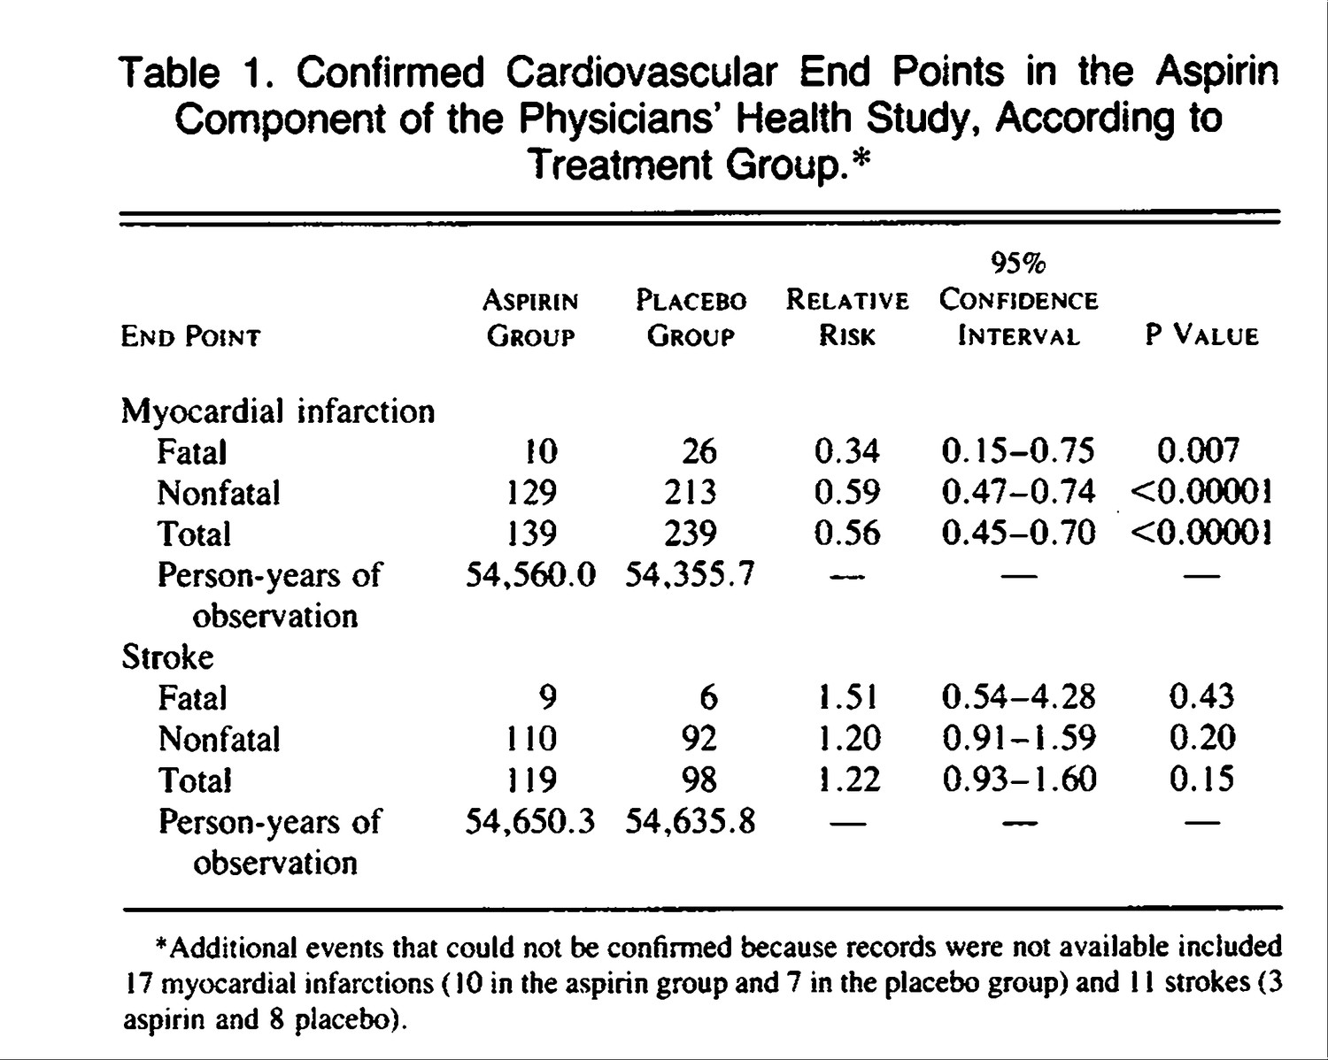

Steering Committee of the Physicians' Health Study Research Group* . N Engl J Med 1989;321:129-135.
Notes:
https://www.nejm.org/doi/full/10.1056/NEJM198801283180431 - Preliminary report
https://www.nejm.org/doi/10.1056/NEJM198907203210301?url_ver=Z39.88-2003&rfr_id=ori:rid:crossref.org&rfr_dat=cr_pub%20%200pubmed - Final report

Slide 9
PHS Aspirin Component terminated early – Why?
Highly statistically significant (P<0.00001) reduction in the risk of total MI among those in the aspirin vs. placebo group
Calculations indicated that to assess effects on overall cardiovascular mortality would take until the year 2000 or later (it was Dec 1987)
Aspirin was subsequently being prescribed for 85% of participants who experienced nonfatal vascular events, making interpretation of mortality endpoints challenging.
Notes:
https://www.nejm.org/doi/full/10.1056/NEJM198801283180431

Slide 10
Beta-Carotene & Lung Cancer

Slide 11
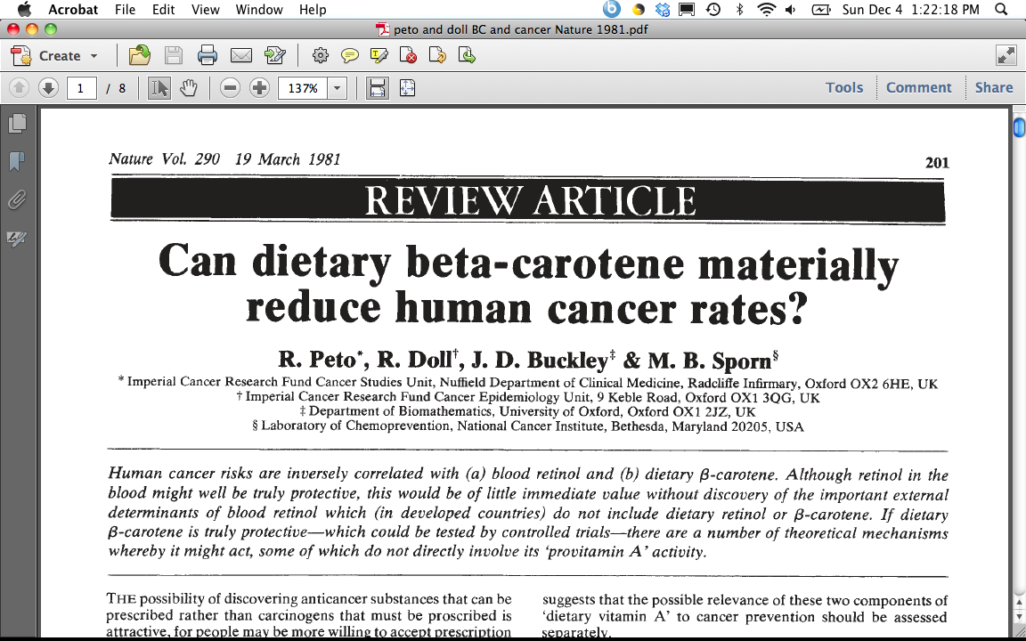
1980’s – Beta-Carotene & Lung Cancer
“This inverse association may, of course, be an artefact, due merely to association of B-carotene ingestion with some truly protective dietary habit(s) or component(s), or to association of B-carotene ingestion with avoidance of some truly harmful dietary habit(s) or component(s).”
“Equally, however, the inverse association between dietary B-carotene and cancer incidence may be due to genuine protective effect of B-carotene against the onset of cancer.”
“Although the evidence thus far available is not compelling that B-carotene is truly protective against cancer (or a fortiori against total mortality) this is not good reason to delay starting controlled trials because even if, as seems probable, a few truly protective agents do await discovery among the dozen or two dietary factors of current interest to the research community, compelling evidence may take decades to emerge without controlled trials.”
CONFOUNDING
TRUTH
Notes:
Ask Class - Who are Doll and Peto?
“Grandfathers of Epidemiology” who Richard Doll and Bradford Hill started the British doctors study in 1951, and published their preliminary and follow-up report in the mid-1950’s providing the earliest evidence that smoking was linked to many serious diseases, first and foremost lung cancer.
30 years later, they published this thoughtful piece on Beta-Carotene and cancer. At the time, the observation had been made that vegetables, in particular those rich in Vit A or carotene seemed to be protective in observational studies, AND some studies that measured retinol and carotene in blood also showed a protective effect, specifically for beta-carotene. At the time, there were only 3 prospective cohort studies that had been done, but these all seemed protective.
1981 Doll & Peto, Nature
ATBC recruited 1985 – 1988
NOTE: Dr. Chan refers to “protective effect” of the observational studies on vegetables and cancer or carotenoids and cancer, quoting older articles of the 1970’s and 1980’s – this should be qualified as an “inverse association” or “potential protective effect” as these results were from case-control and cohort studies and cannot directly comment on true “causal effects.”

Slide 12
1980’s – Beta-Carotene & Lung Cancer
“This inverse association may, of course, be an artefact, due merely to association of B-carotene ingestion with some truly protective dietary habit(s) or component(s), or to association of B-carotene ingestion with avoidance of some truly harmful dietary habit(s) or component(s).”
“Equally, however, the inverse association between dietary B-carotene and cancer incidence may be due to genuine protective effect of B-carotene against the onset of cancer.”
“Although the evidence thus far available is not compelling that B-carotene is truly protective against cancer (or a fortiori against total mortality) this is not good reason to delay starting controlled trials because even if, as seems probable, a few truly protective agents do await discovery among the dozen or two dietary factors of current interest to the research community, compelling evidence may take decades to emerge without controlled trials.”
CONFOUNDING
TRUTH
Notes:
Ask Class - Who are Doll and Peto?
“Grandfathers of Epidemiology” who Richard Doll and Bradford Hill started the British doctors study in 1951, and published their preliminary and follow-up report in the mid-1950’s providing the earliest evidence that smoking was linked to many serious diseases, first and foremost lung cancer.
30 years later, they published this thoughtful piece on Beta-Carotene and cancer. At the time, the observation had been made that vegetables, in particular those rich in Vit A or carotene seemed to be protective in observational studies, AND some studies that measured retinol and carotene in blood also showed a protective effect, specifically for beta-carotene. At the time, there were only 3 prospective cohort studies that had been done, but these all seemed protective.
1981 Doll & Peto, Nature
ATBC recruited 1985 – 1988

Slide 13
Alpha-tocopherol & Beta-carotene Trial, ATBC
P: 29,133 male smokers in Finland, 50-69 yrs old in 1985-88
I: 50 milligrams (mg) alpha-tocopherol (a form of vitamin E)
OR 20 mg of beta-carotene (a precursor of vitamin A)
OR BOTH
C: Placebo
O: Lung cancer (and other cancers)
Vit E, Beta-Carotene Supplementation and Lung Cancer among Smokers (Albanes et al, JNCI, 1996)
Notes:
http://www.annalsofepidemiology.org/article/1047-2797(94)90036-1/pdf

Slide 14
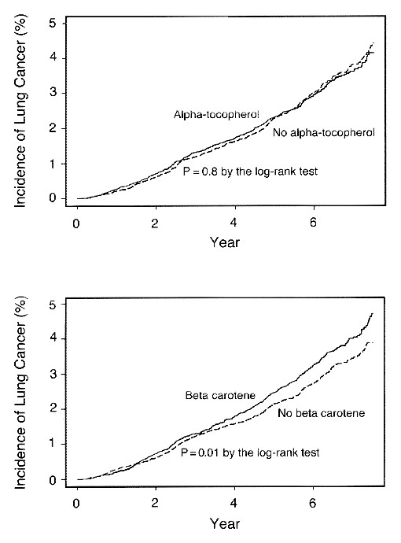
The Alpha-Tocopherol Beta Carotene Cancer Prevention Study Group. N Engl J Med 1994;330:1029-1035.
Kaplan-Meier Curves for the Cumulative Incidence of Lung Cancer among Participants Who Received Alpha-Tocopherol Supplements and Those Who Did Not (Upper Panel) and among Participants Who Received Beta Carotene Supplements and Those Who Did Not (Lower Panel).
More Lung Cancer occurred among men on supplements
Notes:
Figure 1. Kaplan-Meier Curves for the Cumulative Incidence of Lung Cancer among Participants Who Received Alpha-Tocopherol Supplements and Those Who Did Not (Upper Panel) and among Participants Who Received Beta Carotene Supplements and Those Who Did Not (Lower Panel). Data are shown only through 7 1/2 years of follow-up because of the small numbers of participants beyond that time.
Maybe TOO late to intervene with BC or Vit E in a population that has 30 pack years of smoking history
Or… the population was not deficient enough to observe a benefit
For Example…
JNCI 1993 Blot et al, Linxian China RCT combo vit E, BC, and SEL – associated with lower total mortality p=0.03, RR=0.91; esp for cancer RR =0.87 (0.75-1.00)… however baseline BC levels were 3 times LOWER than that in Finland (5.2 ug/dL vs 17 mg/dL)
https://atbcstudy.cancer.gov/

Slide 15
Interpretation Points to Appreciate
Incorrect inference from obs studies on beta-carotene being “causal” - Was beta-carotene THE nutrient in fruits/vegetables accounting for the inverse associations in the observational studies?
Confounding – the benefit in observational studies might have been due to confounding, which, when removed in the RCTS, revealed NO benefit of BC
“The lack of reduction in the incidence of lung cancer among men given the supplemental beta-carotene may be explained by bias, an inadequate duration of supplementations, the use of the wrong dose, or an inappropriate study population.”
Notes:
Maybe TOO late to intervene with BC or Vit E in a population that has 30 pack years of smoking history
Or… the population was not deficient enough to observe a benefit
For Example…
JNCI 1993 Blot et al, Linxian China RCT combo vit E, BC, and SEL – associated with lower total mortality p=0.03, RR=0.91; esp for cancer RR =0.87 (0.75-1.00)… however baseline BC levels were 3 times LOWER than that in Finland (5.2 ug/dL vs 17 mg/dL)
https://atbcstudy.cancer.gov/
http://www.nejm.org/doi/full/10.1056/NEJM199404143301501#t=article
“In the light of all the data available, an adverse effect of beta carotene seems unlikely; in spite of its formal statistical significance, therefore, this finding may well be due to chance.”
What happened next? Subsequent trials indicated that supplemental BC likely does increase risk of Lung cancer in smokers or those with other high risk (asbestos); not associated in general population of non-smokers (physicians health study). (NOTE – these findings were focused on trials that examined supplemental beta-carotene, not beta-carotene received regularly via foods).
The concept of consistency says that you have “one treatment” that is well-defined. This is important to uphold the integrity of the design of a study to make causal inferences. However, one can also imagine that it puts a lot of importance on the decision of choosing exactly which intervention to test, at what dose, for what duration, and in whom. This is why typically there are “phases” of clinical trials designed specifically to determine these sorts of questions before doing the full scale trial. https://www.cancer.gov/about-cancer/treatment/clinical-trials/what-are-trials/phases

Slide 16
PSA Screening & Prostate Cancer

Slide 17
Side note - Principles of Cancer Screening
Healthy person ---→ precursor to cancer ----→ cancer ----→ death
Cancer screening is conducted in healthy populations.
Need to be very careful to not have test or subsequent follow-up work that causes more harm than benefit.
Risk benefit tradeoff is always critical to assess; in this context, you are starting with healthy people, so it doesn’t take much to tip towards ‘harm’
General idea: want to pick up the cancer at an earlier stage and treat it earlier, in the hopes that earlier detection and treatment lowers morbidity and mortality.
Notes:
Further articles on Principles of Cancer Screening:
https://www.ncbi.nlm.nih.gov/pmc/articles/PMC2921618/
https://www.ncbi.nlm.nih.gov/books/NBK223387/
Challenges around over-diagnosis and over-treatment for prostate and breast cancer (perspectives from UCSF faculty) - https://jamanetwork.com/journals/jama/fullarticle/184747
Other DEB Courses that address screening: Clinical Epid (epi 204), Cancer Epid (epi 252)

Slide 18
PSA Screening & Prostate Cancer
A brief history
PSA = prostate specific antigen
Discovered in 1970’s, detectable in blood
First used in 1980’s to monitor prostate cancer after diagnosis, higher levels correspond to worsening of disease
Early 1990’s evidence suggested it could be used to detect prostate cancer as a first-line screening test
FDA approved it for prostate cancer screening in early 1990’s
“PSA Era” – men started routinely being screened for prostate cancer using PSA, insurance covered this simple blood test
RCT’s testing whether PSA screening affects prostate cancer mortality were initiated and ongoing but not completed during this time when many men were getting screened
Notes:
PSA: prostate specific antigen, discovered in 1970’s, initially used clinically to monitor prostate cancer/response to tx.
By early 1990’s studies indicated that it may have use as a first-line screening test. Approved by FDA. Enter – the “psa era” in the US. Many adult men were commonly tested. Incidence of PC shot up, and it was mostly early stage disease. RCTs were started and ongoing during this time to rigorously test the question of whether PSA screening for incident prostate cancer has a benefit on mortality.
NOTE: For a cancer screening test -The goal is to demonstrate whether early screening actually improves mortality… not incidence.
Healthy person ---→ precursor to cancer ----→ cancer ----→ death
The underlying premise of a screening test for a cancer is that you pick up the cancer earlier in its development, when the tumor is more amenable to cure (ideally in some precursor stage, which can be treated before cancer actually develops, e.g., finding colon polyps via colonoscopy before those polyps become cancerous). Some basic tenets about cancer screening are that: a) you can detect it earlier in a low-risk (ideally not too invasive way), b) there must be treatments available that are considered to do more benefit than harm, and c) earlier detection and treatment means better cure rates/lower mortality. All of these things must be true for it to be ethical to implement a cancer screening test into a healthy population. The potential for benefit must outweigh harm, and this is often challenging when you are starting with a healthy population. For more information on screening, see: https://www.ncbi.nlm.nih.gov/pmc/articles/PMC2921618
Recommendations for PSA screening in the USA have changed over time and often been a point of controversy.
2012: D rating for PSA Screening – Do not use PSA based screening for prostate cancer.
https://www.uspreventiveservicestaskforce.org/Page/Document/UpdateSummaryFinal/prostate-cancer-screening
2018: C rating for men 55-69 “individual decision”; D rating for men 70+ - not recommended
https://www.uspreventiveservicestaskforce.org/Page/Document/RecommendationStatementFinal/prostate-cancer-screening1

Slide 19
USPSTF & PSA Screening for Prostate Cancer
Shift in understanding around late 2000’s/2010-ish that prostate cancer = very heterogeneous
  Variation in aggressive forms
  “Indolent” disease (cancer that is so slow-growing it is unlikely to cause any harm during one’s lifetime)
2012 – PSA screening given a D rating
  Over-diagnosis & Over-treatment
2018 – USPSTF updated recommendation:
  PSA screening in men ages 55-69 – C Rating
  PSA screening in men ages 70+ - D Rating
  Between 2012-2018. active surveillance ↑ and over-treatment ↓
Notes:
Recommendations for PSA screening in the USA have changed over time and often been a point of controversy.
2012: D rating for PSA Screening – Do not use PSA based screening for prostate cancer.
https://www.uspreventiveservicestaskforce.org/Page/Document/UpdateSummaryFinal/prostate-cancer-screening
2018: C rating for men 55-69 “individual decision”; D rating for men 70+ - not recommended
https://www.uspreventive

Slide 20
PSA Screening Trials & Prostate Cancer Mortality
 | US Trial - PLCO | European trial | Göteborg trial
N men in trial | 76,000 | 182,160 | 20,000
Median follow-up, years | 13 | 13 | 14
Screening frequency | Annual | Every 4 years | Every 2 years
RR _{screen vs. no screen} | 1.09 (0.87-1.36) | 0.79 (0.69-0.91) | 0.44 (0.28-0.68)
NNS | *** | 781 invited to screen to prevent 1 death (NNI) | 234 to prevent 1 death
Slide acknowledgement:
MJ Stampfer, 2015
Andriole et al. JNCI, 2012; Schröder et al. NEJM, 2012; Hugosson Eur Urol, 2019; Schroder, et.al, Lancet 2014l Hugosson et al. Lancet Oncol, 2010
Notes:
Prostate Lung Colorectal and Ovarian Cancer Screening Trial (PLCO) - US based
PMID: 22228146 PMCID: PMC3260132 Andriole JNCI 2012
Pinsky, Cancer 2017 https://www.ncbi.nlm.nih.gov/pubmed/27911486
European Randomized study of Screening for Prostate Cancer (ERSPC) - Multi-european trial
Schroder, NEJM 2012: main results ERSPC: https://www.ncbi.nlm.nih.gov/pubmed/22417251
Schroder, Lancet, 2014: https://www.ncbi.nlm.nih.gov/pubmed/25108889
Hugossn Eur Urol 2019: https://www.ncbi.nlm.nih.gov/pubmed/30824296
Goteborg – Swedish Trial (was 1 arm of ERSPC), reported separate results earlier than other two studies (https://www.ncbi.nlm.nih.gov/pmc/articles/PMC5907498/; https://www.ncbi.nlm.nih.gov/pubmed/20598634. Hugosson Lan Onc 2010)

Slide 21
PSA Screening and Stage Shift
Slide acknowledgement:
MJ Stampfer, 2015
 | PLCO | ERSPC | Göteborg
N men in trial | 76,000 | 182,160 | 20,000
Median follow-up, yrs | 13 | 13 | 14
RR _{screen vs. no screen} | 1.09 (0.87-1.36) | 0.79 (0.68-0.91) | 0.44 ( 0.28-0.68)
RR adjusted for contamination and nonattendance | Not reported | 0.68 (0.51-0.92) | Not reported
High stage ratio Ratio Control arm Intervention arm | 1.3 2.9% Stage IV 2.3% Stage IV | 2.9 3.8% T4 1.3% T4 | 3.1 3.4% T4 1.1% T4
Pre-trial screening | 44% | Not reported | None
Contamination (%) | ~50% (only 21% of controls had never had PSA) | Spain 7% Rotterdam 31% | Not reported
Screening frequency Control arm Intervention arm | 2.7 in 6 years 5 in 6 years | Not reported Every 4 years | Not reported Every 2 years
Notes:
Prostate Lung Colorectal and Ovarian Cancer Screening Trial (PLCO) - US based
European Randomized study of Screening for Prostate Cancer (ERSPC) - Multi-european trial
Goteborg – Swedish Trial (was 1 arm of ERSPC), reported separate results earlier than other two studies
As you can see, these three trials reported quite different RR on the possible benefit of screening. The RR’s shown here are for PC mortality.
What is clear is that in the US trial (PLCO) there was not evidence of any benefit. Why?
A couple clues are shown in the subsequent rows. First, there was less evidence of stage shift compared to the two European trials. Recall that one of the premises for cancer screening to work is that you are picking up the tumor earlier than previous methods allowed, therefore supporting earlier treatment and better outcomes, theoretically. Here, in the US, the change in the proportion of Stage 4 or late stage disease is less different in the US trial than in the other two trials.
Furthermore, the US population of men were also engaging in voluntary PSA screening BEFORE entering the study. 44% of men had had a PSA test in the US before entering the trial. PSA testing was not as routine throughout Europe at this same time. It was not reported in ERSPC and was stated as ‘none” in the Swedish trial.
The next row highlights issues of “contamination” or participants in the control group actually receiving PSA screening on their own, during the trial. "To be included in our definition of “PSA contamination,” a subject in the control group needed to have had a PSA test within the past year as part of a routine physical examination." As you can see, this was really high in the US study… it was estimated that about 50% of men in the control group received some screening during the study; considering time before the trial and time on trial - it was estimated that nearly 80% of men in the control group had ever had a PSA test. The routine usage of PSA screening was much less in Europe at the time, and consequently, while some "contamination" was reported in ERSPC, it was much less than in PLCO. https://journals.sagepub.com/doi/pdf/10.1177/1740774510374091
Lastly, the frequency of screening was quite different across the trials. One can see that the US trial ended up being a question of nearly annual screening vs every other year screening… rather than a contrast of getting screened every few years vs mainly NOT getting screening. These are 2 very different questions, which largely explains why the results were quite different.
High level takeaway – when RCT results differ on a seemingly similar research question, it is critical to delve into these details and really look at the exact research question that each trial was able to test. Aspects of how a trial is conducted, exact “dose” and timing of intervention, exact characteristics of the study population, etc all shape the specific research question and thus the causal effect that one can make inferences about.

Slide 22
Contamination in PLCO
2,427 of 38,350 men in control arm surveyed ~ screening
  Only 1/3 of men with abnormal PSA/DRE underwent biopsy
Mean number of PSAs in the control arm = 2.7 in 6 years
  vs. 5.0 in the screening arm
Median screening interval in ERSPC was 4.02 years
Slide acknowledgement:
MJ Stampfer, 2015
Pinsky et al, Clinical Trials 2010

Slide 23
PLCO DAG - Ideal
C
Organized annual PSA Screening
Random assignment to PSA screening
Early Detection
More effective Txs
PC Death
Notes:
This is the Goal of the Randomization in PLCO.
Want to be able to study randomization to PSA screening and its effect on PC death, w/o concern about confounding factors associated with screening
Randomization assignment acts as an instrumental variable, associated only with exposure assignment.
Intent to Treat Principle (ITT) - pneumonic "once randomized, always analyzed" - you analyze participants in RCT's according to the group they were assigned to, not based on whether they actually received the intervention or not. This upholds the usage of randomization as an Instr Var and limits confounding.

Slide 24
PLCO DAG – In reality, there was non-adherence
C
Organized annual PSA Screening
Random assignment to PSA screening
Early Detection
More effective Txs
PC Death
Knowledge that you are in the Control Arm bc non-blinded study
Elevated PSA detected via opportunistic screening in Control group
Notes:
However, there was opportunistic screening in the control arm, bc screening was just so common at that time and this study was unblinded, so men knew what arm they were in. This contamination of the control group can cause confounding bias

Slide 25
Summary - Beta-Carotene & PSA examples
Dose, duration, and timing of intervention shape the specific causal question that a trial asks.
Different study populations may experience the same intervention differently; effect modification happens/is real.
In a randomized unblinded study, contamination or lack of adherence or cross-over can greatly impact results and reshape the originally intended research question.
Notes:
In summary – while RCT's remain a gold standard study design to estimate causal effects and make causal inferences, there are still several potential ways bias can creep into such studies. These are important to be aware of when planning such studies, or examining data across different RCT's on similar research questions, and to consider when developing the "target trial" concept for one's observational study.

