Slide 1
Study Design – RCT to Cohort – and Target Trials
Epidemiology 207 - Epidemiology Methods II
June M. Chan, ScD
Professor & Vice Chair, Epidemiology & Biostatistics and Urology
Steven & Christine Burd-Safeway Distinguished Professor, Urology
This work is licensed under a Creative Commons Attribution-NonCommercial-NoDerivatives 4.0 International License.

Slide 2
DISCLOSURES
Individual: Research collaborations with GenomeDx
Urology Dept: Research collaborations with Genomic Health Inc., Genome Dx, & Myriad Genetics
Husband: full time employee for Adela, Inc.

Slide 3
Today’s Topics
Study Design
  Target Trial
  Strengths & Limitations of Randomized Controlled Trials
  Observational Studies
    Case-Control (Matching), Feb 3
    Cohort (continued on Feb 17)
Supplemental Material

Slide 4
Target Trials Topic – All PARTS “Table of Contents”
Part 1 – RCT/COH - Video on CLE
Part 2 – RCT Overview - Slides only
Part 3 – RCT Examples - Video on CLE
Part 4 – RCT Ex. Con’t & Target Trial Heuristic, In CLASS Lec
If time – In class exercise, Target Trials
EXTRAS
Appendix 1 – Life of a Research Study (not core content)
Appendix 2 – Tips on Reading and Critiquing the Scientific Literature (not core content)
Extra Notes from prior yrs (not core content)

Slide 5
Study Design – RCT to COH
Notes:
~ min 33 (2018)

Slide 6

Recap from Epid Methods I – Study Design
Research Studies Based on Humans
Unit of observation
Group (e.g., geographic area)
Individual
Observational
Experimental
Experimental
Ecologic Studies
Randomized
Non-randomized
Observational
Randomized Controlled Trial (RCT)
Non-randomized clinical trial
Between-subject
Cohort
Cross-sectional
Case-Control
Within-subject
Case-crossover
Case only
Self-controlled case series
Notes:
Terminology NOTE
RCT = Randomized Controlled Trial
Sometimes this same acronym may appear also for “Randomized Clinical Trial”; read the context/background to know what authors mean.
NIH Definition of clinical trial: “A research study in which one or more human subjects are prospectively assigned to one or more interventions (which may include placebo or other control) to evaluate the effects of those interventions on health-related biomedical or behavioral outcomes.” https://grants.nih.gov/policy/clinical-trials/definition.htm
Note: Not all ”clinical” trials use randomization for intervention assignment, so a “randomized controlled trial” or “randomized clinical trial” is a subset of all “clinical trials”.
For the purposes of this lecture, we will be focused on Randomized Controlled Trials

Slide 7




Elements of Study Design - PICO
Population
Greek gods
Intervention
(or exposure)
Heart transplant
Comparator
(or control)
No heart transplant
Outcome
Death (after 5 days)
Notes:
Many folks at UCSF use the mnemonic “PICO” which stands for Population, Intervention (or Exposure if Obs study), Control (or Comparison group), and Outcome
For any study you are planning, conducting, or if you are reading an article, very good to identify PICO clearly for yourself.

Slide 8
Elements of Study Design – PICO++
How was the population defined? How was the sample selected?
What is the time-frame (cross-sectional, longitudinal)?
Did we sample using persons or person time?
Was the underlying cohort ‘dynamic’ or ‘fixed’?
How was exposure defined and assessed?
What is the outcome & are we estimating risks, rates, odds, time to event, etc?
Was there non-adherence or could exposure change over time? How was this handled?
Was there drop-out or loss to follow-up? Did participants die before the outcome was measured?

Slide 9
Elements of Study Design
How was the population defined? How was the sample selected?
What is the time-frame (cross-sectional, longitudinal)?
Did we sample using persons or person time?
Was the underlying cohort ‘dynamic’ or ‘fixed’?
How was exposure defined and assessed?
What is the outcome & are we estimating risks, rates, odds, time to event, etc?
Was there non-compliance or could exposure change over time? How was this handled?
Was there drop-out or loss to follow-up? Did participants die before the outcome was measured?

Slide 10
RCT & Cohort to Target Trial

Slide 11
Number of “hits” in Pubmed by study design keyword
“clinical trial” 1,293,507
  “RCT” 739,154
“cohort” 2,596,357
“case-control” 1,546,735
Notes:
Cohort is very commonly going to be the “work horse” study design in many epid studies.
More likely to read papers from a cohort
Stats from jan 2022

Slide 12

Observational & Experimental Studies
Recap from Epid Methods I – Study Design
Experimental studies can be viewed as cohort studies where the investigator assigns the exposure
Observational studies should be viewed (and designed) as attempting to emulate a randomized controlled trial (RCT)
When designing an observational study, ask yourself: What is the RCT that I am trying to emulate?
  What is the “target trial”?
Notes:
EPI 203 notes fr J Martin:
A randomized controlled trial (RCT) is the gold standard design for comparing the effectiveness of different interventions to influence an outcome. We pointed out earlier that the RCT design can be thought of as a type of cohort study where the exposure is assigned to participants, rather than just measured as it occurs in nature. We also can turn this around. That is, a useful insight in the understanding of observational studies is that one should strive to have them emulate an RCT. Observational studies that aim to establish causality should be evaluated with respect to how well they emulate an experimental “target” trial (i.e., an RCT).

Slide 13

Target Trial – as defined by Hernan &. Robins, Ch. 3.6
Causal effect = contrast between average counterfactual outcomes under different treatment values
Imagine (hypothetical) randomized experiment to quantify each specific causal effect → “Target Trial”
Often, we cannot conduct such trials for various reasons and instead, we relay on observational data.
To conduct rigorous observational studies, it is helpful to think about emulating the target trial for our research question.
The more our observational study emulates this target trial, the more the estimates of numerical results should be the same as those that would have come from the target trial.
  To understand better a “target trial” – let’s discuss RCT’s
Notes:
Hernan & Robins What If, section 3.6: “In this Section and throughout the book, the term causal effect refers to a
contrast between average counterfactual outcomes under different treatment
values. Therefore, for each causal effect, we can imagine a (hypothetical) randomized
experiment to quantify it. We refer The target trial–or its logical to that hypothetical experiment
equivalents–is central to the
causal inference framework. When conducting the target trial
is not feasible, ethical, or timely, we resort to causal analyses of observational
data. That is, causal inference from observational data can be viewed as an
attempt to emulate the target trial. If the emulation is successful, there is no
difference between the observational estimates and the numerical results that
the target trial would have yielded (had it been conducted).”

Slide 14
RCT – Brief Summary
Acknowledgement: Deb Grady, MD MPH
This work is licensed under a Creative Commons Attribution-NonCommercial-NoDerivatives 4.0 International License.
Notes:
This next set of slides is NOT RECORDED and is considered a review of aspects of RCT design. Please review on your own, as needed.
We thank Dr. Deb Grady for developing and sharing these slides.

Slide 15
Concept of RCT’s or experimental studies guide other study designs
⚐ “Trial” → there is an intervention, distinct from “Observational” studies
Randomized experiments → paradigm for causal inference
Randomized trials provide helpful idealized framework in which to think about other types of study designs
Counterfactual framework → Randomized Experiments → Target Trial → Observational Study Designs
Notes:
EPI 205 focuses on clinical trial design/conduct
Be deliberate when you use the word “trial”; this means a study with an intervention.
Previously, we introduced the idea of counterfactuals – i.e., what if we could observe the outcomes for everyone under assignment to an exposure/intervention, as well as under assignment to no exposure/intervention (e.g., the Greek god example where we could observe what happened if assigned to heart transplant and not assigned to heart transplant). If we knew the counterfactual outcomes, then one can compute causal effects.
However, we never know all the counterfactuals for a given research question and population in real life. However, the “ideal randomized experiment” is the next best thing we can conceptualize, which allows us to compute average causal effects or contrast average counterfactual outcomes under different treatment conditions.
For each causal effect we are trying to estimate, there’s a hypothetical randomized experiment one can imagine to quantify it.
This hypothetical randomized experiment is the “target trial” for a given causal question. When we cannot actually carry out the target trial due to reasons of ethics, practicality, etc… then we use observational data, and try to design/analyze observational studies that emulate the target trial.
(ref: section 3.6 What If, Hernan & Robins)

Slide 16
Basic Trial Design
Population
Intervention
Outcome
Sample
Randomization
+ Blinding
Placebo
Control
Outcome
Notes:
An example of a basic trial - select persons with memory loss, treat with daily mathematics and memory exercises and see if this improves score on MMSE (mini-mental state exam) and reduces risk of developing dementia.
Note – there is such thing as an uncontrolled trial or time series design. These have no concurrent control group and can produce the wrong answer due to learning, regression to the mean, secular trends and the placebo effect. Note, for example, that it is common to have a 30-50% improvement in depression scores, pain scores, hot flash scores, over time or based on receipt of placebo.
There can also be a controlled trial without randomization. This addresses problems noted above but may make the treatment look good simply because the groups are different to begin with. For example, if you put all the older people in the control group because it’s too hard to teach them mathematics, the rate of developing dementia may be higher in this group simply because they are older. This design is really no different from a double cohort study. Randomization fixes this - for both known (measured) and unknown (unmeasured) potential confounders - I.e., age will be balanced in both groups, as will education, etc. And potential confounders we don’t know about.
There can also be a randomized controlled trial without blinding (e.g., no placebo pill). This could bias outcome ascertainment.
Also note that these three elements - treatment, randomization, and blinding result in the major ethical concerns regarding randomized trials.

Slide 17
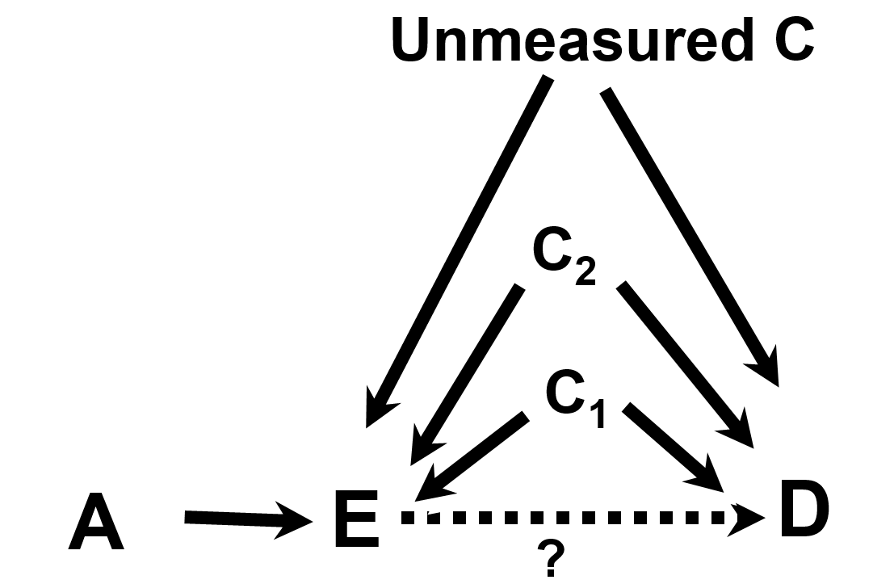
EPI203, Confounding & Interaction
Variable A is referred to as an instrumental variable (IV) or “instrument”
IV: a factor related to exposure but nothing else

Slide 18
EPI203, Confounding & Interaction
Randomization
Here, let A (the IV) be randomization in a RCT.
Randomization is related to the Exposure and nothing else.
In a RCT, we focus on the IV→D relationship (randomized assignment and disease outcomes) in Intent-to-Treat analyses
Notes:
Variable A is referred to as an instrumental variable or “instrument”. An instrument is defined to as a factor related to exposure but to nothing else.

Slide 19
Randomized Controlled Trial attributes:
  Randomization to Exposure (e.g., drug) or a Control (e.g., placebo)
    Addresses known & unknown confounding factors
  Intention to Treat (ITT): “once randomized, always analyzed”
    Maintains randomization
  Blinding minimizes bias in assessments/self-report
Notes:
Randomized Clinical Trial attributes:
Randomization to Exposure (e.g., drug) or a Control (e.g., placebo) addresses known/unknown confounding factors
Intention to Treat (ITT): “once randomized, always analyzed”, maintains randomization
Blinding minimizes bias in assessments
Co-Intervention – additional diagnostic or therapeutic tests or procedures applied to either the intervention or control group in a RCT. Such additions that are not pre-specified by the protocol could introduce confounding and threaten validity of the trial.

Slide 20
RCT Rationale
Why do a randomized blinded trial?
  minimize confounding
  minimize co-interventions
  minimize biased outcome ascertainment
Why not do a randomized trial?
  major ethical issues
  narrow research question
  expensive
  long time from idea to publication
  may not be generalizable
Generally reserved for mature questions
Notes:
People are familiar with reasons to do a RCT, which is often looked towards as a “gold standard” for clinical research. However, also important to emphasize that there are some good reasons NOT to do a trial.
Narrow, expensive, long time – In general, these things mean that RCT’s are not very efficient – a lot of time and money are expended to answer narrowly defined questions. While well-designed and implemented RCT’s can be critically important to advance evidenced based medicine, it’s also important to recognize the tradeoffs in terms of time/money. This is why RCT’s are reserved for “mature questions”.
Re: Generalizability – e.g., RCT’s often have incentives and mechanisms in place that maximize adherence that don’t exist in the real world. So, while you can more accurately measure the effect of the exposure on the outcome, it may not give an appropriate sense of how the exposure/treatment will perform outside of a trial setting.

Slide 21
Equipoise
RCT’s are appropriate to address questions that are in a state of ”equipoise”
Equipoise means that the group or treatment allocations in the trial must be equally acceptable based on the current state of knowledge
Notes:
Before opting to do a randomized controlled trial, it’s critical to reflect on whether the research question is in the state of equipoise – this means that random allocation to either of the treatment arms or groups is equally acceptable. If one is testing a new drug vs. placebo, this means that, to the best of one’s knowledge, the two options are equally likely to do harm or good. If there is not equipoise (e.g., data convincingly suggest that the new drug is better), then one could argue that it is unethical to randomize people to the drug or placebo.

Slide 22
Value of Randomization
Balances baseline characteristics of the treatment groups
  eliminates confounding due to measured and unmeasured factors
  provides an unbiased comparison between groups
Does NOT maintain balance after randomization
  What does that mean?
  Consider an intervention that is not blinded or cannot be blinded
    E.g., an RCT of exercise vs. usual care is hard to blind
Notes:
If your intervention is not blinded to the dr. or participant, self-awareness of the intervention after randomization can lead to the introduction of differences bt groups.
How is randomization done?
Participants are assigned to treatment groups by chance with a known probability
Random number sequence, generated by computer
Tamper-proof system
ordered, sealed envelopes
centralized system (phone, computer, web)

Slide 23
Choice of Intervention
Maximize
  effectiveness (highest tolerable dose)
  safety (lowest effective dose)
  generalizability
  trial design/conduct
    recruitment
    adherence
    blinding

Slide 24
Choice of Control
Inert placebo usually “best” for estimating effect of a treatment on outcome, but not always realistic or feasible
Active therapy or “standard of care”
  Active Comparator Trial - new therapy more effective than standard
    Ho: two treatments equally effective
    Ha: one treatment more effective
  Equivalence Trial - new therapy equivalent
    Ho: two treatments differ by at least X
    Ha: two treatments differ by less than X
Notes:
Best control is inactive placebo
easy to determine benefit or harm
Usually (not always) easy to blind
Some trials use an active treatment of “standard of care” as the comparator. Here, the goal might be to show that the new intervention is better than the standard. The design and statistical analysis here is exactly the same as if the standard of care were a placebo.
But often, the goal is to determine if the new treatment is AS GOOD as the standard of care. Sometimes, we do just want a second line therapy, but generally don’t really care if a new treatment is as good as the standard of care unless it has some advantages, for example better side effect profile, more convenient, or less expensive.
Decision about what is considered “good enough” for non-inferiority trial is based on lit. example: https://jamanetwork.com/journals/jama/fullarticle/2320315?utm_source=silverchair&utm_campaign=marketing&utm_content=article-decade&cmp=1&utm_medium=email
In this example, X was set at 24% for power calculations.
Consider, for example, the problem of conducting a clinical trial with a new drug for prevention of osteoporotic fractures. There are already proven effective drugs for this, namely estrogens, bisphosphonates and PTH. Is it ethical and/or clinically useful to study this new drug compared to placebo? There are many such examples - HTN, depression, lipid lowering, etc.

Slide 25
Adherence
Intervention cannot work if it is not used
Ways to assess adherence
  intervention
    pill count, diaries, biologic measure, measuring device in dispenser
  visits
  study measurements
Notes:
i.e., Cannot accurately measure the effect of an intervention if there are major problems with adherence.

Slide 26
Maximizing Adherence and Follow-up
Choose subjects likely to adhere
  exclude if likely nonadherent
  complete several visits before randomization
  complete a run-in
  (NOTE: items above may reduce generalizability)
Intervention easy and safe
Visits easy and enjoyable
  frequent enough to be engaging
  evening visits, travel and parking reimbursement
  personal relationships with participants
Measurements easy, safe and painless
Never discontinue participants
Notes:
Run-in period is:
“• What is a run-in period? ◦ A run-in period is a time period after inclusion, but before randomization, used to exclude certain patients. Other pre-randomization periods exist, for example, extended screening periods and washout periods. These different pre-randomization periods may overlap in purpose, design and terminology
• What types of run-in periods exist and which patients are excluded? ◦ During the run-in period, all patients receive the same intervention, for example, active treatment, placebo treatment or no intervention. Patients are excluded due to, for example, noncompliance to treatment or data collection, non-response to treatment or response to placebo
• What are the reasons for using a run-in period? ◦ By excluding certain patients, for example, noncompliers or placebo responders, run-in period may increase a study’s power, that is, chance of detecting a potential treatment effect”
Reference, Box 1 from: Teindl Laursen DR et al, Clin Epid, 2019: https://www.ncbi.nlm.nih.gov/pmc/articles/PMC6377048/
As noted in this article, the downside of choosing subjects likely to adhere is that sometimes this comes at the tradeoff of generalizability.

Slide 27
Aspects of High Quality RCTs – Summary
Tamper-proof randomization
Blinding of participants, study staff, lab staff, outcome ascertainment and adjudication
Adherence to study intervention
Complete follow-up
Adequate sample size
Notes:
NOTE:
Given the logistical challenges of implementing and participating in a well-designed RCT, sometimes opting for higher adherence and completeness of follow-up comes at the tradeoff of not enrolling (and therefore not studying) certain populations. Sometimes, those not enrolled in RCT’s have lower access to care (e.g., large tertiary cancer centers may have more clinical trials in their portfolio because of all the affiliated academic faculty than a community clinic) or poorer health status (e.g., patients who are sicker may not wish to be randomized to something), etc. It is important to try to ensure that the population being studied is representative of where the needs and burden exist.

Slide 28
RCT Limitations - Summary
While RCT’s are often considered ”gold standard” & helpful for guiding other study designs, there are also limitations in practice
  Time
  Cost
  Generalizability
  Ethical Issues & need for Equipoise
  Issues related to Dose, Duration, & Timing of Intervention
Notes:
Remember - Equipoise – the group or tx allocations in the trial must be equally acceptable based on current state of knowledge
There are certain questions that will NEVER be addressed in a trial

Slide 29
RCT Examples
Challenges & Lessons Learned
This work is licensed under a Creative Commons Attribution-NonCommercial-NoDerivatives 4.0 International License.

Slide 30
Examples of RCT’s
Aspirin (ASA) & Myocardial Infarction (MI)
Beta-Carotene & Lung Cancer
PSA Screening & Prostate Cancer Death
(Hormone Replacement Therapy (HRT) & heart disease – in class)

Slide 31

Physicians’ Health Study I
Randomized, double-blind, placebo-controlled trial of N~22,071 U.S. physicians
Examined if:
  Low-dose aspirin (325 mg every other day) decreased cardiovascular mortality
  Beta carotene reduced incidence of cancer
Aspirin component terminated earlier than scheduled
Average follow-up 60 months for aspirin component
Jan. 1988, 99.7% still providing information on morbidity
Notes:
https://www.uspreventiveservicestaskforce.org/Page/Document/UpdateSummaryFinal/aspirin-to-prevent-cardiovascular-disease-and-cancer
https://www.ncbi.nlm.nih.gov/pubmed/2664509
https://www.nejm.org/doi/full/10.1056/NEJM198907203210301?url_ver=Z39.88-2003&rfr_id=ori%3Arid%3Acrossref.org&rfr_dat=cr_pub%3Dpubmed

Slide 32
Physicians’ Health Study I
Adherent group
Randomized, double-blind, placebo-controlled trial of N~22,071 U.S. physicians
Examined if:
  Low-dose aspirin (325 mg every other day) decreased cardiovascular mortality
  Beta carotene reduced incidence of cancer
Aspirin component terminated earlier than scheduled
Average follow-up 60 months for aspirin component
Jan. 1988, 99.7% still providing information on morbidity
Notes:
https://www.uspreventiveservicestaskforce.org/Page/Document/UpdateSummaryFinal/aspirin-to-prevent-cardiovascular-disease-and-cancer
https://www.ncbi.nlm.nih.gov/pubmed/2664509
https://www.nejm.org/doi/full/10.1056/NEJM198907203210301?url_ver=Z39.88-2003&rfr_id=ori%3Arid%3Acrossref.org&rfr_dat=cr_pub%3Dpubmed
Balancing adherence with generalizability… Educated MD’s – more likely to take the mailed pill packs as prescribed and maintain follow up bc they valued the scientific endeavor

Slide 33

Physicians’ Health Study I
2x2 Factorial Design
Randomized, double-blind, placebo-controlled trial of N~22,071 U.S. physicians
Examined if:
  Low-dose aspirin (325 mg every other day) decreased cardiovascular mortality
  Beta carotene reduced incidence of cancer
Aspirin component terminated earlier than scheduled
Average follow-up 60 months for aspirin component
Jan. 1988, 99.7% still providing information on morbidity
Notes:
https://www.uspreventiveservicestaskforce.org/Page/Document/UpdateSummaryFinal/aspirin-to-prevent-cardiovascular-disease-and-cancer
https://www.ncbi.nlm.nih.gov/pubmed/2664509
https://www.nejm.org/doi/full/10.1056/NEJM198907203210301?url_ver=Z39.88-2003&rfr_id=ori%3Arid%3Acrossref.org&rfr_dat=cr_pub%3Dpubmed
2x2 factorial design: https://www.ncbi.nlm.nih.gov/pubmed/4023472
https://handbook-5-1.cochrane.org/chapter_16/16_5_6_factorial_trials.htm
Null BC main results: https://pubmed.ncbi.nlm.nih.gov/8602179/

Slide 34
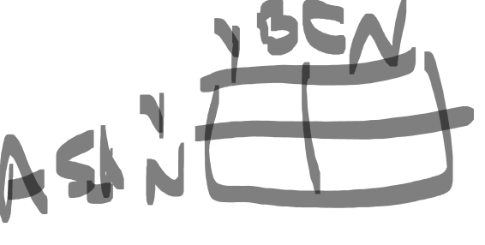
Physicians’ Health Study I
Randomized, double-blind, placebo-controlled trial of N~22,071 U.S. physicians
Examined if:
  Low-dose aspirin (325 mg every other day) decreased cardiovascular mortality
  Beta carotene reduced incidence of cancer
Aspirin component terminated earlier than scheduled
Average follow-up 60 months for aspirin component
Jan. 1988, 99.7% still providing information on morbidity
Notes:
https://www.uspreventiveservicestaskforce.org/Page/Document/UpdateSummaryFinal/aspirin-to-prevent-cardiovascular-disease-and-cancer
https://www.ncbi.nlm.nih.gov/pubmed/2664509
https://www.nejm.org/doi/full/10.1056/NEJM198907203210301?url_ver=Z39.88-2003&rfr_id=ori%3Arid%3Acrossref.org&rfr_dat=cr_pub%3Dpubmed

Slide 35
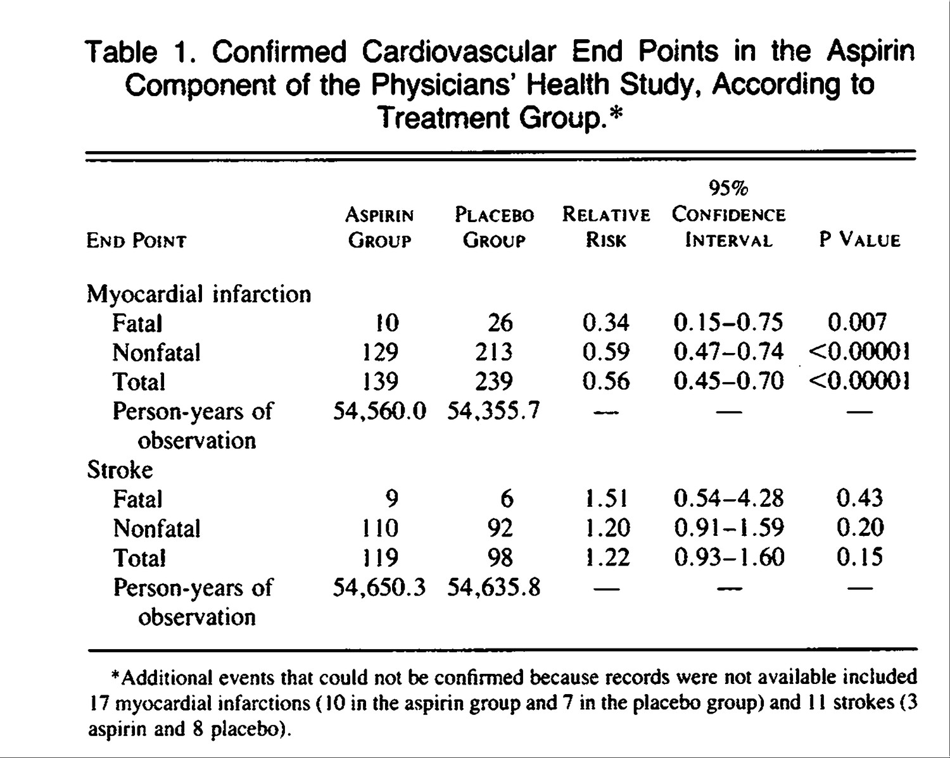

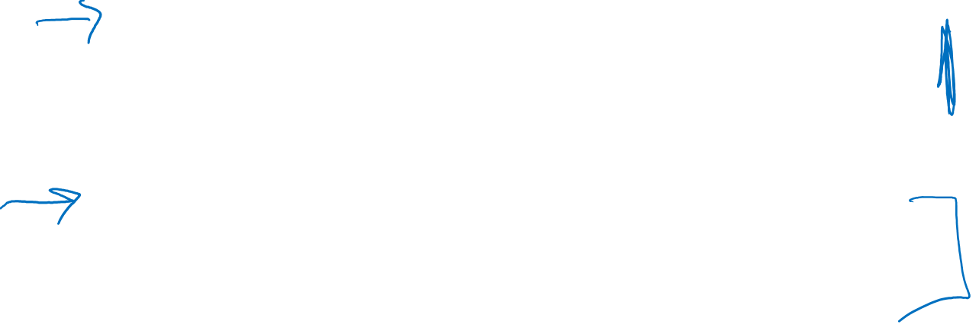
Steering Committee of the Physicians' Health Study Research Group* . N Engl J Med 1989;321:129-135.
Notes:
https://www.nejm.org/doi/full/10.1056/NEJM198801283180431 - Preliminary report
https://www.nejm.org/doi/10.1056/NEJM198907203210301?url_ver=Z39.88-2003&rfr_id=ori:rid:crossref.org&rfr_dat=cr_pub%20%200pubmed - Final report

Slide 36

PHS Aspirin Component terminated early – Why?
Highly statistically significant (P<0.00001) reduction in the risk of total MI among those in the aspirin vs. placebo group
Calculations indicated that to assess effects on overall cardiovascular mortality would take until the year 2000 or later (it was Dec 1987)
Aspirin was subsequently being prescribed for 85% of participants who experienced nonfatal vascular events, making interpretation of mortality endpoints challenging.
Notes:
https://www.nejm.org/doi/full/10.1056/NEJM198801283180431

Slide 37
Beta-Carotene & Lung Cancer

Slide 38
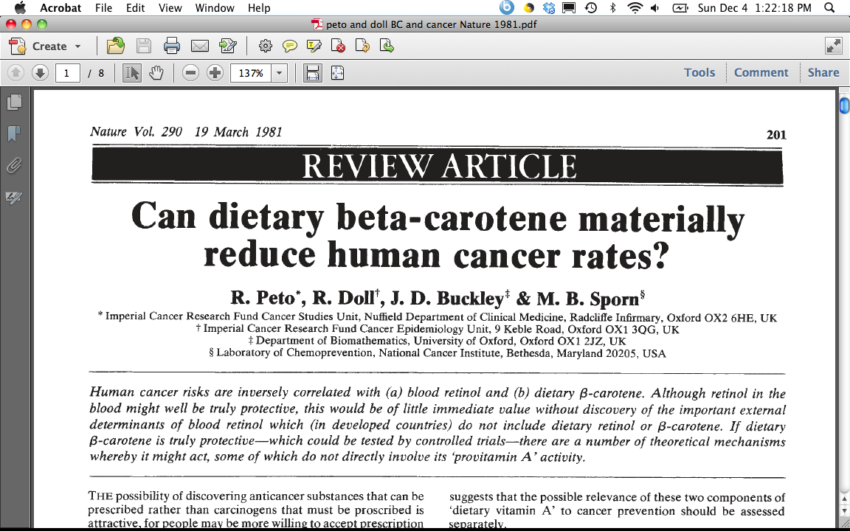

1980’s – Beta-Carotene & Lung Cancer
“This inverse association may, of course, be an artefact, due merely to association of B-carotene ingestion with some truly protective dietary habit(s) or component(s), or to association of B-carotene ingestion with avoidance of some truly harmful dietary habit(s) or component(s).”
“Equally, however, the inverse association between dietary B-carotene and cancer incidence may be due to genuine protective effect of B-carotene against the onset of cancer.”
“Although the evidence thus far available is not compelling that B-carotene is truly protective against cancer (or a fortiori against total mortality) this is not good reason to delay starting controlled trials because even if, as seems probable, a few truly protective agents do await discovery among the dozen or two dietary factors of current interest to the research community, compelling evidence may take decades to emerge without controlled trials.”
CONFOUNDING
TRUTH
Notes:
Ask Class - Who are Doll and Peto?
“Grandfathers of Epidemiology” who Richard Doll and Bradford Hill started the British doctors study in 1951, and published their preliminary and follow-up report in the mid-1950’s providing the earliest evidence that smoking was linked to many serious diseases, first and foremost lung cancer.
30 years later, they published this thoughtful piece on Beta-Carotene and cancer. At the time, the observation had been made that vegetables, in particular those rich in Vit A or carotene seemed to be protective in observational studies, AND some studies that measured retinol and carotene in blood also showed a protective effect, specifically for beta-carotene. At the time, there were only 3 prospective cohort studies that had been done, but these all seemed protective.
1981 Doll & Peto, Nature
ATBC recruited 1985 – 1988
NOTE: Dr. Chan refers to “protective effect” of the observational studies on vegetables and cancer or carotenoids and cancer, quoting older articles of the 1970’s and 1980’s – this should be qualified as an “inverse association” or “potential protective effect” as these results were from case-control and cohort studies and cannot directly comment on true “causal effects.”

Slide 39
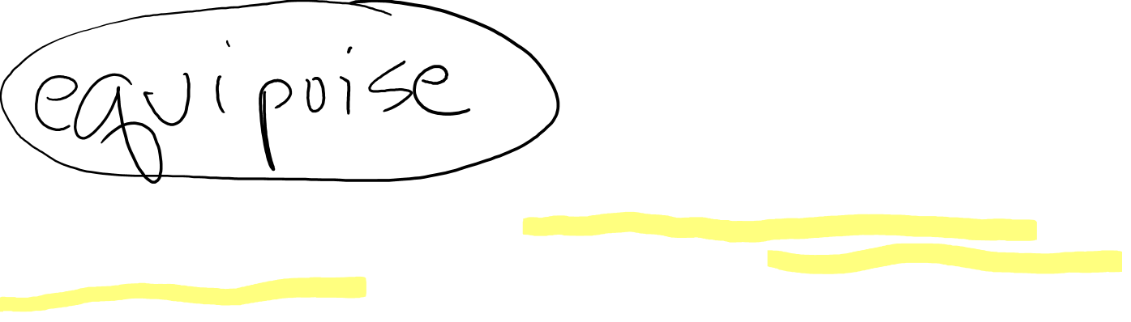
1980’s – Beta-Carotene & Lung Cancer
“This inverse association may, of course, be an artefact, due merely to association of B-carotene ingestion with some truly protective dietary habit(s) or component(s), or to association of B-carotene ingestion with avoidance of some truly harmful dietary habit(s) or component(s).”
“Equally, however, the inverse association between dietary B-carotene and cancer incidence may be due to genuine protective effect of B-carotene against the onset of cancer.”
“Although the evidence thus far available is not compelling that B-carotene is truly protective against cancer (or a fortiori against total mortality) this is not good reason to delay starting controlled trials because even if, as seems probable, a few truly protective agents do await discovery among the dozen or two dietary factors of current interest to the research community, compelling evidence may take decades to emerge without controlled trials.”
CONFOUNDING
TRUTH
Notes:
Ask Class - Who are Doll and Peto?
“Grandfathers of Epidemiology” who Richard Doll and Bradford Hill started the British doctors study in 1951, and published their preliminary and follow-up report in the mid-1950’s providing the earliest evidence that smoking was linked to many serious diseases, first and foremost lung cancer.
30 years later, they published this thoughtful piece on Beta-Carotene and cancer. At the time, the observation had been made that vegetables, in particular those rich in Vit A or carotene seemed to be protective in observational studies, AND some studies that measured retinol and carotene in blood also showed a protective effect, specifically for beta-carotene. At the time, there were only 3 prospective cohort studies that had been done, but these all seemed protective.
1981 Doll & Peto, Nature
ATBC recruited 1985 – 1988

Slide 40
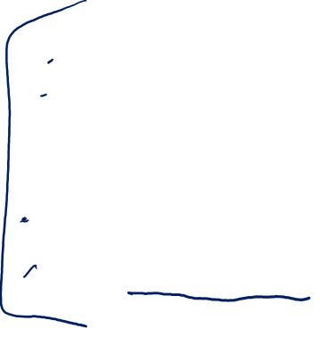
Alpha-tocopherol & Beta-carotene Trial, ATBC
P: 29,133 male smokers in Finland, 50-69 yrs old in 1985-88
I: 50 milligrams (mg) alpha-tocopherol (a form of vitamin E)
OR 20 mg of beta-carotene (a precursor of vitamin A)
OR BOTH
C: Placebo
O: Lung cancer (and other cancers)
Vit E, Beta-Carotene Supplementation and Lung Cancer among Smokers (Albanes et al, JNCI, 1996)
Notes:
http://www.annalsofepidemiology.org/article/1047-2797(94)90036-1/pdf

Slide 41
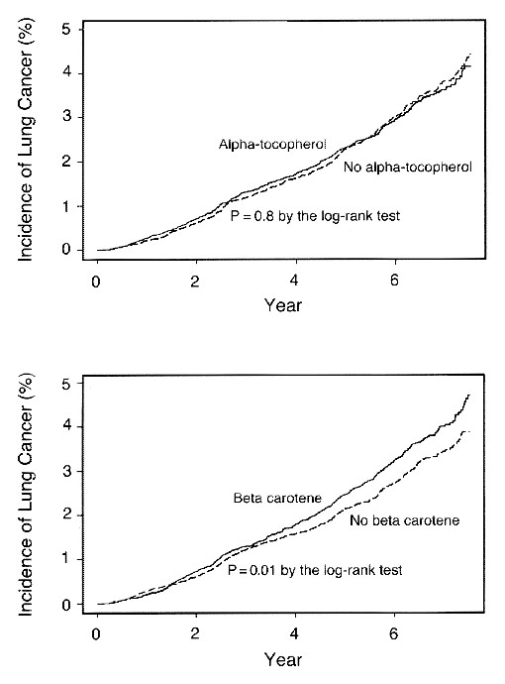
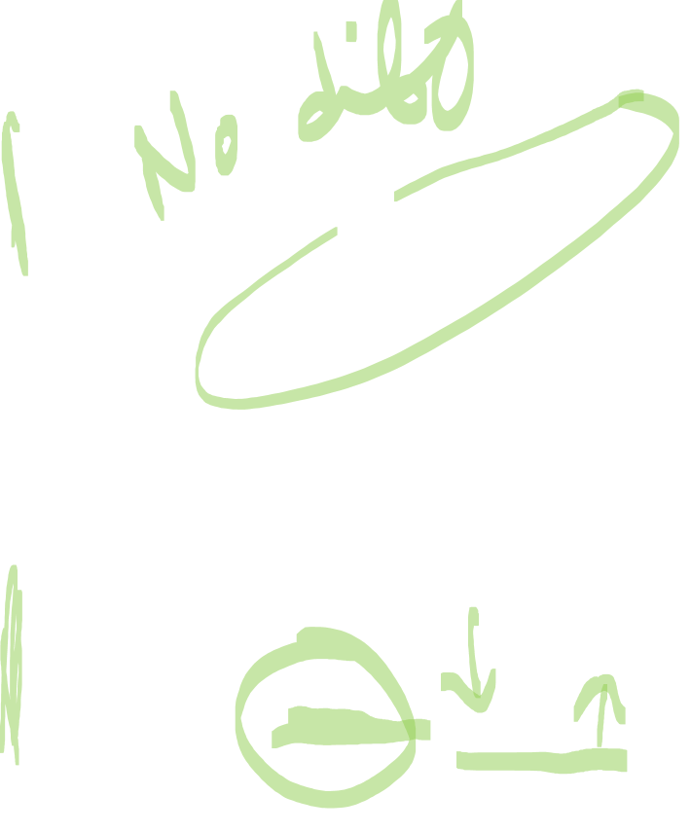
The Alpha-Tocopherol Beta Carotene Cancer Prevention Study Group. N Engl J Med 1994;330:1029-1035.
Kaplan-Meier Curves for the Cumulative Incidence of Lung Cancer among Participants Who Received Alpha-Tocopherol Supplements and Those Who Did Not (Upper Panel) and among Participants Who Received Beta Carotene Supplements and Those Who Did Not (Lower Panel).
More Lung Cancer occurred among men on supplements
Notes:
Figure 1. Kaplan-Meier Curves for the Cumulative Incidence of Lung Cancer among Participants Who Received Alpha-Tocopherol Supplements and Those Who Did Not (Upper Panel) and among Participants Who Received Beta Carotene Supplements and Those Who Did Not (Lower Panel). Data are shown only through 7 1/2 years of follow-up because of the small numbers of participants beyond that time.
Maybe TOO late to intervene with BC or Vit E in a population that has 30 pack years of smoking history
Or… the population was not deficient enough to observe a benefit
For Example…
JNCI 1993 Blot et al, Linxian China RCT combo vit E, BC, and SEL – associated with lower total mortality p=0.03, RR=0.91; esp for cancer RR =0.87 (0.75-1.00)… however baseline BC levels were 3 times LOWER than that in Finland (5.2 ug/dL vs 17 mg/dL)
https://atbcstudy.cancer.gov/

Slide 42

Interpretation Points to Appreciate
Incorrect inference from obs studies on beta-carotene being “causal” - Was beta-carotene THE nutrient in fruits/vegetables accounting for the inverse associations in the observational studies?
Confounding – the benefit in observational studies might have been due to confounding, which, when removed in the RCTS, revealed NO benefit of BC
“The lack of reduction in the incidence of lung cancer among men given the supplemental beta-carotene may be explained by bias, an inadequate duration of supplementations, the use of the wrong dose, or an inappropriate study population.”
Notes:
Maybe TOO late to intervene with BC or Vit E in a population that has 30 pack years of smoking history
Or… the population was not deficient enough to observe a benefit
For Example…
JNCI 1993 Blot et al, Linxian China RCT combo vit E, BC, and SEL – associated with lower total mortality p=0.03, RR=0.91; esp for cancer RR =0.87 (0.75-1.00)… however baseline BC levels were 3 times LOWER than that in Finland (5.2 ug/dL vs 17 mg/dL)
https://atbcstudy.cancer.gov/
http://www.nejm.org/doi/full/10.1056/NEJM199404143301501#t=article
“In the light of all the data available, an adverse effect of beta carotene seems unlikely; in spite of its formal statistical significance, therefore, this finding may well be due to chance.”
What happened next? Subsequent trials indicated that supplemental BC likely does increase risk of Lung cancer in smokers or those with other high risk (asbestos); not associated in general population of non-smokers (physicians health study). (NOTE – these findings were focused on trials that examined supplemental beta-carotene, not beta-carotene received regularly via foods).
The concept of consistency says that you have “one treatment” that is well-defined. This is important to uphold the integrity of the design of a study to make causal inferences. However, one can also imagine that it puts a lot of importance on the decision of choosing exactly which intervention to test, at what dose, for what duration, and in whom. This is why typically there are “phases” of clinical trials designed specifically to determine these sorts of questions before doing the full scale trial. https://www.cancer.gov/about-cancer/treatment/clinical-trials/what-are-trials/phases

Slide 43
PSA Screening & Prostate Cancer

Slide 44

Side note - Principles of Cancer Screening
Healthy person ---→ precursor to cancer ----→ cancer ----→ death
Cancer screening is conducted in healthy populations.
Need to be very careful to not have test or subsequent follow-up work that causes more harm than benefit.
Risk benefit tradeoff is always critical to assess; in this context, you are starting with healthy people, so it doesn’t take much to tip towards ‘harm’
General idea: want to pick up the cancer at an earlier stage and treat it earlier, in the hopes that earlier detection and treatment lowers morbidity and mortality.
Notes:
Further articles on Principles of Cancer Screening:
https://www.ncbi.nlm.nih.gov/pmc/articles/PMC2921618/
https://www.ncbi.nlm.nih.gov/books/NBK223387/
Challenges around over-diagnosis and over-treatment for prostate and breast cancer (perspectives from UCSF faculty) - https://jamanetwork.com/journals/jama/fullarticle/184747
Other DEB Courses that address screening: Clinical Epid (epi 204), Cancer Epid (epi 252)

Slide 45
PSA Screening & Prostate Cancer
A brief history
PSA = prostate specific antigen
Discovered in 1970’s, detectable in blood
First used in 1980’s to monitor prostate cancer after diagnosis, higher levels correspond to worsening of disease
Early 1990’s evidence suggested it could be used to detect prostate cancer as a first-line screening test
FDA approved it for prostate cancer screening in early 1990’s
“PSA Era” – men started routinely being screened for prostate cancer using PSA, insurance covered this simple blood test
RCT’s testing whether PSA screening affects prostate cancer mortality were initiated and ongoing but not completed during this time when many men were getting screened
Notes:
PSA: prostate specific antigen, discovered in 1970’s, initially used clinically to monitor prostate cancer/response to tx.
By early 1990’s studies indicated that it may have use as a first-line screening test. Approved by FDA. Enter – the “psa era” in the US. Many adult men were commonly tested. Incidence of PC shot up, and it was mostly early stage disease. RCTs were started and ongoing during this time to rigorously test the question of whether PSA screening for incident prostate cancer has a benefit on mortality.
NOTE: For a cancer screening test -The goal is to demonstrate whether early screening actually improves mortality… not incidence.
Healthy person ---→ precursor to cancer ----→ cancer ----→ death
The underlying premise of a screening test for a cancer is that you pick up the cancer earlier in its development, when the tumor is more amenable to cure (ideally in some precursor stage, which can be treated before cancer actually develops, e.g., finding colon polyps via colonoscopy before those polyps become cancerous). Some basic tenets about cancer screening are that: a) you can detect it earlier in a low-risk (ideally not too invasive way), b) there must be treatments available that are considered to do more benefit than harm, and c) earlier detection and treatment means better cure rates/lower mortality. All of these things must be true for it to be ethical to implement a cancer screening test into a healthy population. The potential for benefit must outweigh harm, and this is often challenging when you are starting with a healthy population. For more information on screening, see: https://www.ncbi.nlm.nih.gov/pmc/articles/PMC2921618
Recommendations for PSA screening in the USA have changed over time and often been a point of controversy.
2012: D rating for PSA Screening – Do not use PSA based screening for prostate cancer.
https://www.uspreventiveservicestaskforce.org/Page/Document/UpdateSummaryFinal/prostate-cancer-screening
2018: C rating for men 55-69 “individual decision”; D rating for men 70+ - not recommended
https://www.uspreventiveservicestaskforce.org/Page/Document/RecommendationStatementFinal/prostate-cancer-screening1

Slide 46

USPSTF & PSA Screening for Prostate Cancer
Shift in understanding around late 2000’s/2010-ish that prostate cancer = very heterogeneous
  Variation in aggressive forms
  “Indolent” disease (cancer that is so slow-growing it is unlikely to cause any harm during one’s lifetime)
2012 – PSA screening given a D rating
  Over-diagnosis & Over-treatment
2018 – USPSTF updated recommendation:
  PSA screening in men ages 55-69 – C Rating
  PSA screening in men ages 70+ - D Rating
  Between 2012-2018. active surveillance ↑ and over-treatment ↓
Notes:
Recommendations for PSA screening in the USA have changed over time and often been a point of controversy.
2012: D rating for PSA Screening – Do not use PSA based screening for prostate cancer.
https://www.uspreventiveservicestaskforce.org/Page/Document/UpdateSummaryFinal/prostate-cancer-screening
2018: C rating for men 55-69 “individual decision”; D rating for men 70+ - not recommended
https://www.uspreventive

Slide 47

PSA Screening Trials & Prostate Cancer Mortality
 | US Trial - PLCO | European trial | Göteborg trial
N men in trial | 76,000 | 182,160 | 20,000
Median follow-up, years | 13 | 13 | 14
Screening frequency | Annual | Every 4 years | Every 2 years
RR _{screen vs. no screen} | 1.09 (0.87-1.36) | 0.79 (0.69-0.91) | 0.44 (0.28-0.68)
NNS | *** | 781 invited to screen to prevent 1 death (NNI) | 234 to prevent 1 death
Slide acknowledgement:
MJ Stampfer, 2015
Andriole et al. JNCI, 2012; Schröder et al. NEJM, 2012; Hugosson Eur Urol, 2019; Schroder, et.al, Lancet 2014l Hugosson et al. Lancet Oncol, 2010
Notes:
Prostate Lung Colorectal and Ovarian Cancer Screening Trial (PLCO) - US based
PMID: 22228146 PMCID: PMC3260132 Andriole JNCI 2012
Pinsky, Cancer 2017 https://www.ncbi.nlm.nih.gov/pubmed/27911486
European Randomized study of Screening for Prostate Cancer (ERSPC) - Multi-european trial
Schroder, NEJM 2012: main results ERSPC: https://www.ncbi.nlm.nih.gov/pubmed/22417251
Schroder, Lancet, 2014: https://www.ncbi.nlm.nih.gov/pubmed/25108889
Hugossn Eur Urol 2019: https://www.ncbi.nlm.nih.gov/pubmed/30824296
Goteborg – Swedish Trial (was 1 arm of ERSPC), reported separate results earlier than other two studies (https://www.ncbi.nlm.nih.gov/pmc/articles/PMC5907498/; https://www.ncbi.nlm.nih.gov/pubmed/20598634. Hugosson Lan Onc 2010)

Slide 48

PSA Screening and Stage Shift
Slide acknowledgement:
MJ Stampfer, 2015
 | PLCO | ERSPC | Göteborg
N men in trial | 76,000 | 182,160 | 20,000
Median follow-up, yrs | 13 | 13 | 14
RR _{screen vs. no screen} | 1.09 (0.87-1.36) | 0.79 (0.68-0.91) | 0.44 ( 0.28-0.68)
RR adjusted for contamination and nonattendance | Not reported | 0.68 (0.51-0.92) | Not reported
High stage ratio Ratio Control arm Intervention arm | 1.3 2.9% Stage IV 2.3% Stage IV | 2.9 3.8% T4 1.3% T4 | 3.1 3.4% T4 1.1% T4
Pre-trial screening | 44% | Not reported | None
Contamination (%) | ~50% (only 21% of controls had never had PSA) | Spain 7% Rotterdam 31% | Not reported
Screening frequency Control arm Intervention arm | 2.7 in 6 years 5 in 6 years | Not reported Every 4 years | Not reported Every 2 years
Notes:
Prostate Lung Colorectal and Ovarian Cancer Screening Trial (PLCO) - US based
European Randomized study of Screening for Prostate Cancer (ERSPC) - Multi-european trial
Goteborg – Swedish Trial (was 1 arm of ERSPC), reported separate results earlier than other two studies
As you can see, these three trials reported quite different RR on the possible benefit of screening. The RR’s shown here are for PC mortality.
What is clear is that in the US trial (PLCO) there was not evidence of any benefit. Why?
A couple clues are shown in the subsequent rows. First, there was less evidence of stage shift compared to the two European trials. Recall that one of the premises for cancer screening to work is that you are picking up the tumor earlier than previous methods allowed, therefore supporting earlier treatment and better outcomes, theoretically. Here, in the US, the change in the proportion of Stage 4 or late stage disease is less different in the US trial than in the other two trials.
Furthermore, the US population of men were also engaging in voluntary PSA screening BEFORE entering the study. 44% of men had had a PSA test in the US before entering the trial. PSA testing was not as routine throughout Europe at this same time. It was not reported in ERSPC and was stated as ‘none” in the Swedish trial.
The next row highlights issues of “contamination” or participants in the control group actually receiving PSA screening on their own, during the trial. "To be included in our definition of “PSA contamination,” a subject in the control group needed to have had a PSA test within the past year as part of a routine physical examination." As you can see, this was really high in the US study… it was estimated that about 50% of men in the control group received some screening during the study; considering time before the trial and time on trial - it was estimated that nearly 80% of men in the control group had ever had a PSA test. The routine usage of PSA screening was much less in Europe at the time, and consequently, while some "contamination" was reported in ERSPC, it was much less than in PLCO. https://journals.sagepub.com/doi/pdf/10.1177/1740774510374091
Lastly, the frequency of screening was quite different across the trials. One can see that the US trial ended up being a question of nearly annual screening vs every other year screening… rather than a contrast of getting screened every few years vs mainly NOT getting screening. These are 2 very different questions, which largely explains why the results were quite different.
High level takeaway – when RCT results differ on a seemingly similar research question, it is critical to delve into these details and really look at the exact research question that each trial was able to test. Aspects of how a trial is conducted, exact “dose” and timing of intervention, exact characteristics of the study population, etc all shape the specific research question and thus the causal effect that one can make inferences about.

Slide 49
Contamination in PLCO
2,427 of 38,350 men in control arm surveyed ~ screening
  Only 1/3 of men with abnormal PSA/DRE underwent biopsy
Mean number of PSAs in the control arm = 2.7 in 6 years
  vs. 5.0 in the screening arm
Median screening interval in ERSPC was 4.02 years
Slide acknowledgement:
MJ Stampfer, 2015
Pinsky et al, Clinical Trials 2010

Slide 50

PLCO DAG - Ideal
C
Organized annual PSA Screening
Random assignment to PSA screening
Early Detection
More effective Txs
PC Death
Notes:
This is the Goal of the Randomization in PLCO.
Want to be able to study randomization to PSA screening and its effect on PC death, w/o concern about confounding factors associated with screening
Randomization assignment acts as an instrumental variable, associated only with exposure assignment.
Intent to Treat Principle (ITT) - pneumonic "once randomized, always analyzed" - you analyze participants in RCT's according to the group they were assigned to, not based on whether they actually received the intervention or not. This upholds the usage of randomization as an Instr Var and limits confounding.

Slide 51
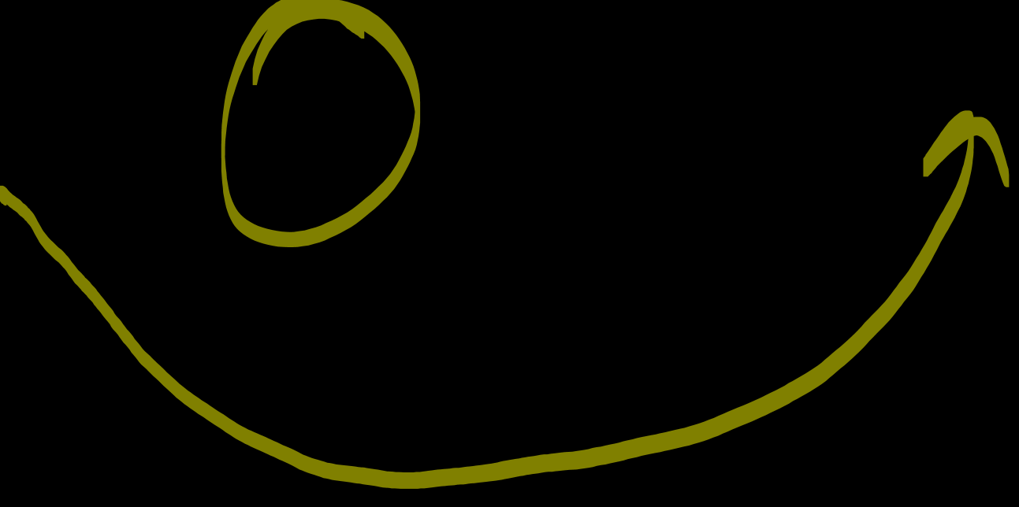
PLCO DAG – In reality, there was non-adherence
C
Organized annual PSA Screening
Random assignment to PSA screening
Early Detection
More effective Txs
PC Death
Knowledge that you are in the Control Arm bc non-blinded study
Elevated PSA detected via opportunistic screening in Control group
Notes:
However, there was opportunistic screening in the control arm, bc screening was just so common at that time and this study was unblinded, so men knew what arm they were in. This contamination of the control group can cause confounding bias

Slide 52
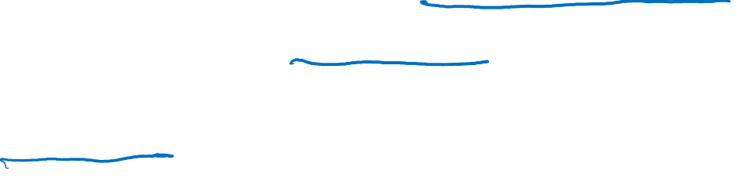
Summary - Beta-Carotene & PSA examples
Dose, duration, and timing of intervention shape the specific causal question that a trial asks.
Different study populations may experience the same intervention differently; effect modification happens/is real.
In a randomized unblinded study, contamination or lack of adherence or cross-over can greatly impact results and reshape the originally intended research question.
Notes:
In summary – while RCT's remain a gold standard study design to estimate causal effects and make causal inferences, there are still several potential ways bias can creep into such studies. These are important to be aware of when planning such studies, or examining data across different RCT's on similar research questions, and to consider when developing the "target trial" concept for one's observational study.

Slide 53
Target Trials – Part 4
In-Class Lecture
June M. Chan, ScD
This work is licensed under a Creative Commons Attribution-NonCommercial-NoDerivatives 4.0 International License.

Slide 54
Recap of Parts 1-3
Definition of Target Trial and how it can be used to motivate the design of observational studies
Background slides on randomized controlled trials (RCT)
RCT Examples – Challenges & Lessons Learned
  Aspirin & MI (myocardial infarction)
  Beta-carotene & Lung Cancer
  PSA Screening and Prostate Cancer Death
  Finer PICO elements shape the exact hypothesis tested
  Adherence & unanticipated effect modification impact results
  QUESTIONS?

Slide 55
Plan for Today
One more RCT example – cohort & RCT example
Target Trial heuristic
In-Class exercise – conceptualizing a target trial
EXTRA Material
Appendix 1: Life of a Research Study
Appendix 2: Tips for Reading & Critiquing Scientific Papers

Slide 56
Cohort vs RCT

Slide 57
Hormone Replacement Therapy (HRT) & CHD
Observational cohort data through mid-1990’s suggested inverse association of HRT and CHD:
  Nurses’ Health Study Results:
    RR: 0.72 (95% CI, 0.55 to 0.95) for CVD mortality
    RR: 0.63 (95% CI 0.56 to 0.70) for total mortality for current users vs. never users, but benefit decreased over time
Further investigated through RCTs (later 1990s-early 2000s)
  Heart and Estrogen/progestin Replacement Study (HERS)
  Women’s Health Initiative (WHI)
In both RCT’s, women with a uterus were randomized to:
    0.625 mg conjugated estrogens + 2.5 mg medroxyprogesterone acetate daily vs. placebo (blinded)
Notes:
NHS: https://www.nejm.org/doi/full/10.1056/nejm199109123251102 HRT and CVD, 1991
https://www.ncbi.nlm.nih.gov/pubmed/9187066 HRT and mortality, 1997
WHI:
37,000 women
Estrogen with (1) and without (2) progesterone
Ages 50-79, with or without CHD
Broad range of US women, 40 centers
Planned 8.5 years
CHD was one key endpoint
Results: https://www.nejm.org/doi/10.1056/NEJMoa030808?url_ver=Z39.88-2003&rfr_id=ori:rid:crossref.org&rfr_dat=cr_pub%3dwww.ncbi.nlm.nih.gov
Design: https://www.sciencedirect.com/science/article/pii/S0197245697000780
HERS centers recruited and randomized 2763 women. Participants ranged in age from 44 to 79 years, with a mean age of 66.7 (SD 6.7) years. postmenopausal women with a uterus and with CHD as evidenced by prior myocardial infarction, coronary artery bypass graft surgery, percutaneous transluminal coronary angioplasty, or other mechanical revascularization or at least 50% occlusion of a major coronary artery.
https://jamanetwork.com/journals/jama/fullarticle/187879 (results)
https://www.sciencedirect.com/science/article/pii/S0197245698000105 (design)

Slide 58
HERS RCT Results
Generally Null
CHD Nonfatal MI CHD Death
“postmenopausal women younger than 80 years with established coronary disease who received estrogen plus progestin did not experience a reduction in overall risk of nonfatal MI and CHD death or of other cardiovascular outcomes.
How can this finding be reconciled with the large body of evidence from observational and pathophysiologic studies suggesting that estrogen therapy reduces risk for CHD?”
Hulley S, JAMA 1998
Notes:
Figure 3.—Kaplan-Meier estimates of the cumulative incidence of primary coronary heart disease (CHD) events (left) and to its constituents: nonfatal myocardial infarction (MI) (center) and CHD death (right). The number of women observed at each year of follow-up and still free of an event are provided in parentheses, and the curves become fainter when this number drops below half of the cohort. Log rank P values are .91 for primary CHD events, .46 for nonfatal MI, and .23 for CHD death.

Slide 59
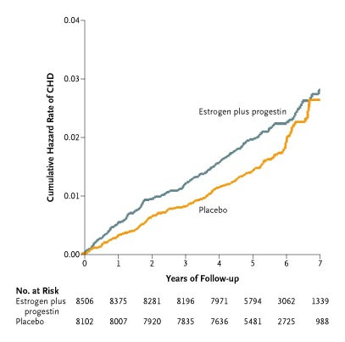
Manson JE et al. N Engl J Med 2003;349:523-534.
WHI RCT Results
Suggestive harmful effect of intervention
Kaplan–Meier Estimates of Cumulative Hazard Rates of CHD.
How would you interpret this Figure?
Notes:
Figure 2. Kaplan–Meier Estimates of Cumulative Hazard Rates of CHD. CHD included nonfatal myocardial infarction and death due to CHD. The overall hazard ratio for CHD was 1.24 (nominal 95 percent confidence interval, 1.00 to 1.54; 95 percent confidence interval with adjustment for sequential monitoring, 0.97 to 1.60).
https://www.nejm.org/doi/full/10.1056/nejmoa030808

Slide 60
NHS vs WHI – HRT & CVD Comparison
What accounts for the apparent discrepancies?
Confounding in Cohort?
Or differences in design features?
  Study Population
  Dose
  Duration
  Timing
Probably still some residual confounding
Considerations:
  WHI older
  Early cohort data primarily on estrogen only
  Estrogen may ↓ risk of CHD but higher doses ↑ risk of stroke
  Timing since menopause may be important due to different biological effects of estrogen on early vs. advanced atherosclerotic lesions
Notes:
Bhupathiraju SN et al, Am J Epidemiol. 2017;186(6):696–708
https://www.ncbi.nlm.nih.gov/pubmed/28938710
Suggestive inverse association from NHS data among women under 60, and within first 10 yrs of menopause (Hernan, Epid, 2008)
85% of NHS women initiated HRT bt 50-59, whereas in WHI, mean age at entry to RCT was 63, and 25% of women had previously used or were currently using HRT when they trial started
Earliest reports from NHS on benefit of CHD would be capturing that early phase of women just beginning menopause, and at the youngest ages. There may be a short term benefit of HRT in women under 59 or with few CHD risk factors; but as time goes on, HRT begins to have more of an adverse effect - which is what was captured in the RCT’s.

Slide 61
We present observational analyses from the NHS to simulate the inclusion and exclusion criteria and dose and formulation of HT used in the WHI trials. When analyses were conducted in the broader age range of 50– 79 years, results were discordant for total MI and for several other outcomes. However, much of the apparent discordance in the WHI versus NHS findings disappeared when we restricted our analyses to the ages of 50–59 years at HT initiation, the age range when more than 60% of women initiated HT use in the NHS.
Bhupathiraju, SN et al
Am J Epidemiol. 2017;186(6):696–708
Notes:
Subsequently, several re-analyses were pursued to try to evaluate the observational data in a way where they better emulated the trials that were done, to see if there might have been missed effects.

Slide 62
Examining sub-groups of Obs. Cohort and RCT data, side by side:
HRT & Total MI, among women 50-79 yrs, and within 10 yrs menopause
◼︎ (squares): WHI (RCT)
◆ (diamonds): NHS (COHORT)
Bhupathiraju SN, AJE 2017
Notes:
https://www.ncbi.nlm.nih.gov/pubmed/28938710
NHS models adjusted for: age, calendar time, smoking status (never, past, current 1–14 cigarettes/day, current 15–24 cigarettes/day, current
>24 cigarettes/day), alcohol intake (g/day: 0, 0.1–4.9, 5–9.9, 10–14.9, ≥15), physical activity (MET-hours/week: <3, 3–8.9, 9–17.9, 18–26.9, ≥27),
body mass index (weight (kg)/height (m)2; <21, 21–22.9, 23–24.9, 25–26.9, 27–29.9, 30–34.9, 35–39.9, ≥40), aspirin use for at least 1 day/month
(yes/no), history of high blood pressure (yes/no), history of hypercholesterolemia (yes/no), history of type 2 diabetes mellitus (yes/no; all models
except diabetes as an outcome), age at menopause (continuous), parental history of early myocardial infarction (yes/no), parental history of cancer
(yes/no), duration of CEE use (in months), and duration of CEE+MPA use (in months).
**NOTE: figure above reflects the CORRECTED legend from the online version of the article. In orig publication the legend had the studies reversed and was incorrect. Above is correct. The errata published post-hoc stated: “the legends for Figures 1–3 incorrectly stated that the results from the Women’s Health Initiative were displayed as diamonds and results from the Nurses’ Health Study were displayed as squares; the reverse is correct.”

Slide 63
Examining sub-groups of Obs. Cohort and RCT data, side by side:
HRT & Total MI, among women 50-79 yrs, and within 10 yrs menopause
“Discrepancies between NHS and WHI could largely be attributed to differences in the age structure of the populations and age at HT initiation.”
◼︎ (squares): WHI (RCT)
◆ (diamonds): NHS (COHORT)
Bhupathiraju SN, AJE 2017
Notes:
https://www.ncbi.nlm.nih.gov/pubmed/28938710
NHS models adjusted for: age, calendar time, smoking status (never, past, current 1–14 cigarettes/day, current 15–24 cigarettes/day, current
>24 cigarettes/day), alcohol intake (g/day: 0, 0.1–4.9, 5–9.9, 10–14.9, ≥15), physical activity (MET-hours/week: <3, 3–8.9, 9–17.9, 18–26.9, ≥27),
body mass index (weight (kg)/height (m)2; <21, 21–22.9, 23–24.9, 25–26.9, 27–29.9, 30–34.9, 35–39.9, ≥40), aspirin use for at least 1 day/month
(yes/no), history of high blood pressure (yes/no), history of hypercholesterolemia (yes/no), history of type 2 diabetes mellitus (yes/no; all models
except diabetes as an outcome), age at menopause (continuous), parental history of early myocardial infarction (yes/no), parental history of cancer
(yes/no), duration of CEE use (in months), and duration of CEE+MPA use (in months).

Slide 64
WHI - HRT and MI
C
Random assignment to HRT
HRT exposure
MI
What was planned
C
What was learned and not accounted for in RCT’s
Age
Random assignment to HRT
HRT exposure
MI
Time since Menopause
Notes:
In the WHI, the goal was to study random allocation to HRT or placebo, for the outcome of MI, with randomization acting as the instrumental variable (i.e., associated with HRT exposure and nothing else).
However, further studies suggested that age and time since menopause (which could be confounders) may each modify the effect of HRT on MI… (click to show interaction DAG)

Slide 65
HRT and MI
C
Random assignment to HRT
HRT exposure
MI
What was planned
C
What was learned and not accounted for in RCT’s
Age
Random assignment to HRT
HRT exposure
MI
Time since Menopause
Notes:
…which means that it may be more accurate to examine the effect of HRT allocation, conditional on age and time since menopause. In fact, when this was done in WHI, results were more similar to the original NHS results, for the sub group of younger women who had experienced menopause more recently, when they went on HRT.
These results suggest that age and time since menopause are effect modifiers of the association of HRT and MI, which means that the primary association of interest (HRT → MI) acts biologically differently, based on age or time since menopause… and without stratifying by these factors, one could miss relevant effects.
NOTE: DAG’s are not great at depicting Effect Modification. Ideally, one would want to examine these questions within sub-groups of Age and time since menopause, or WITHIN strata of the boxed vars above

Slide 66
Summary - RCT interpretation caveats / limitations
Changes in SOC or issues of adherence can hinder the ability to address a meaningful question
  Sample size estimates in planning phase need to anticipate some amount of lack of adherence, but can still under-estimate
Food can be complex, and a reductionist approach to nutrition may over-simplify the benefits
  RCT’s are better for addressing “mature” questions
Apparent discrepancies between observational data & RCT’s may sometimes be explained by nuances in the actual question each addresses
  Framing the hypothesis/study question in detail and considering finer elements of PICO can help shed light
  Consider effect modification or differences in study population
Sometimes RCTs have surprising results that are true
Notes:
Changes in SOC (standard of care) or issues of adherence can cripple the ability to address a meaningful question (PLCO)
Sample size estimates in planning phase need to anticipate some amount of lack of adherence, but can still under-estimate
Food can be complex, and a reductionist approach to nutrition may over-simplify the benefits (ATBC)
RCT’s are better for addressing “mature” questions
Apparent discrepancies bt observational data & RCT’s may sometimes be explained by nuances in the actual question each addresses (pay attn to PICO)
consider effect modification or differences in study population (WHI vs NHS)
Sometimes RCTs have surprising results that are true (WHI, ATBC)

Slide 67

Elements of Study Design –PICO ++ (from Part 1)
How was the population defined? How was the sample selected?
What is the time-frame (cross-sectional, longitudinal)?
Did we sample using persons or person time?
Was the underlying cohort ‘dynamic’ or ‘fixed’?
How was exposure defined and assessed?
What is the outcome & are we estimating risks, rates, odds, time to event, etc?
Was there non-compliance or could exposure change over time? How was this handled?
Was there drop-out or loss to follow-up? Did participants die before the outcome was measured?

Slide 68
Target Trial Heuristic
Acknowledgement: Sonia Hernandez-Diaz, MD DrPH

Slide 69
Key Features of Randomized Controlled Trials | Observational
Notes:
RCT typically have…

Slide 70
Key Features of Randomized Controlled Trials | Observational
Clear Objective(s). Primary and secondary endpoints
Notes:
Clear objectives, with primary and secondary endpoints….we should be able to do that in Obs studies as well as RCT’s

Slide 71
Key Features of Randomized Controlled Trials | Observational
Clear Objective(s). Primary and secondary endpoints
Study population. Inclusion/exclusion criteria
Notes:
Inclusion/exclusion criteria should be clear for both types of studies

Slide 72
Key Features of Randomized Controlled Trials | Observational
Clear Objective(s). Primary and secondary endpoints
Study population. Inclusion/exclusion criteria
Longitudinal
longitudinal (versus cross-sectional) studies in which the temporal order of treatment and outcome is clear
Notes:
When the goal is estimating the causal effect of certain treatment on the outcome, longitudinal studies are preferred over non longitudinal (i.e., cross-sectional) ones in which the temporal order of treatment and outcome may be unclear

Slide 73
Key Features of Randomized Controlled Trials | Observational
Clear Objective(s). Primary and secondary endpoints
Study population. Inclusion/exclusion criteria
Longitudinal
Randomized treatment assignment | No
How to achieve comparability (or exchangeability)?
Matching, stratification, restriction, modeling, etc.
Notes:
Longitudinal studies are usually classified as either experiments (the treatment is assigned by the investigators) or observational
studies (the investigators play no role in treatment assignment). Experiments are said to be randomized when the investigators assign the treatment at random.
They randomized the treatments… we cannot do that in obs studies.
This is one of the key differences and leads to CONFOUNDING BIAS
we have tried to achieve comparability (exchangeability) through addressing confounding in the design or analysis phase
Challenge – many methods can only address confounding factors one is aware of…

Slide 74
Key Features of Randomized Controlled Trials | Observational
Clear Objective(s). Primary and secondary endpoints
Study population. Inclusion/exclusion criteria
Longitudinal
Randomized treatment assignment | No
Blinding | No
Not in the same way as RCT, but often assessments can be done by individuals who are “blinded” to exposure or disease status (e.g., lab measurements, or data abstracted from SOC tests, etc)
Notes:
Blinding is another key difference, although some assessments in OBS studies can be done blinded.
we could also perhaps do blinded analysis
Also, many types of clinical trials are NOT blinded (e.g., exercise, diet, etc)

Slide 75
Key Features of Randomized Controlled Trials | Observational
Clear Objective(s). Primary and secondary endpoints
Study population. Inclusion/exclusion criteria
Longitudinal
Randomized treatment assignment | No
Blinding | No
Statistical Power. Sample size & follow up
Notes:
RCT very carefully estimate the adequate sample size… ethical ramifications if we do not properly design RCT

Slide 76
Key Features of Randomized Controlled Trials | Observational
Clear Objective(s). Primary and secondary endpoints
Study population. Inclusion/exclusion criteria
Longitudinal
Randomized treatment assignment | No
Blinding | No
Statistical Power. Sample size & follow up
International, multicenter,…
Notes:
They are often international, multicenter… we can also do that, we can even collaborate… ☺
Cohorts also can be pooled for even larger studies/analyses

Slide 77
Key Features of Randomized Controlled Trials | Observational
Clear Objective(s). Primary and secondary endpoints
Study population. Inclusion/exclusion criteria
Longitudinal
Randomized treatment assignment | No
Blinding | No
Statistical Power. Sample size & follow up
International, multicenter,…
Reference group. Active therapy or placebo
Notes:
Both types of studies have this. In Coh often also have flexibility over definition…

Slide 78
Key Features of Randomized Controlled Trials | Observational
Clear Objective(s). Primary and secondary endpoints
Study population. Inclusion/exclusion criteria
Longitudinal
Randomized treatment assignment | No
Blinding | No
Statistical Power. Sample size & follow up
International, multicenter,…
Reference group. Active therapy or placebo
Blind adjudication of events
Medical record review
Notes:
Blind adjudication of events (outcomes) can happen in both types of designs

Slide 79
Key Features of Randomized Controlled Trials | Observational
Clear Objective(s). Primary and secondary endpoints
Study population. Inclusion/exclusion criteria
Longitudinal
Randomized treatment assignment | No
Blinding | No
Statistical Power. Sample size & follow up
International, multicenter,…
Reference group. Active therapy or placebo
Blind adjudication of events
Inscription of Protocols
Notes:
Usage of standardized protocols for data collection and follow-up can be common to both Clinical Trials and obs studies

Slide 80
Key Features of Randomized Controlled Trials | Observational
Clear Objective(s). Primary and secondary endpoints
Study population. Inclusion/exclusion criteria
Longitudinal
Randomized treatment assignment | No
Blinding | No
Statistical Power. Sample size & follow up
International, multicenter,…
Reference group. Active therapy or placebo
Blind adjudication of events
Inscription of Protocols
Loss to follow up & Adherence
Notes:
Loss to Follow-up is a challenge for both RCT’s and COHORT studies.
RCTs also face the problem of incomplete adherence and deal with it in the analysis by doing intention to treat (ITT) rather than per protocol.
In obs studies, we sometimes evaluate exposure data from a single timepoint or from updated exposure data; keep in mind that data on time varying exposures and confounding factors can be collected in COHORTS… usage of such data sometimes needs particular attention in analysis phase (IPCW, msm)
Patients who discontinued early, die or are lost to follow up are typically censored at the date of the last contact in both RCT and COH studies

Slide 81
RCT vs. Cohort
RCT features COHORT equivalents
Randomization
Blinding
ITT
Methods to address confounding in design & analysis phase (restriction, matching, stratification, multivariate modeling, etc.)
Structured (& sometimes blinded) assessments (e.g., medical assessments may be part of SOC; labs can be agnostic)
Do not adjust for post-baseline covariates.
  Cohorts can collect data on time-varying exposures & confounders (may need special attention in analysis phase)
Notes:
As with randomized trials, we should not adjust for post-exposure covariates, only baseline covariates… except if we have time-varying exposures, then we do want data on time varying confounders…
Caution: we don’t want to adjust for something in the causal path or for covariates that are influenced by the exposure → Marginal Structural Models & Inverse Prob Censoring Weights (More in BIO 215)

Slide 82
Cohort & Target Trial – Summary
Concept of a target trial can help with cohort design
Counterfactual framework → Randomized Experiments → Target Trial → Observational Study Designs
When cohorts don’t or can’t emulate a trial, may explain apparent discrepancies in the literature.
  NOTE: the observational study may address a different question than the trial and may still be valid.
Sometimes RCTs will have limitations and rigorous observational evidence will be best available data
  How do we use this to guide clinical practice & public health recommendations?
    Weigh the risks and benefits, with best available data
QUESTIONS?

Slide 83
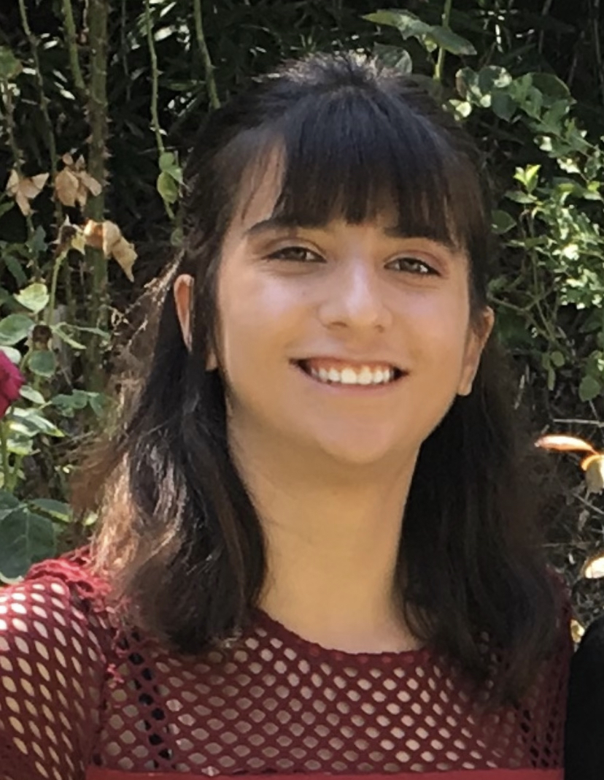
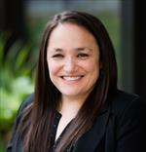
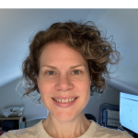
Acknowledgements:
Sonia Hernandez-Diaz, MD DrPH
Harvard TH Chan School of Public Health
Maria Glymour, PhD, UCSF
Deborah Grady, MD, MPH, UCSF
Sarah Goldberg, BA, MAS candidate
Rebecca Graff, ScD, UCSF
Carolyn Smith-Hughes, MS, PhD candidate

Slide 84
Notation or Shorthand we may commonly use…
Bt: between
Ca: cancer or case
Ca-co: Case control study
Coh: Cohort study
E: exposure or exposed or number exposed
E: unexposed or number unexposed
EM – effect modification
D: number with disease
D: those without disease
Dbx: Diabetes
Dx: diagnosis
N: total in a group or population count
Obs: Observational
PT: person-time
RCT: randomized controlled trial
SOC: Standard of Care
Tx: treatment

Slide 85
In-Class Exercise – Target Trials
This work is licensed under a Creative Commons Attribution-NonCommercial-NoDerivatives 4.0 International License.

Slide 86
2 ways to use the target trial concept in practice
Study Planning
  Conceptualize the theoretical target trial first (hypothesis, PICO elements, etc).
  Consider how elements of the cohort can emulate these as best as possible.
  Where the cohort falls short, consider alternatives to limit bias.
Study Critiquing – When you are assessing an existing observational study, consider what the target trial might be that addresses the same/similar question.
  Specify the study elements of the theoretical target trial (RCT)
  Compare where the observational study is unable to emulate the trial.
  Consider what threats to validity are introduced and how well the investigators address these.
Notes:
Note: a target trial is a randomized experiment. It may not be a feasible actual trial one can do. However, conceptualizing the ideal elements/features of a Target trial for a given question will help you try to emulate the obs study as best as possible.

Slide 87
In-Class Exercise
Association of Leisure-Time Physical Activity With Risk of 26 Types of Cancer in 1.44 Million Adults. https://www.ncbi.nlm.nih.gov/pubmed/27183032
“time per week in moderate and vigorous leisure-time physical activities…. Assessed by asking about discrete activities such as walking, running, or swimming, or, alternately, by inquiring about overall weekly participation in moderate- to vigorous-intensity activities. The median activity level was 8 MET-h/wk …. equivalent to 150 minutes of moderate-intensity activity (eg, walking) per week, and comparable to the median activity level for the US population.”
“high vs low levels of leisure-time physical activity were associated with lower risks of 13 of 26 cancers.”
Notes:
In class
Divide into small groups or pairs; each group answers one question from 1-3 below; regroup discuss; answer q4 together.
What is the hypothesis for this study? What are the PICO elements? Read the abstract, skim the methods as necessary
What would the “target trial” be to address the same/similar question? Is it feasible?
What are aspects of the cohort design that cannot emulate the target trial? (or can’t emulate it well)
What types of threats to validity are introduced, consequently, and what are other ways to address (if possible and if we have time to discuss)?
Full text link: https://www.ncbi.nlm.nih.gov/pmc/articles/PMC5812009/

Slide 88
Questions to discuss in small groups
What is the hypothesis for this study? What are the PICO elements? Read the abstract, skim the methods as necessary (link and abstract in NOTES field)
What would the “target trial” be to address the same/similar question? Describe briefly, including PICO elements. Is it feasible?
What are aspects of the cohort design that cannot emulate the target trial? (or can’t emulate it well) Consider the target trial heuristic and identifiability criteria.
What types of threats to validity exist for each study design?
Notes:
(https://www.ncbi.nlm.nih.gov/pmc/articles/PMC5812009/)
ABSTRACT:
“Abstract
IMPORTANCE
Leisure-time physical activity has been associated with lower risk of heart-disease and all-cause mortality, but its association with risk of cancer is not well-understood.
OBJECTIVE
To determine the association of leisure-time physical activity with incidence of common types of cancer and whether associations vary by body size and/or smoking.
DESIGN, SETTING, AND PARTICIPANTS
We pooled data from 12 prospective U.S. and European cohorts with self-reported physical activity (baseline 1987–2004). A total of 1.44 million participants (median age:59 years; range:19–98 years) and 186,932 cancers were included. We used multivariable Cox regression to estimate hazard ratios (HRs) and 95% confidence intervals (CIs) for associations of leisure-time physical activity with incidence of 26 types of cancer. Leisure-time physical activity levels were modeled as cohort-specific percentiles on a continuous basis and cohort-specific results were synthesized by random effects meta-analysis. Hazard ratios for high versus low levels of activity are based on a comparison of risk at the 90th versus 10th percentiles, respectively, of activity.
EXPOSURE
Leisure-time physical activity of a moderate to vigorous intensity.
MAIN OUTCOMES AND MEASURES
Incident cancer during follow-up.
RESULTS
High versus low levels of leisure-time physical activity were associated with lower risks of 13 cancers: esophageal adenocarcinoma (HR=0.58,CI:0.37–0.89), liver (HR=0.73,CI:0.55–0.98), lung (HR=0.74,CI:0.71–0.77), kidney (HR=0.77,CI:0.70–0.85), gastric cardia (HR=0.78,CI:0.64–0.95), endometrial (HR=0.79,CI:0.68–0.92), myeloid leukemia (HR=0.80,CI:0.70–0.92), myeloma (HR=0.83,CI:0.72–0.95), colon (HR=0.84,CI:0.77–0.91), head and neck (HR=0.85,CI:0.78–0.93), rectal (HR=0.87,CI:0.80–0.95), bladder (HR=0.87,CI:0.82–0.92), and breast (HR=0.90,CI:0.87–0.93). BMI adjustment modestly attenuated associations for several cancers, but 10 of 13 inverse associations remained statistically significant after BMI adjustment. Leisure-time physical activity was associated with higher risks of malignant melanoma (HR=1.27,CI:1.16–1.40) and prostate cancer (HR=1.05,CI:1.03–1.08). Associations were generally similar between the overweight/obese and the normal weight. Smoking status modified the association for lung cancer, but not other smoking-related cancers.
CONCLUSIONS AND RELEVANCE
In addition to associations with lower risk of heart-disease and mortality, leisure-time physical activity is also associated with lower risks of many cancer types. Health care professionals counseling inactive adults should emphasize that most of these associations were evident regardless of body size or smoking history, supporting broad generalizability of findings.”

Slide 89
Target Trial Heuristic Identifiability Criteria
Key Issues in Clinical Trials​
Clear Objective(s). Primary and secondary endpoints ​
Study population. Inclusion/exclusion criteria ​
Longitudinal ​
Randomized treatment assignment​
Blinding​
Statistical Power. Sample size & follow up ​
International, multicenter,… ​
Reference group. Active therapy or placebo ​
Blind adjudication of events​
Inscription of Protocols ​
Loss to follow up & Compliance
Exchangeability
Consistency
Positivity
Notes:
While this particular target trial may be unethical, the concepts of the target trial and the identifiability criteria can still help us consider strengths/limitations of the cohort study. Think through each criterion above and consider whether the obs study can “emulate” it’s RCT counterpart for the specific question of interest.

Slide 90
For Next Week
Office Hours, Monday 1/31, 4:10-5pm
HW on Target Trials DUE on 2/3/22 (note q4 shown on next slide as back up)
Lecture on 2/3/22 – Matching in Obs. Studies
  Reading: Chapter 8, pages 171-182, and page 605 Rothman, Greenland, & Lash, 2008
  Watch 3 recorded lecture segments
Staying remote through 2/15.
  May be in person on 2/17 and 3/10
Thank you and have a great week!

Slide 91
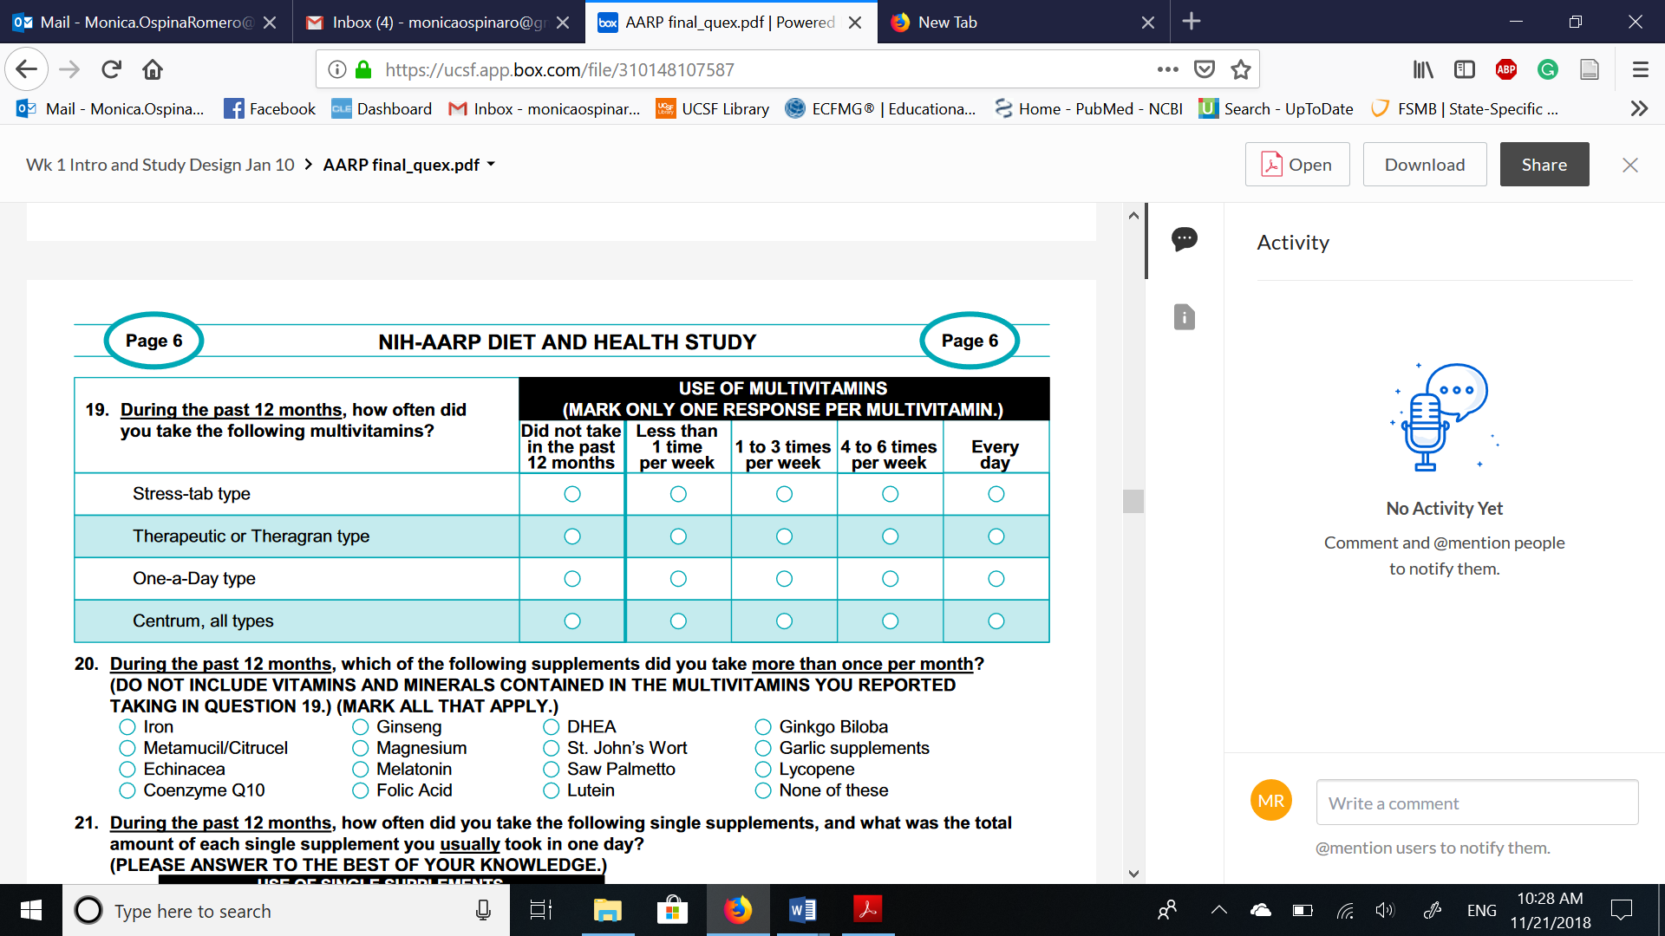
HW3 Ques 4 with image, in case needed
For some reason, in the past, the image shows up variably for people.
4. Below you will find a screenshot of the AARP questionnaire used in this study, specifically, the question that asks about frequency of multivitamin use. Compare the categories presented in this question and the categories of frequency of multivitamin use applied by the authors in Table 2. How did the authors create the category “more than 7 times per week”? Comment on how this classification of the exposure can affect the results of the study and propose other ways to analyze these data. (4 points)

Slide 92
Extra Notes on terms and specific RCT’s discussed above
This work is licensed under a Creative Commons Attribution-NonCommercial-NoDerivatives 4.0 International License.

Slide 93
Terminology ⚐ - Retrospective vs. Prospective
⚐ This terminology is used differently by different authors
  Definition 1 (old one) – based on study design
    Prospective = cohort study
    Retrospective = case-control
  Definition 2 – based on exposure assessment
    Prospective = exposure history is assessed prior to the outcome
    Retrospective = exposure history is assessed at the same time as, or after, the outcome
Notes:
In the rothman chapter
challenge of epid – a lot of terms! And we take terms from the regular dictionary and give it different definitions!

Slide 94
Terminology ⚐ - Retrospective vs. Prospective
  Definition 3 – based on start of study/investigation
    Prospective = the outcomes occur after the implementation of the study protocol
    Retrospective = the outcome occurs before the implementation of the study protocol
  Definition 4 – based on person-time accumulation relative to study start
    Prospective = ‘person-time’ (time on the study) is accumulated after the study begins
    Retrospective = person-time is accumulated before the study begins
  Definition 5 (recommended) – based on potential for influence of Disease
    Prospective = exposure measurement cannot be influenced by disease
    Retrospective = exposure measurement can be influenced by disease
Notes:
Never liked definition 3.
Ques – how can you have collected data prospectively, but still have dis influence it? Can have data assessed prospectively, but then maybe its scored only when you are doing your analysis, and after disease has happened… its possible for disease to influence scoring if someone digs deeper
We don’t want the existence of Disease to influence the measurement of exposure → BIAS
NOTE: there can be a really well conducted retrospective cohort study… it doesn’t ALWAYS mean a retrospective study is more biased…
Temporarility of E before D is very helpful…when writing, often use “exposure assessment was done prospective relative to outcome”

Slide 95
HERS trial results – Variable participation bc women felt side-effects – breaking of the “blinding”
Hulley S, JAMA 1998
Notes:
Figure 2.—Participants taking protocol medications and with pill count of 80% or more, as a percentage of all women at risk for a primary coronary heart disease event.

Slide 96
Implications of PSA Screening for CaP research
Most CaP is harmful only if detected and (over)treated
    Main risk factor for indolent disease – getting screened and having a biopsy
Differing pattern of risk factors between incident & lethal CaP
Larger fraction of cases diagnosed before PSA screening had lethal potential - studies pre-PSA are not always comparable to those conducted in the post-PSA-era
11yr lead time for PSA means studies and trials must be long enough to be meaningful
Slide acknowledgement:
MJ Stampfer, 2015

Slide 97
Appendix 1:
Life of a Research Study

Slide 98
Scientific Process
Figure out what you are really interested in or what you will at least enjoy working on for a while
Develop Research Question & Hypothesis
Identify & Select Team and Expertise Needed
Identify Funding Mechanisms
Design your Study & Make Analysis Plan
Write Proposal & Make a Budget
  Share proposal with colleagues & get feedback
  Review budget with mentors & justify budget
Submit… and revise & resubmit… until funded!
Study Implementation
  Review Team again… now its real, pick good people who are reliable, smart, ethical, and with whom you enjoy working!
Study Reporting – Conferences, Journals, Press, Social Media, Websites, etc

Slide 99
Scientific Process
Figure out what you are really interested in or what you will at least enjoy working on for a while
Develop Research Question & Hypothesis
Identify & Select Team and Expertise Needed
Identify Funding Mechanisms
Design your Study & Make Analysis Plan
Write Proposal & Make a Budget
  Share proposal with colleagues & get feedback
  Review budget with mentors & justify budget
Submit… and revise & resubmit… until funded!
Study Implementation
  Review Team again… now its real, pick good people who are reliable, smart, ethical, and with whom you enjoy working!
Study Reporting – Conferences, Journals, Press, Social Media, Websites, etc

Slide 100
Appendix 2:
Tips for Reading & Critiquing Scientific Papers

Slide 101
Reading & reviewing & writing a scientific manuscript
Title
Abstract
Introduction
Methods
Results
  Tables
  Figures
Discussion
References
Acknowledgements
Author overall recommendations:
  Ask meaningful, interesting and focused questions (i.e., for which both positive or negative result would be of interest)
  Plan a structure for the manuscript
  Writing order: Introduction, Methods, Tables/figures, text of Results, Conclusions, Abstract
  Good first sentence (hook reader), good last sentence (paunch line), and good figure
  One thought per sentence. Related thoughts in paragraphs
  No rambling, no unnecessary words. Active voice
  Logic: the methods should follow from the hypothesis, the results from the methods and the conclusions from the results
Notes:
You have been introduced to broad range of topics and methods in EPI 203.
With those initial tools, one of the best ways to learn epid is now to apply it – by reading/critiquing the peer-reviewed literature and writing your own proposals/ideas.
Would like to spend some time providing some structure for how to read/critique and write scientific reports, which we will be part of your regular HW assignments
This set of slides is intended to help guide you/give you some checklists/structure, as you will be presented with articles/problems sets in this class

Slide 102
Reading & reviewing & writing a scientific manuscript
Title
Abstract
Introduction
Methods
Results
  Tables
  Figures
Discussion
References
Acknowledgements
Editor (decision maker) and Reviewers look for:
Is the article novel, relevant, informative, valid and ethical ?
Would it affect practice or the way we understand a disease?
Is it the first paper, the best paper to date, or the last word on something ?
Is it well organized and well written?
Would the readers of this specific journal be interested?
Is it going to have a high impact and help my impact factor…

Slide 103
Reading & reviewing & writing a scientific manuscript
Title
Abstract
Introduction
  Background (justification)
    Problem
    Need to fill gap
    Solution
  Research question-hypothesis
  Objectives
Methods
Results
Discussion
References
Acknowledgements
READER
What was the justification for the study?
Which were the main objectives?
Does the significance of the problem justify the study? Can this study answer the question?
AUTHOR recommendations
Summarize key background information that makes the study significant
Make clear the hypothesis you are studying and why is it relevant
State your study aims
No need to provide extensive literature review (<40 references)

Slide 104
Reading & reviewing & writing a scientific manuscript
Title
Abstract
Introduction
Methods
  Design (cohort, case-control, etc)
  Population (study base, exclusion/inclusion)
  Disease (definition, selection, controls?)
  Exposure (definition, data collection)
  Analysis (measures, random error, bias reduction)
Results
Discussion
References
Acknowledgements
READER
What was the design?
What was the study population?
What was the outcome of interest? How did they select the cases?
How were the controls or comparison group selected?
What was the exposure of interest? How did they collect the information?
What measures of frequency or association were used in the study?
How did they account for the role of chance?
AUTHOR recommendations
ALL of the above
Clear description of primary versus secondary aims
IRB approval and informed consent

Slide 105
Reading & reviewing & writing a scientific manuscript
Title
Abstract
Introduction
Methods
Results
  Text
  Tables
  Figures, graphs, photos
Discussion
  Summary of main results
  Comparison with literature (consistent/refutes, why)
  Biologic explanation
  Limitations (internal and external validity)
  Implications and recommendations ?
  Conclusions, interpretation of results in context
References
Acknowledgements
READER or REVIEWER
What was the main result from the study?
Do you think confounding is a problem? If yes, what would be the magnitude and direction of the bias?
Do you think selection bias is a problem? If yes, what would be the magnitude and direction of the bias?
Do you think misclassification of exposure is a problem? If yes, what would be the magnitude and direction of the bias?
What would be the main conclusion from this study?

Slide 106
Reading & reviewing & writing a scientific manuscript
Title
Abstract
Introduction
Methods
Results
  Text
  Tables
  Figures, graphs, photos
Discussion
  Summary of main results
  Comparison with literature (consistent/refutes
  Biologic explanation
  Limitations (internal and external validity)
  Implications and recommendations ?
  Conclusions, interpretation of results in context
References
Acknowledgements
AUTHOR recommendations
Main findings clear in the text, with reference to the tables and figures. But don’t repeat all the numbers in the tables in the text
No claims of order (“We are the first to..”)
Don’t focus on criticizing other studies
  Recognize but don’t be overly defensive regarding limitations. Note available evidence to suggest these are not major flaws
Don’t speculate and don’t over-interpret your results
  Conclusions should follow logically from the results and provide clear take home message

Slide 107

Developing a Proposal
ARTICLE
Introduction
  Background (justification=problem+need+solution)
  Research question-hypothesis
  Objectives
Methods
  Design (cohort, case-control, etc)
  Population (study base)
  Disease (definition, selection, controls?)
  Exposure (definition, data collection)
  Analysis (measures, random error, bias)
Results
Discussion
  Comparison with literature
  Biologic explanation
  Limitations (internal and external validity)
References
PROPOSAL
Introduction
  Background (justification, significance)
  Research question-hypothesis
  Objectives
Methods
  Design (cohort, case-control, etc)
  Population (study base)
  Disease (definition, selection, controls?)
  Exposure (definition, data collection)
  Analysis (measures, random error, bias reduction [confounding control, validation studies] and quantification of impact [sensitivity analyses])
  Power
  Limitations and plans to minimize and quantify them
References

