Slide 1

Interaction & Effect Modification
Epidemiology 207 - Epidemiologic Methods II
June M. Chan, ScD
Professor & Vice Chair, Epidemiology & Biostatistics
Steven & Christine Burd-Safeway Distinguished
This work is licensed under a Creative Commons Attribution-NonCommercial-NoDerivatives 4.0 International License.
Notes:
Welcome & Thank you for being here!

Slide 2
DISCLOSURES
Individual: Research collaborations with GenomeDx
Urology Dept: Research collaborations with Genomic Health Inc. & Myriad Genetics
Husband: full time employee for Adela, Inc.

Slide 3

Topics
Interaction & Effect Modification – what do these terms mean in epidemiology?
Why or when do we want to study these?
Interpretation of model coefficients with an interaction term
Statistical Measures of Interaction (View on own, not recorded)
  Importance of Scale - Additive vs. Multiplicative Interaction
Presenting Effect Modification & Interaction, Examples
Interaction under Counterfactual Framework
Appendix (not recorded)
Notes:
Vanderweele, Epidem Methods 2014, Part 1
RGL, p. 71-79
Hernan & Robins, 5.1-5.3

Slide 4
Topics
Interaction & Effect Modification – what do these terms mean in epidemiology?
Why or when do we want to study these?
Interpretation of model coefficients with an interaction term
Statistical Measures of Interaction (View on own, not recorded)
  Importance of Scale - Additive vs. Multiplicative Interaction
Presenting Effect Modification & Interaction, Examples
Interaction under Counterfactual Framework
Appendix (not recorded)
Notes:
Vanderweele, Epidem Methods 2014, Part 1
RGL, p. 71-79
Hernan & Robins, 5.1-5.3

Slide 5

Terminology!!
Interaction
Statistical Interaction
Effect Modification
Effect Measure Modification
Heterogeneity of Effects
Effect Heterogeneity
Mechanistic Interaction
Causal Interaction
Notes:
Additional OPTIONAL terms:
“transportability” – Hernan and Robins v1, p. 48, fine point 4.2
Transportability. Causal effects estimated in one population are often intended to make decisions in another population,
which we will refer to as the target population. Suppose we have correctly estimated the average causal effect of
treatment in our study population under exchangeability, positivity, and consistency. Will the effect be the same in the
target population? That is, can we “transport” the effect from the study population to the target population? The
answer to this question depends on the characteristics of both populations. Specifically, transportability of effects from
one population to another may be justified if the following characteristics are similar between the two populations:
• Effect modification: The causal effect of treatment may differ across individuals with different susceptibility to
the outcome. For example, if women are more susceptible to the effects of treatment than men, we say that sex
is an effect modifier. The distribution of effect modifiers in a population will generally affect the magnitude of
the causal effect of treatment in that population. If the distribution of effect modifiers differ between the study
population and the target population, then the magnitude of the causal effect of treatment will differ too.
• Interference: In many settings, treating one individual may indirectly affect the treatment level of other individuals
in the population. For example, a socially active individual may convince his friends to join him while exercising,
and thus an intervention on that individual’s physical activity may be more effective than an intervention on a
socially isolated individual. The distribution of contact patterns among individuals may affect the magnitude of
the causal effect of treatment in a population. If the contact patterns differ between the study population and
the target population, then the magnitude of the causal effect of treatment will differ too.
• Versions of treatment: The causal effect of treatment depends on the distribution of versions of treatment in the
population. If this distribution differs between the study population and the target population, then the magnitude
of the causal effect of treatment will differ too.
Note that the transportability of causal inferences across populations may sometimes be improved by restricting our
attention to the average causal effects in the strata defined by the effect modifiers (rather than to the average effect),
or by using the stratum-specific effects in the study population to reconstruct the average causal effect in the target
population. For example, the four stratum-specific effect measures (Roman women, Greek women, Roman men, and
Greek men) in our population can be combined in a weighted average to reconstruct the average causal effect in another
population with a different mix of sex and nationality. The weight assigned to each stratum-specific measure is the
proportion of individuals in that stratum in the second population. However, there is no guarantee that this reconstructed
effect will coincide with the true effect in the target population because of possible between-population differences in
the distribution of unmeasured effect modifiers, interference patterns, and distribution of versions of treatment.

Slide 6

Interaction & Effect Modification
“…co-participation in a sufficient cause is the conceptual basis for interaction” (Rothman, v1, 1986, 313)
When no bias is present, so that observed associations validly estimate causal effects of interest, statistical interaction corresponds to effect-measure modification. (RGL, p. 72)
The concept of interaction centers on the idea that the effect of an exposure, compared with a reference or unexposed condition, may depend on the presence of one or more other conditions…(RGL, v3, 2008, p.71)
Notes:
Interesting to note that in 1986 version of Modern Epid (the one I studied from for my written quals!), Interaction and Effect Mod is the second to last chapter of the book. Methods were not nearly as developed for conceptualizing the epidemiologic idea of interaction as they are currently.
Rothman motivates the “measure of interaction on the additive scale” through the causal pie diagrams.

Slide 7

Interaction & Effect Modification
It is not uncommon for the effect of one exposure on an outcome to depend in some way on the presence or absence of another exposure. When this is the case, we say that there is interaction between the two exposures. (Vanderweele, Epid Methods 2014)
If we found that the effect of our primary exposure varied by strata defined by the secondary factor in this way, then we might call this “effect heterogeneity” or “effect modification.” This might be useful, for example, in decisions about which subpopulations to target in order to maximize the effect of interventions. (Vanderweele, Epidemiol Methods 2014)

Slide 8

Subtler Nuances – Mechanistic & Causal Interaction
Mechanistic interaction…is meant to encompass the notion of direct physical or chemical reactions among exposures, their metabolites, or their reaction products within individuals or vectors of exposure transmission (RGL, p. 75)
if we want to intervene on the secondary factor in order to change the effect of the primary exposure then we need to control for confounding of the relationships of both factors with the outcome. When we control for confounding for both factors we might refer to this as “causal interaction” in distinction from mere “effect heterogeneity” mentioned above… (Vanderweele, Epid Methods 2014)
Notes:
NOTE: We apologize, but due to an unknown technical issue, the inking doesn’t align well on the screen for this slide.

Slide 9

Definitions & Distinctions
In practice – terms often will be used interchangeably
In epidemiology, first you use statistics to identify if there is evidence of possible statistical interaction...if there is…
…then there are a few underlying concepts:
  If no bias, then statistical interaction → epid concept of effect modification, effect measure modification, heterogeneity of effects, effect heterogeneity, or biologic interaction
Notes:
You start with “statistical interaction” to show evidence of possible epidemiologic effect mod (or interaction)
Then if there is suggestion of statistical interaction… if you think you’ve addressed bias at least for the main Exp-Dis relationship, and you are mainly interested in the effect of one variable within strata of the other, then folks refer to this as effect measure modification, which has been truncated to “effect modification”… and which is synonymous with effect heterogeneity or heterogeneity of effects. To me, these 4 terms are all synonymous.
If you are actually interested in BOTH variables and their independent and joint effects on the outcome, then folks tend to call this “causal interaction” or “biological interaction” or just “interaction”

Slide 10
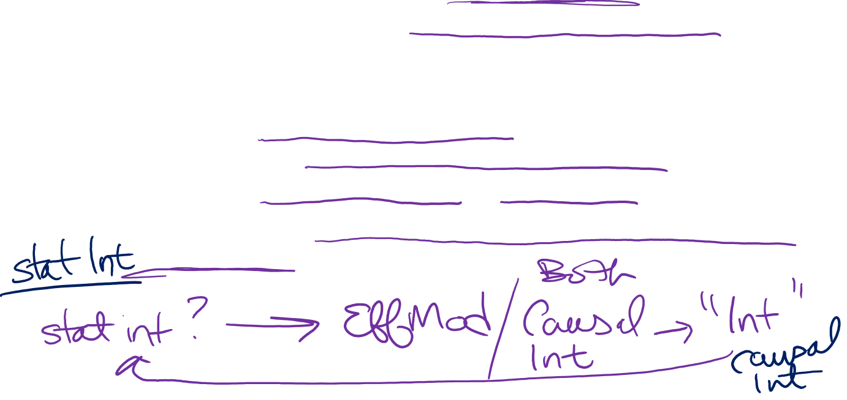
Definitions & Distinctions
If no bias, then statistical interaction → epid concept of effect modification, effect measure modification, heterogeneity of effects, effect heterogeneity, or biologic interaction…
  When you care more about primary exposure and not the modifying factor, some label this effect modification
    Note: need to at least adjust for confounding between primary exposure and disease to make inferences
  When you care about both factors (e.g., an interaction that sheds light on biologic mechanisms for disease) then some tend to call this causal interaction or “interaction”
    Note: need to adjust for confounding for both factors to make inferences
Notes:
You start with “statistical interaction” to show evidence of possible epidemiologic effect mod (or interaction)
Then if there is suggestion of statistical interaction… if you think you’ve addressed bias at least for the main Exp-Dis relationship, and you are mainly interested in the effect of one variable within strata of the other, then folks refer to this as effect measure modification, which has been truncated to “effect modification”… and which is synonymous with effect heterogeneity or heterogeneity of effects. To me, these 4 terms are all synonymous.
If you are actually interested in BOTH variables and their independent and joint effects on the outcome, then folks tend to call this “causal interaction” or “biological interaction” or just “interaction”

Slide 11

Stated another way…
You have 2 independent variables, X and Z, and an outcome Y
Effect modification: The average causal effect of exposure X on outcome Y differs across levels of a third variable, Z
  Differs both meaningfully & statistically
  Focus is on the causal effect of X on Y
  The independent causal effect of Z on Y is not a primary focus
Causal Interaction / “Interaction”: Joint causal effects of 2 (or more) Txs on outcome
  Focus is equally on the effects of X and Z on the outcome Y
Notes:
Although interaction and effect modification are terms that are used interchangeably, these are two different concepts from a causal standpoint.
As we defined earlier, effect modification is when the average causal effect of exposure on outcome differs across levels of a third variable. In these types of analyses, the focus is on the causal effect of X on Y. We include Z, the effect modifier, in our analyses but we generally don’t interpret or pay much attention to the independent causal effect of Z on Y.
On the other hand, interaction involves the examination of the causal effects of two or more treatments on the outcome. It’s a joint intervention of two or more treatments interact to bring about the outcome. Both or all treatments are given equal focus.
In either case, we are assuming bias has been addressed adequately… for effect mod, you need to at least adjust for confounding for primary Exp on Dis; for “interaction”, you need to adjust for both.

Slide 12

Motivation to Look for Statistical Interaction
Biology - Improve understanding of Etiology or Biology
Public Health - Prioritize or target public health resources or interventions (major reason)
Cost/Benefit Assessment - Anticipate effects of interventions in different groups of people (related to 2)
Notes:
Example
Qualitative Interaction, Vanderweele, 1.8
“In some cases, we might think that an exposure has a positive effect for one subgroup and a negative effect
for a different subgroup. Such instances are sometimes referred as “qualitative interactions” or “crossover
interactions” (Peto, 1982; Gail and Simon, 1985).7 Unlike statistical interactions in which the effects within
two subgroups are both in the same direction, but simply differ in magnitude, qualitative interactions do
not depend on the scale that is being used (de González and Cox, 2007). If there is a qualitative interaction
on the difference scale, there will also be a qualitative interaction on the ratio scale.
As an example of such qualitative interaction, Gail and Simon (1985) considered data from a trial of
two therapies for breast cancer, one of which does and the other of which does not involve tamoxifen.
For young patients under age 50 with low progesterone receptor levels, the treatment without tamoxifen
led to higher proportions who were disease-free after 3 years. However, for all other groups (who
were either older, or had higher progesterone receptor levels, or both) the treatment with tamoxifen led
to higher proportions who were disease-free after 3 years. Here, we would likely want to give young patients
with low progesterone receptor levels the treatment without tamoxifen and others the treatment with
tamoxifen.”

Slide 13
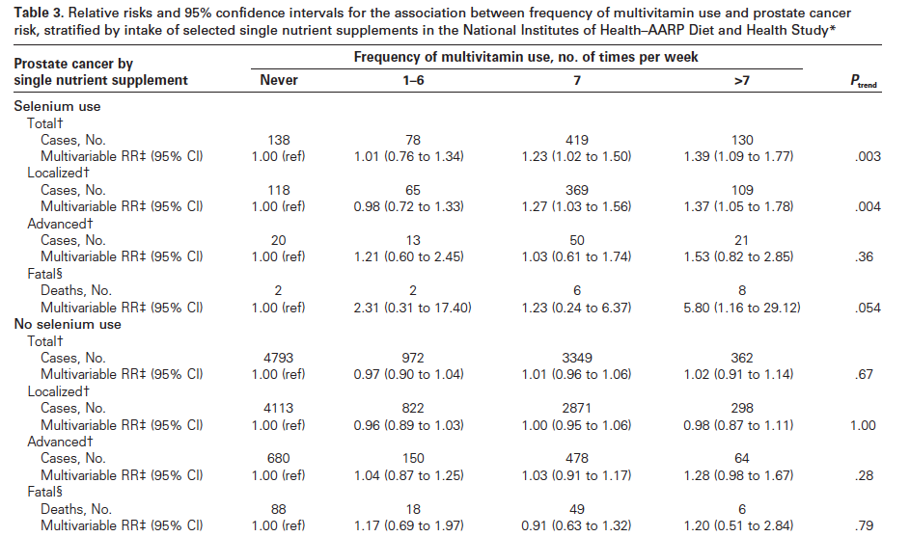

Example: Multivits & Prostate Cancer
“We examined whether the association between multivitamin
use and prostate cancer risk was modified by use of an
individual supplement” (Lawson K et al, JNCI 2007)
( Table 3 ).” (Lawson KA et al, JNCI, 2007)
Focus here is still on multivits, so this is an example of….
Effect Measure Modification
Notes:
This example comes from the paper we read in HW1.

Slide 14

Implications of the possible effect mod?
Possible biological interaction between the vitamins and minerals in a multivitamin, and the single high dose selenium supplement
Having too much of a single nutrient or class of nutrients could have adverse biological effect
Data also guide public health recommendations:
  If you are already taking a selenium supplement, taking a multivit could be harmful…
  → recommendation that individuals review their supplement usage with their physicians, especially if using single supplements
If equally interested in examining multivitamin AND selenium supplement use, look at joint effects compared to a reference group comprised of those taking neither.
  With control for confounding for both factors, this → examination of “causal interaction”

