Slide 1
Interpreting Coefficients in Models with Interaction Terms
EPI 207
June M. Chan, ScD
Professor & Vice Chair, Epidemiology & Biostatistics
Steven & Christine Burd-Safeway Distinguished
This work is licensed under a Creative Commons Attribution-NonCommercial-NoDerivatives 4.0 International License.

Slide 2

Topics
Interaction & Effect Modification – what do these terms mean in epidemiology?
Why or when do we want to study these?
Interpretation of model coefficients with an interaction term
Statistical Measures of Interaction (View on own, not recorded)
  Importance of Scale - Additive vs. Multiplicative Interaction
Presenting Effect Modification & Interaction, Examples
Interaction under Counterfactual Framework
Appendix (not recorded)
Notes:
Vanderweele, Epidem Methods 2014, Part 1
RGL, p. 71-79
Hernan & Robins, 5.1-5.3

Slide 3
Interpreting coefficients when including interaction term in a model
Ex - 2 binary factors, continuous outcome
Notes:
Acknowledgement: Maria Glymour, Chuck McCulloch

Slide 4

Statistical Interaction / Effect (measure) modification
Decide which is of interest: Marginal effect in whole population or conditional effect in a subgroup?
Ex. What is the effect of obesity on blood pressure (SBP) in:
  Men?
  Women?
  Overall?
Typically this type of question is answered by:
  Background understanding → a priori hypothesis & analysis plan
  Pool the data and test interaction term(s)
  Stratify and examine the association within subgroups
Notes:
4

Slide 5
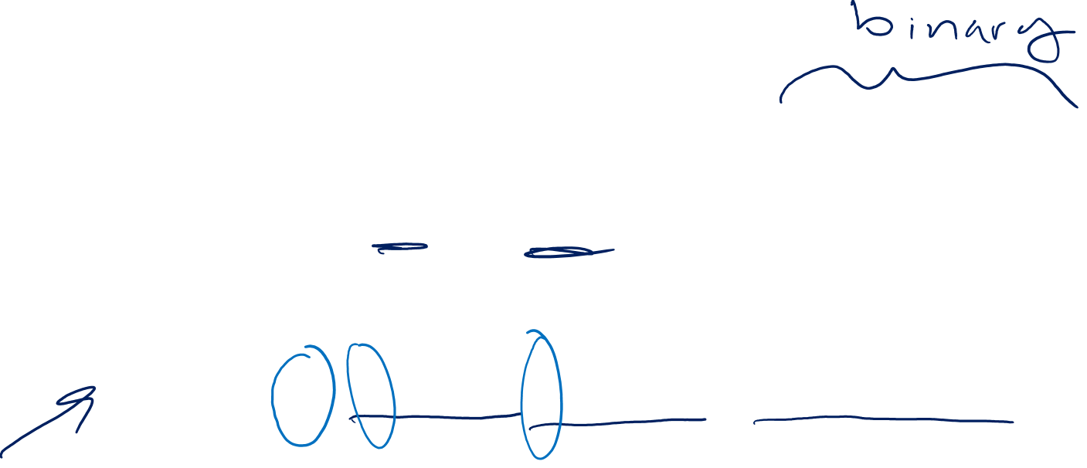
How do we test for statistical interaction?
What would be an equation to examine gender, obesity, and SBP (main effects only; treat each as binary)?
  E(SBP)=b₀+b₁*male+b₂*obese
What about gender, obesity, the interaction of the two, and SBP?
  E(SBP)=b₀+b₁*male+b₂*obese+b₃*male*obese
In the 2nd equation (with interaction term), what is the interpretation of b₀? b₁? b₂?...
Notes:
5
Write down your answers before clicking through
What is the interpretation of each beta? Write this down and hold onto it as we go through the next few slides.

Slide 6
The coefficients from the
equation with the interaction
term are not interpretable…
don’t use them
It’s important to see what happens
to the coefficients from the interaction
model, to understand what you
are modeling, and what you can
interpret from this model.
Notes:
6

Slide 7
In Practice…
We run model with interaction term(s), to check for statistical interaction and we use this to obtain “p-value for interaction” (Likelihood Ratio Test)
To present results, we often run different models (sometimes within strata if there is evidence of eff. mod.) with dummy variables, where coefficients are more interpretable
We will review this in Presenting Results
Notes:
7
Typically, you may hear – we put an interaction term in the model to test for it… but this messes up the interpretation of the coefficients, so be careful. Typically, we test for an interaction using a cross-product term, however if there is an interaction of interest or effect measure modification, it is very common to NOT present results using the model with the cross-product term. This is used to get the p-value for the interaction (often with a Likelihood Ratio Test (LRT) comparing nested models, with the interaction term(s) and without). To display results, we often use dummy variables so that we can have a more interpretable measure of association; either with one reference group, 2 ref groups, or both. More on this later in Presenting Interaction & Eff Mod.

Slide 8
So you may encounter different views on this… I think it’s better to know what one is discarding before just discarding it…
Notes:
…Plus they are not completely ‘uninterpretable’ .. They are just not as obviously interpretable. It will take some math (algebra) and some thinking, but some patterns will emerge by the end of these examples. These coefficients could actually be useful for presenting sub-group analyses.
There are 3 examples in this module – 1) both factors are binary; 2) one factor binary, one con’t; 3) both factors con’t
There’s a lot of math and equations ahead. For these slides, I recommend that you pause in certain places, stare at the math, see if you understand, then continue.
If you have reviewed these types of equations more recently, you may also wish to try writing out the interpretation of each beta coefficient yourself first, for each example, then click through the slides to see if it matches.
Summary points are at end of 2b.

Slide 9

Back to our first example - Gender, Obesity, & Blood Pressure
How do we test for statistical interaction?
  E(SBP)=b₀+b₁*male+b₂*obese+b₃*male*obese
What is the interpretation of b₀?
b₀= SBP in non-obese females
How do we get this?
  If Male=0 and Obese=0 then:
  E(SBP|non-obese female)=b₀+b₁*0+b₂*0+b₃*0*0
Slide Acknowledgement: M Glymour
Notes:
9

Slide 10

Ex. Binary factors, continuous outcome
Gender, Obesity, & SBP
E(SBP)=b₀+b₁*male+b₂*obese+b₃*male*obese
What is the interpretation of b₁?
b₁=the difference in SBP for non-obese males vs non-obese females
Because if we code Male=1 and Obese=0 then:
E(SBP| non-obese male)=b₀+b₁*1+b₂*0+b₃*1*0= b₀+b₁
And if Male=0 and Obese=0 then
E(SBP| non-obese female)=b₀+b₁*0+b₂*0+b₃*0*0=b₀
So, the difference is: b₀+b₁ -b₀ = b₁
Slide Acknowledgement: M Glymour
Notes:
10
NOTE: Coding of variables is important and affects how one interprets the coefficients
Note: the color coding is per slide, and connections between the definition and terms refresh on each new slide. These are just used to help link together terms on each single slide.

Slide 11

Ex. Binary factors, continuous outcome
Gender, Obesity, & SBP
E(SBP)=b₀+b₁*male+b₂*obese+b₃*male*obese
What is the interpretation of b₂?
b₂=the difference in SBP for obese females vs non-obese females
Because if we code Male=0 and Obese=1 then
E(SBP| obese female)=b₀+b₁*0+b₂*1+b₃*0*1= b₀+b₂
And if Male=0 and Obese=0 then
E(SBP| non-obese female)=b₀+b₁*0+b₂*0+b₃*0*0=b₀
So, the difference is: b₀+b₂ -b₀ = b₂
Slide Acknowledgement: M Glymour
Notes:
11
CORRECTION to VIDEO AUDIO: around 13:10-13:15, Dr. Chan incorrectly reads off the slide and says, “so beta0 plus beta2 minus beta0 equals beta0” This was an “audio typo” and, as shown on the slide, she should have said that this equals “beta2”

Slide 12

Ex. Binary factors, continuous outcome
Gender, Obesity, & SBP
E(SBP)=b₀+b₁*male+b₂*obese+b₃*male*obese
Patterns of Interpretation
b₀ = SBP in non-obese females
b₁ = difference in SBP for males vs females, in non-obese
b₂ = difference in SBP for obese vs non-obese, in females
Slide Acknowledgement: M Glymour
Notes:
12

Slide 13

Ex. Binary factors, continuous outcome
Gender, Obesity, & SBP
E(SBP)=b₀+b₁*male+b₂*obese+b₃*male*obese
What is b₃?
b₃= the extra effect of obesity in males compared to obesity in females
How do we get this? (follow argument across next 2 slides…)
First, note that the difference in SBP for obese vs non-obese males is:
E(SBP|obese male) = b₀+b₁*1+b₂*1+b₃*1*1= b₀+b₁+b₂+b₃
minus
E(SBP|non-obese male) = b₀+b₁*1+b₂*0+b₃*1*0= b₀+b₁
→ (b₀+b₁+b₂+b₃) – (b₀+b₁) = b₂+b₃
Slide Acknowledgement: M Glymour
Notes:
13

Slide 14

Ex. Binary factors, continuous outcome
Gender, Obesity, & SBP
E(SBP)=b₀+b₁*male+b₂*obese+b₃*male*obese
b₃=the extra difference in SBP for obese vs non-obese males compared to obese vs non-obese females
How do we get this?
Next, note the difference in SBP for obese vs non-obese females is:
E(SBP|obese female) = b₀+b₁*0+b₂*1+b₃*0*1= b₀+b₂
minus
E(SBP|non-obese female) = b₀+b₁*0+b₂*0+b₃*0*0= b₀
→ b₀+b₂ - b₀ = b₂
Slide Acknowledgement: M Glymour
Notes:
14

Slide 15

Ex. Binary factors, continuous outcome
Gender, Obesity, & SBP
E(SBP)=b₀+b₁*male+b₂*obese+b₃*male*obese
b₃=the extra difference in SBP for obese vs non-obese males compared to obese vs non-obese females
How do we get this?
Therefore:
Effect of obesity in men = b₂+b₃ (from 2 slides back)
Effect of obesity in women = b₂ (from 1 slide back)
So b₃ = the extra effect of obesity among men (compared to obesity in women)
Slide Acknowledgement: M Glymour
Notes:
15

Slide 16

Ex. Binary factors, continuous outcome
Gender, Obesity, & SBP
  E(SBP)=b₀+b₁*male+b₂*obese+b₃*male*obese
  Or:
  b₃=the extra difference in SBP for obese males vs obese females compared to non-obese males vs non-obese females
  E(SBP|obese male)=b₀+b₁*1+b₂*1+b₃*1*1= b₀+b₁+b₂+b₃
  E(SBP|non-obese male)=b₀+b₁*1+b₂*0+b₃*1*0= b₀+b₁
  E(SBP|obese female)=b₀+b₁*0+b₂*1+b₃*0*1= b₀+b₂
  E(SBP|non-obese female)=b₀+b₁*0+b₂*0+b₃*0*0= b₀
  Effect of being male vs fem among obese= b₀+b₁+b₂+b₃-(b₀+b₂)=b₁+b₃
  Effect of being male vs fem among non-obese= (b₀+b₁-b₀)=b₁
  The extra effect of being male vs female among obese (compared to being male vs female among non-obese)
Slide Acknowledgement: M Glymour
Notes:
16
Notice b3 can also be interpreted another way
B3 has both these interpretations and can be defined either way.
Please make sure you understand this example using two binary exposures and a binary outcome before moving on.
In part 2b – we will go over two more examples of interpreting coefficients in linear regression models, one with one continuous and one binary exposure; and one with two continuous exposures. It is encouraged that you pause the video at the beginning of these examples and think about how you would interpret the coeff for each beta, write these down, then proceed to watch/listen to the explanations.

