Slide 1
Example: Interaction when one exposure is continuous
Acknowledgement: SA Kenfield, Li Zhang, Steve Shiboski
This work is licensed under a Creative Commons Attribution-NonCommercial-NoDerivatives 4.0 International License.

Slide 2

Interpretation of Coefficients with Interaction Term
*
Y (SBP) as
*
Y (SBP) as
*
Notes:
CORRECTION: around timepoint 2:10 in the video, Dr. Chan refers to how when beta3=0, the model simplifies to the “standard linear model” – what she meant to say was that when beta3=0, the model simplifies to a simple main effects model (meaning a model without a crossproduct term)..
After this slide, we work through two more examples of interpreting coefficients in linear regression models, one with one continuous and one binary exposure; and one with two continuous exposures. It is encouraged that you pause the video at the beginning of each examples and think about how you would interpret the coeff for each beta, write these down, then proceed to watch/listen.

Slide 3
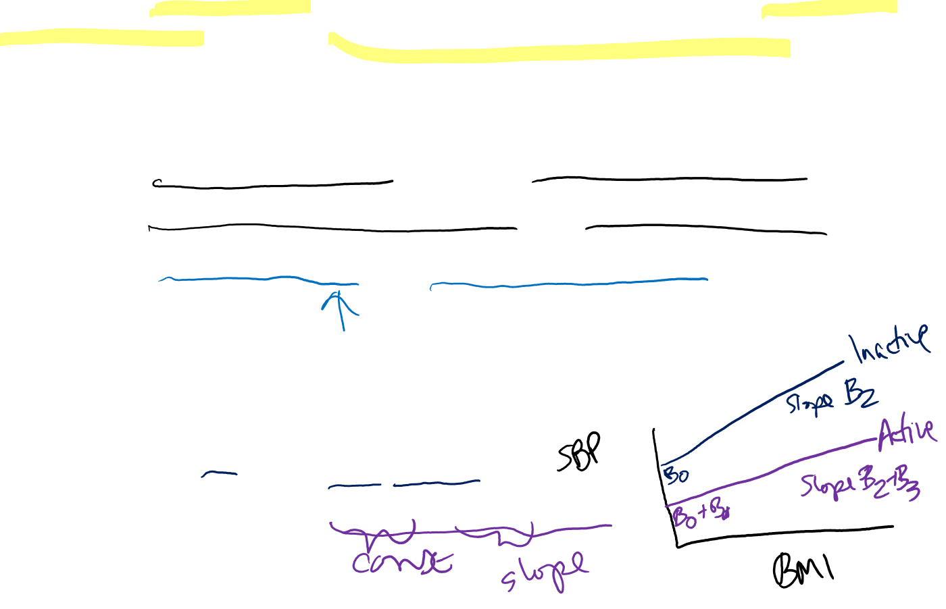
Ex: Does BMI (con’t) modify the relation between physical activity (binary) and systolic blood pressure (SBP)?
Research questions:
  Excess weight increases SBP, but does activity blunt the effect?
  Does a higher BMI lead to a higher SBP only among the inactive?
  Let x₁ = active status (1, 0); and x₂ = BMI (continuous)
Model of interest:
  E [SBP|active, BMI] = β₀ + β₁(active) + β₂(BMI) + β₃(active)*(BMI)
Estimated value of Y (SBP) for each level of active:
  E [SBP|active=0, BMI] = β₀ + β₂(BMI)
  E [SBP|active=1, BMI] = β₀ + β₁ + (β₂+ β₃)(BMI)

Slide 4
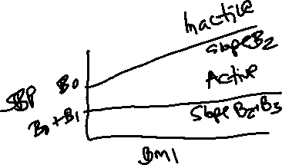


Ex: Does BMI (con’t) modify the relation between physical activity (binary) and systolic blood pressure (SBP)?
Research questions:
  Excess weight increases SBP, but does activity blunt the effect?
  Does a higher BMI lead to a higher SBP only among the inactive?
  Let x₁ = active status (1, 0); and x₂ = BMI (continuous)
Model of interest:
  E [SBP|active, BMI] = β₀ + β₁(active) + β₂(BMI) + β₃(active)*(BMI)
Estimated value of Y (SBP) for each level of active:
  E [SBP|active=0, BMI] = β₀ + β₂(BMI)
  E [SBP|active=1, BMI] = β₀ + β₁ + (β₂+ β₃)(BMI)
Interpretation
  Among inactive, β₂ gives change in SBP for unit increase in BMI
  Among active, β₂+ β₃ gives change in SBP per unit increase in BMI
  β₃ gives extra change in SBP for active vs. inactive, per one unit change in BMI

Slide 5
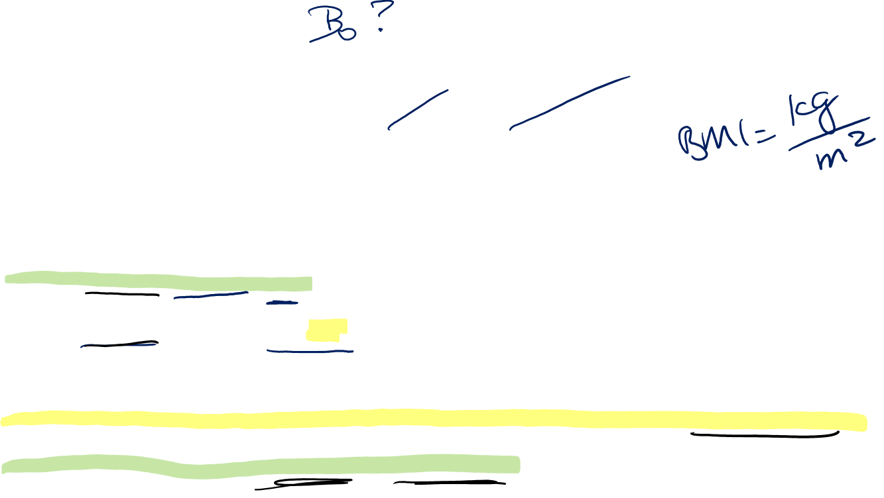
Using rescaling to make coefficients more interpretable
Ex: BMI, activity, SBP
What is the interpretation for β₁?
Model of interest:
  E [SBP|active, BMI] = β₀ + β₁(active) + β₂(BMI) + β₃(active)*(BMI)
Estimated value of Y for each level of active when x₂=0:
  Typically BMI ≠ 0, but to make the coefficients interpretable in an epid sense, consider rescaling variable so x₂ = (BMI-25), then for people with a BMI of 25kg/m², x₂=0
  E [SBP|active=0, BMI=25] = β₀
  E [SBP|active=1, BMI=25] = β₀ + β₁
Interpretation
  Β₁ gives the change in SBP for being active (vs. not active) for those with BMI = 25 kg/m²
  Β₀ gives expected SBP when BMI=25 and non-active
Notes:
Note that BMI is not typically zero… so how do we interpret B₁?
RGL p. 405 provides a clue
Consider rescaling the variable of BMI. Rather than the variable being actual BMI of participants, pick an average value, imagine it is 25 kg/m², and re-scale around this, such that the “bmi” variable in the model is actually “25 – BMI_{i}” for each i^{th} participant. In that case, B1 becomes interpretable as the change in mean SBP for eing active vs not, for those with the “average” BMI of 25.
Note that re-scaling of x₂ does not change the interpretations of B₂ or B₃ on prior slide

Slide 6

Ex: Does BMI (con’t) modify the relation between physical activity (binary) and systolic blood pressure (SBP)?
Regression model for SBP | Coef. | P>|t| | 95% Conf. Interval
_cons (β₀) | 135.588 | 0.000 | 134.1, 137.1
Active (β₁) | -0.547 | 0.525 | -2.2, 1.1
BMI_{c} (β₂) | 0.051 | 0.653 | -0.17, 0.27
Active*BMI_{c} (β₃) | 0.229 | 0.103 | -0.05, 0.51
Conclusions:
(control) Average SBP among inactive with BMI=28.6 kg/m² (mean) is 135.6 mmHg
(active) At avg BMI of 28.6 kg/m², PA (vs. no PA) reduces SBP by 0.55 mmHg
(control) Among inactive, a 1-kg/m² increase in BMI increases SBP by 0.05 mmHg
(active) Among active, a 1-kg/m² increase in BMI increases SBP by 0.23 mmHg
Slide Acknowledgement: SA Kenfield
Notes:
Here, BMI was scaled around the population average in the study of 28.6
So x₂ was coded as “BMI-28.6”
Try interpreting each of the beta’s from the table, then check against the “conclusions” listed here.

Slide 7
Interaction when both exposures are continuous
- Imagine you are now modelling SBP as a function of age (years, continuous) and BMI (kg/m², continuous)
Notes:
Acknowledgement: M. Glymour, C. McCulloch, F. Rerolle, M.Ospina

Slide 8

Ex: Does BMI (kg/m²) modify the relation between age (years) and systolic blood pressure (SBP)?
What is the interpretation for β₀ and β₁?
Model of interest:
  E [SBP| x₁, x₂] = β₀ + β₁x₁ + β₂x₂ + β₃(x₁*x₂)
  Use rescaling (re-centering) to help make coefficients interpretable:
    x₁=age-50 (continuous); x₂=BMI-25 (continuous)
Estimated change in SBP for 1 yr change in age at BMI=25 kg/m²
  E [SBP|age=50, BMI=25] = β₀
  E [SBP|age=51, BMI=25] = β₀ + β₁
  Note: for age = w vs. (w+1), the difference is still β1
Interpretation
  β₀ gives expected SBP for someone age 50 with BMI of 25 kg/m2
  β₁ gives change in SBP per 1 year increase in age, among those with BMI = 25kg/m²
Notes:
E [SBP|age=w, BMI=25] = β₀ + β₁(w-50) = β₀ + β₁(w) - 50β₁
E [SBP|age=(w+1), BMI=25] = β₀ + β₁(w+1-50) = β₀ + β₁(w) - 49β₁
So β1 still corresponds to change in SBP per 1 year increase in age, among those with BMI=25 kg/m²

Slide 9
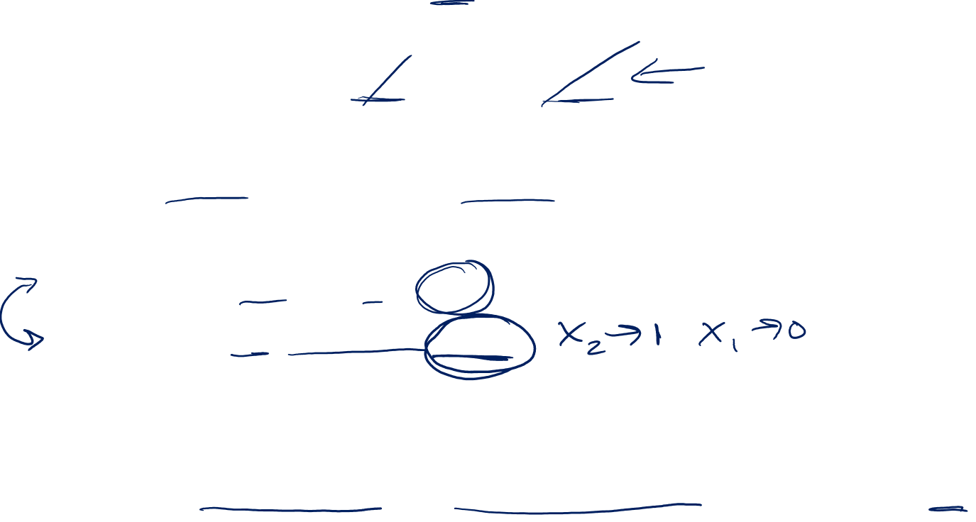
Example: Does BMI (kg/m²) modify the relation between age (years) and systolic blood pressure (SBP)?
What is the interpretation for β₂?
Model of interest:
  E [SBP| x₁, x₂] = β₀ + β₁x₁ + β₂x₂ + β₃(x₁*x₂)
  Use rescaling (re-centering) to help make coefficients interpretable:
    x₁=age-50 (continuous); x₂=BMI-25 (continuous)
Estimated change in SBP for 1 unit change in BMI at age=50
  E [SBP|age=50, BMI=25] = β₀
  E [SBP|age=50, BMI=26] = β₀ + β₂
  Same as on prior slide, this holds for BMI = w vs. BMI = (w+1)
Interpretation
  β₂ gives change in SBP per 1 unit increase in BMI, among those age 50
Notes:
NOTE: the “w” here is just to indicate some value for BMI, and is not meant to be the same value as the “w” on the prior slide.

Slide 10

Example: Does BMI (kg/m²) modify the relation between age (years) and systolic blood pressure (SBP)?
What is the interpretation for β₃?
Model of interest (explanation is independent of rescaling):
  E [SBP| x₁, x₂] = β₀ + β₁x₁ + β₂x₂ + β₃(x₁*x₂)
Estimated change in SBP for 1 unit ↑ in BMI at age = constant = a
  E [SBP|age=a, BMI=b] = β₀ + β₁a + β₂b + β₃(ab)
  E [SBP|age=a, BMI=b+1] = β₀ + β₁a + β₂(b + 1) + β₃(a(b+1))
  = β₀ + β₁a + β₂b + β₂ + β₃(ab) + β₃a
Interpretation
  (β₂ + β₃a) gives change in SBP per 1 unit ↑ in BMI, at age=a
  β₂ + β₃(a+1) = β₂ + β₃a+ β₃ gives change in SBP per 1 unit ↑ in BMI, at age=a+1
  β₂ + β₃(a+2) = β₂ + β₃a+ 2β₃ gives change in SBP per 1 unit ↑ in BMI, at age=a+2
  β₃ gives extra change in SBP per 1 unit ↑ in BMI, as age also increases by 1 yr

Slide 11

Example: Does BMI (kg/m²) modify the relation between age (years) and systolic blood pressure (SBP)?
What is another interpretation for β₃?
Model of interest (no rescaling needed):
  E [SBP| x₁, x₂] = β₀ + β₁x₁ + β₂x₂ + β₃(x₁*x₂)
Estimated change in SBP for 1 yr ↑ in age at BMI = constant = b
  E [SBP|age=a, BMI=b] = β₀ + β₁a + β₂b + β₃(ab)
  E [SBP|age=a+1, BMI=b] = β₀ + β₁a + β₁ + β₂b + β₃((a+1)b)
  = β₀ + β₁a + β₁ + β₂b + β₃(ab) + β₃b
Interpretation
  (β₁ + β₃b) gives change in SBP per 1 yr ↑ in age, at BMI=b
  β₁ + β₃(b+1) = β₁ + β₃b+ β₃ gives change in SBP per 1 yr ↑ in age, at BMI=b+1
  β₁ + β₃(b+2) = β₁ + β₃b+ 2β₃ gives change in SBP per 1 yr ↑ in age, at BMI=b+2
  β₃ gives extra change in SBP per 1 yr ↑ in age, as BMI also increases by 1 unit

Slide 12

Summary & Caveats
Modeling with an interaction term(s) affects interpretation of other coefficients, but they still have definitions that could be useful
Interpretation is dependent on how variables are coded
Rescaling/re-centering can help make coefficients more interpretable
Be aware of the assumptions of linear models
  These examples with continuous variables assumed linear relationship when moving between a change of 1 unit, for each variable
  This may not always be the case, for ex:
    Categorical data (e.g., neighborhoods, race, etc) may be coded as (0, 1, 2,3, etc) but the underlying relationship may not be linear
    Non-linear relationship between BMI and death, etc
  In such cases, may need multiple interaction terms
Interaction effects may not always be linear, could be quadratic, etc
Interpreting coefficients in logistic regression analogous to linear regression

Slide 13
Interpreting coefficients in LOGISTIC regression is analogous to LINEAR regression
If we model Risk using logistic regression model, then we can model Ln(Odds) using a linear regression equation
Interpretation of coefficients (β₀, β₁, β₂, β₃, etc) is similar to what we discussed in linear regression examples
Rather than discussing β₁ as the effect on the predicted value of Y, we interpret exp(β₁) as Odds Ratio
  comparing x₁ = (x + 1) vs. x₁ = x

Slide 14
Interpretation of coefficients in linear vs. logistic regression
Logistic Risk model: R(x₁) = exp(β₀ + β₁x₁) / (1+ exp(β₀ + β₁x₁))
where R(x₁) = Risk as a function of x₁
Range is between 0 and 1, one of the most commonly used models in epid because of a convenient relationship to Odds and Odds Ratio:
1 - R(x₁) = 1 - [exp(β₀ + β₁x₁) / (1+ exp(β₀ + β₁x₁))]
= (1+ exp(β₀ + β₁x₁)) / (1+ exp(β₀ + β₁x₁)) - [exp(β₀ + β₁x₁) / (1+ exp(β₀ + β₁x₁))]
= 1 / (1+ exp(β₀ + β₁x₁))

Slide 15
Interpretation of coefficients in linear vs. logistic regression
1 - R(x₁) = 1 / (1+ exp(β₀ + β₁x₁))
Recall that Odds = R/1-R, so
Odds(x₁) = R(x₁) / 1 - R(x₁) = exp(β₀ + β₁x₁) / (1+ exp(β₀ + β₁x₁))
1 / (1+ exp(β₀ + β₁x₁))
Which simplifies conveniently to: exp(β₀ + β₁x₁)
So now we have Odds(x₁) = exp(β₀ + β₁x₁) in the logistic regression model
Ln(Odds(x₁)) = β₀ + β₁x₁
Ln(Odds(x₁+1)) = β₀ + β₁(x₁+1) = β₀ + β₁x₁ + β₁
Ln(Odds (x₁+1)) – Ln(Odds(x₁)) = (β₀ + β₁x₁ + β₁) – (β₀ + β₁x₁)
Ln(Odds (x₁+1)/Odds(x₁)) = β₁
Odds (x₁+1)/Odds(x₁) = exp(β₁)
Odds Ratio comparing x = (x₁+1) vs. x = x₁ is exp(β1)

