Slide 1
Presenting Interaction & Effect Modification, Examples
June M. Chan, ScD
This work is licensed under a Creative Commons Attribution-NonCommercial-NoDerivatives 4.0 International License.

Slide 2
Topics
Interaction & Effect Modification – what do these terms mean in epidemiology?
Why or when do we want to study these?
Interpretation of model coefficients with an interaction term
Statistical Measures of Interaction (View on own, not recorded)
  Importance of Scale - Additive vs. Multiplicative Interaction
Presenting Effect Modification & Interaction, Examples
Interaction under Counterfactual Framework
Appendix (not recorded)
Notes:
Vanderweele, Epidem Methods 2014, Part 1
RGL, p. 71-79
Hernan & Robins, 5.1-5.3

Slide 3
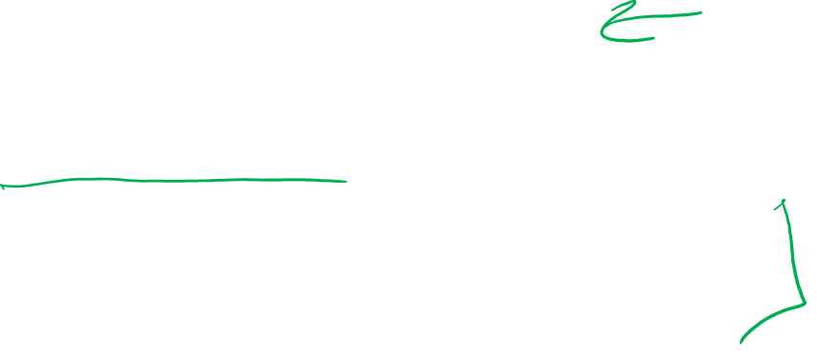
Options for Presenting Interaction / Eff Mod
Single reference group
Estimates for E within G and G within E
Interaction measures on additive and multiplicative scales, with CI and p-values
Noting exposure-outcome confounders for which adjustment have been made (often in footnotes)
Notes:
These are general recs for presenting results regarding statistical interaction in reports. These apply whether or not one is interested in effect measure modification (effect of primary exposure within strata of another variable); or joint interaction effects or “causal interaction” (interest in BOTH factors equally on their joint effects on outcome). As you will see in some of the examples, sometimes, when you are really interested in effect modification only, it seems to be OK to present within stratum results only with different reference groups. However, some will argue that it’s always better to show cross-classified results with a common reference group, regardless.

Slide 4


Statistical Interaction vs. Effect Modification vs. Causal Interaction?

Slide 5

Additive or Multiplicative (statistical) Interaction?
Additive interaction more relevant for public health practice
  Informs which group would benefit most from treatment
Published epidemiologic studies tend to report interaction only on the multiplicative scale
  1 in 50 studies reported interaction on additive scale (Knol 2009)
  Easier to estimate from statistical models
If examining effect mod or “joint effects” is primary objective, report statistical interaction on both scales
Notes:
So which scale should you use to calculate statistical interaction?
additive interaction is more relevant for public health practice because it informs you which group would benefit more from treatment.
However, most published studies report only interaction on the multiplicative scale. This is because it’s easier to estimate from statistical models. The effect estimates and confidence intervals are estimated directly in a regression model and don’t require further manipulations.
The take-home message is that if interaction or eff mod is the primary objective of the study, then it would be most useful to report statistical interaction on both additive and multiplicative scales.

Slide 6
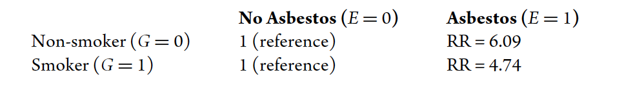
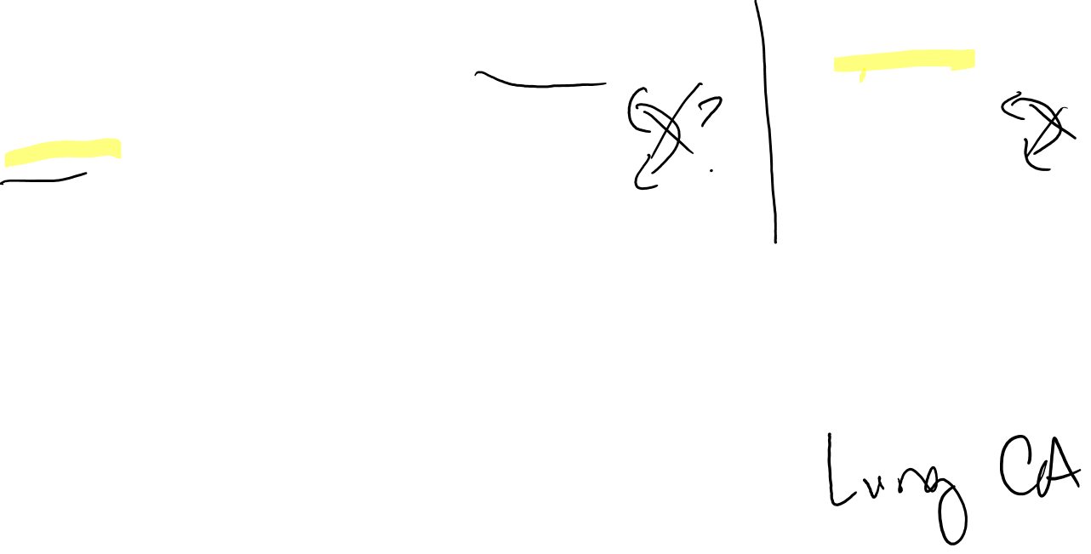
Ex. Presenting stratum-specific effects, separate reference groups
Ex. Presenting stratum-specific effects, separate reference groups → less useful, not recommended
Table 5. Risk Ratios with separate reference groups
Uninformative Presentation
Examining effects of asbestos within levels of smoking?
Examining effects of smoking within levels of asbestos?
Which group has highest risk of outcome?
YES
NO
NO
Notes:
Presented in the Vanderweele text, Table 5
One can see that asbestos exposure is related to greater risk of lung cancer both among non-smokers and among smokers.
But, there are limitations with this approach as well. This approach is only useful for examining the effect of asbestos within levels of smoking. (click) It’s not useful for examining the effects of smoking within levels of asbestos. (clikc) If we look at the E=0 group, we can’t compare a reference group of 1 to 1. Even by looking at the E=1 group, we can’t compare the risk ratios of 6.09 to 4.74 to see who has the higher risks of the outcome. (click)
For this reason, it’s argued that this presentation is uninformative. (click)

Slide 7
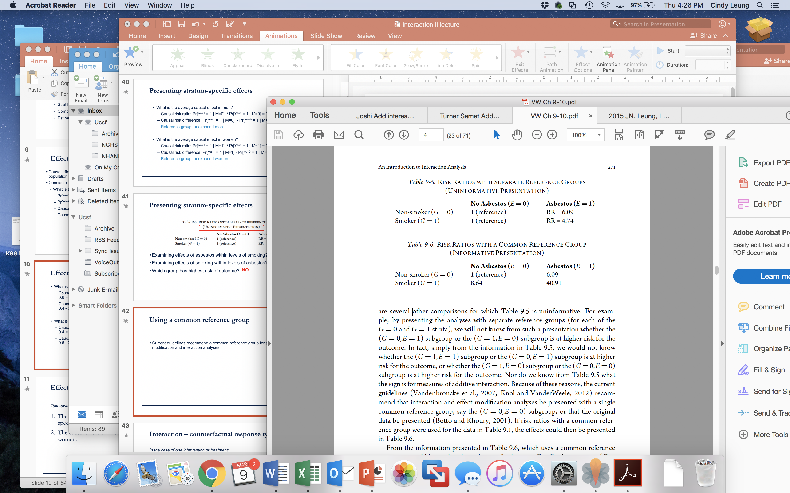

Ex. Presenting stratum-specific effects, with common reference group → more useful, recommended
Table 6. Risk Ratios with common reference group
Informative Presentation
Current guidelines recommend a common reference group for presentation of effect modification and interaction analyses
Examining effects of asbestos within levels of smoking?
Examining effects of smoking within levels of asbestos?
Which group has highest risk of outcome?
YES
YES
YES
Notes:
The solution to this is to use a common reference group, which is generally recommended for presentation of effect modification and interaction analyses (though we have seen and will see some examples where authors are truly interested in within stratum results and present primary results this way).
In this case, we can still examine the effects of asbestos within levels of smoking (click). For non-smokers, risk ratio is 6.09 divided by 1 or 6.09. For smokers, the risk ratio is 40.91 divided by 8.64 or 4.74, as shown in the previous slide.
We can also examine effects of smoking with levels of asbestos (click). For those without asbestos exposure, E=0, the risk ratio is 8.64 divided by 1. For those with asbestos exposure, the risk is 40.91 divided by 6.09 or 6.72.
Which group has the highest risk of the outcome? We can tell by the magnitude of the risk ratios (click). The lowest risk is in the G=0, E=0 group, followed by the E=1, G=0 group, followed by the E=0 and G=1 group. And the highest risk is in the E=1 and G=1 group.
Contrasted with the previous slide, this approach is called informative presentation (click)

Slide 8

Using a common reference group
In practice, code two exposures into 4 new categorical exposure variables representing different exposure combinations, with a common reference
  Rather than having two binary variables, E and G
  Create a 4 categorical dummy variable that represents each exposure combinations
    EG_new1 =1 if (E=0 and G=0), else EG_new1=0 (reference)
    EG_new2 =1 if (E=1 and G=0), else EG_new2=0
    EG_new3 =1 if (E=0 and G=1), else EG_new3=0
    EG_new4 =1 if (E=1 and G=1), else EG_new4=0
  Put EG_new2, EG_new3, and EG_new4 in your model to obtain estimates of each compared to the reference of EG_new1
Notes:
One simply way you could apply this in practice is instead of having two exposure variables and you enter both into the model separately with a product term, you could create a categorical exposure variable with every exposure combination.
In the case of 2 binary variables, E and G, you could create a new dummy categorical variables called EG_new1-4. Then, by entering these new variables into your regression model, you can get separate effect estimates for every combination of exposure using a common reference group.

Slide 9
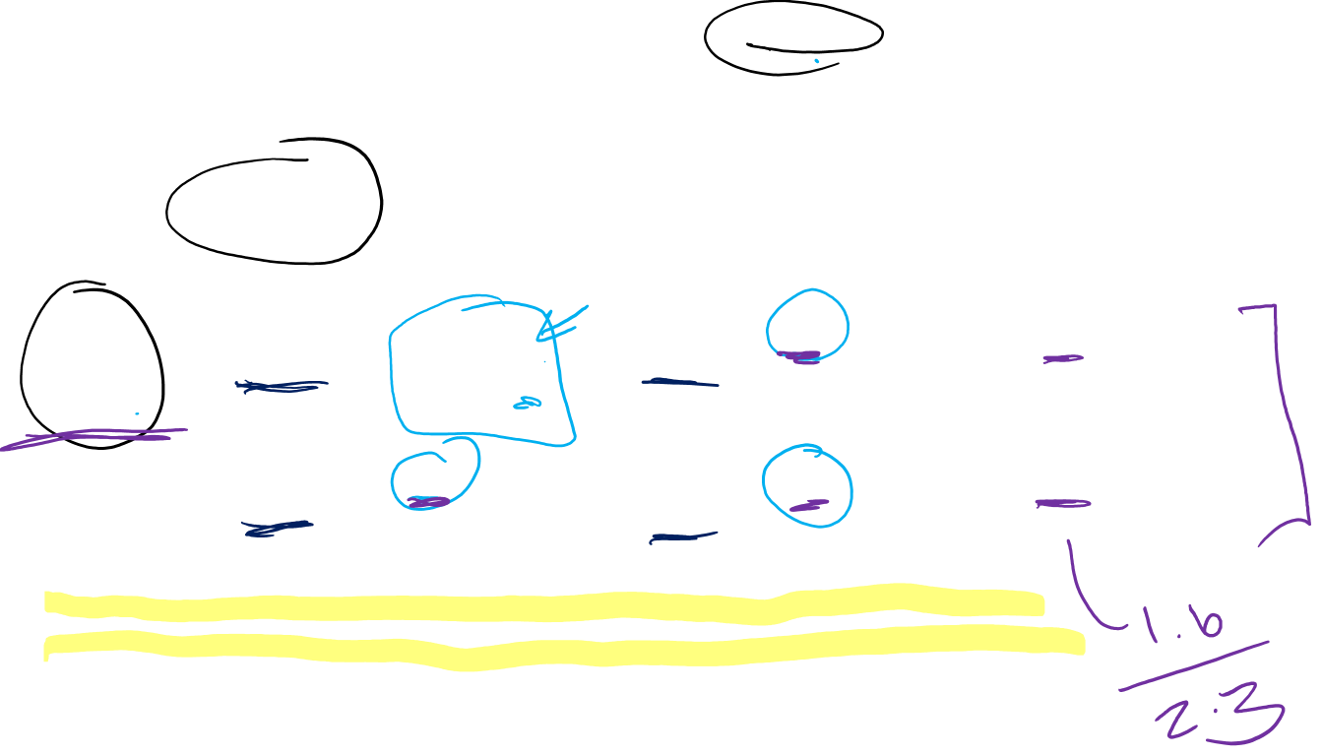
Ex. Presenting Statistical Interaction
 | No Smoking |  | Smoking
 | Probability of delayed conception | Prevalence ratio (95% CI) | Probability of delayed conception | Prevalence ratio (95% CI) | Prevalence ratio (95% CI) for smoking within strata of caffeine use
No caffeine use | 0.082 | 1.0 (reference) | 0.20 | 2.4 (1.4 to 4.1) p = 0.001 | 2.4 (1.4 to 4.1) p = 0.001
Heavy caffeine use | 0.19 | 2.3 (1.4 to 3.8) p = 0.001 | 0.13 | 1.6 (0.88 to 3.0) p = 0.13 | 0.70 (0.35 to 1.4) p = 0.31
Measure of effect modification on additive scale = -0.17; p = 0.018
Measure of effect modification on multiplicative scale = 0.29; p = 0.005
Notes:
This table is an example of detailed reporting on interaction. Goal - to present enough information such that readers can evaluate both scales (additive and multiplicative) even if you, as author, are interested in just one of the two.
Interaction contrast on additive scale: p₁₁ - p₁₀ - p₀₁+ p₀₀ = 0.13 – 0.20 – 0.19 + 0.082 = = -0.26 + 0.082 = - 0.178 (may be slightly off from their quoted -0.17 in the footnote due to rounding?)
Measure of Interaction on multiplicative scale: RR₁₁/RR₁₀RR₀₁ = 1.6/(2.3*2.4) = 0.29

Slide 10
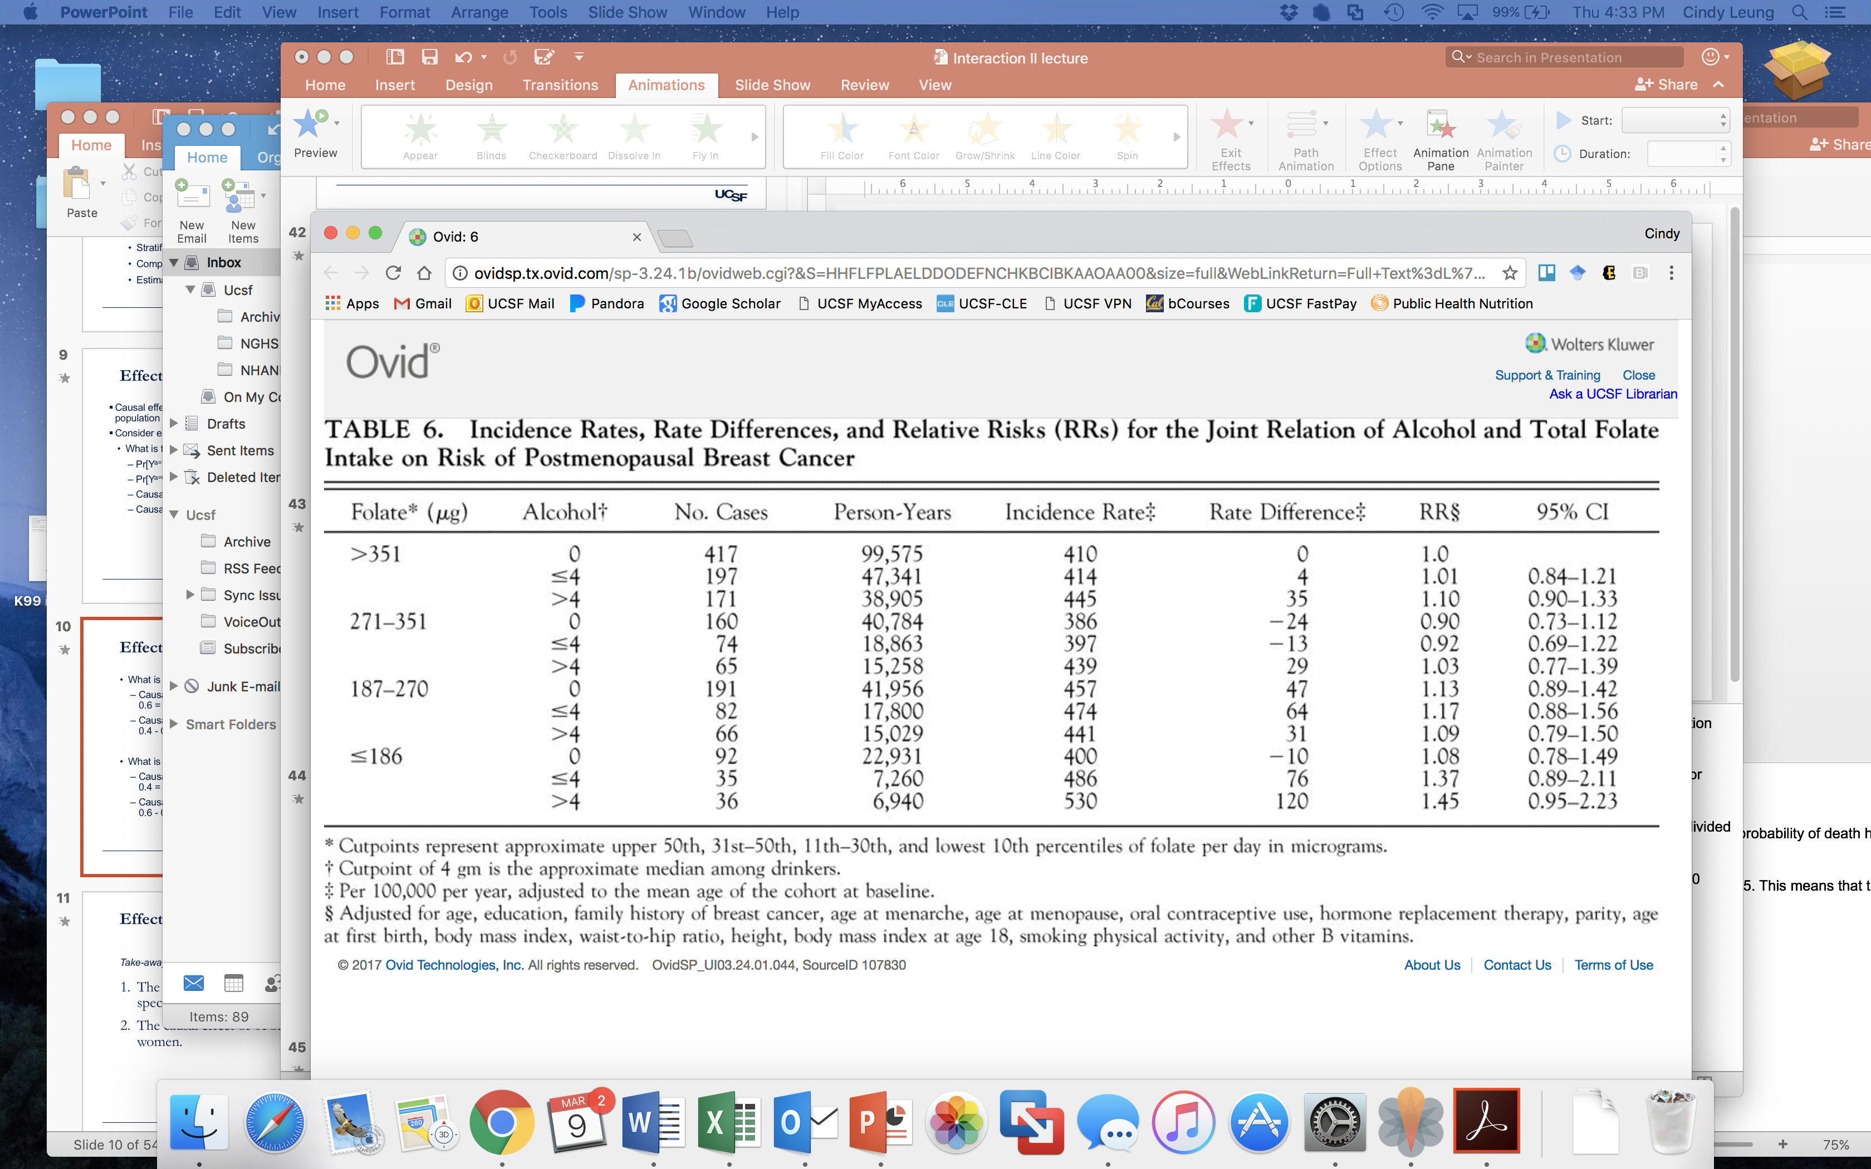
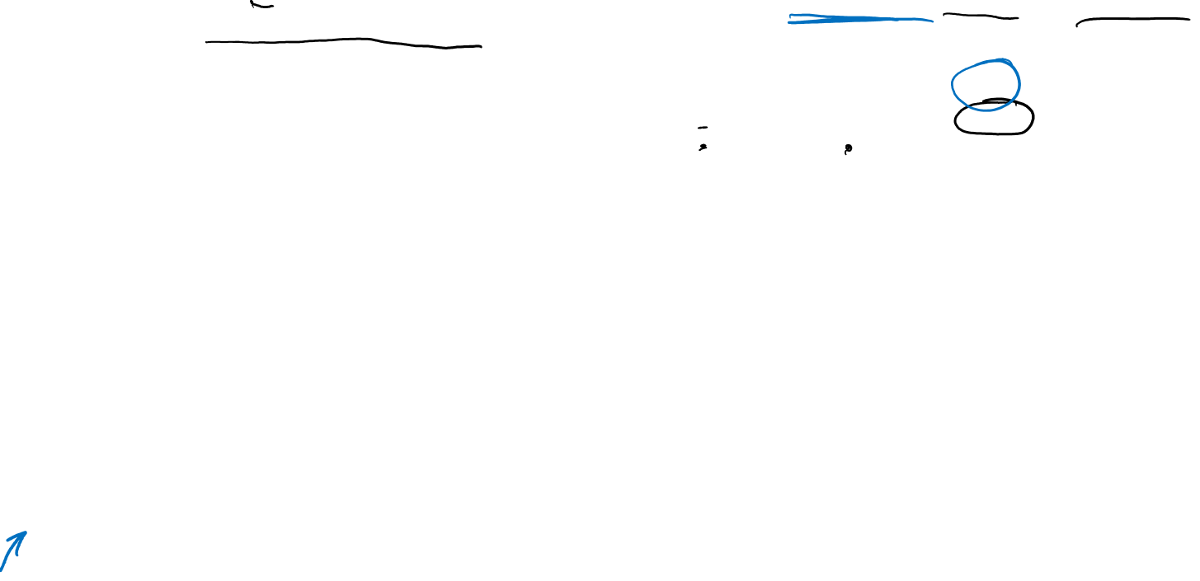
Ex. Using a common reference group
Sellers et al. Dietary folate intake, alcohol, and risk of breast cancer in a prospective study of postmenopausal women. Epidemiology 2001.
Notes:
Here, the authors show folate level as rows, stratified into quartiles (click).
Within each quartile, they then stratified by alcohol consumption ranging from none, moderate to high (click). They then show the incidence rate of breast cancer for each group (click), the corresponding rate difference, (click) and the incidence rate ratios (click). All of these comparisons are made to the lowest risk group – so women with high folate and low alcohol.
From this example, you can see how this presentation facilitates the comparison of results across levels of folate and alcohol, as well as which group has the lowest and highest risks of the outcome.

Slide 11

Ex. Using a common reference group
Sellers et al. Dietary folate intake, alcohol, and risk of breast cancer in a prospective study of postmenopausal women. Epidemiology 2001.
Notes:
Here, the authors show folate level as rows, stratified into quartiles (click).
Within each quartile, they then stratified by alcohol consumption ranging from none, moderate to high (click). They then show the incidence rate of breast cancer for each group (click), the corresponding rate difference, (click) and the incidence rate ratios (click). All of these comparisons are made to the lowest risk group – so women with high folate and low alcohol.
From this example, you can see how this presentation facilitates the comparison of results across levels of folate and alcohol, as well as which group has the lowest and highest risks of the outcome.

Slide 12
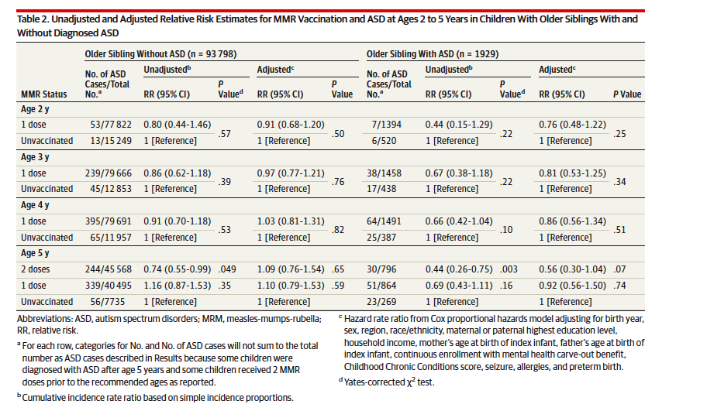
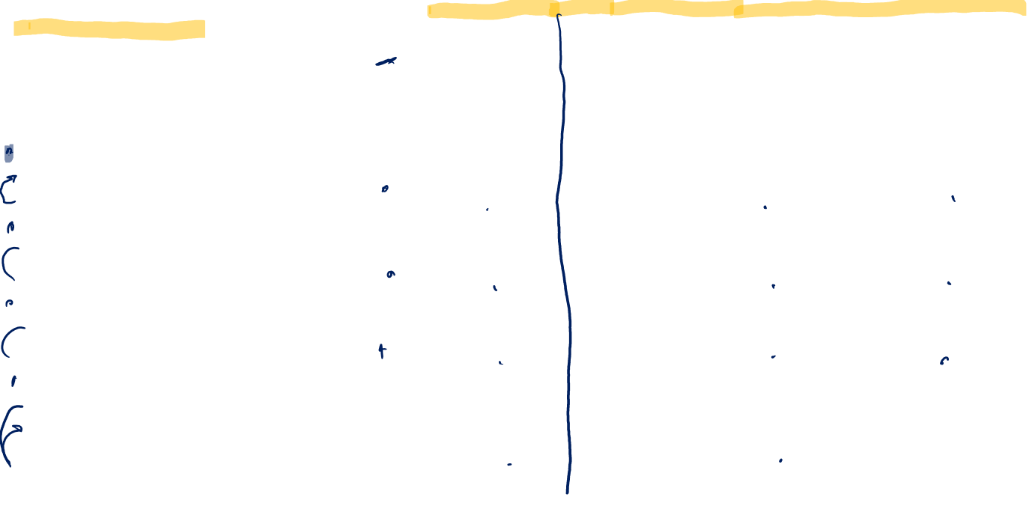
Ex: Reporting within strata with different ref groups
Notes:
https://www.ncbi.nlm.nih.gov/pubmed/25898051
This is an example where the authors had a very strong a priori interest in examining the association of MMR vaccination status in a younger sibling for the outcome of Autism Spectrum Disorder (ASD), stratified by whether that index child had an older sibling with ASD. The authors present their MAIN results within strata of older sibling status with separate reference groups.
One could say that in this study, the interest was more on “effect measure modification”

Slide 13
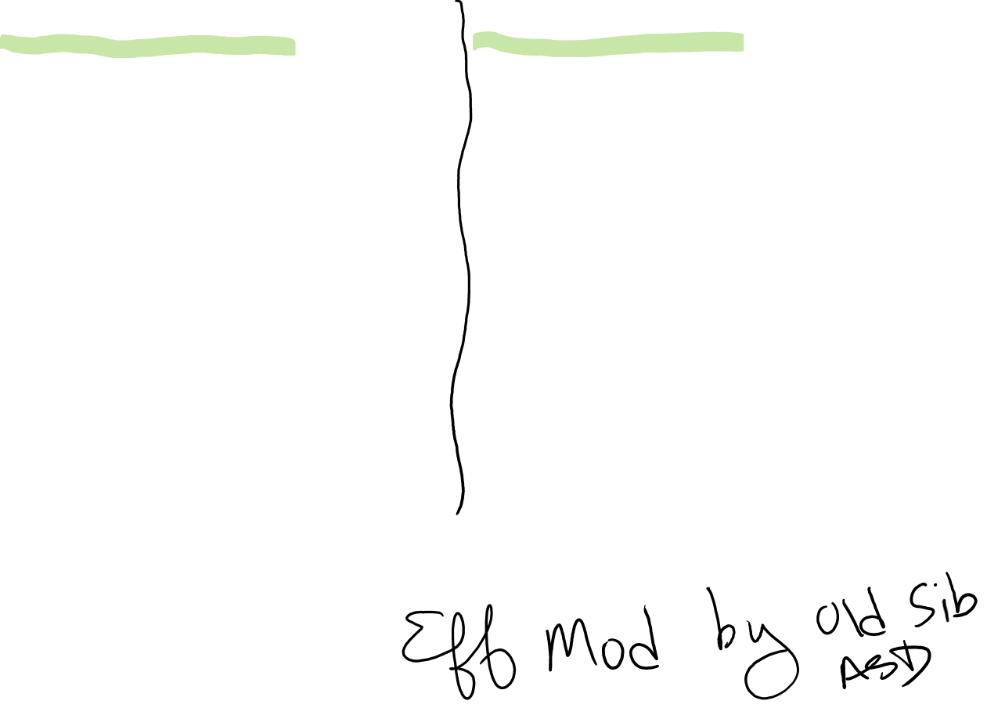
Ex: Reporting within strata with different ref groups
Notes:
https://www.ncbi.nlm.nih.gov/pubmed/25898051
This is an example where the authors had a very strong a priori interest in examining the association of MMR vaccination status in a younger sibling for the outcome of Autism Spectrum Disorder (ASD), stratified by whether that index child had an older sibling with ASD. The authors present their MAIN results within strata of older sibling status with separate reference groups.
One could say that in this study, the interest was more on “effect measure modification”

Slide 14
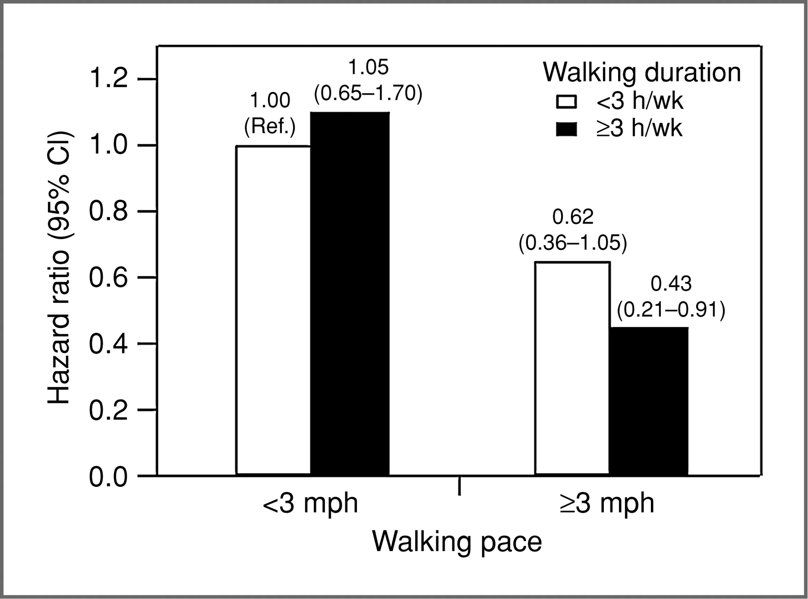


Ex. Common or separate reference groups?
Walking pace, walking duration, & prostate cancer recurrence
Erin L. Richman et al. Cancer Res 2011;71:3889-3895
©2011 by American Association for Cancer Research
Notes:
Postdiagnostic walking duration, walking pace, and risk of prostate cancer progression among 1,455 men diagnosed with clinically localized prostate cancer.
Postdiagnostic walking duration, walking pace, and risk of prostate cancer progression among 1,455 men diagnosed with clinically localized prostate cancer. Adjusted for age at diagnosis (continuous), days from diagnosis to questionnaire (continuous), primary treatment (radical prostatectomy, radiation, other/watchful waiting, hormone), biopsy Gleason sum (<7, 7, >7), and PSA at diagnosis (tertiles). Events/person-years: <3 mph, <3 h/wk = 66/1,289; <3 mph, ≥3 h/wk = 23/471; ≥3 mph, <3 h/wk = 18/569; ≥3 mph, ≥3 h/wk = 8/396. Ten participants (0.7%) who reported being unable to walk and reported no time spent walking were excluded.
HR for Pace independent of duration and all the other covariates noted above was 0.52 (95% CI .29-.91)
https://www.ncbi.nlm.nih.gov/pubmed/21610110
Sometimes it’s helpful to present results investigating Effect Mod or Interaction using a Figure like that shown here.
Here the authors are examining walking pace, walking duration and the risk of prostate cancer recurrence among men initially diagnosed with localized PC.
In this example, are they using a common or separate ref groups?
Well, there’s one ref group here and the categories appear to be cross-classifications of pace by duration, and it looks like ONE ref group.
Can we see the within stratum comparisons for each factor of interest? Yes, if we look here among just the slower walkers we can directly compare these two bars (which look fairly similar); and if we look here among the faster walkers, we observe that these two bars are shorter than 1, and maybe a little different from each other.
Can we go the other way and examine the effect of pace within different duration categories? Yes, if we compare these two black bars (the 0.43 vs. the 1.05), this gives us the effect of faster vs slower pace, among those who walked for 3+ hours/week. If we compare these white bars, that is faster vs. slower pace among those who walked for <3 hrs/week. We can directly compared these hazards bc there’s a common ref group. In both cases, it looks like faster pace is associated with a lower risk of recurrence.
What else could the authors have shown? As mentioned, it could have been good if they reported on additive or multiplicative summary metrics of interaction, but these are not in the footnotes. They do include the various factors that were adjusted for in the multivariate model, and you can view those in the Notes.
In this example, while it is not stated explicitly, in looking at the flow/ the context of the paper, it appears they were primarily interested first in pace and observed an inverse association, and then conducted this analysis to examine if the effect was modified by duration, which it doesn’t appear to be.

Slide 15

Ex. Common or separate reference groups?
Walking pace, walking duration, & prostate cancer recurrence
Erin L. Richman et al. Cancer Res 2011;71:3889-3895
©2011 by American Association for Cancer Research
Notes:
Postdiagnostic walking duration, walking pace, and risk of prostate cancer progression among 1,455 men diagnosed with clinically localized prostate cancer.
Postdiagnostic walking duration, walking pace, and risk of prostate cancer progression among 1,455 men diagnosed with clinically localized prostate cancer. Adjusted for age at diagnosis (continuous), days from diagnosis to questionnaire (continuous), primary treatment (radical prostatectomy, radiation, other/watchful waiting, hormone), biopsy Gleason sum (<7, 7, >7), and PSA at diagnosis (tertiles). Events/person-years: <3 mph, <3 h/wk = 66/1,289; <3 mph, ≥3 h/wk = 23/471; ≥3 mph, <3 h/wk = 18/569; ≥3 mph, ≥3 h/wk = 8/396. Ten participants (0.7%) who reported being unable to walk and reported no time spent walking were excluded.
HR for Pace independent of duration and all the other covariates noted above was 0.52 (95% CI .29-.91)
https://www.ncbi.nlm.nih.gov/pubmed/21610110
Sometimes it’s helpful to present results investigating Effect Mod or Interaction using a Figure like that shown here.
Here the authors are examining walking pace, walking duration and the risk of prostate cancer recurrence among men initially diagnosed with localized PC.
In this example, are they using a common or separate ref groups?
Well, there’s one ref group here and the categories appear to be cross-classifications of pace by duration, and it looks like ONE ref group.
Can we see the within stratum comparisons for each factor of interest? Yes, if we look here among just the slower walkers we can directly compare these two bars (which look fairly similar); and if we look here among the faster walkers, we observe that these two bars are shorter than 1, and maybe a little different from each other.
Can we go the other way and examine the effect of pace within different duration categories? Yes, if we compare these two black bars (the 0.43 vs. the 1.05), this gives us the effect of faster vs slower pace, among those who walked for 3+ hours/week. If we compare these white bars, that is faster vs. slower pace among those who walked for <3 hrs/week. We can directly compared these hazards bc there’s a common ref group. In both cases, it looks like faster pace is associated with a lower risk of recurrence.
What else could the authors have shown? As mentioned, it could have been good if they reported on additive or multiplicative summary metrics of interaction, but these are not in the footnotes. They do include the various factors that were adjusted for in the multivariate model, and you can view those in the Notes.
In this example, while it is not stated explicitly, in looking at the flow/ the context of the paper, it appears they were primarily interested first in pace and observed an inverse association, and then conducted this analysis to examine if the effect was modified by duration, which it doesn’t appear to be.

Slide 16
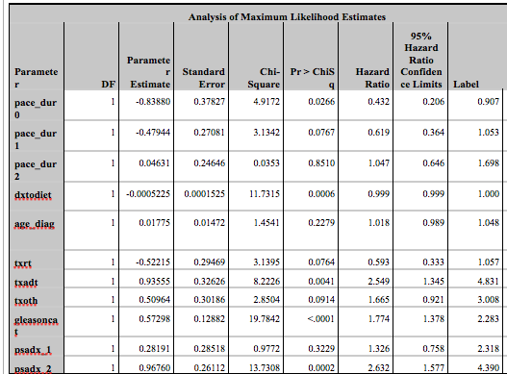

Notes:
SAS output that generated figure on prior slide

Slide 17
Summary - Presentation of results
Corrected (2/8/22)
Present RRs, ORs, or RDs, with confidence intervals for each stratum of the exposures with a common reference
Present absolute risk for each category (when possible)
Present measures of interaction on both additive (IC_{RD}, RERI_{RR}) and multiplicative scales (IC_{RR}) with CIs & p-values
List the confounders for which the relations between both exposures and outcomes were adjusted for.
Notes:
So the key points to take away for the presentation of results are;
Using a single reference category, present the risk ratios, odds ratios, or risk differences, including confidence intervals, for each level of the exposures.
Present absolute risk for each category (when possible)
Present measures of interaction on both the additive and multiplicative scales with appropriate confidence intervals and p-values
And finally, in the presence of interaction, consider exchangeability, positivity, and consistency for both exposures and select your confounders as if you have two independent exposures affecting your outcome. List those variables in a footnote for your table or figure.

Slide 18
Additional Examples from Lit.

Slide 19
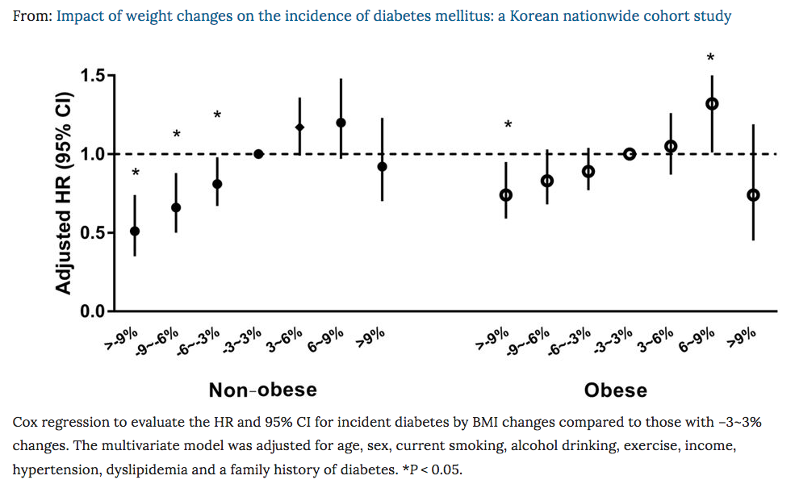
Ques: Common reference or separate?
Notes:
https://www.nature.com/articles/s41598-018-21550-3

Slide 20
Ans: Separate within stratum reference groups
Notes:
https://www.nature.com/articles/s41598-018-21550-3
Example of separate reference groups – separate models appear to have been run among obese and among non-obese. In each model, the reference category was +/-3% change in weight. We know this by seeing the dot on the HR level of 1.0 in each stratum.
This kind of presentation seems fine for presenting effect modification (i.e., effect of weight change on dbx, among those who were obese or non-obese to start with). However, this kind of presentation is not so useful if one was interested in the joint effects of obesity x weight change, since having separate reference groups doesn’t allow direct comparisons of the HR’s across obesity status.

Slide 21
Ex: Gene (MnSOD) x Environment (antioxidant) Interaction
Ques: Common or separate reference groups?
Notes:
https://www.ncbi.nlm.nih.gov/pubmed/19528373

Slide 22
Ex: Gene (MnSOD) x Environment (antioxidant) Interaction
Ans: Common reference grp, 3 outcomes (or models)
Notes:
https://www.ncbi.nlm.nih.gov/pubmed/19528373
In this case, there is a common reference group used, for 3 different outcomes (total, non-aggressive, and aggressive prostate cancer).
The common reference group was being either VV or VA in the MnSOD gene and being in the lowest quartile of antioxidant status

Slide 23
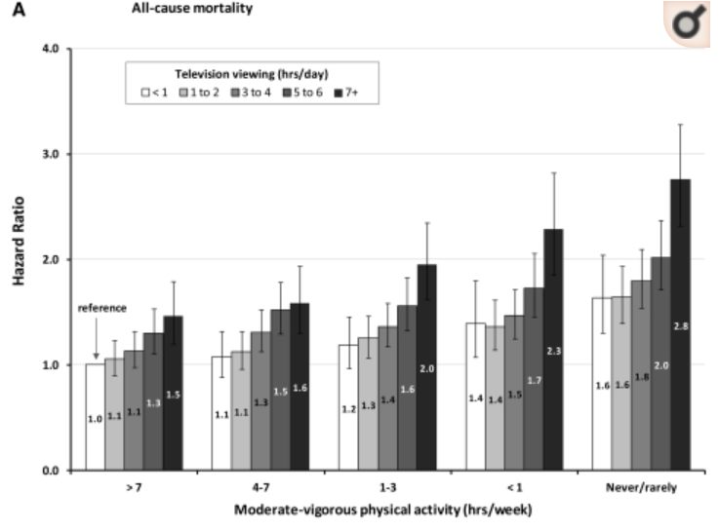
Ques: Common or separate reference group?
Notes:
https://www.ncbi.nlm.nih.gov/pubmed/22218159

Slide 24
Ans. Common reference group
How many dummy variables are used to model this?
Notes:
https://www.ncbi.nlm.nih.gov/pubmed/22218159
24 dummy vars used against the reference category
Need a BIG study for this
This example appears interested in the joint causal effects of physical activity x television watching, on outcome of all cause death

