Slide 1
Randomized Trials & Quantifying Treatment Effects
EBD-2 Chapter 8
Tom Newman, MD, MPH
Professor Emeritus of Epidemiology & Biostatistics and Pediatrics, UCSF
October 30, 2020

Slide 2

Acknowledgements
Funding: An ancestor of this talk was prepared with funding from the "State Attorney General Consumer and Prescriber Education Grant Program, funded by the multi-state settlement of consumer fraud claims regarding the marketing of the prescription drug Neurontin®"
Short version: Pfizer paid a $420 million fine, some of which was designated to educate health professionals about unethical pharma marketing practices
Help with first version (2008): Drs. Lisa Bero and Michael Steinman
Thanks to Martina Steurer for some graphics
Notes:
The settlement covers sales of Neurontin from 1994 through mid-2000, when it was sold by Parke-Davis, a subsidiary of the Warner-Lambert Company.
See: https://www.nytimes.com/2004/05/13/business/pfizer-to-pay-420-million-in-illegal-marketing-case.html

Slide 3
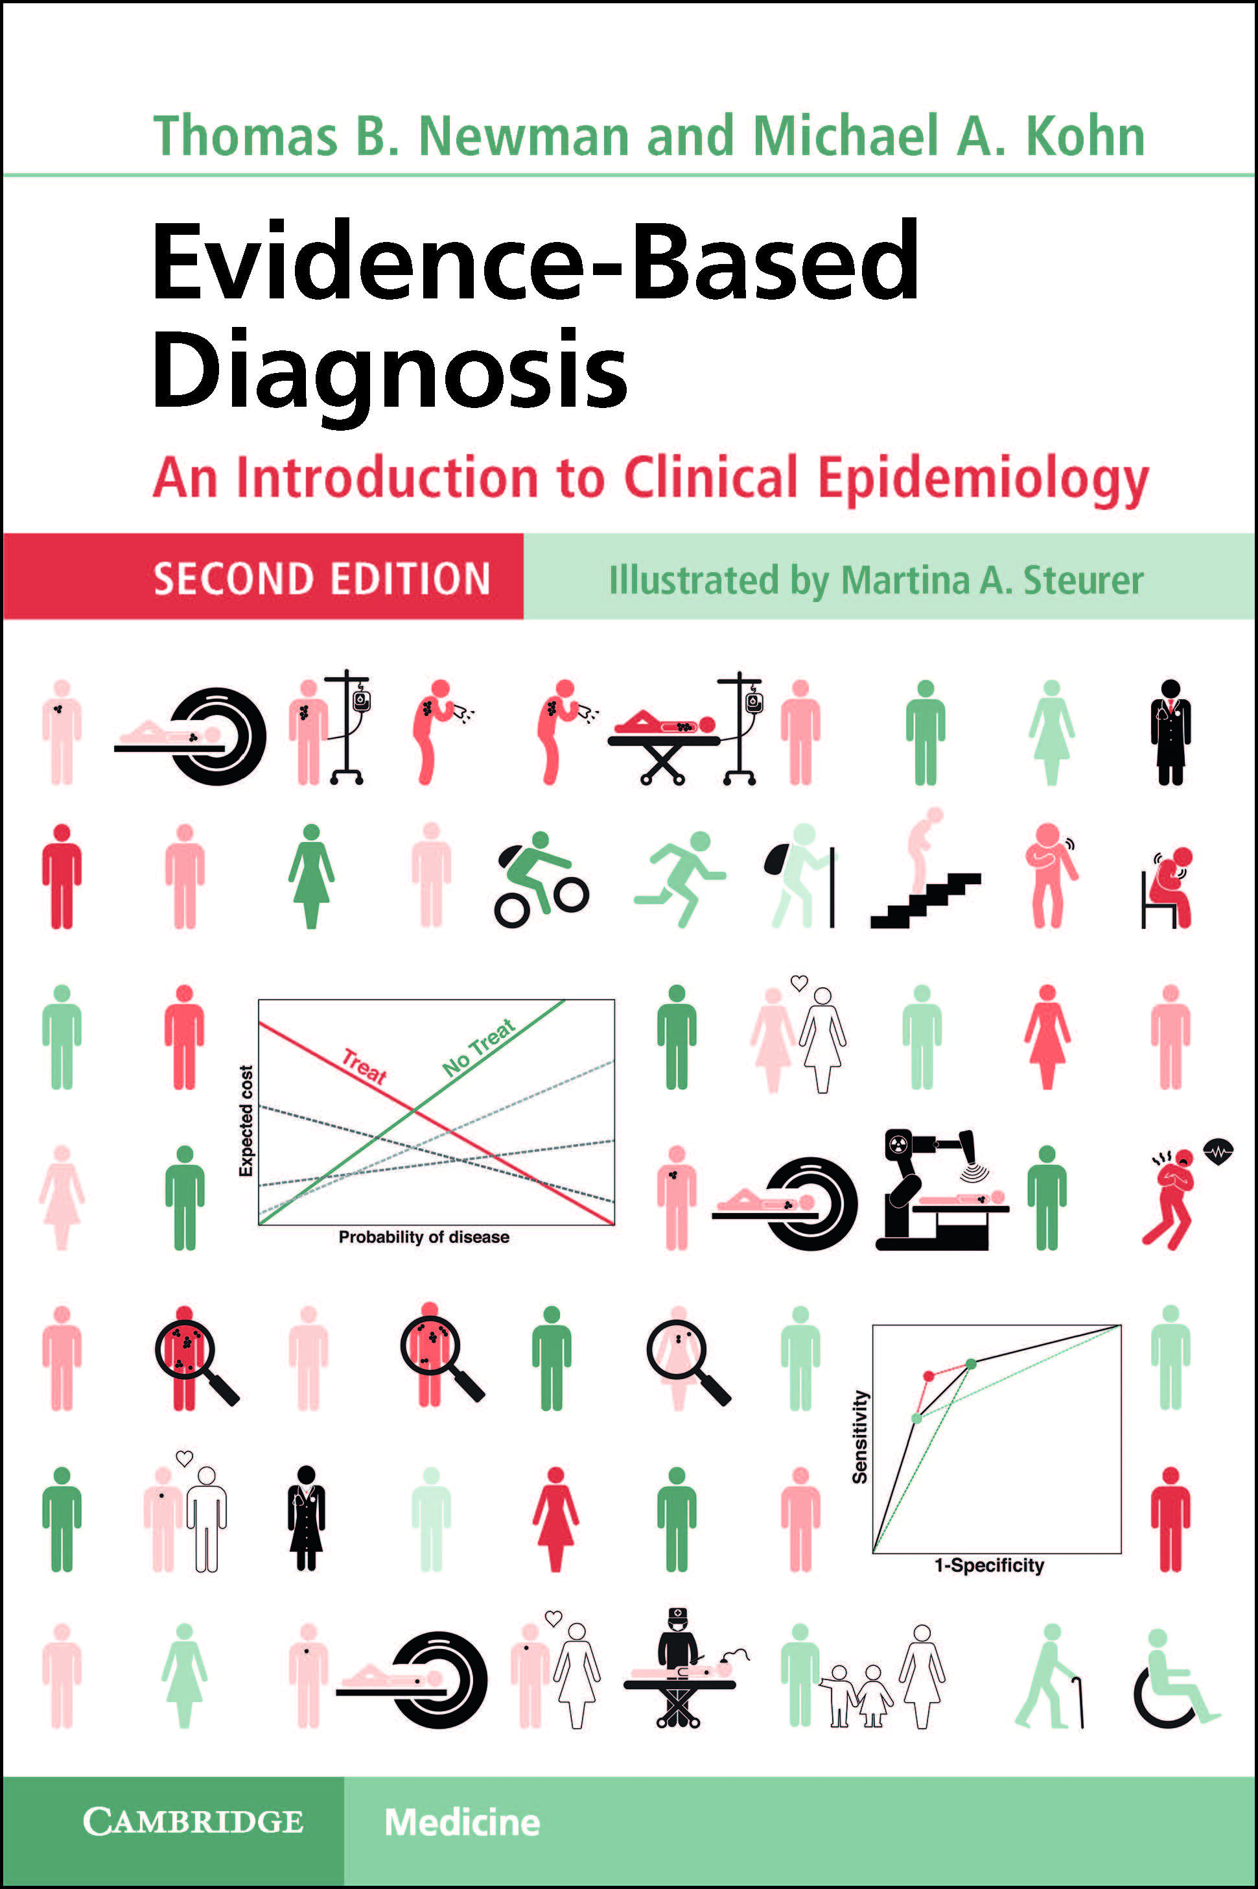
Reminder: You can download the whole book FREE from the UCSF Library.
Update for those who bought are hard copy:
On October 24,2020 Honduras became the 50th nation to ratify the UN Treaty on the Prohibition of Nuclear Weapons.
It will enter into force 90 days from that date (January 22).
Nuclear weapons states need to get on board!

Slide 4
Outline
PART 1
Introduction: why do randomized, blinded trials?
Critical appraisal of RCTs
  Authors and funding source
  Design and conduct
  PART 2
Analysis: Quantifying treatment effects
  Continuous outcomes
  OR, RR, RRR, ARR, NNT
  CBOP & BBOP

Slide 5
Introduction

Slide 6


Why randomize?
Without randomization, there may be other important differences between treated and untreated groups
This makes it hard to estimate the causal effects of treatment
This is the case for exposed and unexposed for cohort studies
Cohort Study
exposed
other influences causing the disease
unexposed
Notes:
Thanks to Martina for graphics.
Red symbolizes sicker patients; green healthier patients. In this case exposure is strongly associated with baseline health

Slide 7



Why randomize?
Causal effects are defined in terms of counterfactual outcomes
Absent time travel, the only way to estimate them is by comparing exchangeable groups
Time Travel
one and same group
unexposed
COUNTERFACTUAL
Randomized Trial
exposed
unexposed
Experience in each group used to estimate the counterfactual outcomes in the other.
exposed
exposed
unexposed
We will let you know immediately when we figure this out, should be soon….
Notes:
The exposed an unexposed groups are not identical but are much more similar in red/green distribution than they were before.

Slide 8

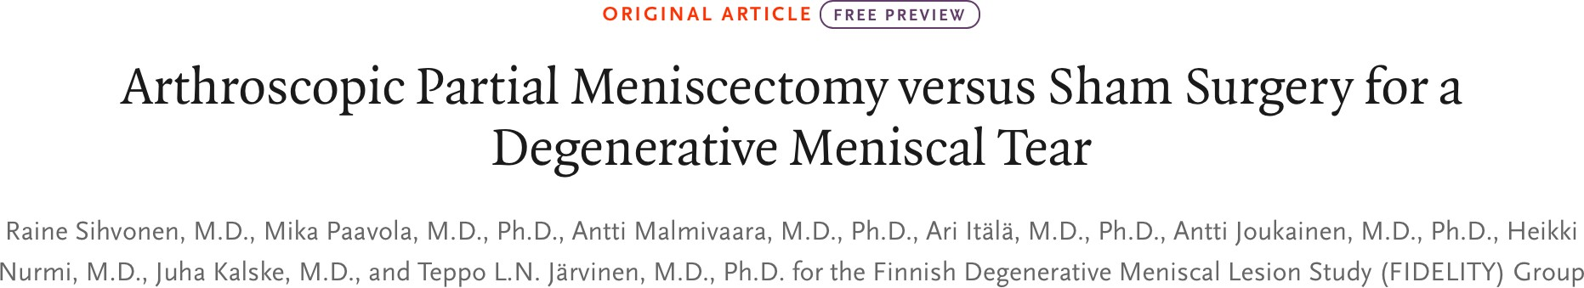
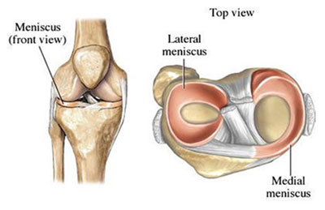


Blinding
Patient
Avoid placebo effect

Slide 9
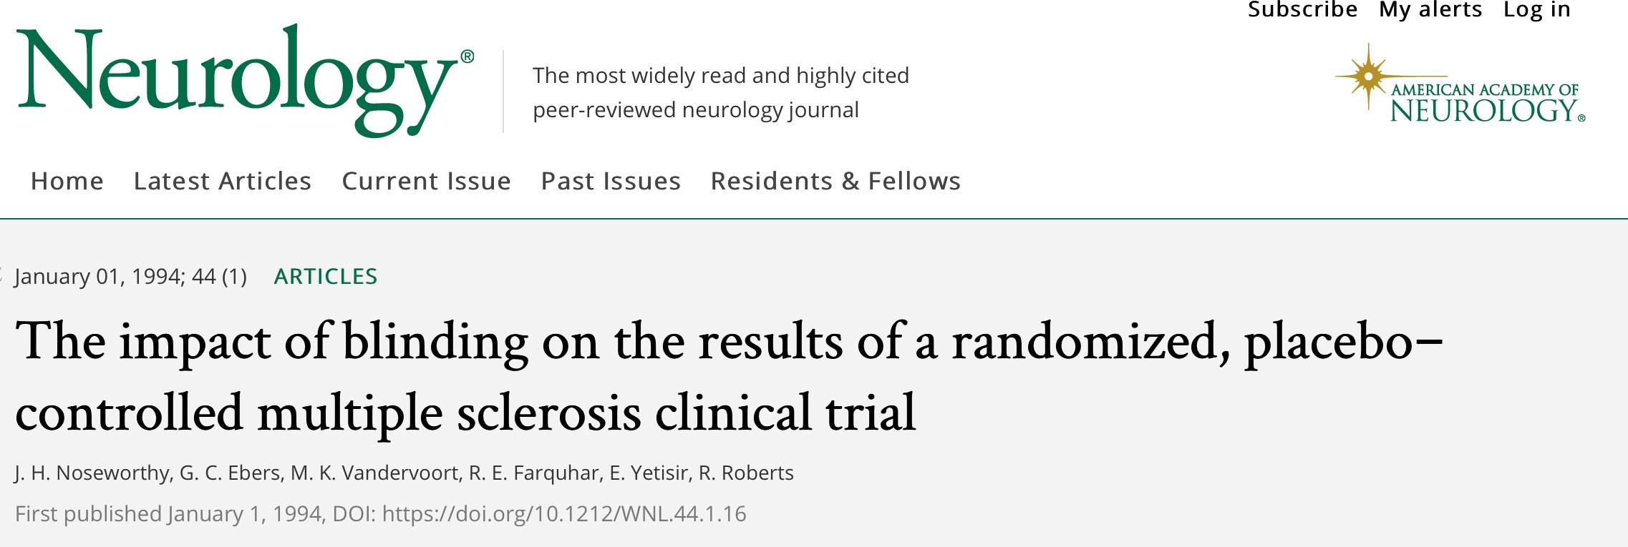
Blinding
Treating clinician
Prevents differential cointerventions
Person assessing the outcome
Prevents biased outcome ascertainment

Slide 10
Issues with blinding
Patients may be able to tell they are on drug
Part of the causal eﬀect of treatment may be related to knowing you are on treatment
I feel nauseated and tired, I must be on the active drug
I did not get surgery, my knee pain is still terrible
I got surgery, that really helped my knee pain
side eﬀects
treatment looks better e.g.,. meniscus surgery

Slide 11
Critical Appraisal: History and Physical of a Research Paper
Authors and funding source
Research question
Study design
Study participants
Predictor variables
Outcome variable
Analysis and presentation of results

Slide 12
Newman's Guide to Medical Advertisements
The more advertisements you see, the more over-priced the drug or treatment
  Because advertising is expensive
The more advertisements you see, the smaller the likely benefit
  Because if the drug were really great, word about it would rapidly spread other ways
↑Advertising
↓ Value

Slide 13
Newman's Guide to Medical News
Most research papers are not newsworthy
  Scientific progress is incremental
Sponsors, universities and some investigators like to get their research publicized
  They write press releases and produce videos exaggerating importance of results
Writing articles and producing news segments is WORK, and the news business is increasingly competitive
  Using press releases saves time and money

Slide 14

New Hope for Migraine Sufferers
https://www.nytimes.com/2020/01/06/well/live/new-hope-for-migraine-sufferers.html?smid=nytcore-ios-share
PERSONAL HEALTH
By Jane E. Brody
"There are now also biologic drugs, monoclonal antibodies that can be given once a month or once every three months, Dr. Dodick said…
"Also of interest is a new class of compounds called gepants to treat migraine attacks… In a study of one such drug, ubrogepant [Ubrelvy®], published in The New England Journal of Medicine…"
(We'll look at that study later.)

Slide 15
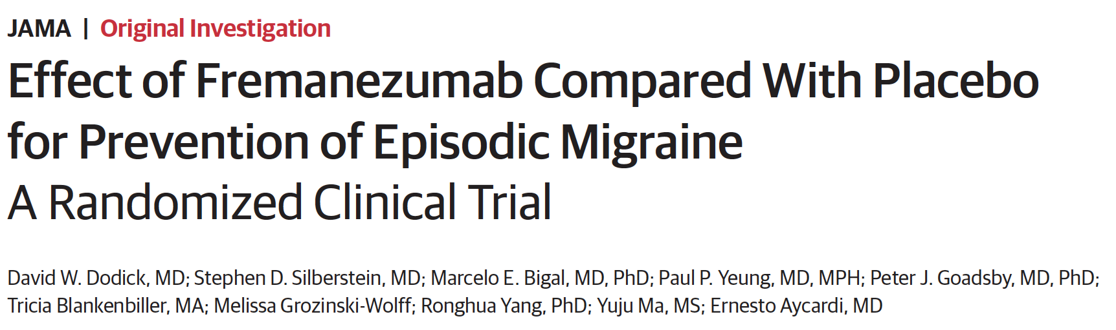
Effect of Fremanezumab Compared With Placebo for Prevention of Episodic Migraine A Randomized Clinical Trial
Problem 8.4
JAMA. 2018;319(19):1999-2008. doi:10.1001/jama.2018.4853. Funded by Teva.
Notes:
IMPORTANCE Fremanezumab, a fully humanized monoclonal antibody that targets calcitonin
gene-related peptide, may be effective for treating episodic migraine.
OBJECTIVE To assess the efficacy of fremanezumab compared with placebo for prevention of
episodic migraine with a monthly dosing regimen or a single higher dose.
DESIGN AND SETTING Randomized, double-blind, placebo-controlled, parallel-group trial
conducted at 123 sites in 9 countries from March 23, 2016 (first patient randomized), to April
10, 2017, consisting of a screening visit, 28-day pretreatment period, 12-week treatment
period, and final evaluation at week 12.
PARTICIPANTS Study participants were aged 18 to 70 years with episodic migraine (6-14
headache days, with at least 4 migraine days, during 28-day pretreatment period). Patients
who had previous treatment failure with 2 classes of migraine-preventive medication
were excluded.
INTERVENTIONS Patients were randomized 1:1:1 to receive subcutaneous monthly dosing of
fremanezumab (n = 290; 225mg at baseline, week 4, and week 8); a single higher dose of
fremanezumab, as intended to support a quarterly dose regimen (n = 291; 675mg of
fremanezumab at baseline; placebo at weeks 4 and 8); or placebo (n = 294; at baseline,
week 4, and week 8).
MAIN OUTCOMES AND MEASURES The primary end pointwas mean change in mean number
of monthly migraine days during the 12-week period after the first dose.
RESULTS Among 875 patients who were randomized (mean age, 41.8 [SD, 12.1] years; 742
women [85%]), 791 (90.4%) completed the trial. From baseline to 12 weeks, mean migraine
days per month decreased from 8.9 days to 4.9 days in the fremanezumab monthly dosing
group, from 9.2 days to 5.3 days in the fremanezumab single-higher-dose group, and from 9.1
days to 6.5 days in the placebo group. This resulted in a difference with monthly dosing vs
placebo of –1.5 days (95%CI, –2.01 to –0.93 days; P < .001) and with single higher dosing vs
placebo of –1.3 days (95%CI, –1.79 to –0.72 days; P < .001). The most common adverse
events that led to discontinuation were injection site erythema (n = 3), injection site
induration (n = 2), diarrhea (n = 2), anxiety (n = 2), and depression (n = 2).
CONCLUSIONS AND RELEVANCE Among patients with episodic migraine in whom multiple
medication classes had not previously failed, subcutaneous fremanezumab, compared with
placebo, resulted in a statistically significant 1.3- to 1.5-day reduction in the mean number of
monthly migraine days over a 12-week period. Further research is needed to assess
effectiveness against other preventive medications and in patients in whom multiple
preventive drug classes have failed and to determine long-term safety and efficacy.
TRIAL REGISTRATION clinicaltrials.gov Identifier: NCT02629861
JAMA. 2018;319(19):1999-2008. doi:10.1001/jama.2018.4853
Editorial page 1985
Supplemental content
CME Quiz at
jamanetwork.com/learning
Author

Slide 16
Dr. Dodick's disclosures
Dr Dodick has received compensation from serving on advisory boards and/or consulting within the past 5 years for Allergan, Amgen, Novartis, Alder, Arteaus, Pfizer, Colucid, Merck, NuPathe, Eli Lilly & Company, Autonomic Technologies, Ethicon Johnson & Johnson, Zogenix, Supernus, Labrys, Boston Scientific, Medtronic, St Jude, Bristol-Myers Squibb, Lundbeck, Impax, MAP, Electrocore, Tonix, Teva, Alcobra, Zosano, ZP Opco, Insys, Ipsen, Acorda, eNeura, Charleston Laboratories, Core, Biohaven, Biocentric,Magellan, Theranica, Xenon, Dr Reddy’s/Promius Pharma, Vedanta, CC Ford West Group, and Foresite Capital. Dr Dodick also owns equity in Epien, GBS/Nocira, Second Opinion, Healint, and Theranica and has received funding for travel, speaking, editorial activities, or royalty payments from Intramed, SAGE Publishing, Sun Pharma, Allergan, Oxford University Press, American Academy of Neurology, American Headache Society,West Virginia University Foundation, Canadian Headache Society, Healthlogix, Universal Meeting Management, WebMD, UptoDate, Medscape/WebMD, Albert Einstein University, University of Toronto, Starr Clinical, Decision Resources, Synergy, MedNet LLC, Peer View Institute for Medical Education, Medicom, Medlogix,Wolters Kluwer Health, Chameleon Communications, Academy for Continued Healthcare Learning, Haymarket Medical Education, Global Scientific Communications, Miller Medical Communications, MeetingLogiX, and Wiley Blackwell. Through his employer, Dr Dodick has consulting use agreements with Neuro Assessment Systems and Myndshft. Dr Dodick also holds board of director positions with King-Devick Technologies, and Epien Inc and holds patent 17189376.1-1466 on a botulinum toxin dosage regimen for chronic migraine prophylaxis.

Slide 17
Useful life skill
Two migraine experts are quoted in Jane Brody's article:
  Dr. Stephen Silberstein (Thomas Jefferson University)
  Dr. David Dodick (Mayo Clinic, Scottsdale)
How much money did these two experts receive from the pharmaceutical industry in 2018?
Google "drug company payments to doctors"
  Find Pro Publica website

Slide 18
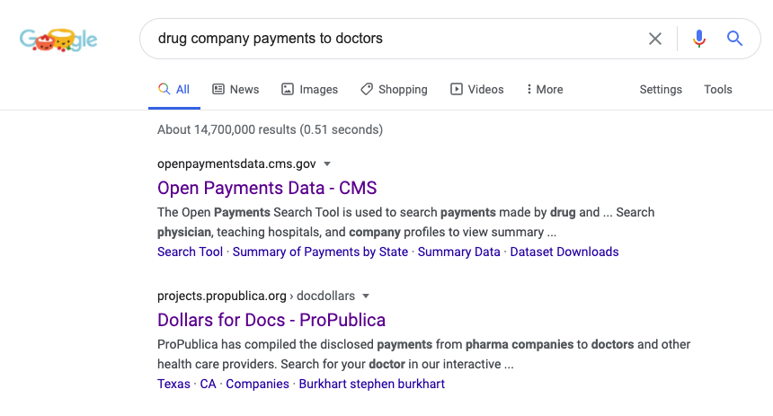

Slide 19
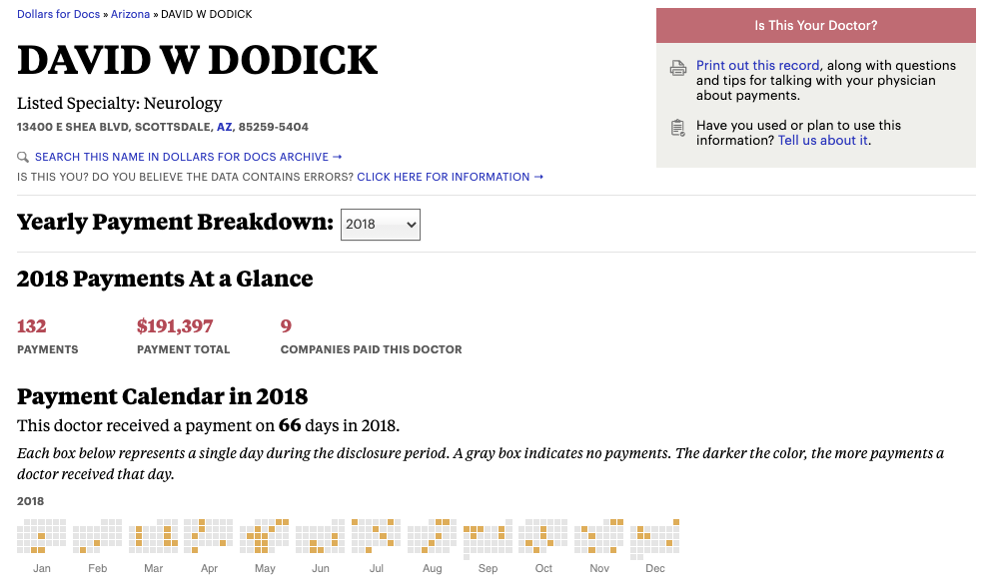
Notes:
Stephen Silberstein got
190 PAYMENTS
$260,905 PAYMENT TOTAL
14 COMPANIES PAID THIS DOCTOR

Slide 20
Critical Appraisal: History and Physical of a Research Paper
Authors and funding source
Research question
Study design
Study participants
Predictor variables
Outcome variable
Analysis and presentation of results (especially effect size and confidence interval)

Slide 21
Study participants: AUSTRI
Long-acting beta agonists (LABA) have increased deaths & life-threatening asthma episodes in many studies
Glaxo Smith Klein did the AUSTRI trial to test safety of LABA salmeterol+ fluticasone vs. fluticasone alone¹
Subjects
  Subjects with a history of life-threatening or "unstable" asthma (e.g., > 2 hospitalizations in previous 12 months) were excluded
  Most (63%) were already taking a LABA + inhaled steroid
¹Stempel DA et al. N Engl J Med 2016;374:1822-30. Funded by GSK
Notes:
Would miss early adverse effects

Slide 22
Ferric Carboxymaltose in Patients with Congestive Heart Failure (CHF) and Iron Deficiency
Randomized double-blind trial
Subject: 459 patients with CHF and iron deficiency anemia
Intervention: IV iron preparation vs. placebo
Outcomes: Symptoms, quality of life, etc.
Results: Moderate or much improvement 50% vs 28%; "odds ratio for improvement" with iron = 2.51 (95% CI 1.75 to 3.61)
Anker SD et al. New Engl J Med 11/17/2009

Slide 23
Ferric Carboxymaltose in Patients with Heart Failure and Iron Deficiency: Issues
Sponsored by Vifor Pharma
Subjects: need not have failed oral iron
Comparison group: placebo rather than oral iron
Answers a commonly asked, clinically uninteresting, probably unethical research question!
  Does an expensive, new, potentially toxic drug work better than placebo for a condition for which a safe and inexpensive treatment already exists?
Why use the odds ratio in an RCT?
  See slides 51-52
Anker SD et al. New Engl J Med 11/17/2009

Slide 24
Critical Appraisal: History and Physical of a Research Paper
Authors and funding source
Research question
Study design
Study participants
Predictor variables
Outcome variable
Analysis and presentation of results (especially effect size and confidence interval)

Slide 25
Predictor variable: Drugs and Doses Being Compared
Selection of comparison drug and dose
  Lower dose
  More toxic
  Ineffective (or placebo)

Slide 26
Dodick NEJM Study compares with placebo
Jane Brody's column provides a direct link to this paper
Randomized, double-blind trial in 89 US Centers, funded by Allegan
N = 1672 adults randomized 1:1:1 to placebo, ubrogepant 50 mg or ubrogepant 100 mg tablets
Freedom from pain at 2h: 11.8%, 19.2% and 21.2% (Adjusted P = 0.002)
Ubrogepant is FDA-approved, marketed as Ubrelvy® and sells for ~$85/pill (either 50 mg or 100 mg)*
Unanswered question: is it as good as acetaminophen or ibuprofen?
*Goodrx.com accessed 10/27/20
Notes:
BACKGROUND
Ubrogepant is an oral, small-molecule calcitonin gene–related peptide receptor
antagonist for acute migraine treatment.
METHODS
We conducted a randomized trial to evaluate the efficacy, safety, and side-effect profile
of ubrogepant. We assigned adults with migraine, with or without aura, in a 1:1:1
ratio to receive an initial dose of placebo, ubrogepant at a dose of 50 mg, or ubrogepant
at a dose of 100 mg for treatment of a single migraine attack, with the option
to take a second dose. The coprimary efficacy end points were freedom from pain at
2 hours after the initial dose and absence of the most bothersome migraine-associated
symptom at 2 hours. Secondary end points included pain relief (at 2 hours),
sustained pain relief (from 2 to 24 hours), sustained freedom from pain (from 2 to
24 hours), and absence of symptoms associated with migraine (photophobia, phonophobia,
and nausea) at 2 hours.
RESULTS
A total of 1672 participants were enrolled; 559 were assigned to receive placebo, 556
to receive 50 mg of ubrogepant, and 557 to receive 100 mg of ubrogepant. The percentage
of participants who had freedom from pain at 2 hours was 11.8% in the
placebo group, 19.2% in the 50-mg ubrogepant group (P = 0.002, adjusted for multiplicity,
for the comparison with placebo), and 21.2% in the 100-mg ubrogepant group
(P<0.001). The percentage of participants who had freedom from the most bothersome
symptom at 2 hours was 27.8% in the placebo group, 38.6% in the 50-mg
ubrogepant group (P = 0.002), and 37.7% in the 100-mg ubrogepant group (P = 0.002).
Adverse events within 48 hours after the initial or optional second dose were reported
in 12.8% of participants in the placebo group, in 9.4% in the 50-mg ubrogepant
group, and in 16.3% in the 100-mg ubrogepant group. The most common adverse
events were nausea, somnolence, and dry mouth (reported in 0.4 to 4.1%); these
events were more frequent in the 100-mg ubrogepant group (reported in 2.1 to 4.1%).
Serious adverse events reported within 30 days in the ubrogepant groups included
appendicitis, spontaneous abortion, pericardial effusion, and seizure; none of the
events occurred within 48 hours after the dose.
CONCLUSIONS
A higher percentage of participants who received ubrogepant than of those who received
placebo had freedom from pain and absence of the most bothersome symptom
at 2 hours after the dose. The most commonly reported adverse events were nausea,
somnolence, and dry mouth. Further trials are needed to determine the durability and
safety of ubrogepant for acute migraine treatment and to compare it with other drugs
for migraine. (Funded by Allergan; ClinicalTrials.gov number, NCT02828020.)

Slide 27
Critical Appraisal: History and Physical of a Research Paper
Authors and funding source
Research question
Study design
Study participants
Predictor variables
Outcome variable(s)
Analysis and presentation of results (especially effect size and confidence interval)

Slide 28
Outcome variable
Surrogate outcomes vs. patient relevant
Composite outcomes
Multiple outcomes, time periods, subgroups, etc
  Selective reporting of positive outcomes

Slide 29
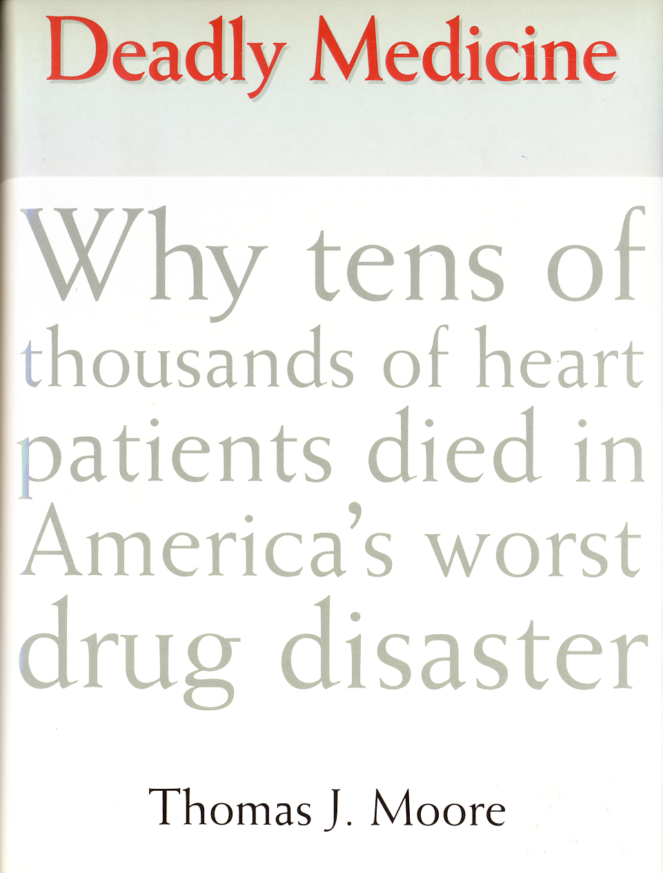
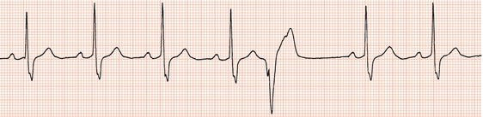
Surrogate Outcomes: Cardiac Arrhythmia Suppression Trial (CAST)*
Asymptomatic premature ventricular contractions (PVCs) after myocardial infarctions are a risk factor for sudden death
Encainide and flecainide decrease PVCs (Surrogate Outcome)
Increased total mortality by 10 months 8.3% vs. 3.5% (P <0.0001)
Tens of thousands of excess deaths in the US**
*Echt DS et al. N Engl J Med. 1991;324:781-8
**Moore TJ. Deadly Medicine. NY: Simon and Schuster, 1995
Notes:
Total mortality 63/755 vs 26/717 P=0.000 086 after 10 months
But now Viox may be a bigger disaster:

Slide 30
Composite outcomes
Grouped outcomes, such as “Severe Asthma Exacerbation” in the AUSTRI trial of salmeterol+fluticasone vs. fluticasone alone¹
  Asthma admission OR
  Asthma ED visit with systemic steroids OR
  Systemic steroids × ≥ 3 days
Only 5 of 106 severe exacerbations in 1230 kids were admissions (3 with salmeterol + fluticasone, 2 with fluticasone alone)
This info in web supplement only
¹Stempel DA et al. N Engl J Med 2016;374:1822-30

Slide 31
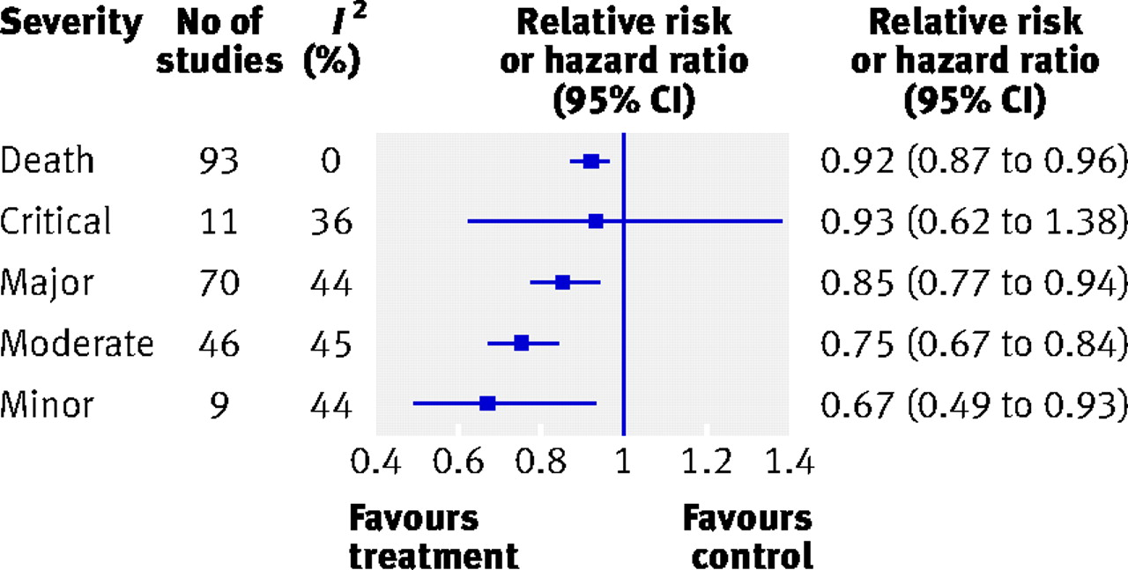

Meta-analysis of composite endpoints in cardiovascular trials*
*Ferreira-Gonzalez, I. et al. BMJ 2007;334:786
Copyright ©2007 BMJ Publishing Group Ltd.

Slide 32
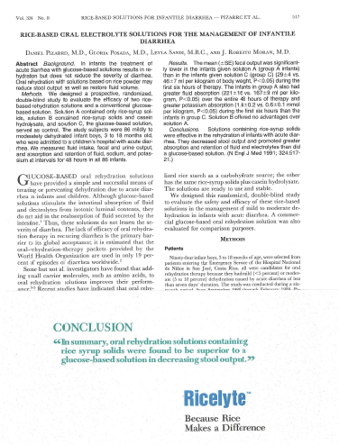
Multiple Outcomes, Time Periods, etc.

Slide 33
Multiple Outcomes, Time Periods, etc.
Pizarro D et al. New Engl J Med1991;324:517-21

Slide 34
Multiple Outcomes, Time Periods, etc.
Pizarro D et al. New Engl J Med1991;324:517-21

Slide 35
Multiple Outcomes, Time Periods, etc.
Compared 6 different fluid and electrolyte outcomes of 3 different preparations in 5 different time periods (90 comparisons total)
  7 comparisons: ≥ 1 of their products better
  7 comparisons: ≥ 1 of their products worse
  76 comparisons: no differences
Clinical outcomes (time to rehydration, duration of diarrhea): no differences
Pizarro D et al. New Engl J Med1991;324:517-21

Slide 36
It didn’t actually contain rice…
MEAD JOHNSON ORDERED TO TAKE 'RICE' OUT OF 'RICELYTE' NAME
AP , Associated Press
Aug. 19, 1992 4:48 PM ET
INDIANAPOLIS (AP) _ A federal judge has ordered Mead Johnson & Co. to change the name of its Ricelyte infant nutritional supplement and withdraw many of its health claims.

Slide 37
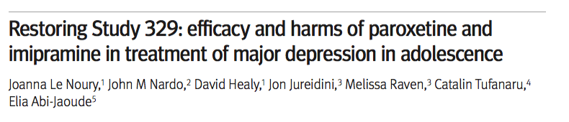
Restoring Study 329
BMJ 2015;351:h4320
Independent re-analysis of a ghost-written RCT¹ sponsored by Glaxo-Smith-Kline
Original conclusion: “Paroxetine…generally well tolerated and effective…”
Re-analysis: Paroxetine had no significant effect on pre-specified primary outcomes and caused significant harm
¹Keller MB et al. J Am Acad Child Adolesc Psychiatry 2001;40:762-72
Notes:
https://www.justice.gov/usao-ma/file/872506/download 8/16/16. . J Am Acad Child Adolesc Psychiatry

Slide 38
Restoring Study 329
BMJ 2015;351:h4320
Original investigators had added 19 outcome measures to the original 8 and highlighted positive ones
Adverse effects grouped and classified to hide harm
Sordid details: see DOJ complaint.²
GSK pled guilty to criminal charges and paid $3 billion settlement (for many other misdeeds, too).³
² https://www.justice.gov/sites/default/files/opa/legacy/2012/07/02/us-complaint.pdf . Accessed 10/27/20.
³ http://www.nytimes.com/2012/07/03/business/glaxosmithkline-agrees-to-pay-3-billion-in-fraud-settlement.html?_r=0
Notes:
https://www.justice.gov/usao-ma/file/872506/download 8/16/16. . J Am Acad Child Adolesc Psychiatry

Slide 39
Restoring Study 329: Making excess adverse effects go away
Adverse event reported only if >5%; agitation could be coded as anxiety, nervousness, hyperkinesis or emotional lability
Hid psychiatric adverse effects by grouping them with headaches and dizziness as “nervous system” effects
Suicidal behavior called “emotional lability”
Failed to report adverse effects after stopping medication
Dismissed events not believed related to medication by study investigators
BMJ 2015;351:h4320
Notes:
https://www.justice.gov/usao-ma/file/872506/download 8/16/16. . J Am Acad Child Adolesc Psychiatry

Slide 40
Fines: A Cost of Doing Business*
GSK's $3 billion fine covered misdeeds related to Paxil®, Wellbutrin® and Avandia® over 10 years
Over those 10 years GSK's sales of those drugs were $28 billion.
*https://www.nytimes.com/2012/07/03/business/glaxosmithkline-agrees-to-pay-3-billion-in-fraud-settlement.html
Notes:
Despite the large amount, $3 billion represents only a portion of what Glaxo made on the drugs. Avandia, for example, racked up $10.4 billion in sales, Paxil brought in $11.6 billion, and Wellbutrin sales were $5.9 billion during the years covered by the settlement, according to IMS Health, a data group that consults for drugmakers.

Slide 41
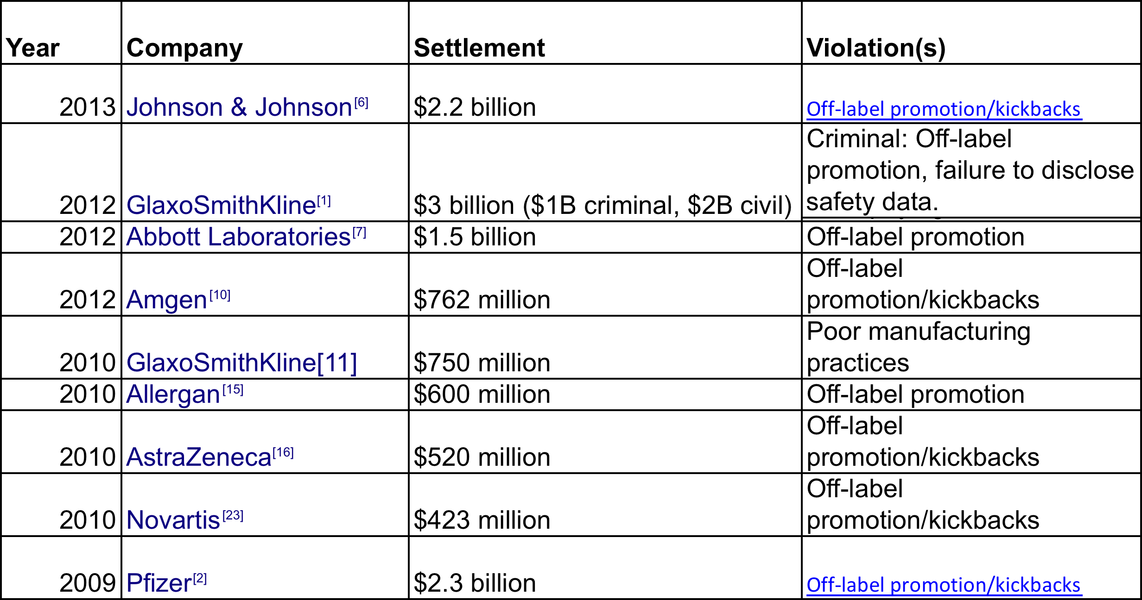
Recent Large Big Pharma Settlements
Source: https://en.wikipedia.org/wiki/List_of_largest_pharmaceutical_settlements, accessed 8/16/16
Notes:
Not included in the above: the $420 Million Pfizer paid in 2004 for illegal marketing of Neurontin by Parke-Davis:

Slide 42
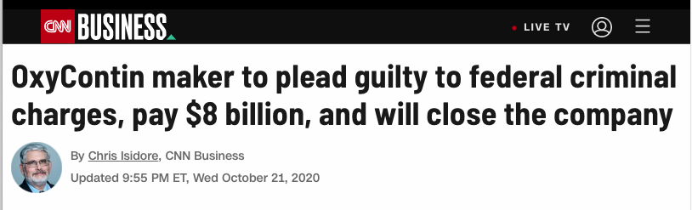

Slide 43
Why Olanzapine Beats Risperidone, Risperidone Beats Quetiapine, and Quetiapine Beats Olanzapine:
An Exploratory Analysis of Head-to-Head Comparison Studies of Second-Generation Antipsychotics
Answer: it depends who sponsors and designs the trial
Heres S et al. Am J Psychiatry. 2006 Feb;163(2):185-94
Notes:
Answer: depends who sponsors trial.
Olanzapine=Zypexa
Risperidone = Risperdal
Quetiapine = Seroquel

Slide 44
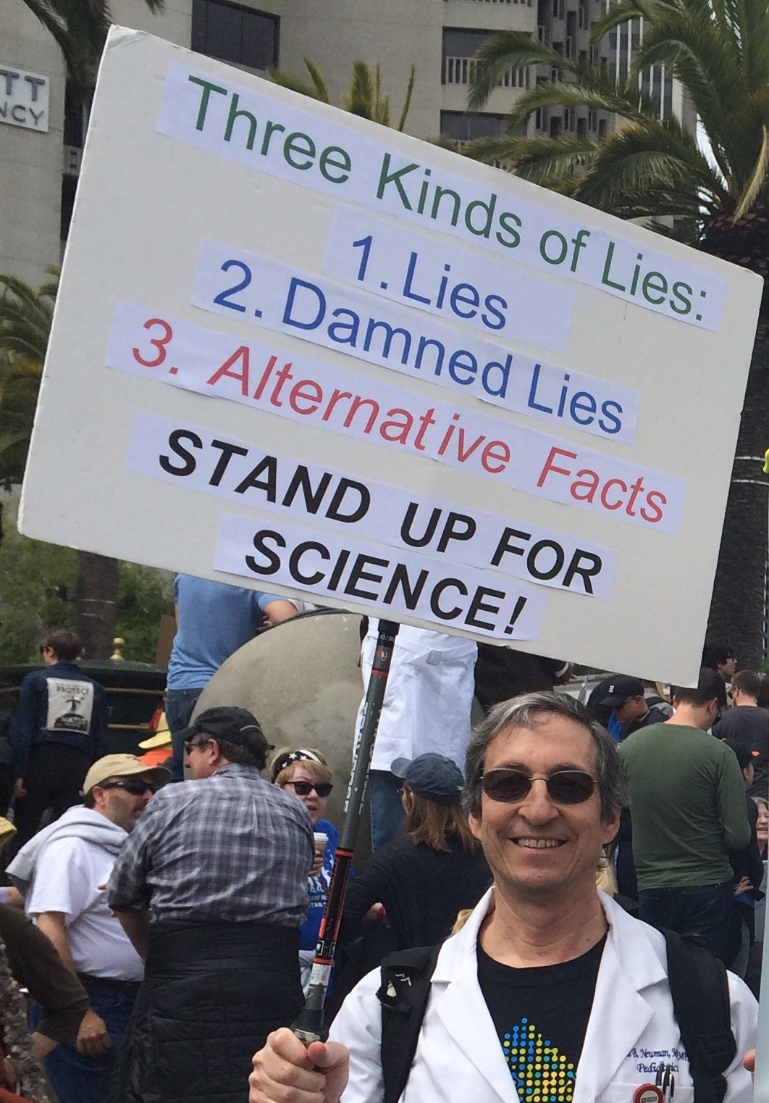
End of Part 1

Slide 45
Randomized Trials & Quantifying Treatment Effects- Part 2
Tom Newman, MD, MPH
Professor Emeritus of Epidemiology & Biostatistics and Pediatrics, UCSF
October 30, 2020

Slide 46
Outline
PART 1
Introduction: why do randomized, blinded trials?
Critical appraisal of RCTs
  Authors and funding source
  Design and conduct
  PART 2
Analysis: Quantifying treatment effects
  Continuous outcomes
  OR, RR, RRR, ARR, NNT
  CBOP & BBOP

Slide 47
Critical Appraisal: History and Physical of a Research Paper
Authors and funding source
Research question
Study design
Study participants
Predictor variables
Outcome variable(s)
Analysis and presentation of results

Slide 48
Analysis and Presentation of Results
Intention to treat, as treated and per protocol analyses
Effect size vs. P-values –next week
Risk ratio vs. Odds ratio
Relative vs. absolute effect size
Number needed to treat (NNT)
Cost per bad outcome prevented (CBOP)
Benefit per bad outcome prevented (BBOP)

Slide 49




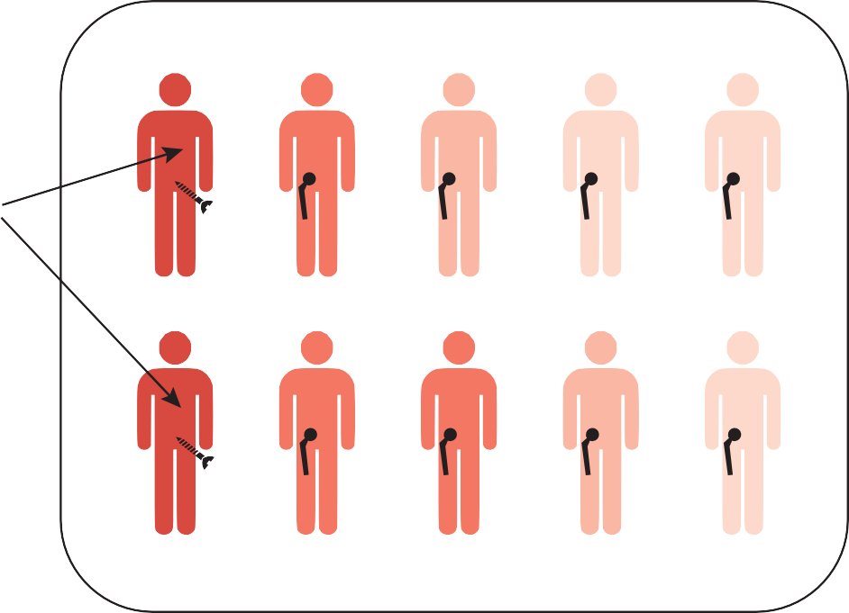
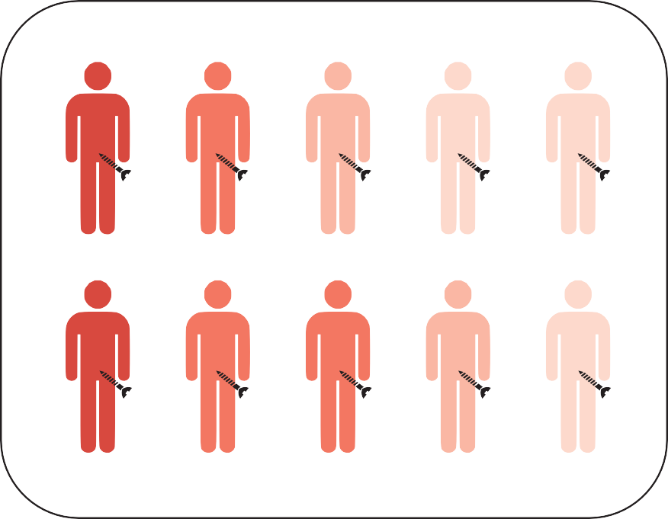
Analysis of RCTs
Hip replacement vs hip screws for acute hip facture
Randomization
These patients randomized to the hip replacement group are too sick for the hip replacement - they will get a
hip screw
Hip replacement
Hip screw

Slide 50
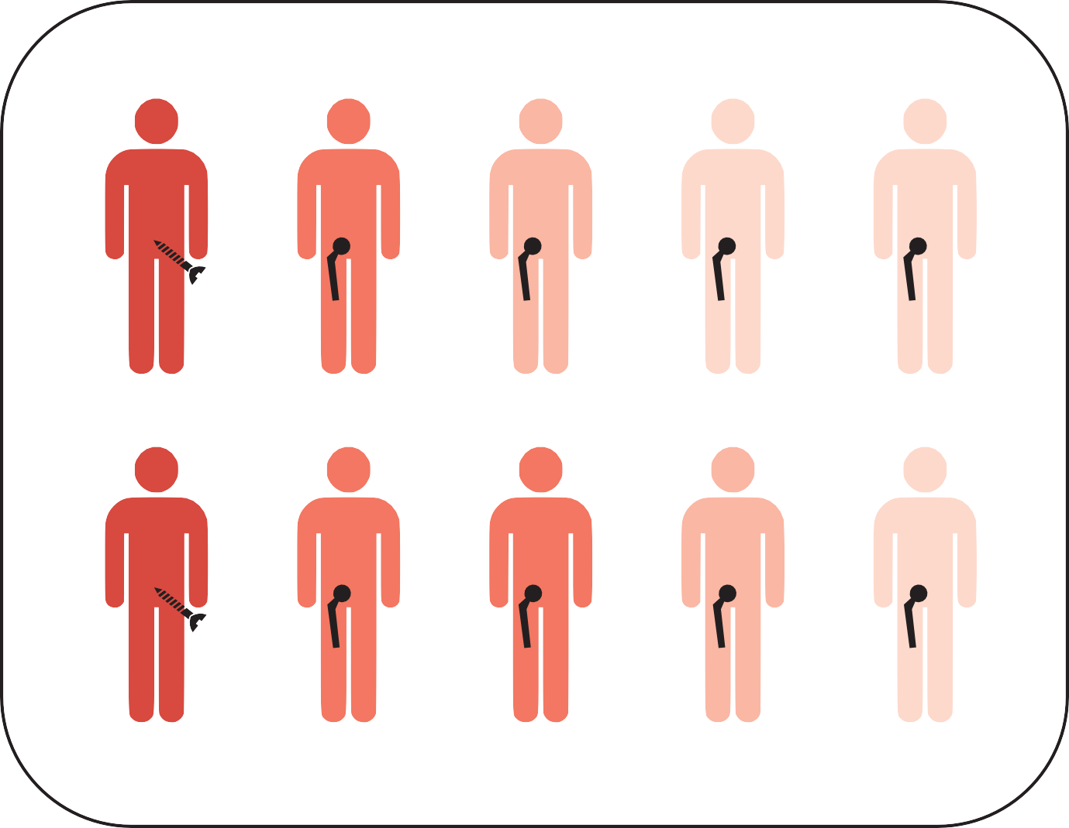
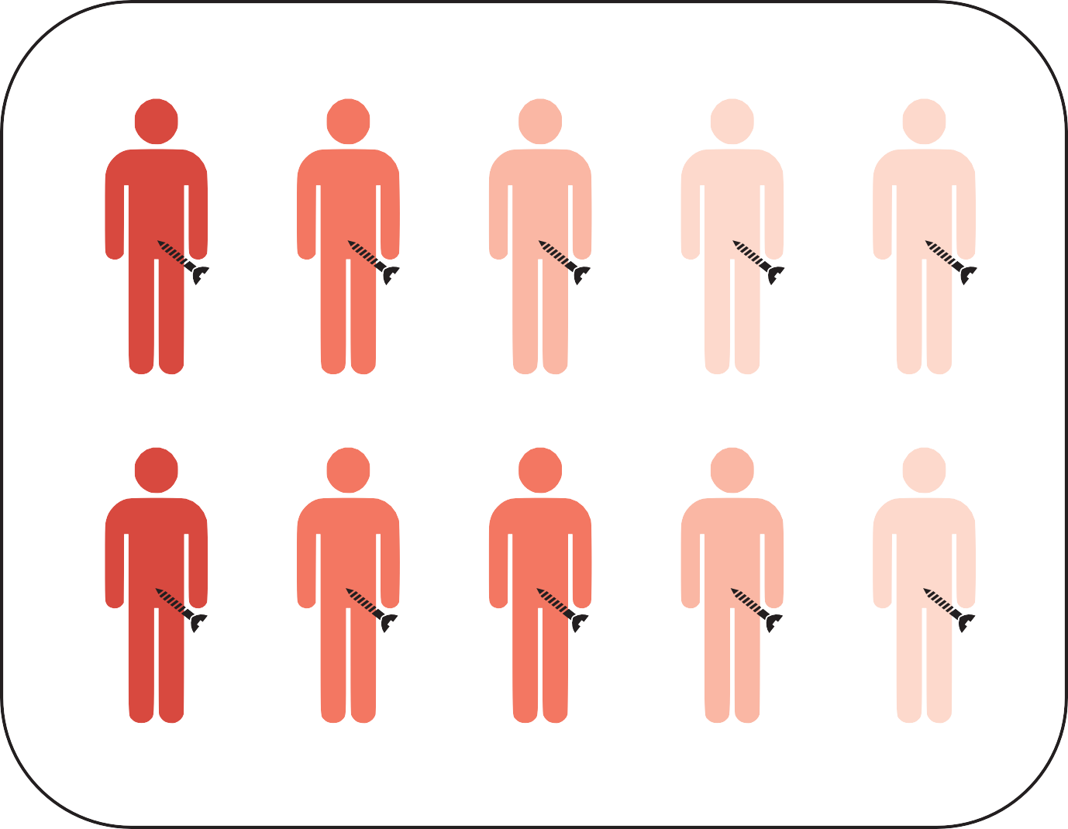
Analysis of RCTs: Intention to treat (ITT)
All subjects are analyzed according to the randomization group

Slide 51
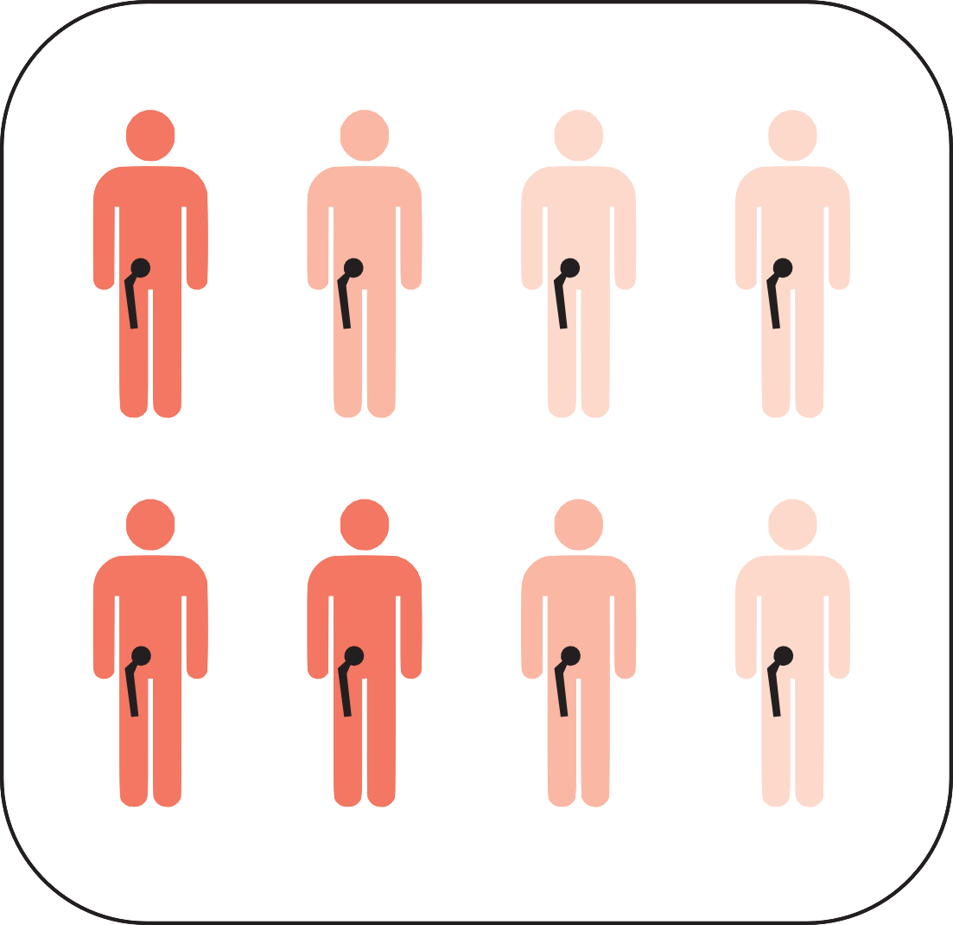
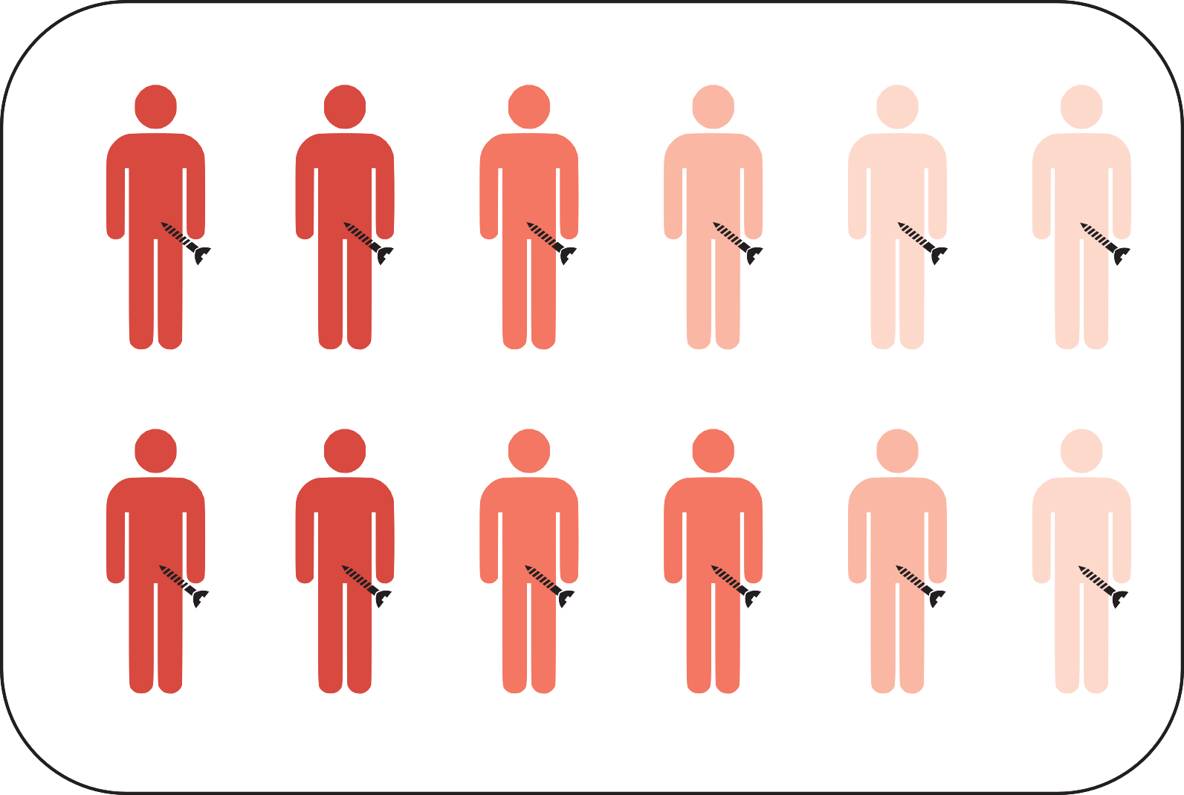
Analysis of RCTs: As treated
Subjects are analyzed according to treatment received

Slide 52
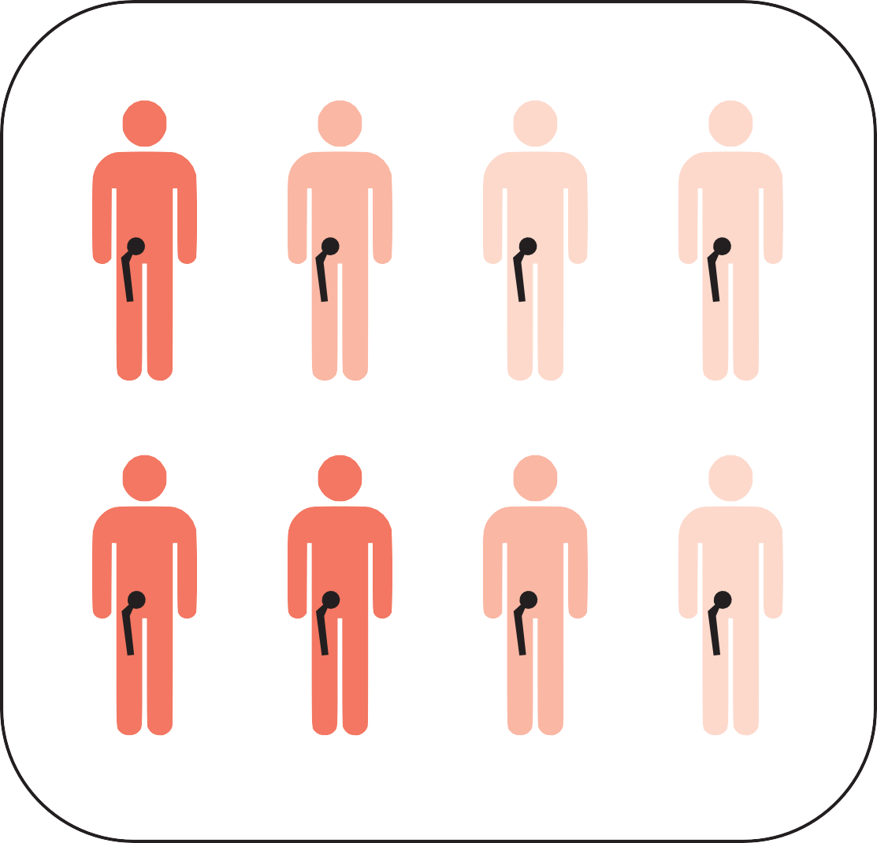

Analysis of RCTs: Per protocol
Only subjects treated according to the study protocol are analyzed

Slide 53


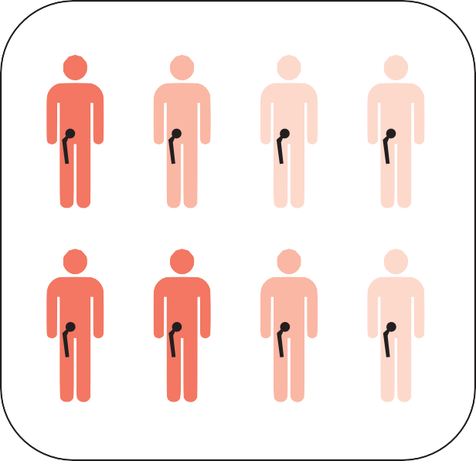
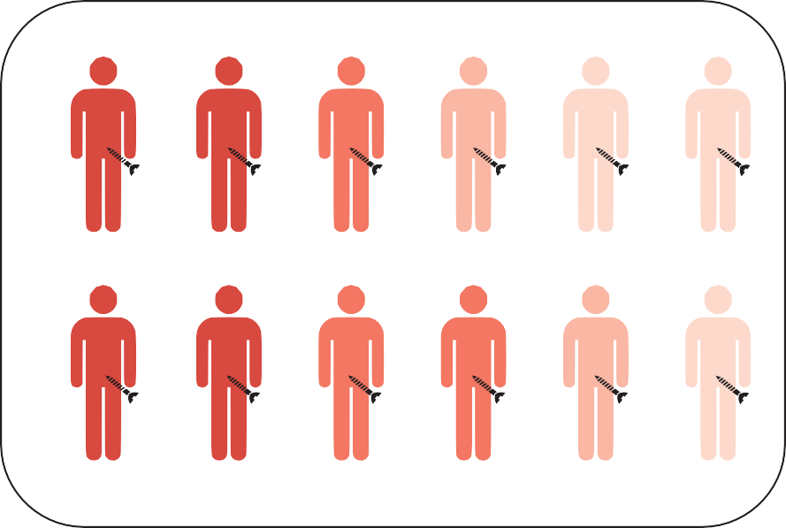
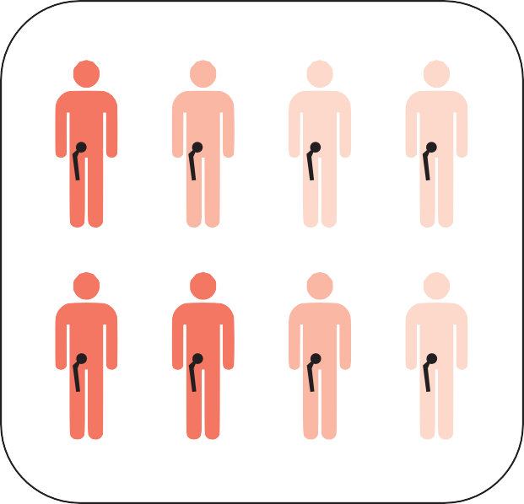

Analysis of RCTs
28
A
Intention to treat
all subjects are analyzed according to the randomization group
Bias towards the null
B
Bias in favor of hip replacement
As treated
Subjects are analyzed according to treatment received
C
Bias in favor of hip replacement
Per protocol
Only subjects treated according to the study protocol are analyzed

Slide 54
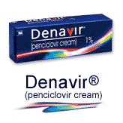
Penciclovir for Recurrent Oral Herpes Simplex Virus (HSV)*
Randomized, double-blind trial sponsored by manufacturer
1573 patients from 31 US Clinics
1% Penciclovir or placebo applied every 2 hours while awake
Penciclovir group more had rapid resolution (P<0.001)
*Spruance et al. JAMA 1997;277:1374-9
Notes:
Cost:
(*Drugstore.com accessed 4/10/12)

Slide 55
Penciclovir Effect Size, Continuous outcome
Median time to healing : 5.5 vs. 4.8 days (13% shorter with penciclovir, P < 0.001)
When sample size is large, P-value can be small even if effect size is meager
Denavir® $809 for 5 g*
* Lowest price (Costco with coupon) 10/27/20 at www.GoodRx.com.
Notes:
Google LA Times “A $2,500 tube of cold-sore cream? Now that stings.”
10/26/21: It's up to $843.

Slide 56
A $2,500 tube of cold-sore cream? Now that stings*
*http://www.latimes.com/business/la-fi-lazarus-20150306-column.html
Notes:
Jim Makichuk bought a 5-gram tube of Zovirax, a prescription cold-sore cream, a few years ago in Canada for $34.65. That was the over-the-counter price; no insurance involved.
He recently purchased a fresh 5-gram tube from a Kaiser Permanente pharmacy in Los Angeles. It cost him $95, or nearly three times as much as the Canadian price — with insurance.
But that's not what raised Makichuk's eyebrows.
What surprised him was a report Kaiser sent him on prescriptions he filled in January. There was the tube of Zovirax, and there was the $95 payment Makichuk made.
And beside that was a listing for what Kaiser paid for the cream: $2,532.80.
"I don't get it," Makichuk, 68, of Sherman Oaks, told me. "How could they possibly pay that much?"
The answer to that question leads down the rabbit hole of U.S. healthcare costs and the frequently inexplicable prices of prescription drugs.
It also highlights the fact that Americans pay more for meds than citizens of most other developed countries, which regulate drug prices to prevent price gouging.
Makichuk said he contacted Kaiser to see if a mistake had been made about the total price tag.
"I talked to a couple of people," he recalled. "They said that's just how much it costs."
It isn't. I found a Canadian site called Universal Drugstore selling acyclovir, the generic equivalent of Zovirax, for $21.
I found another site, Canada Drugs, selling a 6-gram tube of acyclovir for $47.88. Six grams of name-brand Zovirax could be had for $44.94.
The manufacturer of Zovirax, Britain's GlaxoSmithKline, says the major markets for the drug are Europe, Russia and Australia. Along with cold sores, Zovirax is a leading treatment for genital herpes.
Glaxo sold the U.S. and Canadian rights for Zovirax in 2011 to Canadian company Valeant Pharmaceuticals for $300 million.
In 2012, the U.S. Food and Drug Administration said Valeant was making unsubstantiated claims about Zovirax on its website. It said the company was overstating the effectiveness of the drug and ordered it to stop.
A year later, Valeant agreed to supply what it called an "authorized" generic version of Zovirax to Irish drug company Actavis, which would have the exclusive right to market and distribute it in the United States.
Now, I need to clarify a key point. Actavis and two other generic-drug makers, Mylan and Amneal Pharmaceuticals, market a generic version of Zovirax ointment. There's no generic version of the Zovirax cream prescribed for Makichuk.
What's the difference?
"There really isn't any," said Dr. Boris Zaks, a Beverly Hills dermatologist. "Creams are more cosmetically elegant because you rub them in. Ointments can leave some residue. They can be a little greasier."
Technically speaking, an ointment is 80% oil and 20% water. A cream is 50% oil and 50% water. Both Zovirax cream and Zovirax ointment have the same amount of the same active ingredient, acyclovir.
"An ointment can be more soothing," said Dr. Dale Westrom, a dermatologist in Santa Rosa, Calif. "People with sensitive skin do better with ointments."
Both Westrom and Zaks said they prefer the pill version of generic acyclovir for their patients. It works better, they said, and is cheaper than the cream or the ointment.
Makichuk said neither the Kaiser doctor nor the pharmacist balked at providing him with 5 grams of cold-sore cream costing more than $2,500. Also, neither mentioned the far cheaper ointment, he said.
John Nelson, a Kaiser spokesman, declined to discuss specifics of Makichuk's experience for privacy reasons.
He said only that there's no generic available for Zovirax cream and that "the price we have is very similar to others in the market."
That's true, as a search for Zovirax cream on the price-comparison website GoodRx will show. But it doesn't remove the stench from all this.
Why is name-brand Zovirax cream priced at such a ridiculously high level? I put that to Valeant Pharmaceuticals.
Laurie Little, a Valeant spokeswoman, said the cost of the cream "takes into account many factors, the cost of the active and inactive ingredients, the manufacturing process, the packaging and its related process, as well as the distribution and a myriad of other expenses."
So there.
As for why the Zovirax cream available in Canada is so cheap, that's simple: It's manufactured in Britain, not the U.S., and British law requires that drug prices be reasonable. So does Canadian law.
If there's a take-away from Makichuk's story, it's that America's healthcare system is designed to maximize cash flow for its corporate players and that there are few safeguards to keep costs down.
Not coincidentally, according to the financial-advice website NerdWallet, healthcare bills are the No. 1 cause of personal bankruptcy in this country.
And no amount of skin cream will make that sting go away.
David Lazarus' column runs Tuesdays and Fridays. He also can be seen daily on KTLA-TV Channel 5 and followed on Twitter @Davidlaz. Send your tips or feedback to david.lazarus@latimes.com.
David Lazarus
CONTACT
David Lazarus is an award-winning business columnist for the Los Angeles Times, focusing on consumer affairs. He also appears daily on KTLA-TV Channel 5 and is a part-time radio host. His work appears in newspapers across the country and has resulted in a variety of laws protecting consumers.
COMMENTS (1)
Copyright © 2018, Los Angeles Times

Slide 57
Effect Size: Odds Ratio vs. Risk Ratio
The authors also reported the odds ratio for healing by day 7 was 1.7 (P <0.001)
Many readers think this means the probability of healing was 1.7 times (70%) greater with penciclovir
But it's the odds of healing that are 1.7 times higher
Actual healing rates were 78% vs. 68% (0.78/0.68 = 1.15)
*Spruance et al. JAMA 1997;277:1374-9

Slide 58
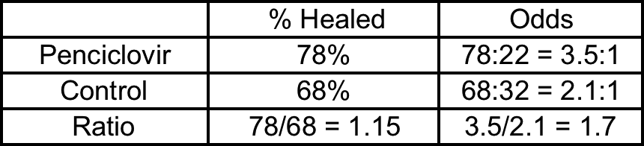
Effect Size: Odds Ratio vs. Risk Ratio
The key is the difference between probability and odds: odds = P/(1-P)
Avoid the odds ratio when the outcome is common!
Recall for IV iron: Moderate or much improvement 50% vs 28%; "odds ratio for improvement" with iron = 2.51
*Spruance et al. JAMA 1997;277:1374-9

Slide 59
Effect Size: Relative vs. Absolute
(Dichotomous Outcome Variables)
RR = Risk Ratio =Relative Risk
= Risk in intervention group
Risk in control group
RRR = Relative Risk Reduction = 1– RR
ARR = Absolute Risk Reduction = Risk in control group – Risk in intervention group
NNT = Number Needed to Treat = 1/ARR
Notes:
RR is very standard - the RRR is less
When people express RR as percent reduction it’s unclear what they mean
The ARR is sometimes called risk difference; can be confusing if risk in int group is higher, then ARR is negative - know which group had worst outcome.
Abbreviations used in Cochrane reviews

Slide 60
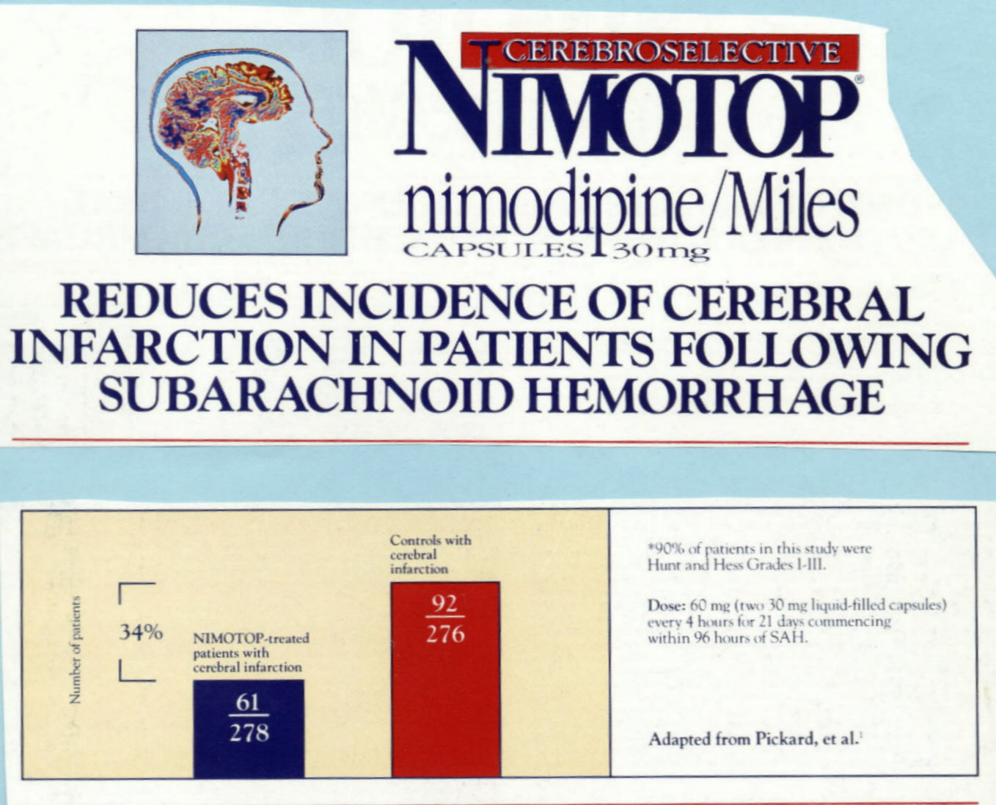
Q: What does the 34% reduction mean?

Slide 61
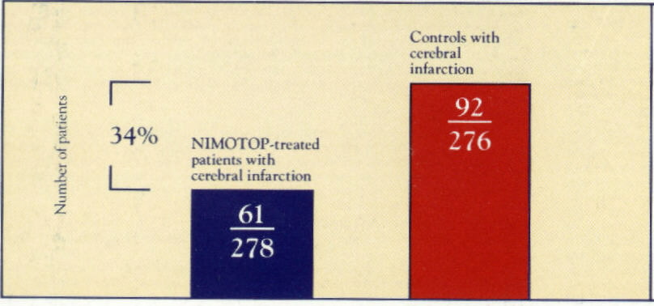
Nimotop® Ad Graph
22%
33%
RR = 21.8%/33% = .66
RRR = 1-0.66 = 34%
ARR = 33% - 21.8% = 11.2%

Slide 62
100%
90%
80%
70%
60%
50%
40%
30%
20%
10%
0%
To scale
Original figure
11%

Slide 63
Why is NNT 1/ARR? For each 100 patients:
67 no stroke anyway
33% strokes with no treatment
11 strokes prevented
22 strokes with Nimotop®
22% strokes with with treatment

Slide 64
NNT in AUSTRI Trial, 12-17 years
Hospitalization: N/A, no efficacy
Severe asthma exacerbation (mostly preventing a course of oral steroids)
    ARR = 64/615 (10.4%) - 42/615 (6.8%) = 3.6%/6 months
    NNT= 1/3.6% = 28 (x 6 months) = 168 person- months (14 person-years) of fluticasone + salmeterol (vs fluticasone alone) to prevent 1 course of oral steroids (~$62,000)
¹Stempel DA et al. N Engl J Med 2016;374:1822-30

Slide 65


Zelnorm® for Constipation

Slide 66
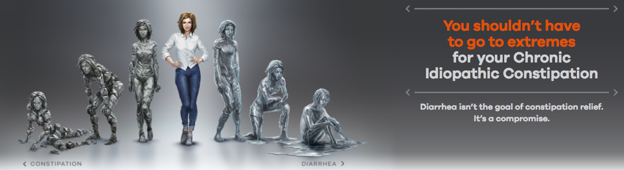
Trulance® (plecanatide) for Constipation*
Randomized, double-blind Phase III trial
Subjects: 1394 patients with chronic idiopathic constipation in 164 clinical centers
Treatment: Plecanatide 3 or 6 mg or placebo
*Miner et al. Am J Gastroenterol 2017;112:613-21
Notes:
See Miner 2017 filed under articles

Slide 67
Trulance® (plecanatide) for Constipation -2*
Primary outcome: "durable overall complete spontaneous bowel movement (CSBM) responders" = ≥ 3 CSBM/wk + increase from baseline of ≥ 1 CSBM/wk at least 9 of the 12 weeks including at least 3 of the last 4 weeks.
Results: Primary outcome in 21.0% with plecanatide 3 mg/d, 19.5% with 6 mg/d, 10.2% with placebo (P<0.001)
Risk difference for 3 mg = 10.8%, NNT 9.3
*Miner et al. Am J Gastroenterol 2017;112:613-21
Notes:
See Miner 2017 filed under articles

Slide 68
Annual Cost per Durable Overall CSBM Responder
Risk difference for 3 mg = 10.8%, NNT 9.3
Cost for 30 3 mg tabs (with coupon) = $439*
Annual cost per responder ~$49,000
Using CSBM as a continuous variable, there was a difference of 1.3 CSBM per week at a cost of ~$102/wk, so ~$79 per CSBM
*www.GoodRx.com accessed 10/27/20
Notes:
See Miner 2017 filed under articles.
10/26/21 Trulance ® is up to $495 for 30 x 3 mg

Slide 69
Trulance® (plecanatide) for Constipation*
Why did they use 164 centers to enroll 1394 subjects with constipation?
Hint: constipation is not a rare disease
*Miner et al. Am J Gastroenterol 2017;112:613-21
Notes:
See Miner 2017 filed under articles

Slide 70
Seeding trials
Blur the line between research and marketing
"Thinly veiled attempts to entice doctors to prescribe a new drug being marketed by the company."*
Suspect seeding is a goal whenever the number of centers for industry-sponsored trials is high relative to sample size and rarity of disease.**
*Kessler DA et al. NEJM 1994;331:1350-53
**Psaty B and Rennie D. JAMA 2006; 295: 2787-9

Slide 71
Within group comparisons
Correct approach: compare groups according to group assignment (between groups)
Within-group comparisons-- > misleading

Slide 72
Combination Therapy With Desmopressin and an Anticholinergic Medication for Nonresponders to Desmopressin* (Problem 8.3)
Significant decrease in wet nights with anticholinergic med added, not with placebo
Does this show ACh works?
Pediatrics, 2008; 122:1027-1032
Notes:
KM – Desmopressin-related publications frequently supported by drug money (Ferring pharmaceuticals). 41 kids (7 non-compliant w/ records). Outcomes were bedwetting per a 1 week nocturnal record at f/u. 1 month of tx – primary outcome was 50% reduction in wet nights

Slide 73
Combination Therapy With Desmopressin and an Anticholinergic Medication for Nonresponders to Desmopressin*
Responders (≥ 50% reduction in wet nights):
  8/18 (44%) vs 5/16 (31%); P = 0.43
Conclusion: "This study represents the first prospective, placebo-controlled trial examining the effect of desmopressin in combination with long-acting, anticholinergic, bladder-relaxing therapy for monosymptomatic primary nocturnal enuresis."
Pediatrics, 2008; 122:1027-1032
Notes:
KM: Wonderfully uninformative conclusion, but at least they did not conclude that it worked! 3-year trial – enrolled only 48 subjects, 7 of whom elected not to participate, and 7 of whom did not comply with bed-wetting journals so n = 34

Slide 74
Incorporating Cost
NNT= # needed to treat to prevent one bad outcome
C= cost to treat one patient
NNT x C= treatment cost to prevent one bad outcome

Slide 75
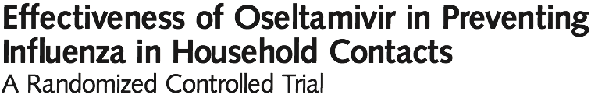
Tamiflu® or not?
RCT oseltamivir vs. placebo to prevent influenza in household contacts of patients with flu-like symptoms
Stratified by whether index case had lab proved flu
Minimal loss to f/u, ITT analysis
JAMA 2001;285:748-54

Slide 76
Oseltamivir Prophylaxis
Index case Proven Flu +
Index case not Proven Flu +
 | Flu + Contact | Flu – Contact | Totals
Tamiflu | 3 | 206 | 209
Placebo | 26 | 180 | 206
 | Flu + Contact | Flu – Contact | Totals
Tamiflu | 1 | 283 | 284
Placebo | 8 | 248 | 256
Risk_{T}= 3/209 = 1.4%
Risk_{C}= 26/206= 12.6%
RR= 1.4%/12.6%= .11
RRR= 1-11%= 89%
Risk_{T}= 1/284 = 0.35%
Risk_{C}= 8/256= 3.1%
RR= 0.35%/3.1%= .11
RRR= 1-11%= 89%
ARR= 12.6%-1.4%= 11.2%
ARR= 3.1%-0.35%= 2.7%
Why is ARR different between the two groups?
Notes:
Because the index flu- group has a much lower baseline risk of flu in household contacts (3.1% vs. 12.6%)– this is how RRR can be misleading. Important to know the baseline risk!

Slide 77
Oseltamivir prophylaxis ~ $40
Index case Proven Flu +
Index case not Proven Flu +
 | Flu + Contact | Flu – Contact | Totals
Tamiflu | 3 | 206 | 209
Placebo | 26 | 180 | 206
 | Flu + Contact | Flu – Contact | Totals
Tamiflu | 1 | 283 | 284
Placebo | 8 | 248 | 256
ARR= 12.6% - 1.4%= 11.2%
NNT= 1/11.2%= 9
Cost= 9*$40= $360
It costs about $360 to prevent a case of flu in household contacts of flu+
ARR= 3.1% - 0.35%= 2.7%
NNT= 1/ 2.7%= 37
Cost= 37*$40
It costs about $1480 to prevent a case of flu in household contacts of flu-
Cost per bad outcome prevented= CBOP
Notes:
The baseline risk of contracting influenca is 4 times lower in the flu negative group so the absolute benefit is 4 times lower and the cost per flu case prevented is 4 times higher

Slide 78
CBOP: Is it worth it?
Depends on BBOP= Benefit per Bad Outcome Prevented
Earlier (in Chapter 2), we valued shortening duration of flu by 1 day at $160.
Typical flu lasts 5 days, so 5 x $160 = $800
Add something for possible preventing additional transmission and get BBOP= $1080 (to make math come out even)
Since BBOP>CBOP we should treat if we know the index case is flu+

Slide 79
Treatment Thresholds
What if we don't know if our index patient has the flu?
If BBOP>CBOP, at what probability of disease would benefits outweigh costs?
  What is the treatment threshold (P_{TT})?
Recall P_{TT}= C/C+B
We know C ($40), but what is B?

Slide 80
What is B?
B = expected benefit of treatment
B = BBOP × ARR - C
Benefit of preventing a bad outcome
Absolute Risk Reduction (how much does treatment reduce the risk)
Cost

Slide 81
Getting to P_{TT}= C/(C+B)
B= BBOP × ARR – C
ARR= 1/NNT
B= BBOP/NNT− C
P_{TT}= C/(C+ BBOP/NNT− C)= C/(BBOP/NNT)
P_{TT}= C x NNT/BBOP
P_{TT}= CBOP/BBOP

Slide 82
Back to the Flu example
Treatment cost = $40
BBOP = $1080
NNT= 9
P_{TT}= 9*40/1080= 0.33
* If you treat household contacts when the index cases’s probability of the flu is 33% or higher, you will not spend more than the BBOP of $1080 to prevent a case of flu

Slide 83
Number needed to Harm
Adverse effects of treatment
Trade-off between side effects and outcome prevention

Slide 84
Plecanatide (Trulance) to treat chronic constipation
  Unintended side effect: Diarrhea

Slide 85
Setting up for NNH
 | Diarrhea | No Diarrhea | Total | Risk
Plecanatide | 28 | 446 | 474 | 5.9%
Placebo | 6 | 452 | 458 | 1.3%
RR= 5.9%/1.3%= 4.5
ARR= 1.3%-5.9%= -4.6%
ARI= 5.9%-1.3%= 4.6%
NNH= 1/ARI= 21.7
For every 22 patients treated , we will cause one additional case of diarrhea
Notes:
Set up table same way as your usual 2x2 table but now adverse event is the outcome you are interested in.

Slide 86
The trade-off
Trade-off between side effects and primary outcome prevention
Harms/Bad outcome prevented= ARI/ARR
NNT/NNH
Trulance example:
  NNT for primary outcome 9.3
  NNH: 22
NNT/NNH= 9.3/21.7= 0.43= We cause 0.43 cases of diarrhea for each durable responder

Slide 87
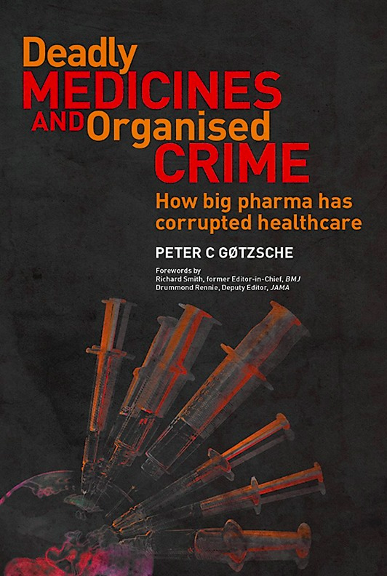
References
Angell M (former editor of NEJM). The Truth About the Drug Companies: How They Deceive us and What You Can Do About It. New York: Random House 2005
Bero L. Industry sponsorship and research outcome: a Cochrane Review. JAMA Intern Med. 2013 Apr 8;173(7):580-1
Gøtzsche P. Deadly Medicines and Organized Crime: How Big Pharma has corrupted Healthcare. Boca Raton: CRC Press, 2013

Slide 88
Cut slides

Slide 89
ACCORD Diabetes Trial: Surrogate Outcome
NHLBI-sponsored trial, N=10,251
Intervention: frequent blood tests, injections, etc. to target HbA1C <6% vs 7-7.9%
Result: Intervention led to lower HbA1C (6.6% vs 7.7%) (<0.001)
ACCORD Study Group. NEJM 2008;358:2545-59 ; NEJM 2011;364:818-28

Slide 90
ACCORD Diabetes Trial: Patient-Relevant Outcomes
Decreased nonfatal MI (3.6% vs 4.6%; HR 0.76, P= 0.004)
No significant effect on primary (composite) outcome of nonfatal MI, nonfatal stroke or cardiovascular death
Increased cardiovascular death, leading to higher total mortality (5.0% vs 4.0%; HR 1.22 P= 0.04)
  Persisted at 5-year follow-up (P=0.02)
ACCORD Study Group. NEJM 2008;358:2545-59 ; NEJM 2011;364:818-28

Slide 91
More from the Jane Brody NYT column…
"Unfortunately, the biologics are expensive, and insurance companies usually insist that patients fail to get relief from three months of treatment with each of two other drugs before they will cover the cost."
"However, for some patients, including some with heart conditions, insurance coverage can be more readily obtained if their doctors document that the older drugs are medically hazardous for them.
"Still, too often, doctors have to pursue a time-consuming appeal process to get the coverage their patients require."
"Dr. Silberstein urged patience when trying a new drug for migraine. He and his colleagues studied patients who had little relief after a month or two on a biologic, but by six months had almost no headaches."

Slide 92
Choice of Comparison Drug:
Ineffective
Meta-analysis of fluconazole vs. amphotericin to prevent fungal infections in neutropenic cancer patients*
Almost all studies (92% of included patients) sponsored by Pfizer
Amphotericin B given orally to comparison groups (79% of patients)
Amphotericin is poorly absorbed orally
*Johansen HK, Gotzsche PC. JAMA 1999;282:1752-59
Notes:
Problems in the Design and Reporting of Trials of Antifungal Agents Encountered During Meta-analysis. Similar issues later reported with voriconazole, also by Pfizer.

Slide 93
VESTRI Trial -1
26-week trial conducted in 567 trial centers in 32 countries
Children 4-11 years with >= 1 asthma exacerbation in the previous year; none within 30 days, no "unstable" asthma
Randomized 1:1 to fluticasone-salmeterol vs fluticasone alone
Outcome: death, endotracheal intubation, or hospitalization
¹Stempel DA et al N Engl J Med 2016;375:840-9.

Slide 94
VESTRI Trial - Design
26-week trial conducted in 567 trial centers in 32 countries
Children 4-11 years with >= 1 asthma exacerbation in the previous year; none within 30 days
Randomized 1:1 to fluticasone-salmeterol vs fluticasone alone
Outcome: death, endotracheal intubation, or hospitalization
¹Stempel DA et al N Engl J Med 2016;375:840-9.

Slide 95
VESTRI Trial – Analysis and Results
"The statistical design specified that noninferiority would be shown if the upper boundary of the 95% confidence interval of the hazard ratio for the primary safety end point was less than 2.675…
"The hazard ratio with fluticasone–salmeterol versus fluticasone alone was 1.28 (95% confidence interval [CI], 0.73 to 2.27), which showed the noninferiority of fluticasone–salmeterol (P = 0.006).
Who can explain what the P-value means?
¹Stempel DA et al N Engl J Med 2016;375:840-9.

Slide 96
Effect Size vs. P-values
Effect size: How big is the difference between the groups?
P-value: How big is the difference compared with what might be expected by chance alone?

Slide 97
P-values are very dependent on sample size!
Small sample size: clinically significant effects can be missed. (Study underpowered)
  Problem for equivalence studies
Large sample size: statistically significant effects might not be clinically significant. (Study overpowered)
Power depends on the number of outcomes. E.g., if the outcome is rare, may need a very large sample size
Notes:
Can miss important things
Its not just the sample size; it’s the number of outcomes. If you’re studying something rare, like suicide, you may only have 1000 people you might have 1 in 1 group in 0 in other but you’ll still see non-significant.

Slide 98
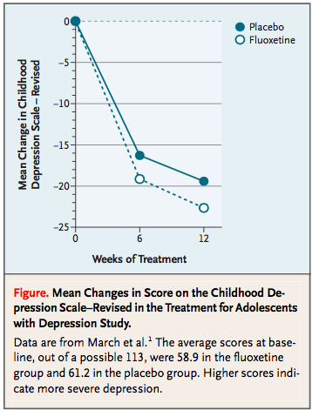
Within vs Between Group Comparisons
Fluoxetine vs. Placebo effect on depression in adolescents
Looking at mean change in depression scale in each group over time (not comparing placebo vs. fluoxetine). Looks like placebo group did pretty well!
Notes:
TN: This shows why a placebo group is needed, but in this study they did compare changes between groups.
Need the citation for this graph on the slide! (I don’t have that many NEJM publications!)

