Slide 1
Segregation

Slide 2
Measures of Residential Segregation
Five dimensions
  Evenness/dissimilarity
  Exposure
  Clustering
  Concentration
  Centralization

Slide 3

Evenness/index of dissimilarity
The degree to which groups (e.g., ethnic groups) are evenly spread across the city
“How many people would have to move in order to make each census tract have the same distribution as the city as a whole?”
Suppose:
b_{i} = the black population of the i^{th} areal unit, e.g. census tract
B = the total black population of the large geographic entity
w_{i} = the white population of the i^{th} area unit, e. g. census tract
W = the total white population of the large geographic entity
The index of dissimilarity measuring the segregation of whites from blacks:

Slide 4
Evenness

Slide 5
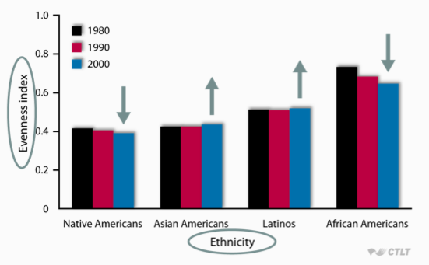
Evenness in US cities over time

Slide 6

Isolation/Exposure
Inverse of the probability that a person of one ethnic group shares a census tract with a person of a particular other ethnic group
Assume:
w_{i} = the white population of a component part (like a census tracts) of the larger geographic entity
t_{i}= the total population of a component part of the larger geographic entity
W_{i} = the total white population of the larger geographic entity
Then the isolation index for whites equals:
You are summing all the components of the area

Slide 7
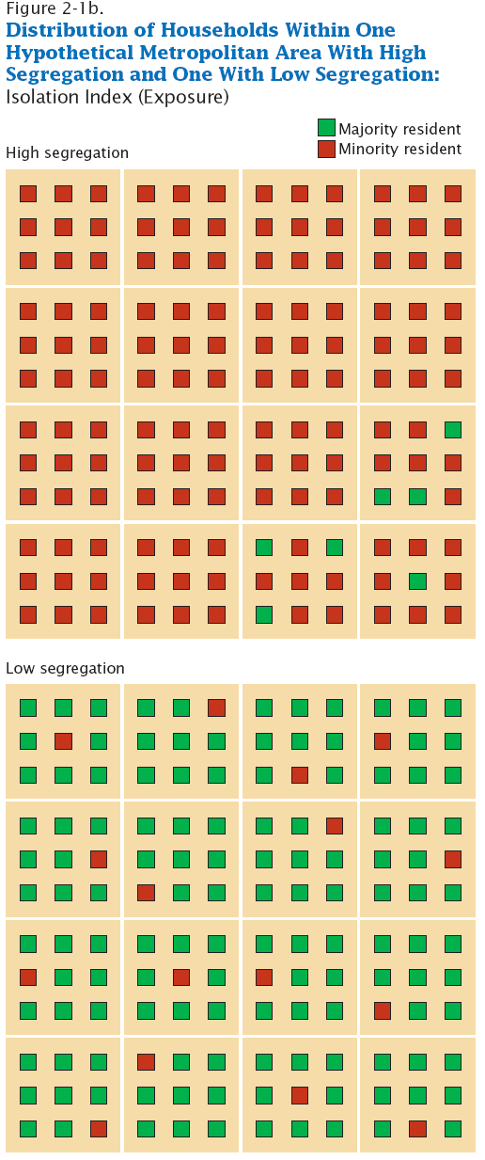
Isolation/Exposure

Slide 8
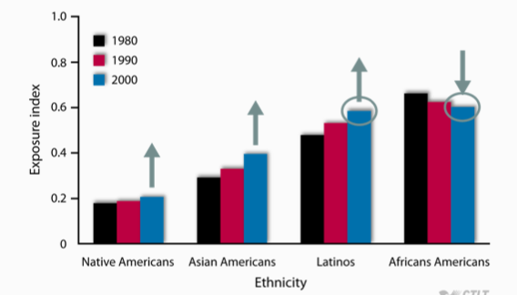
Exposure, compared to European Americans

Slide 9

Delta Index/Concentration
The proportion of geographic space occupied by census tracts with a large percentage of a particular ethnic group

Slide 10
Delta Index/Concentration

Slide 11
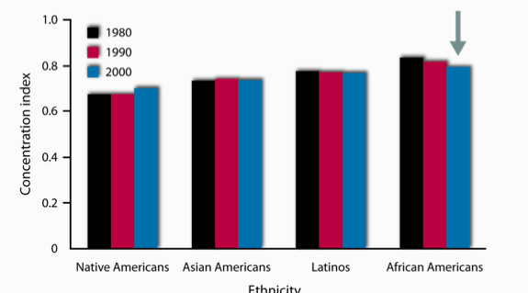
Concentration, compared to European Americans

Slide 12

Absolute Centralization Index
Closeness of the census tracts with a large percentage of a particular ethnic group to the central business district of the city
Ai= the land area of area i
Xi= the minority population

Slide 13
Absolute Centralization Index

Slide 14
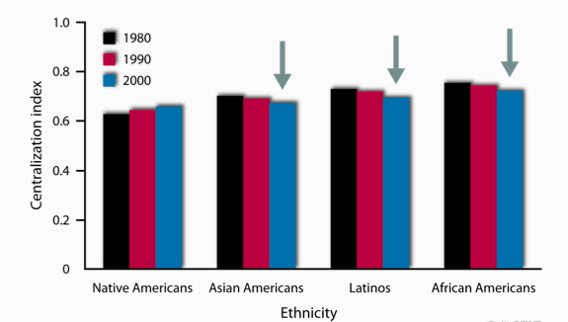
Centralization, European Americans comparison

Slide 15
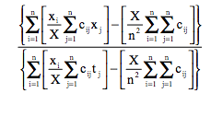
Spatial Proximity Index/clustering
The degree to which census tracts with a large percentage of a particular ethnic group are contiguous

Slide 16
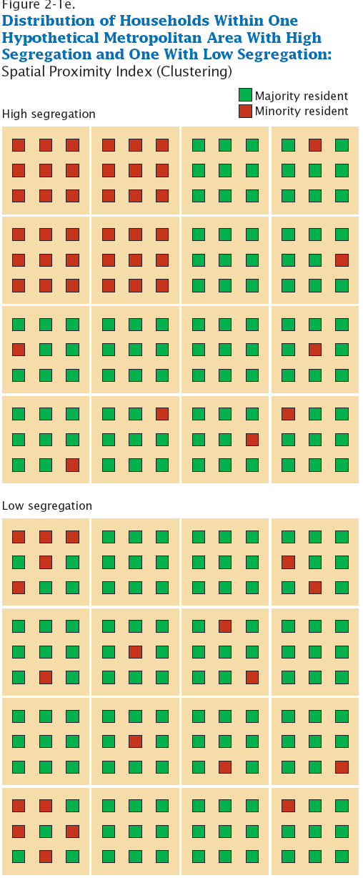
Spatial Proximity Index/clustering

Slide 17
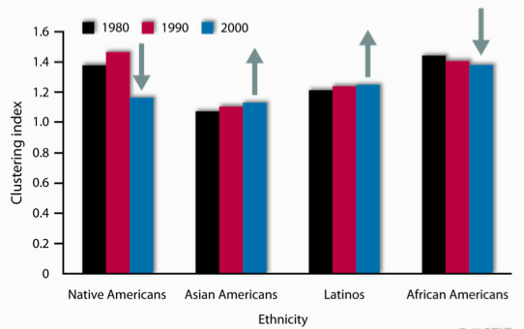
Clustering, compared to European Americans

Slide 18
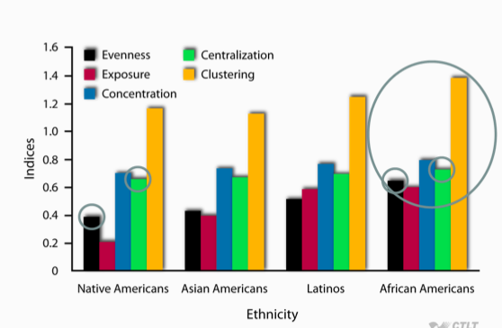
Today

Slide 19
Can measure Social Class or Income
Relatively little research on this, compared to ethnicity
  What studies there are show that social class segregation has increased a little over the last part of the 20th century
  In particular, has increased among ethnic minorities
Spatial concentration of poverty
  Combination of unrelenting ethnic segregation and slightly increasing social class segregation

Slide 20
Residential Segregation in public health research
Most models only use evenness

Slide 21
Thank you!
Questions?
Notes:
Final boiler plate language: 2 versions
Through its singular focus on health, UCSF is leading revolutions in health.
UCSF is driven by the idea that great breakthroughs are achieved when the best research, the best education and the best patient care converge.

Slide 22
References
Astone, Nan. 2009. “Urban Demography.” Retrieved (http://ocw.jhsph.edu/courses/PrinciplesPopulationChange/PDFs/PopChange-sec8_Astone.pdf).
Haub, Carl. 2009. “What Is a City? What Is Urbanization?” Population Reference Bureau. Retrieved (http://www.prb.org/Publications/Articles/2009/urbanization.aspx).
Fink, Günther, Isabel Günther, and Kenneth Hill. 2014. “Slum Residence and Child Health in Developing Countries.” Demography 51(4):1175–97.
Massey, Douglas S. and Nancy A. Denton. 1988. “The Dimensions of Residential Segregation.” Social Forces 67(2):281.
Matthews, Zoë et al. 2010. “Examining the ‘Urban Advantage’ in Maternal Health Care in Developing Countries.” PLoS Medicine 7(9):e1000327.
Montgomery, Mark R. 2009. Urban Poverty and Health in Developing Countries. Population Reference Bureau Washington, DC. Retrieved August 28, 2015 (http://www.prb.org/pdf09/64.2urbanization.pdf).
Montgomery, Mark R. and Alex C. Ezeh. 2005. “Urban Health in Developing Countries.” Pp. 317–60 in Handbook of Urban Health, edited by S. Galea and D. Vlahov. Springer US. Retrieved August 28, 2015 (http://link.springer.com.ucsf.idm.oclc.org/chapter/10.1007/0-387-25822-1_17).
Nolan, Laura B. 2015. “Slum Definitions in Urban India: Implications for the Measurement of Health Inequalities.” Population and Development Review 41(1):59–84.
United Nations Department of Economic and Social Affairs, Population Division. 2014. World Urbanization Prospects: The 2014 Revision : Highlights. United Nations. Retrieved (http://esa.un.org/unpd/wup/Highlights/WUP2014-Highlights.pdf).
Weeks, John R. 2008. Population: An Introduction to Concepts and Issues. 10th ed. Belmont, CA: Thompson-Wadsworth.

