Slide 1
Aging and Dependency Ratios
Nadia Diamond-Smith, PhD, MSc
Canice E. Christian, MSc

Slide 2
Aging:
Demographic study of older populations
  Their size and composition
  Their mortality and morbidity
  The causes of demographic change among older populations
  The consequences of demographic change among older populations

Slide 3
Global Average Annual Growth Rates

Slide 4
But, There is Great Variation by Age

Slide 5
Population aging
Older persons are continually making up a larger proportion of the population
This is occurring in every world region and in nearly every country

Slide 6
Percent of population over 60 years old
Year
Notes:
% of pop over 60

Slide 7
Possible implications of global population aging for public health
RETOOLING HEALTH CARE SYSTEMS
In most of the world, health care systems have been designed around a particular set of needs, e.g.:
child and maternal health
infectious and communicable disease
An aging world requires a change in health care philosophy toward
degenerative disease
long-term care
Expenditure studies show costs of health care in old age to be significantly greater than costs at any other age.

Slide 8
Implications for public health
- Goal of medical science to reduce the gap between life span and longevity.
- Increasing one may not mean increasing the other.
- Rectangularization of mortality: Life span remains
the same but variation in age at death declines.

Slide 9
Rectangularization of mortality
0
55
110

Slide 10
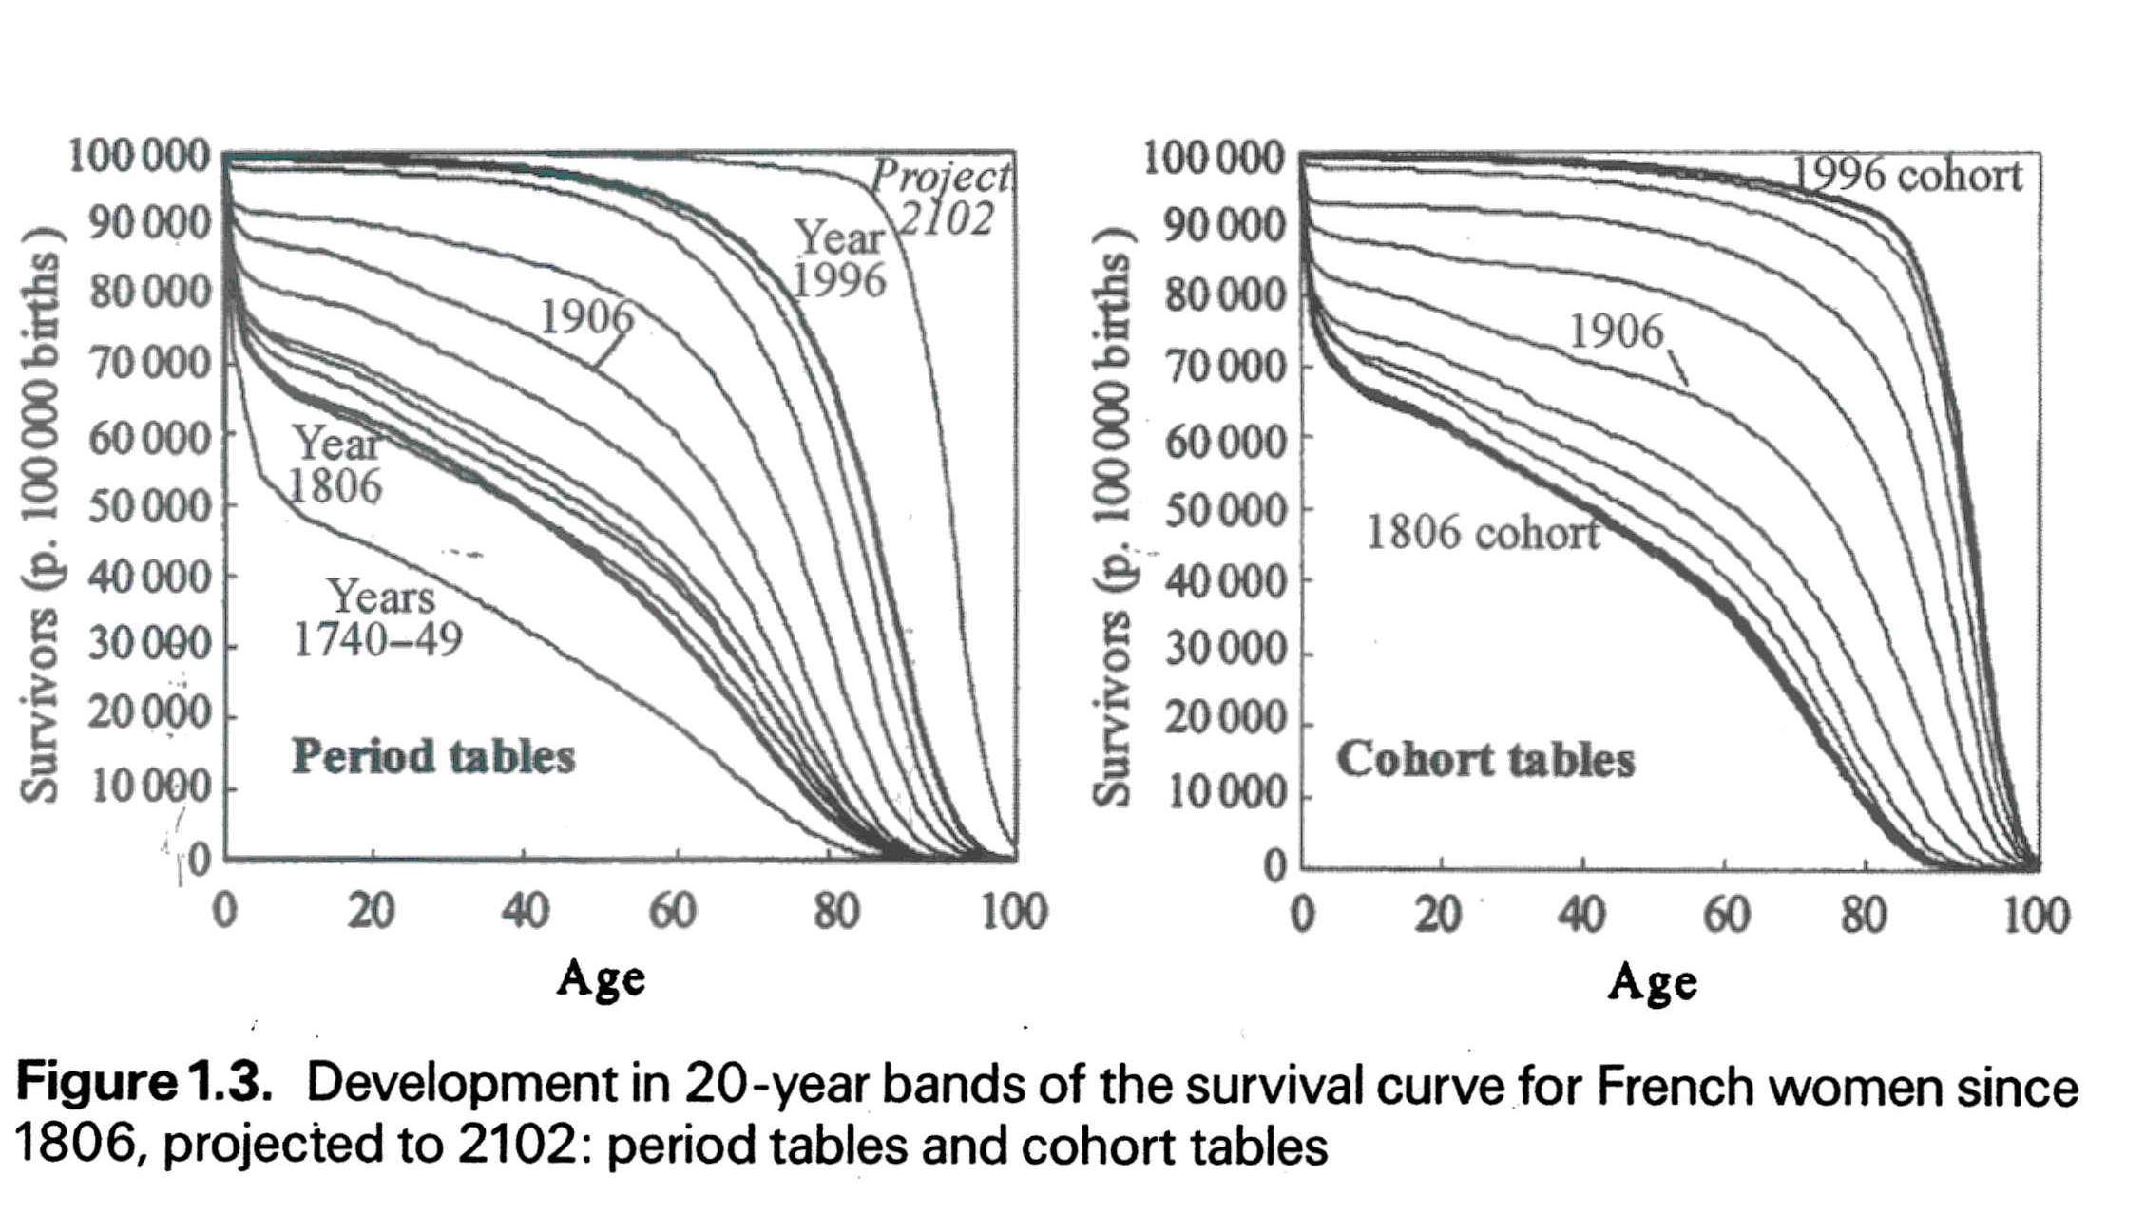
Rectangularization is evident in places where data is available
Page 21 fig 1.3

Slide 11
QUANTITY VERSUS QUALITY OF LIFE
Are the extra years of life healthy years, or are we extending our years lived in poor health?
.
Optimistic view: There has been a compression of morbidity into the final years of life.
Pessimistic view: Modern medicine extends life but it does so by saving people from dying without giving them years of healthy life.

Slide 12
Standardized survival, disability, and morbidity curves
Proportion surviving
Surviving healthy
Surviving
unhealthy

Slide 13
Standardized survival, disability, and morbidity curves
Proportion surviving

Slide 14
Expansion of morbidity – longer life worsening health
Proportion surviving
Surviving healthy
Surviving
unhealthy

Slide 15
Compression of morbidity – longer life better health
Proportion surviving
Surviving healthy
Surviving
unhealthy

Slide 16
Dynamic equilibrium – healthy years to increase proportionately to total years
Proportion surviving
Surviving
unhealthy
Surviving healthy

Slide 17
Dependency Ratio
Ratio describing the number of people of working age compared to older and/or younger people of non-working age in a population
Way to describe the burden of aging populations and/or growing populations on the working age population
  Burden in care giving, financial support, government resources
Can also calculate the youth and elderly dependency ratios on their own

Slide 18
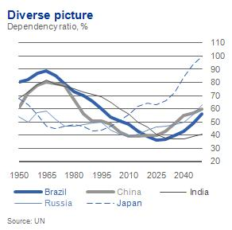
Dependency Ratios by Country

Slide 19
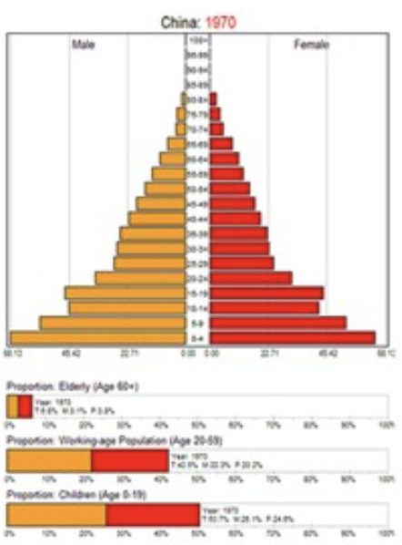
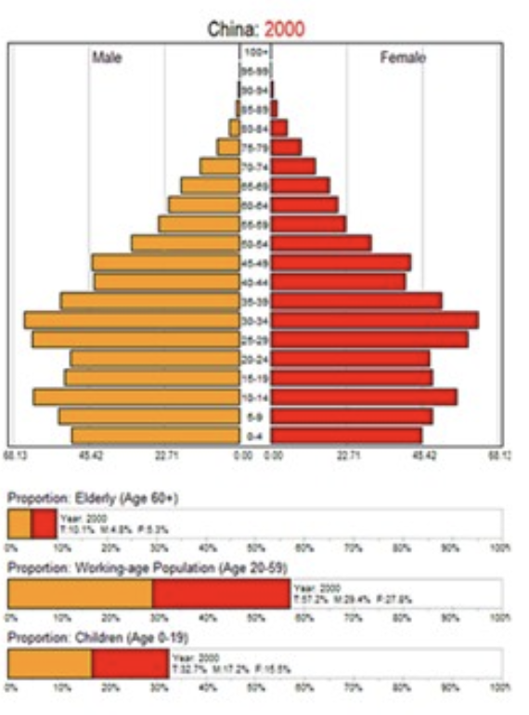
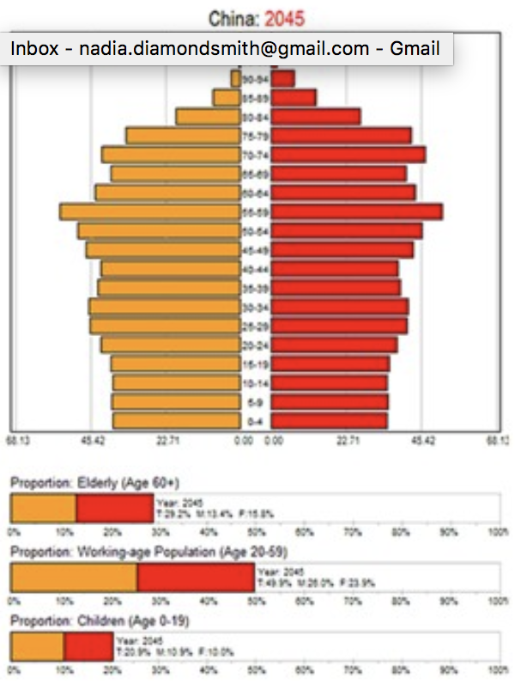
Example: China

Slide 20
Demographic Dividend
A transitional period that countries go through while fertility is falling and mortality is falling
Idea that falling fertility will lead to a small youth population, while there is still a relatively small old age population
So the working aged population will grow more than the elderly or young population for a few years
Should lead to a time of increasing productivity because labor force population is growing more than the dependent population
A short period in time, lasts maybe 5 decades
  Then population aging begins
Much interest in capitalizing on the demographic dividend in SSA especially where fertility is just beginning to fall

Slide 21
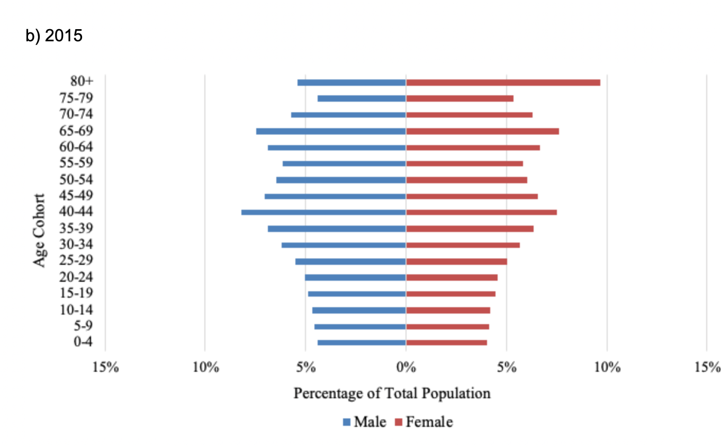
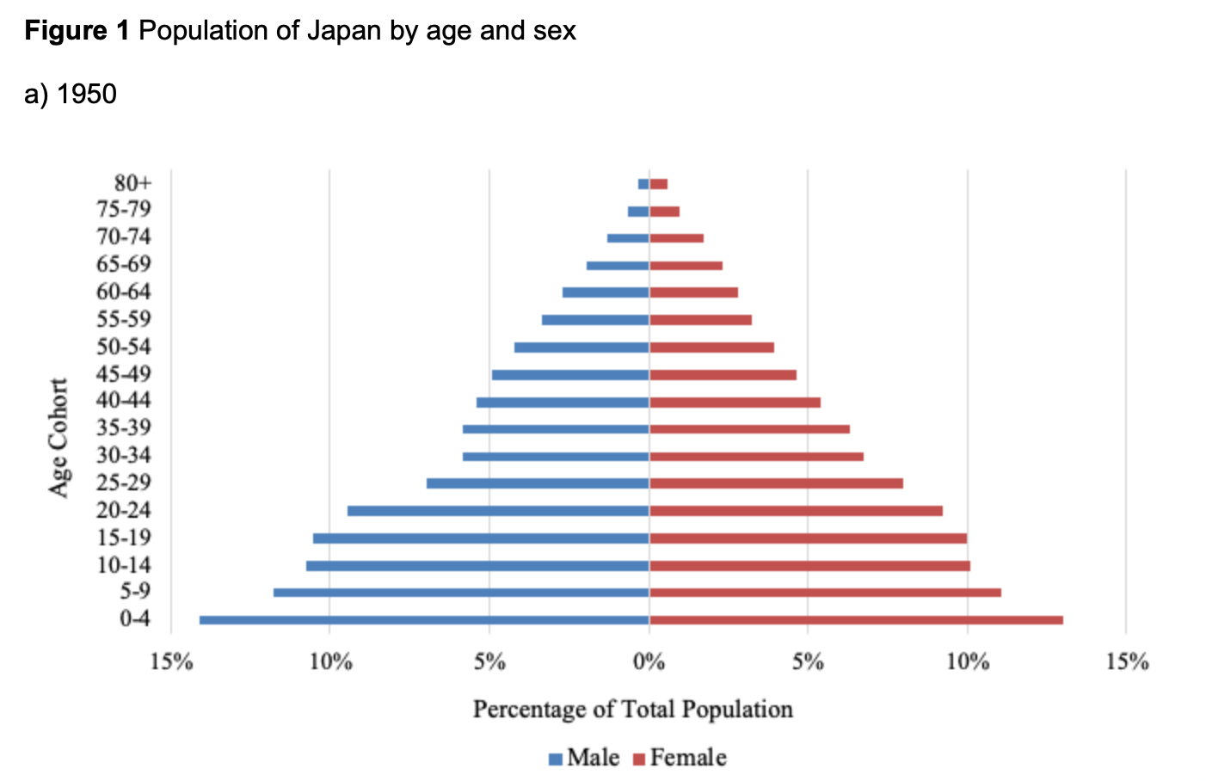
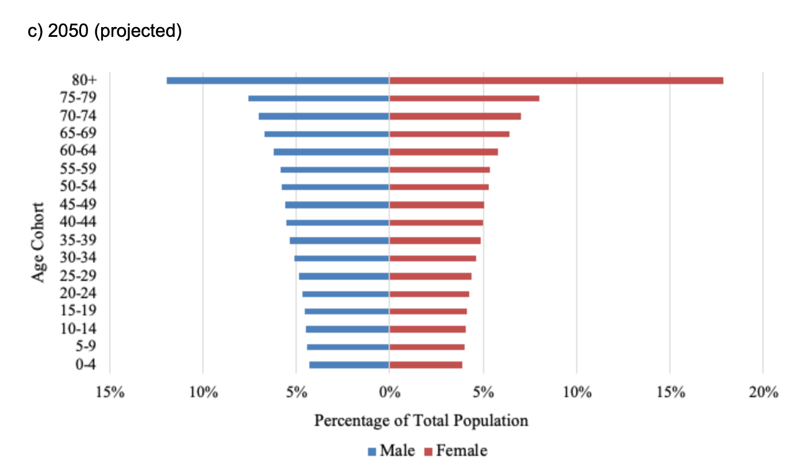
Population Pyramids: Japan
Notes:
https://voxeu.org/article/japan-s-age-wave-challenges-and-solutions
Japan’s age wave: Challenges and solutions by David Bloom, Paige Kirby, JP Sevilla, Andrew Stawasz 03 December 2018

Slide 22
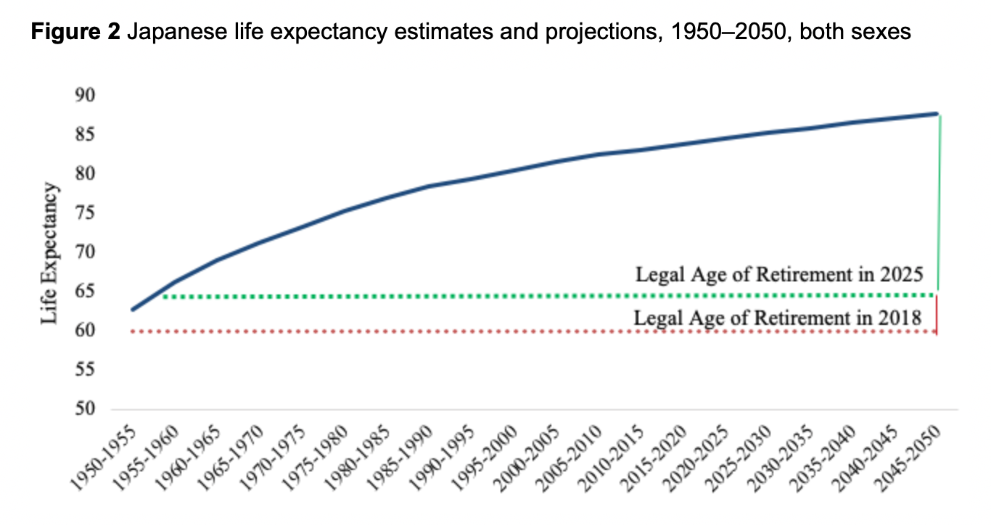
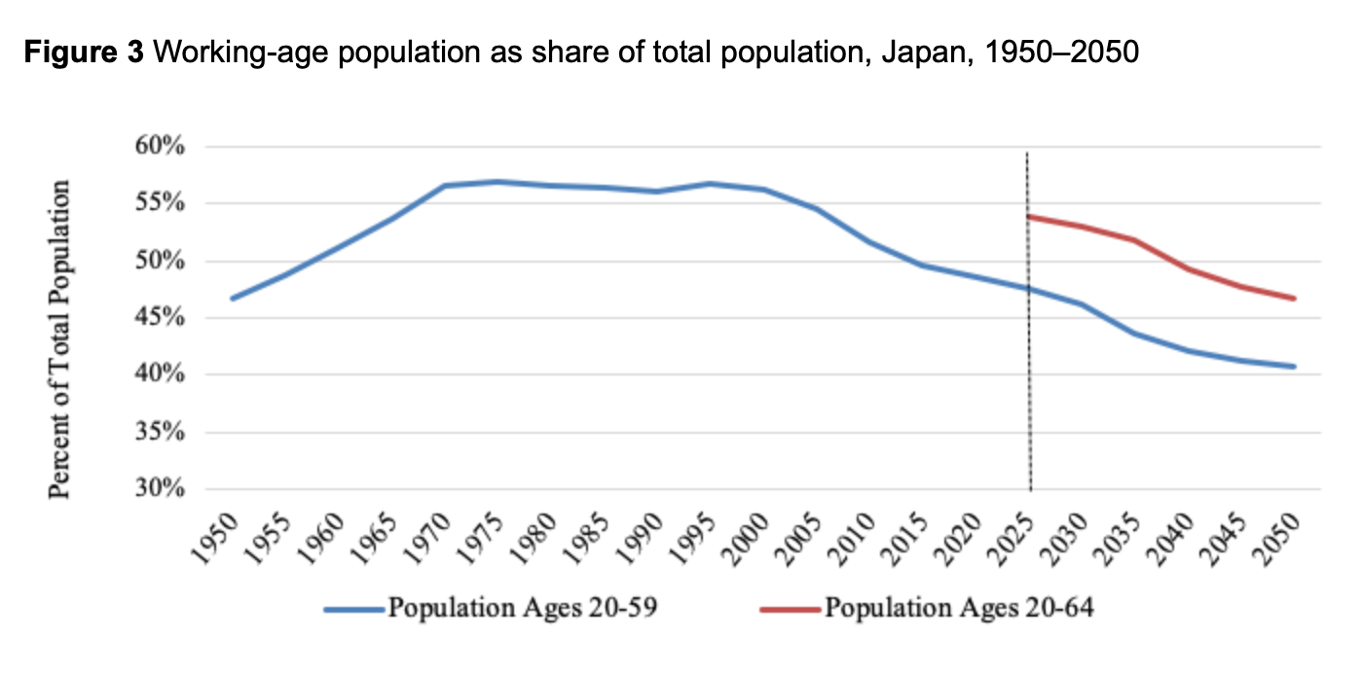
Shifting retirement age

Slide 23
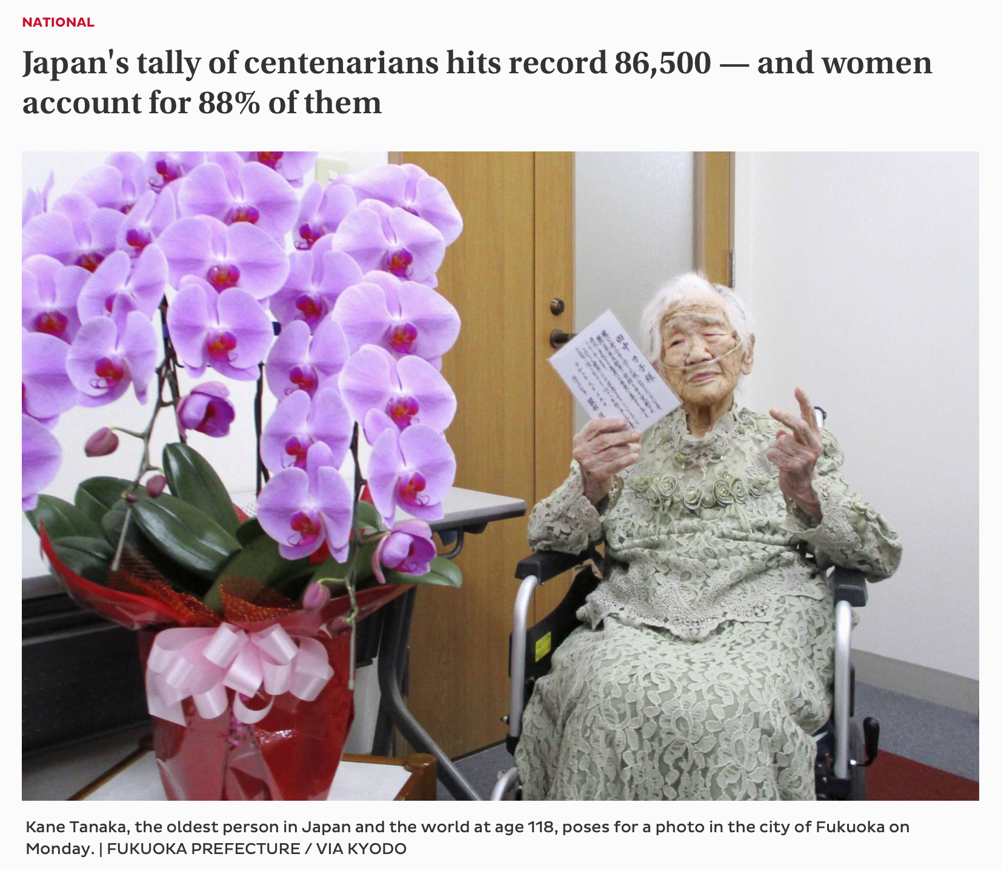
Notes:
https://www.japantimes.co.jp/news/2021/09/14/national/japan-centenarian-record/
September 14th 2021

Slide 24

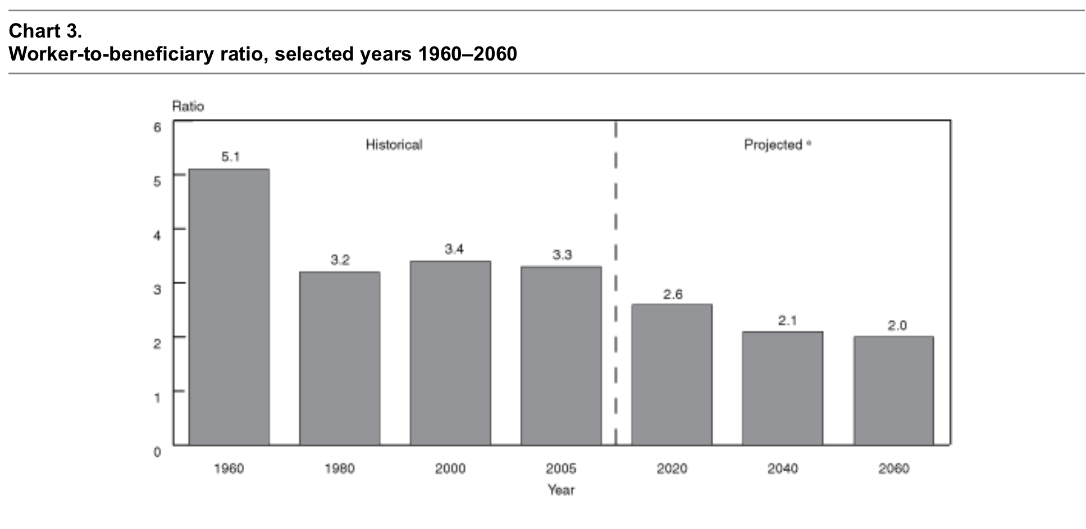
Social Security in the United States

Slide 25
Relationship between Population Age Structure and COVID-19 Cases and Attributable Deaths in Italy
Canice Christian
Final Presentation
December 2nd, 2020

Slide 26
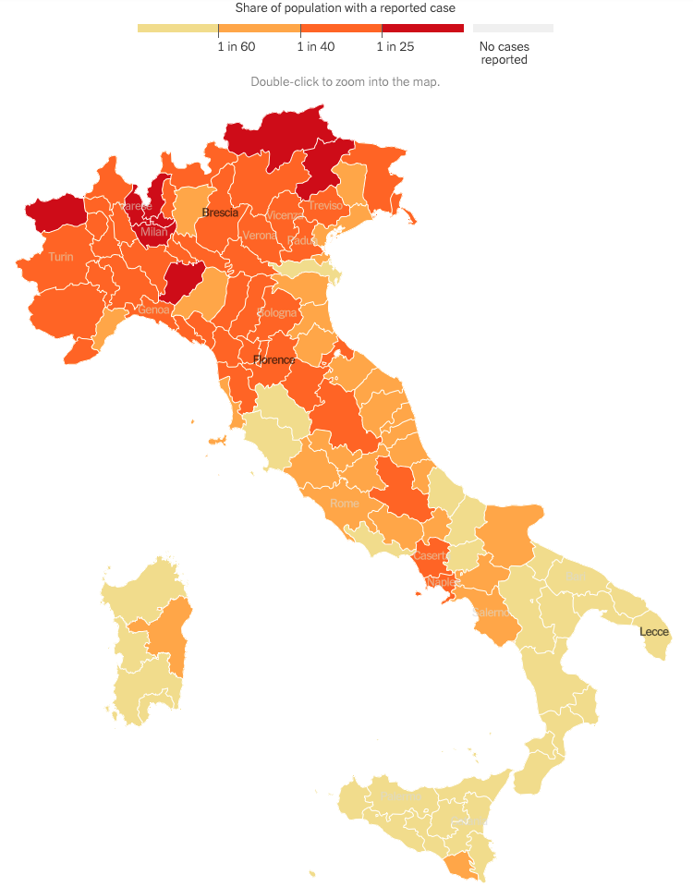
Research Aims & Methods
Certain areas of Italy have been dramatically impacted by COVID-19 while other regions have not (Figure 1). The goal of this analysis is to determine the relationship between the age structure of the population of Italian regions and provinces and the outcome of COVID cases and mortality.
Analysis 1: Determine the relationship between elderly-dependency ratios and number of confirmed COVID-19 cases at the province level of Italy (n=107)
Methods: (1) OLS Regression with COVID-19 cases as outcome and the primary predictor of elderly dependency ratio ( (# over >65)/(#15-64))*100), controlling for predictors of % Urban of population, population, and mean income. (2) Correlation matrix with same indicators as OLS regression
Analysis 2: Determine the relationship between elderly-dependency ratios and number of deaths attributable to COVID-19 at the regional level of Italy (n=20)
Methods: (1) Correlation matrix with elderly-dependency ratio and deaths due to COVID-19
NYTimes, 2020

Slide 27
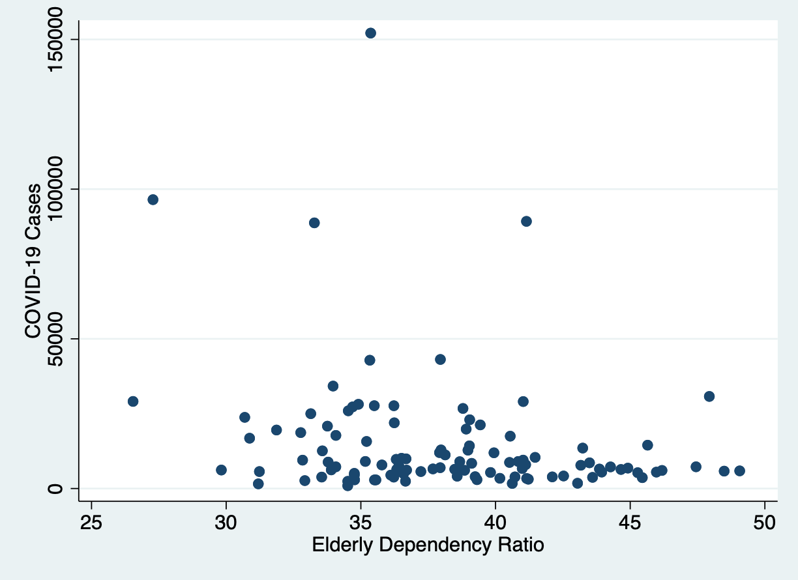
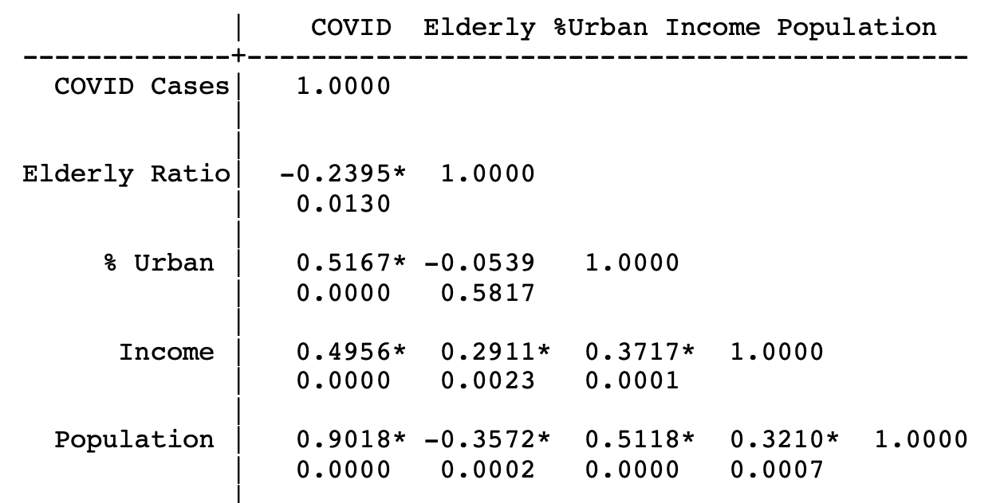
Preliminary Results:
COVID Cases and Age-Dependency
OLS Regression Results: Coefficients on the elderly-dependency ratio & % urban of province were not significant.
⇨Every 100 Euro increase in mean income in a province was associated with 173.2 more COVID-19 Cases, on average in the population, after controlling for % urban, elderly-dependency ratio and total population (p<0.001).
⇨Every 1000 person increase in population in a province was associated with a 27.7 more COVID-19 cases, after controlling for % urban, elderly-dependency ratio and income (p<0.001)
Milan

Slide 28
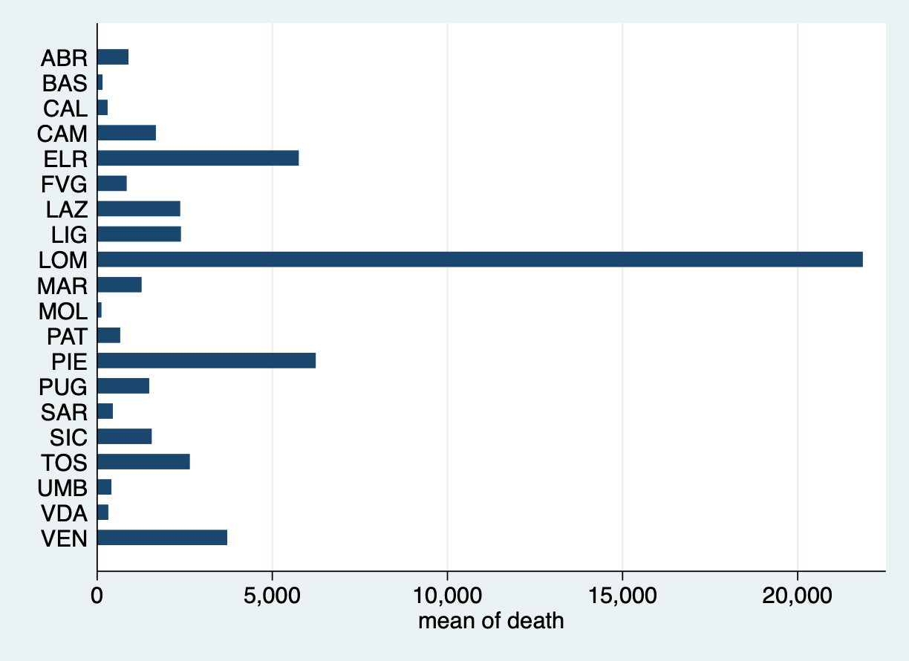
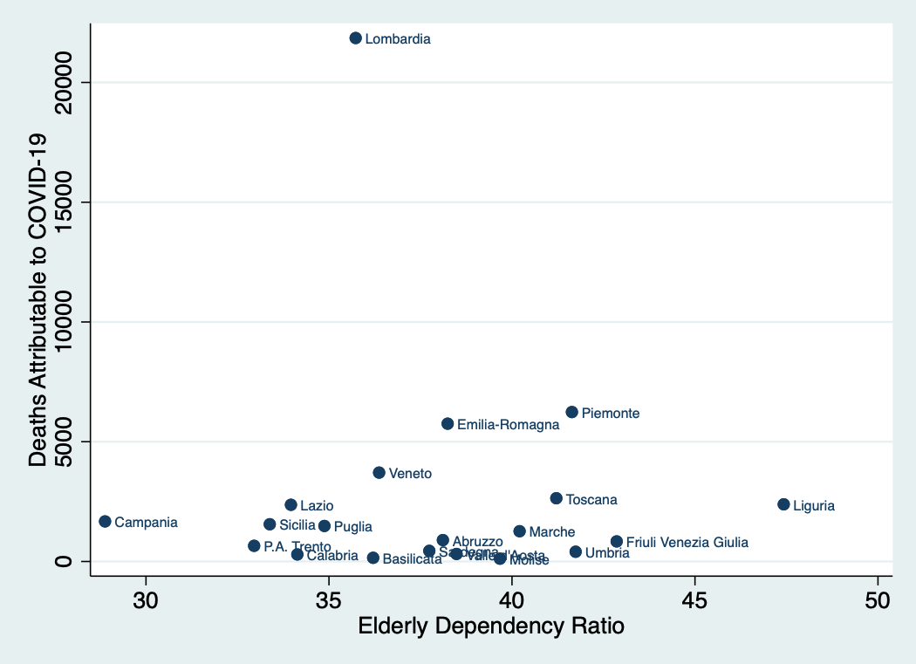
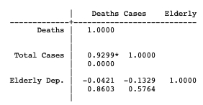
Preliminary Results:
COVID-19 Mortality and Age-Dependency
Deaths Attributed to COVID-19

Slide 29
Discussion
Key Result: The data suggest that elderly-dependency ratios and the percent urban was not the driving factors for the number of COVID-19 cases in Italian provinces. At the regional level, mortality attributed to COVID-19 was not correlated with elderly-dependency ratios. Mean income and population size were related to the number of COVID-19 cases.
Conducting the OLS Regression using population density yielded a significant result on the coefficient, indicating higher population density is related to greater number of COVID-19 cases
Early research showed that COVID-19 cases were occuring in the Lombardy Region where there is extensive business travel which may explain higher income provinces being related to the number of COVID-19 cases.[1]
Limitations:
⇨Due to data constraints, I could not conduct an analysis on COVID-19 attributable mortality at the province level so variations in mortality and how that relates to age structure may not have been able to be picked up by the analysis at the regional level.
⇨ Possible unmeasured confounding and small sample size (n=107 provinces) may have limited the ability for a more in depth analysis:
[1] Lorenzo, 2020

Slide 30
Thank you!
Questions?

