Slide 1
Alternatives to Randomized Trials for Estimating Treatment Effects and Understanding P-values and Confidence Intervals
Tom Newman, MD, MPH
2019 Slides with 2021 Updates
Lec 8 Alternatives to RCTs & P-values 2021

Slide 2
Outline
Announcements
Alternatives to RCT’s (Chapter 9)
  Confounding by indication
  Natural experiments and IV’s
  Falsification tests for bias or confounding
  Immortal time bias
P-values and Confidence intervals (Chapter 11)
  Meaning of P-values; analogy with diagnostic tests
  Confidence intervals
  (Bayesian statistics example?)

Slide 3
Announcements (2021)
Exam question was due this AM at 8:30
Section leaders review them and send favorites to Michael and me
Selection for exam depends partly on how many others wrote questions on that material.
Tues 11/23: No class!
No section on 11/25 (Thanksgiving) or 12/2
Tuesday 11/30: Course review
Tuesday 12/1/20, 6:00 PM: Take-home final will be posted
MONDAY 12/6, 11:59 PM: Exam due
Final to be discussed in following Large Group (12/7)

Slide 4
Background
Why do randomized blinded trials?
  Randomize: to assemble comparable groups (avoid confounding)
  Blinding to avoid placebo effect, cointerventions, and bias in measuring outcome variable
Observational studies of treatments
  May be able to assemble comparable groups or use statistical adjustment
  Won’t be blinded (good and bad aspects to this)

Slide 5
Why is it hard to assemble comparable groups without randomizing?
People who get treated tend to differ from those who don’t
Important differences are with respect to risk of the outcome
  Treated people often at higher risk (confounding by indication for treatment); “suppression” of benefit
  Treated people may be at lower risk (selection bias, healthy complier effect)

Slide 6
When is causal inference from observational studies easy?
Treatment
  rapidly acting
  well-understood biologically
Outcomes
  Not related to indications for treatment
  Rarely if ever occur spontaneously
  Strongly associated with treatment
Examples
  Glasses for refractive errors
  Mushroom poisoning and liver failure
  Landmines and limb injuries

Slide 7
When it’s hard:
Treatments are slowly acting, mechanisms are not well understood, outcomes are related to indications for treatment, are common (among untreated), delayed, and/or weakly associated with treatment.
Examples
  Do anticonvulsants cause learning disabilities in children?
  Do antidepressants increase the risk of suicide?
  Do proton pump inhibitors like omeprazole (Prilosec®) increase the risk of esophageal cancer?
  Does epidural labor anesthesia increase the risk of Cesarean delivery?

Slide 8
Natural Experiments and Instrumental Variables
Natural experiments: Find a times or places when/where receipt of treatment was quasi-randomized
  E.g., interrupted time series analyses where something changed (e.g. new intervention became available or bilirubin instrument recalibrated)
  Regression discontinuity designs, where receipt of the intervention depends on a sharp cutoff of an underlying continuous variable (not in EBD-2)
Instrumental variables (IV): measurable factors that influence probability of treatment (or exposure to the factor of interest) that are not otherwise associated with outcome
Difference between these: exposure itself quasi-randomized vs. something that affects likelihood of exposure
Notes:
An interrupted time series design is a specific type of regression discontinuity design.

Slide 9
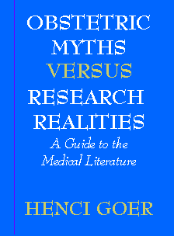
Natural experiment example-1
Epidural anesthesia is associated with higher C-section rates
Could be due to confounding by difficult or prolonged labor
Natural experiment: US Department of Defense began offering labor epidurals in 1993
Myth: "Epidurals are safe for mother and baby."
Fact: An epidural increases the odds of cesarean for lack of progress somewhere between 2- and 8-fold…

Slide 10
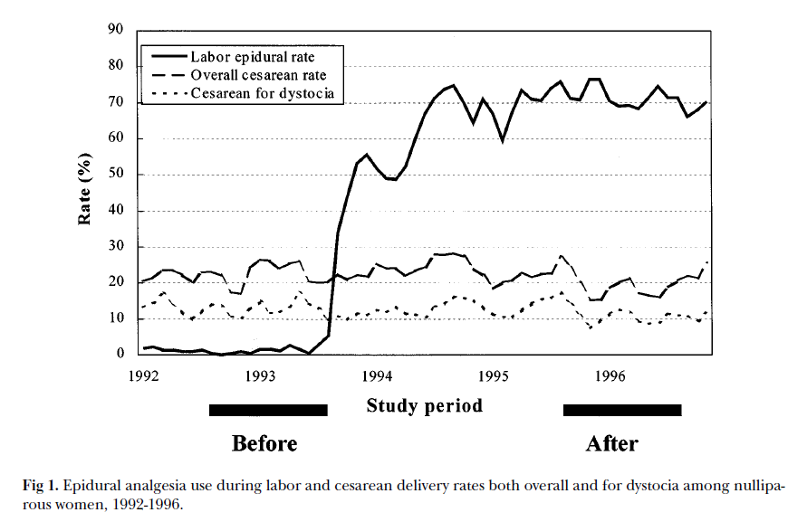
Natural Experiment -2 : Epidural anesthesia and Caesarian delivery*
*Zhang et al, 2001. Thanks to Susan M. Lee (MAS 2014)
Notes:
Zhang J, Yancey MK, Klebanoff MA, Schwarz J, Schweitzer D. Does epidural analgesia prolong labor and increase risk of cesarean delivery? A natural experiment. Am J Obstet Gynecol 2001;185(1):7-7.

Slide 11
Natural experiment example-3*
The figure is convincing, but the natural experiment is of policy change, not epidurals
An Instrumental Variable analysis allows us to estimate the causal effect of epidurals as a result of the policy change
The IV takes into account
  The estimate (and its precision) of how much the policy change affected use of epidural anesthesia
  The estimate (and its precision) of how much the policy change affected the risk of Cesarean deliveries
* Zhang et al, . Am J Obstet Gynecol 2001;185(1):7-7.
Notes:
Zhang J, Yancey MK, Klebanoff MA, Schwarz J, Schweitzer D. Does epidural analgesia prolong labor and increase risk of cesarean delivery? A natural experiment. Am J Obstet Gynecol 2001;185(1):7-7.

Slide 12
First IV in a medical journal? Delayed Effects of the Military Draft on Mortality*
Origin of study: Agent Orange concern
Predictor variable of interest: military service
Instrument: draft eligibility, based on the draft lottery
Data source: computerized death certificate registries, CA and PA
Outcome: mortality after time at risk of military service
*Hearst N, Newman TB, Hulley SB. NEJM 1986; 314:620-24
Notes:
Feel free to skip this section if you have heard it before.

Slide 13
Instrumental variable analysis
May require large sample sizes, especially if instrument is weak
  In this case draft eligibility rather than military service
Effect of actual exposure attenuated; biased towards null
Achieve statistical significance with large sample size
Use instrumental variable analysis to reverse bias towards null (with various assumptions)

Slide 14
Instrumental variable assumptions
Instrument is associated with exposure (the stronger the association, the better)
The instrument is NOT associated with the outcome except through the exposure (conditional on other known covariates)
  Does not (independently) cause the outcome
  Instrument-outcome relation not confounded

Slide 15
Why not compare outcomes according to the predictor variable of interest?
Like an “as treated” analysis in a randomized trial
Biased comparison – those who serve in the military start out healthier
“Healthy warrior effect”
  Similar to “healthy worker effect” and “healthy vaccinee effect”

Slide 16
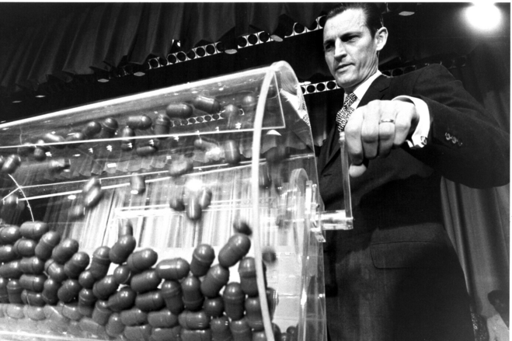
Delayed Effects of the Military Draft on Mortality
The instrumental variable: draft lottery number below cutoff (based on date of birth)
Instrumental variable associated with predictor variable of interest, not expected to be independently associated with outcome
Notes:
Photo from: http://www.wsj.com/articles/SB122047565663596423
Curtis W. Tarr spins the lottery drum during his term as Selective Service director, between 1970 and 1972.

Slide 17
BUT: Having an eligible number was a weak predictor of military service:

Slide 18
Draft Lottery Study: Results
Called “Junk Science” by then Secretary of the Navy (later Senator) Jim Webb
Hearst N, Newman TB, Hulley SB. NEJM 1986; 314:620-24

Slide 19
RCT as an Instrumental Variable: Health effects of exclusive breast feeding
Can’t do an RCT of exclusive breast-feeding
Can do an RCT of breast-feeding PROMOTION
Random assignment to BF promotion group should be associated with exclusive breast feeding, but not independently associated with outcome
Need very large sample size
Algebraic correction

Slide 20
Promotion of Breastfeeding Intervention Trial (PROBIT)
Cluster-randomized trial at 31 sites in Belarus
Subjects 17,046 term singleton infants with birth weight > 2500 g, initially breastfed
Intervention: so-called WHO/UNICEF “Baby Friendly Hospital” (BFH) Initiative
Outcomes:
  Breastfeeding at 3, 6, 9,12 months
  Allergic, gastrointestinal and respiratory disease
F/U to 12 months on 16,491 (96.7%)
Kramer MS, et al. JAMA 2001;285:413-20.
Notes:
A maternity facility can be designated 'baby-friendly' when it does not accept free or low-cost breastmilk substitutes, feeding bottles or teats, and has implemented 10 specific steps to support successful breastfeeding:
Have a written breastfeeding policy that is routinely communicated to all health care staff.
Train all health care staff in skills necessary to implement this policy.
Inform all pregnant women about the benefits and management of breastfeeding.
Help mothers initiate breastfeeding within one half-hour of birth.
Show mothers how to breastfeed and maintain lactation, even if they should be separated from their infants.
Give newborn infants no food or drink other than breastmilk, unless medically indicated.
Practice rooming in - that is, allow mothers and infants to remain together 24 hours a day.
Encourage breastfeeding on demand.
Give no artificial teats or pacifiers (also called dummies or soothers) to breastfeeding infants.
Foster the establishment of breastfeeding support groups and refer mothers to them on discharge from the hospital or clinic.

Slide 21
PROBIT, RQ #1
Does a “Baby Friendly Hospital” increase exclusive breastfeeding?
  Predictor = Group assignment (BFH yes/no)
  Outcome = Exclusive breast feeding
  Intention-to-treat (ITT) analysis is fine
Results: Exclusive BF at 3 months (rounded) 40% vs 5%; P < 0.001

Slide 22
Probit RQ #2
Does exclusive breastfeeding reduce the risk of eczema in the infant?
If the only effect of BFH related to eczema is increasing exclusive BF, then we can look at effect of BFH on eczema:
  Predictor = BFH
  Outcome = Eczema
  Intention to treat (ITT) analysis: biased towards null; informative mainly if study positive
Eczema risk, BFH vs control (ITT):
3.3% vs 6.3%; adjusted OR = 0.54, 95% CI: (0.31, 0.95), accounting for clustering; P = 0.03

Slide 23
PROBIT, RQ #3
How much does exclusive breastfeeding reduce the risk of eczema in the infant? (What is the NNEBF*? )
ITT won’t work -- too much misclassification. (ITT gives the number needed to be exposed to the BFH intervention, not the NNEBF.)
Solution: IV analysis of RCT
*Number Needed to Exclusively Breast Feed

Slide 24
Complier Average Causal Effect (CACE)
If all of the BFH difference in eczema is due to the difference in exclusive breast feeding, it can be shown* that the absolute risk reduction for exclusive BF would need to be:
Eczema risk reduction = 6.3% – 3.3% = 8.6%
BF risk difference 40% – 5%
In other words, the ITT risk difference is divided by the difference in proportions that actually received the treatment of interest.
* See speaker notes for this slide and optional slides 98-107 later in this presentation. The CACE is also called the Local Average Treatment Effect or the Wald estimator.
Notes:
This is the simple derivation, assuming “treatment homogeneity”
We assume that the observed rate of eczema is a weighted average of the rates in those who do (A) and do not (B) exclusively breast feed.
Then if p1 and p2 are proportions exclusively breastfed in the intervention and control groups, the observed rates of eczema in the two groups, R_{i} and R_{c} would be:
R_{I} = p₁A + (1-p₁)B
R_{C}= p₂A + (1-p₂)B
So we observe Ri and Rc and we want to find A and B, To obtain the risk difference, we first subtract the two equations:
R_{I} = p₁A + (1-p₁)B
R_{C}= p₂A + (1-p₂)B
R_{C} -R_{I} =p₂A -p₁A + B- p₂B-B+p₁B
R_{C} -R_{I} = p₁(B-A) +p₂(A-B)
R_{C} -R_{I} = p₁(B-A) -p₂(B-A)
B-A = (R_{C}- R_{I})/(p₁-p₂)
So absolute risk reduction for the risk of eczema for exclusive BF is:
(6.3%-3.3%)/(40%-5%)= 8.6%.
(Note that if we kept both numerator and denominator as treatment – control we would just have a risk difference rather than a risk reduction and the risk difference A– B would be negative.)
Note a rigorous derivation is more complicated; all we can really measure is the effect of the intervention in those who breastfeed in response to it. Additional slides on the ‘Local Average Treatment Effect” from Biostat 215 are pasted later in this presentation.

Slide 25
Number Needed to Exclusively Breastfeed (NNEBF) and caveats
Since ARR = 8.6%, the NNEBF to prevent 1 case of eczema is about 1/.086 = 12
Caveats:
  Results are for the effect of breastfeeding in response to the intervention
  Assumes that the only effect of the Baby Friendly Hospital is via difference in exclusive breastfeeding
Similarly, effects of draft lottery only apply to those who served as a result of the lottery.
These are sometimes called marginal effects.

Slide 26
Summary/other examples
If variables known NOT to be (independently) associated with outcome are associated with treatment of interest, consider this approach.
Generalizes to many “natural experiments.”
  E.g., an intervention is intermittently available, or only available to certain groups

Slide 27
More natural experiments:
Does childhood schooling affect old age memory or mental status? Using state schooling laws as natural experiments*
The income and health effects of tribal casino gaming on American Indians.**
Mortality and Treatment Patterns Among Patients Hospitalized With Acute Cardiovascular Conditions During Dates of National Cardiology Meetings***
* Glymour MM et al. J Epidemiol Community Health. 2008 Jun;62(6):532-7
** Wolfe B et al. Demography. 2012 May;49(2):499-524
*** Jena AB, et al. JAMA Intern Med. 2015;175(2):237-244
Notes:
Wolfe et al: Additional income appears to lead to decreases in smoking, heavy drinking, obesity, hypertension, diabetes, and days of anxiety.
The legalization of American Indian casino gaming in the late 1980s allows examination of the relationship between income and health in a quasi-experimental way. Revenue from gaming accrues to individual tribes and has been used both to supplement tribe members’ income and to finance tribal infrastructure. We assembled annual data from 1988-2003 on tribal gaming, health care access (from the Area Resource File), and individual health and socioeconomic characteristics data (from the Behavioral Risk Factors Surveillance System). We use this information within a structural, difference-in-differences framework to study the effect of casino gaming on tribal members’ income, health status, access to health care, and health-related behaviors. Our difference-in-differences framework relies on before-after comparisons among American Indians whose tribe has at some time operated a casino and with-without comparisons between American Indians whose tribe has and those whose tribe has not initiated gaming. Our results provide identified estimates of the positive effect of gaming on American Indian income and on several indicators of American Indian health, health-related behaviors, and access to health care.

Slide 28
Falsification tests to estimate bias or confounding
Measure the association in a group more or less susceptible to the causal effect and see if difference is in the direction expected
Measure a predictor that would be associated with the outcome due to the same bias as the predictor of interest (and see if it is)
Measure an outcome that would be associated with the predictor due to same bias as the outcome of interest and see if it is
Specify these in advance*
Sometimes called "negative controls."
*Prasad V and Jena A. Prespecified Falsification End Points. Can They Validate True Observational Associations? JAMA 2013;309:241-2

Slide 29
Alternate group examples
Examine the effect of the draft lottery on long term mortality in women*
  No effect, but no effect in men either after age 39
Compare effect of increasing ED co-pay (to $25 or $35!) on ED utilization by presenting condition**
  No effect on ED visits for conditions classified as “always an emergency”
  Progressively greater decline in utilization for conditions classified as "often an emergency”, "sometimes not an emergency", or "often not an emergency”
  (They also compared with groups whose copay was not increased.)
*Conley D and Heerfrom J. Demography (2012) 49:841–855
**Selby J et al. N Engl J Med. 1996 Mar 7;334(10):635-41
Notes:
Question for Selby et al was whether changes in ED utilization following change in co-pay were causal. Causal inference strengthened by the gradient observed.

Slide 30
Alternate outcome: Screening sigmoidoscopy and colon cancer mortality
Possible bias: patients who agree to sigmoidoscopy are likely to be different
Outcome of interest: Cancers within the reach of the sigmoidoscope: apparent protection (OR= 0.41)
Alternate outcome: More proximal cancers: No effect (OR= 0.96).
Selby et al, NEJM 1992;326:653-7

Slide 31
Alternate predictor: Pioglitazone, Rosiglitazone and Bladder Cancer
Nested case-control study using the UK General Practice Research Database
Subjects enrolled at time of new prescription of an antidiabetes drug
Pioglitazone associated with subsequent bladder cancer incidence (OR = 1.83; 95% CI 1.10 to 3.05
No association with Rosiglitazone (OR = 1.14 (95% CI 0.78 to 1.68)
Azoulay et al BMJ 2012;344:e3645

Slide 32
Alternate Predictor: Suicide Risk in Bipolar Disorder During Treatment With Lithium and Divalproex
Retrospective cohort study of Kaiser Permanente and Group Health patients with bipolar disorder
Patients treated with divalproex at 2.1 times suicide risk of those receiving no treatment
Concern: confounding by indication
Results: Suicides per 1000 person/years
  31.3 for treatment with divalproex
  15 for no treatment (P<0.001)
  10.8 for Lithium (P<0.001)
If confounding by indication, expect same bias for Lithium
Goodwin et al. JAMA. 2003;290:1467-1473
Notes:
Am J Psychiatry. 2011 Oct;168(10):1050-6. doi: 10.1176/appi.ajp.2011.11010163. Epub 2011 Jul 18.
Treatment of suicide attempters with bipolar disorder: a randomized clinical trial comparing lithium and valproate in the prevention of suicidal behavior.
Oquendo MA1, Galfalvy HC, Currier D, Grunebaum MF, Sher L, Sullivan GM, Burke AK, Harkavy-Friedman J, Sublette ME, Parsey RV, Mann JJ.
Erratum in
Am J Psychiatry. 2012 Feb;169(2):223.
Abstract: Example of an underpowered study
OBJECTIVE:
Bipolar disorder is associated with high risk for suicidal acts. Observational studies suggest a protective effect of lithium against suicidal behavior. However, testing this effect in randomized clinical trials is logistically and ethically challenging. The authors tested the hypothesis that lithium offers bipolar patients with a history of suicide attempt greater protection against suicidal behavior compared to valproate.
METHOD:
Patients with bipolar disorder and past suicide attempts (N=98) were randomly assigned to treatment with lithium or valproate, plus adjunctive medications as indicated, in a double-blind 2.5-year trial. An intent-to-treat analysis was performed using the log-rank test for survival data. Two models were fitted: time to suicide attempt and time to suicide event (attempt or hospitalization or change in medication in response to suicide plans).
RESULTS:
There were 45 suicide events in 35 participants, including 18 suicide attempts made by 14 participants, six from the lithium group and eight from the valproate group. There were no suicides. Intent-to-treat analysis using the log-rank test showed no differences between treatment groups in time to suicide attempt or to suicide event. Post hoc power calculations revealed that the modest sample size, reflective of challenges in recruitment, only permits detection of a relative risk of 5 or greater.
CONCLUSIONS:
Despite the high frequency of suicide events during the study, this randomized controlled trial detected no difference between lithium and valproate in time to suicide attempt or suicide event in a sample of suicide attempters with bipolar disorder. However, smaller clinically significant differences between the two drugs were not ruled out.

Slide 33
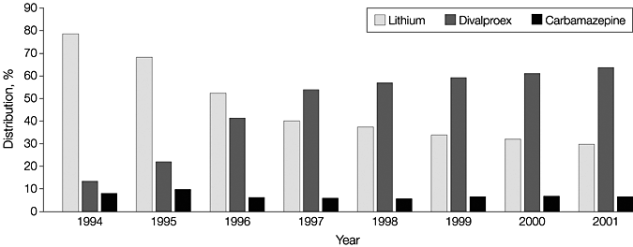
Initial Mood Stabilizer Prescription by Year of Initial Diagnosis
Goodwin et al. JAMA. 2003;290:1467-1473
Notes:
Potential instrumental variables analysis – look at suicide attempts by YEAR, both overall and in treatment groups separately.

Slide 34
Immortal time bias (hard)
Bias due to improper classification of exposed and unexposed time periods at risk
Watch for it any time there is follow-up time prior to exposure
  Red flag: "ever exposed" compared with "never exposed"
  The time period BEFORE exposure in the exposed gets counted as unexposed person-time only if there's an event, leading to falsely high unexposed event rates

Slide 35
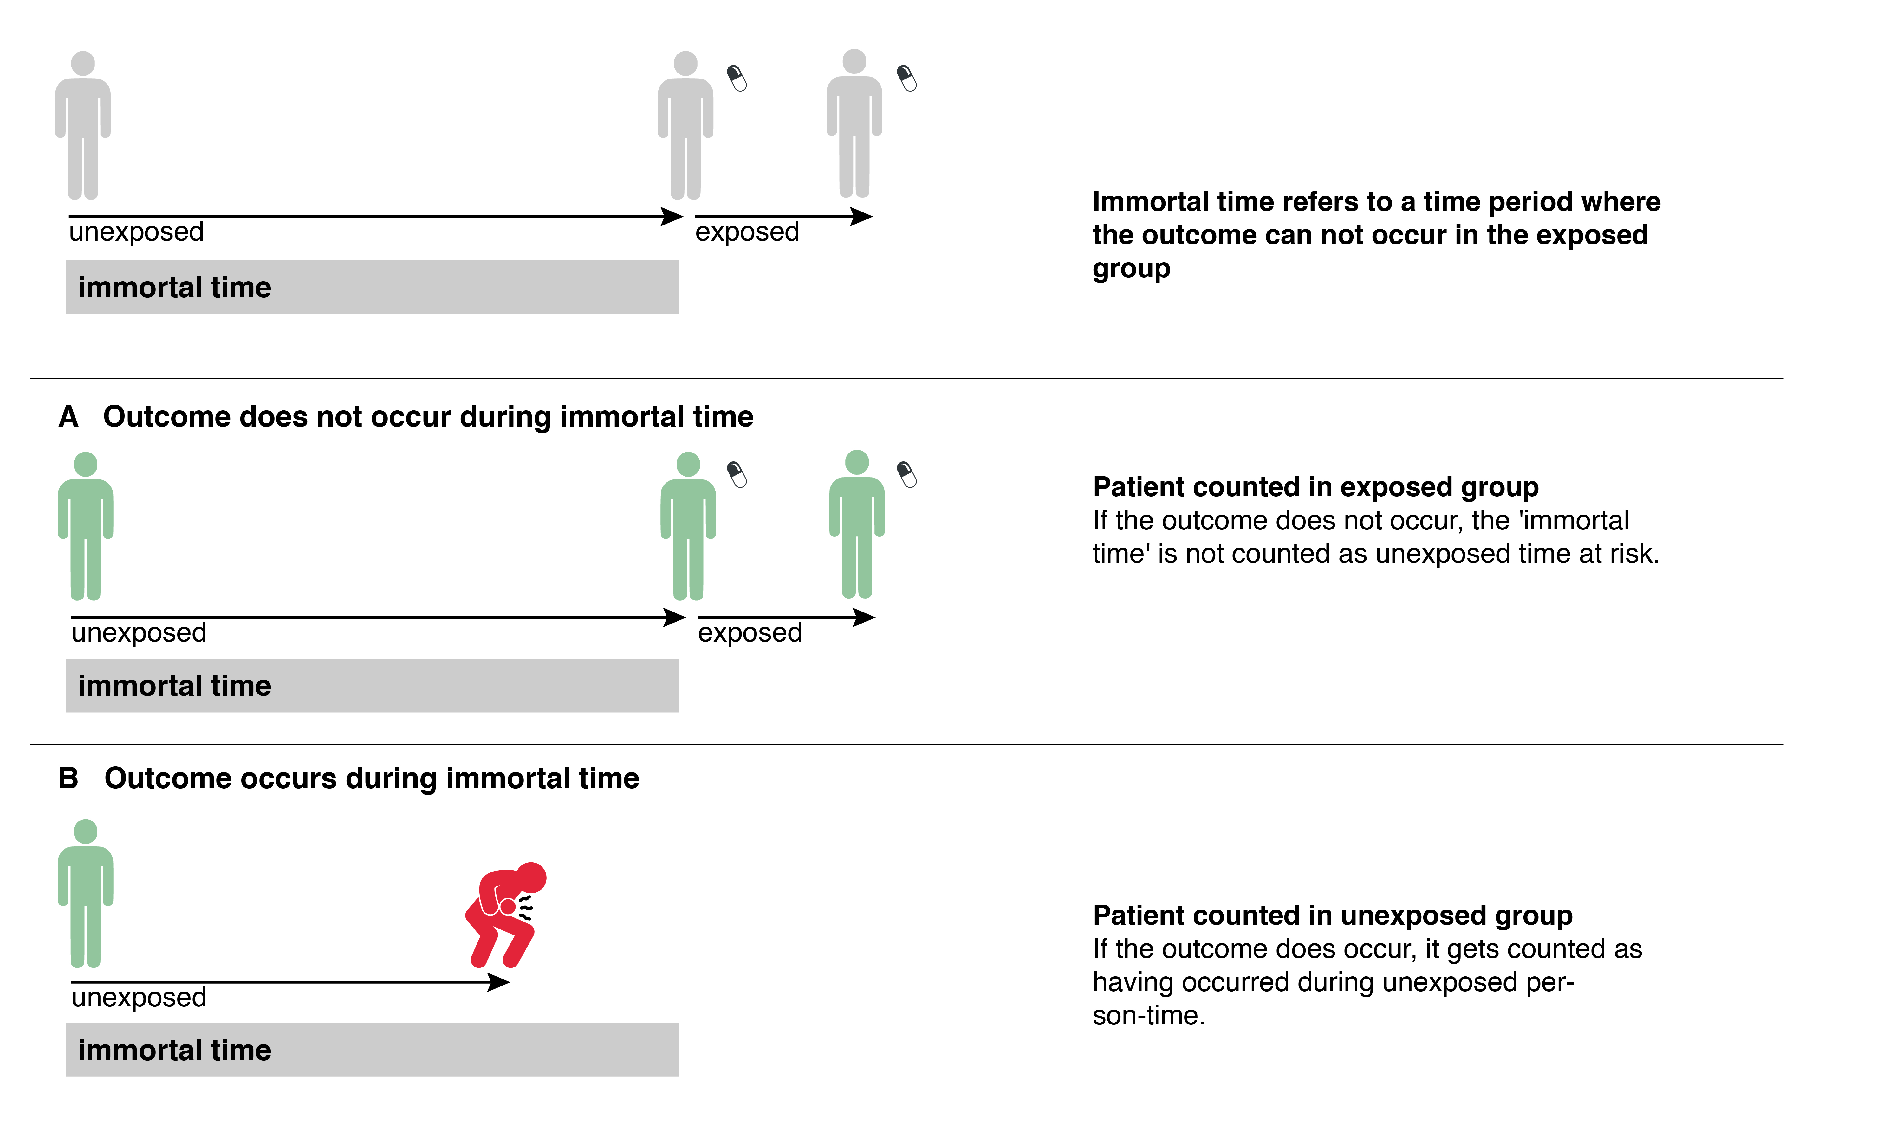
Immortal time bias

Slide 36
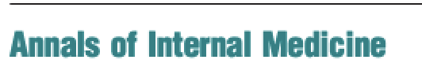

Immortal time bias example
Compared life expectancy of Oscar winners with Oscar nominees who did not win
Found ~3.9 years longer life expectancy in winners

Slide 37
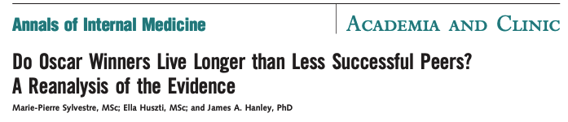
Immortal time bias example
Nominees who won in subsequent years were counted as winners
  Some died before they could win
  Time between nomination and winning "immortal"

Slide 38
Example 1: Julianne Moore
First nominated 1998 (age 38) for Boogie Nights
Also nominated 2000, 2003
Won in 2017 (age 57) for Still Alice
Time between 1998 and 2017 was immortal
  If she had died in that period, death would have gone in the nominated but did not win column
By Georges Biard, CC BY-SA 4.0, https://commons.wikimedia.org/w/index.php?curid=69500486

Slide 39
Example 2: James Dean
Nominated 1955 (age 24) for East of Eden
Died in a car crash that year
If he had not died, might have gone on to win an Oscar later in life
Oscar winners oversample survivors
This work is in the public domain in the United States because it was published in the United States between 1924 and 1977 without a copyright notice.

Slide 40
How to think about immortal time bias (and many other biases)
Think about observational studies as trying to simulate a randomized trial
  Called the "target trial"
Who would be included?
When would follow-up begin (the equivalent of the time of randomization)
Need intention to treat analysis
For Oscars example, nominees who later win need to stay in nominee group to avoid bias (ITT not "as treated")

Slide 41
Questions?

Slide 42
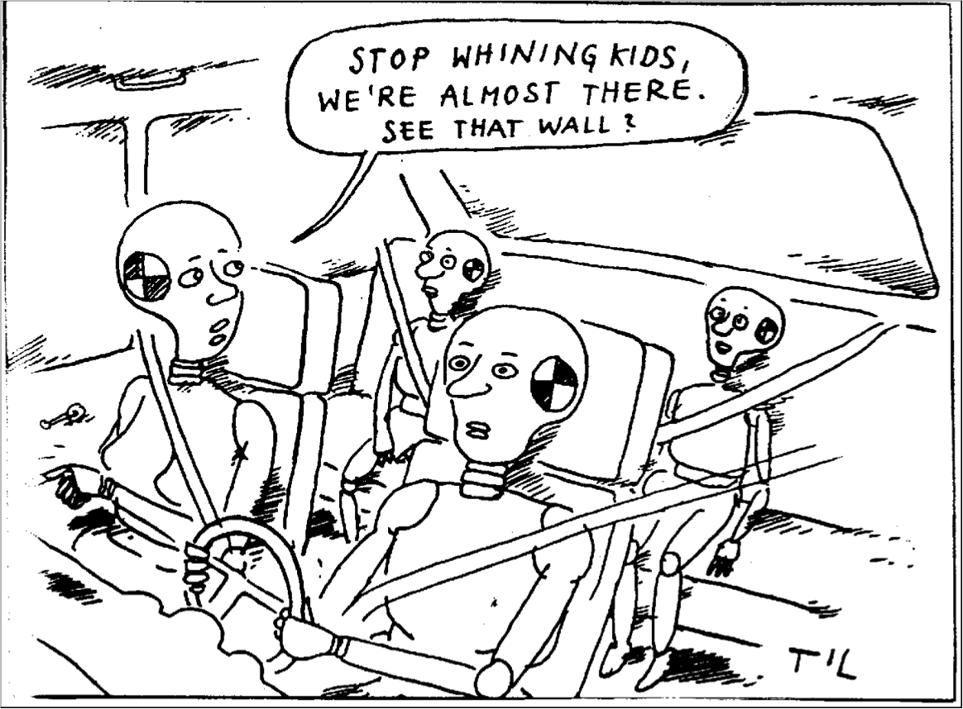
BREAK!

Slide 43
P-Values and Confidence Intervals
Justification and background
P-values
  What they don’t and do mean
  Analogy with diagnostic test results
Confidence intervals
  What they don’t and do mean
  CI for “negative” studies; absolute vs. relative risk
Recent example: cooling babies

Slide 44
Justification: Why cover this material here?
P-values and confidence intervals are ubiquitous in clinical research
Widely misunderstood and mistaught
You have a head start on Bayes’s theorem
Bayesian analyses are entering the mainstream clinical research literature

Slide 45
Two types of probability
Stochastic: based on repeatable random processes
  Can be estimated from theory and equations (e.g., coin tosses, poker hands)
  Can be estimated or verified empirically by repeated trials
Epistemic: (from Greek episteme = knowledge) subjective estimates based on imperfect knowledge
  Can’t be verified experimentally; sampling space unclear
  Example: P(Nuclear weapon use in 2020)
  Goodman SN. Circulation 2013;127: 2367-2369

Slide 46
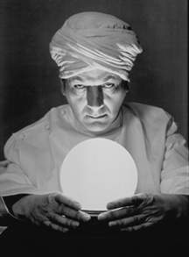
Two types of statisticians
Frequentists reject epistemic probability estimation as unscientific
Bayesians acknowledge subjectivity, but assert that subjective estimation of probability is essential for making decisions and advocate for ways to make it more explicit
  Goodman SN. Circulation 2013;127: 2367-2369

Slide 47
Review of traditional (frequentist, Neyman and Pearson) statistical significance testing
State null (H₀) and alternative (H_{A}) hypotheses
Choose α
Calculate value of test statistic from your data
Calculate P- value from test statistic
If P-value < α, reject H₀

Slide 48
Caveat
Neyman and Pearson never meant to use hypothesis testing as a basis for decisions (as the FDA does)
  Does not account for EFFECT SIZE
  Does not account for PRIOR PROBABILITY
  Does not account for RELATIVE COSTS of Type 1 and Type 2 errors.

Slide 49
Audience Response
If the P-value is 0.05, there is a 95% probability that…
  The null hypothesis is false
  There really is a difference in the population
  You would get a statistically significant result if you repeated the study
  More than one of the above
  None of the above

Slide 50

Notes:
If the P-value is 0.05, there is a 95% probability that…
https://www.polleverywhere.com/multiple_choice_polls/qfYDacR9yNW5tGe

Slide 51
So if P = 0.05, what IS there a 95% probability of?

Slide 52
What P values mean
The probability of obtaining a value of the test statistic equal to more extreme than was obtained in the study if the null hypothesis is true.
So if P= 0.05 there is a 95% chance of obtaining a test statistic less extreme than was obtained in the study if the null hypothesis is true.
P-values can’t tell you the probability that H₀ is true because they are calculated ASSUMING it is true.

Slide 53
Recall “False Negative confusion” from Chapter 2
Sensitivity of rapid strep test is 85%
Therefore, false negative rate is 15%
Therefore, 15% of those with a negative rapid strep are false negatives
ERROR!

Slide 54
2 definitions of “false negative rate”
Strep
No Strep
Total
Rapid Test +
TP
FP
TP+FP
Rapid Test -
FN
TN
TN+FN
TP+FN
FP+TN
Vertical: 1-sensitivity
= FN/(TP+FN)
Horizontal: 1 - negative predictive value
= FN/(FN+TN).

Slide 55
“False positive confusion” is similar: 2 definitions of “false positive rate”
Strep
No Strep
Total
Rapid Test +
TP
FP
TP+FP
Rapid Test -
FN
TN
TN+FN
TP+FN
FP+TN
Vertical: 1-specificity
= FP/(FP+TN)
Horizontal: 1 - positive predictive value
= FP/(TP+FP).

Slide 56
“False positive confusion” happens with statistical hypothesis testing
H_{A} True
H₀ True
Study +
Power
α
Study -
β
1-α
Vertical: Statistical testing, P-values
Horizontal: What you need to know to make decisions
  Unfortunately, you can't get it from just the study!
Notes:
Deductive reasoning: start with hypothesis (H0), predict data. Inductive: start with data, develop hypothesis.

Slide 57
Common P-value error
Reporting P as an inequality rather than a number, e.g. P < 0.05, P <0.01, P >0.05 etc.
  This is like reporting levels of (the liver enzyme) ALT as “ALT > 40” rather than ALT = 55 or ALT=1000.
  Exception: analytes below the limits of detection (e.g., lead level <2) or above assay limits; P <0.0001 (except in genome studies)

Slide 58
Extending the Analogy (See Ch 11)
Intentionally ordered tests and hypotheses stated in advance
  Higher prior probability
Multiple tests and multiple hypotheses
  Lower prior probability
Laboratory error and bias
  Tests and studies can be spuriously positive, but not due to chance
Alternative diagnoses and confounding
  Tests and studies can be truly positive, but not due to the disease you are testing for
Notes:
Maybe a deeper exposition here of the epistemic nature of P-values, since subjective judgments come into play deciding which null hypothesis to test. – which things to group together in a single family.

Slide 59

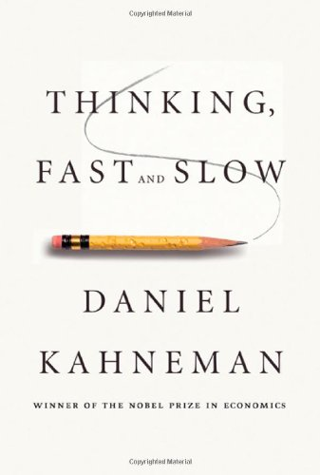

Beyond EBD: Additional Recommended Reading

Slide 60
CONFIDENCE INTERVALS

Slide 61
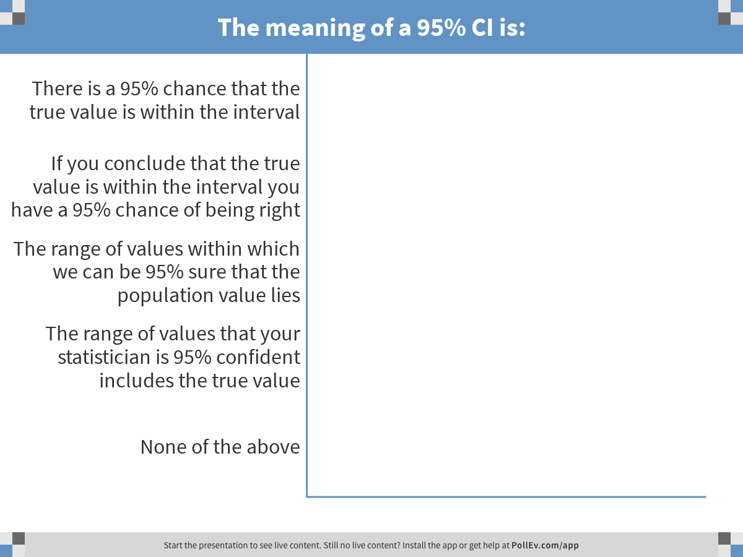
Notes:
The meaning of a 95% CI is:
https://www.polleverywhere.com/multiple_choice_polls/WRrloeK17V9xk4S

Slide 62
One source of confusion: Statistical “confidence”
(Some) statisticians say: “You can be 95% confident that the population value is in the interval.”
This is NOT the same as “There is a 95% probability that the population value is in the interval.”
“Confidence” is tautologously defined by statisticians as what you get from a confidence interval.
Full credit for D or E.

Slide 63
Cocktail napkin illustration -1
If a 95% CI has a 95% chance of containing the true value, then a 90% CI should have a 90% chance and a 40% CI should have a 40% chance of containing the true value.
Take out a coin. Imagine a “study” to see if it is fair, i.e., P(Heads)=0.5
The study involves tossing the coin 10 times and recording results

Slide 64
Cocktail napkin illustration -2
You flip the coin 10 times and get 5 heads
Point estimate of P(Heads)=0.5;
95% CI (0.19, 0.81)
90% CI = (0.22,0.78)
40% CI = (0.37, 0.63).
Does this mean there’s only a 40% probability that P(Heads) is in the interval (0.37, 0.63)?
If so then there must be a 60% chance that the true value for P(Heads) is <0.37 or >0.63)?
So by flipping 5 heads out of 10, we end up with a 60% probability the coin is unfair?

Slide 65
Confidence Intervals apply to a Process
Consider an opaque bag with 19 oranges and 1 grapefruit
The process of selecting a fruit at random has a 95% probability of yielding an orange
But once I’ve selected one, does it still have a 95% chance of being an orange (even if I haven’t seen it yet)?
You may have prior knowledge that changes the probability (e.g., grapefruits are larger than oranges)
Similarly 95% CI refer to the process of doing the study and calculating intervals

Slide 66
Correct definition
Over many repetitions of the study (with different samples) it is expected that 95% of the 95% CI will include the true (population) value.
Like most statistics, 95% CI deal only with random error (e.g., that arises from studying a sample from a population).
Confidence intervals cannot give you posterior probability because they don’t account for prior probability.

Slide 67
Confidence Intervals for negative studies: 5 levels of sophistication
Example: Oral amoxicillin to treat possible occult bacteremia (bacteria in the blood) in febrile children*
  Randomized, double-blind trial
  3-36 month old children with T≥ 39º C (N= 955)
  Treatment: Amox 125 mg/tid (≤ 10 kg) or 250 mg tid (> 10 kg) (tid=3x/day)
  Outcome: “major infectious morbidity”
*Jaffe DM et al., New Engl J Med 1987;317:1175-80

Slide 68
Amoxicillin for possible occult bacteremia 2: Results
Bacteremia in 19/507 (3.7%) with amox, vs 8/448 (1.8%) with placebo (P=0.07)
“Major Infectious Morbidity” 2/19 (10.5%) with amox vs 1/8 (12.5%) with placebo (P = 0.9)
Conclusion: “Data do not support routine use of standard doses of amoxicillin…”

Slide 69
5 levels of sophistication
White belt: P > 0.05 = treatment does not work
Yellow belt: Look at power for study. (Authors reported power = 0.24 for OR=4. Therefore, study underpowered and negative study uninformative.)

Slide 70
5 levels of sophistication, cont’d
Green belt: Look at 95% CI!
Authors calculated OR= 1.2 (95% CI: 0.02 to 30.4)
  This is based on 1/8 (12.5%) with placebo vs 2/19 (10.5%) with amox
  (They put placebo on top)
  (Silly to use OR)
With amox on top, RR = 0.84 (95% CI: 0.09 to 8.0)
This was the sophistication level of TBN in a letter to the editor (with Bob Pantell, in 1987)

Slide 71
5 levels of sophistication, cont’d
Blue belt: Make sure you do an “intention to treat” analysis!
  It is less clinically relevant to restrict attention to bacteremic patients (since we don’t know at the time we treat them)
  So it should be 2/507 (0.39%) with amox vs 1/448 (0.22%) with placebo
  RR= 1.8 (95% CI: 0.16 to 19)

Slide 72
Brown belt: the clinically relevant quantities are the Absolute Risk Reduction (ARR) and 95% CI!
Major infectious morbidity in 2/507 (0.39%) with amox vs 1/448 (0.22%) with placebo
ARR = −0.17% {amoxicillin worse}
95% CI (−0.9% {harm} to +0.5% {benefit})
Therefore, LOWER limit of 95% CI (i.e., best case) for is NNT= 1/0.5% = 200
So this study suggests that if the treatment works at all, we would need to treat ≥ 200 children to prevent “Major Infectious Morbidity” in one.

Slide 73
Stata output
. csi 2 1 505 447
| Exposed Unexposed | Total
-----------------+------------------------+----------
Cases | 2 1 | 3
Noncases | 505 447 | 952
-----------------+------------------------+----------
Total | 507 448 | 955
| |
Risk | .0039448 .0022321 | .0031414
| |
| Point estimate | [95% Conf. Interval]
|------------------------+----------------------
Risk difference | .0017126 | -.005278 .0087032
Risk ratio | 1.767258 | .1607894 19.42418
Attr. frac. ex. | .4341518 | -5.219315 .9485178
Attr. frac. pop | .2894345 |
+-----------------------------------------------
chi2(1) = 0.22 Pr>chi2 = 0.6369

Slide 74
Example: EBD-1 Problem 11.3
RCT of sentinel node biopsy vs axillary dissection in 516 women with small (< 2 cm) primary breast cancer tumors*
Results:
  Much less morbidity with sentinel biopsy
  Mortality 2/259 (0.8%) in sentinel node biopsy group vs. 6/257 (2.3%) in axillary node dissection group after ~46 months.
Conclusion: “Safe and accurate method of screening” nodes for metastasis…”
Editorial:** Study was too small; need multicenter studies with power to detect a 2% difference in mortality.
*Veronesi et al. NEJM 2003; 349:546-53
**Krag and Ashikaga, NEJM 2003; 349:603-5
Notes:
Other adverse events – mets, recurrence, etc. csi 13 21 246 236

Slide 75
Example: EBD-1 Problem 11.3
Given 2.3% mortality in axillary dissection group, power to find a 4.3% mortality rate in sentinel biopsy group was only 17%!
So do we conclude (as editorialists did) that study was woefully underpowered?
*http://www.sample-size.net/proportions-effect-size/
Notes:
Other adverse events – mets, recurrence, etc. csi 13 21 246 236

Slide 76
EBD-1 Problem 11.3: Total mortality
. csi 2 6 257 251, ex
| Exposed Unexposed | Total
-----------------+------------------------+------------
Cases | 2 6 | 8
Noncases | 257 251 | 508
-----------------+------------------------+------------
Total | 259 257 | 516
| |
Risk | .007722 .0233463 | .0155039
| |
| Point estimate | [95% Conf. Interval]
|------------------------+------------------------
Risk difference | -.0156243 | -.0369425 .0056939
Risk ratio | .3307593 | .0673847 1.623539
Prev. frac. ex. | .6692407 | -.6235388 .9326153
Prev. frac. pop | .3359173 |
+-------------------------------------------------
1-sided Fisher's exact P = 0.1401
2-sided Fisher's exact P = 0.1750

Slide 77
Example: EBD Problem 11.3
Brown belt, KEY POINT:
Look at the 95% CI for the ARR!
In this case, because of the favorable trend in the opposite direction, it excludes even a 1% increase in mortality!

Slide 78
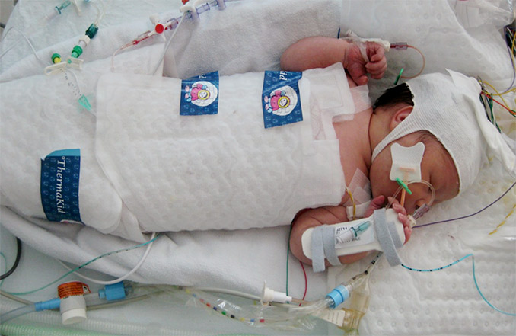
Bayesian Statistics Example: Cooling babies to protect their brains
Previous studies show cooling babies who didn’t get enough oxygen around the time of birth leads to better neurodevelopmental outcomes
Benefit shown if cooling starts within 6 hours, but that can be hard to arrange
RCT to see if cooling started 6-24 hours would also work
Laptook et al. Effect of Therapeutic Hypothermia Initiated After 6 Hours of Age on Death or Disability Among Newborns With Hypoxic-Ischemic Encephalopathy: A Randomized Clinical Trial. JAMA 2017;318:1550-60
Photo from http://www.ucl.ac.uk/impact/case-study-repository/neonatal-cooling
Notes:
Photo from http://www.ucl.ac.uk/impact/case-study-repository/neonatal-cooling

Slide 79
Bayesian Statistics Example: Cooling babies to protect their brains-2
Outcome: Death or ≥ moderate disability at 18-22 months
Instead of traditional analysis, did Bayesian analysis using 3 pre-specified prior probability distributions for RR (95% CI)
  Enthusiastic: 0.72; (0.36,1.44)
  (same effect as seen if <6 hours)
  Neutral: 1.0; (0.5, 2.0)
  Skeptical: 1.1; (0.55, 2.2)
Laptook et al. Effect of Therapeutic Hypothermia Initiated After 6 Hours of Age on Death or Disability Among Newborns With Hypoxic-Ischemic Encephalopathy: A Randomized Clinical Trial. JAMA 2017;318:1550-60

Slide 80
Bayesian Statistics Example: Cooling babies to protect their brains-3
Results
With neutral prior, 64% probability of at least 2% absolute benefit
Prior | RR | 95% CI | P-TB%*
N/A (Frequentist) | 0.87 | (0.52, 1.48) | N/A
Enthusiastic | 0.78 | (0.52, 1.15) | 90
Neutral | 0.86 | (0.58, 1.29) | 76
Skeptical | 0.89 | (0.60, 1.32) | 73
*Probability of treatment benefit
Laptook et al. Effect of Therapeutic Hypothermia Initiated After 6 Hours of Age on Death or Disability Among Newborns With Hypoxic-Ischemic Encephalopathy: A Randomized Clinical Trial. JAMA 2017;318:1550-60

Slide 81
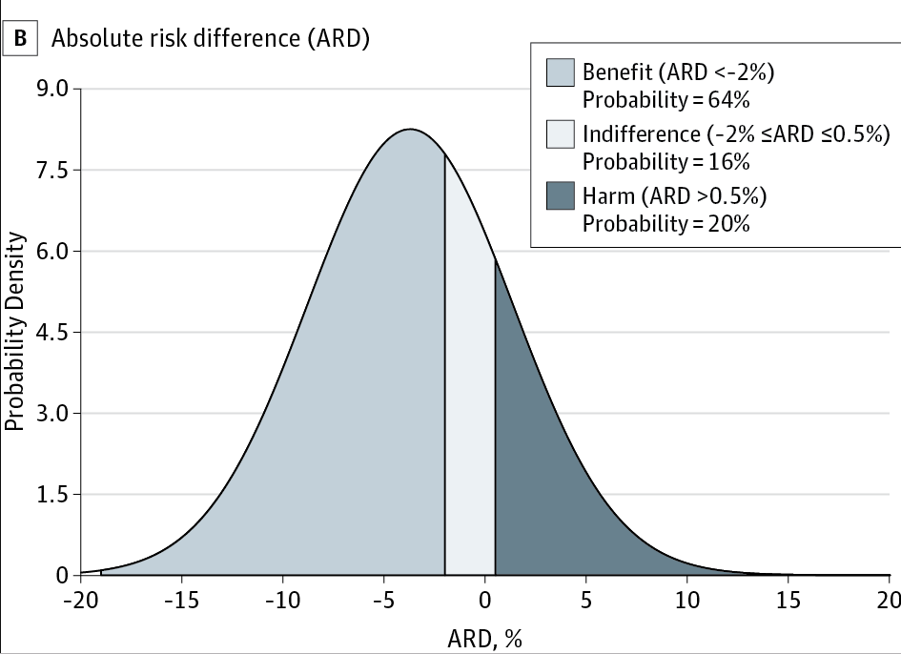
Bayesian Statistics Example: Cooling babies to protect their brains-5
JAMA 2017;318:1550-60

Slide 82
Bayesian Statistics Example: Cooling babies to protect their brains-5
Problem: How do we use these numbers joint decision making?
  “76% chance that the treatment works”?
  64% chance that it reduces risk by at least 2%?
Analogy with diagnostic tests: once we have posterior probability, we still need to compare it with a treatment threshold
Laptook et al. Effect of Therapeutic Hypothermia Initiated After 6 Hours of Age on Death or Disability Among Newborns With Hypoxic-Ischemic Encephalopathy: A Randomized Clinical Trial. JAMA 2017;318:1550-60

Slide 83
Questions?

Slide 84
Extra slides (time permitting)

Slide 85
Beyond EBD
Our brains are a product of evolution
Survival advantage for increased sensitivity (at the cost of decreased specificity) at identifying patterns and attributing meaning
Multiple experimental studies demonstrating this
Excessive with some mental illnesses

Slide 86
Beyond EBD: P-values
Problems with P-values and multiple and post-hoc hypotheses are not just problems of low prior probabilities

Slide 87
Beyond EBD- Example of Suspect P-value
I am trying to decide whether to submit 2 or 3 abstracts to the Pediatric Academic Societies meeting.
On the way to work I was passed by 3 cars in a row that had a 2 in the 4th position of the license plate. Is this a sign?
The probability of this occurring by chance alone is only 0.1³= 1/1,000
Therefore, reject H_{o} and accept H_{A} that it is a sign that my research team should only submit 2 abstracts to the PAS meeting this year, not 3.

Slide 88
Beyond EBD-1: Example of Suspect P-value. What’s wrong?
EBD: The prior probability of H_{A}, that some higher power would send me a sign in this way is very low.
But also: The P-value calculation is fishy.
  Stating hypotheses in advance helps protect against selecting which null hypothesis to test (and how) after looking at the data

Slide 89
Many possible choices for tests of H₀ for my trip to work
Probability of a 2 or 3 (2-tailed test) in the 4th position of the license plate of any 3 cars in a row
Probability of a 2 or 3 in any position of the license plate of any 3 cars in a row
Probability of any event any time in the day that might have 2s or 3s in it that I could take as a sign

Slide 90
Stating the hypothesis in advance provides some protection from spurious P-values
I will look at the 4th position of the license plates of the first 3 cars that pass me after 7:16:00 AM and see if all are 2’s or all are 3’s.

Slide 91
Application to clinical research
Many of you will be exploring your own data
You will find interesting associations
You will come up with reasons why they might be real or important
You will calculate P-values for them and will be tempted to report and believe them
BE CAREFUL!

Slide 92
When P-values and Confidence Intervals Disagree
Usually P < 0.05 means 95% CI excludes null value
But both 95% CI and P-values are based on approximations, so this may not be the case
Risk difference and risk ratio may also give different statistical significance
If you want 95% CI and P-values to agree, use “test-based” confidence intervals – see next slide
If you want better 95% CI for risk difference, type “findit rdci”

Slide 93
Example of inconsistency
. csi 2 18 28 58,ex
| Exposed Unexposed | Total
-----------------+------------------------+------------
Cases | 2 18 | 20
Noncases | 28 58 | 86
-----------------+------------------------+------------
Total | 30 76 | 106
| |
Risk | .0666667 .2368421 | .1886792
| |
| Point estimate | [95% Conf. Interval]
|------------------------+------------------------
Risk difference | -.1701754 | -.3009557 -.0393952
Risk ratio | .2814815 | .069523 1.13965
Prev. frac. ex. | .7185185 | -.1396499 .930477
Prev. frac. pop | .2033543 |
+-----------------------------------------
chi2(1) = 4.07 Pr>chi2 = 0.0437
1-sided Fisher's exact P = 0.0345
2-sided Fisher's exact P = 0.0542
Notes:
Note P-value for Chi-squared is significant but 95% CI for the RR overlaps 1. (The ex option is for exact CI.)

Slide 94
Alternative Stata output: Test-based CI
.
. csi 2 18 28 58,tb
| Exposed Unexposed | Total
-----------------+-----------------------+------------
Cases | 2 18 | 20
Noncases | 28 58 | 86
-----------------+-----------------------+------------
Total | 30 76 | 106
| |
Risk | .0666667 .2368421 | .1886792
| |
| Point estimate | [95% Conf. Interval]
|-----------------------+------------------------
Risk difference | -.1701754 | -.3363063 -.0040446 (tb)
Risk ratio | .2814815 | .0816554 .9703199 (tb)
Prev. frac. ex. | .7185185 | .0296801 .9183446 (tb)
Prev. frac. pop | .2033543 |
+-------------------------------------------------
chi2(1) = 4.07 Pr>chi2 = 0.0437

Slide 95
Conclusions re: Confidence Intervals
Confidence intervals for negative studies are more informative than power because
  They show the range of results consistent with the study findings
  Confidence intervals for ARR account for absolute event rates, and can be useful even when power is low
P-values and confidence intervals are approximate, and not always consistent especially for small sample sizes
There is nothing magical about 0.05

Slide 96
Bonferroni
Bonferroni Inequality: If we do k different tests, each with significance level α, the probability under H₀ that one or more will be significant is less than or equal to k × α
Bonferroni Correction: If we test k different hypotheses and want our total Type I error rate to be no more than alpha, then we should reject H₀ only if P < α/k

Slide 97
Derivation
Let A & B = probability of a Type I error under H₀ for hypotheses A and B
P(A or B) = P(A) + P(B) – P(A & B)
Under Ho, P(A) = P(B) = α
So P(A or B) = α + α - P(A & B) = 2α - P(A & B).
Of course, it is possible to falsely reject 2 different null hypotheses, so P(A & B) > 0. Therefore, the probability of falsely rejecting either of the null hypotheses must be less than 2α.
Note that often A & B are not independent, in which case P(A&B) will be higher and Bonferroni will be even more excessively conservative

Slide 98
Problems with Bonferroni correction
Overly conservative (especially when hypotheses are not independent)
Maintains specificity at the expense of sensitivity
Does not take prior probability into account
Not clear when to use it
BUT can be useful if results still significant

Slide 99
Trouble at the lab*
“When testing a specific hypothesis, scientists run statistical checks to work out how likely it would be for data which seem to support the idea to have come about simply by chance. If the likelihood of such a false-positive conclusion is less than 5%, they deem the evidence that the hypothesis is true ‘statistically significant.’ They are thus accepting that one result in 20 will be falsely positive—but one in 20 seems a satisfactorily low rate.”
Can you find the error in the quote above?
*http://www.economist.com/news/briefing/21588057-scientists-think-science-self-correcting-alarming-degree-it-not-trouble/print
Notes:
One result in 20 will be falsely positive only if all null hypotheses are actually true! (Assuming no "P-hacking")

Slide 100
Additional Slides showing derivation of the Complier Average Causal Effect = Local Average Treatment Effect in the PROBIT study

Slide 101
Estimates of Average Causal Effect (ACE) typically assume treatment homogeneity
We assume that the observed rate of eczema is a weighted average of the rates in those who exclusively breast feed (A) and those who do not (B)
  Effect of breast feeding is the same in everyone
  That is A_{i} = A_{c} and B_{i} = B_{c}
Then if the proportion exclusively breastfed is p₁ in the intervention group and p₂ in the control group, the observed rates of eczema R_{c} in the control group and R_{i} in the intervention group will be:
R_{C}= p₂A + (1-p₂)B
R_{I} = p₁A + (1-p₁)B

Slide 102
IV to get ACE assuming treatment homogeneity
So we observe R_{i} and R_{c} and we want to find A and B, To obtain the risk difference, we subtract the two equations and rearrange :
R_{C}= p₂A + (1−p₂)B = p₂A + B−p₂B
R_{I} = p₁A + (1−p₁)B = p₁A + B−p₁B
R_{C} -R_{I} =p₂A − p₁A − p₂B + p₁B
R_{C} -R_{I} = p₁(B−A) + p₂(A−B)
R_{C} -R_{I} = p₁(B−A) − p₂(B−A) =(p₁-p₂)(B−A)
B-A = (R_{C}- R_{I})/(p₁-p₂)

Slide 103
Algebraic correction
Thus, if all of the difference in eczema is due to the difference in exclusive breast feeding, the absolute risk reduction is:
6.3% – 3.3% = 8.6%
40% – 5%
In other words, the observed risk difference is divided by the difference in proportions that actually received the exposure of interest
This would be the Average Causal Effect (ACE)
Notes:
This is the AVERAGE CAUSAL EFFECT, which is identifiable only if the effect is uniform, the effect of BF is the same in all subgroups, no interaction. As per end of Eric’s last lecture,
Linear structural equation modeling traditionally assumed treatment homogeneity
• effect of exposure uniform across target population • Under homogeneity, IV analysis estimates ACE
• implicitly posits ability to change exposure or treatment across the population

Slide 104
What’s the problem with this?
Assumes there are only 2 rates of eczema: A in exclusively BF and B in not exclusively BF, independent of group assignment
But what if those who BF exclusively in response to the intervention are different from those who do so anyway?
  E.g., if intervention stressed benefits of preventing eczema, mothers more concerned about eczema might be more responsive to the intervention

Slide 105
Recall question posed was:
What would the risk ratio and risk difference for eczema be if everyone in the intervention group and no one in the control group had exclusively breast fed?
Answer: can’t tell from this study
  Reason: Responsiveness to intervention may depend on baseline risk of eczema
  (Extreme example: the intervention could be effective at increasing breastfeeding only in those mothers whose babies are at risk for eczema.)
  Therefore, can’t assume Can’t assume A_{i} = A_{c} and B_{i} = B_{c}

Slide 106
Solution
Change the question we are asking to one that can be answered by the data
Or, as Eric puts it, change the identifying assumptions.

Slide 107
Consider 4 types of infants with 4 different eczema rates (“Principal stratification”)
Those who breast feed regardless (“ALWAYS”); Eczema rate=A
Those who breast feed in response to the intervention (“COMPLIERS”); Eczema rate = B
Those who formula feed regardless (“NEVER”); Eczema rate = C
Those who formula feed in response to the intervention (“DEFIERS”) Eczema rate= D
We need (for now) to assume there are no defiers. This is the Monotonicity assumption.
We also assume eczema rates A and C are not affected by treatment assignment

Slide 108
Recall definitions of p₁= exclusive BF in intervention group=40% and p₂ = exclusive BF in control group =5%. What is the proportion of compliers?
Control
Intervention
Formula feed
Formula feed (eczema rate C)
P₁
Breast feed
P₂
Breast feed (A)

Slide 109
Proportion of compliers is p₁-p₂
Control
Intervention
Formula feed anyway
Formula feed anyway
P₁
P₁
BF from int. only
BF from int. only
=COMPLIERS
P₂
P₂
BF Anyway
BF Anyway
Reason: the groups were randomly assigned, so there is no reason to expect baseline differences in proportions of different types of mothers/infants
Breast feeding

Slide 110
Predicted eczema rates:
R_{c} = p₂A + (p₁-p₂)B_{c} + (1-p₁)C
R_{i} = p₂A + (p₁-p₂)B_{i} + (1-p₁)C
Control
Intervention
Formula feed anyway
Formula feed anyway = C
P1
P1
BF from int. only
BF from int. only
= B
P2
P2
BF Anyway
BF Anyway =A
Notes:
Ri and Rc are observed rates. A, B and C are eczema rates in those who always BF, BF in resp to intervention and never BF.
Add brackets to indicate p2 is asubset of p1

Slide 111
Exclusion restriction assumption
A=A_{i}=A_{c}; C=C_{i}=C_{c}
  Reason: We don’t expect a breastfeeding intervention to affect the risk of eczema except by altering breastfeeding. In A and C groups (by definition) the intervention has no effect on breast feeding.
(Violated if intervention covers other topics, like when to introduce solid foods.)

Slide 112
Risk difference
A: Always
B: Compliers
C: Never
Predicted Eczema Rates then are:
R_{c} = p₂*A + (p₁-p₂)*B_{c} + (1-p₁)*C
R_{i} = p₂*A + (p₁-p₂)*B_{i} + (1-p₁)*C
Risk difference for BF in response to intervention is then:
R_{c}-R_{i} = (p₁-p₂)*(B_{c}-B_{i})
B_{c}-B_{i}=(R_{c}-R_{i})/(p₁-p₂)

Slide 113
What does B_{c}-B_{i} estimate?
The expected difference in eczema rates due to breastfeeding for mothers/infants who comply with the breast feeding intervention
It is sometimes called the “Complier Average Treatment Effect” or the “Local Average Treatment Effect (LATE).”
Notes:
Note if there are defiers, then the rather than estimating the proportion of compliers, P2-P1 estimates the proportion of compliers minus the proportion of defiers. As long as the proportion of defiers is low, compared with compliers, it’s not a big problem.

Slide 114
Counseling the Undecided Mother
For a mother who is undecided about exclusive breastfeeding, the difference in eczema rates B_{c}-B_{i} is arguably the most relevant quantity!
Since this is 8.6%, we can say that NNEBF is about 12

Slide 115
What if I want a Risk Ratio, not a Risk Difference?
Recall:
R_{i} = p₂*A + (p₁-p₂)*B_{i} + (1-p₁)*C
R_{c} = p₂*A + (p₁-p₂)*B_{c} + (1-p₁)*C
Simply taking the quotient of these two and rearranging gives:
B_{i}/B_{c} = (R_{i} -X)/(R_{c}-X)
where X = p₂*A +(1-p₁)*C
Note that both A and C are estimable from the data
A = risk in “always” group (e.g., exclusive BF in control group)
C = risk in “never” group (e.g., formula feeding in intervention group).

Slide 116
Uh Oh. Does this mean RR in draft lottery paper are wrong?
Well, the numbers are probably OK, but the text isn’t quite right
Instead of saying we estimated the RR for military service, we should said we estimated the RR for military service due to the draft lottery. That is, it is quite possible that the effects of serving in the military for those who volunteered are different from those who were drafted, and the study cannot address the former.

Slide 117
Eric’s more abstract way of saying the same thing: Identifying assumptions-1
What IV methods estimate depends on what additional identifying assumptions are made
Linear structural equation modeling traditionally assumed treatment homogeneity
  Effect of exposure uniform across target population
  Under homogeneity, IV analysis estimates ACE
  Implicitly posits ability to change exposure or treatment across the population
This was what we were estimating when we used A and B only, not A, B and C.

Slide 118
Eric’s more abstract way of saying the same thing: Identifying assumptions-2
Re-interpretation of IV using potential outcomes makes identifying assumption of monotonicity in cases with binary instrument and exposure
  Pr(E ) non-decreasing in instrument
  In an RCT with treatment assignment as instrument: compliers, always-takers, never-takers, but no defiers
Under monotonicity, IV estimates local average treatment effect (LATE) in sub-population in which exposure is influenced by instrument
(In other words, we are comparing potential outcomes of compliers if they complied vs. if they did not comply.)
PROBIT model with A, B & C

Slide 119
Deleted slides

Slide 120
Alternate outcomes 2: Proton Pump Inhibitors and Community-Acquired Pneumonia*
Proton pump inhibitors associated with higher risk of community acquired pneumonia in observational studies
Association biologically plausible (increased bacterial colonization)
Confounding possible – PPI prescribed to higher-risk patients
Strategy: see if PPI similarly associated with less plausible illnesses
* Jena AB et al. J Gen Intern Med 2013; 28(2):223–30

Slide 121
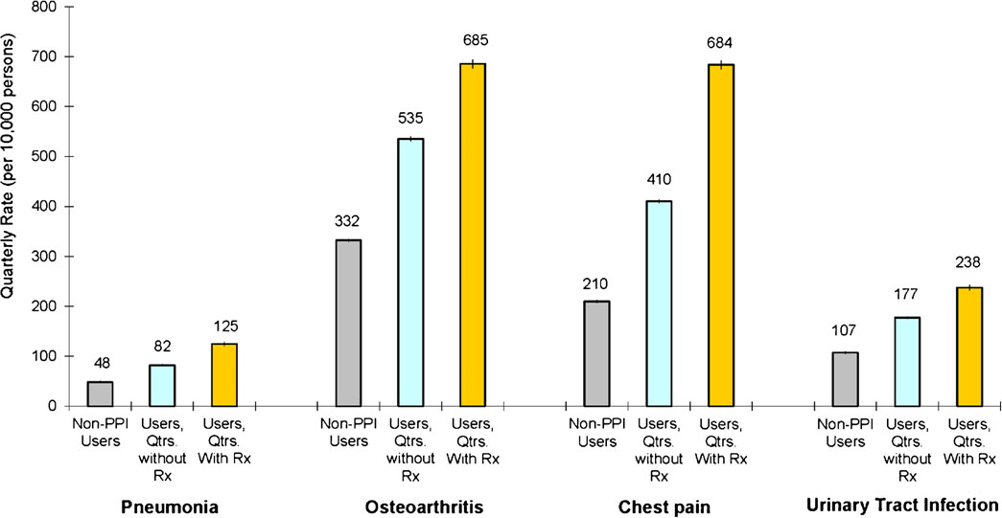
Unadjusted results
Jena AB et al. J Gen Intern Med 2013; 28(2):223–30
Notes:
Figure 1. Unadjusted quarterly rates of community-acquired pneumonia, osteoarthritis, chest pain, and urinary tract infection medical
claims among users and nonusers of proton pump inhibitors. Unadjusted quarterly rates of each condition were calculated for those never
filling a prescription for a PPI (termed nonusers of PPIs), users (defined as persons who filled at least one prescription for a PPI) during
quarters in which a prescription was not filled, and users during quarters in which a prescription was filled. Rates were determined from
ICD-9 codes in administrative data and are displayed at the quarterly level per 10,000 persons. 95 % confidence intervals reported in graph.

Slide 122
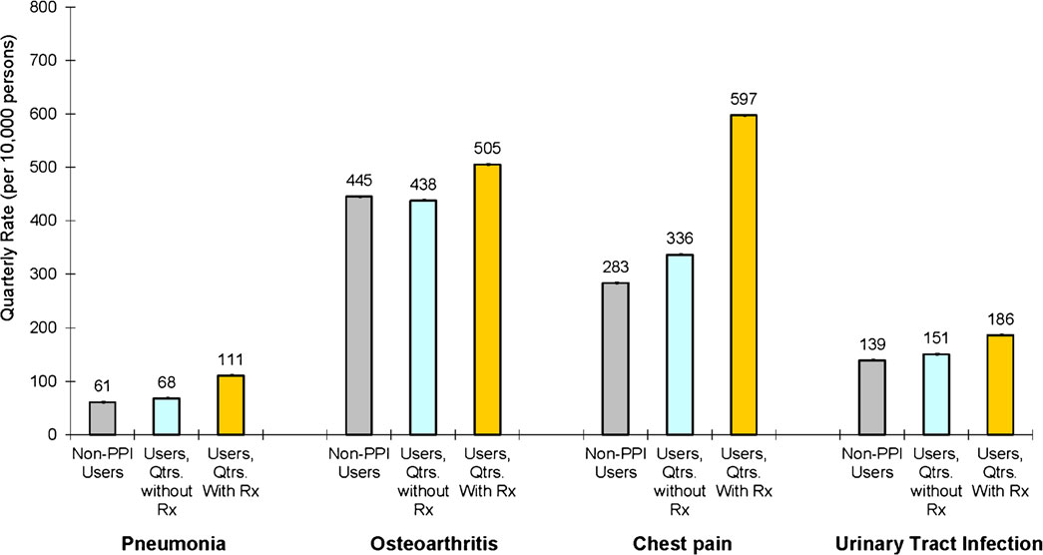
Adjusted results
Jena AB et al. J Gen Intern Med 2013; 28(2):223–30
Notes:
Figure 2. Adjusted quarterly rates of community-acquired pneumonia, osteoarthritis, chest pain, and urinary tract infection medical claims
among users and nonusers of proton pump inhibitors. Adjusted estimates are from a multivariate linear probability model with individual
fixed effects, quarterly indicators for various comorbidities, and demographic characteristics such as age, marital status, income, and
geographic location. Rates are displayed at the quarterly level and are per 10,000 persons. 95 % confidence intervals reported in graph.

Slide 123
Long-term Survival Following Partial vs Radical Nephrectomy Among Older Patients With Early-Stage Kidney Cancer*
Retrospective cohort study
Subjects: Medicare beneficiaries with early kidney cancer treated with partial or radical nephrectomy
  Partial: remove the part of the kidney with tumor. (Newer treatment)
  Radical: remove entire kidney, collecting system, adrenals and lymph nodes
Outcome: long term survival
*Tan et al. JAMA 2012;307(15):1629-1635

Slide 124
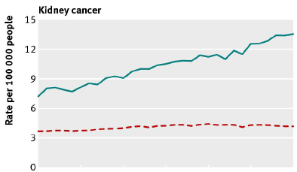


Kidney cancer incidence and mortality
From Moynihan R et al. BMJ 2012;344:e3502, adapted from Welch HG and Black WC. JNCI: 2010;102:605-13
Notes:
Recall from lecture on Ch 6 t here is some evidence of overdiagnosis of kidney cancer. So we might want to do a less radical operation, since some (maybe half?) of these cancers are probably pseudodisease.

Slide 125
Long-term Survival Following Partial vs Radical Nephrectomy Among Older Patients With Early-Stage Kidney Cancer*
Instrument: “Differential distance” to a partial nephrectomy surgeon
Outcomes: Overall survival and kidney cancer-specific survival
*Tan et al. JAMA 2012;307(15):1629-1635

Slide 126
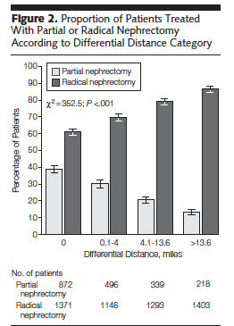
Differential Distance Instrument*
Distance to closest surgeon performing partial nephrectomy minus distance to closest surgeon performing radical nephrectomy
*Tan et al. JAMA 2012;307(15):1629-1635

Slide 127
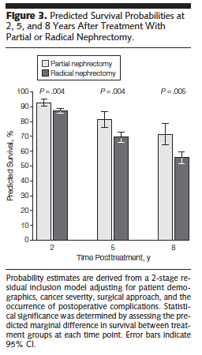
Results*
Longer predicted survival for those who lived closer to a partial nephrectomy surgeon
With assumptions, can be converted to effect of partial nephrectomy on survival
Details: Biostat 215 (Spring Qtr)
*Tan et al. JAMA 2012;307(15):1629-1635

Slide 128
Propensity Scores -1
Big picture: want to know if association between treatment and outcome is CAUSAL
Recall competing explanation = confounding by indication for treatment:
  Factor must be associated with outcome
  Factor must be associated with treatment
Traditional approach: adjust for factors associated with outcome
Alternative approach: Create a new variable, propensity to be treated with the intervention
  Then match, stratify, or include it in multivariable analyses

Slide 129
Advantages of Propensity Scores
Better ability to control for cofounding variables if treatment is much more common than the outcome
  Model can include more potential confounders, interactions, etc.
The underlying process leading to treatment may be better understood, leading to greater confidence that relevant confounders have been included
  Can ask treating clinicians how they decide whom to treat
You can more easily tell when treated and untreated groups are not comparable due to lack of overlap of propensity scores

Slide 130
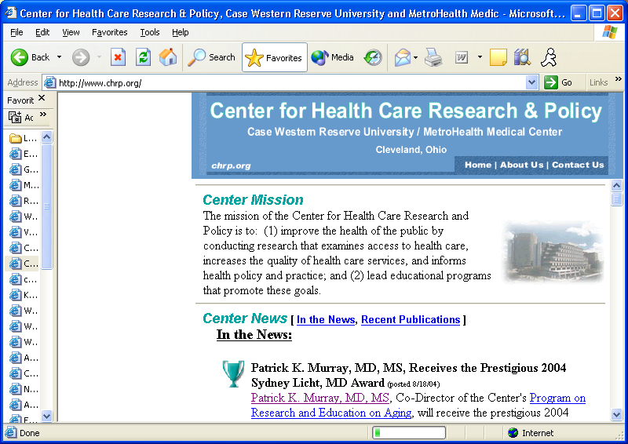


How Much Overlap In The Propensity Scores Do We Want?
Propensity to
receive treatment
Propensity to
receive treatment
Propensity to
receive treatment
1
1
1
A
B
C
0
0
0
Not Treated
Treated
Not Treated
Treated
Not Treated
Treated
www.chrp.org
Notes:
Situation A: nothing to compare – you’re done
Situation B: no need for propensity score – direct matching will do little – no selection bias
Situation C: near-optimal situation for PS – overlap in covariates allows matching to substantially improve selection bias problem
Slide Courtesy of Thomas Love
A good instrumental variable should not be included in the propensity score, otherwise you get Panel A.

Slide 131
Disadvantages of Propensity Scores
Introduces another step, layer of complexity
  Need a model for propensity
  May use a model for outcome, given treatment and propensity
  Possibility of doing it many ways and choosing the one that gives you the answer you want
  Magnified with inverse-probability weighting (Biostat 215)
Many readers and investigators don’t understand them
  Attitudes range from distrust to belief that they are magical
Don’t work well for multi-level or time varying exposures
Won’t help you understand or quantify effects of other variables on outcome

Slide 132
Example: Late Impact of Getting Hyperbilirubinemia or photoTherapy (LIGHT): Aim 2
Systematic search for possible adverse effects of phototherapy
Previous studies have suggested possible associations with asthma, diabetes and childhood cancer
KP preliminary data suggested early increase in cancer, particularly nonlymphocytic leukemia
Newman TB et al. Pediatrics 2016;137:e20151354

Slide 133
LIGHT Sample Size
Survived discharge from KP and followed at least 60 days, N=499,621
Phototherapy, N= 39,403
Leukemia, N=223
  Nonlymphocytic leukemia, N = 54
  Both phototherapy and nonlymphocytic leukemia, N=11
Created two propensity scores for phototherapy
  One for all subjects
  One for those with high bilirubin levels

Slide 134
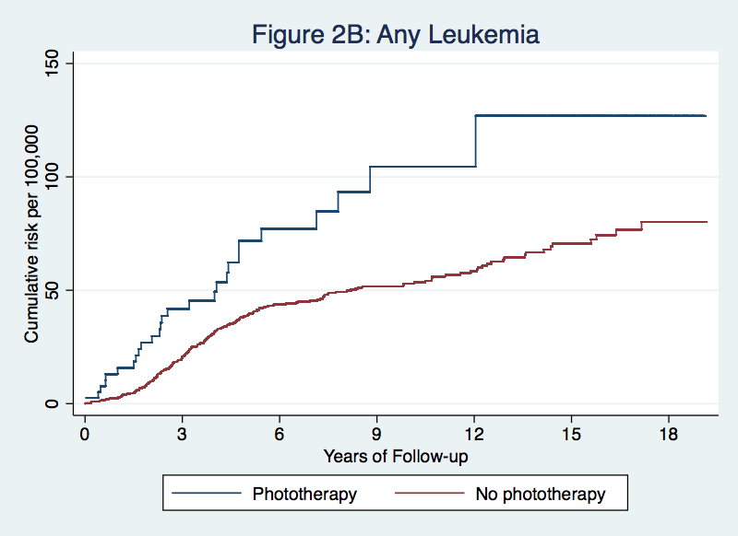
Crude Cumulative Incidence per 100K
Newman et al. Pediatr 2016; 137:e20151354
Notes:
Stata code for graph:
capture drop surv_pt surv_nopt cumcases*
stset cancer_risk_time, failure(anyleuk_ge1orTR)
sts gen surv_pt=s if pt_any==1
sts gen surv_nopt=s if pt_any==0
gen cumcases_pt=(1-surv_pt)*100000
gen cumcases_nopt=(1-surv_nopt)*100000
twoway (line cumcases_pt _t, sort connect(stairstep)) ///
(line cumcases_nopt _t, sort connect(stairstep)), ///
ytitle("Cumulative risk per 100,000") xtitle(Years of Follow-up) xlabel(0(3)18) ///
title("Figure 2B: Any Leukemia") leg(off) ///
name(CumAnyLeuk_PT, replace)
graph export Anyleuk_survival_nolegend.tif, as(tif) wid(800) replace
*Thanks to Chuck McCulloch for code

Slide 135
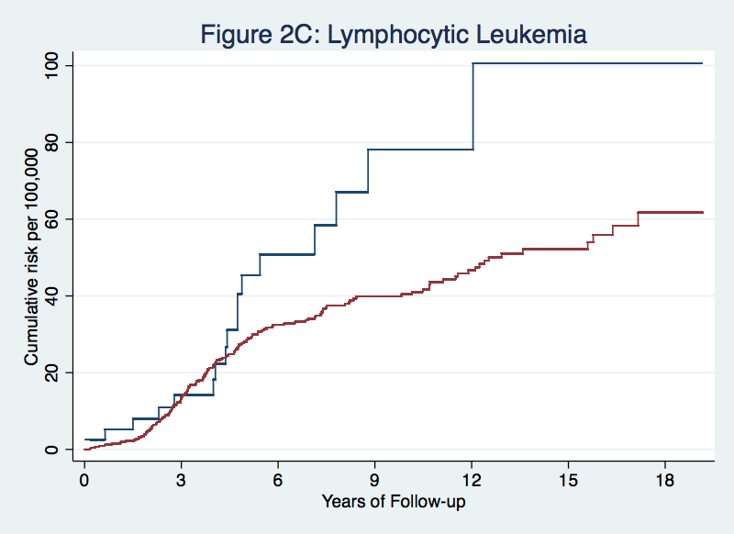
LIGHT Results: Lymphocytic Leukemia
Newman et al. Pediatr 2016; 137:e20151354
Notes:
8/18

Slide 136
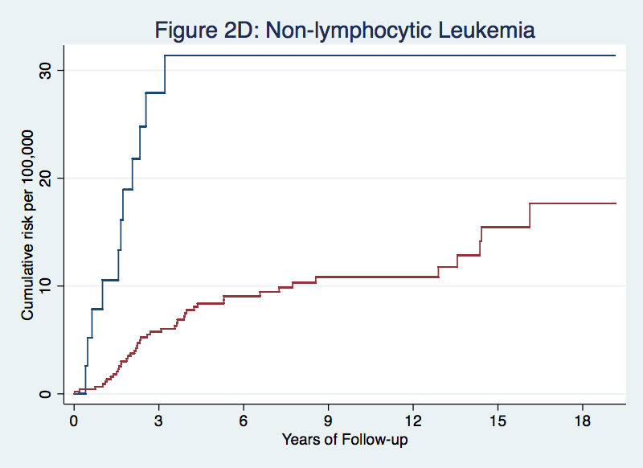
LIGHT Results: Nonlymphocytic leukemia
Newman et al. Pediatr 2016; 137:e20151354

Slide 137
LIGHT Results Comparison: Any leukemia by peak TSB ≥ 15 mg/dL if no phototherapy
Crude HR 1.04, P=0.86

Slide 138
Hazard ratios by cancer type and model.
Most associations no longer statistically significant after adjustment.

Slide 139
Model assessment-3
First look, LIGHT study Aim 2 “data mining”
Common AHRQ groupings of diagnoses
Crude and adjusted HR for phototherapy
Notes:
In the LIGHT study we are using propensity adjustment to screen for adverse effects of phototherapy. These are our very first results showing effects of propensity adjustment.

Slide 140
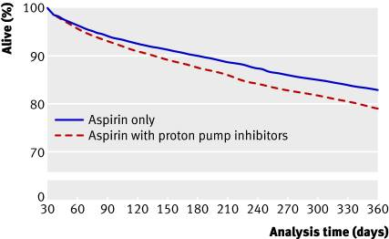
Proton pump inhibitor use and risk of adverse cardiovascular events in aspirin treated patients with first time myocardial infarction: nationwide propensity score matched study*
*Charlot M et al. BMJ. 2011 May 11;342:d2690
Notes:
Nationwide study from Denmark; N for this study 19,925 pts who filled a prescription for ASA within 30 days of d/c.
Adverse CV events: recurrent MI, stroke or CV death. Figure is mislabeled – this is not just survival.
Excluded pts on clopidogrel. ASA 75 mg daily.
We quantified a propensity score for the likelihood of receiving proton pump inhibitors within the first year from discharge by multivariate logistic regression analysis conditional on baseline covariates (see table 1)

Slide 141
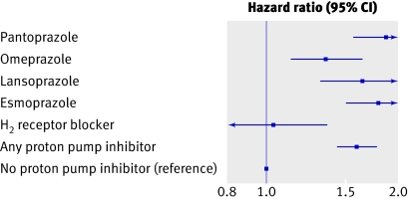
Alternate predictor: H2 blocker
Fig 3. Time dependent adjusted propensity score matched Cox proportional hazard analysis of risk of cardiovascular death, myocardial infarction, or stroke for subtypes of proton pump inhibitors and H₂ receptor blockers

Slide 142
Propensity score caveats
Can only compare subjects whose propensity scores overlap
  Can only generalize to subjects who could have received either treatment
  Limitations similar to exclusions from clinical trials
Important variables may be missing from your model
Most convincing when RR gets farther from 1 with propensity analysis

Slide 143
Propensity score question
Are there examples where:
  1. Propensity score analyses gave substantially different results from traditional multivariate methods (e.g. logistic regression) and
  2. The propensity score answer was closer to the right answer?
TN is still looking!

Slide 144
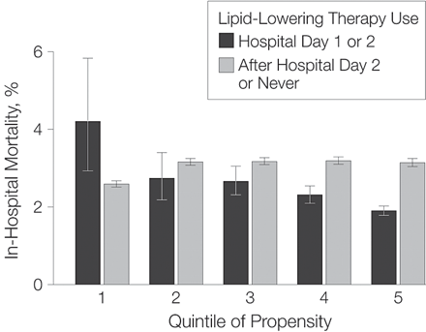
Problem 10.5
Does perioperative use of lipid-lowering drugs decrease mortality following cardiac surgery?
Why are error limits on the first bar so much wider?
Should we encourage everyone to get this treatment?

Slide 145
Hospital cardiac mortality during national cardiology meetings
Retrospective cohort study
Subjects: Medicare beneficiaries (mean age ~79) hospitalized during dates of AHA or ACC meetings 2002-2011 for acute MI (N=8,570), heart failure (N=19,282) or cardiac arrest (N=1,564) or same days of the week for previous and following 3 weeks (N ~6 × higher)
Predictor: hospitalized during or not during meetings
Outcome: 30-day mortality
Jena AB, et al. JAMA Intern Med. 2015;175:237-244

Slide 146
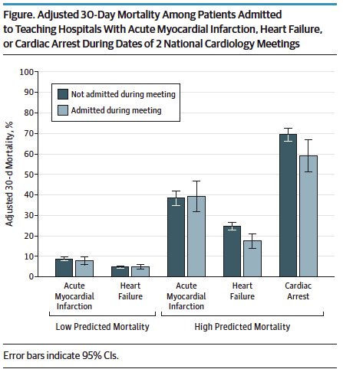
Alternative outcomes and predictors: mortality during national cardiology meetings*
P < .001
No effect in non-teaching hospitals
P < .001
Jena AB, et al. JAMA Intern Med. 2015;175:237-244
Notes:
Jena AB, et al. JAMA Intern Med. 2015;175(2):237-244.
No effect in non-teaching hospitals

Slide 147
30-day cardiac mortality during national cardiology meetings
What would be some possible alternate subjects, predictors and outcomes?
Jena AB, et al. JAMA Intern Med. 2015;175:237-244

Slide 148
30-day cardiac mortality during national cardiology meetings
Alternate subjects: Effect not seen at community hospitals, only academic medical centers.
Alternate predictors: Hospitalization during oncology, gastroenterology, and orthopedics meetings had no effect on cardiac mortality outcomes
Alternate outcomes: Hospitalization during cardiology meetings had no effect on gastrointestinal hemorrhage or hip fracture mortality
Jena AB, et al. JAMA Intern Med. 2015;175:237-244

Slide 149
30-day cardiac mortality during national cardiology meetings
Conclusion: “One explanation for these findings is that the intensity of care provided during meeting dates is lower and that for high-risk patients with cardiovascular disease, the harms of this care may unexpectedly outweigh the benefits.”
Alternative explanations (thanks to Mitch Psotka, Epi 204 student in 2015) :
  Mortality was unusually high before or after meetings due to preparation or catch up
  Lower short term mortality was due to fewer procedures being done, which would affect 90-day mortality favorably even if it caused higher 30-day mortality
Jena AB, et al. JAMA Intern Med. 2015;175:237-244

Slide 150
Estimating biases: Cautionary Tale
Nurses’ Health Study¹
  Vitamin E assoc. with decreased risk of coronary heart disease (CHD; RR ~0.6)
  No significant effect of multiple vitamins
Health Professionals Study²
  Vitamin E assoc. with decreased risk of CHD (RR ~0.6)
  No significant effect of Vitamin C
TN began taking Vitamin E
¹N Engl J Med. 1993;328:1444-9
²N Engl J Med 1993;328:1450-6

Slide 151
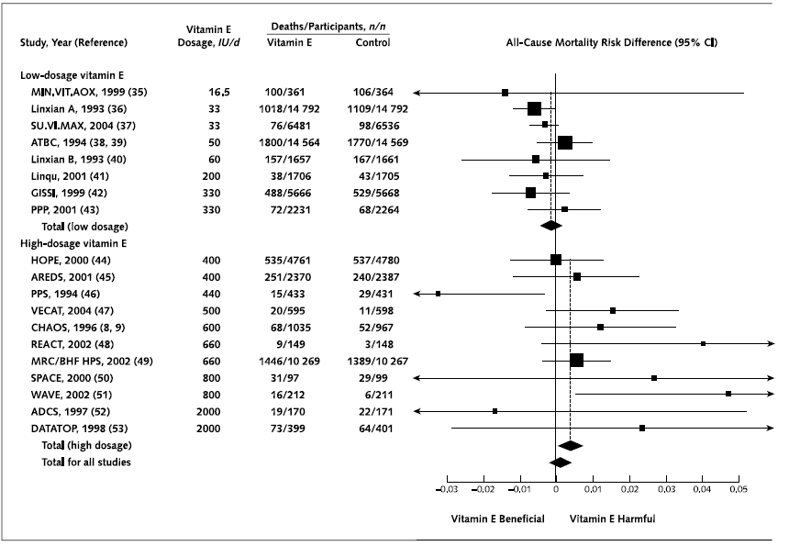
Meta-analysis: high-dosage vitamin E supplementation may increase all-cause mortality
Miller ER et al. Ann Intern Med. 2005 Jan 4;142(1):37-46

Slide 152
Problem 10.1
RQ: Do small doses of mercury in the vaccine preservative thimerosal cause autism?
Data source: electronic data from a large HMO (very high N)
Opportunity:
  Rhogam (Rh Immune Globulin) is given to Rh-negative women during pregnancy (if they get good prenatal care)
  It had 25 mcg of Hg per dose until 2001
  You have data from an electronic record 1990 to the present with blood types, Rhogam, diagnoses of autism
Assume:
  You are interested in effects of 25 mcg of Hg given prenataly
  The incidence of autism has been increasing
  Blood type is not associated with autism
What could you use as an instrument to study the effect of thermosal?
What groups would you compare?

Slide 153
False Discovery Rate (FDR)
A way of dealing with multiple hypothesis testing with very large numbers of hypotheses
Traditional approach (Bonferroni):
  If you are testing k hypotheses, divide alpha by k
  Too conservative for high k.
  Too conservative if hypotheses are related
FDR increasingly used in genetic studies

Slide 154
Basic approach for FDR
Under H₀ the distribution of P-values should be uniform.
So 5% of P <0.05, 1% of P <0.01, etc.
So if we test 1000 hypotheses, expect 10 to have P<0.01 and 1 to have P<0.001 under H₀
  If we observe 10 with P<0.001 (and they are independent) then we estimate 1 is due to chance and 9 are not, for FDR = 10%.
  If we test 1000 hypotheses and observe 5 with P<0.001, we would have FDR = 20%.

Slide 155
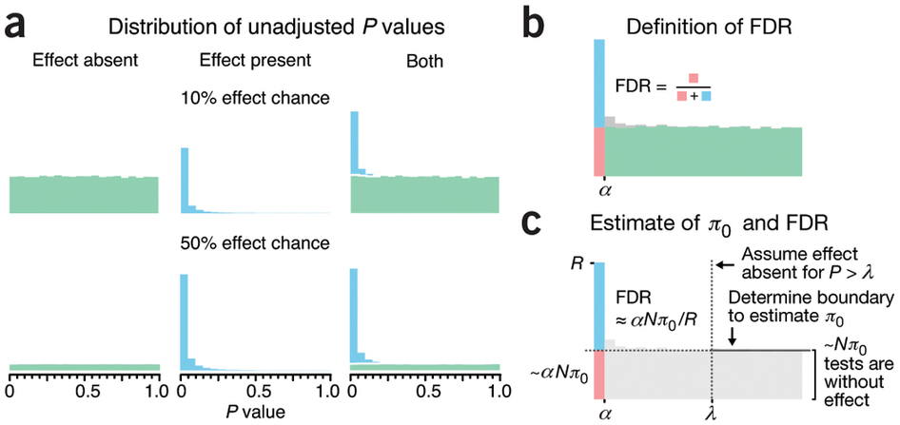
FDR Illustrated
Krzywinski M, Altman N. Nature Methods 11, 355–356 (2014)

Slide 156
Confidence intervals for small numerators*
*Newman TB. If almost nothing goes wrong, is almost everything alright? Interpreting small numerators. JAMA. 1995;274:1013.

Slide 157
Confidence intervals for small numerators
We observe 3 deaths among 500 subjects treated with crabistatin. What is upper limit of the 95% CI for 3/500
Rule of 3,5,7,9,10 for the numerator of the CI if 0,1,2,3,4 is the numerator of the proportion
So it’s 9/500 = 1.8%
  (Exact answer is 1.74%)

Slide 158
Confidence intervals for small numerators: examples
We observe no serious adverse events among 200 subjects treated with crabistatin. What is upper limit of the 95% CI for 0/200?
  1%
  1.5%
  2.5%
  5%
  Can’t tell
Notes:
B. 1.5%. Exact answer = 0.149, but stata gives you the upper limit of the 1-sided 97.5% CI

Slide 159
Notes:
We observe no serious adverse events among 200 subjects treated with crabistatin. What is the upper limit of the 95% CI for 0/200?
https://www.polleverywhere.com/multiple_choice_polls/sDJgrX3imclKnFd

Slide 160
Analogy between diagnostic tests and research studies
Diagnostic Test | Research Study
Absence of disease | Null hypothesis is true
Presence of disease | Alternative hypothesis is true
Severity of illness in the diseased group
Test result
Cutoff for distinguishing positive and negative results
Magnitude of difference between groups
P-value
Alpha

Slide 161
Analogy between diagnostic tests and research studies-2
Diagnostic Test | Research Study
Negative result (test within normal limits)
Positive result
 | Power
False positive rate (1- specificity)
Prior probability of disease
P-value > alpha
P-value < alpha
Sensitivity
Alpha
Prior probability of alternative hypothesis

Slide 162
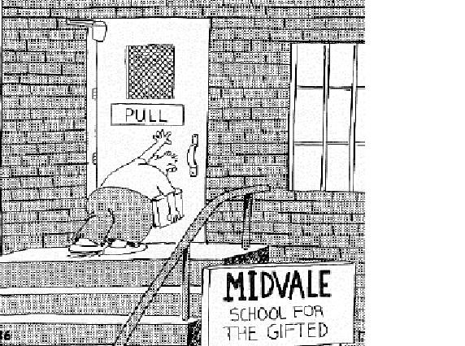
Confidence intervals for small numerators: examples
A diagnostic test has 98% sensitivity in a study that includes 50 patients. What is the approximate LOWER limit of the 95% CI for sensitivity?
  49%
  45/50 = 90%
  47/50 = 94%
  80%
  Can’t tell
Read the question carefully!
Notes:
TP= 49/50, so FN 1/50 so upper limit 5/50 so lower limit of sensitivity = 45/50=90%. Exact answer is 89.4%.

Slide 163
Example: Douglas Altman Definition of 95% Confidence Intervals*
"A strictly correct definition of a 95% CI is, somewhat opaquely, that 95% of such intervals will contain the true population value.
“Little is lost by the less pure interpretation of the CI as the range of values within which we can be 95% sure that the population value lies.”
*Quoted in: Guyatt, G., D. Rennie, et al. (2002). Users' guides to the medical literature : essentials of evidence-based clinical practice. Chicago, IL, AMA Press.

Slide 164
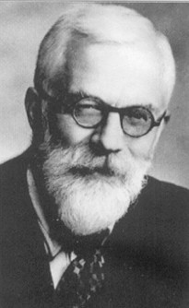
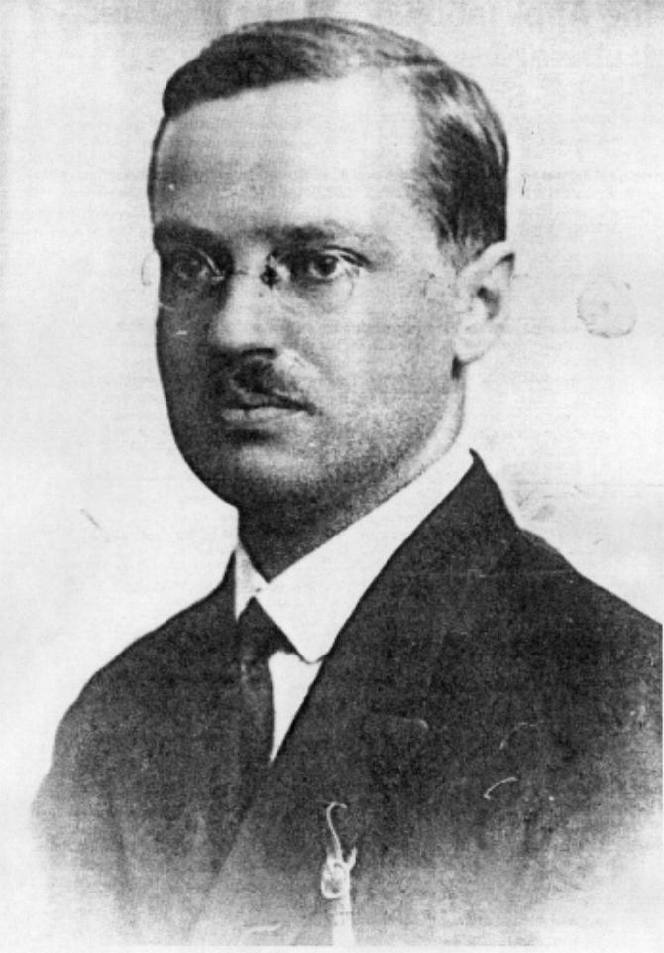
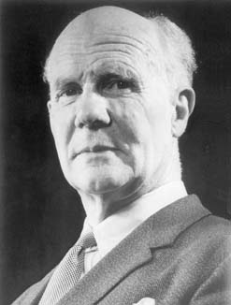
History of P-values and Statistical Significance Testing*
R.A. Fisher, 1920s: P-values as a rough estimate of the strength of evidence against H_{o}
Neyman and Pearson, 1933: Statistical hypothesis testing as way of controlling long term error rates:
  “…without knowing whether each separate hypothesis is true or false, we may search for rules to govern our behavior with regard to them, in following which we insure that, in the long run of experience, we shall not often be wrong.”
*Goodman SN. Seminar Hematol 2008; 45:135-40
Notes:
Potraits, top to bottom: Fisher, Neyman, Pearson

Slide 165

Notes:
A diagnostic test has 98% sensitivity in a study that includes 50 patient. What is the approximate LOWER limit of the 95% CI for sensitivity? (Type answer as a % or "can't tell.")
https://www.polleverywhere.com/free_text_polls/gfSb1CmQfh94JOH

