Slide 1
Start recording!

Slide 2
Alternatives to Randomized Trials for Estimating Treatment Effects and Understanding P-values and Confidence Intervals
Interactive Large Group
Tom Newman, MD, MPH
Notes:
To add to the ILG:
Josh Angrist announcement
Immortal time bias
Counterfactual figure from EBD-2
Noninferiority trials figure from EBD-2

Slide 3
Please turn camera on!
At least 6 of you, and if you ask a question
It's really hard not being able to see your faces.
I don't mind seeing pets, kids, roommates, unmade beds, etc. (though if you are worried about that, you can use a virtual background)

Slide 4
Announcements 2021
These announcements are the only thing different in the 2021 Version of the PPT slides for this week's lecture
  So, if you are reading this, the 2020 version is fine
Exam question was due this AM at 8:30
Section leaders review them and send favorites to Michael and me
Selection for exam depends partly on how many others wrote questions on that material.

Slide 5
Announcements, 2021 (cont'd)
Tues 11/23: No class!
No section on 11/25 (Thanksgiving) or 12/2
Tuesday 11/30: Course review
Tuesday 12/1/20, 6:00 PM: Take-home final will be posted
MONDAY 12/6, 11:59 PM: Exam due
Final to be discussed in following Large Group (12/7)

Slide 6

Fun facts:
1. Norman Hearst and I helped him get started using the draft lottery when he was a grad student at Princeton.
2. First one to review EBD-1 on Amazon

Slide 7
Plan for this session
Discuss any questions about the lecture, homework or reading (including Dirty Dozen article)
Classic example of immortal time bias
  Target trial concept
EBD-2 Problem 9.6
EBD-2 Problem 11.3
95% CI for small numerators (shortcut)

Slide 8
Material covered in lecture
Alternatives to RCT’s (Chapter 9)
  Confounding by indication
  Natural experiments and IV’s
  Falsification tests for bias or confounding
  Immortal time bias
P-values and Confidence intervals (Chapter 11)
  Meaning of P-values; analogy with diagnostic tests
  Confidence intervals
  Bayesian statistics example

Slide 9
Immortal time bias: Classic example
RQ: Do inhaled steroids prevent death or readmissions in COPD patients?
Exposed group: filled a prescription for inhaled steroids within 90 days of discharge
Unexposed group: did not fill a prescription for inhaled steroids within 90 days of discharge
Outcome: readmission to the hospital within 12 months after discharge
Result: 24% decrease in hospitalizations and 29% decrease in mortality
Am J Respir Crit Care Med. 2001;164(4):580-4.
Notes:
Patients who received inhaled corticosteroid therapy postdischarge (within 90 d) had 24% fewer repeat hospitalizations for COPD (95% confidence interval [CI], 22 to 35%) and were 29% less likely to experience mortality (95% CI, 22 to 35%) during 1 yr of follow-up after adjustment for various confounding factors.

Slide 10
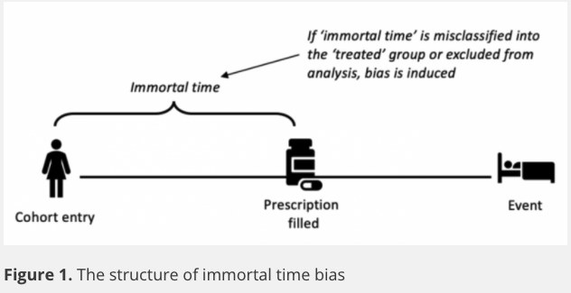
https://catalogofbias.org/biases/immortal-time-bias/

Slide 11
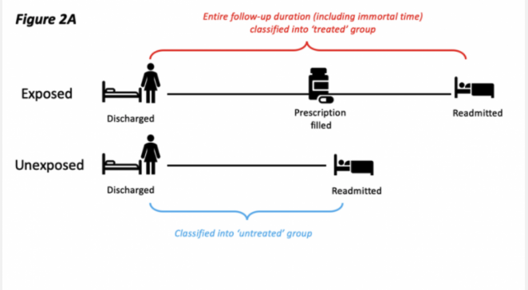

Slide 12
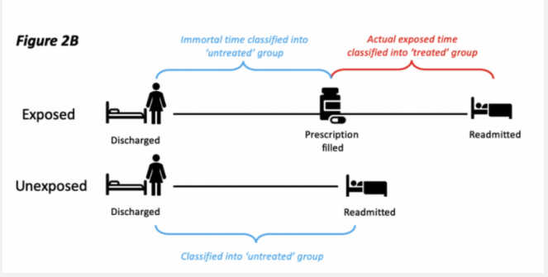

Slide 14
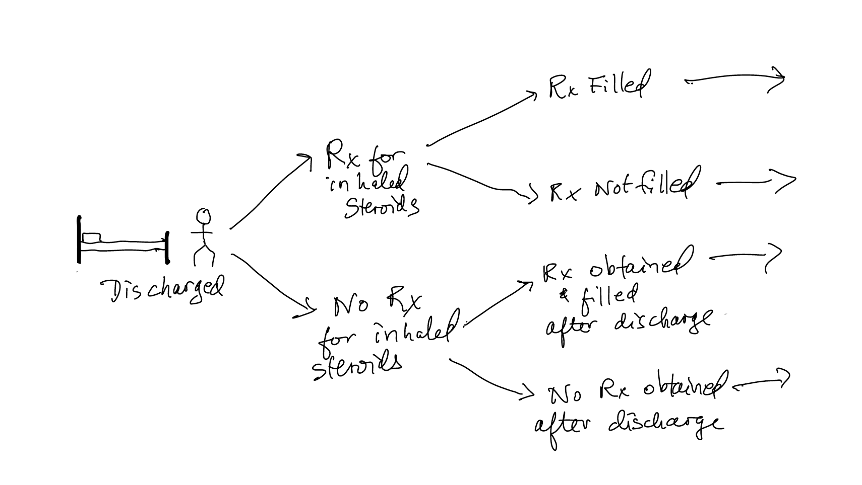
Alternative: Intervention is a prescription at the the time of discharge, regardless of if/when it is filled

Slide 15
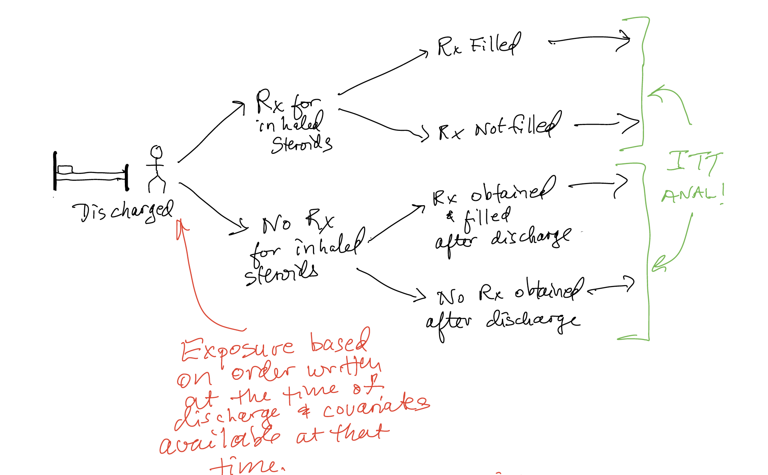
Target trial

Slide 16
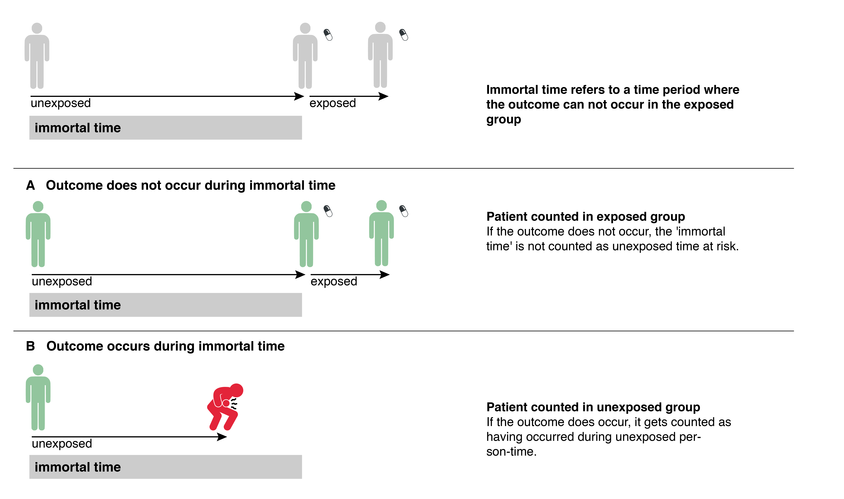
Immortal time bias, Martina's figure

Slide 17
College education and age at first birth (EBD-2 Problem 9.6)
From a New York Times article: "Women with college degrees have children an average of seven years later than those without — and often use the years in between to finish school and build their careers and incomes."
Is there "infertile time bias" here? Explain

Slide 18
Prenatal antidepressants and the risk of autism (EBD-2 Problem 11.3)
Results: Risk of autism spectrum disorder was significantly higher with serotonergic antidepressant exposure (4.51 exposed vs 2.03 unexposed per 1000 person-years…multivariable-adjusted HR, 1.59 (95% CI, 1.17-2.17) After inverse probability of treatment weighting…the association was not significant (HR, 1.61 (95% CI, 0.997-2.59)"
Conclusion was: "…in utero serotonergic antidepressant exposure…was not associated with autism spectrum disorder in the child."
Brown et al. JAMA. 2017;317(15):1544-52

Slide 19
Confidence intervals for small numerators*
*Newman TB. If almost nothing goes wrong, is almost everything alright? Interpreting small numerators. JAMA. 1995;274:1013.

Slide 20
Confidence intervals for small numerators: examples
We observe no serious adverse events among 200 subjects treated with crabistatin. What is upper limit of the 95% CI for 0/200?
  1%
  1.5%
  2.5%
  5%
  Can’t tell
Notes:
B. 1.5%. Exact answer = 0.149, but stata gives you the upper limit of the 1-sided 97.5% CI

Slide 21
Confidence intervals for small numerators
We observe 3 deaths among 500 subjects treated with crabistatin. What is upper limit of the 95% CI for 3/500
Rule of 3,5,7,9,10 for the numerator of the CI if 0,1,2,3,4 is the numerator of the proportion
So it’s 9/500 = 1.8%
  (Exact answer is 1.74%)

Slide 22
Questions?

