Slide 1
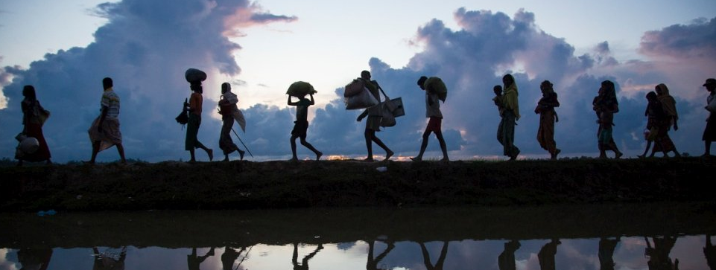
Migration & urbanization
Emily Treleaven
Institute for Social Research
University of Michigan
November 10, 2021
Notes:
Introduction (ISR, research interests).

Slide 2
Outline
Migration
Urbanization
Case studies: parental migration & child health outcomes in Nepal and Cambodia
Q&A

Slide 3
Why should health researchers and providers care about migration and urbanization?
Migrant status, urban residence, and neighborhood are closely tied to health outcomes and disparities
Rapidly changing demographic and macro-economic environment affects program delivery and intervention effectiveness
Changing populations = changing health needs!

Slide 4
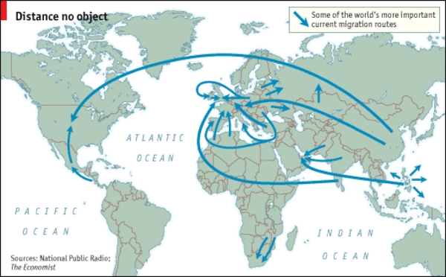
Migration

Slide 5
Definitions: Types of migration
  Movement of individuals from one place to another, crossing geographical boundary
International migration: Movement across national boundaries
Internal migration: Movement within the same country
Forced migration: involuntary forum of migration related to environmental and social factors (such as armed conflict, famine)
  Refugees
  Internally displaced persons
Notes:
Typically use migrant when someone chooses to go
Refugee is someone who has left their home and has no new home to go to (typically international); use IDP for a refugee within their country of origin

Slide 6
Definitions: Migration patterns
By origin and destination: Rural-to-urban, rural-to-rural, urban-to-urban
Temporary vs. permanent
Circular: Temporary and repetitive movement between origin and destination, usually for labor
    Seasonal
Chain migration: process that occurs after a small number of pioneering groups lead the way somewhere else and others from the same community follow.
    Migrant networks
    May lead to clustering of people from a specific region into certain neighborhoods or small towns at the destination

Slide 7
Motivations for migration
Push vs. pull factors
Push factors: Motivations to leave origin
Pull factors: Motivations to go to destination
Common reasons for migration
    Work (labor/economic)
    Education
    Family and/or marriage
    Political (conflict, safety)
    Environmental

Slide 8
Motivations for migration
Family decision-making
  Altruism
  Exchange theory
  Intergenerational solidarity
  New economics of labor migration

Slide 9
Selection factors: Socio-demographic
Age
Gender
Education
Social networks
Socio-economic status

Slide 10
Consequences for family members left behind
Increased income for household of origin via remittances
    Improved diet, nutritional status, and food security
    Retention in school
    Higher health expenditures
    Impacts on care-seeking behaviors
Psychosocial impacts on left behind
Physical impacts for elderly caregivers
    Burden on elderly caregivers
    Access to care, nutrition for children
    Differential impacts by who migrates (feminization of migration)

Slide 11
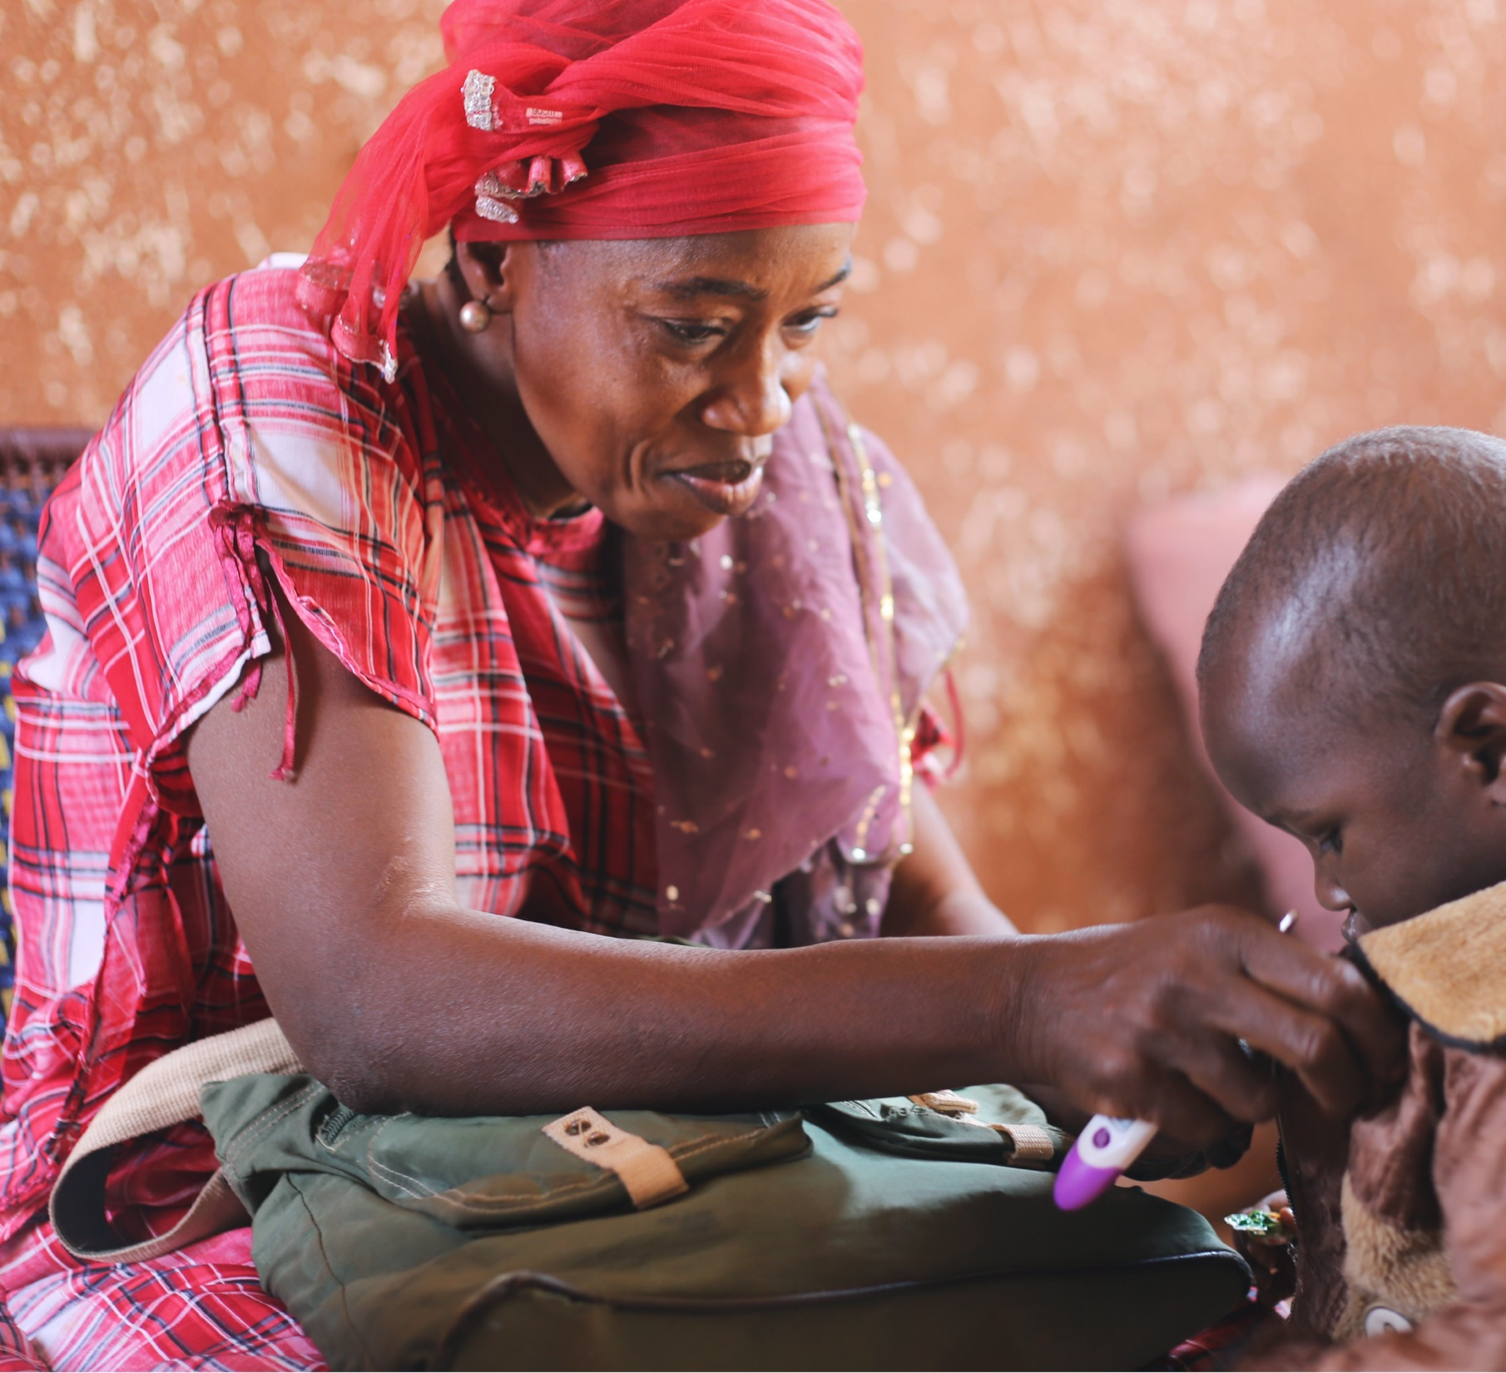
Global trends in migration

Slide 12
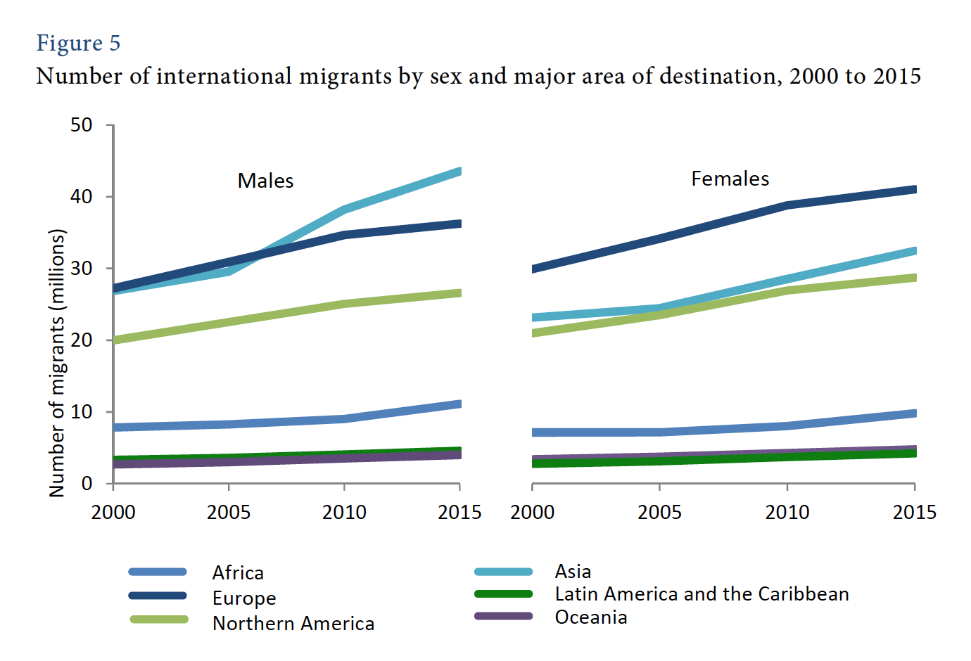
UNDESA 2015
Notes:
Clear increase in overall N migrants
Notice uptick in female migrants: changing opportunities for women – increased female labor force participation
Impacts sending families when a woman migrates

Slide 13
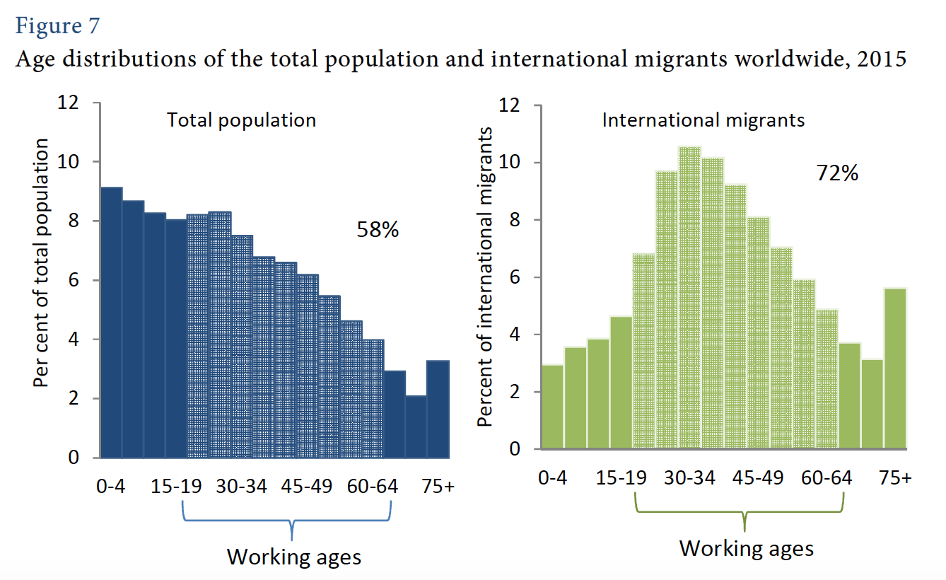
UNDESA 2015
Notes:
We see that it is working age adults who comprise a large proportion of the migrant population
I couldn’t find trends for internal migration (more difficult to track in plcaes without strong record keeping/registration systems….IE many LMICs).... But it’s obviously both more costly and more difficult in terms of visas/permissions/getting somewhere undocumented to go int’l, so chldren may be more likely to migrate internallly, vs. Being left behidn in the care of other relatives when a parent migrates internationally

Slide 14
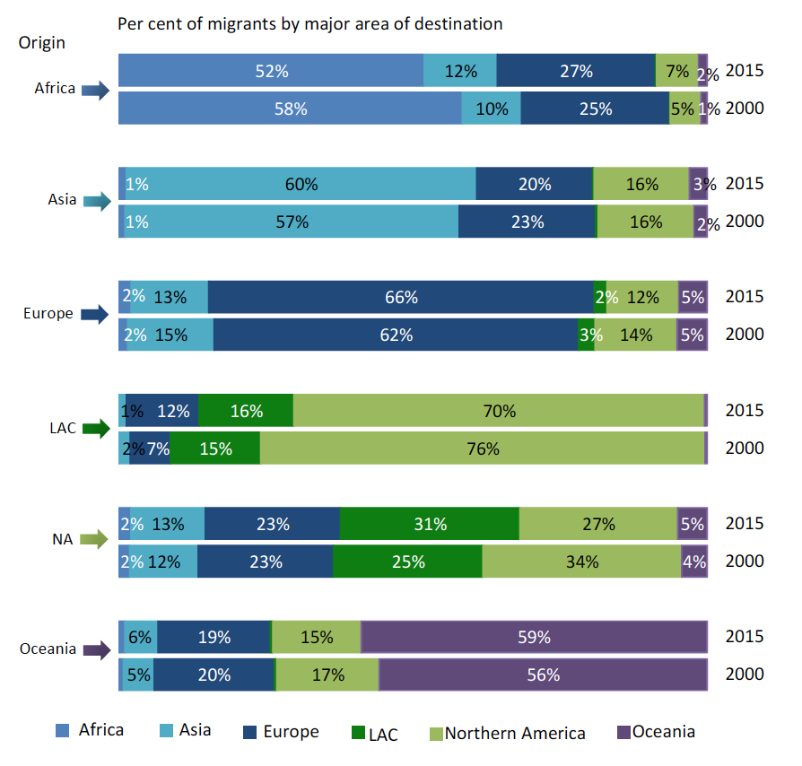
UNDESA 2015

Slide 15
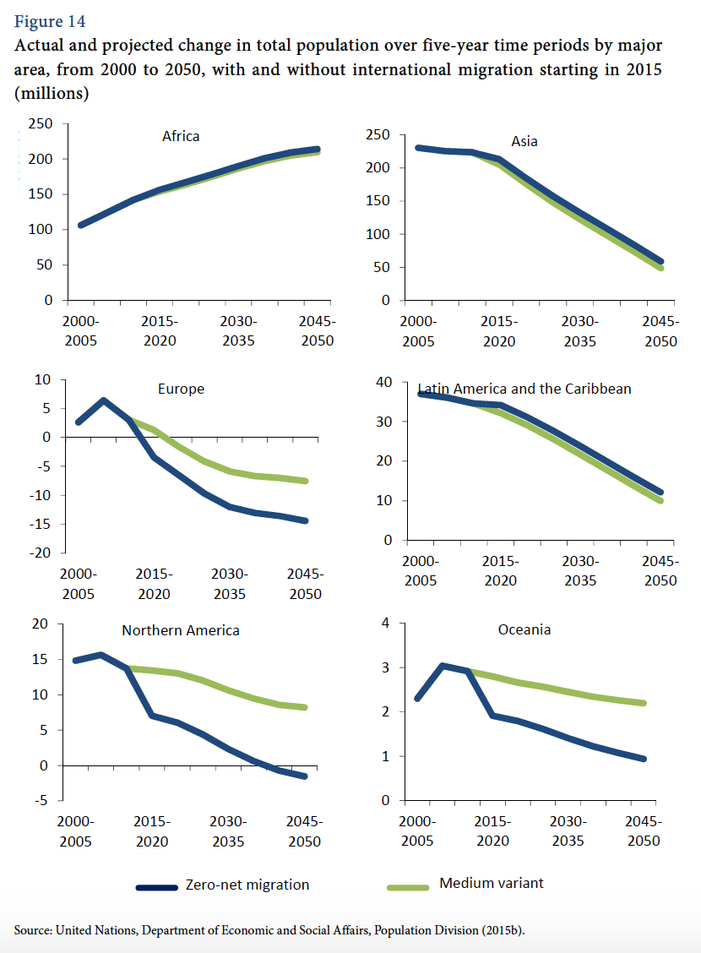
UNDESA 2015

Slide 16


Studying relationships between migration & health
Notes:
This is a photo from Southern Jersery Family Medical Centers showing a Migrant Outreach Coordinator performing a health assessment on a volunteer health promoter who works with other migrant farm workers

Slide 17
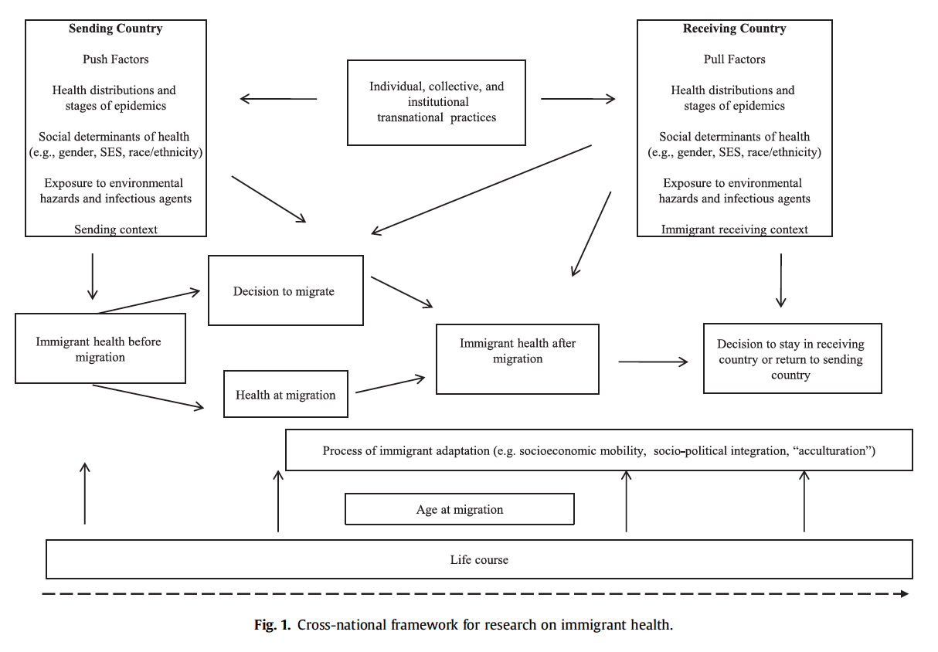
Acevedo Garcia et al 2012
Notes:
Integrating social epidemiology into immigrant health research: A cross-national
Framework
It’s complidated!

Slide 18
Healthy migrant effect
Finding that immigrants have better health status and outcomes than the origin population in many settings (destinations)
Selection of out-migrants by health status
  Healthiest most likely to migrate
  Most likely to be successful migrants
  May be more likely to migrate further (international vs. internal)
Immigrants (at destination) may not represent the distribution of health status of the origin population

Slide 19
Salmon bias
Finding that immigrants have a mortality advantage (longer life expectancy, lower mortality rates) than origin population
Potentially due to unhealthy migrants returning to country/area of origin
    Healthiest migrants remain at destination
    Predictors of return migration are distinct

Slide 20
Epidemiologic paradox
First-generation immigrants to the U.S. are healthier than people of similar ethnic backgrounds born in this country
    Range of health outcomes: infant mortality, adult mortality, birth outcomes, cardiovascular, obesity, among others
    Hummer et al (2007):
        Immigrants to the US from Mexico have lower NMR than white women, US-born Mexican American women, and non-Hispanic black women
        US-born Mexican American have lower NMR than non-Hispanic black women despite similar SES
Notes:
First-hour, first day, and first-week mortality rates among infants born in the U.S. to Mexican immigrant women are about 10% lower than infants of non-Hispanic, white U.S.-born women
Infants born to U.S.-born Mexican American women exhibit rates of mortality that are statistically equal to those of non-Hispanic white women
Infants born to U.S.-born Mexican American women fare considerably better than infants born to non-Hispanic black women, with whom they share similar socioeconomic profiles.

Slide 21
Disruption & adaptation; acculturation
Disruption
    Migrants experience acute financial hardship immediately after migrating
    Unfamiliarity/barriers to accessing health services
Adaptation
    Improved economic status over time
    Increased social networks
    Improved access to health care
    Acculturation: Group level or individual level process of change that occurs when two cultures are in sustained contact with each other (Berry, 1994)

Slide 22
Considerations in health research: theory
Theoretical perspectives/frameworks:
Social determinants (see Acevedo-Garcia et al. 2012)
Structural determinants
Cultural perspective (acculturation)
Intersectionality: What are the moderating effects of different characteristics with migrant status? (age, cohort, gender, SES)

Slide 23
Considerations in health research: study design
Defining
    Population of interest: who counts as a migrant?
    Appropriate reference group
Sampling frame
    Undocumented
    Seasonal/circular migrants
Selection bias
    Healthy migrant effect
    Salmon bias
Notes:
Appropriate reference group (see Ro & Fleischer)
Selection bias—Hummer, Ro & Fleischer

Slide 24
Considerations in health research: study design & modeling
Defining exposure and outcome
Cross-sectional vs. longitudinal data
Length of exposure
Timing of exposure vs. outcome
Endogeneity
  Common causes of migration and outcome of interest (behaviors)
Notes:
Timing of exposure/outcome: DHS

Slide 25
urbanization

Slide 26
Definitions: Urbanization
Urban: Spatial concentration of people whose lives are organized around non-agricultural activities; function of:
    Population size
    Land area
    Ratio of population to space (density)
    Economic and social organization
Notes:
Spectrum from rural to peri-urban to urban

Slide 27
Definitions: Urbanization
Urbanization: Process of social change and reorganization into cities and towns from rural areas (usually marked by shifts from agriculture)
    % of population living in urban areas
    Rate of urbanization: Growth rate of level of urbanization
Urban transition: Predominantly rural predominantly urban

Slide 28
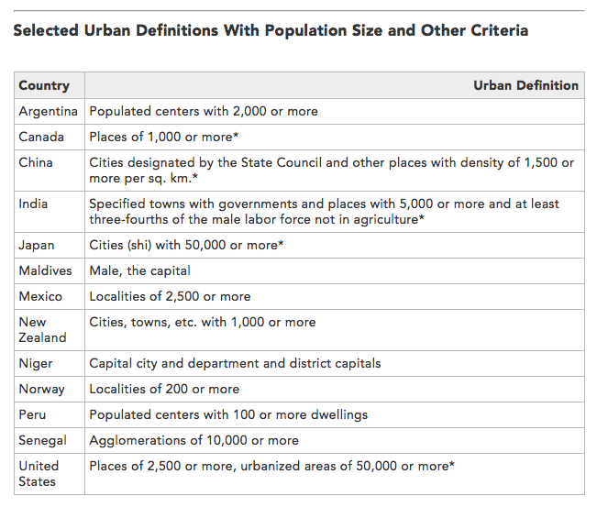
Notes:
A key consideration in examining urbanization is the wide variation in definitions of what is urban, which varies by countries
Source: Population Reference Bureau
http://www.prb.org/Publications/Articles/2009/urbanization.aspx

Slide 29
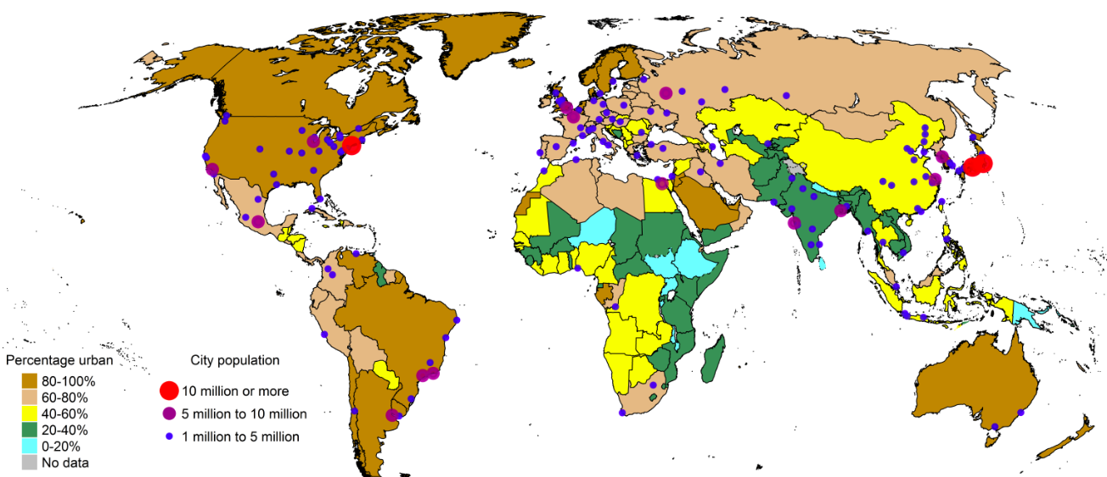
1970: % urban, urban agglomeration by size
UN World Urbanization Prospects, 2014 Revision
Notes:
Not long ago, the vast majority of the world’s population was rural
1850 = 2%
1900 = 6%
1950 = 16%

Slide 30
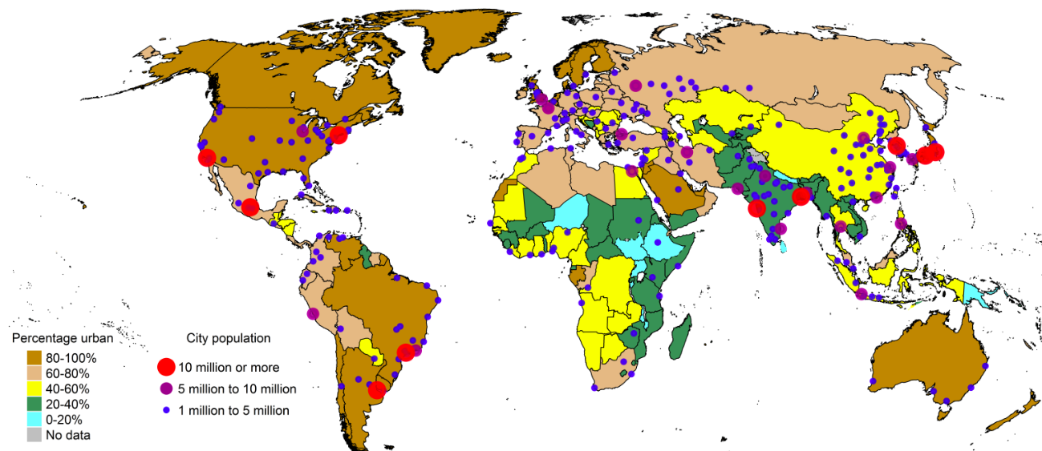
1990

Slide 31
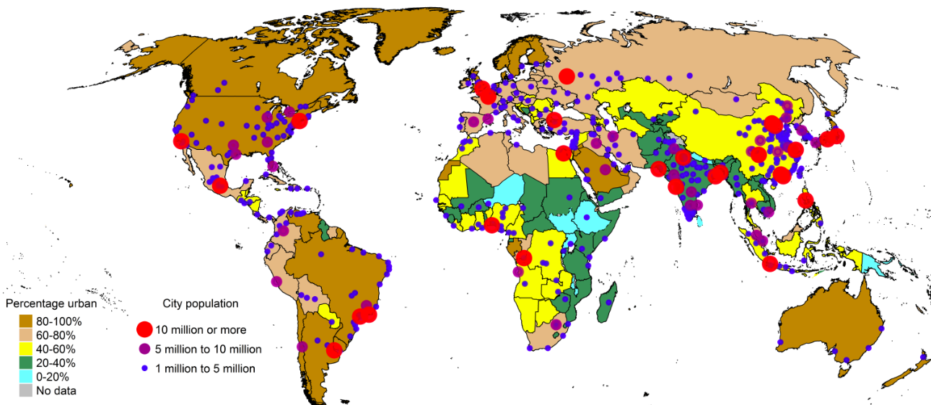
2014

Slide 32
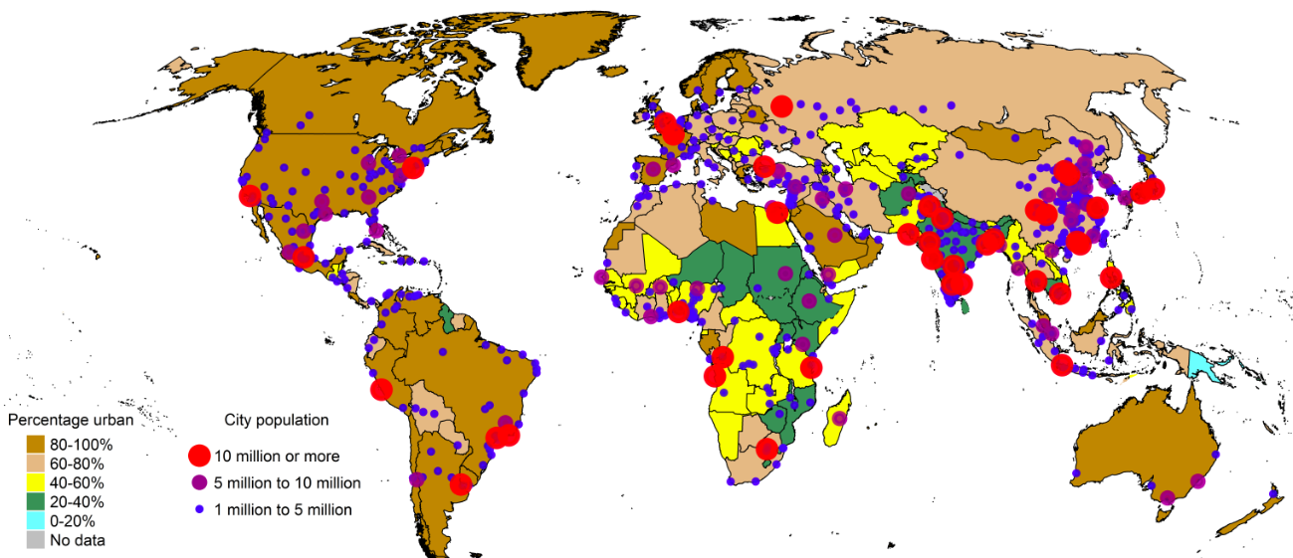
2030 (projected)

Slide 33
Global trends in urbanization
More people live in urban than rural areas (54% of world population)
North America, Latin America, Europe most urbanized
Africa, Asia least urbanized
    Fastest urbanization rates
    Largest cities now concentrated in Global South
Almost half of urban residents live in cities <500,000 population

Slide 34
What contributes to urbanization?
1. Natural population increase
    Fertility
    Mortality
2. Migration
    Rural to urban internal migration
    Rural to urban international migration
3. Reclassification
Notes:
Natural increase = excess of births over death, so for urban areas, the population increase that occurs due to higher fertility than mortality among urbanites
City populations also increase through migration, as new residents move from rural areas to urban areas. This might be internal or international
Important from a heath policy perspective to understand what is driving population growth (or decline) in a specific urban area – ie, if migration is the major cause of growth, that might drive different planning than if it’s primarily through natural growth
- for example, distribution of population within the city will be different, so may need to allocate health services differently, and migrants may have specific health needs
- also means different age structure of population
Early cities had to be constantly replenished by migrants from the hinterlands, because they had higher death rates and lower birth rates than the countryside did, which usually resulted in an annual excess of deaths over births. The economically self-sustaining character of modern urban areas began with the transformation of economies based on agriculture (produced in the countryside) to those based on manufactured goods (produced in the city) and has expanded to those based on servicing the rest of the economy (and often located in the suburbs). Control of the economy made it far easier for cities to dominate rural areas politically and thus ensure their own continued existence in economic terms. (Weeks)
Industrial Revolution created demand for higher population in urban areas
In OECD countries in the 1800s, urban growth due to in-migration (excess mortality in cities; pre-demographic transition globally – high fertility and high mortality in both urban, rural areas)
As urbanization increased in LMICs in last few decades, natural increase was a major factor – in 1990s, accounted for 50-70% of growth in Africa, Asia & LAC
More recently, migration is playing a bigger role, as is reclassification (hard to compare over time and across countries due to changing definitions of urban)
Migration increased in these regions, esp. internal
Generally, better access to contraceptives and with higher cost of living, lower fertility in urban areas compared to rural, so migration plays a larger role in growth
Reclassification: annexation

Slide 35
Natural population growth: Urban areas
Fertility decline in urban areas vs. rural: earlier, faster
    Higher availability of contraception
    Education, income, media exposure
    Changes in marriage patterns
Garenne 2014
Notes:
In developing countries, fertility decline usually has occurred earlier and faster in urban areas than in rural areas, for a variety of reasons, and in particular because of wider availability of modern contraception. Urban areas are also associated with higher levels of income, higher levels of education, and better access to mass media (Rustein, 2002; Westoff et al., 2011).
Source: Garenne, Michel. DHS Analytical Study 42, Trends in Marriage and Contraception in sub-saharan Africa: a Longitudinal perspective on factors of fertility decline

Slide 36
Rural to urban migration
After first demographic transition, migration critical for urban growth
    Age structure impacted by children/parents left behind
If primarily young adults in-migrating:
    Inflated natural increase: higher urban birth rate (reproductive age); lower death rate

Slide 37
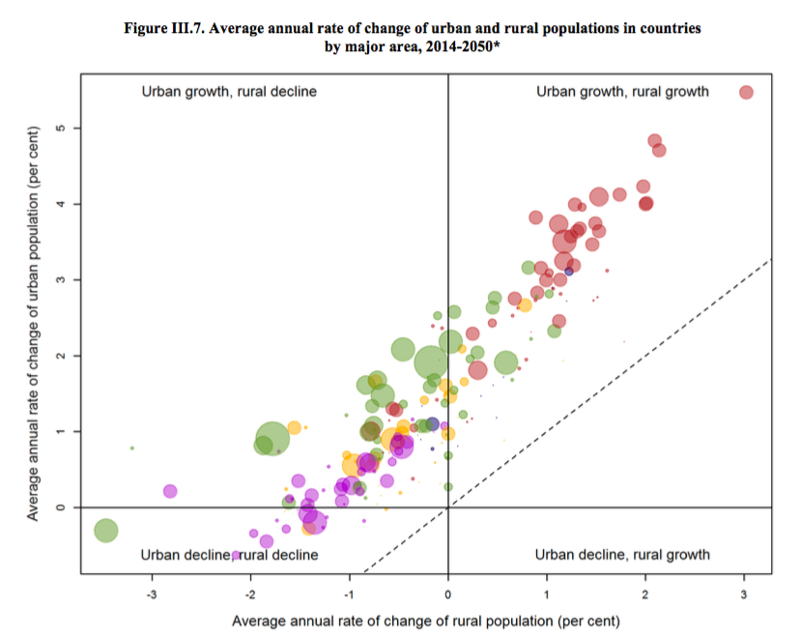
Notes:
This graph shows urban growth on the Y axis and rural growth on the x axis, where each dot is a different country, and the size of the dot represents the relative size of that country’s popluation
Note NO urban decline, rural growth – everyone is urbanizing!
Some developed countries, esp. Europe and Japan are experiencing overall population decline due to below replacement fertility
Asia we see generally movement towards urban areas, and growth in those populations
Africa growth in both urban, rural
Red = Africa
Green = Asia
Yellow = LAC
Purple = North America, Europe
Source: UN World Urbanization Prospects, 2014 Revision

Slide 38
How do cities shape health?
Urban crowding
Transmission dynamics
Exposures
Built environment
Availability or lack of health services
Differences from rural areas
    Economy (cash)
    Social networks
    Diet & physical activity
Notes:
The increase from 300 million urban inhabitants in developing countries in 1950 to 2.6 billion in 2010 (United Nations 2012) has outpaced the absorption capacity of labor markets and the develop- ment of infrastructure and social services, undermining public health and exacerbating the risks of environmental hazards (Lerch).
BUILT ENVIRONMENT: the physical transformation of the physical and natural environment that humans undertake in order to create a place where they can live. It includes the infrastruc- ture for piped water and sewerage, electricity and other types of energy, roads, buildings, parks, and everything else that physically represents what we think of as a city. These neighborhoods represent the context in which much of life will be played out for its residents, and this is an interactive process in which the people help to shape the social and physical fabric of a neighborhood and, at the same time, the na- ture of the neighborhood promotes or constrains the options that people have in life.
. Asia in particular is urbanizing quickly, and is expected to be almost two-thirds urban by 2050 (United Nations Department of Economic and Social Affairs, Population Division 2014). Rather than in megacities, much of this growth is expected to take place in small and medium size cities. These cities and towns tend have higher rates of poverty than large cities, often face shortages of health workers, and lack the physical and health infrastructure to accommodate large population growth (Montgomery 2009; Montgomery and Ezeh 2005a).
PLANNING AND POLICY CHALLENGE!
Crowding, for example, tends to promote the transmission of infec- tious diseases like pneumonia, diarrhea, and tuberculosis (Unger and Riley 2007), and neighbors’ open defecation is negatively associated with child height (Spears 2013).

Slide 39
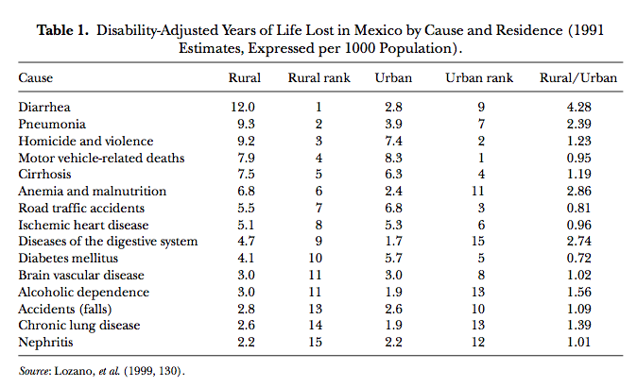
Notes:
Globally, we see differences in urban vs rural mortality causes
Source: Montgomery & Ezeh 2005 in Handbook of Urban Health

Slide 40
Urban advantage vs. penalty
Urban advantage: Lower mortality in urban areas compared to rural
Urban penalty: Excess urban mortality compared to rural areas
Historically, urban penalty in developed countries
Currently, urban advantage in developing countries

Slide 41
Intra-urban inequality
Important to compare within urban inequalities to urban-rural inequalities
Greater variation in SES and education in urban areas
    Important predictors of access to care
Ex: Translates to greater variations in child health outcomes among urban children vs. rural
Notes:
Greater SES-related inequality in child mortality and malnutrition status in urban areas
The urban poor often disadvantaged compared to rural children (vaccination, nutritional status)

Slide 42
Intra-urban health inequalities
Majority of urban growth projected to be in small & midsize cities, but….
Small or midsize cities do not enjoy the same quantity or quality of services available in the largest cities

Slide 43
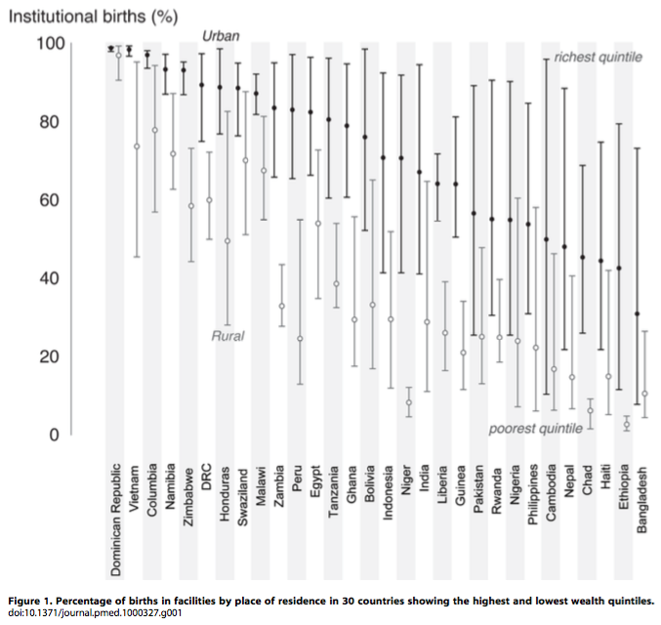
Matthews et al 2010
Notes:
The “urban advantage” is, for some, non-existent. The urban poor do not necessarily have better access to services than the rural poor, despite their proximity to services. Patterns of health inequality differ with context, and there are examples of countries with relatively small degrees of urban inequity.
mining the “Urban Advantage” in Maternal Health Care in Developing Countries, Mathews et al 2010 PLoS One

Slide 44
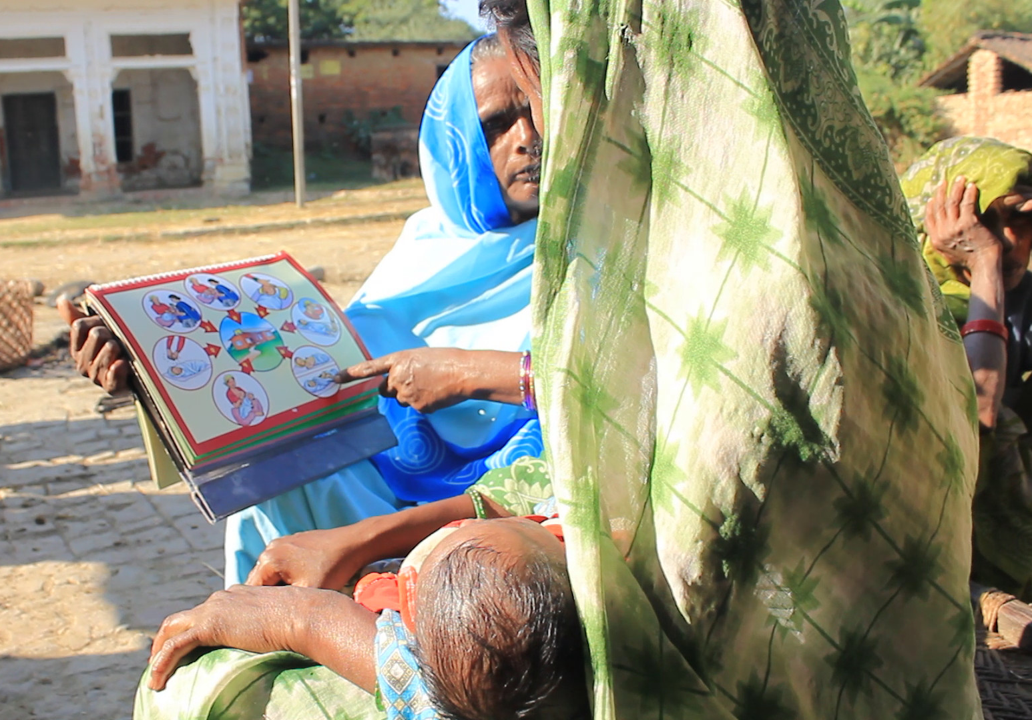
Case studies: parental migration & child health
Notes:
This is a photo from USAID Nepal showing a FCHV counseling a mother and baby

Slide 45
Case study 1: cambodia
As out-migration increases, how does increasing diversity in children’s living arrangements associate with children’s health disparities?
How do skipped-generation migrant-sending families make decisions for children’s health?
Notes:
Research on family structure and child health in many settings—including US—suggests that different family structures are associated with variation in children’s health outcomes
What is this relationship like in a setting with high rates of labor migration
And in particular, what is the experience of children in skipped gen families?

Slide 46
Family structure & child outcomes: Cambodia DHS
4 waves of the Camobdia Demographic & Health Survey (2000, 2005, 2010, 2014)
Analytic sample = 15,774 children under 5 with information on living arrangements and nutritional status
Measures
    Outcome = wasting
    Living arrangements: nuclear (reference), multigenerational, single parent, skipped-generation
Multilevel mixed-effects regression models
Notes:
Restricted to children with two living parents: sample EXCLUDES children whose parents have died. This is so I can strengthen assumption that parents not co-resident are migrants
Excludes children living in institutions or apart from a parent or grandparent (children in “other” situations was too small of a group to examine analytically)
Multilevel mixed-effects regression models
Random effects for village (PSU), household
All individual, household covariates entered as fixed effects
Estimate average marginal effects from Model 3
Model 1: Socio-demographic controls
Model 2: Adds year of survey
Model 3: Adds household wealth (mediator)
Model 4: Adds interaction term: living arrangement X year

Slide 47
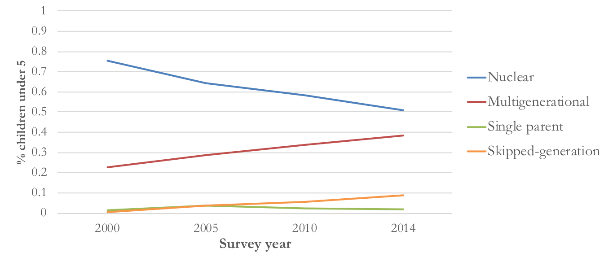
Family structure & child outcomes: Cambodia DHS
Notes:
Living arrangements of children under five with two living parents, Cambodia DHS 2000 to 2014 (N=15,774)

Slide 48
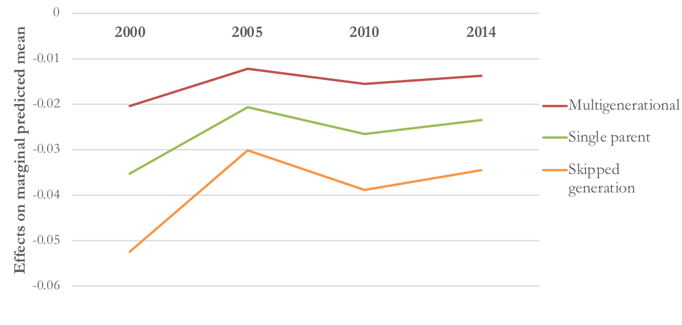
Family structure & child outcomes: Cambodia DHS
Notes:
I estimated AMEs from a model with controls for child age and sex, household characteristics including wealth, and year of survey. AMEs are shown here by living arrangement (compared to nuclear families) and survey year. The takeaway is that compared to children in nuclear households, children in skipped-generation HH have significantly lower odds of acute malnutrition, but that the relative advantage has sig decreased over time
AME = average change in probability of wasting for a (1 unit) change in living arrangements (ie, from nuclear to SG) for all members of the population with all covariates held at their actual values (rather than at their means)

Slide 49
Healthcare decision-making in skipped-generation families
In-depth interviews with 25 grandparent caregivers in 4 provinces in Cambodia
    Caregivers for 1+ grandchild <10 year of age in a skipped-generation household
    Age range 42-74 (median 61.5)
    20 women, 5 men
    SES ranged stable to food insecure
Semi-structured interview guide
Open coding, grounded theory approach
Treleaven & Ngin 2021
Notes:
Restricted to children with two living parents: sample EXCLUDES children whose parents have died. This is so I can strengthen assumption that parents not co-resident are migrants
Excludes children living in institutions or apart from a parent or grandparent (children in “other” situations was too small of a group to examine analytically)
Multilevel mixed-effects regression models
Random effects for village (PSU), household
All individual, household covariates entered as fixed effects
Estimate average marginal effects from Model 3
Model 1: Socio-demographic controls
Model 2: Adds year of survey
Model 3: Adds household wealth (mediator)
Model 4: Adds interaction term: living arrangement X year

Slide 50
Healthcare decision-making in skipped-generation families
Grandparents act as gatekeepers of information about illness and control parents’ involvement
Grandparents relied on financial and social support to help grandchildren reach care
Parents primarily involved to fund care except in cases of very severe illness
    Remittance frequency, method tied to care decisions
    Provider payment method more important than overall cost to grandparents
Parents within Cambodia more involved in decisions than parents who migrated internationally
Notes:
DESCRIBE…
Now I’ll read a few quotes that illustrate the variation in experience of these households, and how closely the experience of the family left behind is tied to the economic success—or lack thereof—of the migrant family member

Slide 51
“Whenever my granddaughter needs medicine, [her mother] always send the money. I don't need to worry … I don't need to wait until the end of the month.”
Notes:
The elderly grandmother of two in Kandal relied on monthly remittances from two migrant daughters working in Thailand; the family's financial position had improved after her daughters left.

Slide 52
“We could access the public hospital because we could be treated even though we don’t have enough money. We are unable to pay for the private clinic. However, we are very busy and have to take care of our home. That’s why we decided to go to the private clinic.”

Slide 53
“I cannot owe money to the pharmacist for so long. If the pharmacist injects medicine today, he will come to get money tomorrow about 7 or 8 am … I borrow money from my neighbor and when I have money, I will pay them back … Sometimes, my daughter asks her boss to get her salary advanced. It is so difficult for my family.”
Notes:
grandmother in Kandal lived with her husband, her own elderly father, and two grandchildren; the household regularly experienced food insecurity. As their migrant daughter did not earn enough working in a restaurant in Phnom Penh to regularly remit, the grandmother faced financial challenges when her grandchildren fell ill

Slide 54
Case study 2: nepal
How does community context affect the relationship between parental migration and child health?
How does selection into migration affect the relationship between parental migration and child health?
Notes:
I now work with a 26 year panel study in Nepal, the Chitwan Valley Family Study (CVFS), that is an excellent data source to study migration because labor migration is prevalent in the area and IMPORTANTLY CVFS has documented measures of migration—timing and destination—prospectively over time. So we know more than with a cross-sectional data source like the DHS.
I’ll present some preliminary models related to a few questions on migration and child health I am working on using CVFS data

Slide 55
Community context as an effect modifier?
Low migration prevalence neighborhoods (N=843)
 | OR | SE | 95% CI
Father ever migrated internationally 3+ months | 0.70 | 0.13 | 0.49 | 1.02
High migration prevalence neighborhoods (N=947)
 | OR | SE | 95% CI
Father ever migrated internationally 3+ months | 1.27 | 0.21 | 0.93 | 1.75
Controlling for child age, sex, ethnicity, parental education, household SES, and neighborhood infrastructure
Notes:
Looking at the association between father’s international migration (ever migrated 3+ months during child’s lifetime) and the risk of stunting among children under 10, stratified by the proportion of all households in a neighborhood that had sent an international migrant in the preceding year (<50% vs 50+%)
Using mixed-effects regression models that have a random effect for neighborhood
And while both CIs include 1, this still illustrates that there seems to be some effect modification by community migration prevalence here
When we look at underweight as a nutritional outcome, we see similarly low rates in low migration prevalence neighborhoods, but not in high migration neighborhoods
Median 51%, SD 15%, range 0-94%

Slide 56
What is the role of selection into migration?
Stunting among children under 10 (N=1152)
 | OR | SE | 95% CI
Father ever migrated during child’s lifetime | 1.91 | 0.32 | 1.38 | 2.64
Father ever migrated prior to child’s lifetime | 1.33 | 0.36 | 0.79 | 2.24
Wasting among children under 5 (N=680)
 | OR | SE | 95% CI
Father ever migrated during child’s lifetime | 0.71 | 0.23 | 0.38 | 1.35
Father ever migrated prior to child’s lifetime | 0.60 | 0.26 | 0.25 | 1.41
Controlling for child age, sex, ethnicity, parental education, household SES
Notes:
We often compare migrant-sending households to non-migrant sending households….but depending on how we measure “migrant-sending” we might have some major misclassification bias. To look at this, I divided children in CVFS into 3 groups:
Children whose father had migrated internationally for 3+ months at any time during their lifetime
Children whose father had never migrated internationally during their own lifetime (never migrants)
And a third group of children whose father had migrated internationally for 3+ months before the child was born, but not during their lifetime—so these are men who HAVE migrated, but we might misclassify them as non-migrants because they did not migrate during their child’s lifetime
We can then compare the 3 groups---assuming there are financial benefits of migration, and detrimental effects of parental absence, this 3 way comparison can get at the effects of wealth vs. parental absence, and how that affects children’s nutritional status
This are mixed-effects regression models that have a random effect for neighborhood look at the association between paternal migration and child’s risk of stunting
And we see children whose father migrated DURING their lifetime have a sig higher risk of stunting, while children whose father migrated prior to their lifetime are not sig different than children of never migrants
But when we look at wasting, we don’t see a significant difference between groups, but it appears that in this case the children of ever migrants are better off than never migrants
SO together, these relationships suggest there may be something to the timing of migration in a child’s lifetime, and the potential accumulation of resources associated with migration
Next steps are looking more specifically at remittances and household wealth and circumstances, and how those change over time with parents’ migration

Slide 57
Q&A

Slide 58
References
Astone, Nan. 2009. “Urban Demography.” Retrieved (http://ocw.jhsph.edu/courses/PrinciplesPopulationChange/PDFs/PopChange-sec8_Astone.pdf).
Haub, Carl. 2009. “What Is a City? What Is Urbanization?” Population Reference Bureau. Retrieved (http://www.prb.org/Publications/Articles/2009/urbanization.aspx).
Fink, Günther, Isabel Günther, and Kenneth Hill. 2014. “Slum Residence and Child Health in Developing Countries.” Demography 51(4):1175–97.
Massey, Douglas S. and Nancy A. Denton. 1988. “The Dimensions of Residential Segregation.” Social Forces 67(2):281.
Matthews, Zoë et al. 2010. “Examining the ‘Urban Advantage’ in Maternal Health Care in Developing Countries.” PLoS Medicine 7(9):e1000327.
Montgomery, Mark R. 2009. Urban Poverty and Health in Developing Countries. Population Reference Bureau Washington, DC. Retrieved August 28, 2015 (http://www.prb.org/pdf09/64.2urbanization.pdf).
Montgomery, Mark R. and Alex C. Ezeh. 2005. “Urban Health in Developing Countries.” Pp. 317–60 in Handbook of Urban Health, edited by S. Galea and D. Vlahov. Springer US. Retrieved August 28, 2015 (http://link.springer.com.ucsf.idm.oclc.org/chapter/10.1007/0-387-25822-1_17).
Nolan, Laura B. 2015. “Slum Definitions in Urban India: Implications for the Measurement of Health Inequalities.” Population and Development Review 41(1):59–84.
United Nations Department of Economic and Social Affairs, Population Division. 2014. World Urbanization Prospects: The 2014 Revision : Highlights. United Nations. Retrieved (http://esa.un.org/unpd/wup/Highlights/WUP2014-Highlights.pdf).
Weeks, John R. 2008. Population: An Introduction to Concepts and Issues. 10th ed. Belmont, CA: Thompson-Wadsworth.

