Slide 1

Directed Acyclic Graphs – Part III
Epidemiology 207 - Epidemiology Methods II
Rebecca E. Graff, ScD
Assistant Professor, Department of Epidemiology & Biostatistics
Based on Slides from Maria Glymour and Miguel Hernán

Slide 2
Learning Objectives (Weeks 2 & 3)
Overview of DAGs
Research Design Interlude
DAGs for Common Problems in Epidemiology
  Confounding
  Bias in RCTs
  Selection Bias
  Measurement Bias
Limitations of DAGs
2

Slide 3
DAGs for Common Problems in Epidemiology
Bias in RCTs

Slide 4
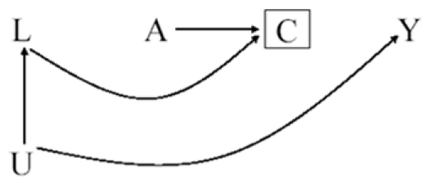
Example RCT
A: ART Treatment Arm
Y: 3-year Risk of Death
U: Level of Immunosuppression
L: Symptoms, CD4 Count, etc.
C: Loss to Follow-up
4

Slide 5
Confounding & Selection Bias
Can confounding occur in this marginally randomized RCT?
  No
Can selection bias occur in this marginally randomized RCT?
  Yes
5
Notes:
There are no common causes of A and any other variable on account of treatment being randomly assigned
Individuals in both randomized experiments and observational studies may be lost to follow-up or drop out of the study before their outcome is ascertained.

Slide 6
More on Selection Bias in RCTs
⛔️ Pr(Y = 1 | A = a)
✅ Pr(Y = 1 | A = a, C = 0)
Randomization protects against confounding, but not necessarily against selection bias
6
Notes:
When individuals are lost to follow-up the risk of the outcome among those assigned to antiretrovirals and among those assigned to no therapy cannot be computed because the value of the outcome Y is unknown for the censored individuals (C = 1).
Only the risks among the uncensored Pr[Y= 1|A = a, C = 0] can be computed.
Unfortunately, this restriction of the analysis to the uncensored individuals induces selection bias.
Uncensored individuals who remained through the end of the study (C = 0) are not exchangeable with individuals that were lost (C = 1); conditioning on the collider C induces an association between A and Y

Slide 7
Selection Before Randomization
A: ART Treatment Arm
Y: 3-year Risk of Death
U: Level of Immunosuppression
L: Symptoms, CD4 Count, etc.
C: Volunteer Status
C
A
Y
L
U
7
Notes:
No bias arises in randomized experiments from selection into the study before treatment is assigned.
Even though only volunteers are included in RCTs, they are not affected by volunteer bias because participants are randomly assigned to treatment only after agreeing to participate (C = 0).
Generalizability or external validity will be affected, but the results from the randomized trial will be internally valid

Slide 8
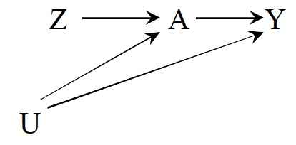
Noncompliance
For example:
  Z: Exposure assignment
  A: Exposure
  Y: Outcome
  U: Factors affecting adherence and the outcome
What kind of analysis looks at the effect of A on Y?
What kind of analysis looks at the effect of Z on Y?
→ as-treated
→ intention-to-treat
8
Notes:
intention to treat is generally favored in randomized experiments to preserve the lack of confounding that is guaranteed by randomization in large enough samples

Slide 9
Unblinding
How might you draw a DAG representing unblinding?
  Z: Exposure assignment
  A: Exposure
  Y: Outcome
  U: Blinded status
9

Slide 10
Unblinding
How might you draw a DAG representing unblinding?
  Z: Exposure assignment
  A: Exposure
  Y: Outcome
  U: Blinded status
10

