Slide 1

Directed Acyclic Graphs – Part IV
Epidemiology 207 - Epidemiology Methods II
Rebecca E. Graff, ScD
Assistant Professor, Department of Epidemiology & Biostatistics
Based on Slides from Maria Glymour and Miguel Hernán

Slide 2
Learning Objectives (Weeks 2 & 3)
Overview of DAGs
Research Design Interlude
DAGs for Common Problems in Epidemiology
  Confounding
  Bias in RCTs
  Selection Bias
  Measurement Bias
Limitations of DAGs
2

Slide 3
Questions from the Recorded Lecture?

Slide 4
DAGs for Common Problems in Epidemiology
Selection Bias

Slide 5
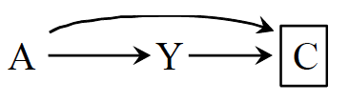
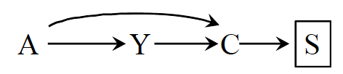
What is Selection Bias?
Bias due to the process used to select subjects into the study or into the analysis
Consequence of conditioning on a common effect of exposure and outcome
  Or on a common effect of a cause of the exposure and a cause of the outcome
5
Notes:
Two sources of association:
the causal effect of A on Y
The open path between A and Y resulting from conditioning on a common effect
These DAGs are EXAMPLES
Even within types of bias, there isn’t only one structure that represents the bias in all its forms
Depends on the causal questions, the nodes and relationships among them can change.
Selection bias can also be a common effect of a cause of exposure and the outcome itself or a common effect of the exposure itself and a cause of the outcome

Slide 6
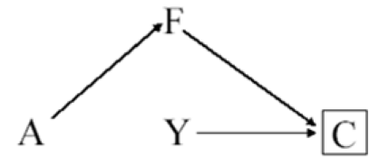
Inappropriate Selection of Controls
For example:
  A: Postmenopausal hormones
  Y: Coronary heart disease
  F: Hip fracture
  C: Selection into study
6
Notes:
The arrow from disease status Y to selection C indicates that cases in the population are more likely to be selected than non-cases, which is the defining feature of a case-control study.
In this case-control study, the investigator decided to select controls (C = 0) preferentially among women with a hip fracture.
Because treatment A has a protective causal effect on hip fracture, the selection of controls with hip fracture implies that treatment A now has a causal effect on selection C.
In a case-control study, the odds ratio is by definition conditional on having been selected into the study (C = 0). If individuals with hip fracture are oversampled as controls, then the probability of control selection depends on a consequence of treatment A (as represented by the path from A to C) and “inappropriate control selection” bias will occur.
Again, this bias arises because we are conditioning on a common effect C of treatment and outcome.
A heuristic explanation of this bias :
Among individuals selected for the study (C = 0), controls are more likely than cases to have had a hip fracture.
Therefore, because estrogens lower the incidence of hip fractures, a control is less likely to be on estrogens than a case, and hence the A-Y odds ratio conditional on C = 0 would be greater than the causal odds ratio in the population.

Slide 7
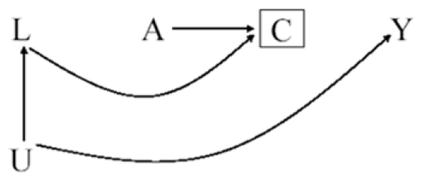
Differential Loss to Follow-up
For example:
  A: Antiretroviral therapy
  Y: AIDS
  C: Censoring
  L: Symptoms, CD4, viral load
  U: Immunologic status
7
Notes:
DAG from DAGs for RCT lecture
Example of what the structure of differential loss to follow-up (i.e., informative censoring) can look like
Differential loss to follow-up can take on many forms
In addition, other types of bias can take on the same form

Slide 8
Non-response / Missing Data Bias
For example:
  A: Antiretroviral therapy
  Y: AIDS
  C: Reluctance to answer questions
  L: Symptoms, CD4, viral load
  U: Immunologic status
8
Notes:
The variable C can represent missing data on the outcome for any reason, not just as a result of loss to follow up.
For example, individuals could have missing data because they are reluctant to provide information or because they miss study visits.
Regardless of the reasons why data on Y are missing, restricting the analysis to individuals with complete data (C = 0) may result in bias.

Slide 9
Exercise
How might you draw a DAG representing volunteer (self-selection) bias?
  A: Smoking
  Y: Coronary heart disease
  C: Volunteered to participate
  L: Heart disease awareness
  U: Family history of heart disease
9

Slide 10
Exercise – Solution
How might you draw a DAG representing volunteer (self-selection) bias?
  A: Smoking
  Y: Coronary heart disease
  C: Volunteered to
  participate
  L: Heart disease awareness
  U: Family history of heart disease
10

Slide 11
Another Healthy Worker Bias
For example:
  A: Chemical exposure
  Y: Death
  C: Being at work
  L: Physical exam
  U: Health status
11
Notes:
The study is restricted to individuals who are at work (C = 0) at the time of outcome ascertainment.
Being exposed to the chemical reduces the probability of being at work in the near future (e.g., exposure can cause disabling asthma)

Slide 12
Prevalent User Bias
A
Y₋₁
C
Y₁
L
For example:
  A: Aspirin use
  Y₋₁: Death before time 0
  Y₁: Death after time 0
  C: Selection into study
  L: Exercise
12
Notes:
This creates a potential collider bias because exposed individuals who do not have the event prior to T₀ may have other characteristics (L) that protected them from an early event and also bias associations with later event rates.

Slide 13
Adjusting for Selection Bias
Design
  E.g., sampling controls that represent the exposure distribution in the population
Analysis
  Stratification
13
Notes:
Stratification boxes nodes
In this DAG representing differential loss to follow-up, we can stratify on L to deal with the selection bias

Slide 14
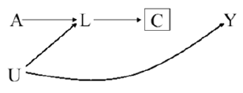
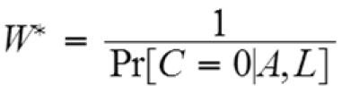
Adjusting for Selection Bias
But what about this DAG?
  Stratification doesn’t work!
Inverse Probability Censoring Weighting
    Same concept as IPW
    But treat censoring as the “exposure”
    Everyone in the pseudo-population is uncensored
14
Notes:
Differential loss to follow-up can also take on this structure
C is a descendant of L, so we already have an open pathway between A and Y
To close the pathway, we can remove any arrows into C via inverse probability censoring weighting
Inverse probability weighting appropriately adjusts for selection bias in this situation because this approach is not based on estimating effect measures conditional on the covariates L, but rather on estimating unconditional effect measures after reweighting the subjects according to their exposure and their values of L.
Stratification boxes nodes, whereas IPW removes arrows

Slide 15
DAGs for Common Problems in Epidemiology
Measurement Bias
Notes:
Also called information bias

Slide 16
What is Measurement Bias?
Bias due measurement of study variables with error, such that the observed associational measure does not equal the causal measure
No single structure describing measurement bias
16

Slide 17
Relevant Variables
For example:
  A: Exposure
  A*: Exposure measurement
  U_{A}: Factors other than A that determine the value of A* (i.e., measurement error)
  Y: Outcome
  Y*: Outcome measurement
  U_{Y}: Factors other than Y that determine the value of Y* (i.e., measurement error)
17

Slide 18
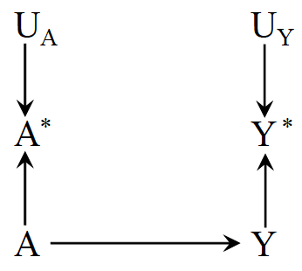
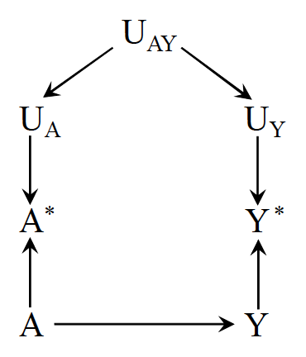
Nondifferential Measurement Error
Independent nondifferential measurement error
Dependent nondifferential measurement error
18
Notes:
E.g., A = cholesterol-lowering drugs, Y = liver disease
According to the rules of d-separation, the measurement errors Ua and Uy are independent because the path between them is blocked by colliders (either A* or Y*)
E.g., haphazard data entry errors
In other settings, however, the measurement errors for exposure and outcome may be dependent, as depicted in the second figure
For example, dependent measurement errors will occur if the information were obtained retrospectively by phone interview and an individual’s ability to recall her medical history (Uay) affected the measurement of both A and Y.
Both Figures represent settings in which the error for treatment Ua is independent of the true value of the outcome Y, and the error for the outcome Uy is independent of the true value of treatment A.
We then say that the measurement error for treatment is nondifferential with respect to the outcome and that the measurement error for the outcome is nondifferential with respect to the treatment.
Note that the mismeasured variables are NOT boxed
We aren’t conditioning on mismeasurement

Slide 19
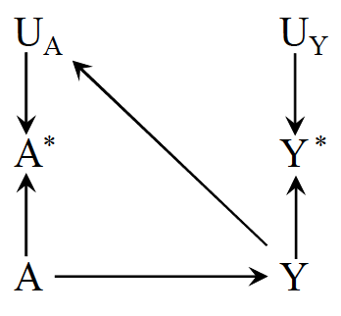
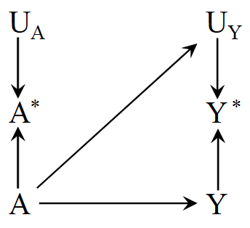
Independent Differential Measurement Error
Independent differential measurement error of exposure
Independent differential measurement error of outcome
19
Notes:
In the first figure, measurement errors of treatment and outcome are independent but differential, such that the true value of the outcome affects the measurement of the treatment
E.g., A = drug use, Y = dementia
A ascertained by interviewing demented study participants
The second figure, shows an example of independent but differential measurement error in which the true value of the treatment affects the measurement of the outcome (i.e., an arrow from A to Uy).
E.g., A differential measurement error of the outcome will occur if physicians, suspecting that drug use A causes liver toxicity Y, monitored patients receiving drug more closely than other patients.
Note that the mismeasured variables are NOT boxed
We aren’t conditioning on mismeasurement

Slide 20
Exercise
How might you draw a DAG representing recall bias?
  A: Alcohol use
  A*: Recalled alcohol use
  U_{A}: Factors other than A that determine the value of A* (i.e., measurement error)
  Y: Birth defects
  U_{Y}: Factors other than Y that determine the value of Y* (i.e., measurement error)
20

Slide 21
Exercise – Solution
How might you draw a DAG
representing recall bias?
  A: Alcohol use
  A*: Recalled alcohol use
  U_{A}: Factors other than A that determine the value of A* (i.e., measurement error)
  Y: Birth defects
  U_{Y}: Factors other than Y that determine the value of Y* (i.e., measurement error)
21
Notes:
One would expect an arrow from Y to Ua in a study to compute the effect of alcohol use during pregnancy A on birth defects Y if alcohol intake is ascertained by recall after delivery–because recall may be affected by the outcome of the pregnancy.
The resulting measurement bias is often referred to as recall bias

Slide 22
Reverse Causation Bias
For example:
  A: Drug A
  A*: Blood levels of drug A
  Y: Liver toxicity
22
Notes:
A bias with the same structure might arise if blood levels of drug A* are used in place of actual drug use A, and blood levels are measured after liver toxicity Y is present–because liver toxicity affects the measured blood levels of the drug.
The resulting measurement bias is often referred to as reverse causation bias

Slide 23
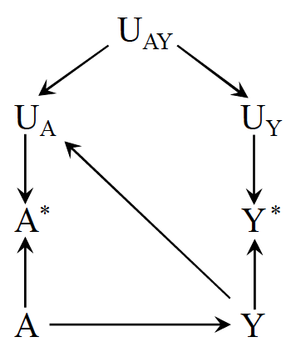
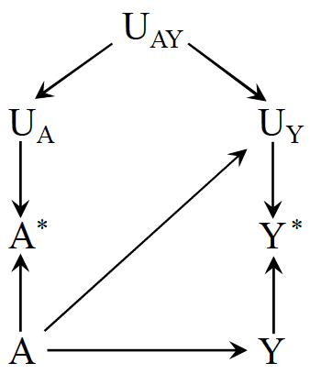
Dependent Differential Measurement Error
Dependent differential measurement error of exposure
Dependent differential measurement error of outcome
23
Notes:
These figures depict measurement errors that are both dependent and differential, which may result from a combination of the settings described above.

Slide 24
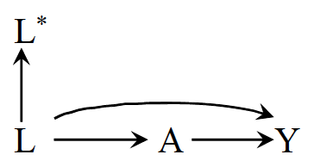
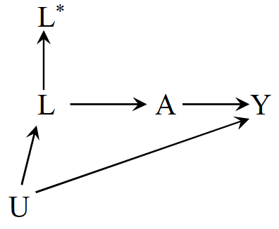
Mismeasured Confounders
Conditioning on L* does not block the backdoor path between A and Y in either scenario
24

Slide 25
Limitations of DAGs

Slide 26
Some Objections to DAGs
DAGs do not display effect modification
  If Z modifies the effect of X on Y, then Z must itself affect Y.
  Effect modification is scale dependent, so showing an effect modifier implies a scale and DAGs do not represent any scale
  Some progress on this: e.g., VanderWeele’s sufficient cause framework
  If Z and X both affect Y, then there is some scale on which Z modifies the effect of X and vice versa
26

Slide 27
Some Objections to DAGs
DAGs do not represent the magnitude of bias
  Major limitation
  Lots of work now on (a) signing the bias and (b) estimating the magnitude
  Simulations and bias bounding formulas
27

Slide 28
Some Objections to DAGs
DAGs do not match the complex, dynamic feedback loops in the real world
  DAGs can represent feedback between two variables
  DAGs can represent complex interventions (e.g., deliver this set of 4 treatments vs only 2 of these)
  DAGs match (one of the) things you want to know: will intervening in a specific way elicit a change in health?
  To say “it’s all very complicated and impossible to specify which variables come first” is to abdicate any hope of guiding clinical or policy decisions
  DAGs do not tell you everything, and complex systems simulations are often useful as a next step to predict spillovers and interactions with variables you do not have in your DAG; the simulation will presumably rely on causal parameter inputs.
28

Slide 29
Some Objections to DAGs
I’m not sure about which causal structure is right
  Do you know enough to rule some DAGs out?
  What are the commonalities across all plausible DAGs?
  Useful to state: under these assumptions, we can draw these inferences; need evidence on the assumptions from other sources
I don’t know anything about the causal structure
  This is not an objection to DAGs, this is an objection to ever drawing causal inferences
29

Slide 30
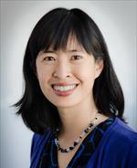





Acknowledgements
June Chan
Shelley DeVost
Maria Glymour
Miguel Hernán
Francois Rerolle
Carolyn Smith
Hughes
30

Slide 31
Until Next Time…
Finish Homework #2
Read Chapter 6 and skim Chapter 7 in Rothman, Greenland, and Lash 2008
Watch the recorded Target Trials lectures
Office Hours: Monday@ 4:10pm on Zoom

Slide 32
Questions?

