Slide 1
Identifying and Selecting Self-Report Measures for Health Disparities Research: Part I
Anita L. Stewart, Ph.D.
University of California, San Francisco
Clinical Research with Diverse Communities
EPI 222, Spring 2014
April 24, 2014

Slide 2
Content of Measurement Lectures
Importance of good outcomes
Importance of good measures
Measurement terminology
Process of selecting measures
  Defining concepts
  Locating potential measures
  Critiquing measures, selecting best
Pretesting measures
Modifying measures
This
week

Slide 3
Content of Measurement Lectures
Importance of good outcomes
Importance of good measures
Measurement terminology
Process of selecting measures
  Defining concepts
  Locating potential measures
  Critiquing measures, selecting best
Pretesting measures
Modifying measures
Next
week

Slide 4
Overview – Part I
Importance of good outcomes
Importance of good measures
Measurement terminology
Process of selecting measures
  Defining concepts
  Locating potential measures

Slide 5
Broader Issue: Selecting Appropriate Outcomes for a Research Study
Luckett and King (reading) pertains in part to choosing good “outcomes” concepts
  Part of study design
Choosing good measures of each concept is second issue

Slide 6
Selecting Outcomes for Randomized Controlled Trials
Clinical trials of new medications, procedures, or treatments require standard set of patient-reported health outcome measures
  In addition to clinical and physiological measures

Slide 7
Selecting “Patient-Reported Outcome Measures” (PRO or PROM): 6 Principles
Consider PROMs early in design process
Choose PROM proximal to intervention
Identify candidate PROMs based on content and scaling
Appraise reliability, validity, and
track records
Practical concerns
Take minimalist approach to
ad hoc items

Slide 8
Selecting “Patient-Reported Outcome Measures” (PROM or PRO): 6 Principles
Consider PROMs early in design process
Choose PROM proximal to intervention
Identify candidate PROMs based on content and scaling
Appraise reliability, validity, and
track records
Practical concerns
Take minimalist approach to
ad hoc items
Select
outcome
concepts

Slide 9
Selecting “Patient-Reported Outcome Measures” (PROM or PRO): 6 Principles
Consider PROMs early in design process
Choose PROM proximal to intervention
Identify candidate PROMs based on content and scaling
Appraise reliability, validity, and
track records
Practical concerns
Take minimalist approach to
ad hoc items
Select
outcome
concepts
Select
measures

Slide 10
Proximal vs Distal Outcomes
Consider mechanisms of change due to intervention
Select “outcomes” that are proximal
  More directly affected by intervention
  Less affected by other factors (life in general)

Slide 11
Defining Concepts For Your Study (cont)
For outcomes, describe:
  How intervention or independent variables might affect it
  Specific types of changes you expect

Slide 12
Example: Mechanisms to Outcomes In Choral Singing Intervention
Component | Mechanism | Outcome | Measure
Learn and read lyrics and melody | Cognitive stimulation | Memory, verbal fluency | Rey Short-term Memory
Social support | Meet new people, sense of belonging | Social support | MOS Social Support Survey
Mood | Singing is uplifting, creates joy | Depression | PHQ-9 Depression Scale
Lung capacity and vocal control | Ability to hold breath through phrases | Respiratory function | Blazer Shortness of Breath Scale

Slide 13
Overview – Part I
Importance of good outcomes
Importance of good measures
Measurement terminology
Process of selecting measures
  Defining concepts
  Locating potential measures

Slide 14
Inappropriate Measures can Mean:
Inability to detect true associations or true change
Reasons:
  Measuring wrong concept
  Poor data quality (e.g. missing data)
  Poor variability
  Poor reliability and validity
  (more measurement error)
Notes:
Can jeopardize ability to detect associations
Ability to compare scores across diverse groups
Ability to accurately describe levels of health within a group
Ability to compare to norms

Slide 15
“Outcomes” Terminology
Health-related quality of life (HRQL)
Quality of life (QoL)
Patient-reported outcomes (PROs)
  Patient-reported outcome measures (PROMs)
Patient Reported Outcomes Measurement Information System (PROMIS)

Slide 16
Disparity Populations
Groups with significantly higher rates of disease incidence, prevalence, morbidity, mortality, or survival compared to general population …
  Racial/ethnic minority
  Low socioeconomic status (income, education)
  Limited English proficiency
  …. Many others

Slide 17
Health Disparities Research
Focuses on differences in health and its determinants between disparity and non-disparity populations…
  Minority vs. non-minority
  Lower income vs. others
  Lower education vs. others
  Limited English Proficiency vs. others

Slide 18
Issues in Health Disparities Research
Principles of selecting good measures apply to all research
Additional considerations in health disparities research pertaining to disparity populations

Slide 19
Issue in Health Disparities Research
Most self-reported measures developed and tested in mainstream, well-educated groups
Less information on how well they work in disparity groups
  Appropriateness
  Reliability and validity
…..although this is changing rapidly

Slide 20
All Research in SF Bay Area Includes Disparity Population Groups
Samples naturally include “disparity” groups
Measures need to be appropriate to all subgroups
  Even if health disparities is not the focus

Slide 21
Overview – Part I
Importance of good outcomes
Importance of good measures
Measurement terminology
Process of selecting measures
  Defining concepts
  Locating potential measures

Slide 22
“Measures” Terminology
Measure: single- or multi-item scale or index
Item: question/statement including response scale
Scale: aggregation of items based on accepted scaling method
Index: aggregation of scales into a summary score
Instrument: published, named measure or set of measures

Slide 23
Things to Pay Attention to in Items
Item stem
  Content
  Time frame
  Complexity
Response scales
  Type (frequency, intensity)
  Number of choices
  Specific choices
  Distance between choices
Response choices match item stem

Slide 24
Composition of an Item
During the past month,
how much of the time have you felt tired?
1 Never
2 A little of the time
3 Some of the time
4 Most of the time
5 All of the time
Item
stem
Response
scale

Slide 25
Composition of an Item
Time frame
During the past month,
how much of the time have you felt tired?
1 Never
2 A little of the time
3 Some of the time
4 Most of the time
5 All of the time
Item
stem
Response
scale

Slide 26
Composition of an Item
During the past month,
how much of the time have you felt tired?
1 Never
2 A little of the time
3 Some of the time
4 Most of the time
5 All of the time
Item
stem
Proportion
of time
response
scale

Slide 27
Comparing Items
During the past 2 weeks, how often have you felt tired?
1 Never
2 Once or twice
3 A few times
4 Fairly often
5 Very often
During the past 2 weeks,
how much of the time have you felt tired?
1 Never
2 A little of the time
3 Some of the time
4 Most of the time
5 All of the time

Slide 28
Comparing Items
During the past 2 weeks, how often have you felt tired?
1 Never
2 Once or twice
3 A few times
4 Fairly often
5 Very often
During the past 2 weeks,
how much of the time have you felt tired?
1 Never
2 A little of the time
3 Some of the time
4 Most of the time
5 All of the time
Frequency
response scale
Proportion of time
response scale

Slide 29
Response Scale Choices –
“Vague, Imprecise Quantifiers”
How often?
  Very often, pretty often, not too often
  Sometimes, often, never
How much?
  Too little, about right, too much
  Below average, average, above average
Bradburn NM. Public Opinion Quart 1979, 92-101.

Slide 30
What Makes a Good Item – in General?
Short and concise item stem
Only one “concept” per item
  No complex items
Good match of item stem and response choices

Slide 31
Additional Criteria for Good Items in Health Disparities Research
Reading level – 5th or 6th grade
Terminology is translatable
No jargon or colloquialisms
  Universally understood

Slide 32
Wording is Everything!
Do you favor cutting government entitlements to reduce the budget deficit?
  61% favor
  25% oppose
  14% no opinion
Do you favor cutting programs such as social security, Medicare, Medicaid and farm subsidies to reduce the budget deficit?
  23% favor
  66% oppose
  11% no opinion
NBC/Wall Street Journal Poll
Courtesy Nan Rothrock - n-rothrock@northwestern.edu

Slide 33
Single-item “Measures”
Advantages
  Score is easily interpreted
Disadvantages
  Impossible to assess complex concept
  Limited variability, often skewed
  Reliability usually low

Slide 34
Multi-Item Measures or Scales
Multi-item scales are created by combining two or more items into an overall measure or scale score
“Summated ratings scales”

Slide 35
Advantages of Multi-item Measures (vs Single Items)
More scale values (improves distribution)
Improves reliability
Reduces % missing (can estimate score if items missing)
More likely to reflect concept (richer content)
Note Luckett and King, page 3151: global items

Slide 36
Scale Construction Methods
To create a multi-item scale requires applying a scale construction approach
  Multitrait scaling
  Factor analysis

Slide 37
Summated Rating Scales: Scaling Analyses
To create a summated rating scale, set of items need to meet several criteria
Need to test whether the items hypothesized to measure a concept can be combined
  i.e., that items form a single concept

Slide 38
Example of a 2-item Summated Ratings Scale
How much of the time .... felt tired?
1 - All of the time
2 - Most of the time
3 - Some of the time
4 - A little of the time
5 - None of the time
How much of the time
…. felt full of energy?
1 - All of the time
2 - Most of the time
3 - Some of the time
4 - A little of the time
5 - None of the time
Notes:
For a fatigue scale where higher scores are more fatigue:
1. Reverse the tired item (so a 5 is tired all of the time) (higher score is more fatigue)
2. Add them together
3. Score ranges from 2 (1 on both) to 10 (5 on both)

Slide 39
Five Criteria to Qualify as a Summated Ratings Scale
Item convergence
Item discrimination
No unhypothesized dimensions
Items contribute similar proportion of information to score
Items have equal variances

Slide 40
Multidimensional and Unidimensional Measures/Scales
Multidimensional measure
  Scores for each sub-domain
Unidimensional measure
  Only one score
Dimensionality must be empirically tested
  Factor analysis identifies number of factors or dimensions

Slide 41
Example of Unidimensional Measure
Perceived Stress Scale (PSS)
14 items, subjective experiences of stress
  felt confident could handle life’s problems
  able to control irritations in your life
  difficulties piling up so high, could not overcome them
Single score from all items
Cohen, S, J Health Soc Behav 24:385-396, 1983

Slide 42
Example of Multidimensional Measure
Patient Satisfaction Questionnaire (PSQ)
55 items, 18 subscales, e.g.
  Access to care
  Technical quality
  Interpersonal manner
  Explanations
  Continuity of care
Marshall GN et al., Psychol Assess, 5:477-483, 1993
Notes:
See Psychiatric measures, p. 180

Slide 43
Overview – Part I
Importance of good outcomes
Importance of good measures
Measurement terminology
Process of selecting measures
  Defining concepts
  Locating potential measures

Slide 44
PROCESS of Selecting Measures for Your Studies
Describe your target population
Define concept (variable)
Identify potential measures
Review and critique measures for:
--conceptual and psychometric adequacy
--practical considerations
Pretest best measure
If problematic:
modify and pretest again
Final measure

Slide 45
PROCESS of Selecting Measures for Your Studies
Describe your target population
Define concept (variable)
Identify potential measures
Review and critique measures for:
--conceptual and psychometric adequacy
--practical considerations
Pretest best measure
If problematic:
modify and pretest again
Final measure

Slide 46
Describe Your Target Population
Age (range, mean)
Health status
  chronic conditions
  % frail, cognitively impaired
Socioeconomic status
  % low education
  % limited literacy
Race/ethnicity
Language
  % limited English proficiency

Slide 47
PROCESS of Selecting Measures for Your Studies
Describe your target population
Define concept (variable)
Identify potential measures
Review and critique measures for:
--conceptual and psychometric adequacy
--practical considerations
Pretest best measure
If problematic:
modify and pretest again
Final measure

Slide 48
Overview – Part I
Importance of good outcomes
Importance of good measures
Measurement terminology
Process of selecting measures
  Defining concepts
  Locating potential measures

Slide 49
Concept/Construct/Latent
Variable
A variable that is relatively abstract
  e.g. health status, stress, acculturation
Latent - present but not visible, unobservable
Latent trait - unobservable set of characteristics that can be empirically inferred and estimated through answers to a set of questions

Slide 50
Measures of Concepts/Latent Variables
Concepts are operationalized in terms of observed indicators or “measures”
Measures are proxies for the latent variables we cannot directly observe

Slide 51
Depicting Associations Between Latent Variables
CONCEPT
Variable A
CONCEPT
Variable B
Notes:
Figure from p. 15 chapter 2 Understanding the Latent Variable (from Scale development) DeVellis?
NOTE: depiction is of relationship between two latent variables – Oversimplification
The latent variables is the phenomenon of interest. A scale or measure developed to measure a latent variable is intended to estimate its actual magnitude.
One can observe relationships between two latent variables using two measures of each variable.
This assumes that each measure is a good representation of that latent variable.
The person’s level on the latent variables is presumed to “cause” the person’s answer to questions in the measure (hence the arrow from the latent variable to the measure)

Slide 52
Depicting Associations Between Latent Variables
CONCEPT
Stress
CONCEPT
Health Status

Slide 53
Depicting Measures of Latent Variables
Stress
Health Status
Measure A
Measure B

Slide 54
Depicting Measures of Latent Variables
Stress
Health Status
Perceived
Stress Scale
SF-36

Slide 55
Depicting Associations Between Latent Variables (revisited)
CONCEPT
Stress
CONCEPT
Health Status

Slide 56
Associations are In Fact Only Those Between Selected Measures
Stress
Health Status
Perceived
Stress Scale
SF-36

Slide 57
Concepts/Latent Variables Are Usually Multidimensional
Due to abstract nature, most are complex
  Hard to define
Multidimensional
  Concepts within concepts

Slide 58
Multidimensional “Dimensions”
Physical Health
Physical
functioning
Health
perceptions
Pain
Energy &
fatigue
Notes:
All dimensions or domains are “concepts”

Slide 59
Multidimensional “Dimensions”
Physical Health
Physical
functioning
Health
perceptions
Pain
Energy &
fatigue
Pain
severity
Pain
frequency

Slide 60
Defining Concepts for Your Study
How does concept fit into your research question?
  Outcome?
  Determinant of health?
Define concept from your perspective, taking into account …
  Study questions
  Target population

Slide 61
Overview – Part I
Importance of good outcomes
Importance of good measures
Measurement terminology
Process of selecting measures
  Defining concepts
  Locating potential measures

Slide 62
PROCESS of Selecting Measures for Your Studies
Describe your target population
Define concept (variable)
Identify potential measures
Review and critique measures for:
--conceptual and psychometric adequacy
--practical considerations
Pretest best measure
If problematic:
modify and pretest again
Final measure

Slide 63
Identify Potential Measures
Identify candidate measures
Multi-item measures with known psychometric properties
Most good measures published
  Original development information
  Applications (subsequent publications)
DO NOT develop your own questions unless absolutely necessary

Slide 64
Sources of Potential Measures
Reviews of measures
  Compendia
  Literature reviews
Web, various databases
Organizations and research centers
Government agencies
  National and state surveys
Universities and individual researchers

Slide 65
Compendia and Reviews
Specific measures of various concepts are compiled, reviewed, or listed
  Many books reviewing array of concepts
  Special journal issues review and critique various measures
  Literature reviews
Handout: Compendia of measures

Slide 66

CADC Measurement/Methods Core
http://dgim.ucsf.edu/cadc/mm/

Slide 67
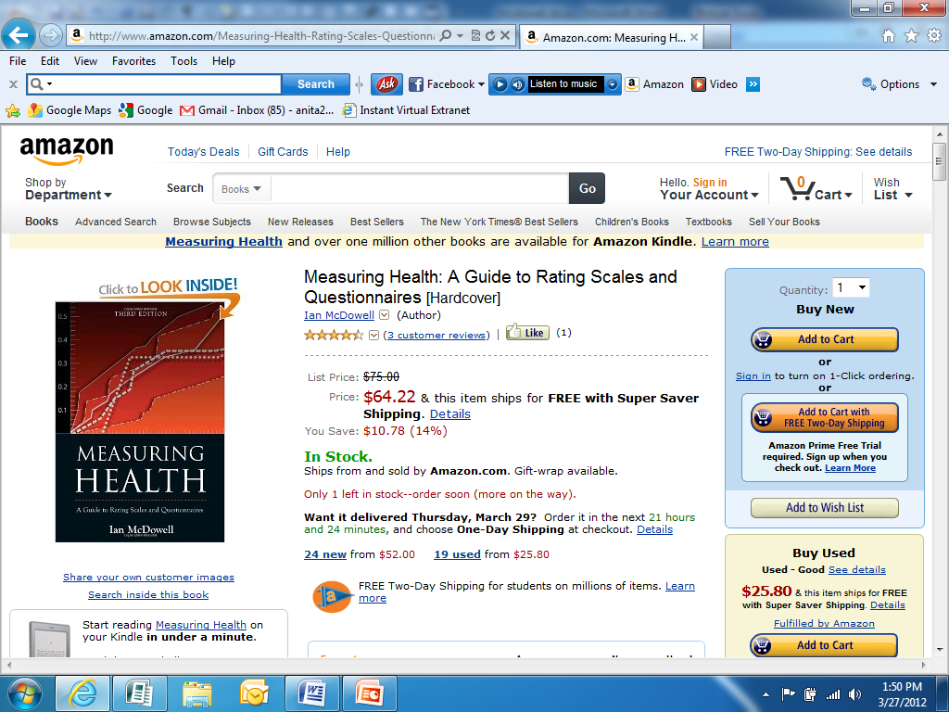
Best Compendium
  Reviews measures of
  Physical disability
  Social health
  Psychological well-being
  Anxiety
  Depression
  Mental status
  Pain
  General health status
  Quality of life
McDowell and Newell, 2006, Third Edition

Slide 68
Literature Reviews of Measures
Diet in minority populations
Park/recreation environments
Physical activity
Culture…
Socioeconomic status of elderly…

Slide 69
Reviews of Measures: Examples
Structured reviews
  Cross-cultural assessment of geriatric depression: A review of the CES-D and the GDS
  (Mui, J Ment Health Aging, 2001;7:137-164)
  A review of physical activity measures used among U.S. Latinos: guidelines for developing culturally appropriate measures
  (Martinez, Ann Beh Med, 2008;36:195-207)
Narrative reviews
  Acculturation: measures of ethnic accommodation to the dominant American culture
  (Skinner, J Ment Health Aging, 2001;7:41-52)

Slide 70
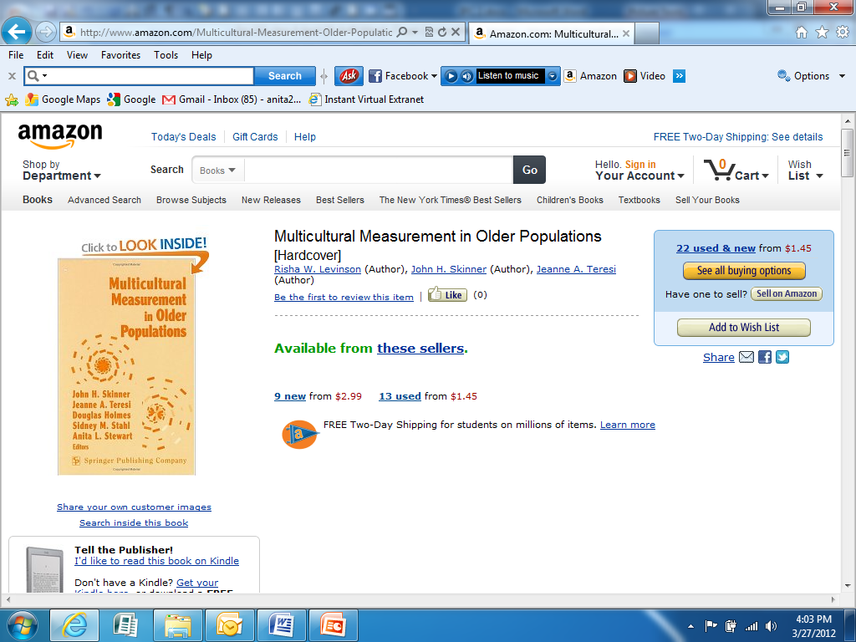
Resource: Reviews Measures for Diverse Populations (2002)
  Reviews measures that have been used cross-culturally:
  Acculturation
  Socioeconomic status
  Social support
  Cognition
  Health
  Depression
  Religiosity
Notes:
The volume contains reviews of measures that have been used
cross-culturally in the areas of: acculturation, socio-economic status, social supports, cognition, health
and functional capacity, depression, health locus of control, health-related quality of life, and religiosity.

Slide 71
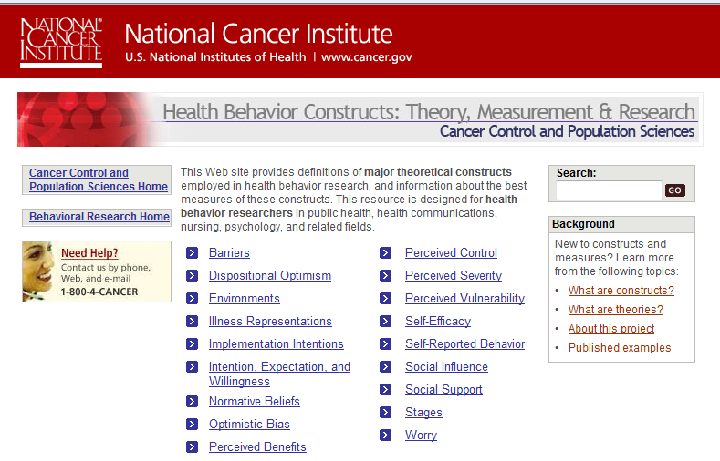
Compendia on Web: NCI
http://dccps.cancer.gov/brp/constructs/index.html
Notes:
Reviews concepts and measures of constructs such as perceived control, social support, and perceived vulnerability/susceptibility to illness

Slide 72

Google and Google Scholar
More practical for searching on vague terms
Follow up on PubMed
http://scholar.google.com

Slide 73
Consider Alternative Labels to Search
Search on your term – see what other terms come up
Housing instability
  Homelessness
Clinical assertiveness
  Interpersonal behavior
  Physician communication

Slide 74
Locating Measures: Organizations and Research Centers
Some organizations and academic centers specialize in measurement development
Provide instruments and scoring information

Slide 75
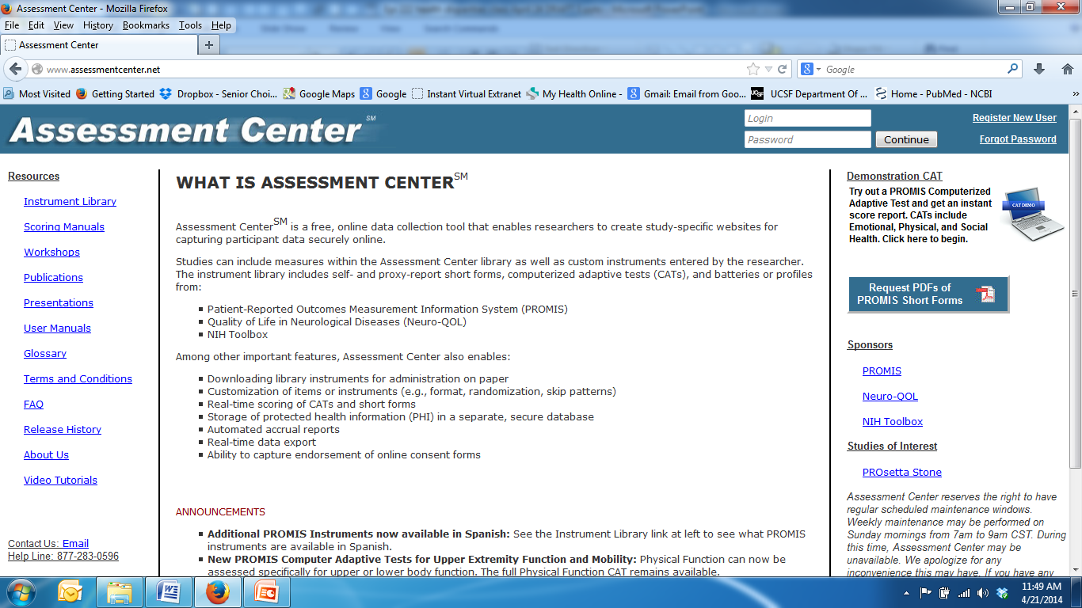
NIH Assessment Center Measures
PROMIS, Neuro-QOL, NIH Toolbox
Various profiles and short forms
Computer Adapted Testing (CAT)
Handout: Instruments Available for Use in Assessment Center

Slide 76
Example: PROMIS-57 Profile
Physical function
Anxiety
Depression
Fatigue
Sleep disturbance
Satisfaction with participation in social roles
Pain

Slide 77

RAND Health Program: Surveys
Measures, scoring, publications for measures of:
  Health-related quality of life
  Quality of care, patient satisfaction
  Maternal, child, and adolescent health
http://www.rand.org/health/surveys_tools.html

Slide 78
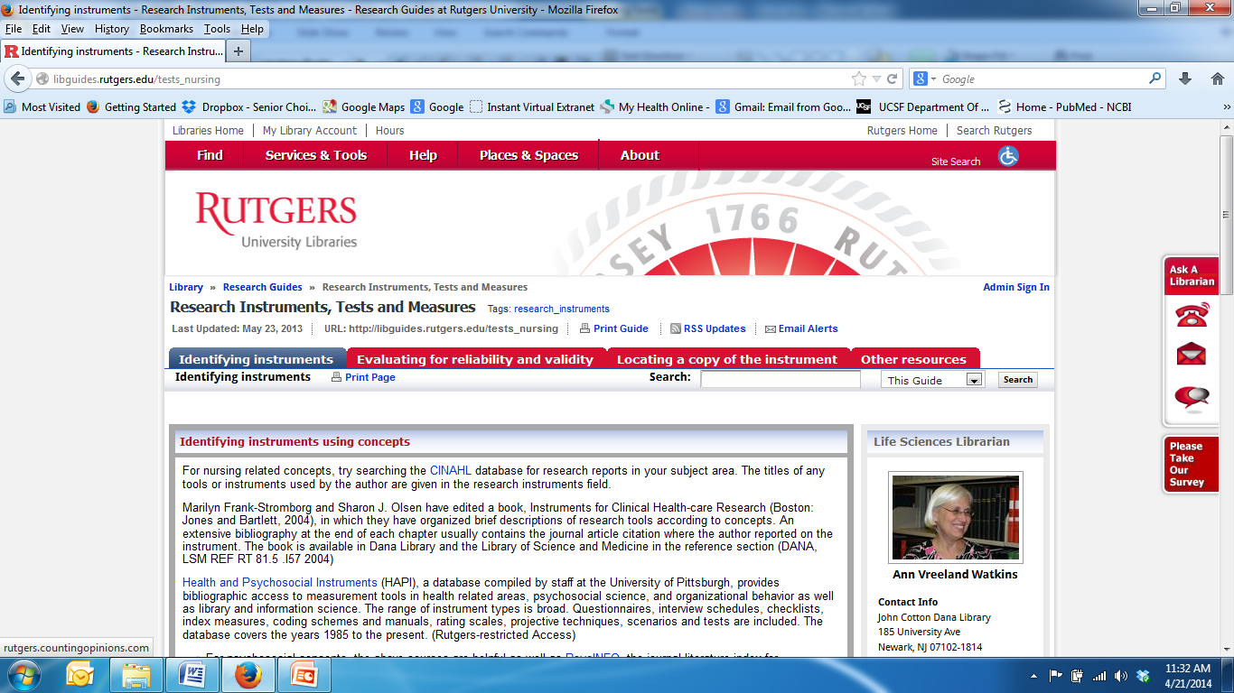
Rutgers University Libraries: Measures for Nursing Research
http://libguides.rutgers.edu/content.php?pid=237257&sid=1960000
Over 100 compendium volumes with links
libguides.rutgers.edu/tests_nursing

Slide 79

MacArthur Research Network on Socioeconomic Status (SES) & Health
Reviews concepts and measures in psychosocial, environment, and SES domains
http://www.macses.ucsf.edu

Slide 80
MacArthur Network Psychosocial “Notebook” (Measures)
Anxiety
Coping
Depression
Discrimination
Hostility
Optimism
Personal control
Psychological stress
Purpose in life
Self-esteem
Social support
Vitality and vigor
http://www.macses.ucsf.edu/research/psychosocial/default.php

Slide 81
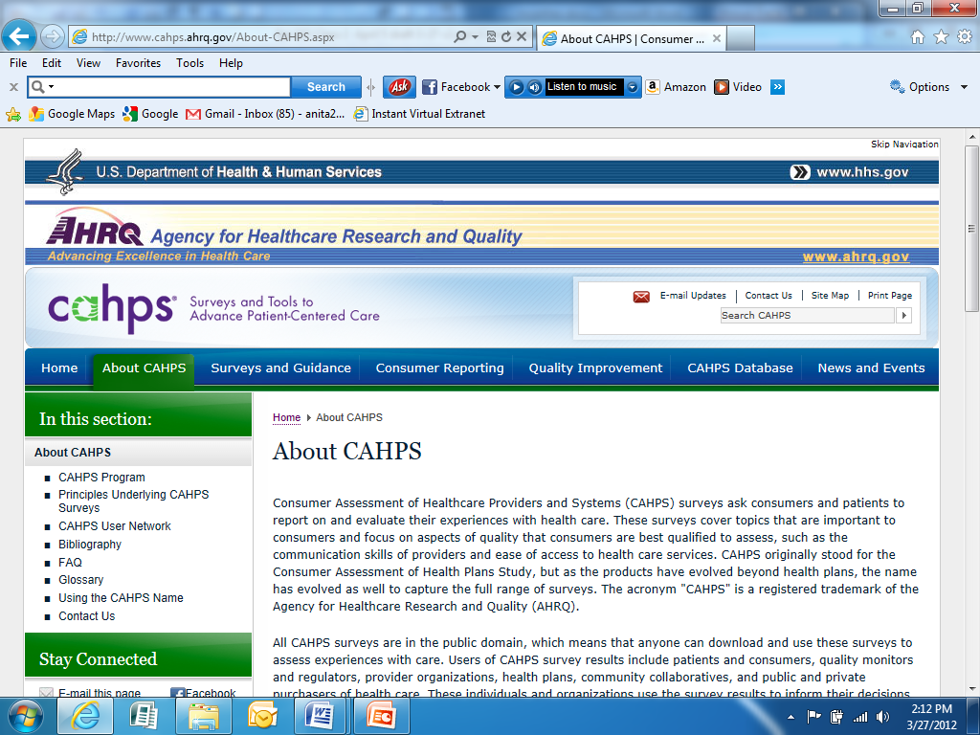
Consumer Assessment of Healthcare Providers and Systems (CAHPS) Surveys
Consumer and patient surveys to report and evaluate their health care experiences
  Facilities (e.g., hospitals, nursing homes)
  Ambulatory care (e.g., health plans, dental plans, home health care, surgical care)
https://www.cahps.ahrq.gov/

Slide 82
Locating Measures: Large Research Studies
Many large-scale, multi-center and longitudinal studies have developed and used measures on health-related topics
Increasingly, they are posting these on “study” websites

Slide 83
Locating Measures: Finding Authors of Measures
Published research using measure you are interested in
  Unpublished measures often described in methods
  Authors may provide measures

Slide 84
PROCESS: Identify Measures for Your Research
Goal: find measure developed with stringent methods
Your task
  Find candidate measures
  Review for adequacy and appropriateness for your research
    Additional review for health disparities research

Slide 85
Class 4 Homework - April 24, 2014
Complete rows 1-13 in matrix
  Use form posted on the website
Include your name in the filename
  Smith_HW_epi222_class4
Email by Tuesday April 29 to
  Anita.Stewart@ucsf.edu

