Slide 1
Mini EdTech Training Series:
Zoom advanced polling and quizzing
Xinxin Huang
UCSF School of Nursing
Ed Tech and Curricular Innovation HUB

Slide 2
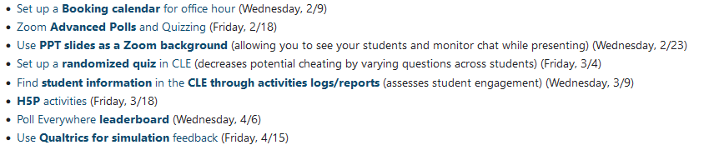
Housekeeping
Session is being recorded
Materials and resources will be available on the CLE
Sign up future sessions here

Slide 3

Objectives
By the end of this mini session, you will be able to
Understand Zoom polling strength and weakness
Set up advanced polling and quizzing
Use 6 new polling question types
Get the polling results
Create a “blank poll”

Slide 4
General info before demo
Requires Zoom 5.8.3 or higher. All participants must update
Enable adv polling in setting
Enable setting for allow alternative hosts to add/edit polls if needed
a max of 50 polls, with each poll having a max of 50 questions.
Uploaded images must be either PNG or JPEG format, and cannot exceed 2 MB.
If a poll is relaunched in a meeting, the poll report will only display the last poll occurrence
No way for in-person & remote students to participate together

Slide 5
Question types
Two previous question types: Single choice, Multiple choice
Six new question types: Short answer, Long answer, Matching, Rank order, Rating, Fill in the blank.
Questions types that can be used in Quizzes
  4 question types can be marked with a correct answer: Single choice, Multiple choice, Matching, Rank order

Slide 6
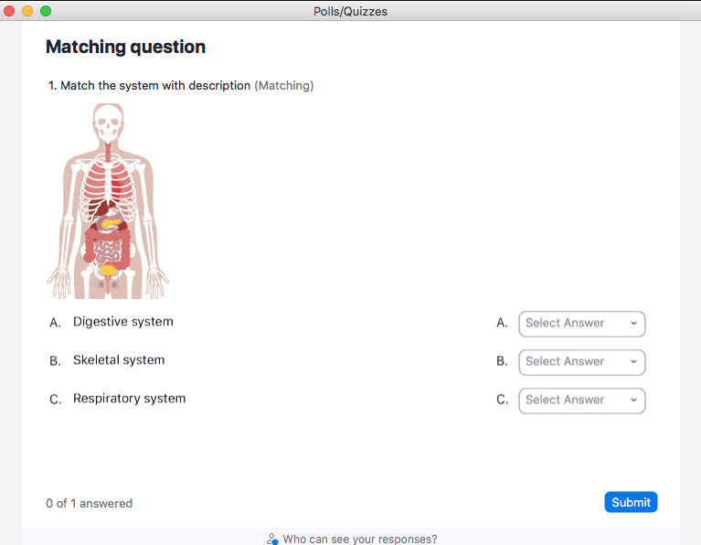
Question types

Slide 7
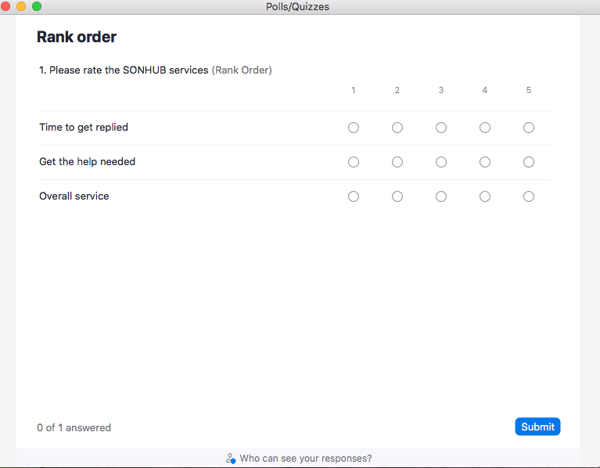
Question types

Slide 8
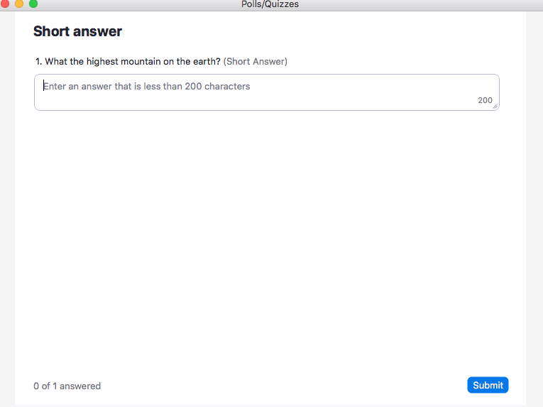
Question types

Slide 9
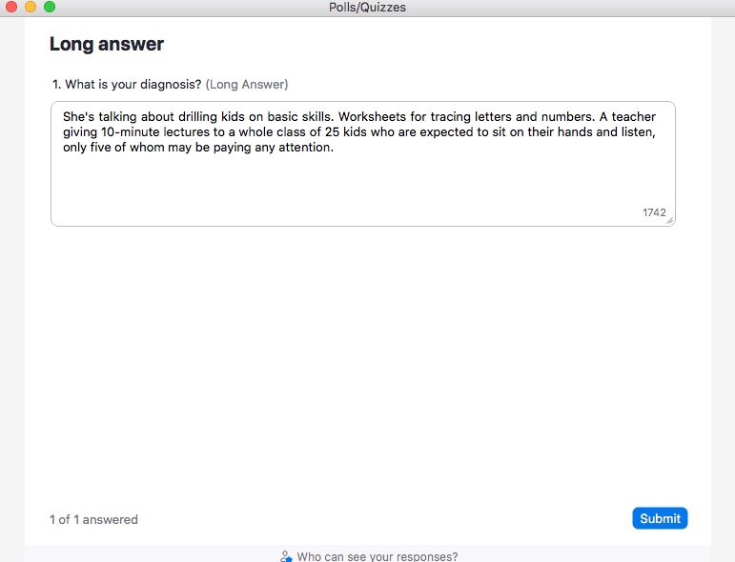
Question types

Slide 10
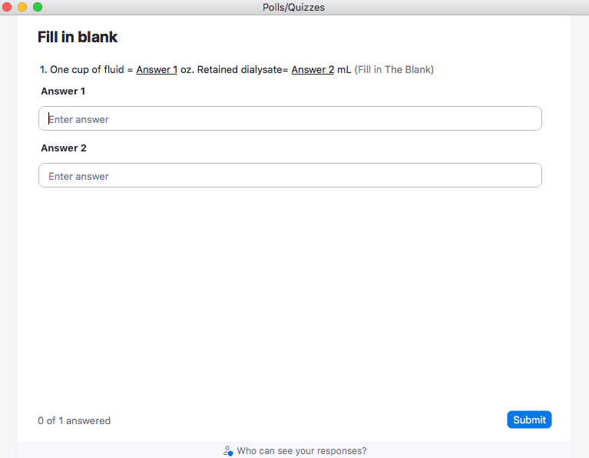
Question types

Slide 11
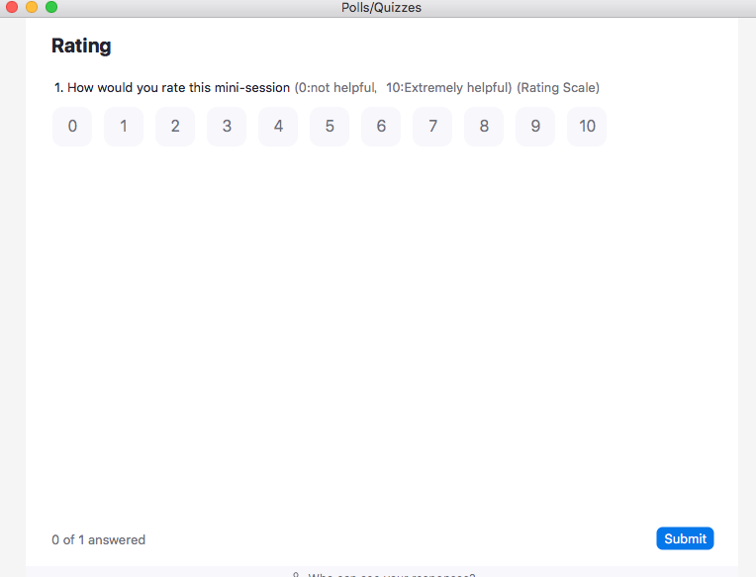
Question types

