Slide 1
Using EHR data in RCTs
Lecture 6 – Practitioner Lecture on conducting RCTs using EHR data with examples from the PCORnet Blood Pressure Control Laboratory and Learning Health System Trials

Slide 2
Outline
Introduction to practitioner lectures in Epi 231
Doing RCTs with EHR data – Overview
PCORnet Blood Pressure Control Laboratory
  PCORnet, common data models
  BP Track, BP MAP and BP Home
Learning Health System RCTs
  Concept and program at UCSF
  Embedded RCTs
  Interrupted time series analysis (alternative to RCTs for QI work)

Slide 3
Practitioner lectures in Epi 231
Examples of “relatively mature” research projects
  Methods, study designs and results
  Pitfalls, experiences in the trenches
Lineup
  Me
  Sara Murray
  Julian Adler-Milstein
  Leo Liu
  Rohit Vashist

Slide 4
RCTs with EHR data
RCTs are good!
  Randomization ensures expectation of equivalent groups
  i.e., no confounding (measured or unmeasured, “by indication” or otherwise)
  Major enhancement to causal inference

Slide 5
RCTs with EHR data
RCTs are good!
  Randomization ensures expectation of equivalent groups
  i.e., no confounding (measured or unmeasured, “by indication” or otherwise)
  Major enhancement to causal inference
But are they possible?

Slide 6
RCTs with EHR data
What do you need for an RCT?
  Identify relevant patients
  Assess inclusion/exclusion criteria
  Consent(?) and enroll in the study
  Randomly assign to different groups
  Deliver group-specific interventions
  Collect outcome data prospectively

Slide 7
RCTs with EHR data
What do you need for an RCT?
  Identify relevant patients
  Assess inclusion/exclusion criteria
  Consent(?) and enroll in the study
  Randomly assign to different groups
  Deliver group-specific interventions
  Collect outcome data prospectively
How can an EHR system help with this?

Slide 8
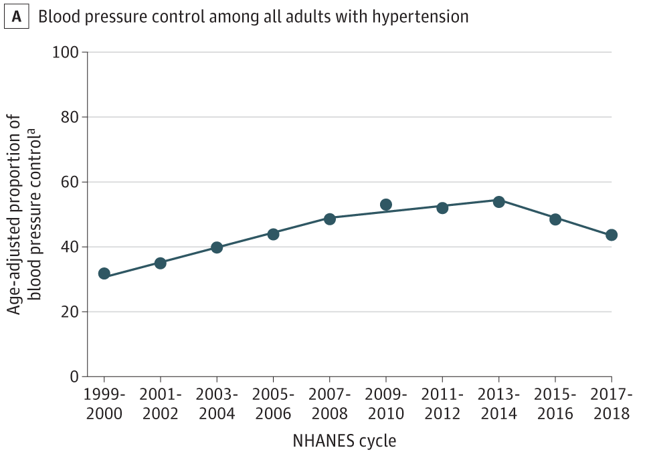
PCORnet BP Control Lab
Better BP control prevents heart attacks and strokes
BP control is not ideal and getting worse
We need better surveillance and interventions that improve BP control at scale and reduce disparities
  New tech, virtual care, new programs
Muntner et al. JAMA 2020;324:1190-1200

Slide 9
PCORnet BP Control Lab
The Opportunity
Blood pressure is measured and recorded digitally in the EHR
  Finding patients uncontrolled BP, measuring improvement, etc
Critical processes also recorded
  Medication orders
  Return visits
Can we use EHR data to study BP control at scale in the US?

Slide 10
PCORnet BP Control Lab
Using PCORnet for large scale EHR-based research
  Common data model
  Network of willing researchers and process for finding collaborators
  Coordinating center
  Contracting pathways established
  Prep-to-research queries supported

Slide 11
PCORnet BP Control Lab
Using PCORnet for large scale EHR-based research
  Common data model
  Network of willing researchers and process for finding collaborators
  Coordinating center
  Contracting pathways established
  Prep-to-research queries supported

Slide 12
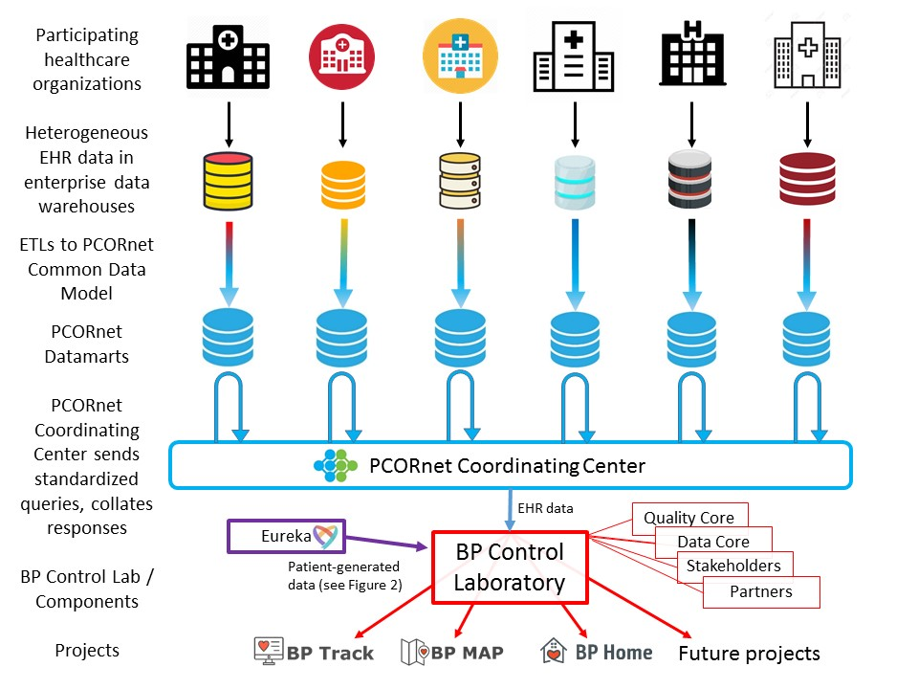
PCORnet BP Control Lab
Using PCORnet’s Common Data Model
Circ CQO 2020;13(3):e006115 – in syllabus

Slide 13
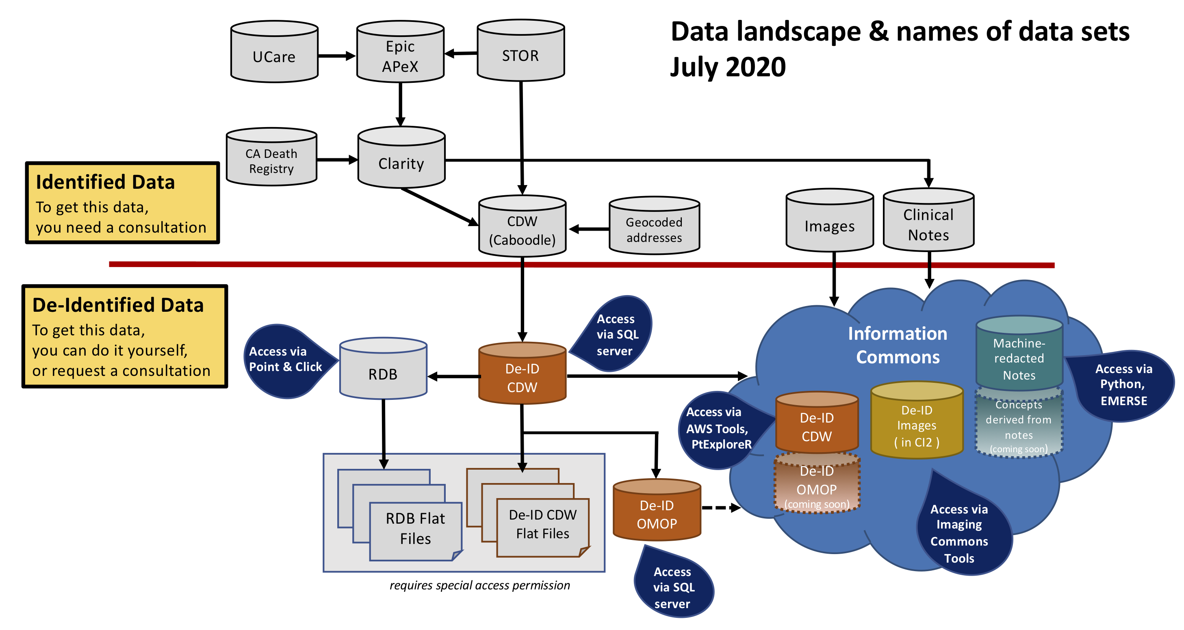
Data.ucsf.edu

Slide 14
PCORnet
Common Data Models
Data.ucsf.edu

Slide 15
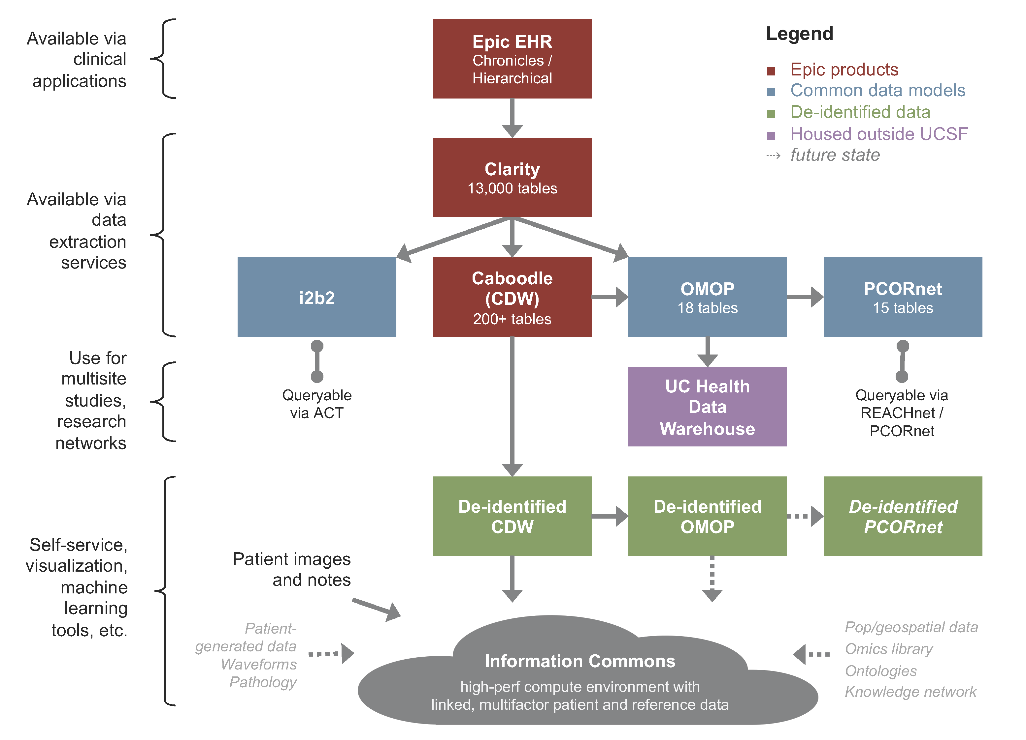

Slide 19
https://pcornet.org/data/

Slide 20
https://pcornet.org/data/

Slide 25
PCORnet BP Control Lab
Using PCORnet’s Common Data Model
  1 set of SAS programs
  Coordinating center
Makes large scale research with EHR’s possible

Slide 26
PCORnet BP Control Lab
Using PCORnet’s Common Data Model
  1 set of SAS programs
  Coordinating center
Makes large scale research with EHR’s possible
→ 3 studies (2 RCTs)

Slide 27
Circ CQO 2020;13(3):e006115 – in syllabus

Slide 28
BP Track
SAS programs produce BP Control Metrics
  1 measurement per health system-year per quarter
  Overall, and then stratified by age/sex/race-ethnic subgroup
  10 main BP Control Metrics

Slide 29
BP Track
SAS programs produce BP Control Metrics
  1 measurement per health system-year per quarter
  Overall, and then stratified by age/sex/race-ethnic subgroup
  10 main BP Control Metrics
    BP Control to 140/90, and to 130/80
    BP Improvement
    Confirmatory BP measurement when high
    Terminal digit = 0
    Medication intensification with new class of meds
    SBP reduction after medication intensification
    F/U encounter within 1 month
    2 medication choice metrics

Slide 30
Extensive specifications documentation
Code development, validation and beta-testing
Query results compiled and used for analyses

Slide 31
BP Track, Wave 4
BP Control to <140/90
Wide variation
Disparities
Tiny improvements

Slide 32
BP Track, Wave 4
Med intensification with new class
Very low overall
NO typical disparities
Average SBP reduction after med intensification = 15mmHg

Slide 33
BP Track, Wave 4
BP Improvement (control or 10 mmHg lower)
Lots of variation and room for improvement
No typical disparities
Marked seasonal variation

Slide 34
BP Track, Wave 5 preliminary
Major differential impact from the Pandemic

Slide 35
BP MAP
Cluster RCT of a quality improvement intervention
  American Medical Association-led program
  BP M.A.P. Program
    Measure accurately, Act rapidly, Partner with patients
    Strong preliminary results
  Does it scale?
  How much support do clinics need?

Slide 36
BP MAP
We found 24 safety net clinics interested in BP control programs
Full support vs. Self-Guided (vs. Usual Care)
  Digital guide, Site/Clinical Champions, Practice Facilitator, Kickoff
  +/- AMA support with “Improvement Specialist” throughout f/u
Outcome: BP Control at 6 months
  Used our BP Control Metrics for outcome assessment
  Also other metrics, by subgroup, etc

Slide 37
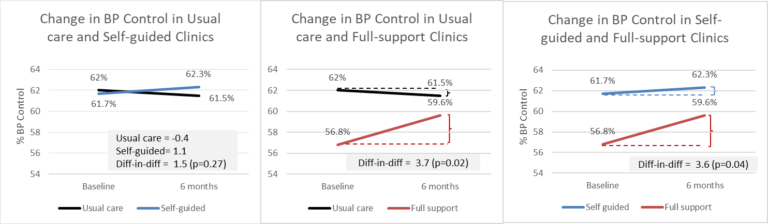
BP MAP – Preliminary Results
Modest average clinic-level improvement in Full Support at 6m
  Nominal significance vs. Usual Care, not vs. Self-Guided
Drop-off in engagement from clinic staff after first module completed
  “Measure accurately” improved. No change in med intensification.

Slide 38
BP Home
What kind of home monitor should patients use?
  Patient-driven research question from advisory group
Individual-level RCT
  Patients with SBP>145 in clinic, “will work on lowering SBP” by 10+ mmHg
  Randomized
  Mailed a regular home BP monitor vs. Bluetooth-enabled with app
  Basic instructions on use, AMA/AHA materials, no specific program
Outcomes
  Demonstrated clinic SBP
  “Net Promoter Score” – Would you recommend to a friend?

Slide 39
Circ CQO 2020;13(3):e006115 – in syllabus

Slide 40
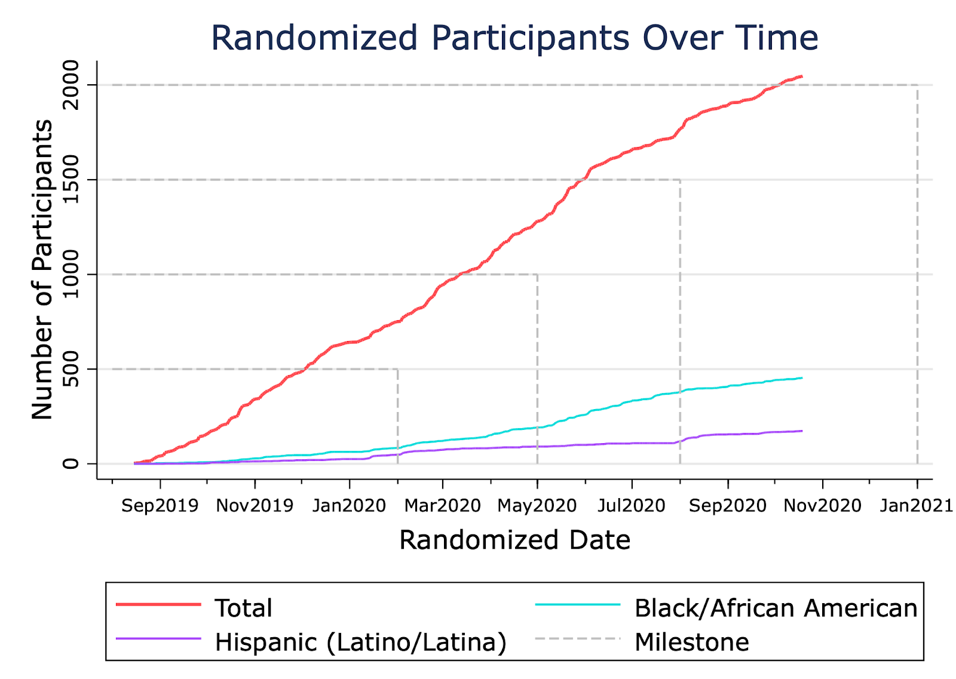
BP Home – In progress
Recruitment of 2000+ patients achieved ahead of schedule
EHR data extraction trial run underway

Slide 41
RCTs with EHR data
What do you need for an RCT?
  Identify relevant patients
  Assess inclusion/exclusion criteria
  Consent(?) and enroll in the study
  Randomly assign to different groups
  Deliver group-specific interventions
  Collect outcome data prospectively
How can an EHR system help with this?

Slide 42
RCTs with EHR data
What do you need for an RCT?
BP Home
  Identify relevant patients EHR
  Assess inclusion/exclusion criteria Eureka
  Consent(?) and enroll in the study Eureka
  Randomly assign to different groups Eureka
  Deliver group-specific interventions Study team
  Collect outcome data prospectively EHR + Eureka
How can an EHR system help with this?

Slide 43
RCTs with EHR data
What do you need for a cluster RCT?
BP Home BP MAP
  Identify relevant randomization units EHR Study team
  Identify relevant observation units EHR EHR
  Assess inclusion/exclusion criteria Eureka EHR
  Consent randomization units Eureka Study team
  Enroll observation units Eureka EHR
  Randomly assign to different groups Eureka Study team
  Deliver group-specific interventions Study team Study team
  Collect outcome data prospectively EHR + Eureka EHR

Slide 44
Learning Health Systems
National Academy of Medicine:
  “Science, informatics, incentives, and culture are aligned for continuous improvement and innovation, with best practices seamlessly embedded in the delivery process and new knowledge captured as an integral by-product of the delivery experience.” – National Academy of Medicine

Slide 45
Learning Health Systems
National Academy of Medicine:
  “Science, informatics, incentives, and culture are aligned for continuous improvement and innovation, with best practices seamlessly embedded in the delivery process and new knowledge captured as an integral by-product of the delivery experience.”
  “…a system that gains knowledge from every care delivery experience and is engineered to promote continuous improvement.”

Slide 46
Learning Health Systems
National Academy of Medicine:
  “Science, informatics, incentives, and culture are aligned for continuous improvement and innovation, with best practices seamlessly embedded in the delivery process and new knowledge captured as an integral by-product of the delivery experience.”
  “…a system that gains knowledge from every care delivery experience and is engineered to promote continuous improvement.”
  RCTs are the best way to “gain knowledge”
  LHS Vision: Embed RCTs in our health system so that every patient is randomized at least once during their encounter…

Slide 47
Learning Health System
“Embedded” RCTs are:
  Embedded in clinical workflow
  Embedded in EHR technology

Slide 48
Learning Health System RCTs
Embedded in clinical workflow
  “Unsuspecting” clinicians will encounter the intervention
    Whether they know it or not
    No prior knowledge of the research required
  Must not perturb usual care “too much”
    Extra time, unbillable services, etc
    Patient consent? Extra data collection?
  Allow clinicians (and patients) to make clinical decisions
    Pragmatic, non-protocolized interventions

Slide 49
Learning Health System RCTs
Embedded in EHR technology
  Patients identified by APEX (our Epic EHR)
  Randomization implemented by APEX
  Intervention(s) are delivered by APEX
    APEX is designed to support clinical decision-making and “nudge” clinicians to deliver better care
  Outcomes are measured using APEX data

Slide 50
Learning Health System RCTs
Embedded RCT for quality improvement intervention
→ Randomized Quality Improvement trial
  Start with “50% Implementation” with randomization, and monitor
  Depending on results, switch to 100% implementation or 0% implementation
  Ethics, monitoring issues, etc…see publication, other talk in syllabus

Slide 51
Learning Health System RCT: Example 1
COPD Orders
Standardizing COPD orders
  Lead – Ari Hoffman
Background
  Lots of standard COPD treatments that are not getting done at UCSF; and readmission rates are high
Plan
  Develop standard orders (2 versions), and insert into admission order sets for persons at high risk

Slide 52
COPD orders
Insert standard orders into admission orders
30-day readmission?
Predict COPD at discharge
R
ED patients
Usual care
= predictive analytics
= modification of workflow
R
= randomization

Slide 53
COPD Orders - Basic analysis
. cs outcome1 interv
| RANDOM_ARM |
| Exposed Unexposed | Total
-----------------+------------------------+-----------
Cases | 51 29 | 80
Noncases | 189 172 | 361
-----------------+------------------------+-----------
Total | 240 201 | 441
| |
Risk | .2125 .1442786 | .1814059
| |
| Point estimate | [95% Conf. Interval]
|------------------------+------------------------
Risk difference | .0682214 | -.0027582 .1392009
Risk ratio | 1.472845 | .972059 2.231626
Attr. frac. ex. | .3210418 | -.0287442 .5518962
Attr. frac. pop | .2046642 |
+-------------------------------------------------
chi2(1) = 3.43 Pr>chi2 = 0.0641
MORE readmissions?!

Slide 54
COPD Orders
Should we trust the basic result?
Don’t we have an expectation of benefit/QI?
Can we take that into account?

Slide 55
COPD Orders
Should we trust the basic result?
Don’t we have an expectation of benefit/QI?
Can we take that into account?
Bayesian analysis:
  Specify your “prior” (best guess before the study)
  Update your prior with data → “posterior”
  We can do this on a monthly basis for LHS RCTs…

Slide 56
COPD Orders - Bayesian analysis
Posit a “prior probability” of benefit and use Bayesian statistics to update “posterior probability” every month
We (should have) learned relatively quickly about futility/harm…

Slide 57
COPD Orders
Summary: Intervention HALTED → “0% implemented”

Slide 58
Learning Health System RCT: Example 2
Healthy Start
Nomogram for expected weight loss in neonates
  Lead – Valerie Flaherman
Background
  Well babies are expected to lose weight in first weeks
  But losing too much weight is dangerous
  Nomogram and web tool exists
Plan
  Autopopulate web-based nomogram and show to clinicians as guide to supplementation

Slide 59
Healthy Start
Predict weight loss
Display nomogram + guidance on feeding
Guideline-concordant feeding?
Well-baby nursery
R
Usual care
= predictive analytics
= modification of workflow
R
= randomization

Slide 60
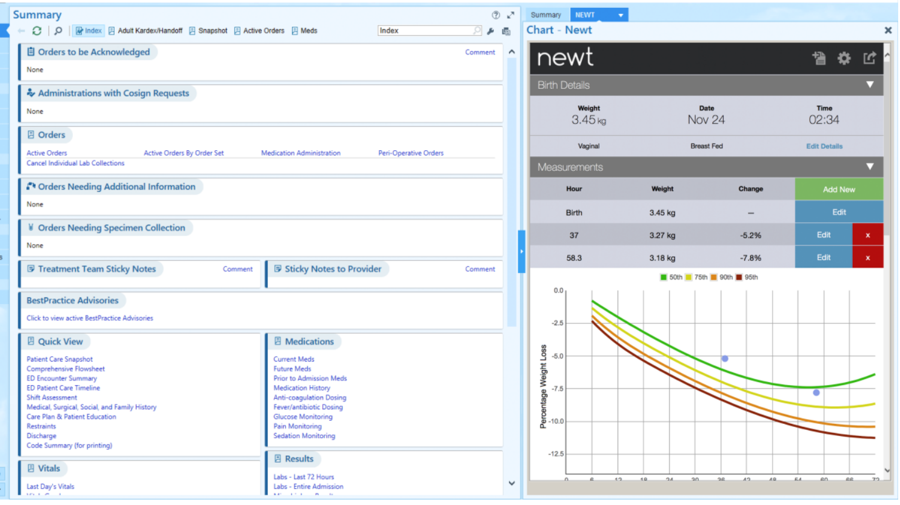
Healthy Start

Slide 61
Healthy Start - Basic analysis
. cs outcome1 interv
| RANDOM_ARM |
| Exposed Unexposed | Total
-----------------+------------------------+-----------
Cases | 932 922 | 1854
Noncases | 313 323 | 636
-----------------+------------------------+-----------
Total | 1245 1245 | 2490
| |
Risk | .7485944 .7405622 | .7445783
| |
| Point estimate | [95% Conf. Interval]
|------------------------+------------------------
Risk difference | .0080321 | -.0262245 .0422887
Risk ratio | 1.010846 | .9653882 1.058444
Attr. frac. ex. | .0107296 | -.0358528 .0552172
Attr. frac. pop | .0053937 |
+-------------------------------------------------
chi2(1) = 0.21 Pr>chi2 = 0.6459
No effect!?

Slide 62
Healthy Start - Bayesian analysis
“Uninformative prior”, no real evidence of benefit for harm

Slide 63
Healthy Start
“But everyone likes it!”
Could this have actually provided benefits to everyone even though it was only 50% implemented?

Slide 64
Healthy Start
“But everyone likes it!”
Could this have actually provided benefits to everyone even though it was only 50% implemented?
Interrupted time series analysis
  Specify target population, keep constant across time
  Estimate both the IMMEDIATE effect and a CHANGE IN SLOPE
  Plot aggregate results on a monthly basis

Slide 65
Interrupted time series + RCT analysis
P-values:
<.001 Bump at t=0
.94 Change in slope
Implementation in half pts led to benefit in all?
  “Contamination”

Slide 66
Health Start
Summary: 100% implemented

Slide 67
RCTs with EHR data
What do you need for an RCT?
BP Home BP MAP LHS
  Identify relevant randomization units EHR Study team EHR
  Identify relevant observation units EHR EHR EHR
  Assess inclusion/exclusion criteria Eureka EHR EHR
  Consent randomization units Eureka Study team ---
  Enroll observation units Eureka EHR EHR
  Randomly assign to different groups Eureka Study team EHR
  Deliver group-specific interventions Study team Study team EHR
  Collect outcome data prospectively EHR + Eureka EHR EHR

Slide 68
LHS Program at UCSF
APeX-Enabled Research (AER) – develops custom modifications of APeX (for hire with grant funding)
LHS Demonstration Projects
LHS Oversight Committee

Slide 69
More on LHS RCTs
Interesting methods issues:
  Multi-level clustering and analysis
  Which level to randomize?
  Predictive analytics – before or after randomization?
  Bayesian analysis and interim monitoring
  Ethics
  Clinical decision support and SMART on FHIR apps
Reading: “RCTs of EHR interventions” (Annals of IM article)
Recorded lecture : “Learning Health System Research Projects” (from DCR)

Slide 70
Summary
Common data models are critical to network research using EHR data
  OMOP, PCORnet
  They are imperfect, incomplete, and error-prone but necessary!
EHR systems can be used to execute RCTs
  Data for patient selection, baseline measurements, outcomes
  Randomization and intervention delivery (requires programming!)
Other systems are also usually needed
  Consent, intervention delivery, survey data collection, etc
Learning health systems
  Special type of research – RCTs, interrupted time series, difference in differences, etc

Slide 71
See you in class!
We'll have an interactive live session on Tuesday...

