Slide 1
Discussion: How to critique ML papers
Biostat216

Slide 2
Papers
Sung, Jaeyun, Yuliang Wang, Sriram Chandrasekaran, Daniela M. Witten, and Nathan D. Price. 2012. “Molecular Signatures from Omics Data: From Chaos to Consensus.” Biotechnology Journal 7 (8): 946–57. https://doi.org/10.1002/biot.201100305.
Norgeot, Beau, Giorgio Quer, Brett K. Beaulieu-Jones, Ali Torkamani, Raquel Dias, Milena Gianfrancesco, Rima Arnaout, et al. 2020. “Minimum Information about Clinical Artificial Intelligence Modeling: The MI-CLAIM Checklist.” Nature Medicine 26 (9): 1320–24. https://doi.org/10.1038/s41591-020-1041-y.

Slide 3
Quick summary of Sung 2012
...
Omics technologies can be used to define molecular signatures: "A set of biomolecular features together with a predefined computational procedure that applies those features to predict a phenotype of clinical interest on a previously unseen patient sample."
At the time of this paper there was little standardization in how signatures were built. (There has been some improvement since).
This paper introduced a set of procedures to build better predictors.

Slide 4
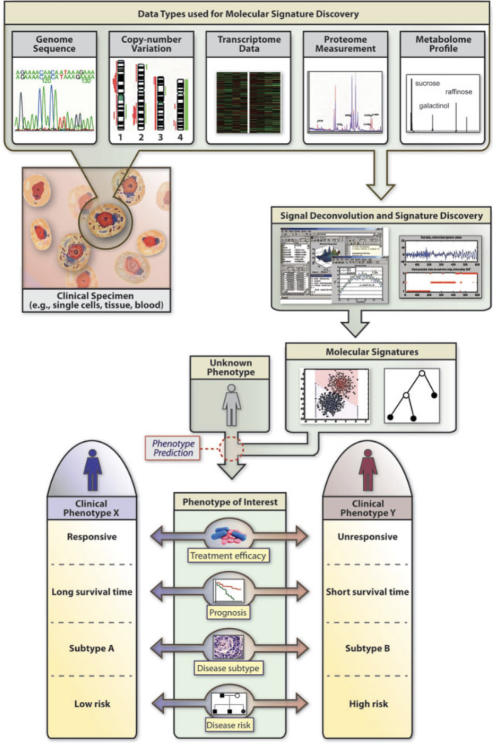

Slide 5
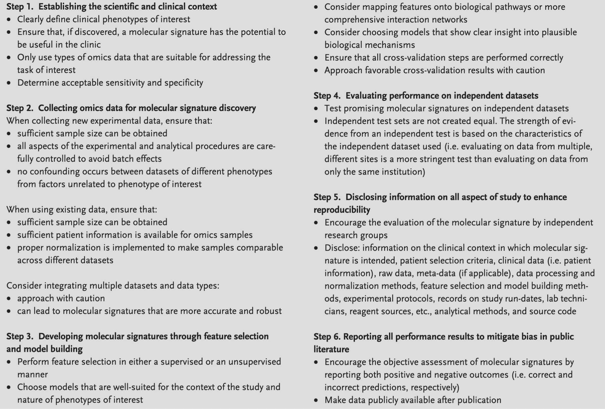

Slide 6
Topic of discussion for Sung 2012
How would one determine acceptable sensitivity and specificity?
What is wrong with Approach 1 for cross-validation and why is Approach 2 better?
What is the difference between identifying signature features in a supervised or unsupervised manner?
Would one prefer that an independent test set was generated in exactly the same way as the training set or would one prefer that it varied in some way, and if so, in what way?
Is it enough to describe a signature in text, or is more needed, and if so, what is needed?

Slide 7
Quick summary of Norgeot 2020
Because many clinical AI algorithms do not provide sufficient documentation on the data source, model development, and validation, the authors propose a set of documentation that provides the minimum information about clinical AI modeling (MI-CLAIM).
Goals of MI-CLAIM:
  enable a direct assessment of clinical impact, including fairness and bias
  to allow rapid replication of the technical design process of any legitimate clinical AI study

Slide 8
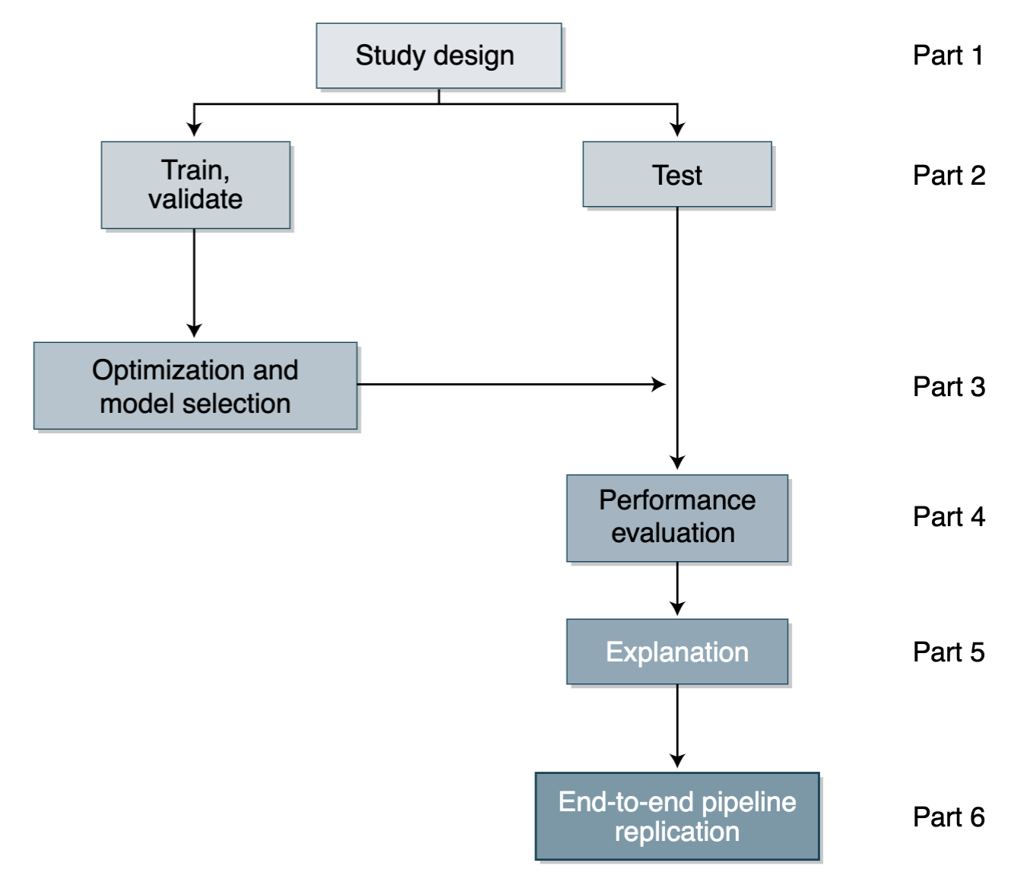

Slide 9
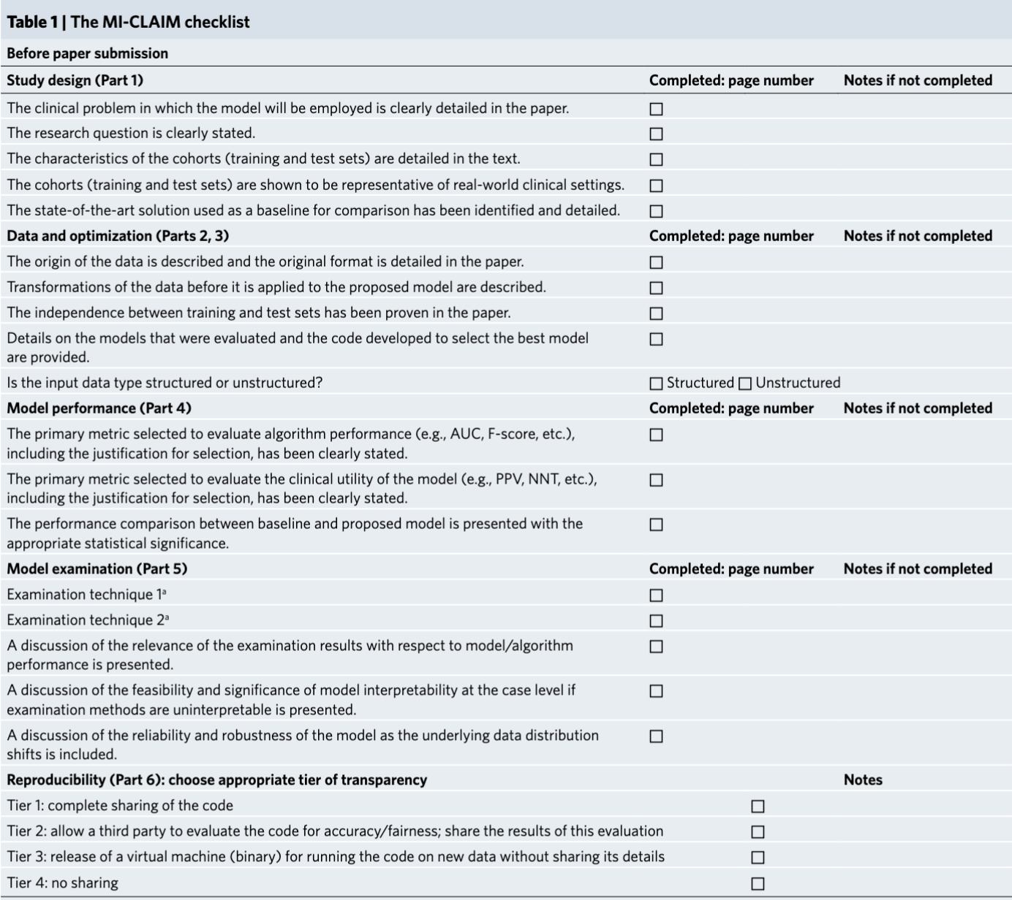

Slide 10
Topic of discussion for Norgeot 2020
Do you agree with the set of criteria presented in MI-CLAIM? Are there criteria you would like to add or remove from MI-CLAIM?
Which items in MI-CLAIM are often omitted (or ignored) in today's clinical AI papers?
How likely will MI-CLAIM be adopted by researchers? Are there certain criteria that are likely to be ignored? How can we enforce researchers to follow MI-CLAIM (or other similar checklists)?
How does MI-CLAIM compare to other frameworks?
  e.g. Google model cards: https://modelcards.withgoogle.com/face-detection#overview
Notes:
What is a clinically meaningful performance metric? AUC is not, in my opinion. What is a clinically useful threshold?
What is a clinically meaningful increase in model performance over baseline models?
Describe confounders that may be in the data. Describe missingness patterns, their potential impacts, and how it was handled.

Slide 11
