Slide 1
The Cost-Effectiveness of the Female Condom
Prepared for
The Bill and Melinda Gates Foundation
Elliot Marseille , DrPH, MPP - Health Strategies International
James G. Kahn, MD, MPH - UCSF

Slide 2
FC Cost Effectiveness Analysis:
Research Questions
What is the incremental cost-effectiveness of promoting FCs . . .
Compared with MCs?
Compared with other well-accepted HIV prevention interventions?

Slide 3
FC Cost Effectiveness Modeling:
Health Outcomes
HIV cases averted
Adverse obstetric outcomes averted
DALYs averted
Use of “DALYs” allows us to combine HIV and
obstetric outcomes and to compare FCs
with other HIV interventions in addition to MCs.

Slide 4
The Model Consists of Three Modules:
Market, Epidemic, Obstetric
Market
Supply and Demand Module
Cost, Price, Demand, Elasticity, MC coverage,
Substitution, Saturation
Obstetric Outcomes Module
Unintended pregnancies,
Spontaneous & induced abortions,
Ectopic pregnancies,
Maternal mortality
Adverse obstetric outcomes averted
DALYs
Cost savings
Newly protected episodes
Epidemic Projection Module
Risk behavior profile,
Transmission probabilities,
Prevention scenarios
HIV and STD prevalence
HIV cases averted
DALYs
Cost savings
Net program costs
Net cost per:
HIV case averted
DALY averted
Deterministic model implemented in Excel; probabilistic multi-way sensitivity analyses

Slide 5
The FC Cost Effectiveness Model Estimates Both Health and Economic Outcomes
Economic Outcomes
Cost per newly protected sex episode – for FC vs. MC.
Program and net cost per HIV infection averted – for FC, to compare with other prevention strategies.
HIV cases averted – for FC vs. MC, inverse function of cost per newly protected episode.
Adverse obstetric outcomes averted – for FC vs. MC, a wash, relevant in comparing FC vs. other prevention
DALYs averted – derived from above. Allows us to combine HIV and obstetric outcomes; and to compare FCs with other HIV interventions in addition to MCs.
Health Outcomes

Slide 6
Key Determinants of the Cost Effectiveness Results:
Data Sources, Challenges, Responses
Driver
Sources
Data Challenges
Responses
Substitution
6 Published studies; 11 data points.
No data from many countries and risk groups. Available data consistent.
Wide range of MC use and substitution examined.
Marginal Cost of
the MC
Analysis of PSI data; No published studies.
Methods not perfectly suited to our purpose. Results suggestive only.
Assume high ‘base case’ values.
Cost of the FC
PSI detailed cost data from 12 countries; up to 9 years.
How low can non-commodity costs go?
In sensitivity analysis, assume costs of the “FC2”
Cost / Ability to Target by MC Use
None.
Limited canvassing of experts to date; more to follow.
Should assume high costs if feasible at all. Analysis assumes no cost for now.
Subject to sensitivity analyses

Slide 7
Four Illustrative Scenarios
Regular SWs: High HIV prevalence in SWs and partners; High MC use; High Substitution
SW (“Drunk client”): Target FCs to episodes in which MCs not used, so very low substitution; High HIV prevalence.
Married women: Low HIV prevalence in women and partner(s); Low MC use; Low substitution
Single women: Moderate HIV prevalence in women and partners; Moderate MC use; Moderate substitution

Slide 8
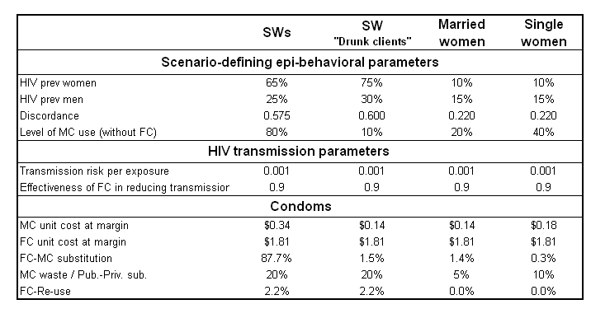
Input Values for the Four Scenarios

Slide 9
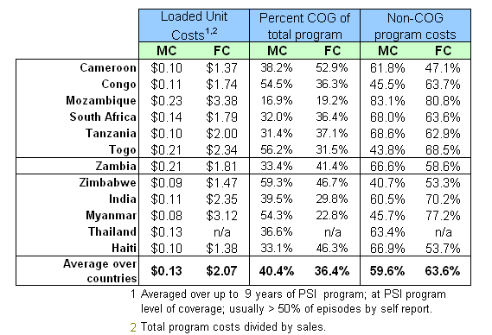
Fully Loaded Costs, MC and FC
FCs have higher unit costs than MCs because: (a) higher commodity costs and
(b) higher fixed costs due to lower volumes.
Zambia MC costs higher than average; FC lower than average; ➔ FC-favorable cost structure.
Realistic loaded cost goal: Bring FC non-COG program cost to same level as MC?
This means reduction of 6% in program costs, i.e., from 63.6% to 59.6%
FSGCODE-DATE&NAME

Slide 10
Substitution Is a Major Determinant of
Cost Effectiveness Results at High MC Use Levels
To the extent that FCs displace MCs that would otherwise be used, substitution increases the effective cost of FCs per newly-protected episode.
What is the evidence on substitution?

Slide 11
Aggregated over
6 Brazilian cities
Notes:
This or next, not both

Slide 13
What Have We Learned About the Marginal Cost of MCs at High MC Coverage?
Published literature is very limited. We found two studies, one longitudinal and one cross sectional.
  They found decreasing marginal costs.
  However these studies don’t capture the rising cost of marketing as high market saturation is reached.
Our own analyses of PSI data, suggests somewhat increasing marginal costs, perhaps due to marketing.
Proposed resolution
While both published studies suggest decreasing marginal costs, and our analyses of PSI data are equivocal, we make the FC-favorable assumption of constantly increasing marginal costs.
None of these estimation methods are ideal for our purposes. The main problem is that they report total sales volume without percent of episodes covered in population.

Slide 14
Three Dilemmas Impede FC Cost-Effectiveness
Dilemma 1
When MC use levels are low
… MC marginal costs are also low and it is thus cheaper to protect next episode with MC than with FC.
Dilemma 2
When MC use levels are high
… MC marginal costs are high, however, substitution rates are also high. Therefore cost of protecting next episode with FC is subject to countervailing trend.
Dilemma 3
When MC use levels are very high
If target episodes where marginal cost of MC is ∞, appropriate comparison for FC is other
HIV interventions, not MC

Slide 15
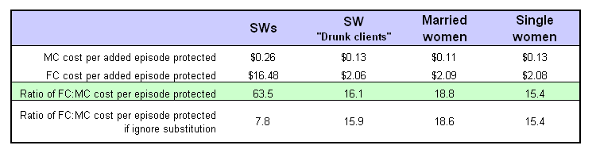
Calculating CE Outcomes: FC versus MC
Average FC and MC costs across 12 countries
(FC = $2.07 MC = $0.13 at ~50% coverage)
MCs are far cheaper than FCs per newly-protected episode in Zambia,
and even more so in a country with average FC and MC fully loaded costs

Slide 16
FCs Are Not CE Compared with MCs and Likely Cost Over $9,000 per HIV Case Averted

Slide 17
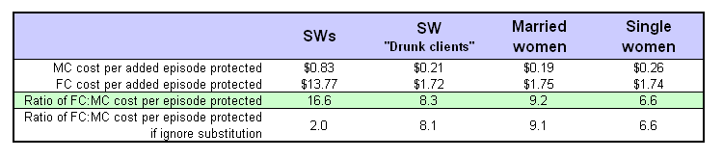
A Favorable Scenario
Fully loaded MC cost: $1.81 for Zambia reduced by 6% so that average non-COG costs are same for FC as for MC = $1.73. (See slide on fully loaded costs)
Fully loaded MC cost is $0.23 as found in Mozambique (highest among PSI countries)
MC marginal cost curve at 0.60 exponentiation. (See earlier “Curve shape” slide for marginal cost curve). This means fully loaded cost = $0.29 at 50% coverage and $0.67 at 80% coverage.
Compared with MCs, FCs remain
uneconomical by substantial margins.

Slide 18
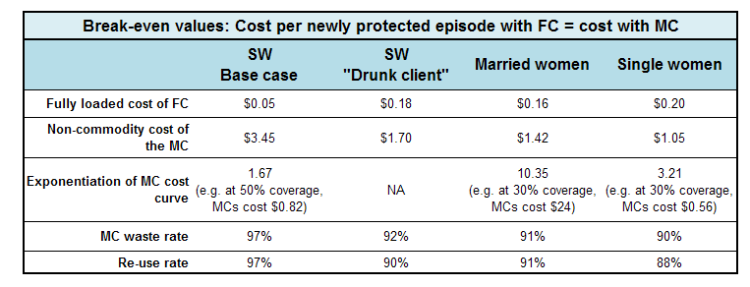
Break-Even Values for Selected Parameters
It is difficult to imagine circumstances in which these ‘break-even’ values would be present.

Slide 19
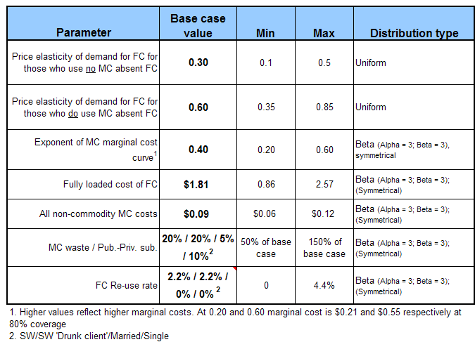
Multivariate Sensitivity Analyses
After 100,000 trials: Very high confidence of highly non-CE findings for FC for all 4 scenarios.

Slide 20
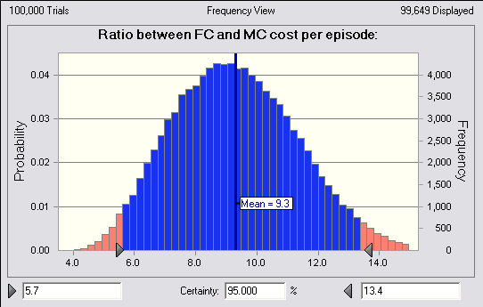
Monte Carlo’ Multivariate sensitivity analysis:
Single Women Scenario
Results after 100,000 trials
95% probability that ratio lies between 6 and 13
Notes:
20

Slide 21
FC Cost-Effectiveness vs.
Other HIV Prevention Methods
Cost per HIV infection averted
FC $3,300 (if feasible, w/o targeting cost; ~$9,000 probably more realistic) - $28,000
Male Circumcision $180 - $3,900
VCT $390 - $480
pMTCT $ 20 - $2,200
SW programs <$100
STI treatment (if works) $250 - $500
IEC (weak data) $60 - $22,000
Above values are unadjusted for averted lifetime HIV medical costs. These are $6,000 - $12,000, depending on local prices and % on ART. Any prevention strategy costing less than this per HIV infection averted would generate net savings. However, the order of preference for prevention does not change within any geographic setting – a lower unadjusted cost per HIV infection averted yields correspondingly more favorable net savings.

Slide 22
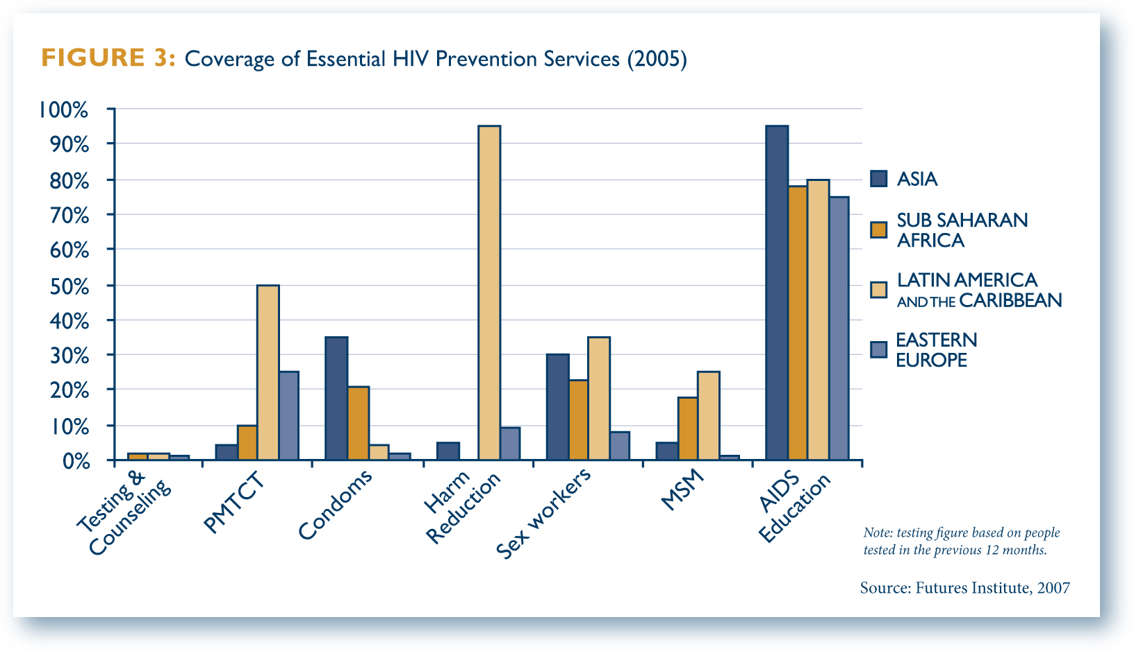
FCs Might Be CE When More Efficient Interventions Are Widely Used
BUT: There Is Low Prevention Coverage in Developing Countries
Highly CE adult male circumcision with coverage of ~0% should be included

Slide 23
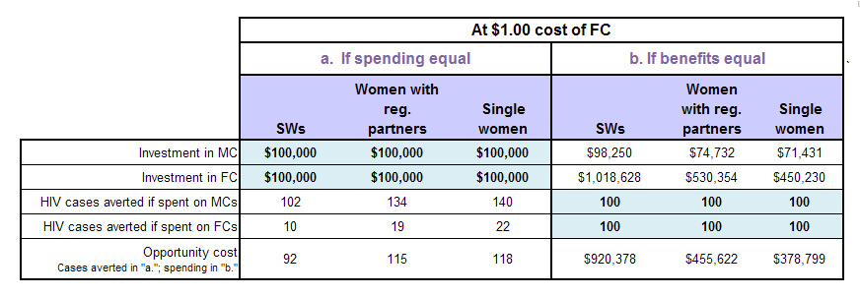
But what about the quantified benefits of the FC such as Empowerment of Women?
Likely that FC is most efficient way to promote empowerment?
What about education; skills development; micro-lending; legal - institutional reform?

Slide 24
FC is not efficient versus the other prevalent barrier method (MC) even in the best circumstances; nor is it CE compared with other HIV prevention strategies
Summary of Results
In the scenarios we examined FCs were > 6 to > 60 times more expensive than MCs per newly protected sex episode.
The cost per HIV infection averted for FC is $3,300 (optimistically) to $28,000. Compared with a range of under-implemented HIV prevention options, FCs are several times more costly per HIV infection averted.
Substitution is an important driver of results in the SW analysis, but does not determine results in the non-SW scenarios with lower HIV risk and MC use
FCs might be cost-effective in limited populations if 3 conditions are met:
  Target high risk group such as SWs
  Further target FCs to sex episodes where MCs would not otherwise be used; &
  Accomplish above targeting without dramatically increasing program costs
  OR
Coverage by the portfolio of more economical HIV prevention options (male condoms and other) has already been very substantially realized.
Notes:
24

