Slide 1
Meta-Analysis and Evidence-Based Medicine

Slide 2
Using Meta-Analyses for Decision-Making
“... the outlook for thrombolysis in unstable angina has dimmed considerably. The ballgame is in late innings and the home team is losing badly. Soon the meta-analysts will arrive, like sportscasters, to announce the final score.”
David Waters and Jules Lam, Circulation 86: 1642-1644, 1992

Slide 3
Background – How much do you know?
Who ‘invented’ meta-analysis & in what discipline?
Why is meta-analysis easier to explain to non-statisticians than ANOVA or mixed models?
How long does a meta-analysis take?
Why do we perform a meta-analysis?
What is the hierarchy of evidence?
How do I choose an outcome?
What are the different types of meta-analysis?
How do I validate my model?
What are the major issues/controversies?

Slide 4
Background – How much do you know?
Earliest use of meta-analysis was in Education by Gene Glass:
Glass, G. V (1976). Primary, secondary, and meta-analysis of research. Educational Researcher.

Slide 5
Background – How much do you know?
Analysis of Variance vs. Meta-analysis
ANOVA is used with individual patient data to understand differences between trials or subgroups within a trial. Meta-analysis is used to find the overall effect, synthesizing similar outcomes either on a study (publication) basis or using individual data.

Slide 6
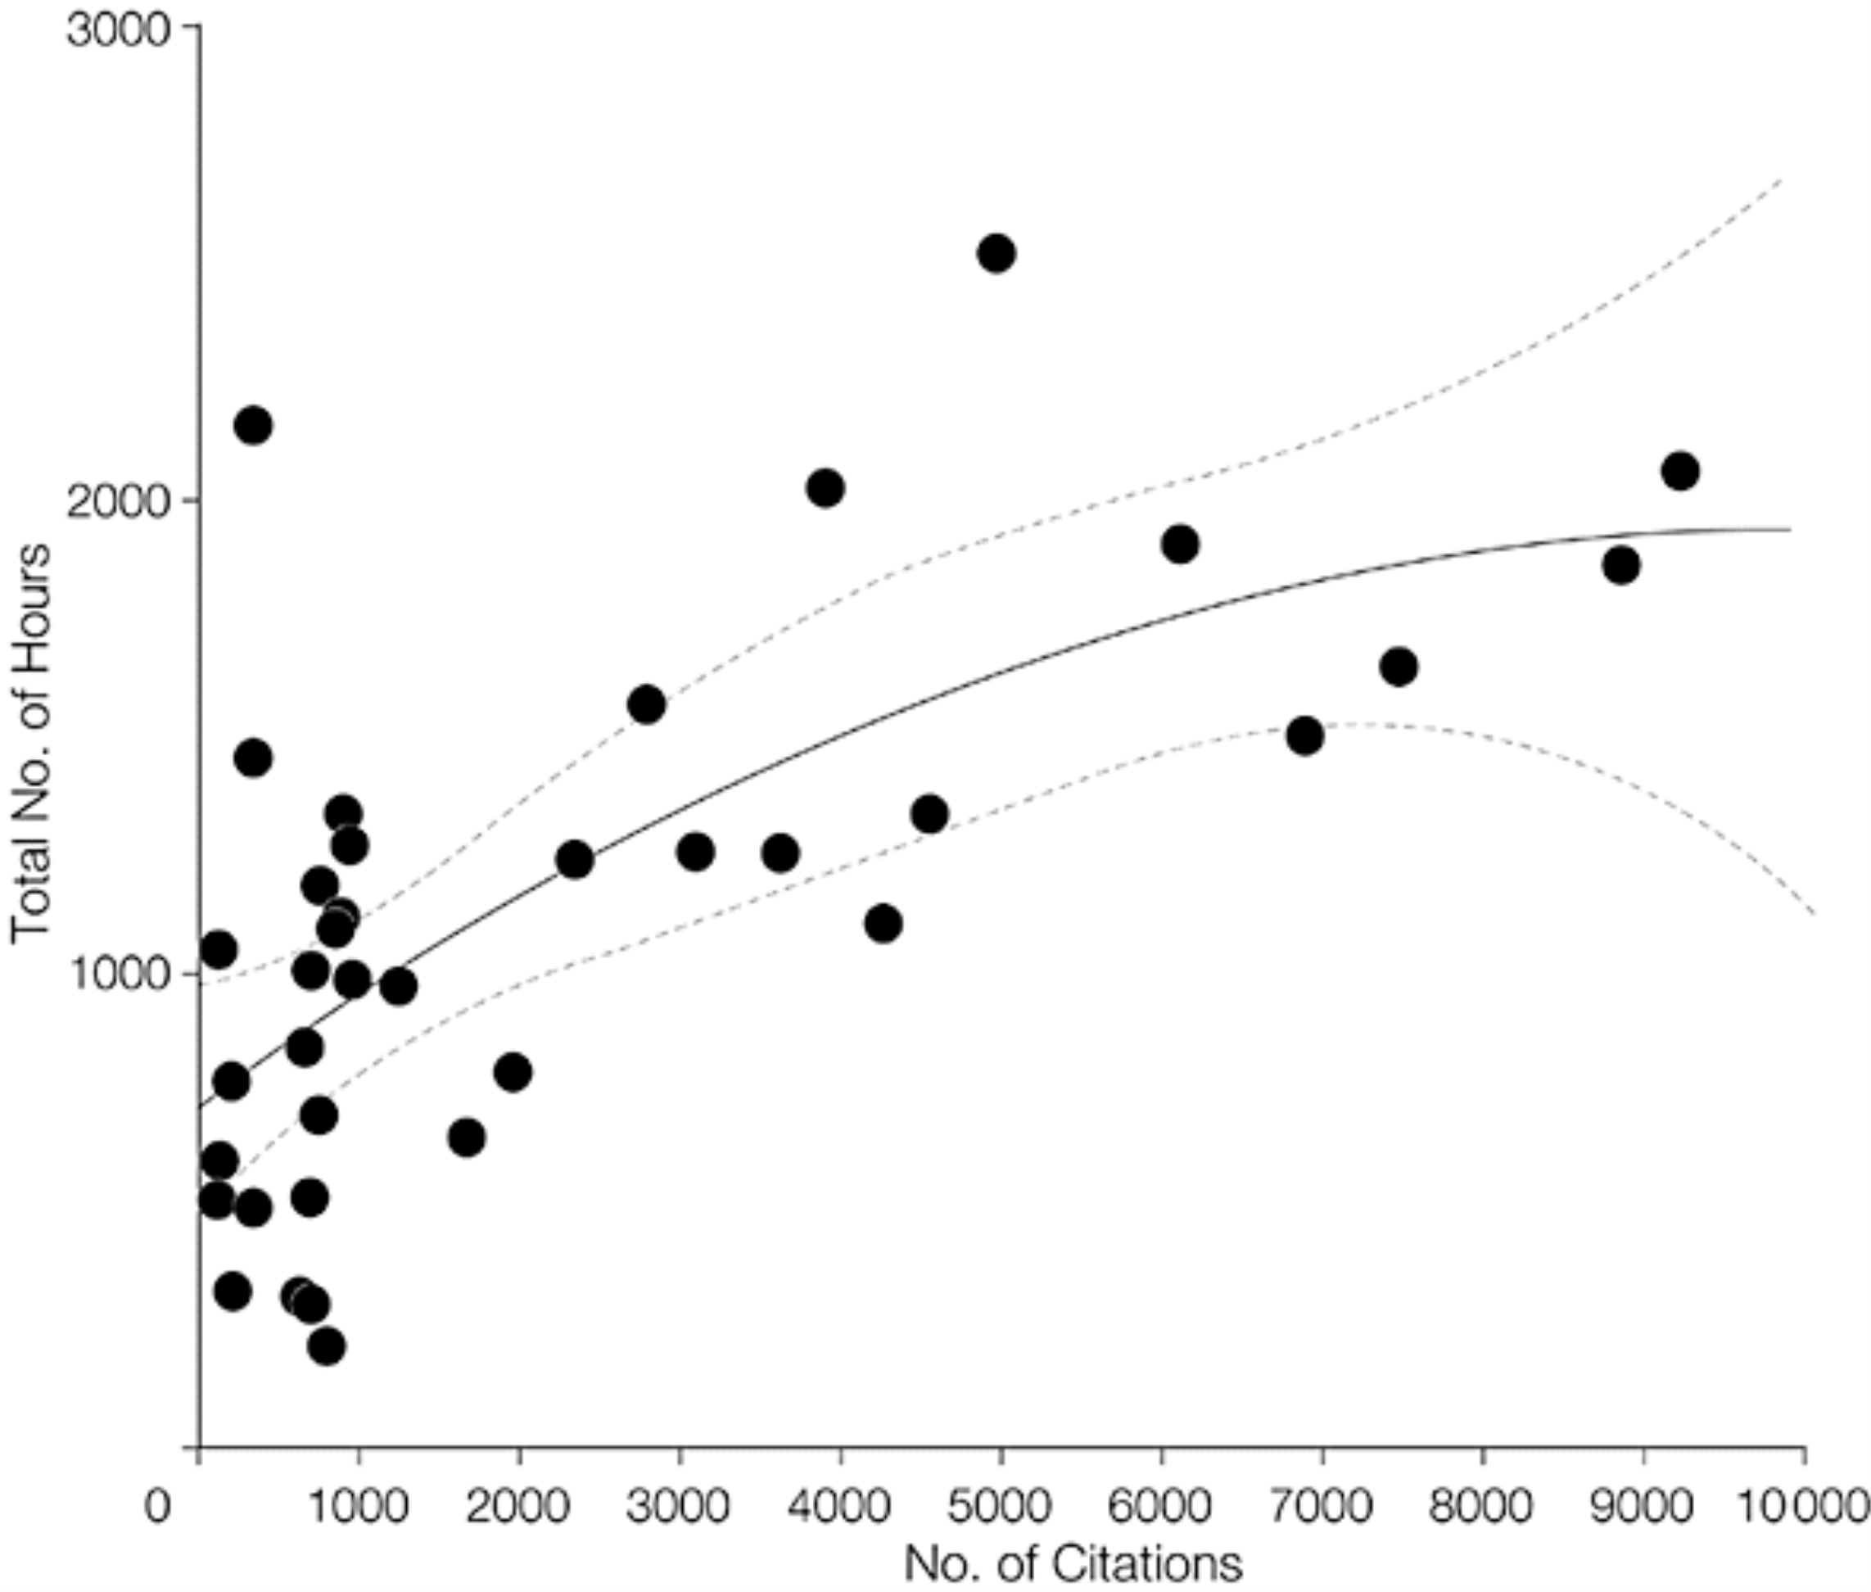
Background – How much do you know?
How long does a meta-analysis take?
Mean total number of hours = 1139 Median = 1110, Range =216 to 2518
Allen & Olkin, JAMA. 1999;282(7):634-635. doi:10-1001/pubs.JAMA-ISSN-0098-7484-282-7-jbk0818

Slide 7
Background – How much do you know?
Why do we perform a meta-analysis?
All our trials are too small
We’re applying for a new indication
We want to make a marketing claim or rebut a marketing claim from a competitor
We want to show superiority of our treatment

Slide 8
Quick Review
Models
  NOT Vote Counting
  NOT synthesis of p-values
  Fixed Effects Models
  Random Effects Models
  Survival Data
  Diagnostic Studies - ROC Curves
  Bayesian Models
  Network Meta-Analyses & Indirect Effects
  Markov Transition Models

Slide 9
Fixed-effects model
Random-effects model
Fixed-effects meta-analysis assumes that the intervention has a single true effect.
Random-effects meta-analysis assumes that the effect of the intervention varies across studies.

Slide 10
Fixed-effects model
Random-effects model
OR
Which should I choose?
  Good news – most software produces both
  Both theoretical and practical reasons
    Generalizability
      What is the focus of this meta-analysis?
      Can I assume this is the whole population?
    Heterogeneity
      How different are these studies?

Slide 11
Survival Analyses
Reconstruct actuarial life tables
- impute interim time-points
Reconstruct log rank statistics
- need p-values
Deconstruct survival curves
- using a ruler, ‘graph mapping software’
Combine into summary survival curve

Slide 12
Diagnostic Studies
Objective may be diagnosis, imaging modalities,
evaluation vs. a gold standard
Studies may use different thresholds
- compute 2 x 2 tables for each study
Compare areas under the ROC curve using logit models

Slide 13
Systematic Review and Meta-analysis of the Literature Regarding the Diagnosis of Sleep Apnea
Susan D. Ross MD, FRCPC, Iris A. Sheinhait MA, Katherine J. Harrison BA, Marion Kvasz MD, MPH, Janet E. Connelly BS, Steven A. Shea PhD, &I. Elaine Allen PhD

Slide 14
Bayesian Hierarchical Models
Conceptual Model: Evidence (or likelihood)
= What the data say
Inference or Bayesian analysis:
What the data say + What you know (Prior information)
= What you believe (Posterior information)
Action or Decision analysis:
What you believe + Consequences (utility, cost)
= What you DO

Slide 15
Bayesian Hierarchical Priors
Useful when data available on many “similar” units (individuals, areas, studies, subgroups,…)
Data x_{i} (events) and parameters θ_{i} (log odds) for each unit i=1,…,N
Three different assumptions:
  Independent parameters: units are unrelated, and each θ_{i} is estimated separately using data x_{i} alone
  Identical parameters: observations treated as coming from same unit, with common parameter θ
  Exchangeable parameters: units are “similar” (labels convey no information) → mathematically equivalent to assuming θ_{i}’s are drawn from common probability distribution with unknown parameters

Slide 16
Meta-analysis example
8 small RCTs of IV magnesium sulphate following acute myocardial infarction
Data: x_{ig} = deaths, n_{ig} = patients in trial i, treatment group g (0=control, 1=magnesium) and compute θ_{i} where θ_{i} is the log odds ratio for treatment effect
If not willing to believe trials are identical, but no reason to believe they are systematically different → assume θ_{i}’s are exchangeable with hierarchical prior
    θ_{i} ~ Normal(μ, σ ²)
    μ, σ ² also treated as unknown with (vague) priors
Spiegelhalter, D., Abrams, K. and Myles, J. (2004). Bayesian Approaches to Clinical Trials and Health Care Evaluation, Wiley, Chichester.

Slide 17
Meta-analysis example: ORs & 95% Credibility Intervals
Spiegelhalter, D., Abrams, K. and Myles, J. (2004). Bayesian Approaches to Clinical Trials and Health Care Evaluation, Wiley, Chichester.

Slide 18
Network Meta-analyses Evaluating Indirect Effects using Bayesian Hierarchical Modeling
Evidence includes studies of two treatments:
  comparing one to the other
  comparing each to a placebo
  comparing each to a third comparator*

Slide 19
Estimating Missing Effect Sizes
Incomplete Block Design with Complete Individual Patient data
TYPE OF INTERVENTION
Standard Type1 Type2 Type3
Region
A X X X
B X X
C X X X
D X X
E X X
F X X

Slide 20
Estimating Missing Effect Sizes
Use Hierarchical Modeling Techniques
y_{ijk} = m_{i} + t_{i} + L_{j} + R(L)_{jk} + (tL)_{ij} + e_{ijk} ,
where y_{ijk} is the outcome for the ijk^{th} patient
m_{i} is the i^{th} intervention mean
t_{i} is the intervention effect
L_{j} is the group effect

Slide 21
Estimating Missing Effect Sizes
Testing the Hierarchical Model
R(L)_{jk} is the effect of subject within a group.
(τL)_{ij} is the intervention-by-group effect.
e_{ijk} is the error and the k-subscript indicates patient within group.
Intervention effects are then tested using, .
F = MS(intervention) MS(group*intervention).

Slide 22
Testing Treatment Differences Between Placebo Controlled Studies
Outcomes at 30 Days Composite (Death or MI)*
Study Drug # of Patients # Studies Odds Ratio 95% CI
Drug A 9,606 5 0.45 (0.37, 0.55)
Drug E 5,834 4 0.82 (0.69, 0.98)
Drug T 3,634 3 0.73 (0.57, 0.92)
  *Example: compare the efficacy and safety of a new GPIIb/IIIa receptor inhibitor for patients undergoing PCI (percutaneous coronary interventions) [unpublished MetaWorks work product]

Slide 23
Testing Treatment Differences Between Placebo Controlled Studies
One-way ANOVA comparing treatments:
Drug A vs. Drug E p < 0.001
Drug A vs. Drug T p < 0.01
Drug E vs. Drug T p > NS
Another way to think of indirect effects…networks

Slide 24
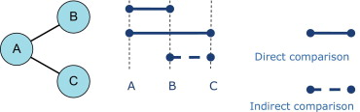
Types of Indirect Effects (1)
Similarity assumption in an indirect treatment comparison. AB trials and the AC trials are comparable on effect modifiers, and an unbiased indirect estimate for the relative effect of C versus B can be obtained from the estimates of the effect of B ...
Jeroen P. Jansen , Rachael Fleurence , et al, Value in Health, Volume 14, Issue 4, 2011, 417 - 428

Slide 25
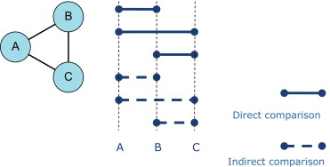
Types of Indirect Effects (2)
Must ensure that there is consistency in a mixed treatment comparison. AB trials, AC trials, and BC trials are comparable in effect modifiers, and for each pairwise comparison, the direct and indirect estimates are consistent.
Jeroen P. Jansen , Rachael Fleurence , et al, Value in Health, Volume 14, Issue 4, 2011, 417 - 428

Slide 26
Markov Chain Meta-Analyses: Transition Matrices
Where is it being applied?
Policy analyses in mental health
-modeling transition probabilities within a mental health system
-probability of transition to outpatient or readmission
Genome analyses
-modeling likelihood of gene pairings

Slide 27
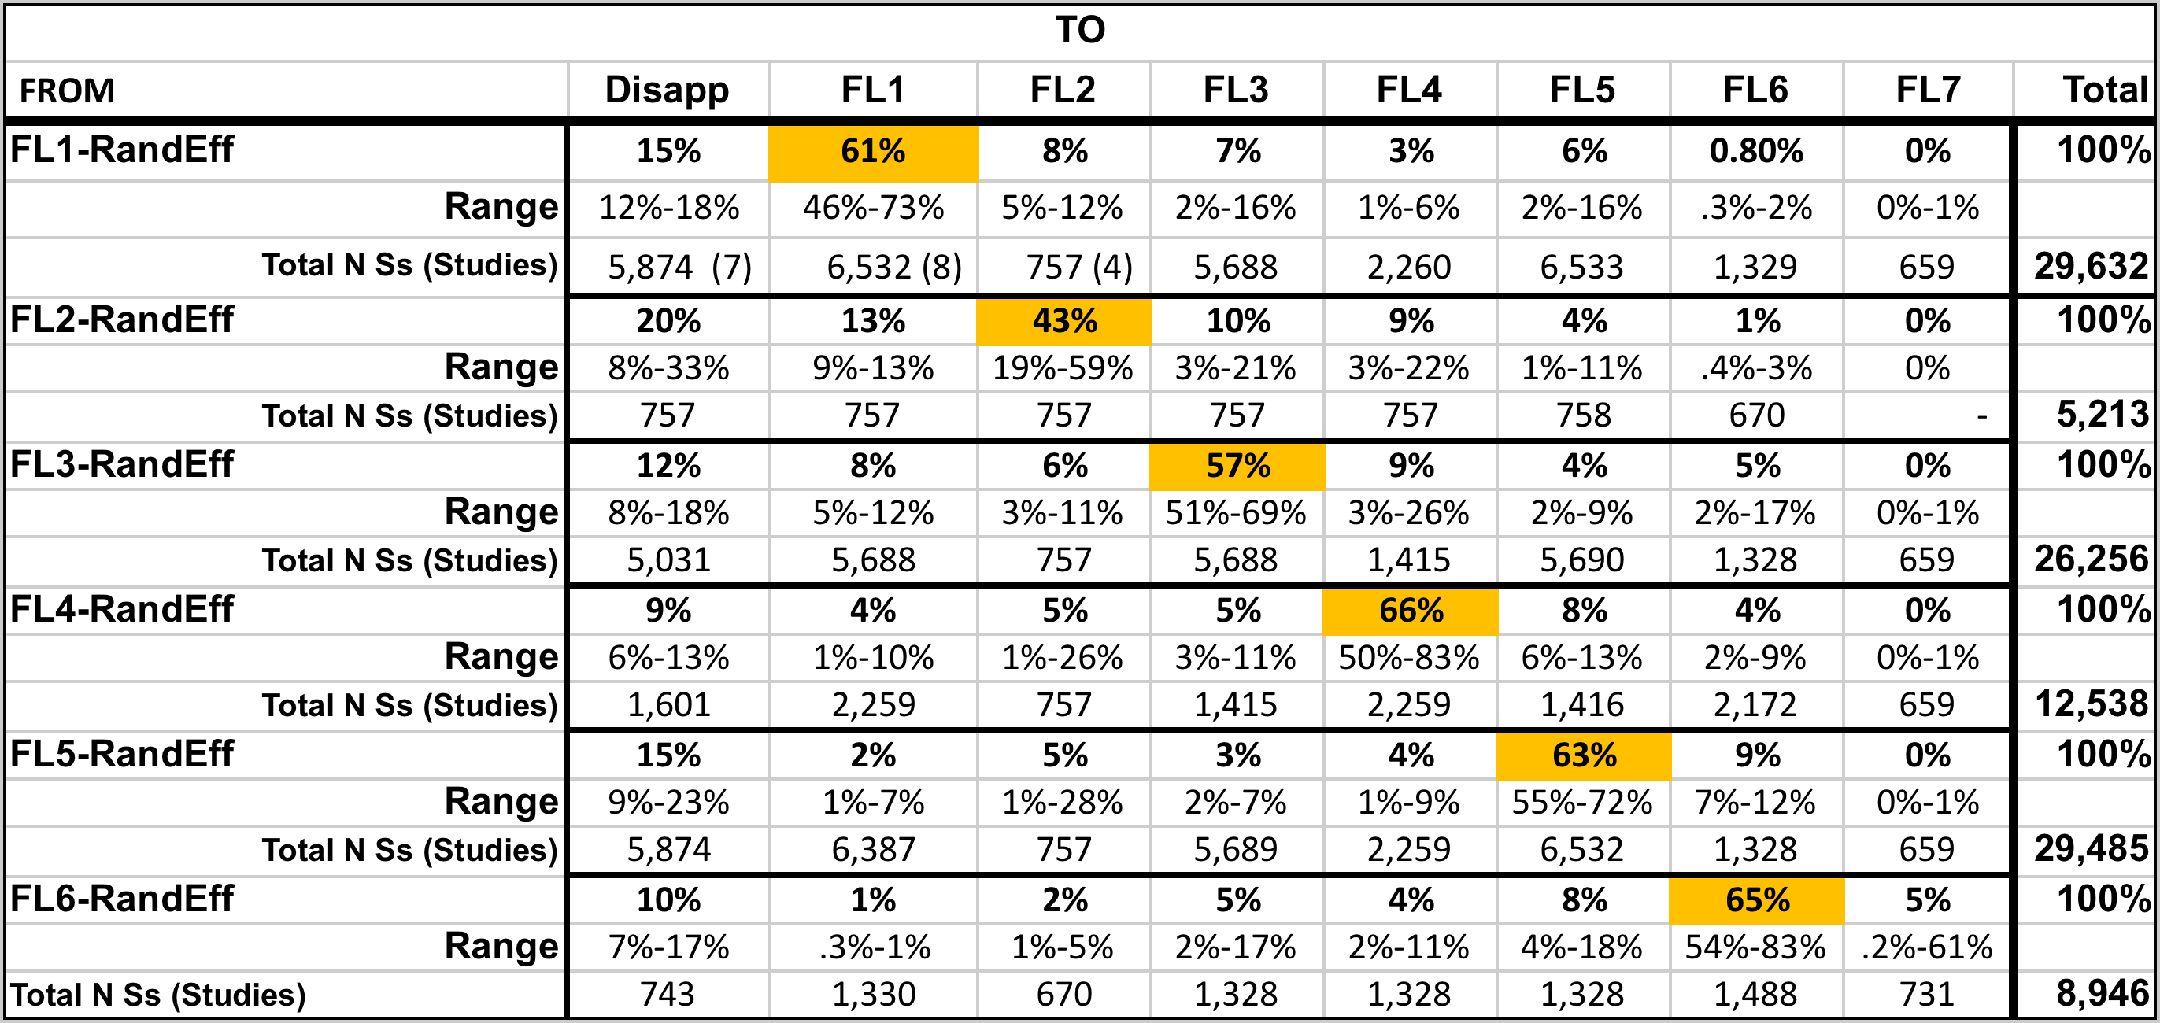
Relative effect sizes (and 95% intervals) of psychotherapeutic interventions
S. Leff & IE Allen, 2014 Work in Progress

Slide 28
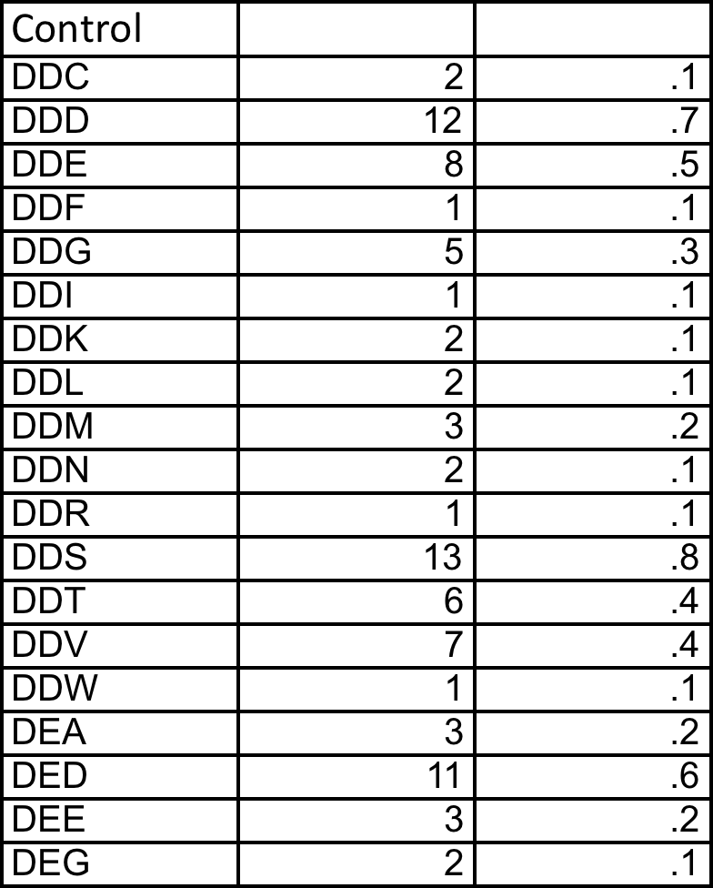
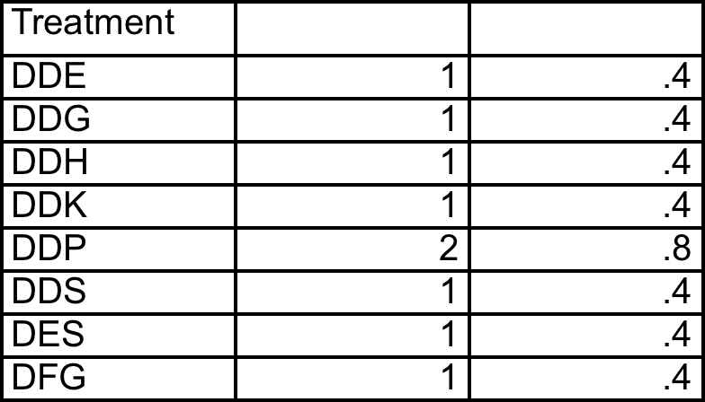
Amino Acid Transitions: Comparing Control to Treatment

Slide 29
You have your results, everything looks promising…what now?
Sensitivity analyses & validation!
Some biases to keep in mind.

Slide 30
The Bias List: How can we test these?
INTERNAL BIASES
Selection bias
(eg. lack of randomization)
Performance bias
(eg. lack of blinding)
Attrition bias
(eg. loss to follow-up)
Detection bias
(eg. differences in outcome)
Other bias suspected
(eg. Inconsistent results)
EXTERNAL BIASES
Population bias
(eg. differences in participants)
Control bias
(eg. different control strategies)
Intervention bias
(eg. differences in dose/timing)
Outcome bias
(eg. different outcome definitions)

Slide 31
Remember: Heterogeneity is your friend
  Clinical heterogeneity
  Methodological heterogeneity
  Statistical heterogeneity
    Cochran’s Q or I² Statistics
    Covariate adjustment
    Quality Scoring adjustment
    Study sponsorship adjustment
    Meta-regression
    Individual or grouped Jackknife
    Subgroup analyses
    Funnel plots
    NNT
    Fail safe number

Slide 32
How to Handle Heterogeneity
Fixed effects model can measure it
Random effects model controls for it (but does not explain it)
Always test for it (Cochran’s Q & I²)
Stratify and explore reasons for it (Jackknife)
Regress important covariates to examine their effect
Don’t omit outlier studies
Use the information to design better studies

Slide 33
Meta-Regression & Beyond
Subgroup analyses
Examining the control rate
Identification of important covariates
Control for baseline differences
Control for sponsorship
Caveat: Need sufficient studies to use these

Slide 34
Look Fred, This seems to be the
same thing…SUMMARIZED

Slide 35
My Favorite Meta-analyses Projects
Meta-analysis and the law
Unique Applications

Slide 36
Using Meta-Analysis as a Primary Evidence Tool*
Aredia – Zometa Deutsch v. Novartis Pharm. (E.D.N.Y. 2011)
Avandia In re Avandia Marketing (E.D. Pa. 2011)
Baycol In re Baycol Prods. (D. Minn. 2007)
Benzodiazepine Vinitski v. Adler, (PhilaCt. Common Pleas 2004)
Blood substitutes - Biopure v. NIH (2008)
Celebrex – Bextra In re Bextra & Celebrex Marketing (2007, 2009)
E5 (anti-endotoxin monoclonal antibody for sepsis) (1996)
Fenfluramine, Phentermine In re Diet Drugs Prod. (E.D.Pa. 2000)
Fosamax In re Fosamax Prods. Liab. Litig., (S.D.N.Y. 2009)
Gadolinium In re Gadolinium-Based Contrast Agents (N.D. Ohio 2010)
Hydroxycut In Bechler v. MuscleTech (2003 & 2006)
Lipitor in S.Carolina v. Pfizer (2011, 2013)
Neurontin In re Neurontin Marketing, Sales Practices (D. Mass. 2009)
Paxil (SSRI) In Tucker v. Smithkline Beecham Corp (S.D.Ind. 2010, 2013)
Procrit In Amgen v. OrthoBiotech (2009)
Prozac (SSRI) In Rimberg v. Eli Lilly & Co. (2009)
(RIAA) In A&M Records, Inc. v. Napster, Inc., 239 F.3d 1004 (2001, 2007)
Seroquel In re Seroquel Products Liab. (M.D. Fla. 2009)
Thimerosal – Vaccine Salmond v. Sec’y Dep’t of HHS, (Fed.Cl. 1999)
Trasylol In re Trasylol Prods. Liab. Litig.,(S.D. Fla. 2010)
Ultra Dawn In Proctor & Gamble class action suit (2002)
Vioxx Merck & Co v. Ernst, (Tex. Ct. App. 2009) (Tex. 2011)
X-Ray Contrast Media Bracco v. Amersham (D.N.J. 2009, 2012)
Zoloft (SSRI) Miller v. Pfizer, Inc.,(10th Cir. 2004)
Zymar Senju Pharmaceutical Co. Ltd. v. Apotex Inc. (D.Del. 2011)
Zyprexa In re Zyprexa Products Liab. (E.D.N.Y. 2007)
*Cases I worked on

Slide 37
Does Ultra Dawn Live Up to Its Name?
Consumer Reports that Ultra Dawn may not be a ‘significant’ improvement over regular Dawn
  CR policy is that it does not release its experimental results or design or the tests it performs
  What does ‘significant’ mean?
Law firm in California files a class action suit to reimburse users of Ultra Dawn for the difference in price
Proctor & Gamble law firm hires MetaWorks to reproduce P&G’s analysis and also produce a meta-analysis of all the (internal) trials comparing Ultra Dawn to regular Dawn
Exhaustive internal protocol of analyses but only select pertinent information given to Ingram Olkin from Stanford, who will testify for P&G

Slide 38
Overall Summary Provided to I.Olkin & to P&G
All the experiments carried out by Procter & Gamble comparing Ultra Dawn to Standard Dawn were reviewed. The test procedures and statistical methodologies used to establish the superiority of Ultra Dawn vs. Standard Dawn were statistically rigorous.
All the statistical analyses were replicated with increase in fat dissolved as the primary outcome.
Meta-analyses performed of the experiments conducted by Procter & Gamble comparing Ultra Dawn with Standard Dawn.
Meta-analysis showed the superiority of Ultra Dawn vs. Standard Dawn.
Effect Size 95% Confidence Interval Significance Level
0.85& [0.65 to 1.06] p < 0.001
What type of meta-analysis model is appropriate? What was the outcome of the lawsuit?
*Ultra Dawn **Regular Dawn &in favor of Ultra Dawn

Slide 39
Safety of Ephedrine Weight Loss Supplements
Class action suits after deaths linked to ephedrine and FDA issuing new regulations for the supplement
Objective: Quantify selected efficacy and safety outcomes of Hydroxycut™ when used as indicated as a dietary supplement, with or without caloric restriction and exercise, in overweight healthy adults
  Efficacy in Weight Loss
  Safety in no excessive increase in BP or pulse
Hydroxycut was marketed by MuscleTech, a Canadian company, for several years, and was tested for selected efficacy and safety outcomes in 6 randomized controlled trials (RCTs) sponsored by MuscleTech since 1999
What meta-analysis model is appropriate here?

Slide 40
Safety Analyses
 | k | n | Baseline |  | 8 Weeks |  | Effect size for MD (95%CI) |  | MD (95% CI)*
 |  |  | Control | Intervention | Control | Intervention
Average SBP (mmHg)
LOCF | 6 | 150 | 122.1 | 122.1 | 120.2 | 121.8 | 0.90 (-.35, 2.15) p = 0.156 |  | -1.95 (-5.05, 1.14)
Completers | 6 | 124 | 122.7 | 122.5 | 119.2 | 122.5 | -0.15 (-1.66, 1.36) p = 0.845 |  | -3.07 (-6.71, 0.57)
Average DBP (mmHg)
LOCF | 6 | 150 | 78.5 | 77.8 | 75.6 | 75.7 | 0.75 (-1.01, 2.25) p = 0.400 |  | -0.53 (-3.65, 2.58)
Completers | 6 | 124 | 74.9 | 76.8 | 74.9 | 76.7 | 1.46 (-0.26, 3.18) p = 0.097 |  | -1.28 (-4.97, 1.06)
Average Pulse (bpm)
LOCF | 5 | 132 | 77.6 | 76.5 | 74.1 | 76.0 | 0.11 (-1.32, 1.55) p=0.880 |  | -2.21 (-5.76, 1.34)
Completers | 5 | 107 | 77.3 | 77 | 73.7 | 76.0 | 0.46 (-0.14, 1.06) p=0.129 |  | -3.13 (-6.97, 1.34)
k = number of studies
n = total number of subjects in group
SBP = systolic blood pressure
DBP = diastolic blood pressure
mmHg = millimeters of mercury
bpm = beats per minute
LOCF = last observation carried forward (includes all subjects who started for whom any follow-up data were available)
Completers = only subjects completing at least 8 weeks on study
MD = mean difference
CI = confidence interval
* Mean difference of test change - control change (kg)
FDA & Trial Outcomes?

Slide 41
Amgen v. Ortho-Biotech (Aranesp v. Procrit)
AHRQ evidence report (done by MetaWorks) finds no difference between the two products
Ortho-Biotech sues Amgen for price fixing
Amgen hires MetaWorks & Ortho-Biotech hires the Analytics Group (LJ Wei from Harvard’s Biostat Group)
Important outcomes are Quality of Life (FACT-F & FACT-G) and number of times transfused
Issues with LJ’s analyses: No protocol, only fixed-effects models, no examination of heterogeneity, no sensitivity analyses, one kin study & one study missing
FDA & Trial Outcomes?

Slide 42
Bracco v. Amersham (X-Ray Contrast Media)
Dueling Marketing Claims – Amersham hires Chris Schmid from Brown U. to debunk a meta-analysis sponsored by Bracco & publishes its own meta-analysis
Bracco hires MetaWorks (now UBC) & the Analysis Group for statistical analysis to debunk Amersham’s publication
Re-analysis of both meta-analyses by each company
Teaching the judge (she was an English major) about statistics, odds ratios, meta-analyses, and Bayes

Slide 43
Renal Safety of Iodixanol(IOCM) v. Iopamidol (LOCM) on the incidence of Contrast Induced Nephropathy
Amersham uses per protocol rather than ITT patient group
Omits 6 studies where there were no events
Only uses fixed-effects models
The interesting deposition of Dr. McCullough

Slide 44
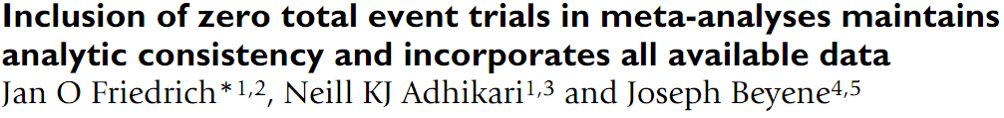
Renal Safety of Iodixanol v. Iopamidol on incidence of Contrast Induced Nephropathy
Re-analyzed Amersham Study – uses ITT patient group
Includes the six studies where there were no events
Outcome?

Slide 45
Meta-Analysis & Public Policy
US Environmental Protection Agency – using systematic reviews to estimate the value of a statistical life (VSL)
Using meta-analyses of transition probabilities for estimating monthly transitions for outpatient mental health services
Using meta-analysis to decide if a clinical trial is feasible
Final thoughts…

Slide 46
Trial Feasibility: Asthma
Question: Will a planned multicenter phase 4 trial ($10 million estimate) succeed in proving that drug P is better than drug Z?
EBMI tool: Meta-analysis of all sponsor’s trials of drug P vs. G-SK drug Z.

Slide 47
Drug P or Z Vs. Placebo: All Outcomes
#Study/
Outcome Treatment Arms #Pts
FEV 1 Z₁ 3 1042
FEV 1 P₁ 4 805
AM PEFR Z 3 1042
AM PEFR P₁ 4 805
PM PEFR Z₁ 3 1042
PM PEFR P₁ 4 2805
β agonist Z 3 1042
β agonist P₁ 4 805
Odds Ratio and 95% C.I.
-6
-4
-2
0
2
4
6
Favors Placebo
Favors Treatment
Random Effects Model
Notes:
7

Slide 48
Sample Size:
Estimated Clinical Trial Sample Size
Outcome A B Required Sample Size
per Group**
FEV1
Overall 0.069 0.068 27,000
Recommended Dose* 0.066 0.077 7,000
Morning PEFR
Overall 0.054 0.062 1,700
Recommended Dose* 0.053 0.055 10,500
Evening PEFR
Overall 0.051 0.039 3,700
Recommended Dose* 0.051 0.036 2,500
Beta-Agonist Use
Overall 0.299 0.245 2,000
Recommended Dose* 0.321 0.250 2,300
** α = 0.05, 1-β = 0.80
Notes:
11

Slide 49
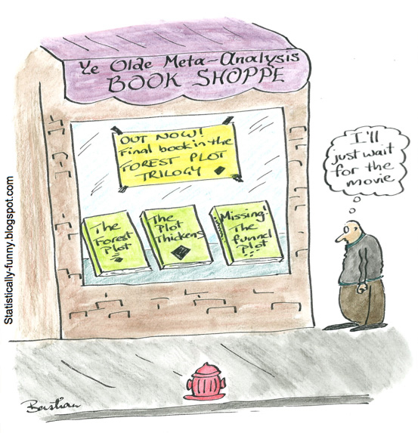
Thank you.
Any Questions?
Ready for a short quiz?

