Slide 1
Systematic Reviews
EPI 214
Module 1-C: PICO Protocol
Mohsen Malekinejad, MD, DrPH

Slide 2
Assuming that your topic of interest has not recently been covered and would indeed be an important contribution in a high-priority area of research:
It’s time to define the exact parameters of your review

Slide 3
The protocol
Protocol is a work-plan for the systematic review
Helps to focus thinking; allows tasks to be allocated
Also (when registered in PROSPERO) helps others to know that you are reviewing this topic
In the protocol, you will really “flesh out” all aspects of your PICO
Review methods must be decided a priori
A very clear protocol up front saves a lot of work down the road
Notes:
If you need to change or refine your pico during your data extraction but you must document it and include it in the appendixes saying what you started out as and why it changed
- It’s okay to change before your data extraction. But not during data analysis

Slide 4
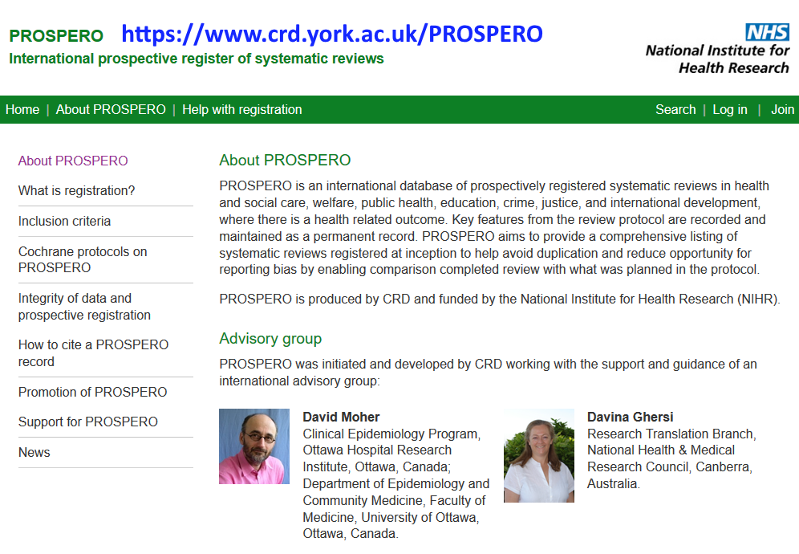

Slide 5
Cochrane guidance on titles
[Intervention] for [health problem]
[Intervention A] versus [Intervention B/Control] for [health problem]
[Intervention] for [health problem] in [participant group/location]
 Be sure to add: “A systematic review”

Slide 6
PICO framework
Population, Intervention, Comparator, Outcome
  Some like to add a “T” , PICOT, for “time-frame” of interest (e.g. 1982-2018, 1996-2018, 2000-2018)
  Some like to add an “S”, PICOS, for “study designs”
Main thing is to use the P.I.C.O. components!

Slide 7


Slide 8
PICO framework
Treatment as prevention (individual-level and community-level outcomes)
P | I | C | O
Adults, adolescents and children with HIV infection, on antiretroviral therapy (ART), living in resource-limited settings | Multi-faceted psychosocial interventions (including e.g. patient navigator, microfinance, adherence clubs etc.) | Usual care | Retention in ART program Mortality Viral load suppression ART adherence
“PICO question”: In adults and adolescents with HIV infection and on antiretroviral therapy (ART ), do multi-faceted psychosocial interventions (compared to usual care) lead to improved retention in care, reduced mortality, improved viral load suppression and improved ART adherence?

Slide 9
Population
Consider how best to define eligible populations. Some possibilities include:
Adults (standard age ≥18 years, but many LMIC studies start lower)
Adolescents (standard WHO age range is 10-19)
Children (but be specific about age range)
Males, or females, or both
Localized, e.g. children in Latin American countries, women in South Asian countries
Limited populations, e.g. “street youth,” “people who inject drugs,” “adults over age 50,” “pregnant women” etc.
Notes:
Be specific about inclusion and exclusion criteria

Slide 10
Intervention
Decision: “Lumping” or “splitting” topics?
Lumping = covering several closely-related interventions in a review
Splitting = being very specific about the intervention
  e.g. “Honey as a topical treatment for acute and chronic wounds”
One way to “lump” is through several “approaches” to an intervention
  e.g. “Multi-faceted psychosocial interventions to improve ART retention”
Notes:
Explicitly say who is providing the intervention, how the intervention is being provided/applied,
Lumping would be multiple interventions that are related (ex: mental health programs)

Slide 11
Comparator
Question comparing an intervention vs. control, usual care or “no intervention”
These are very different from comparisons of intervention A vs. intervention B
Choice has large implications for interpreting results
Suggest that you avoid head-to-head comparisons in this course – stick with the “neutral” comparators

Slide 12
Outcomes
To the extent possible, outcomes should be “patient-important” outcomes
Outcomes should be as objective and direct as possible
Intermediate outcomes are often necessary
  e.g. “undetectable viral load” as an indicator of adherence
Subjective outcomes are often necessary
  e.g. “self-reported 95% adherence”
Should have all major outcomes associated with the intervention
Notes:
Want to make sure you include adverse effects

Slide 13
Outcomes (2)
“Secondary” outcomes may be necessary
  e.g. subjective outcomes of a drug or other clinical intervention
Don’t forget adverse outcomes and harms
Don’t forget outcomes in regard to health equity

Slide 14

How PICO informs Protocol Development
Relevant studies & data
Population
Intervention
Comparison
Outcome
Notes:
Intersect defines search strategies, data synthesis

Slide 15
Formulating PICO question as a title for your review
Systematic review titles are generally rather formulaic. Capture PICO concepts.
Multifaceted psychosocial interventions [compared to usual care] for improving antiretroviral program retention and other outcomes in people living with HIV in low- and middle-income countries: A systematic review
Multifaceted psychosocial interventions for improving health outcomes in people with HIV in LMIC: A systematic review
Adherence clubs for improving health outcomes in people with HIV: A systematic review
Microfinance interventions to improve ART program retention in people living with HIV in sub-Saharan Africa: A systematic review

Slide 16
Components of the protocol
Background
Review objectives
Describe selection criteria
Describe proposed search methods and strategy in detail
  Important first to obtain guidance from specialist research librarian
Describe how you will systematically apply selection criteria
  In duplicate, reproducible, transparent
Describe how you will assess risk of bias in included studies
Describe how you will analyze results, using meta-analysis if appropriate and possible
  How you will investigate heterogeneity, reporting bias
  How you will perform sensitivity analyses, if needed
Notes:
More applicable to a more formal review

Slide 17
Background
Give a contextualizing, big picture overview of the problem
May include discussion of the importance or prevalence of the problem in the population and the results of similar (& sometimes tangential) reviews conducted on the topic.
Explains why this review is necessary

Slide 18
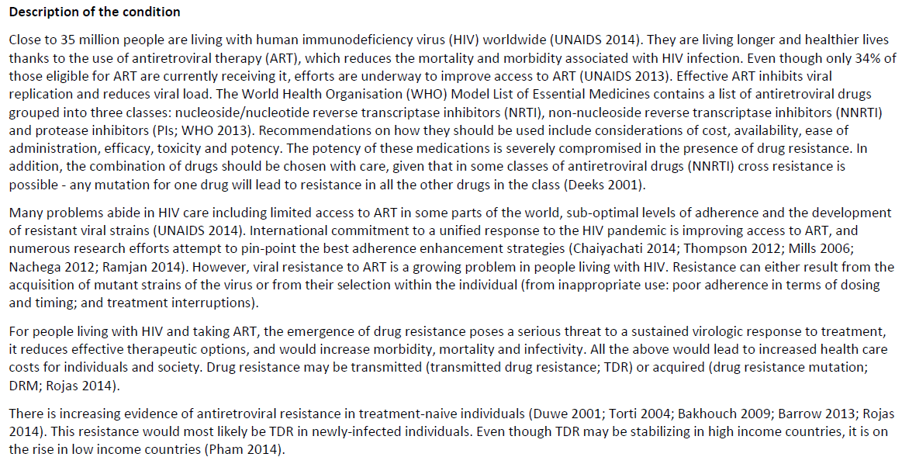
Very small, I know – sorry -- please refer to the Tambe protocol

Slide 19
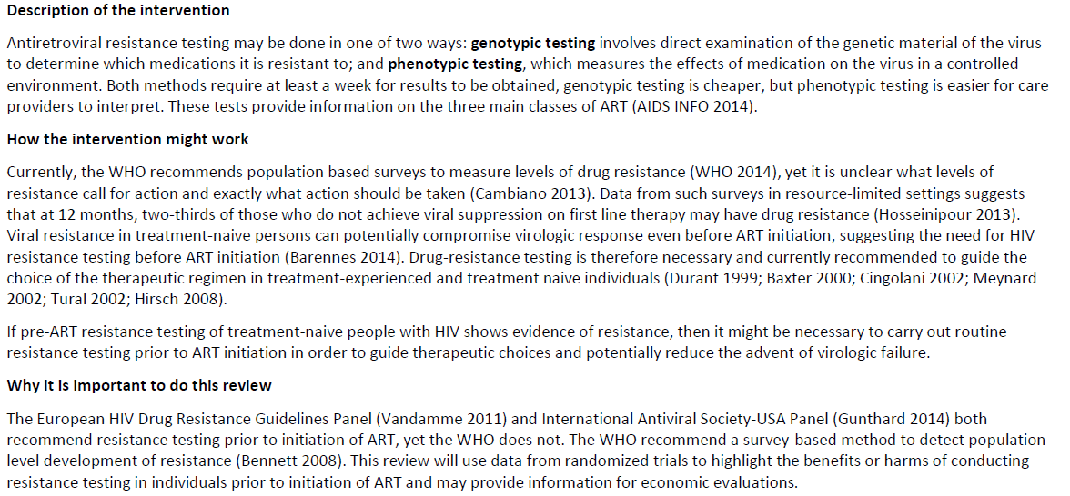

Slide 20
Objectives
A brief statement of your goal in conducting the review. For example:
“To evaluate the effectiveness of antiretroviral resistance testing (genotypic, phenotypic, or virtual phenotypic) in reducing morbidity and mortality in treatment-naive people living with HIV”

Slide 21
Methods
The most important section
Greatly-expanded PICO, with much more
Spells out in detail the criteria studies must meet to be included in the review
Explains in detail the search methods, screening methods, plans for data collection and analysis plans

Slide 22
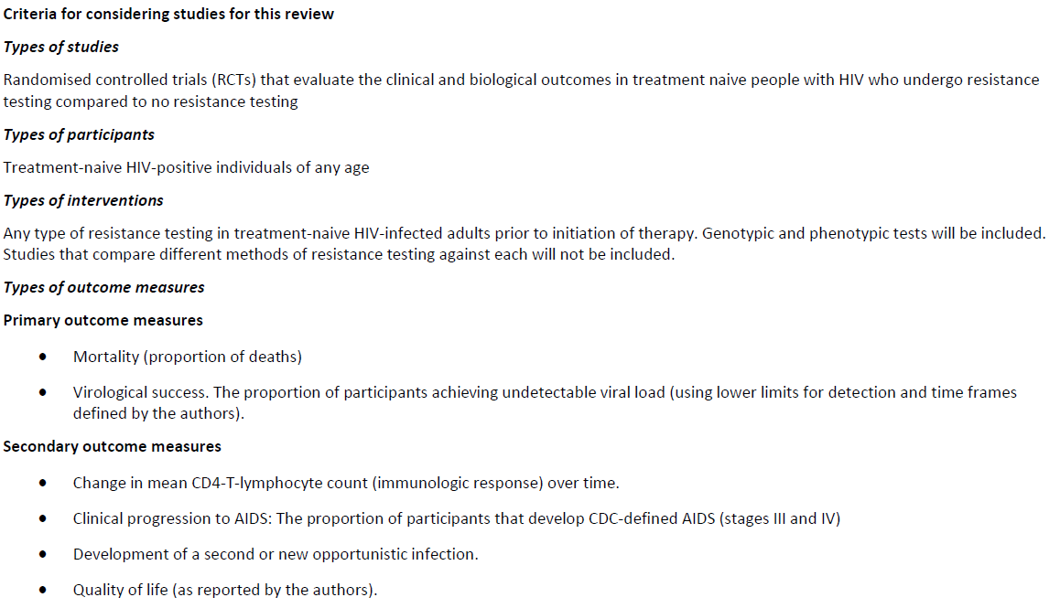

Slide 23
Types of studies
RCTs
Quasi-RCTs
Prospective cohort studies
Retrospective cohort studies
Controlled before and after studies
Uncontrolled before and after studies
Interrupted time series
Qualitative research (usually to augment the review’s quantitative research)

Slide 24
Study design
If it’s likely that RCTs exist to address your question sufficiently well, there’s probably no need to include observational studies
If it’s unclear whether there are RCTs, you should probably include observational studies (with comparators)
If you’re pretty sure there are no RCTs, you should include observational studies (with comparators)
HOWEVER: Observational studies are often a better source of adverse event data or data that cannot be obtained through an RCT

Slide 25
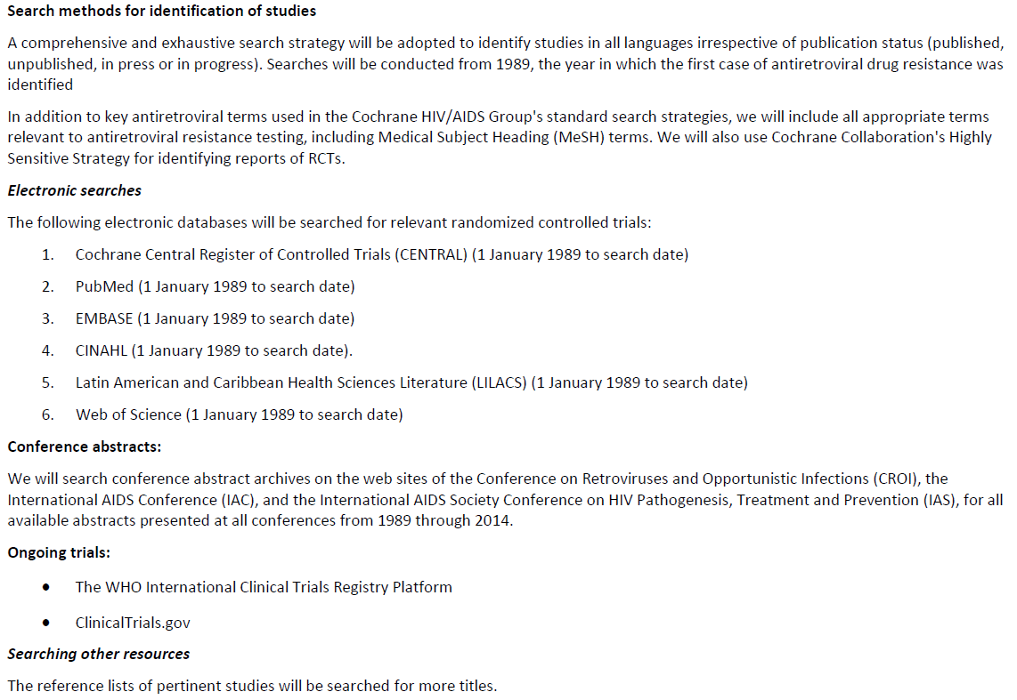

Slide 26
A note about search methods
The authors of this protocol do not provide a draft search strategy. It’s increasingly common to do so, and it’s emerging as good practice, but it’s not always done.

Slide 27
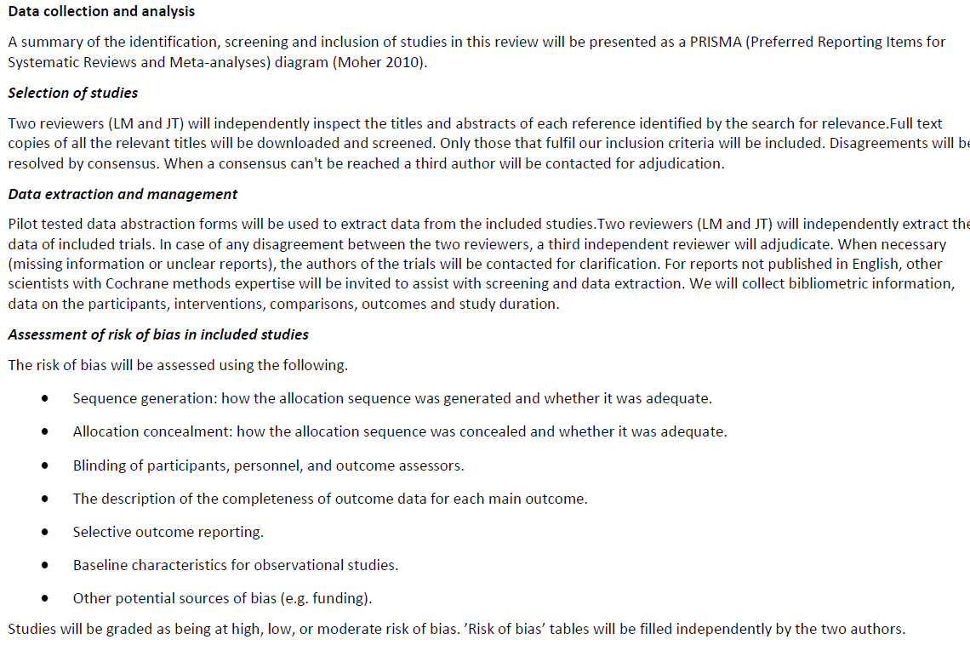

Slide 28
A note about data extraction
The authors of this protocol do not provide much detail about the types of data they will extract. They provide one sentence:
  “We will collect bibliometric information, data on the participants, interventions, comparisons, outcomes and study duration.”
Many protocols are similar in this brevity. We prefer to have these components fleshed out a little better.
We will discuss this in detail another time! For now just FYI.
Notes:
All the pico components, those are the ones you are extracting

Slide 29
Data items to consider
Interventions
Total number of intervention groups;
For each intervention and comparison group of interest:
  1. Specific intervention;
  2. Intervention details (sufficient for replication, if feasible);
  3. [Integrity of intervention];
  Outcomes
  4. Outcomes and time points (i) collected; (ii) reported
Source
Study ID
Review author initials
Citation and contact details;
Methods
Study design;
Total study duration;
Sequence generation;
Allocation sequence
concealment;
Blinding;
Other concerns about
bias;
Participants
Total number;
Setting;
Diagnostic criteria;
Age;
Sex;
Country;
[Co-morbidity];
[Socio-demographics];
[Ethnicity];
[Date of study];

Slide 30
Data items to consider (2)
For each outcome of interest:
Outcome definition (with diagnostic criteria if relevant);
Unit of measurement (if relevant);
For scales: upper and lower limits, and whether high or low score is good
Results
Number of participants allocated to each intervention
group;
For each outcome of interest:
Sample size;
Missing participants;
Summary data for each intervention group
(e.g. 2×2 table for dichotomous data; means and
SDs for continuous data);
[Estimate of effect with confidence interval; P value];
[Subgroup analyses];
Miscellaneous
Funding source;
Key conclusions of the study authors;
Miscellaneous comments from the study authors;
References to other relevant studies;
Correspondence required;
Miscellaneous comments by the review authors.
Notes:
Want some data that can help you calculate CI’s, effect size

Slide 31
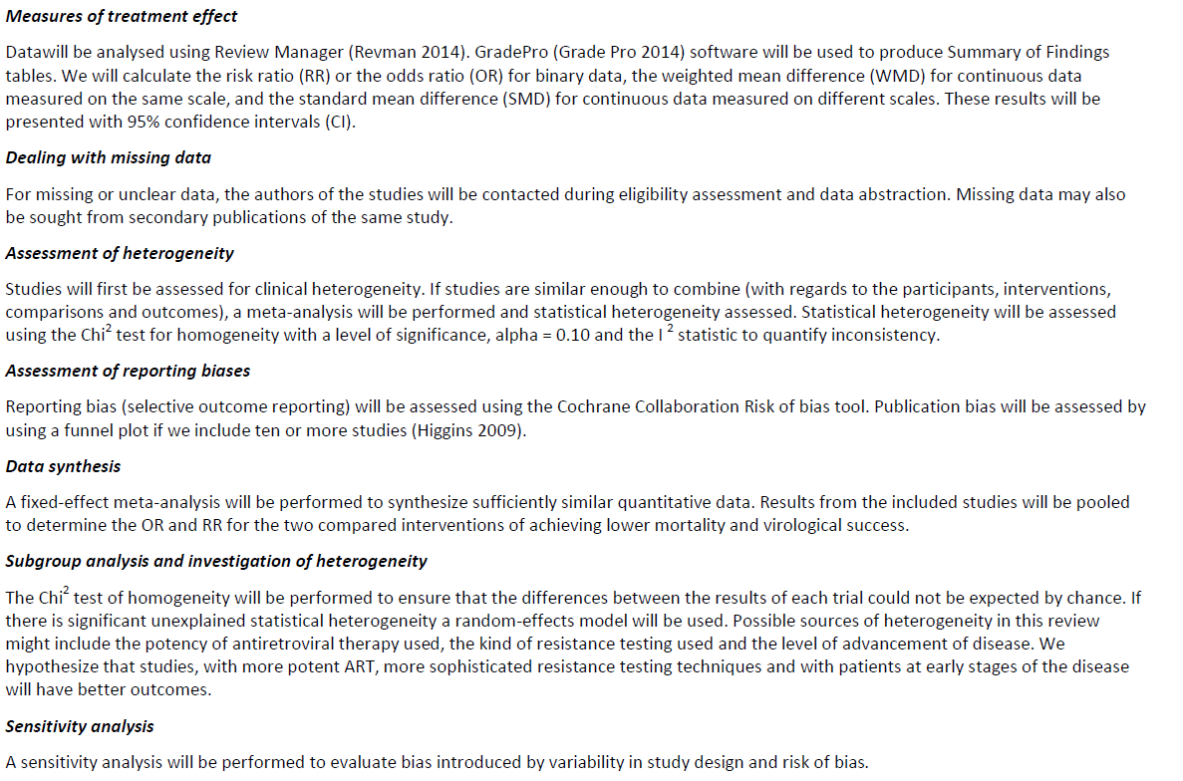

Slide 32
Final bits
Acknowledgements: Note the names of anyone (e.g. medical librarians who proved help with draft search strategy, colleagues suggesting edits, etc.
Sources of funding: Note any grants or other funding you have received to conduct the review. If none, just say “None.”
Declaration of interests: Note that you have no conflicts of interest (unless you do have one!)

Slide 33
Protocol / Eligibility PICO vs. Analysis PICO

Slide 34
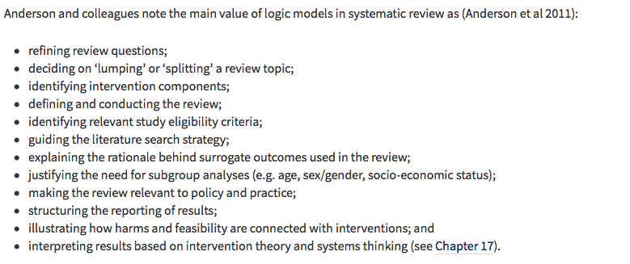
Use of Logic Model

