Slide 1
Systematic Reviews
EPI 214
Module 1-B: Choosing Topic
Mohsen Malekinejad, MD, DrPH

Slide 2
Choosing a topic for review
How should you choose a topic for review?
It’s optimal to fill a need (a global health research priority)
Best not to duplicate effort
It’s optimal if you already know there are some studies that would likely be eligible for inclusion
It’s optimal if the topic interests you!
Notes:
(e.g. other very recent review -- or review-in-progress -- on very similar topic)

Slide 3
Research priorities
Several ways to identify research priorities.
  Policy document (e.g. WHO) explicitly addresses research priorities
  Recent “narrative” (non-systematic) review on the general area of research points out a gap in the evidence for your topic
  You notice a few recent RCTs of a “new” and promising intervention
  You notice a rather “old” systematic review with inconclusive findings, while topic remains very important
Notes:
If it’s a new field you can write up your protocol and then when the papers are published you can start the systematic review

Slide 4
Not duplicating effort
“Scoping” searches: You want to be sure someone hasn’t recently done (or is doing) a review on your topic
In PubMed, put a few relevant keywords AND “systematic review,” and see what you get
  put the same keywords and (randomized OR randomized) instead of “systematic review” to get a rough idea of whether there may be RCTs on the topic)

Slide 5
Checking for ongoing (but not yet published) reviews on your topic
Protocol = detailed a priori “work-plan” for review
Most important protocol registry: PROSPERO at University of York, BMC, Systematic Reviews.
  Includes Cochrane review protocols
  https://www.crd.york.ac.uk/prospero/
Cochrane Library: “publishes” Cochrane protocols on its site, but protocols not usually indexed in PubMed etc.

Slide 6
Choosing topic: e.g., HIV-STI review

Slide 7
Choosing topic: e.g., HIV-STI review

Slide 8
Choosing topic: e.g., HIV-STI review

Slide 9
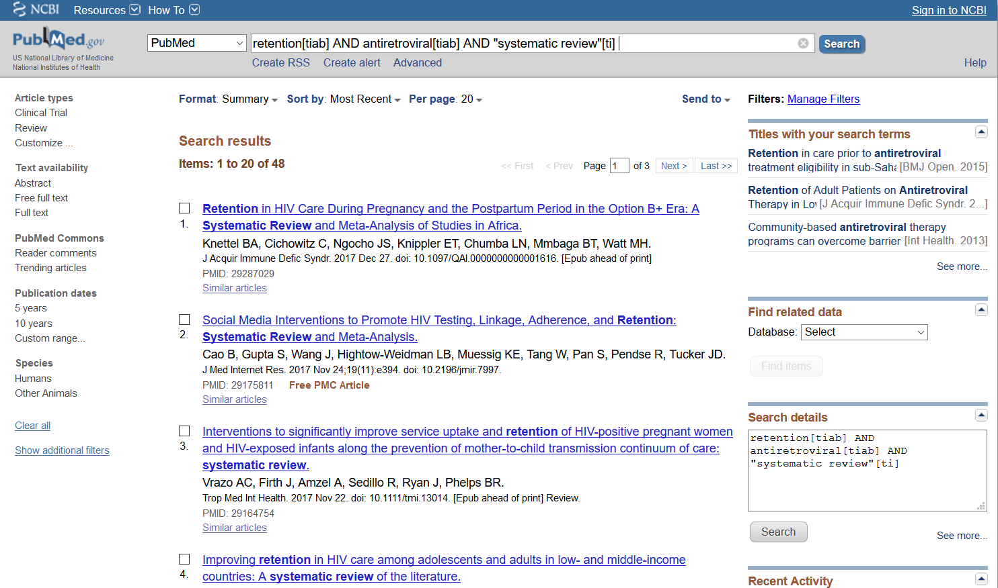
Scoping in PubMed

Slide 10
Additional Slides

Slide 11
GH213 – Students’ SR Topics
Educational interventions to decrease gender-based violence for adolescent boys in low- and middle-income countries
Pre-Exposure Prophylaxis for Reducing Risk of Maternal to Child Transmission in High-Risk HIV-negative Women
Implementation interventions to improve the uptake of cardiovascular disease prevention strategies in sub-Saharan Africa
Micronutrient Supplementation Interventions Administered During the Pregnancy Period to Improve Newborn Morbidity and Mortality
Impact of health literacy interventions on outcome of patients with diabetes and hypertension
Association between Adverse Childhood Experiences and Initiation of Substance Use During Childhood and Young Adulthood
Identifying the association between Adverse Childhood Experiences and Pediatric Asthma

Slide 12
GH213 Students’ SR Topics (~cont)
Effect of Home-based care on STI diagnosis
Phospholipase II (PLA2) Inhibitor Candidates for Snakebite Treatment
Dietary Interventions for Reducing Cardiovascular Disease in South Asia
Tax Policies to Reduce Consumption of Foods High in Saturated Fats, Highly Processed Foods & Sugar-Sweetened Beverages
Smartphone Applications, wearables, and consumer gadgets for sleep disorder breathing
Effectiveness of early enrollment into palliative care for Central Nervous System cancer patients
The Intersection between Climate Change and Malaria in Sub-Saharan Africa
Intermittent preventative treatment for decreasing malaria incidence among infants in Sub Saharan Africa
Global uptake of syphilis point of care rapid diagnostic testing in community and institutional settings
Interventions to Reduce Malnutrition in Children Living in Slums
Trans-disciplinary Academic Partnerships in Global Health
Palliative care services for children with terminal illness in Sub-Saharan Africa

