Slide 1
Systematic Reviews
EPI 214
Module 1-A: Introduction
Mohsen Malekinejad, MD, DrPH

Slide 2
Course overview
  Goal: Provide you with all major theoretical and practical aspects of conducting a high-quality systematic review (SR)
  Essential if doing SR at some point
  Very useful research skillset

Slide 3
Course principles
Focus on effect of interventions
“systematic reviews” ~ “rigorously done” systematic reviews
Notes:
We touch on other domains ( disease burden, qualitative, etc.) and same methods are generally applicable, but not discussed in details in this course.

Slide 4
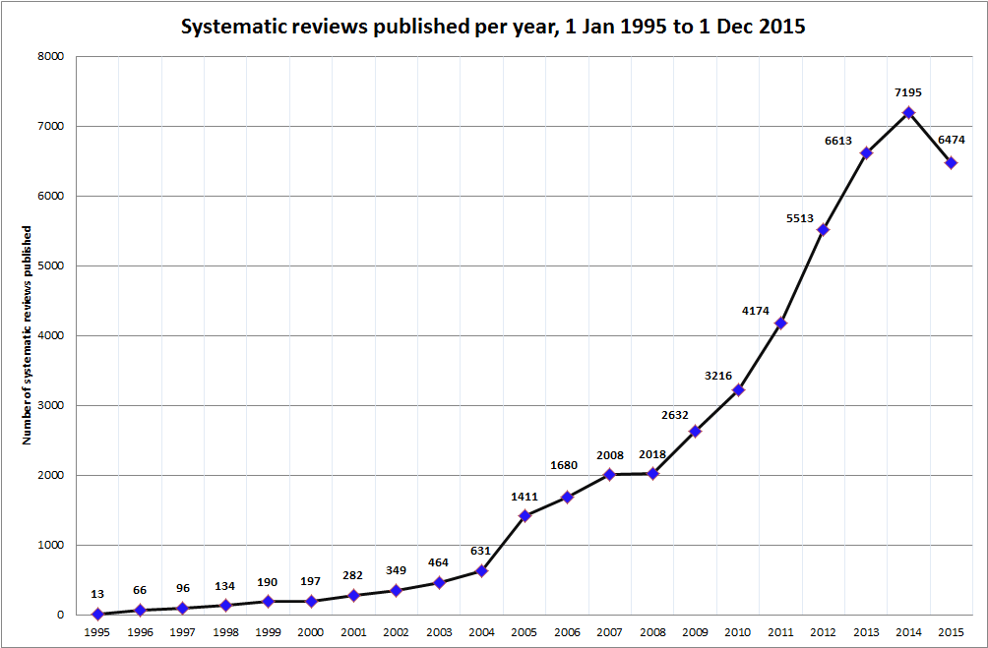
Number of peer-reviewed systematic reviews published (Data source: Web of Science)
Generated by Hacsi Horvath (Dec 2015)

Slide 5
Why systematic reviews become so popular and important?
Massive numbers of publications
Diversity in publication
  Form (print and electronic), languages, settings
Results of PS often appear contradictory
Quality of primary studies not equal and often unclear

Slide 6
What systematic review is about?
As an anonymous GHS 2018 graduate student explained it to her husband:
“to make a big study from a bunch of smaller studies?”

Slide 7
What is a systematic review?
“collects all empirical evidence that fits pre-specified eligibility criteria in order to answer a specific research question ”
http://www.cochrane-handbook.org/
Notes:
Check Cochrane

Slide 8
Key characteristics of systematic reviews
Clearly stated set of objectives
Pre-defined eligibility criteria for primary studies
Explicit & reproducible methodology
Systematic search to identify all studies meeting eligibility criteria
Assessment of validity (risk of bias) of findings from PS
Systematic synthesis (and presentation) of characteristics & findings of PS
http://www.cochrane-handbook.org/
Notes:
No minimum number of studies needed for a systematic review. “empty systematic review” don’t even have any studies.

Slide 9
What makes a review, systematic?
Domain | Systematic review (Rigorously done) | Narrative Review (Typical)
General approach | Systematic & transparent | Expert-driven & opaque
Article search | Systematic & Comprehensive | Convenient & limited
Article selection | Pre-specified criteria | Ad-hoc decisions
Data extraction | Pre-specified criteria | Unclear
Analysis methods | Explicitly described | Insufficiently explained
Heterogeneity | Assessed | Not assessed
Risk of bias of PS | Assessed | Not assessed
Validity of findings | High | Low or unclear
Reproducibility | Possible | “Almost” impossible

Slide 10
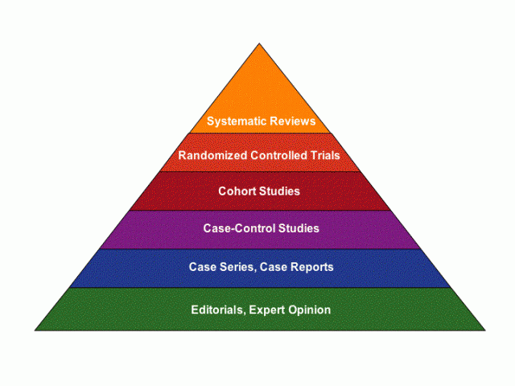
Hierarchy of evidence (?)
Notes:
Simplistic view. There are nuances. Consider rigorously done multiple cohort studies vs. a single small RCT with mediocre randomization process?
How about a bad systematic review that missed small but important studies?
How about systematic review of multiple Cohort studies vs. a large well design RCT?

Slide 11
What is a meta-analysis?
Using statistical methods to
combine quantitative data from
primary studies that are:
derived from a SR, and
are sufficiently comparable, and
have low (or at least known) risk of bias

Slide 12
Types of reviews
Reviews
Narrative/literature/ traditional
Systematic
Cochrane
Meta-analysis
Notes:
Not in scale
Can combine quant data with systematic review = meta analysis
Only really do a meta if you have done a systematic review
Meta analysis with narrative can be biased because they combine the studies they want to show.

Slide 13


History of evidence-based medicine
1948
1979
First RCT on tuberculosis treatment was published
Cochrane proposes international systematic reviews of clinical trials, organized by specialty
Obstetrician, Iain Chalmers, began to card file known controlled trials in perinatal medicine
Chalmers establishes an international nonprofit organization, The Cochrane Collaboration
1974
1992
Notes:
- 1948: First RCT published:
Streptomycin treatment of pulmonary tuberculosis. Br Med J. 1948 Oct 30;2(4582):769-82
1974: UK obstetrician Iain Chalmers begins card file of all known controlled trials in perinatal medicine in response to a paper from Arche Cochrane calling for more efficiency in medical practices.
1979: Cochrane proposes international systematic reviews of clinical trials, organized by specialty
1992: Chalmers establishes the Cochrane Collaboration
- International nonprofit organization
- Prepare, disseminate and update systematic reviews of interventions in health care
- Cochrane methods became the “gold standard” for rigorous review methodology

Slide 14
Cochrane Collaborative Review Groups (>50)
Produce systematic reviews relevant to a particular disease or health issue for inclusion in the Cochrane Library
Examples
  Infectious Diseases Group
  Drug and Alcohol Group
  Heart Group
  Injuries Group
  Skin Group
  Pregnancy and Childbirth Group
  Stroke Group
  Breast Cancer Group

Slide 15

The Cochrane Library
www.thecochranelibrary.com
Notes:
Will insert recent

Slide 16
The Cochrane Library
Cochrane Systematic reviews : Cochrane reviews and protocols
Database of Reviews of Effects: Other systematic reviews appraised by the Centre for Reviews and Dissemination
Cochrane Central Register of Controlled Trials: Bibliography of controlled trials (some not indexed in MEDLINE).
Health Technology Assessment Database: HTA reports
NHS Economic evaluation database: Economic evaluations of health care interventions.
Notes:
DATABASES:
Cochrane Systematic reviews : Cochrane reviews
Database of Reviews of Effectiveness
Other systematic reviews from around the world which have been appraised by the NHS Centre for Reviews and Dissemination.
Cochrane Central Register of Controlled Trials
Bibliography of controlled trials (some not indexed in MEDLINE).
Cochrane database of Methodology Reviews
Cochrane reviews of methodological studies.
The Cochrane Methodology register
Bibliography of studies relating to methodological aspects of research synthesis
About the Cochrane Collaboration: Information about review groups, Fields, Centres, etc. Contact details provided.
Health Technology Assessment Database:
Health Technology Assessment reports from around the world.
NHS Economic evaluation database:
Economic evaluations of health care interventions.

Slide 17
Typical questions of interest answered by systematic reviews
In the context of intervention effectiveness:
Does the intervention work ?
How much does it work?
Other important questions:
How does the intervention work?
Is the intervention feasible?

Slide 18
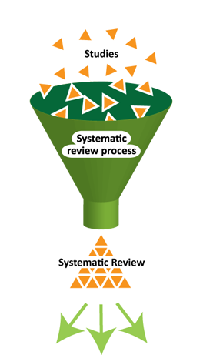
Main steps for conducting SR
Structured and transparent
process involving:
  Formulate research question (s)
  Plan the review (via a protocol)
  Comprehensive search
  Selection of studies
  Data extraction
  Standardization of data
  Assess risk of bias
  Data synthesis (may include meta-analysis)
  Interpretation of results
  Reporting
Notes:
Meta: how to assess quant data, especially when different studies present different values (OR,Pval, etc)

Slide 19
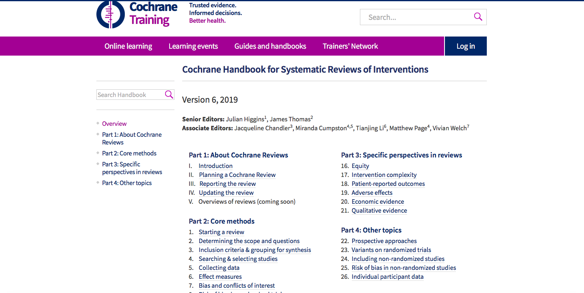

Slide 20
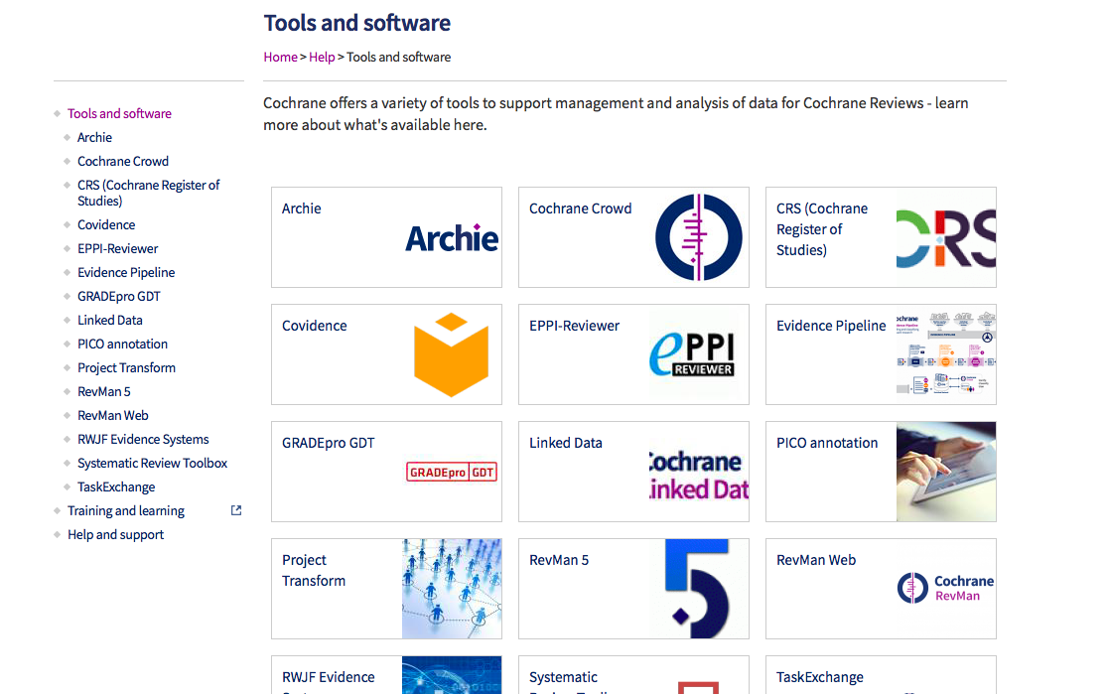
Notes:
Covidence: can let you upload your citations, screening of studies, and extract data
Revman: can help you write your protocol
Organize your reviews in excel

Slide 21
Other big names to know
(not exhaustive list)
Campbell collaboration: SR of the effects of social intervention
EPPI-Centre: Evidence for Policy and Practice Information and Co-ordinating Centre
PROSPERO: Center for review and dissemination, York
  International prospective register of SRs
EQUATOR: Enhancing the QUAlity and Transparency Of health Research
  Detailed reporting guidelines (including PRISMA)
GRADE: Grading of Recommendations Assessment, Development and Evaluation

Slide 22
Use of systematic reviews
(interventional studies)
Establish clinical effectiveness
Inform health and public policies
Inform clinical guidelines
Identify gaps in knowledge and set future research agenda
Justify grant funding for research
Provide structured way to disseminate knowledge
Inform disease modelling
?

Slide 23
Example of policies informed by systematic reviews
Traffic safety laws
  seatbelt, motorcyclists helmet
Tobacco control laws
Routine immunization
?
Notes:
Ex: Essential medicines list, formal recommendations on breast feeding

Slide 24
SR are done in other areas
Disease risk factors
Prevalence, incidence, or burden of diseases
Rate of diseases progression
Cost-effectiveness
Program performance
Implementation characteristics of studies
Methodology
Diagnostic test accuracy
Qualitative studies

Slide 25


Slide 26


Slide 27
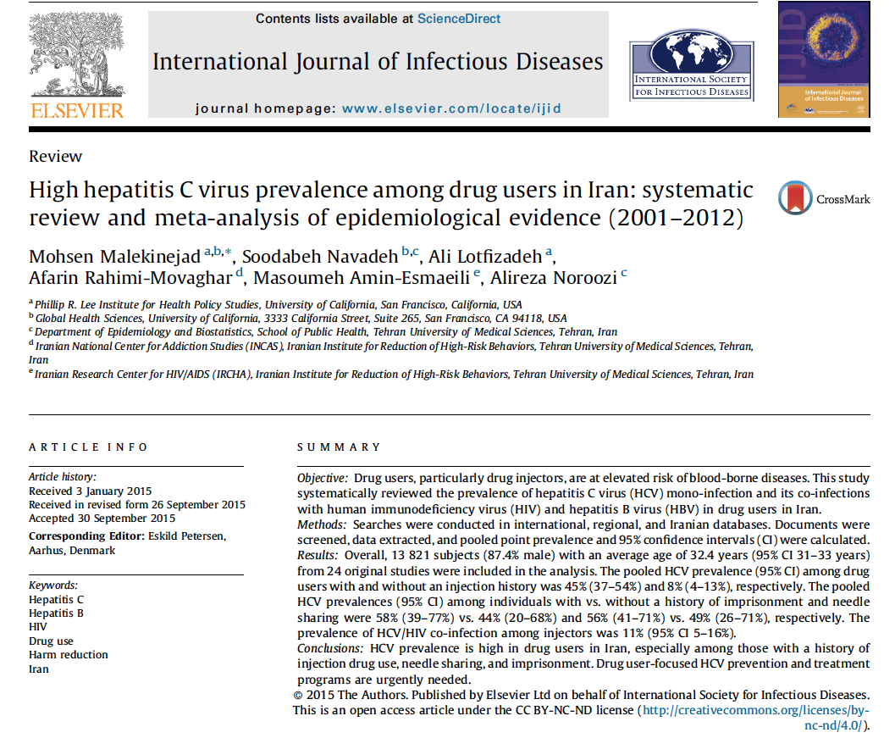

Slide 28
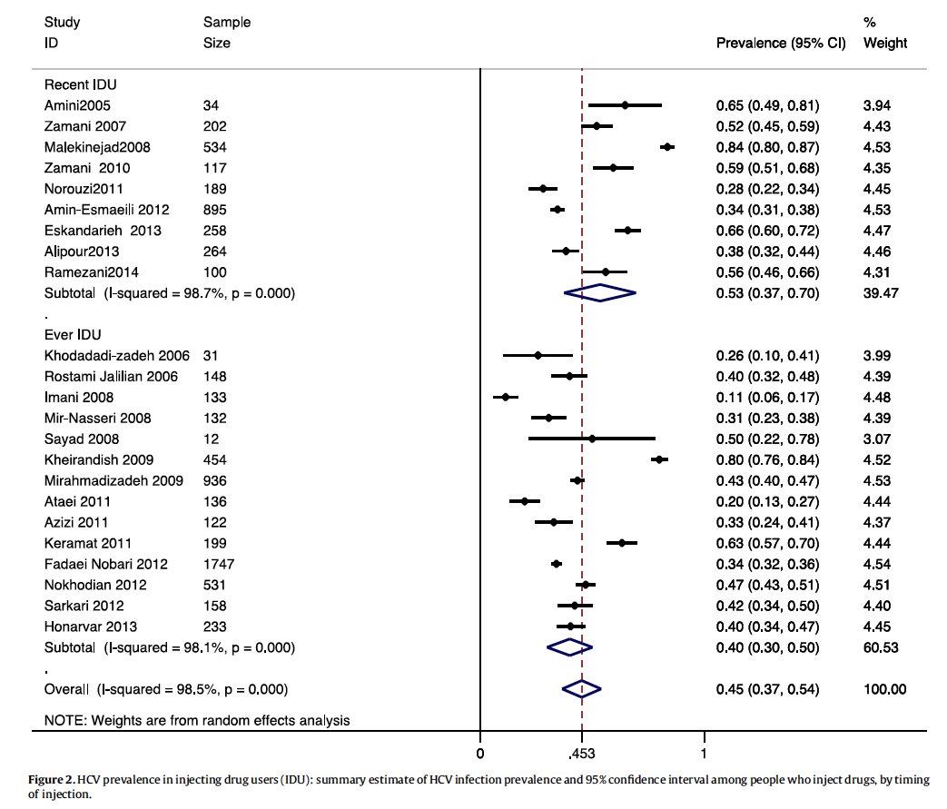
Example 1-graph
Notes:
Example of forest plot

Slide 29
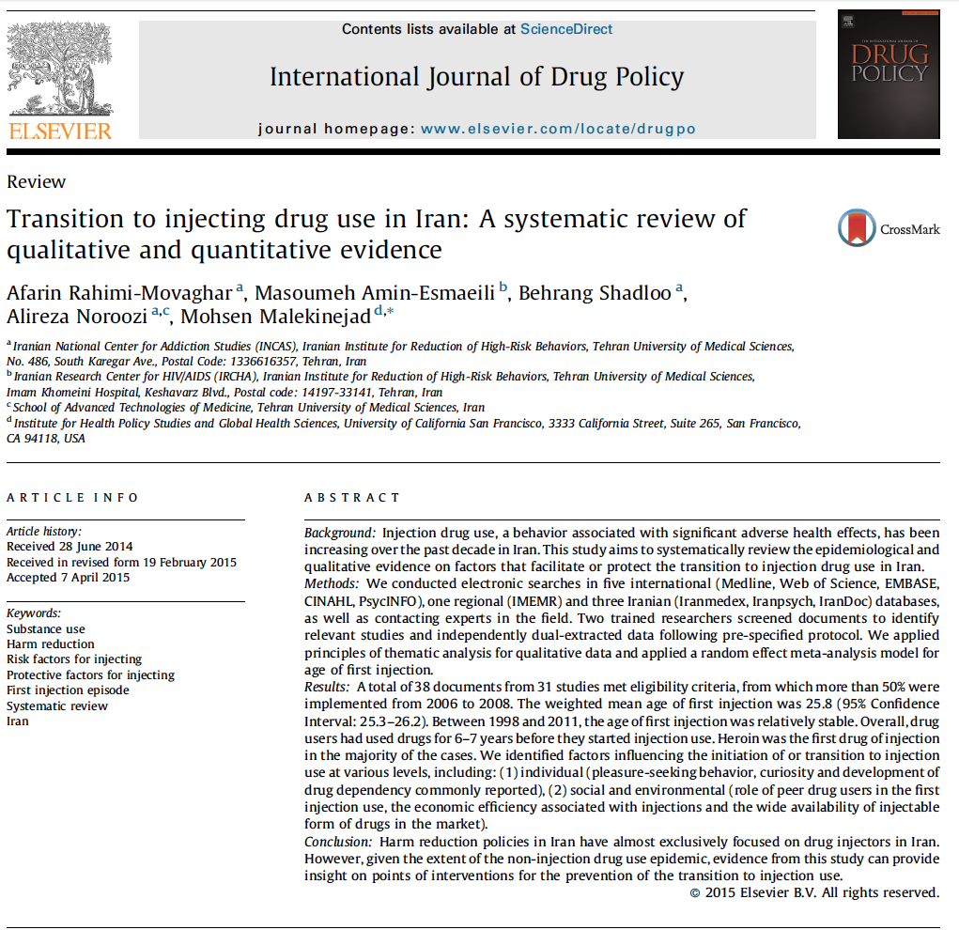
Example 2

Slide 30

Example 3

Slide 31

Example 4

Slide 32
SR e.g., for care cascade: targeted tuberculosis testing and linkage to care in homeless populations in the US BMC 2018 Parriot, Malekinejad, et al

Slide 33
SR e.g., for disease prevalence
HCV infection in people who inject drugs in Iran
45% ( 37 – 54)

Slide 34
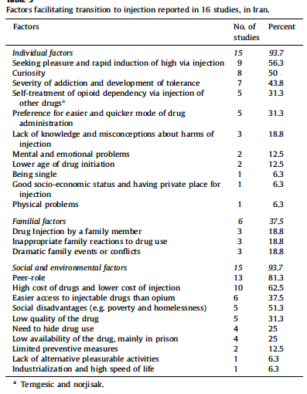
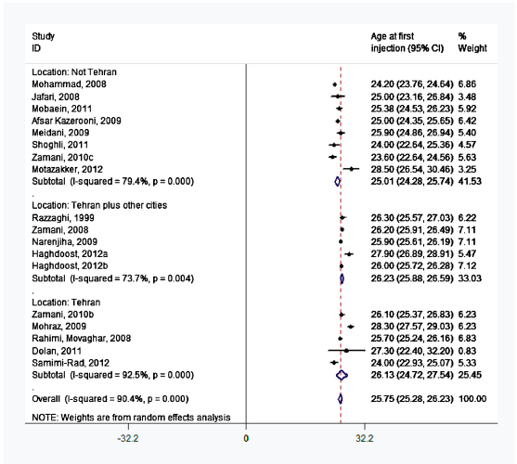
SR e.g., for mixed method: qualitative and quantitative

Slide 35
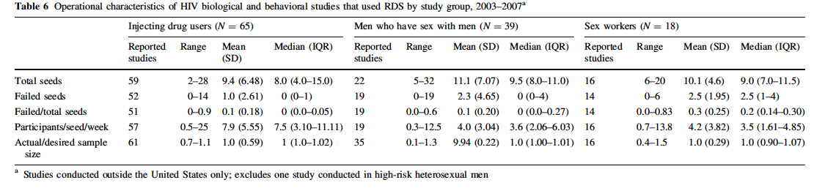
SR e.g., for review of methodology

Slide 36
When systematic reviews add most value?
Typically when…
  there is a substantive research question, and
  there are several primary studies, but
  there are uncertainties about findings
    too many small and/or observational studies but no single large RCT
    There are multiple RCT with conflicting findings

Slide 37
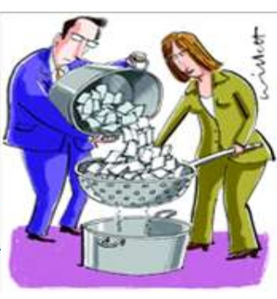
Limitations (by nature) of SR
Dependent on quality and quantity of PS
  may be no trials/evidence
  PS may be of poor quality
  dependent on the quality of reporting
Results still may be inconclusive
Does not necessarily translate to change in practice
Relatively time and resource consuming
Parts of that still subjective (e.g., risk of bias assessment)
Never 100% sure that all studies captured
Requires periodic updating

Slide 38
Unfinished systematic reviews?
Common reasons
  Underestimating resources needed
  Competing priorities
  Change of interest
  Published by others
Solutions
  Quick scoping search for existing SRs
  Check registries (Cochrane, PROSPERO) for existing protocols
  Keep the scope of SR meaningfully narrow
  Allocate sufficient resources
  Set reasonable timeline
Notes:
According to Petticrew & Roberts, 2006, SR cost $104,000, and, Average time in hour: 1139, range: 216 to 2,518

Slide 39
Housekeeping stuff
Office hours: by appointment
Class website will be dynamic
Class assignments due 8 am on the class dates
Late submission: 5% mark down after due date, 5% for every day after that.
Schedule librarian consultation

Slide 40
Assignments & Grades
Class Schedule

