Slide 1
Systematic Reviews
EPI 214
Module 2-A: Developing Search Strategies Mohsen Malekinejad, MD, DrPH
Credit to: Hacsi Horvath

Slide 2
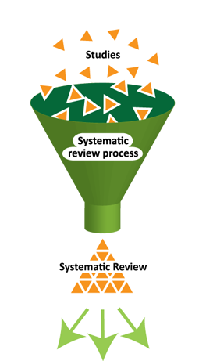
Main steps for conducting SR
Structured and transparent
process involving:
  Formulate research question (s)
  Plan the review (via a protocol)
  Comprehensive search
  Selection of studies
  Data extraction
  Standardization of data
  Assess risk of bias
  Data synthesis (may include meta-analysis)
  Interpretation of results
  Reporting
Notes:
Meta: how to assess quant data, especially when different studies present different values (OR,Pval, etc)

Slide 3
Objective of this session
Help you develop search strategy for your protocol
Help to understand why we do things this way
Notes:
Start with search with one database and then work from there

Slide 4
Cochrane vs. real life
Cochrane Handbook describes “trials search coordinator” who will design strategies and likely even conduct searches for you
In non-Cochrane world, situation is different…
UCSF Library can help you design strategies, choose databases etc.: https://www.library.ucsf.edu/help/education
Skills you develop in designing and applying search strategies for systematic reviews will serve you well in other searching

Slide 5
Searching is a skilled and time consuming activity
  Identify sources to search
  Think up all the right search terms, including indexing terms; also syntax
  Formulate the actual strategies
  Deal with technicalities (e.g. of databases)
  Plan plenty of time for developing and testing search strategies

Slide 6
The goal
First goal of comprehensive searches is to find studies that might be relevant to your review question.

Slide 7
Common challenges
A main goal of systematic reviews is to identify ALL studies meeting inclusion criteria!
Profusion of published and unpublished material
Much “hidden”: only 50% abstracts presented at conferences are later published in full
Different databases use different terms to classify studies; different algorithms of searching
Different databases cover different, often discrete areas of literature
  However: Often much overlap

Slide 8
Databases: MINIMUM in reviews of interventions
MEDLINE
  (PubMed is an interface through which we search MEDLINE – there are several others)
  Not enough to search only MEDLINE!
Embase
Cochrane Central Register of Controlled Trials (“CENTRAL”)

Slide 9
Medical Subject Heading
(MeSH) terms
Most articles in PubMed “tagged” with MEDLINE’s indexing terms: “MeSH terms.”
  (Tutorials & instruction on PubMed, may be worth a look)
However, most recent articles (~5-6 months) have not been tagged
MEDLINE librarians also inconsistent in their application of MeSH terms
  Thus important also to use free-text terms.

Slide 10
Embase “Emtree”
Hierarchal organization of biomedical & sociomedical concepts
Analogous to MeSH terms but organized differently
Also very detailed
Pretty easy to work with

Slide 11
Comparing Databases
Embase Coverage
>29 million records
>8500 journals
Covers MEDLINE & drug and pharmacy journals
EMBASE
Includes all of MEDLINE and more
PubMed Coverage
>25 million records
Covers medical, biomedical, and life sciences (includes MEDLINE)
MEDLINE
MEDLINE Coverage
> 22 million records
>5600 journals
Covers medical & biomedical sciences
Notes:
Theoretically, Embase covers all Medline, but some still argue that the Medline should be searched separately due to use of different indexing system.
https://kemh.libguides.com/library/search_tips/faqs/difference_between_pubmed_medline_embase
Last updated Oct 2020

Slide 12
Cochrane “CENTRAL”
CENTRAL
MEDLINE
EMBASE
OTHER SOURCES
Single best database (best yield) in searches for RCTs and other controlled trials
>1,275,000 records

Slide 13
Databases: Regional?
WHO regional indices
African Index Medicus (AFRO AIM)
Eastern Mediterranean (EMRO  IMEMR)
Europe (EURO  EURO)
American/Pan-American (AMRO/PAHO  LILACS)
Southeast Asia (SEARO  IMSEAR)
Western Pacific (WPRO  WPRIM)
Accessible through WHO “Global Health Library”

Slide 14
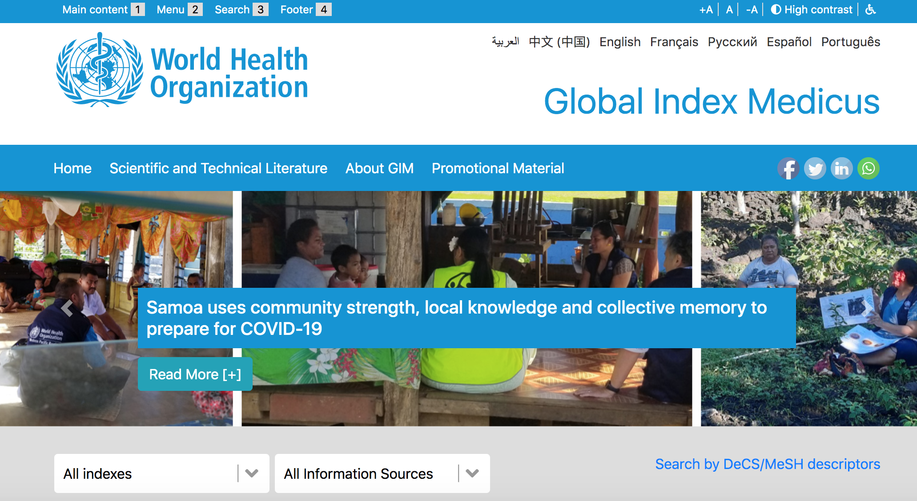
www.globalhealthlibrary.net
Can be very “pokey” and frustrating, if not actually broken.
Still, may be worth including.

Slide 15
Databases: Specialized?
3ie Impact Evaluation Repository
CINAHL
EconLit
Education Resources Information Center (ERIC)
Web of Science
  PsycINFO
  Sociological Abstracts
others

Slide 16
“Grey literature”
Usually not peer-reviewed
Conference abstract archives
  AIDS, IAS Pathogenesis, CROI, ICASA
  APHA
  Other conferences?
  Abstracts not always online
Dissertations (via ProQuest Dissertations)?
FDA adverse events database?
Depending on topic, NGO or government program reports may provide relevant data.

Slide 17
Other approaches
Reference lists of highly relevant papers
Tracking forward of papers citing included studies: Web of Science; Embase (sort of)
Tables of Contents for key journals
Authors of highly relevant papers
Trials registries:
  clinicaltrials.gov
  WHO’s ICTRP

Slide 18
Why such mad, relentless searching? (1)
Investigators often fail to publish research when findings are negative or statistically non-significant
If they do publish such research, it’s often only after long delay; or in an obscure journal; or in a non-English language journal
Up to half of research presented at conferences not later published in peer reviewed journals
Scherer et al, 2007; Song et al, 2010; Dwan et al, 2013

Slide 19
Why such mad, relentless searching? (2)
Risk of selection bias if you miss one of those null or negative studies
Systematic review goal to be comprehensive – might as well give it a shot!
  However: Don’t plan to search irrelevant databases; consider whether your topic is the type of thing that might e.g. be a dissertation’s focus, reported in grey literature, indexed in a psychology database, etc.
Search all appropriate databases and other sources!

Slide 20
Search strategies (1)
Characteristics of search strategies:
  Sensitivity – ability to identify all the relevant studies
  Specificity – ability to exclude irrelevant studies, also known as precision
Inverse relationship between sensitivity and specificity – means that a large number of articles retrieved may not be relevant to the review question
  High sensitivity will tend to have low specificity
Find right balance through test searches in PubMed: refine as needed

Slide 21
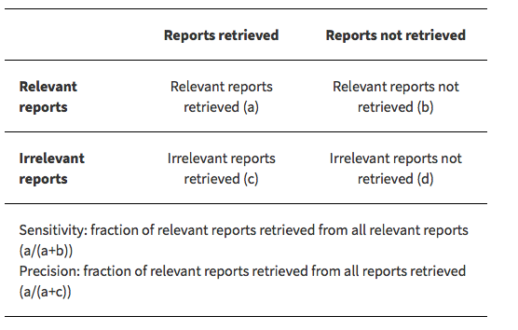

Slide 22
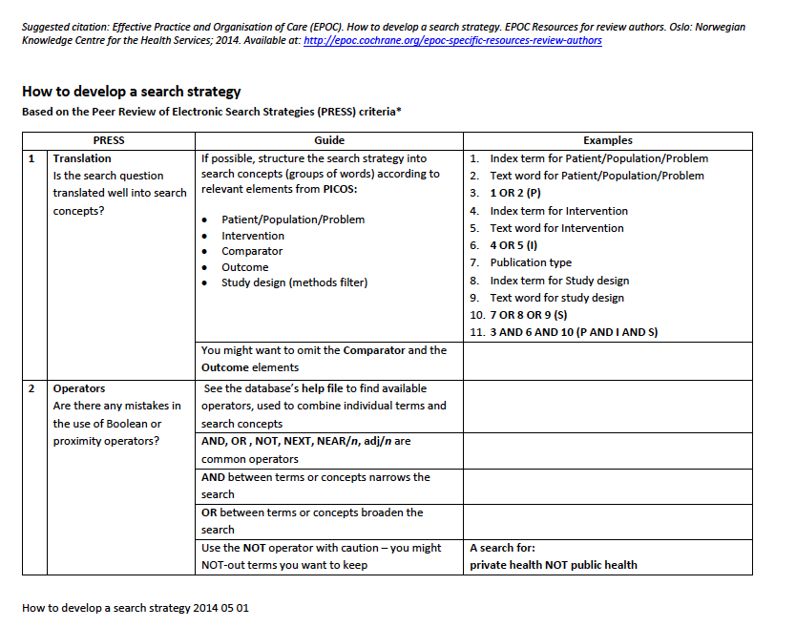
See Class Resources for Complete Document

Slide 23
Search strategies (2)
Necessary to use indexing terms (e.g. MeSH, Emtree terms) as well as free text terms
  PubMed and Embase use these; other databases may not
Redundancy in terms desired because people express themselves in remarkably varied ways
My approach is to develop the PubMed strategy first; then later modify it for use in the other databases
Notes:
Break out search strategy by concept, concept that has to do with intervention, and ones that have to do with your study design

Slide 24
Conceptual areas (1)
If possible, structure your strategy in groups of words according to key conceptual areas – possibly (but not always) from PICO
    May not be necessary or desirable to include terms for your comparator or outcomes
If appropriate, also include study design terms

Slide 25
Conceptual areas (2)
P Adults, adolescents & children with HIV
I Psychosocial interventions to improve retention in
antiretroviral therapy programs in LMIC
C Usual care
O Retention, mortality, viral load suppression
Study designs: RCTs and non-RCTs
Consider: Possibility that including “psychosocial” terms might exclude relevant studies not using specified terms!
Can be tricky to think of “all possible variations”

Slide 26
Conceptual areas (3)
Broad topic (e.g. HIV) terms: Check strategies used in relevant Cochrane or other systematic reviews Check assigned MeSH terms of relevant studies; look around in MeSH Free text: Brain-storm as needed: all common synonyms, acronyms, alternative spellings etc. | Narrower topic (e.g. ART) terms: Check strategies used in relevant Cochrane or other systematic reviews Check assigned MeSH terms of relevant studies; look around in MeSH Brain-storm as needed: all common synonyms, acronyms, alternative spellings etc.
Study design terms: Decide whether you need them If so, see later slides! | Related narrow topic (e.g. retention) terms: Check strategies used in relevant Cochrane or other systematic reviews Check assigned MeSH terms of relevant studies; look around in MeSH Brain-storm as needed: all common synonyms, acronyms, alternative spellings etc.

Slide 27
Conceptual areas (4)
Use Boolean connectors, especially AND & OR.
For PubMed, learn most important syntax elements: [tiab], [ti], [tw], [mh]
Truncation of some words may be OK – but be careful

Slide 28
Boolean logic
Combine terms with Boolean operators, especially “AND” & “OR”
  Don’t really trust “NOT” in PubMed; accidental exclusions
Boolean operators must be entered in uppercase
OR: Records must contain at least one of search terms
AND: Records must contain all search terms
“Nesting” of terms within parentheses
  e.g. HIV AND ((antiretroviral OR anti-retroviral) AND retention)

Slide 29
PubMed syntax
[tiab] Term must appear in title or abstract
[ti] Term must appear in title
[mh] or [MeSH] or [mesh] MeSH term
[tw] Text word – any field in the record except for authors, affiliations
  Is not a full text search!
e.g. HIV[tiab] AND ((antiretroviral therapy, highly active[mh] OR antiretroviral[tiab] OR anti-retroviral[tiab]) AND retention[tiab])

Slide 30
Truncation
* (asterisk) is a “wildcard” operator
Truncate words, add * to capture references containing stem word, and any letters following
Random* captures randomized, randomised, randomly, random…

Slide 31
Search strategies (4)
Consider that with groupings of terms, you could:
Search one group at a time, and combine all at the end
String all groups together and search all at once
I normally prefer the first option, as it’s easier to trouble-shoot if results don’t seem right

Slide 32
#5 | #1 AND #2 AND #3 AND #4
#4 | ("randomized controlled trial"[pt] OR "controlled clinical trial"[pt] OR "clinical trials as topic"[mh] OR "random allocation"[mh] OR "double-blind method"[mh] OR "single-blind method"[mh] OR "clinical trial"[pt] OR "research design"[mh:noexp] OR "comparative study"[pt] OR "evaluation studies"[pt] OR "follow-up studies"[mh] OR "prospective studies"[mh] OR "cross-over studies"[mh]OR "clinical trial"[tw] OR ((singl*[tw] OR doubl*[tw] OR trebl*[tw]) AND (mask*[tw] OR blind*[tw])) OR placebo*[tw] OR random*[tw] OR "control"[tw] OR "controls"[tw] OR prospectiv*[tw] OR volunteer*[tw]) OR ("cohort studies"[mh] OR "case-control studies"[mh] OR "comparative study"[pt] OR "risk factors"[mh] OR "cohort"[tw] OR "compared"[tw] OR "groups"[tw] OR "case control"[tw] OR "multivariate"[tw])
#3 | Continuity of patient care[mh] OR (retention[tiab] OR retain*[tiab] OR "lost to follow-up"[tiab] OR "loss to follow-up"[tiab] OR ("loss*"[tiab] AND "follow up"[tiab]) OR LTFU[tiab] OR attrition[tiab] OR "loss to care"[tiab] OR "lost to care"[tiab] OR "loss to program*"[tiab] OR "lost to program*"[tiab] OR default*[tiab] OR engage*[tiab] OR disengage*[tiab])
#2 | (HAART[tiab] OR ART[tiab] OR cART[tiab] OR antiretroviral[tiab] OR anti-retroviral[tiab] OR anti-viral[tiab] OR antiviral[tiab] OR "Antiretroviral Therapy, Highly Active"[Mesh])
#1 | Search (HIV Infections[MeSH] OR HIV[MeSH] OR HIV*[tiab] OR hiv-1[tiab] OR hiv-2*[tiab] OR hiv1[tiab] OR hiv2[tiab] OR hiv infect*[tiab] OR human immunodeficiency virus[tiab]OR human immune deficiency virus[tiab] OR human immuno-deficiency virus[tiab] OR human immune-deficiency virus[tiab] OR ((human immun*) AND (deficiency virus[tiab])) OR acquired immunodeficiency syndrome*[tiab] OR acquired immune deficiency syndrome*[tiab] OR acquired immuno-deficiency syndrome*[tiab] OR acquired immune-deficiency syndrome*[tiab] OR ((acquired immun*) AND (deficiency syndrome[tiab])) or “sexually transmitted diseases, viral”[mh])
Notes:
1: HIV
2: treatment for HIV
3: outcome
4: study design

Slide 33
#5 | #1 AND #2 AND #3 AND #4
#4 | ("randomized controlled trial"[pt] OR "controlled clinical trial"[pt] OR "clinical trials as topic"[mh] OR "random allocation"[mh] OR "double-blind method"[mh] OR "single-blind method"[mh] OR "clinical trial"[pt] OR "research design"[mh:noexp] OR "comparative study"[pt] OR "evaluation studies"[pt] OR "follow-up studies"[mh] OR "prospective studies"[mh] OR "cross-over studies"[mh]OR "clinical trial"[tw] OR ((singl*[tw] OR doubl*[tw] OR trebl*[tw]) AND (mask*[tw] OR blind*[tw])) OR placebo*[tw] OR random*[tw] OR "control"[tw] OR "controls"[tw] OR prospectiv*[tw] OR volunteer*[tw]) OR ("cohort studies"[mh] OR "case-control studies"[mh] OR "comparative study"[pt] OR "risk factors"[mh] OR "cohort"[tw] OR "compared"[tw] OR "groups"[tw] OR "case control"[tw] OR "multivariate"[tw])
#3 | Continuity of patient care[mh] OR (retention[tiab] OR retain*[tiab] OR "lost to follow-up"[tiab] OR "loss to follow-up"[tiab] OR ("loss*"[tiab] AND "follow up"[tiab]) OR LTFU[tiab] OR attrition[tiab] OR "loss to care"[tiab] OR "lost to care"[tiab] OR "loss to program*"[tiab] OR "lost to program*"[tiab] OR default*[tiab] OR engage*[tiab] OR disengage*[tiab])
#2 | (HAART[tiab] OR ART[tiab] OR cART[tiab] OR antiretroviral[tiab] OR anti-retroviral[tiab] OR anti-viral[tiab] OR antiviral[tiab] OR "Antiretroviral Therapy, Highly Active"[Mesh])
#1 | Search (HIV Infections[MeSH] OR HIV[MeSH] OR HIV*[tiab] OR hiv-1[tiab] OR hiv-2*[tiab] OR hiv1[tiab] OR hiv2[tiab] OR hiv infect*[tiab] OR human immunodeficiency virus[tiab]OR human immune deficiency virus[tiab] OR human immuno-deficiency virus[tiab] OR human immune-deficiency virus[tiab] OR ((human immun*) AND (deficiency virus[tiab])) OR acquired immunodeficiency syndrome*[tiab] OR acquired immune deficiency syndrome*[tiab] OR acquired immuno-deficiency syndrome*[tiab] OR acquired immune-deficiency syndrome*[tiab] OR ((acquired immun*) AND (deficiency syndrome[tiab])) or “sexually transmitted diseases, viral”[mh])
STRING FOR CONTROLLED CLINICAL TRIALS
STRING FOR OBSERVATIONAL STUDIES
COCHRANE HIV/AIDS GROUP HIV STRING

Slide 34
#5 | #1 AND #2 AND #3 AND #4
#4 | "randomized controlled trial"[pt] OR "controlled clinical trial"[pt] OR randomized[tiab] OR placebo[tiab] OR "drug therapy"[sh] OR randomly[tiab] OR trial[tiab] OR groups[tiab] OR random*[tw]
#3 | Continuity of patient care[mh] OR (retention[tiab] OR retain*[tiab] OR "lost to follow-up"[tiab] OR "loss to follow-up"[tiab] OR ("loss*"[tiab] AND "follow up"[tiab]) OR LTFU[tiab] OR attrition[tiab] OR "loss to care"[tiab] OR "lost to care"[tiab] OR "loss to program*"[tiab] OR "lost to program*"[tiab] OR default*[tiab] OR engage*[tiab] OR disengage*[tiab])
#2 | (HAART[tiab] OR ART[tiab] OR cART[tiab] OR antiretroviral[tiab] OR anti-retroviral[tiab] OR anti-viral[tiab] OR antiviral[tiab] OR "Antiretroviral Therapy, Highly Active"[Mesh])
#1 | Search (HIV Infections[MeSH] OR HIV[MeSH] OR HIV*[tiab] OR hiv-1[tiab] OR hiv-2*[tiab] OR hiv1[tiab] OR hiv2[tiab] OR hiv infect*[tiab] OR human immunodeficiency virus[tiab]OR human immune deficiency virus[tiab] OR human immuno-deficiency virus[tiab] OR human immune-deficiency virus[tiab] OR ((human immun*) AND (deficiency virus[tiab])) OR acquired immunodeficiency syndrome*[tiab] OR acquired immune deficiency syndrome*[tiab] OR acquired immuno-deficiency syndrome*[tiab] OR acquired immune-deficiency syndrome*[tiab] OR ((acquired immun*) AND (deficiency syndrome[tiab])) or “sexually transmitted diseases, viral”[mh])
IF WE WERE SURE WE ONLY WANTED PROPER RCTs
Sn 98%, Sp 13%
COCHRANE HIV/AIDS GROUP HIV STRING

Slide 35
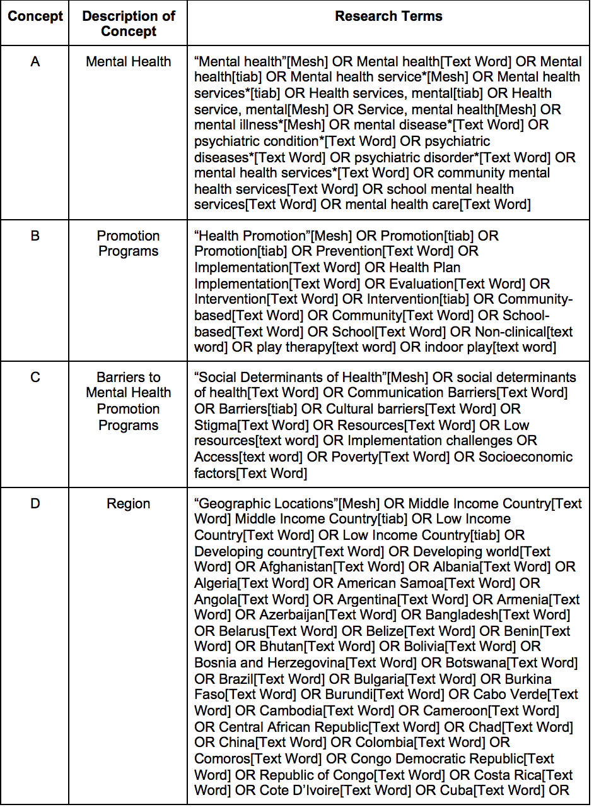
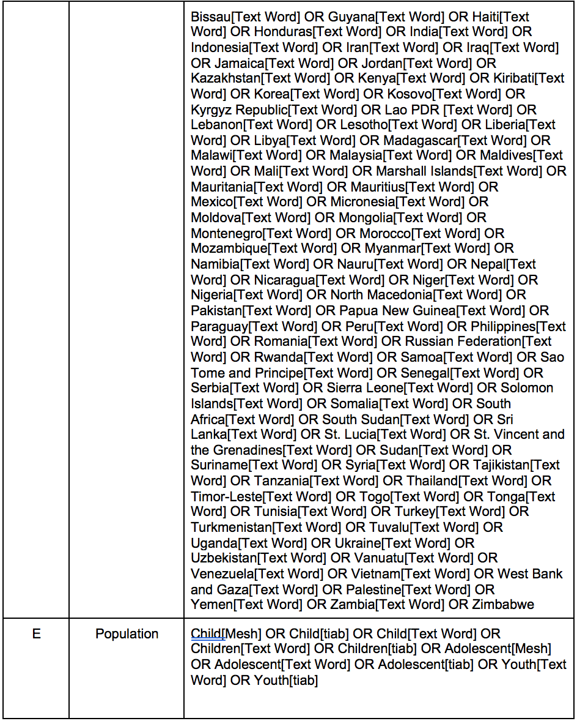
Search Strategy Example
Notes:
Search strategy adapted from Halemah Shuman’s Capstone (2020).

Slide 36
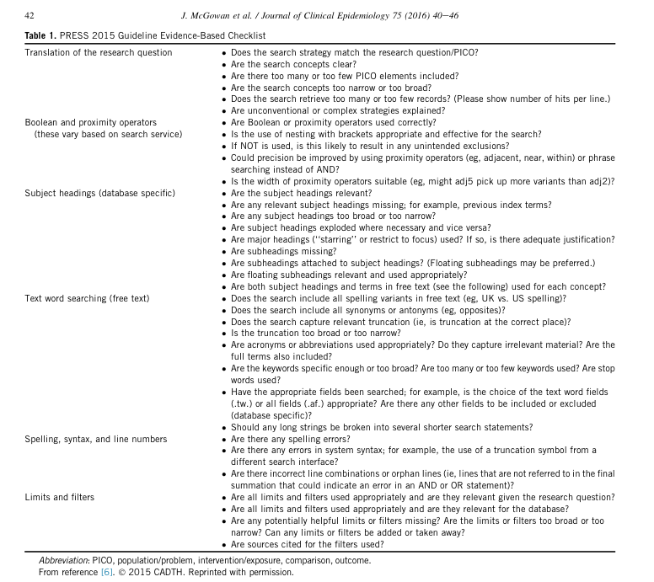
Peer-review of your search strategies is important.

Slide 37



A couple of stipulations
No limitation by language
  Plenty of journals publish in Chinese, French, German, Portuguese, Russian, Spanish and other languages
  Someone will be found to translate key portions! Much easier to connect with people nowadays
No limitation by publication status (published, unpublished, in press)

Slide 38
When Stop Refining Search strategies
Trade off of time/resources and sensitivity
Hard to make objective decision – usually informed by past experiences
Make sure you find at least a good number of studies found by other SRs and/or recommended by experts, and your searches yielded a few more new.

Slide 39
Adapting PubMed strategies for the other databases (1)
With Embase, use “Emtree” syntax as well as plain language terms
They make it fairly easy to develop strategies using Emtree; interface also permits searches of where terms must appear (e.g. titles only, titles and abstracts etc.)
Syntax for the other databases generally quite simple

Slide 40
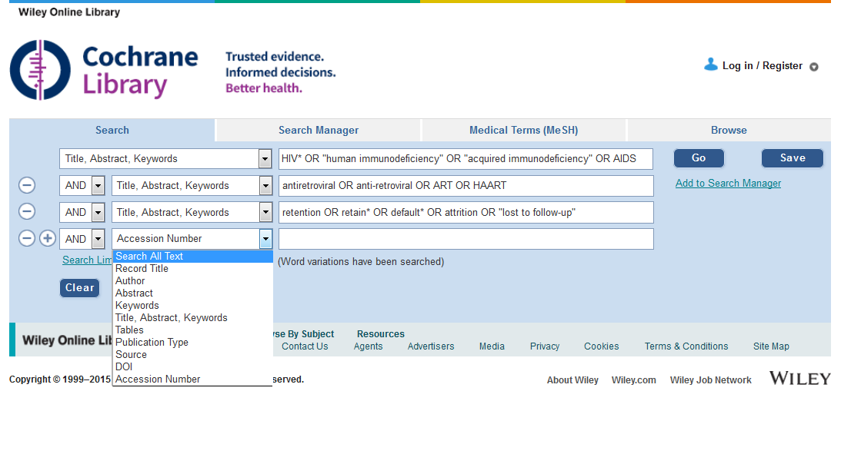

Slide 41
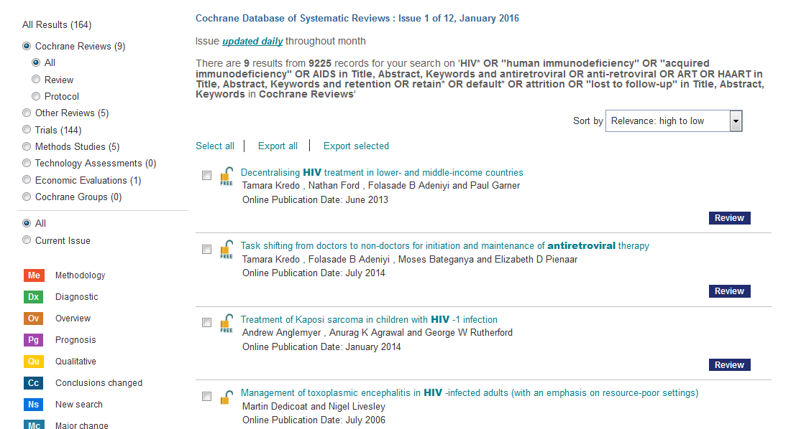

Slide 42
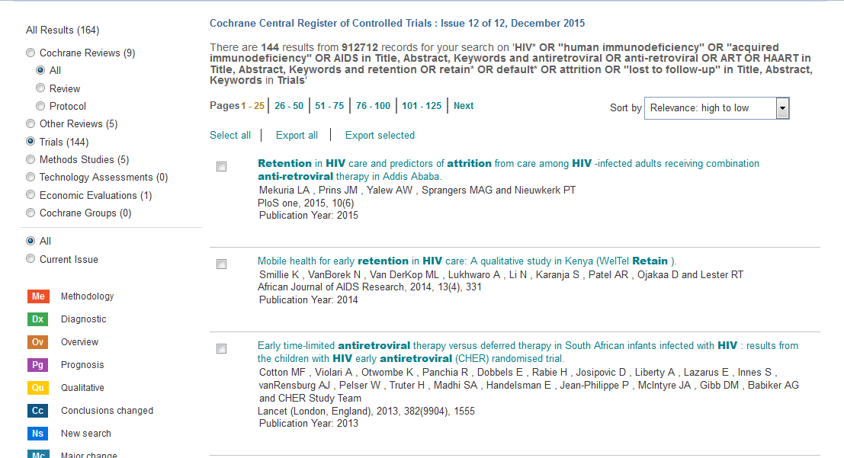

Slide 43
Most databases function in a way similar to this
Most have simple interface; option to use more complex syntax (still easy)
Various boxes to tick or un-tick, date limits, other limits
Before committing to particular strategy, be sure results seem appropriate
You could use highly relevant (but perhaps poorly-titled) article as “gold standard” – does strategy catch this article in this database?
Also check that number of results seems appropriate. If 1000 in PubMed, 100 in Web of Science may indicate error in strategy.
  On the other hand, may just be a factor of “coverage.” Check strategy anyway.

Slide 44
OK this is important
For each database, keep a log of searches
  Database name
  Date of search
  Time-span of searches (e.g. 1 January 1996 to 14 January 2016)
  Strategy used
  Number of hits
  Comment
You will need all this detail when you write up your review!

Slide 45
After you’ve done your database searches and recorded your methods & results
Import all search results into a bibliographic citation manager, e.g. EndNote, Refworks
Remove duplicate records
First we will discuss searches of “grey literature”

Slide 46
More info!
Make an appointment with a UCSF Search Expert
https://www.library.ucsf.edu/ask-an-expert/literature/

Slide 47
Additional Slides

Slide 48
Grey literature (1)
We’ve already discussed (briefly) the need to search conference abstracts, possible use of dissertations, FDA adverse event data etc.
Governments, NGOs, universities etc. often publish highly relevant research outside peer-reviewed literature – as reports on their web sites
Check Grey Lit Report at the New York Academy of Medicine: http://www.greylit.org
Suggest that you also use advanced syntax in Google to search web sites of a few key agencies & organizations
How many is “a few”? It depends.

Slide 49
Grey literature (2)
Perhaps you select 8-10 important agencies and organizations whose work could have resulted in a report that meets your inclusion criteria.
Difficult to search web sites of some organizations
You can use Google (or Google Scholar) to search these sites more efficiently

Slide 50
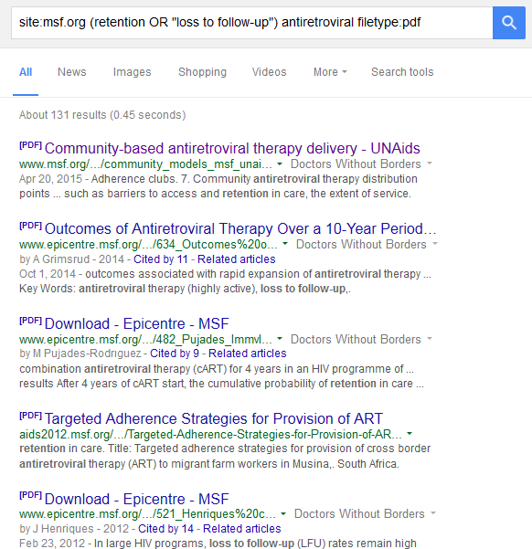
site:msf.org
filetype:pdf
Can also be
ppt, pptx,
doc, docx
xls, xlsx
& a few others
Add a few search terms
(note use of “or” in parentheses)

Slide 51
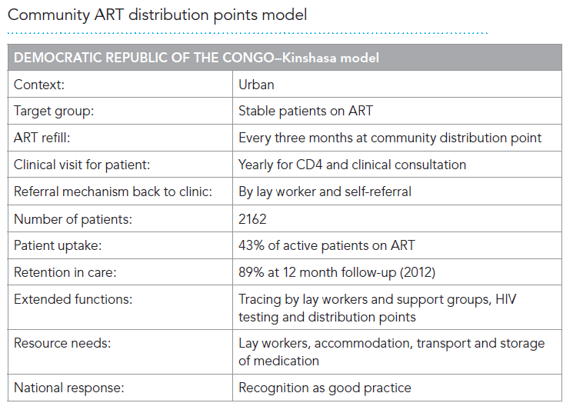
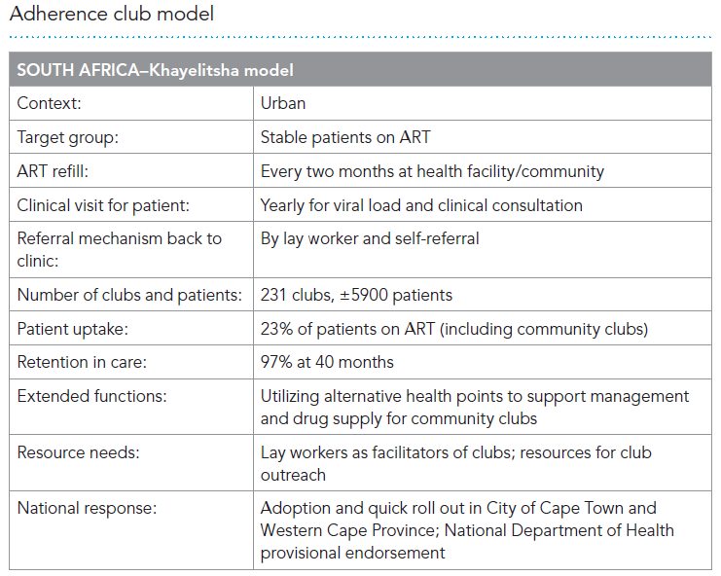
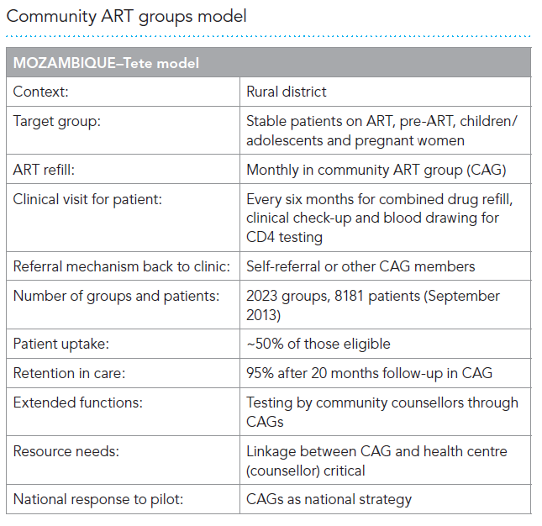

Slide 52
Grey literature Documentation
Not necessary to document grey lit searches in such detail, number of results etc. Search string doesn’t need to be as complex.
Main thing is to note the sites you searched.
Usually cannot be put into citation manager, unless you enter them manually.

Slide 53
Study design strings (1)
Cochrane highly sensitive strategy for finding RCTs (Sn 98%; Sp 13%):
"randomized controlled trial"[pt] OR "controlled clinical trial"[pt] OR randomized[tiab] OR placebo[tiab] OR "drug therapy"[sh] OR randomly[tiab] OR trial[tiab] OR groups[tiab]

Slide 54
Study design strings (2)
However, someone else discovered that this worked just about as well (Sn 98%, Sp 29%):
random*[tw]

Slide 55
Study design strings (3)
To also capture controlled clinical trials :
"randomized controlled trial"[pt] OR "controlled clinical trial"[pt] OR "clinical trials as topic"[mesh] OR "random allocation"[mesh] OR "double-blind method"[mesh] OR "single-blind method"[mesh] OR "clinical trial"[pt] OR "research design"[mesh:noexp] OR "comparative study"[pt] OR "evaluation studies"[pt] OR "follow-up studies"[mesh] OR "prospective studies"[mesh] OR "cross-over studies"[mesh]OR "clinical trial"[tw] OR ((singl*[tw] OR doubl*[tw] OR trebl*[tw]) AND (mask*[tw] OR blind*[tw])) OR placebo*[tw] OR random*[tw] OR "control"[tw] OR "controls"[tw] OR prospectiv*[tw] OR volunteer*[tw]

Slide 56
Study design strings (4)
To capture observational studies:
"cohort studies"[mh] OR "case-control studies"[mh] OR "comparative study"[pt] OR "risk factors"[mh] OR "cohort"[tw] OR "compared"[tw] OR "groups"[tw] OR "case control"[tw] OR "multivariate"[tw]

