Slide 1
Systematic Reviews
EPI 214
Module 2-B: Citation Management &
Study Screening
Mohsen Malekinejad, MD, DrPH

Slide 2
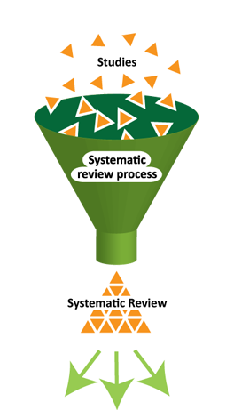
Main steps for conducting SR
Structured and transparent
process involving:
  Formulate research question (s)
  Plan the review (via a protocol)
  Comprehensive search
  Selection of studies
  Data extraction
  Standardization of data
  Assess risk of bias
  Data synthesis (may include meta-analysis)
  Interpretation of results
  Reporting
Notes:
Meta: how to assess quant data, especially when different studies present different values (OR,Pval, etc)

Slide 3
After the searches…
Download search results from each database
How will you review them? You might have thousands.
Citation management software will help.
You and at least one co-author can use it to screen search results.

Slide 4
Software
Software | Price | Disadvantages
Mendeley | Free, through UCSF | Could not import search results Seems oriented to individual citations
Zotero | Free | Unable to remove duplicate references Trouble uploading large number of records
Endnote | Expensive | Complicated to use
RefWorks | Free | Not as robust
Rayyan | Free | There could be better handling of duplicates
Any of these software would be fine for managing records & screening search results
Notes:
A short demo of Rayyan will be provided at the end of the session.

Slide 5
Duplicates, and clearly irrelevant records
After the searches, pool search results from all databases in a citation management software.
Remove duplicate records
Remove clearly irrelevant records
It is acceptable for one reviewer to do the above

Slide 6
Two reviewers
With duplicate records and clearly irrelevant records removed, two reviewers working independently will review titles, abstracts and keywords of all remaining records
Independent dual screening protects against accidental oversight
Notes:
Develop RQ, criteria, pico, etc
Develop search strategy
Search and get rid of duplicates
Apply inclusion and exclusion criteria to see which studies to include and exclude

Slide 7
Inclusion criteria
While screening records, it is helpful to have your detailed inclusion criteria close at hand
Be fairly strict in applying the inclusion criteria
Studies that are interesting but are clearly not what you’re looking for should be excluded

Slide 8
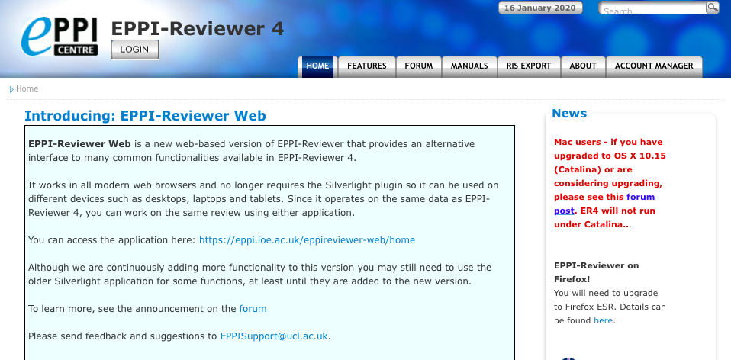
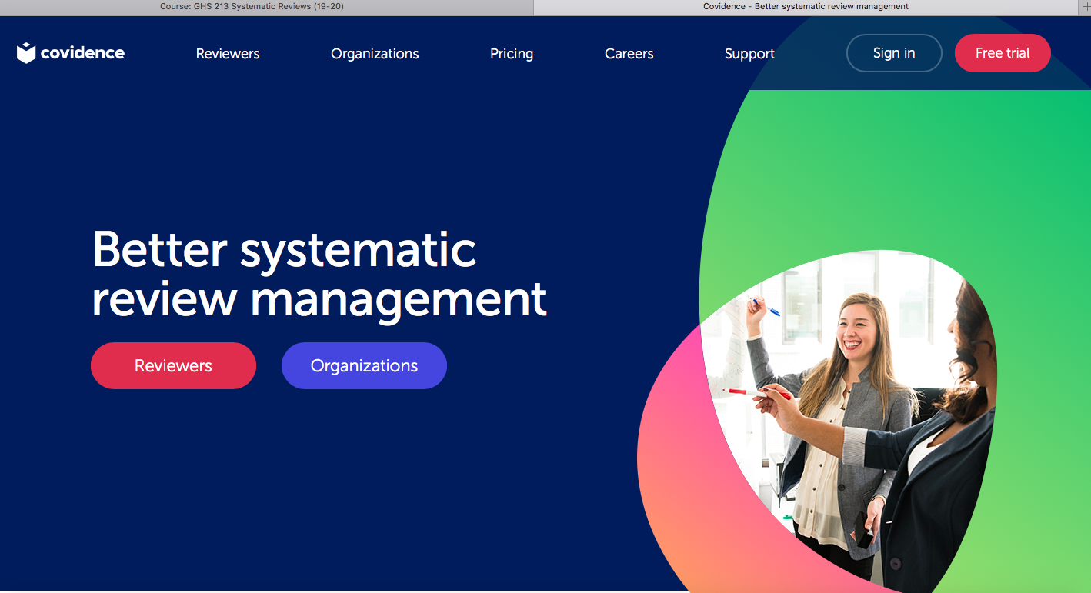


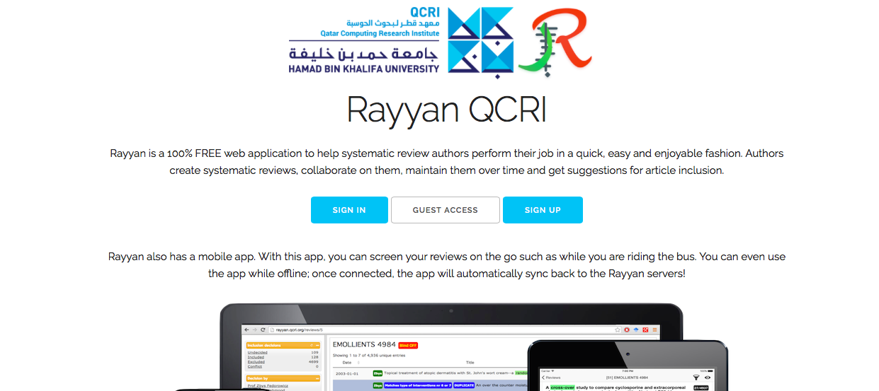
Systematic Review Process Management Tools
Free for Cochrane Authors o/w subscription based – A-Z including collaborative platform for screening + active learning
Free for Cochrane Authors o/w subscription based – A-Z including collaborative platform for screening.
Fee based – A-Z including data synthesis
Free – machine learning prioritizing citations for screening
Free –citation management & screening tool + active Learning

Slide 9
Process (1)
Frist review titles, abstracts and keywords (without yet going to full text
While screening, each reviewer should denote the provisional eligibility or ineligibility of each study – basically “provisional yes” and “no”
  So for the title and abstract review, “yes” means “maybe” – because the next step is to get the full text
Within software, you can create sub-folders for each category
Notes:
For the full text review you document why you are excluding and including

Slide 10
Process (2)
With their respective lists of yes and no and references, reviewers should meet to compare
Ideally, a perfect match
Usually, some discordance
Try to convince each other “why” before going to full texts; reason it out
If unable, neutral third person can help decide

Slide 11
Process (3)
Obtain full text articles for all “yes”
Reviewers examine independently
Keep applying inclusion criteria!
Decide status for each
(bear in mind that one study can have several associated papers; consider the study as a whole)

Slide 12
The big decisions
Reviewers meet again to compare decision-making about all provisional “yes” papers
Ideally, a perfect match!
Often (usually?) some discordance
Try to reason it out, considering study characteristics in context of inclusion criteria
If unable, neutral third person can help decide

Slide 13
Included studies
You should now have your included studies.
For all “provisional yes” studies that you eventually excluded after full text review, make a brief note about why you excluded it, e.g.
  “Was not an RCT”
  “No comparator group”
  “Conducted in high-income country”
  Etc.

Slide 14
Automating Screening Process
Machine learning and text mining
  Growing field of research
  Potentially reduce screening work load 30-90%
  Trade off: reduce sensitivity
Classifiers: e.g., to identify RCTs - built on a large amount of accurate data
Active learning
  Semi-automation of screening by prompting more relevant studies based on PICO
  Can’t be used to eliminate others

Slide 15
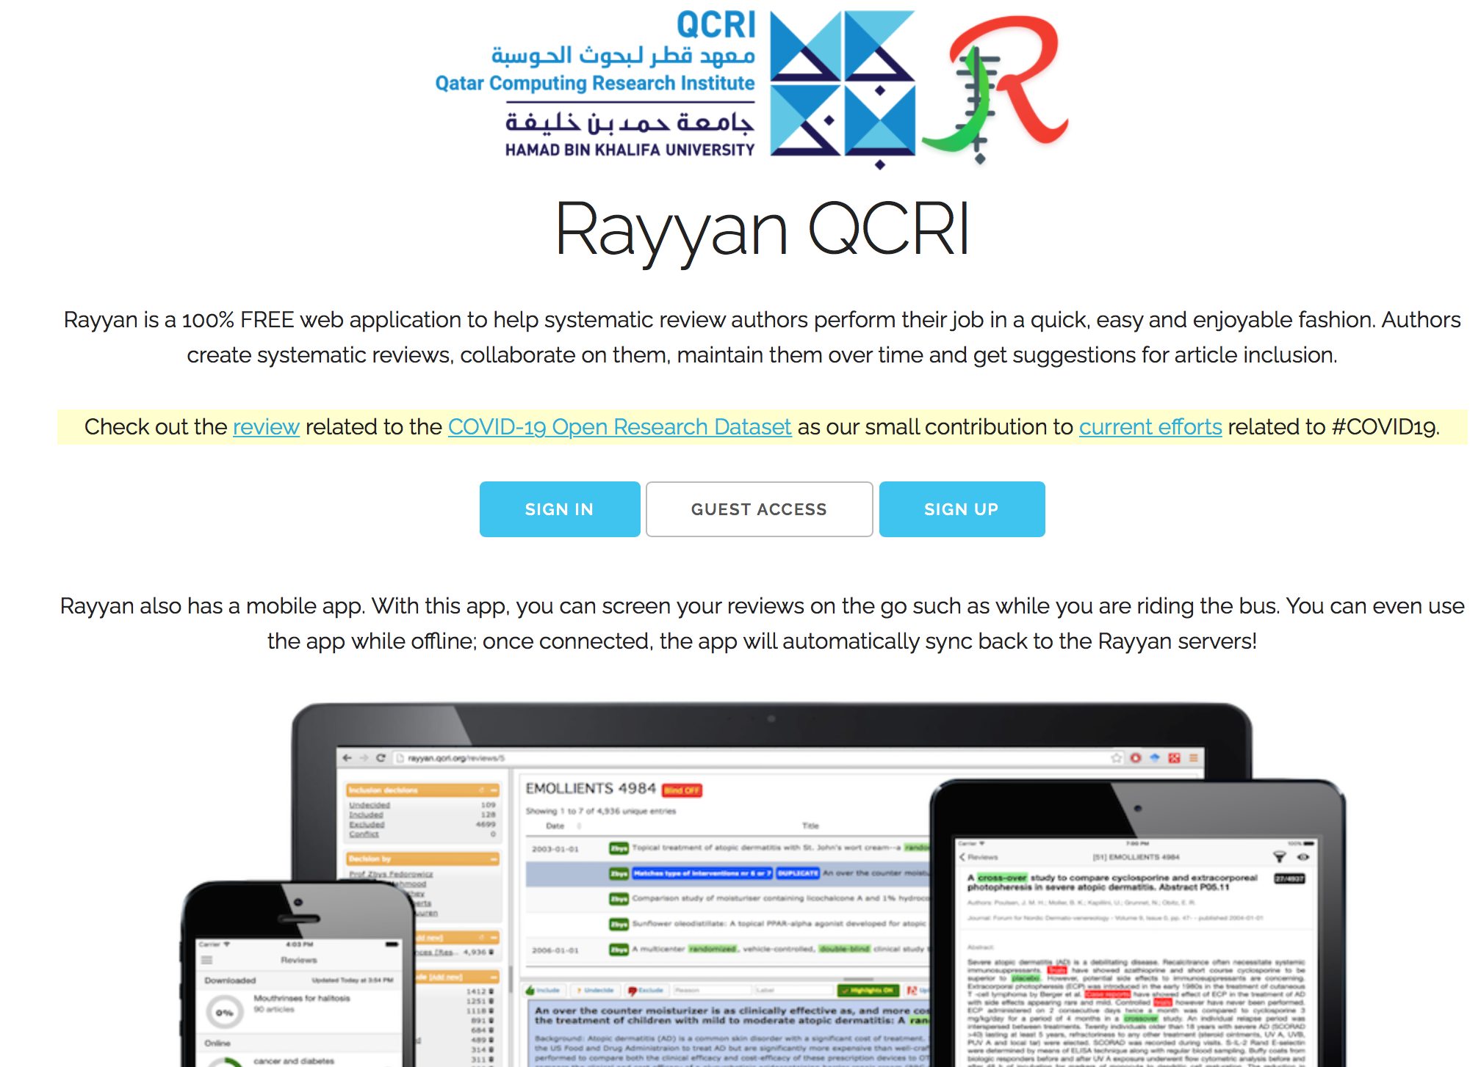
Rayyan

Slide 16
Numbers (1)
Just as with the searches, it is necessary to keep a log detailing disposition of search results. Keep track of the following:
Number of records downloaded from each database
Number of duplicate records removed
Number of clearly irrelevant records excluded in first cut, with brief and general note about nature of these studies (e.g. animal studies, in vitro studies etc.)

Slide 17
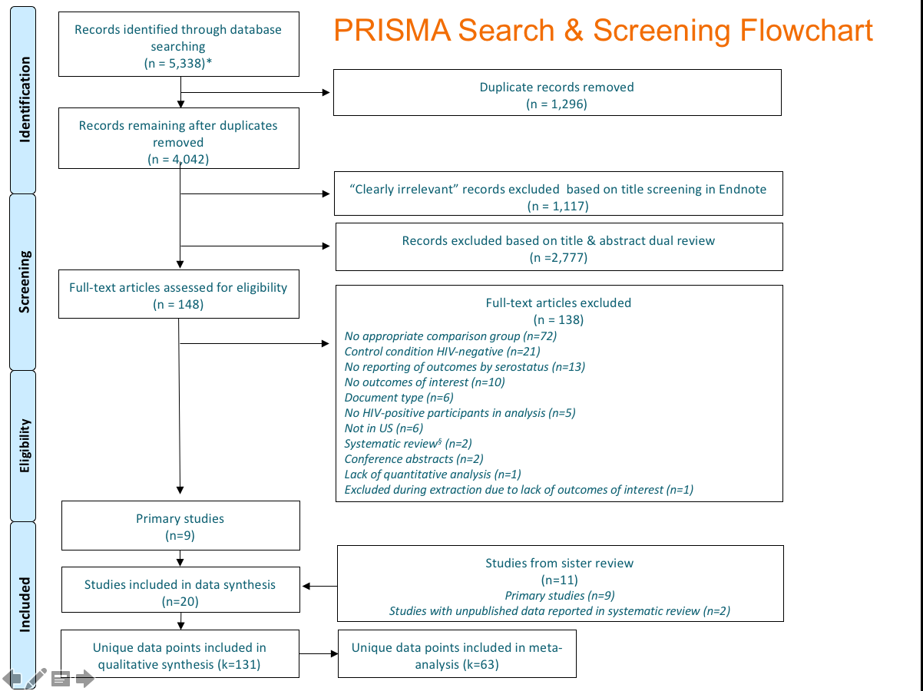

Slide 18
Numbers (2)
Number of records excluded by two reviewers looking at titles, abstracts & keywords; again with brief and general note
Number of records excluded after full-text review, with specific reasons for each

