Slide 1
Systematic Reviews
(EPI 214)
Module 2 – C: Data Extraction & Standardization
Mohsen Malekinejad, MD, DrPH

Slide 2
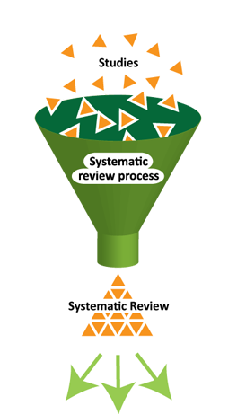
Main steps for conducting SR
Structured and transparent
process involving:
  Formulate research question (s)
  Plan the review (via a protocol)
  Comprehensive search
  Selection of studies
  Data extraction
  Standardization of data
  Assess risk of bias
  Data synthesis (may include meta-analysis)
  Interpretation of results
  Reporting
Notes:
Meta: how to assess quant data, especially when different studies present different values (OR,Pval, etc)

Slide 3
Data extraction
Structured process for abstracting and collecting key information from primary studies
  Informed by PICO
  Meet systematic review objective & analysis needs
  Should follow methods as described in protocol
  Use standardized data collection forms
  Pretest the method
  Use two coders (ideally working independently)

Slide 4
Data extraction: abstracting vs. coding
Abstracting: transferring key information from PS in a narrative format sometimes “almost” as written in source document
Coding: transforming narrative information into numerical and categorical variables using pre-specified decision roles and definitions

Slide 5
What to extract?
  Key data :
    PICO components
    Findings
      Sample size
      Time period over which data were collected
    Research design
    Data to assess risk of bias
    Other data as necessary
Notes:
If you use a tool that has been validated is less bias
Assess tools used to get your results

Slide 6
Data collection tools
Paper and pencil
Spreadsheet software
Specialized software: RevMan
Database software
Web-based survey
Web-based specialized apps

Slide 7
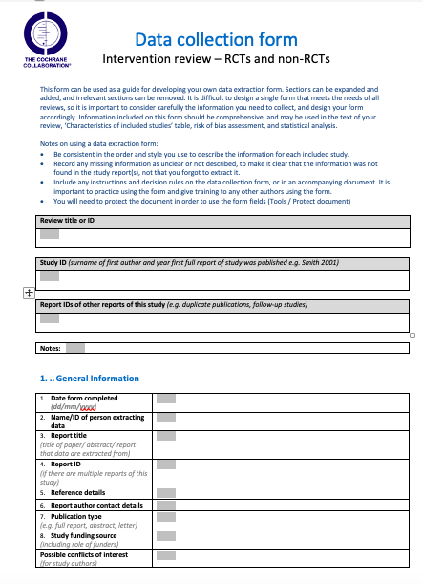

Slide 8
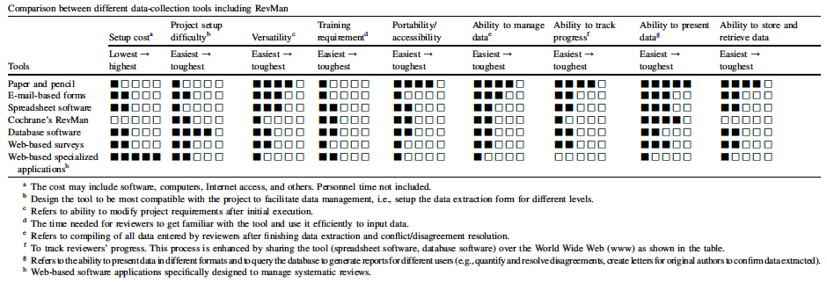
Data collection tools comparison

Slide 9
How much to extract?
Depends on your:
  Objective
  Data analysis plan
  Resources
Avoid extracting info unlikely be used

Slide 10
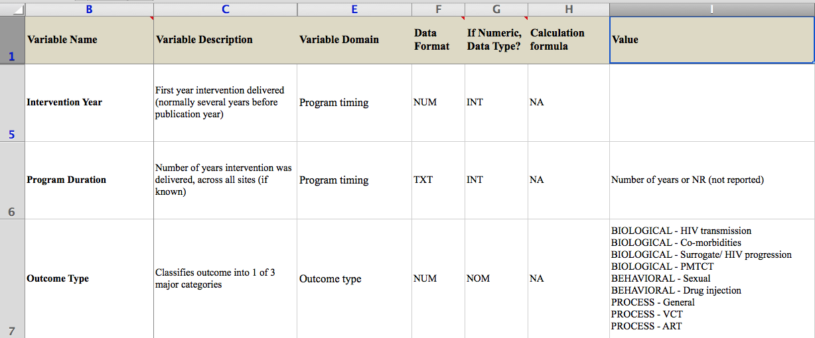
Example of data extraction codebook

Slide 11

EQUATOR
Detailed reporting guidelines
  CONSORT Statement (reporting of randomized controlled trials)
  STARD (reporting of diagnostic accuracy studies)
  STROBE (reporting of observational studies in epidemiology)
  PRISMA (reporting of systematic reviews), which replaced QUOROM
  MOOSE (reporting of meta-analyses of observational studies)
http://www.equator-network.org/resource-centre/library-of-health-research-reporting/

Slide 12




Slide 13
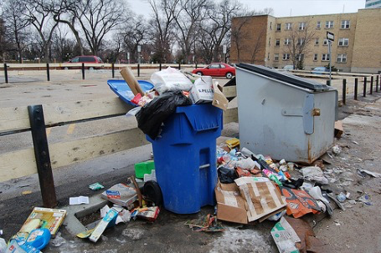
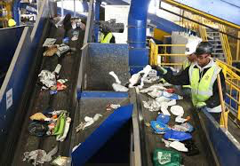

Slide 14
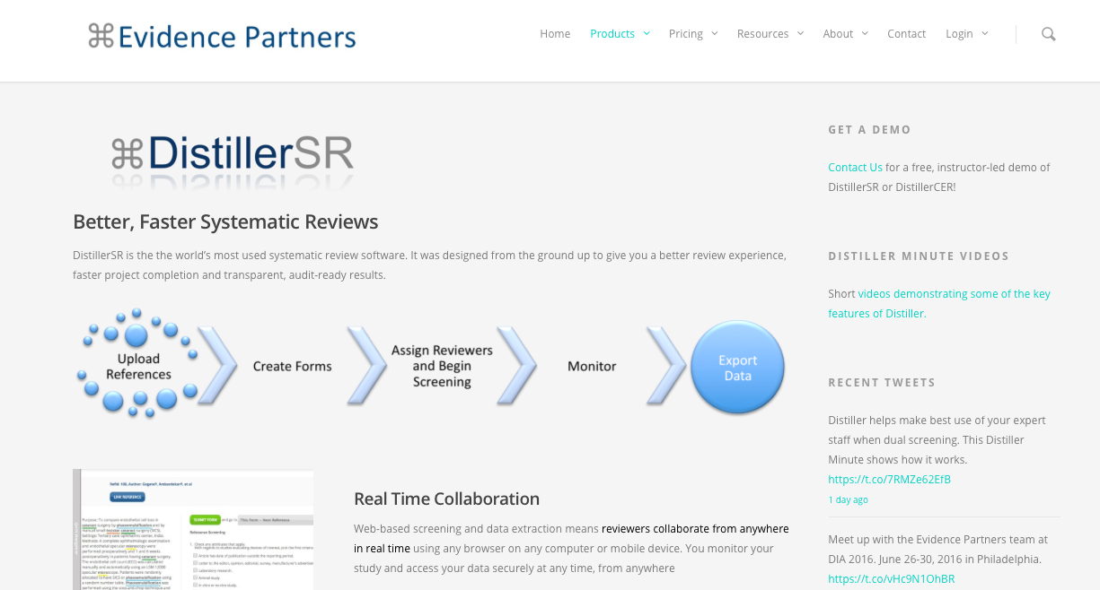

Slide 15
Data extraction – missing data
Plan to collect “key” missing data
  Look for cited past work associated with the same study in Intro, method, and discussion
  Should link multiple reports of the same study
  Published protocol (sometimes on project's website)
  Contact authors
  Grey literature ( project final reports, conf abstracts)

Slide 16
Data standardization
The process for generating common and comparable (combinable) data within and across primary studies
  Descriptive info : e.g., characteristics of intervention, study settings, target population
  Quantitative info: effect size (Numerators & Denominators of 2 X2 table, Risk Ratio, Odds Ratio, Hazard Ratio, Prevalence, Incidence, Number Need to Treat, Confidence Interval, P-value, etc.)

Slide 17
Description of Intervention
Example 1- Seller 1994
Community-wide intervention focused on Latino youth. Included activities and promotion to educate and promote awareness of HIV/AIDS and use of condoms. Workshops and presentations at schools, community orgs, health centers, at community events; group discussions at adolescents' homes. Also, radio and television PSAs, posters in public spaces and businesses, and a newsletter produced by peer leaders. Street "canvassing included distribution of a kit that provided condoms and pamphlets on how to use them. Condoms were also freely available at the intervention office and at all intervention activities.”

Slide 18
Description of intervention
Example 2 - Alstead 1999
A media campaign promoting condom use among youth including posters, radio spots, and billboards/bus signs, as well as t-shirt giveaways, condom instruction cards, and brochures distributed at schools/health fairs. Free condom bins or vending machines (w/condoms for $.25) were placed in targeted locations (e.g., "men's and women's restrooms at community centers, parks, bowling alleys, pizza parlors, and coffee shops; …public recreation area of a community center,...community service agencies, record stores, and clothing stores."). From p499-500: The media campaign and condom distribution was implemented in 3 communities in/around Seattle with relatively high rates of STD and teenage pregnancy, but that differed in terms of pre-existing HIV/AIDS resources. Southeast Seattle had condom vending machines in high schools, HIV/AIDS peer education in high schools, and "a CBO serving people of color had an office in the community that offered HIV testing, condoms, and a variety of HIV and STD education programs." West Seattle had condom vending machines in some high schools, but no other identified pre-existing services. Renton did not have any identified pre-existing condom distribution/peer mentoring/education programs.

Slide 19
Standardized Intervention
Seller 1994: Ongoing CD + [General HIV & sexual health education + Formal condom use training + Street outreach] (Professional staff + Peers + Media)
Alstead 1999: Ongoing CD + [Behavioral & skill building] (Media)

Slide 21
Standardized Condom Use Outcomes
Non-condom use at sex episode: Self-report of having unprotected sex at last episode, or the proportion of a set of episodes that are unprotected.
Not always using condoms: Self-report of having at least one episode of unprotected sex in the recall period.

Slide 22
Randomized controlled trial
The Present |  |  |  | The Future
 |  | 100 Condom Use distribution (CUD) |  | 10 Condom Use+ | 90 Condom use –
200 | R
 |  | 100 no Condom Use distribution (CUD) |  | 20 Condom Use+ | 80 Condom use -

Slide 23
Strength of associations
Need a way to indicate strength of association between predictor and outcome variables.
This can be estimated by:
  Risk ratio
  Relative risk
  Relative risk for incidence (hazard)
  Odds ratio
  Correlation coefficient
  Terms risk ratio, rate ratio, relative risk, relative hazard are often mixed and confused

Slide 24
Relative risk is the risk of outcome in intervention group compared to risk in control
Predictor | Outcome variable at end of study |  | Total
 | Condom Use + | Condom Use -
CUD | a | b | a+b
No CUD | c | d | c+d
Total | a+c | b+d | N
Relative risk = [a/(a+b)] /[ c/(c+d)]
Risk of outcome in group with predictor ÷
risk of outcome in group without predictor

Slide 25
Relative Risk & Relative Risk Reduction
Predictor variable | Outcome variable |  | Total
 | Condom Use + | Condom Use -
CUD | 40 (20%) | 160 (80%) | 200
No CUD | 100 (50%) | 100 (50%) | 200
Total | 150 | 250 | 400
N=400 subjects, Condom use measured over 1-year period, no drop-out
Relative risk = (40/200) / (100/200) = 0.4
Relative Risk Reduction = (50 % - 20%) / 50% = .6
RRR = 1 – RR = 1 – 0.4 = .6 OR 60%

Slide 26
Odds ratio
Predictor | Outcome variable |  | Total
 | Condom Use + | Condom Use -
CUD | a | b | a+b
No CUD | c | d | c+d
Total | a+c | b+d | N
Odds Ratio:
Cohort study Odds of outcome in those with predictor/
Odds of outcome in those without predictor =
(a/b) / (c/d) = ad/bc
Case control: Odds of predictor in those with outcome/
Odds of predictors in those without outcome =
(a/c) / (b/d) = ad/bc

Slide 27
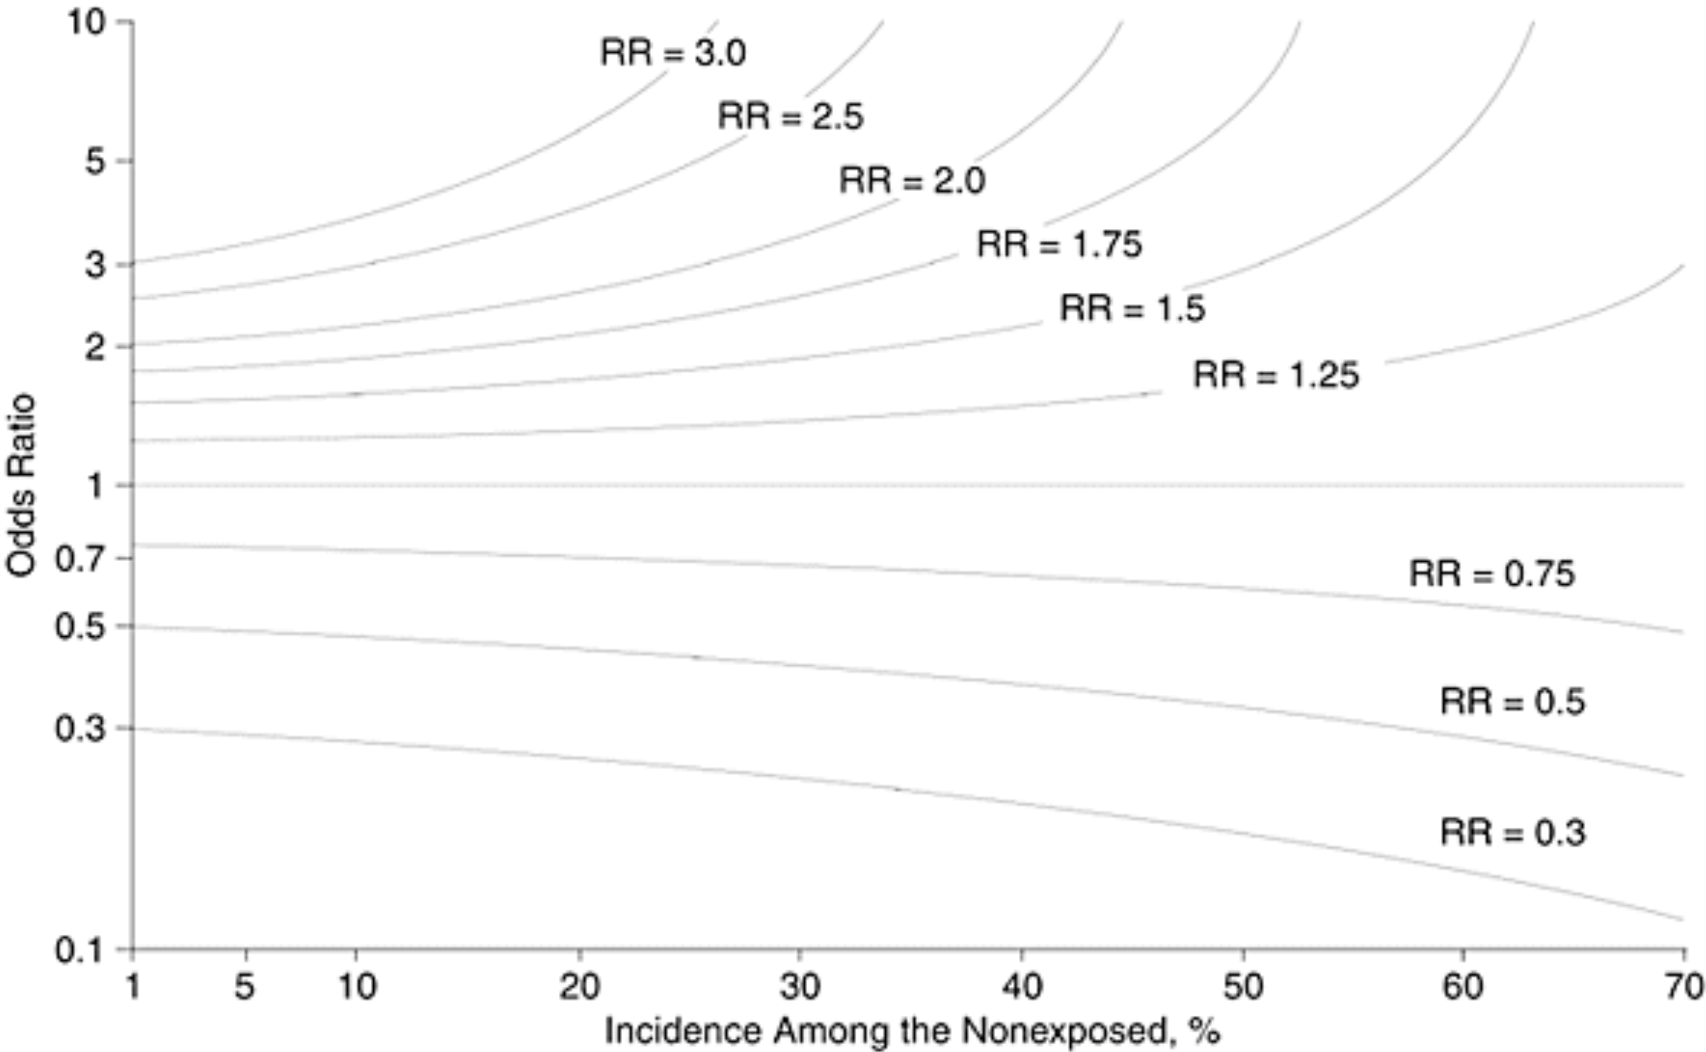
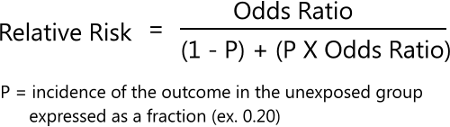
Risk Ratio & Odds Ratio Relationship
JAMA. Zhang 1998

Slide 28
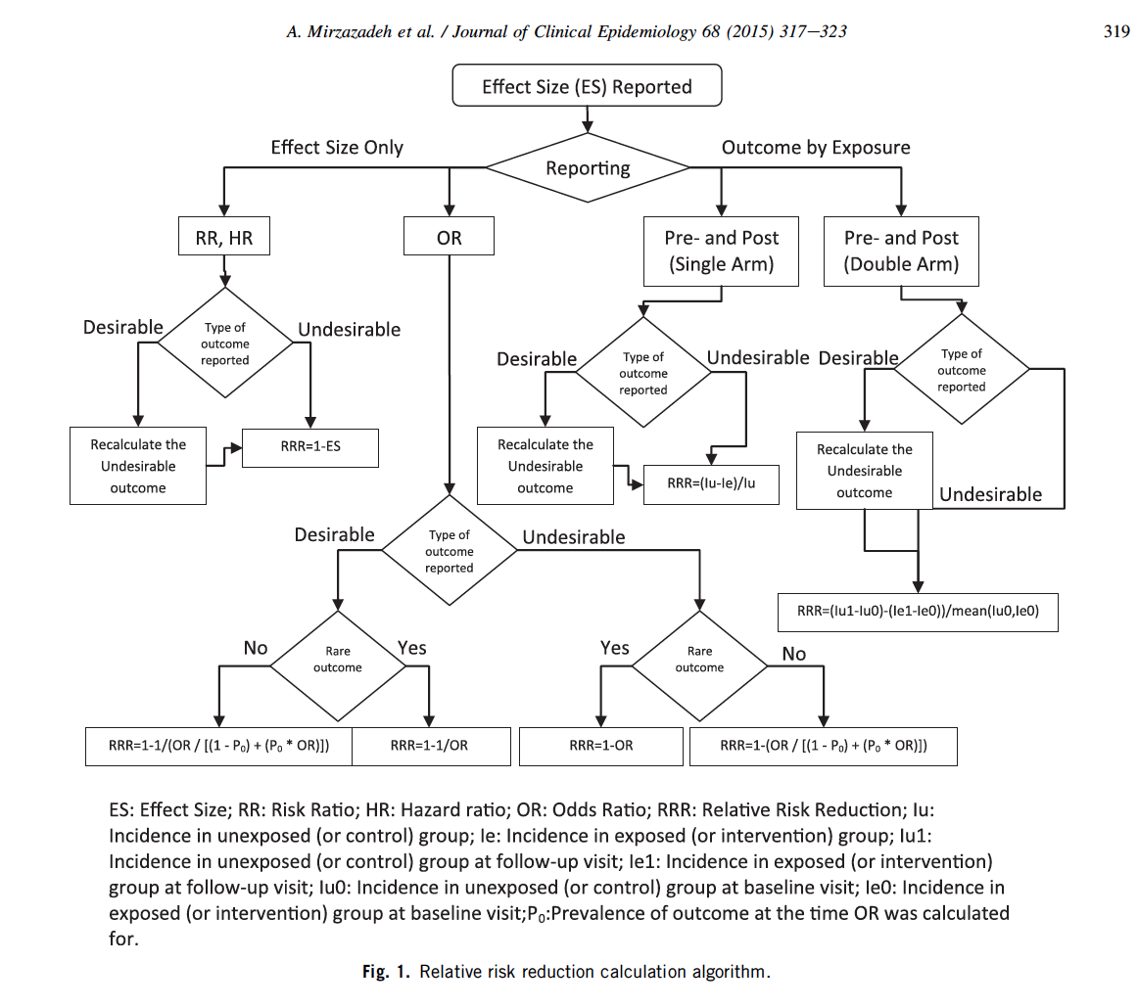

Slide 29
Precision of measurements -
95% confidence intervals
Generally – indicates that if the study were repeated numerous times, 95% of the time, the true value would lie between these limits
Not symmetrical around a point values for RR, OR, RRR (because calculated using log-values)

