Slide 1
Systematic Reviews
(EPI 214)
Module 3 – A: Data Synthesis Approaches
Mohsen Malekinejad, MD, DrPH

Slide 2
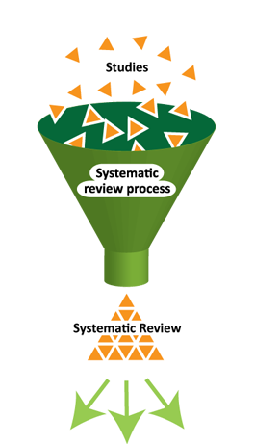
Main steps for Conducting SR
Structured and transparent
process involving:
  Formulate research question & PICO
  Plan the review (via a protocol)
  Comprehensive search
  Selection of studies
  Data extraction
  Standardization of data
  Assess risk of bias**
  Data synthesis (may include meta-analysis)
  Interpretation of results
  Reporting
Notes:
In terms of the process:
Yellow – steps that are somewhat different
Red – varies ALOT

Slide 3
Data Synthesis
“Synthesis is a process of bringing together data from a set of included studies with the aim of drawing conclusions about a body of evidence.”

Slide 4
Systematic review:
Data Synthesis Approach?
Depends on:
  objective of systematic review
  type of included studies and data
  quality of available data
  quantity of available data

Slide 5

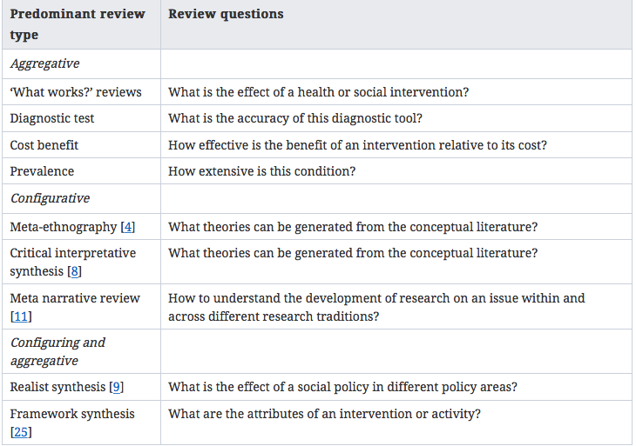

Slide 6
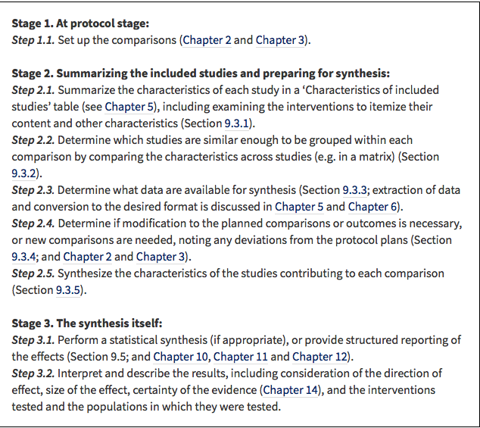
Data Synthesis Steps: Intervention Effect

Slide 7
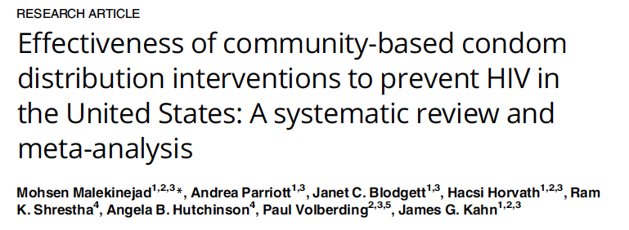
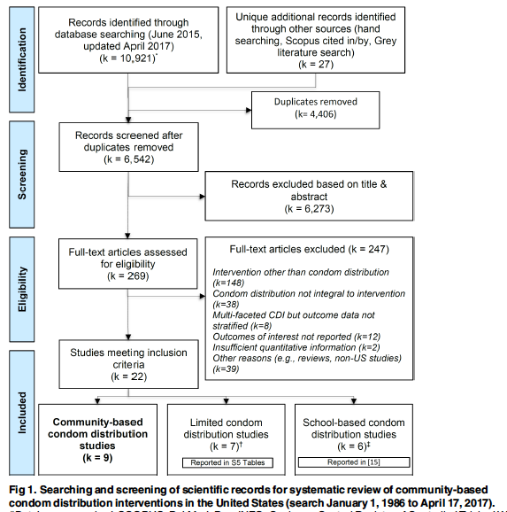

Slide 8
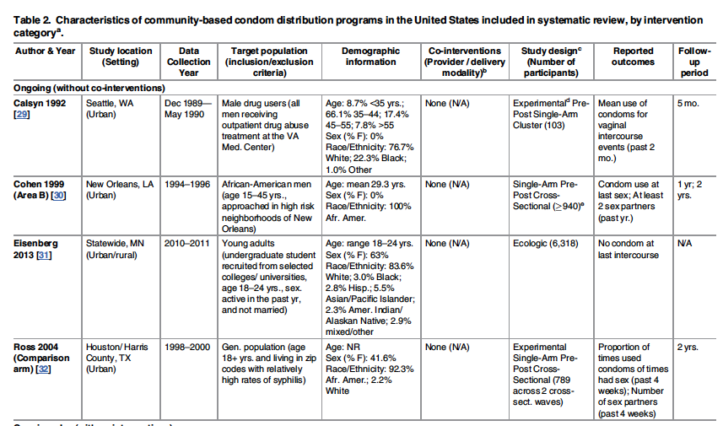

Slide 9
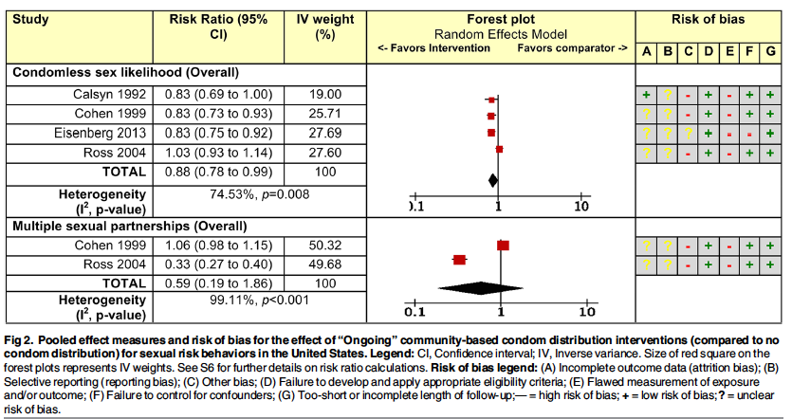

Slide 10
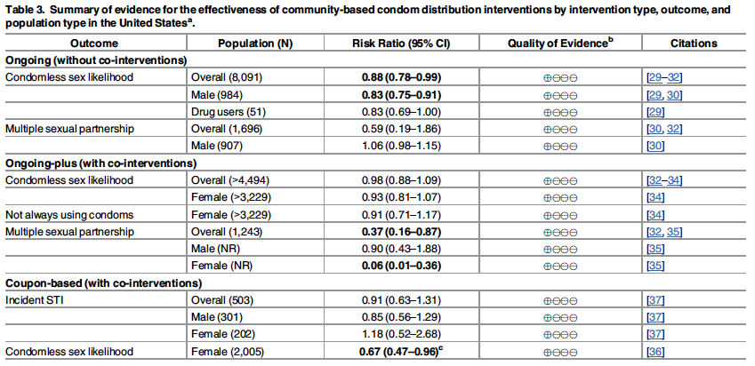

Slide 11

Example 3

Slide 12
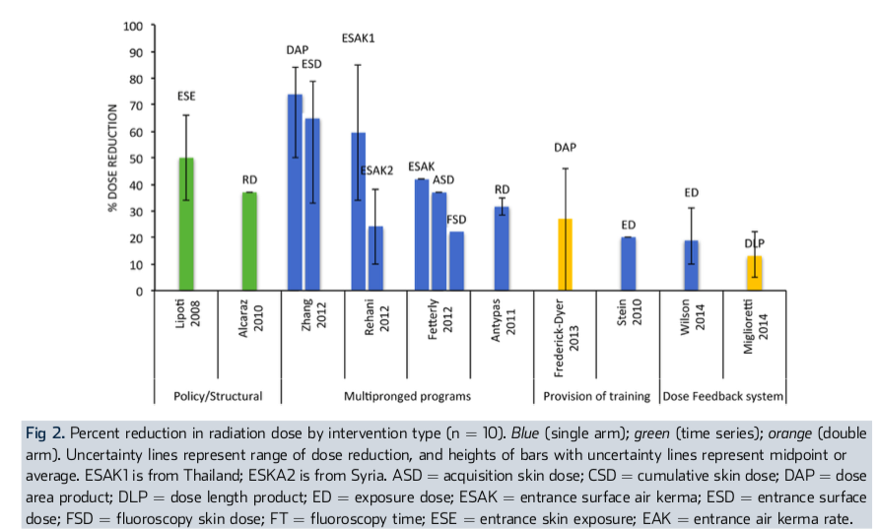

Slide 13
SR e.g., for intervention effect
Lucia Abascal

Slide 14
How about other SR Types?
Disease risk factor(s) (principles very similar to SR of interventions)
Prevalence, incidence, or burden of disease
Rate of disease progression
Program performance
Implementation characteristics of studies
Methodology
Diagnostic test accuracy
Qualitative studies
….

Slide 15
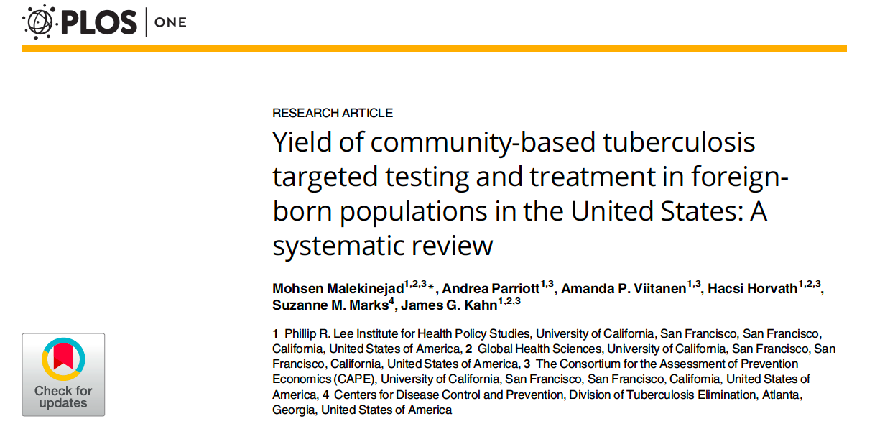

Slide 16
PICO Example – TB Test & Treat Program Performance in the US
Objective: “systematically review the scientific literature to assess the performance of community-based programs to identify, test for LTBI, and link to treatment foreign-born populations in the US. Our primary focus is strategies to reach populations in the US without documented legal status”

Slide 17
TB Test & Treat SR - Outcome
Number of
  individuals who were reached
  subjects reached and became eligible
  eligible subjects consented for testing
  eligible subjects who were tested
  eligible whose test was read
  eligible subjects who tested positive
  eligible subjects who agreed to start treatment
  eligible subjects who started treatment
Any reported cost associated with steps above
Any reported time interval (duration) associated with above

Slide 18
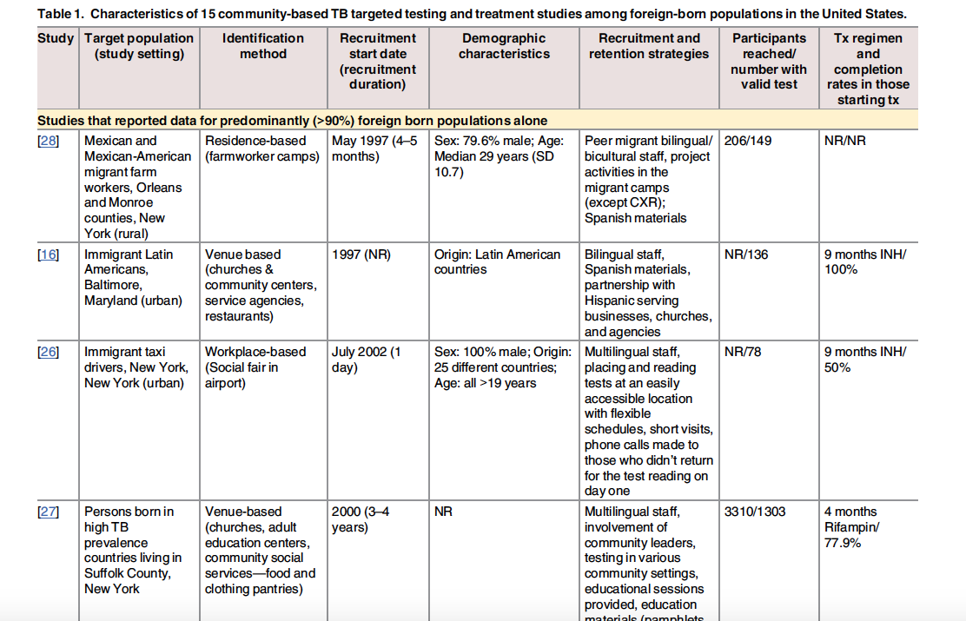

Slide 19
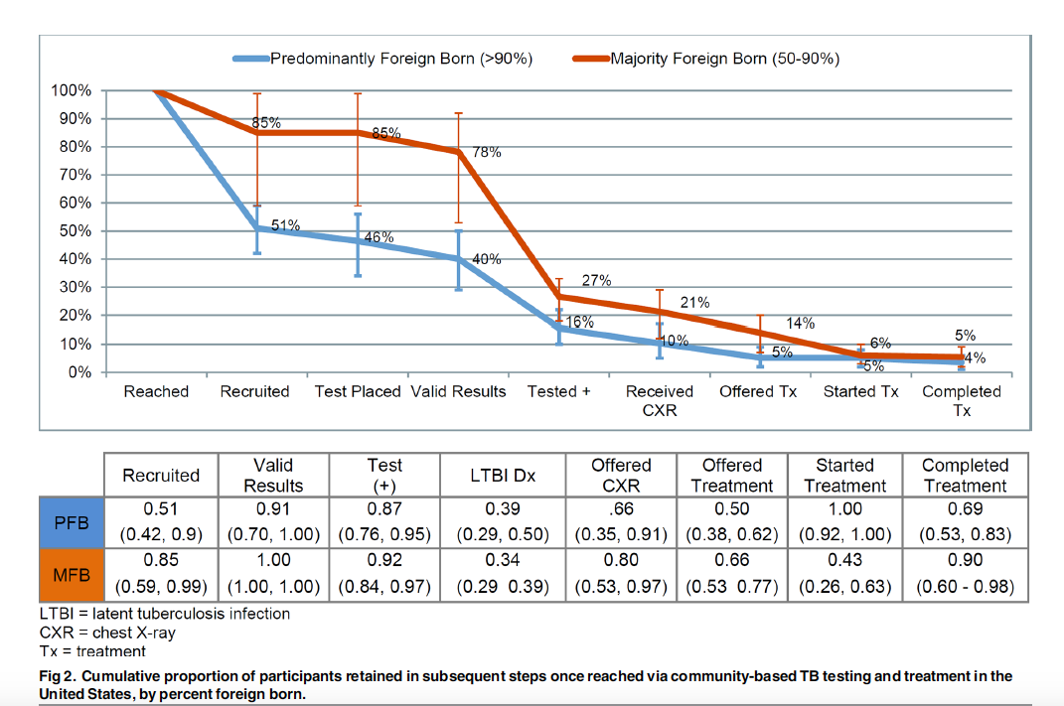

Slide 20
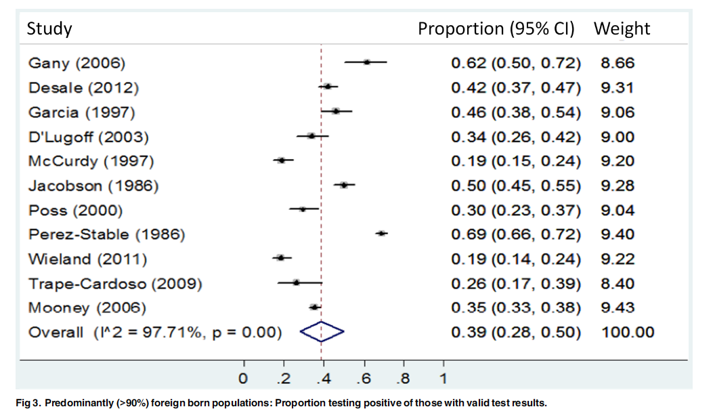

Slide 21
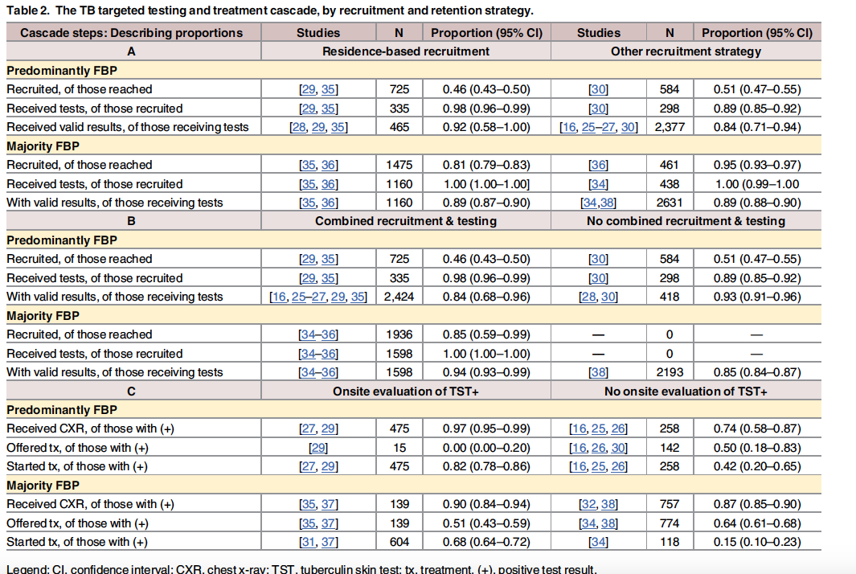

Slide 22
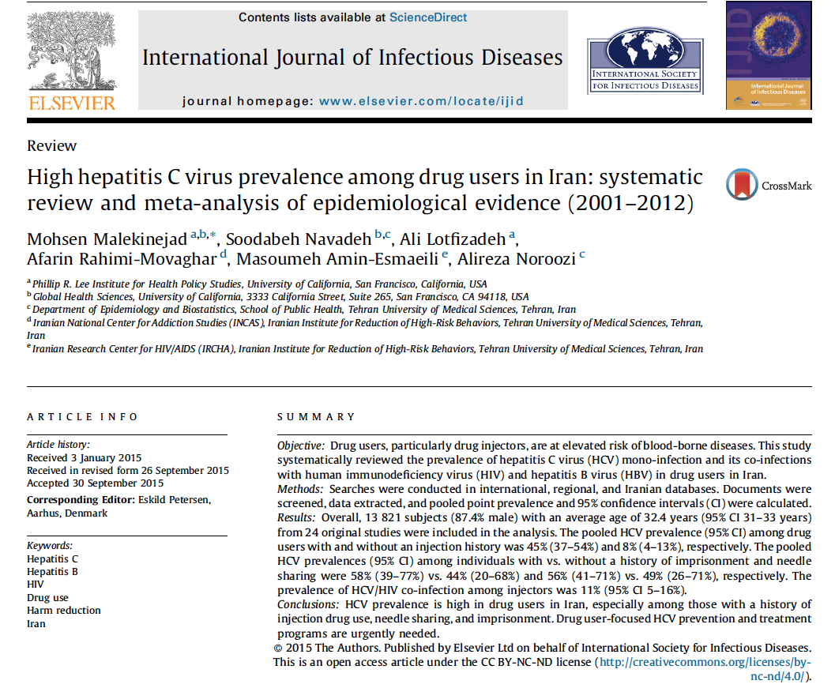

Slide 23
Objective
To provide an accurate estimate of the prevalence of HCV infection (and its co-infections with HIV & HBV) among drug users in Iran

Slide 24
Eligibility Criteria
Target population: drug using individuals NOT in correctional or inpatient healthcare facility during or immediately before time of survey.
Document type: primary prevalence and/or incidence biological data with sufficient methodological info (excluded self-report, modeling, media type)
Disease: HCV infection & co-infections with HBV/HIV
Study design: all quantitative
Geographic setting: Iran (all provinces)
Date & language: No restrictions
** Included short-term mandatory drug rehabilitation detention centers

Slide 25
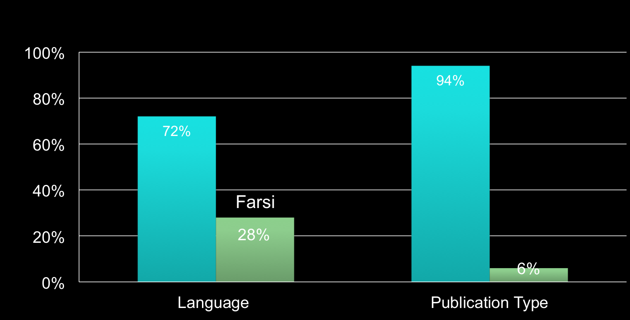
Results: Characteristics of 32 Included Citations (from total of 4730)
Pub Year: 2001 - 2012
Peer-reviewed
English
Technical Report

Slide 26
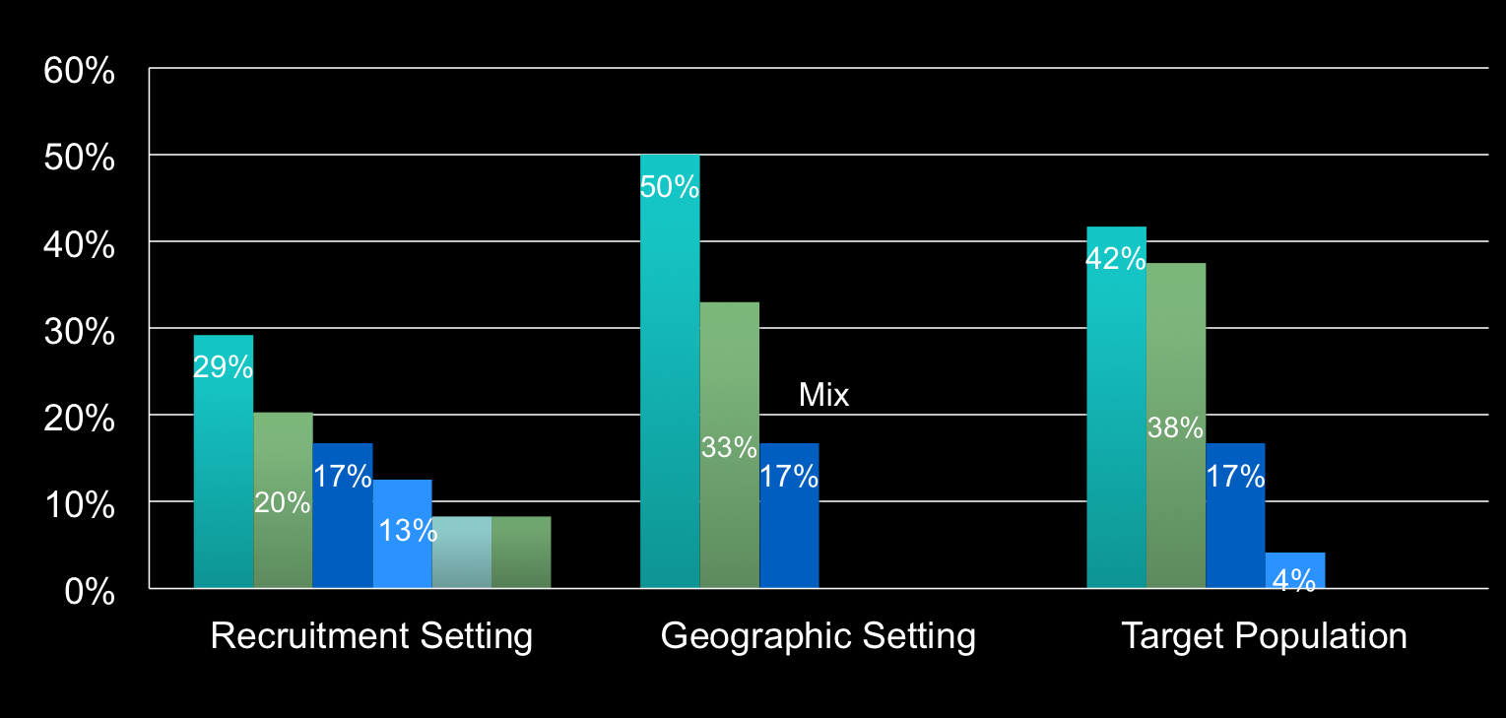
Results: Characteristics of Included Unique Studies (N = 24)
Tehran
Ever injector
Drug tx center
Recent injector
Not Tehran
Health facilities
Mix
DIC
Mix
Community
Other
Never injector
Sampling Method: 22 (92%) Convenient

Slide 27
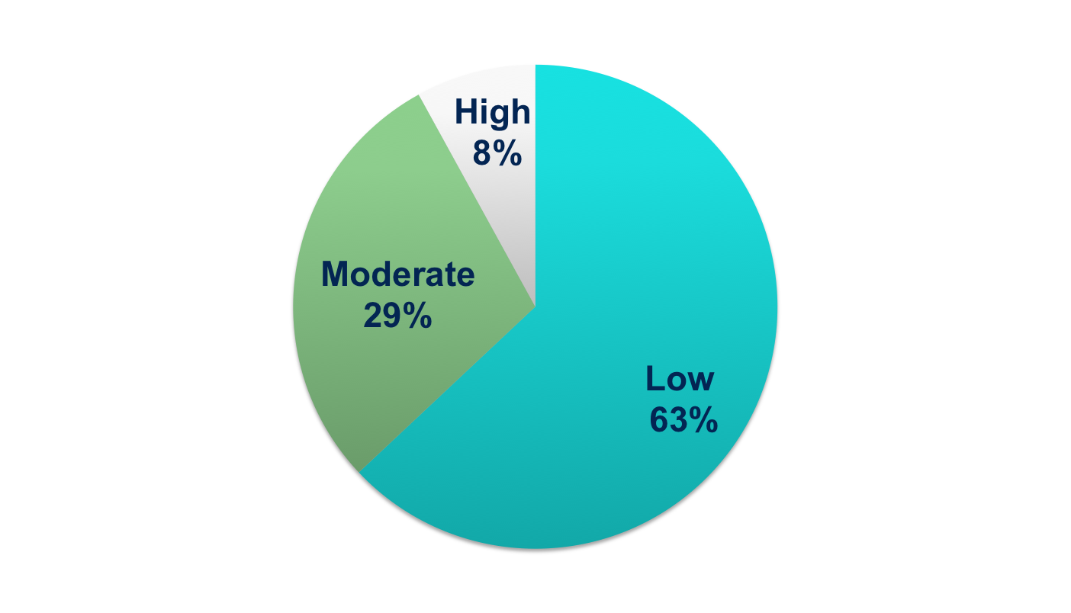
Results: Quality of Studies (N = 18)
Notes:
Visuals are always helpful

Slide 28
Results: Pooled HCV prevalence among PWID in Iran (all studies)
45% ( 37 – 54)

Slide 29
Results: Pooled HCV prevalence among PWNID (All studies)
8% ( 4 – 13)

Slide 30
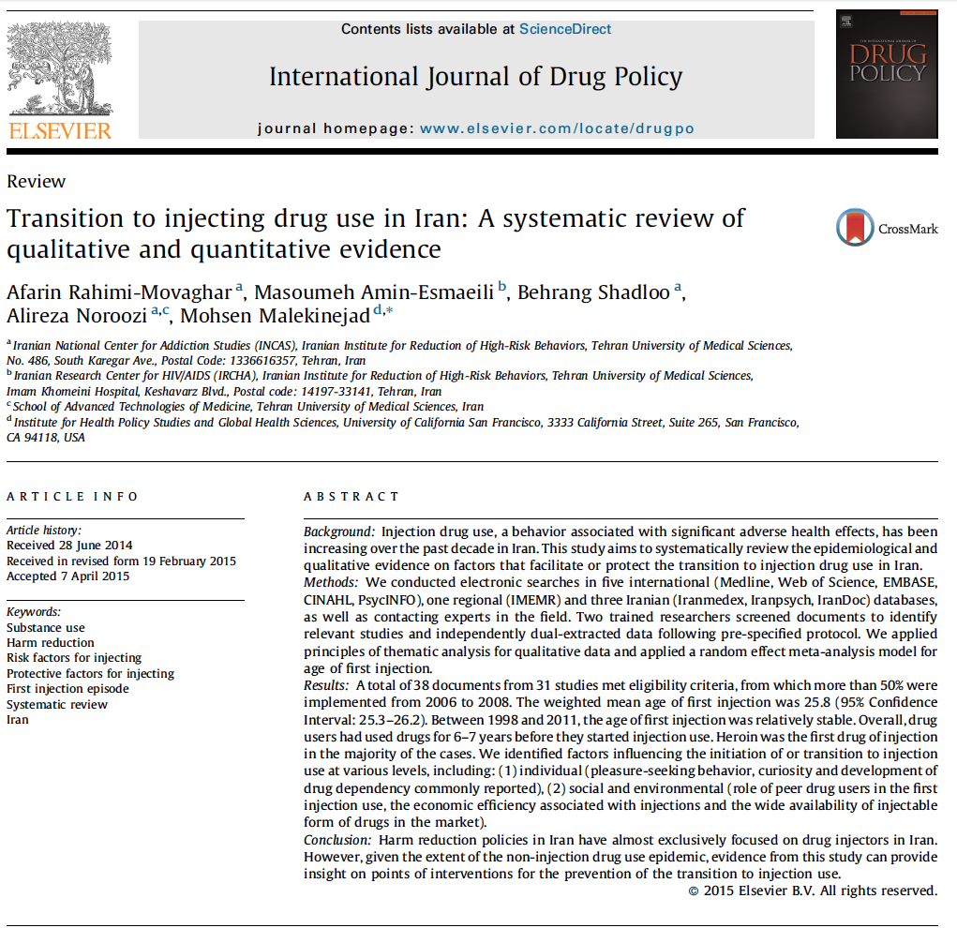
Example 2

Slide 31
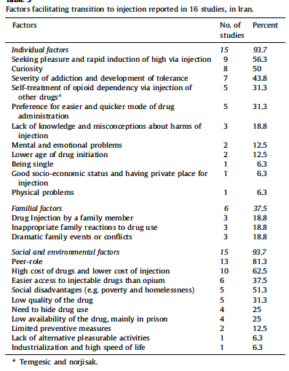
Notes:
Capture themes and concepts. You should come up with ways to summarize data so you can do things like dividing them

Slide 32
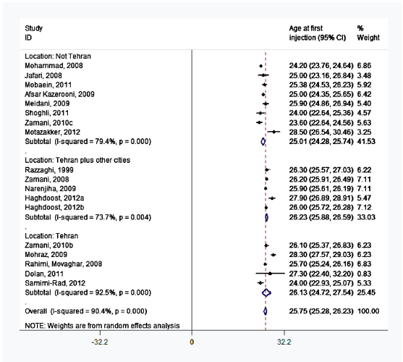

Slide 33

Example 4

Slide 34
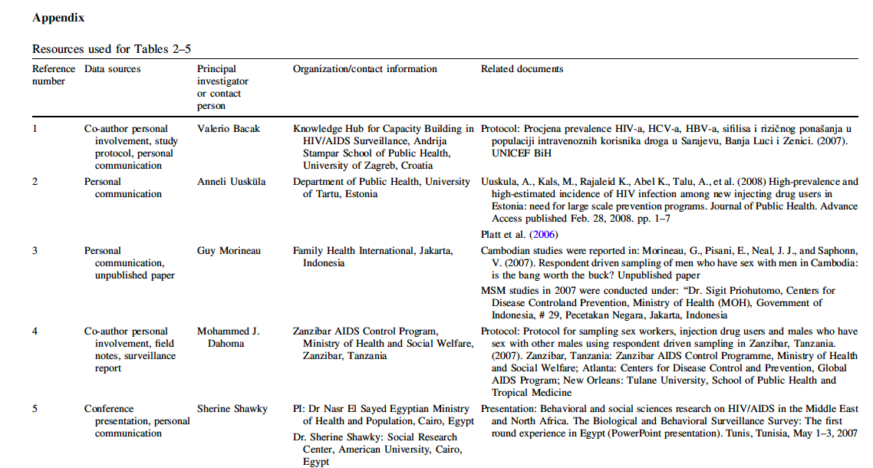

Slide 35
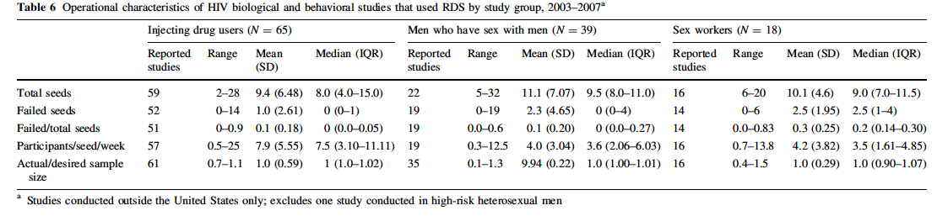

Slide 36


Slide 37
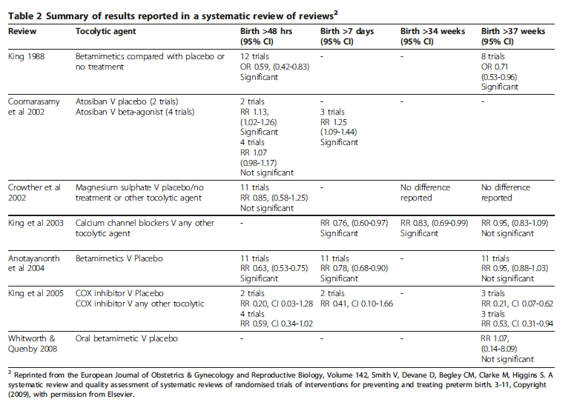

Slide 38
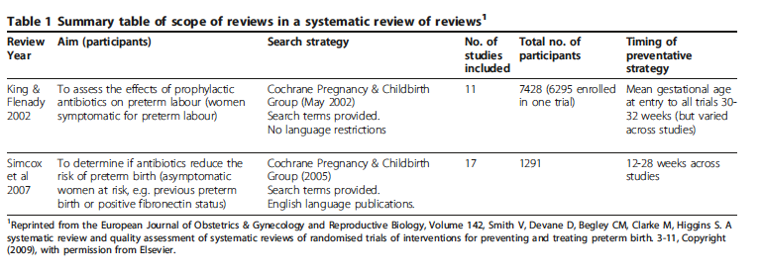

Slide 39
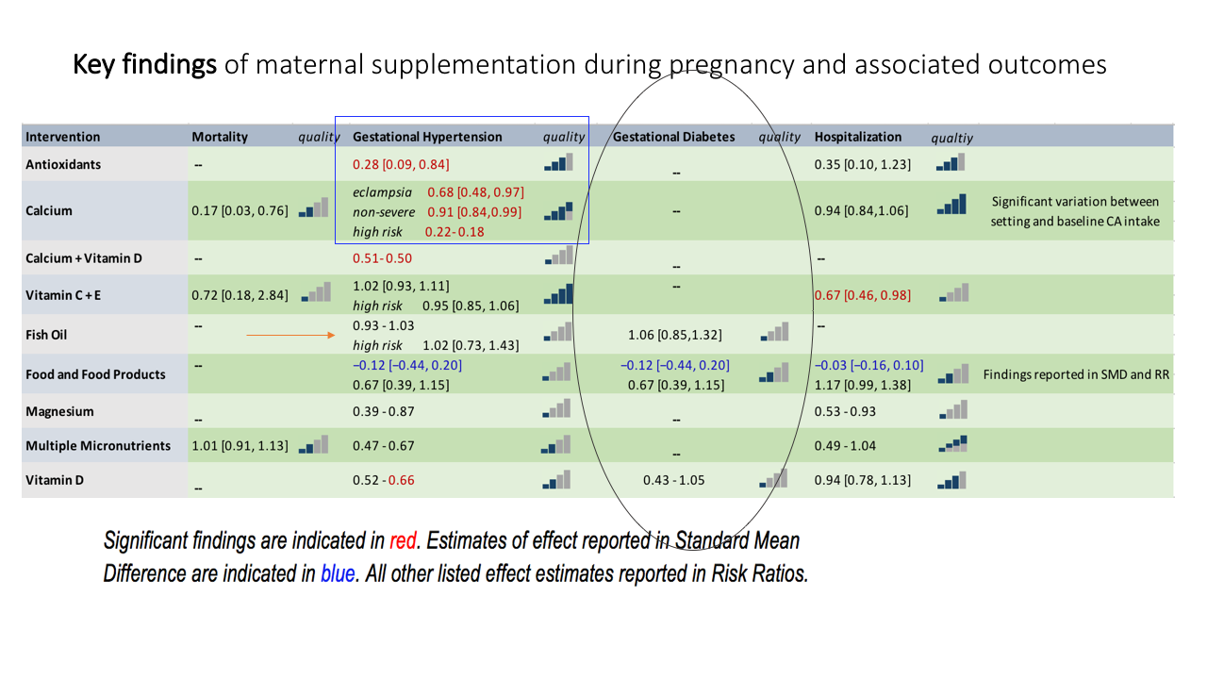
SR e.g., for intervention effect: review of reviews
Kezia Mustak capstone 2018

Slide 40
SR e.g., for association between risk factors & health outcome
Vahid Namdari-zandi capstone 2018

Slide 41
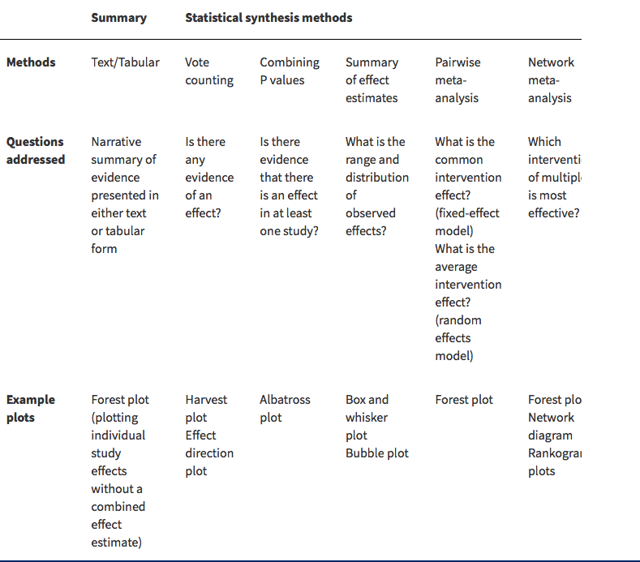
Data Synthesis Methods: Intervention Effect

