Slide 1
Systematic Reviews
(EPI 214)
Module 3 – B: Introduction to Meta-analysis
Mohsen Malekinejad, MD, DrPH

Slide 2
Objective of Systematic Review
To synthesize important information across studies and provide a summary of findings.

Slide 3
Meta-analysis (MA)
The statistical methods used to combine two or more data points derived from primary studies.
MA generates an estimate for the summary statistics (with its confidence interval ) a metric of choice (e.g., relative risk, odds ratio, prevalence).

Slide 4
Why Performing Meta-analysis?
Increase precision of overall estimate
Investigate reasons for differences in risk estimates between studies
Discover patterns of risk amongst studies

Slide 5

Meta-analysis: Generic Formula
Yi = intervention effect estimated in the ith study
Wi = weight given to the ith study
  The bigger the weight given to the ith study, the more it will contribute to the weighted average
  The weights reflect the amount of information that each study contains
  For ratio measures (OR, RR, etc), Yi is the natural logarithm of the measure
Notes:
The larger the sample size=more info that study has

Slide 6
Forest Plot – Combining Effect of Different Interventional Studies
Favours treatment
Favours control
No effect

Slide 7
https://www.meta-analysis.com

Slide 8
Confidence Intervals
Indication of how precise the findings are
Sample size greatly impacts the CI
the larger the sample size the smaller the CI, the greater the power and confidence of the estimate

Slide 9

Meta-analysis: Inverse-variance Method
Common and simple version of the meta-analysis procedure
Weight given to each effect size (Y_{i} ) is the inverse of the variance of the effect estimate (Se_{i} )
For fixed-effect meta-analysis
Larger studies → smaller standard errors → more weight
Notes:
Larger variance = distribution is larger
One method to assign weight Inverse of variance is putting weight to the RR or OR

Slide 10

When should we perform meta-analysis?
If there are:
  primary studies with similar PICO, and
  sufficient quantitative data points (at least 2)
  data are on same metric/scale (or can be converted to a common metric)
Be careful:
  Primary studies too heterogeneous – statistical or otherwise
  There is high risk of bias
Notes:
If studies report either RR or OR, must choose either RR or OR to report and make sure that’s the same across all studies

Slide 11
Metrics for Meta-analysis
  Analytical studies
    Dichotomous data: OR, RR, RRR, ARR, NNT
    Continuous data: Mean difference, Standard Mean Difference
  Descriptive studies
    Dichotomous data: prevalence, incidence, rate, test sensitivity, test specificity
    Continuous data: Mean, standard mean, median

Slide 12
Prepare for Meta-analysis
Map out combinable data by your PICO
Decide the best summery effect to present your findings
Convert various effect measures to the common metric of interest
Organize data in a meta-analysis software

Slide 13
Systematic review (Fictional Example)
Objective: To assess the effectiveness of a new generation of blood pressure drugs on cardiovascular outcomes in > 50 years old patients in the US.

Slide 14
SR – Database (Fictional)
Study code
population
Intervention
outcomes
Notes:
RR = relative risk, OR = Odds Ratio, MD = mean difference, D+ = diabetic, D – non Diabetic.

Slide 15
How to combine?
Depends on question we are trying to answer:
  average effect of both drugs across all populations?
  differences between the effect of treatment A and B?
  the effect of new drugs on diabetic vs. non diabetic patients ?

Slide 16
Example 1 - MA for HBP
Primary Study | Population (Diabetic) | Treatment type | High Blood Pressure | Myocardial Infarction
1a | D + | A | RR | --
1b | D - | A | RR | --
2 | D - | A | MD | OR
3 | D + | A | RR | OR
4a | D - | B | RR | RR
4b | D - | A | RR | --
5a | D - | A | RR | RR
5b | D - | B | RR | RR
5c | D + | A | RR | RR
5d | D + | B | RR | RR
6 | D - | B | MD | --
Average effect across population and Tx types
Notes:
If just the yellow you are measuring the average effect of the class of drugs regardless if they have diabetes or not

Slide 17
Example 2 – MA for HBP
Primary Study | Population (Diabetis) | Treatment type | High Blood Pressure | Myocardial Infarction
1a | D + | A | RR | --
1b | D - | A | RR | --
2 | D - | A | MD | OR
3 | D + | A | RR | OR
4a | D - | B | RR | RR
4b | D - | A | RR | --
5a | D - | A | RR | RR
5b | D - | B | RR | RR
5c | D + | A | RR | RR
5d | D + | B | RR | RR
6 | D - | B | MD | --
Average effect of both Tx types by diabetic status

Slide 18
Example 3 – MA for HBP
Primary Study | Population (Diabetic) | Treatment type | High Blood Pressure | Myocardial Infarction
1a | D + | A | RR | --
1b | D - | A | RR | --
2 | D - | A | MD | OR
3 | D + | A | RR | OR
4a | D - | B | RR | RR
4b | D - | A | RR | --
5a | D - | A | RR | RR
5b | D - | B | RR | RR
5c | D + | A | RR | RR
5d | D + | B | RR | RR
6 | D - | B | MD | --
Average effect for all populations by Tx type

Slide 19
Example 4 – MA for MI
Primary Study | Population (Diabetic) | Treatment type | High Blood Pressure | Myocardial Infarction
1a | D + | A | RR | --
1b | D - | A | RR | --
2 | D - | A | MD | OR
3 | D + | A | RR | OR
4a | D - | B | RR | RR
4b | D - | A | RR | --
5a | D - | A | RR | RR
5b | D - | B | RR | RR
5c | D + | A | RR | RR
5d | D + | B | RR | RR
6 | D - | B | MD | --
Effect of different Tx types by diabetic status

Slide 20
Rearranging Data for Example 2
Primary Study | Population (Diabetic) | High Blood Pressure
1a | D + | RR
3 | D + | RR
5c | D + | RR
5d | D + | RR
1b | D - | RR
4a | D - | RR
4b | D - | RR
5a | D - | RR
5b | D - | RR
2 | D - | MD
6 | D - | MD

Slide 21
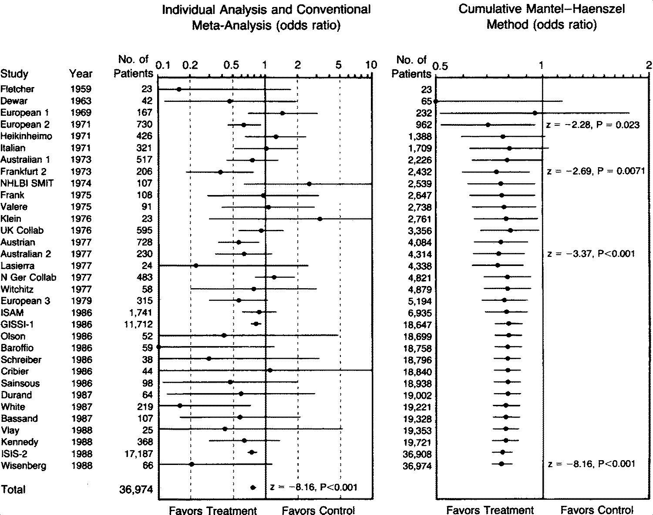

Lau J et al. N Engl J Med 1992;327:248-254.
Conventional and Cumulative Meta-Analyses of 33 Trials of Intravenous Streptokinase for Acute Myocardial Infarction.
“Cumulative meta-analysis of therapeutic trials facilitates the determination of clinical efficacy and harm and may be helpful in tracking trials, planning future trials, and making clinical recommendations for therapy”
Notes:
Figure 1. Conventional and Cumulative Meta-Analyses of 33 Trials of Intravenous Streptokinase for Acute Myocardial Infarction. The odds ratios and 95 percent confidence intervals for an effect of treatment on mortality are shown on a logarithmic scale. A bibliography of the published trial reports is available from the authors.

