Slide 1
Systematic Reviews
(EPI 214)
Module 3 – C: Assessment of Heterogeneity
Mohsen Malekinejad, MD, DrPH

Slide 2
Heterogeneity (Statistical)
Amount of variation in the results of included studies
Observed intervention effects more different from each other than one would expect due to random error
Can be due to:
  Clinical diversify: variability in PICOs
  Methodological diversity: Variability in study design and risk of bias

Slide 3
How to assess Heterogeneity?
1 - Visual Inspection
Difference between studies
Favours treatment
Favours control
No effect
Notes:
Most important step
No overlap = studies that are really different

Slide 4

How to Assess Heterogeneity ?
2 - Statistical Test
Chi-squared (χ2) test
  assesses whether observed differences
  in results are compatible with chance alone
  Q is the chi-squared statistic
  Df = degree of freedom
  I² = percentage of the variability in effect estimates that is due to heterogeneity
  Test results are included in the output of commonly used software (Stata, RevMan)

Slide 5
Interpretation of Test of Heterogeneity
  Evidence of heterogeneity of intervention effect:
    Low p value
    Large Q relative to its degree of freedom
    Large I² ( range: 0% - 100% )
      Thresholds are suggested for the interpretation of I²
      Interpretation depends on
        strength of evidence for heterogeneity (e.g. chi-squared test)
        Type of included studies: lack of statistical evidence of heterogeneity is not equal to lack of heterogeneity if only a few studies
Notes:
60% and above is high
30-50% moderate
Below that is low

Slide 6
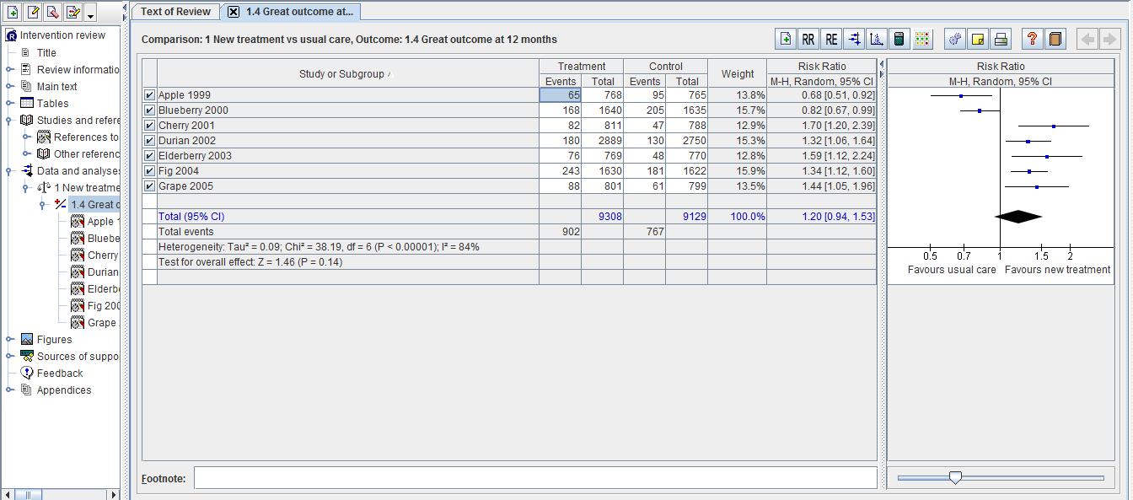
RevMan – Fictional Example
(High Heterogeneity)
Tau is the variance of the effect size parameters across the population of studies and it reflects the variance of the true effect sizes. The square root of this number is referred to as tau (T). T2 and Tau reflect the amount of true heterogeneity and used in the random-effect model.

Slide 7
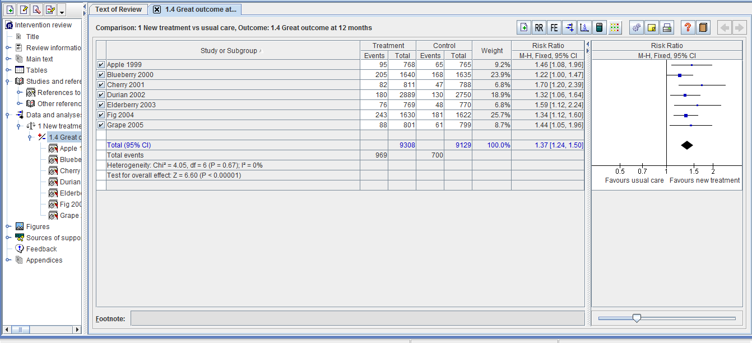
RevMan – Fictional Example
(Low Heterogeneity)

Slide 8
How to Address Heterogeneity?
Check data for errors
Explore heterogeneity
  Avoid reporting a single summary measure
  preform sub-group analysis or meta-regression
Perform random-effects meta-analysis (if warranted)
Change the metric (effect measure type)
Report findings of primary studies without meta-analysis

Slide 9
Meta-analysis Models
Two statistical methods for pooling results
  Fixed-effect: assumes one true effect size and differences in results across studies are due to random error
  Random-effects: assumes underlying effects may vary across studies, and incldued studies are a random sample of these effects.
67

Slide 10
Fixed-effect Model
All included studies measure same outcome
Assume any difference observed is due to chance
No inherent variation in source population
Variation within study, not between studies
Inappropriate where there is heterogeneity present
CI of summary measure reflects variability between patients within sample
Notes:
Last bullet-> bc it assumes that it’s due to random error, which is unlikely for high heterogeneity

Slide 11
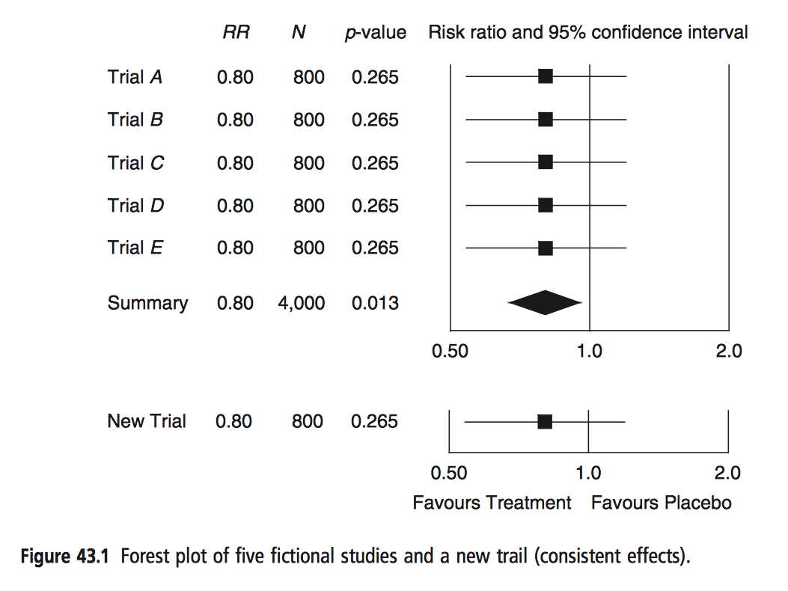
MA: Fixed-Effect Model
Bornstein 2009. Introduction to Meta-Analysis.

Slide 12
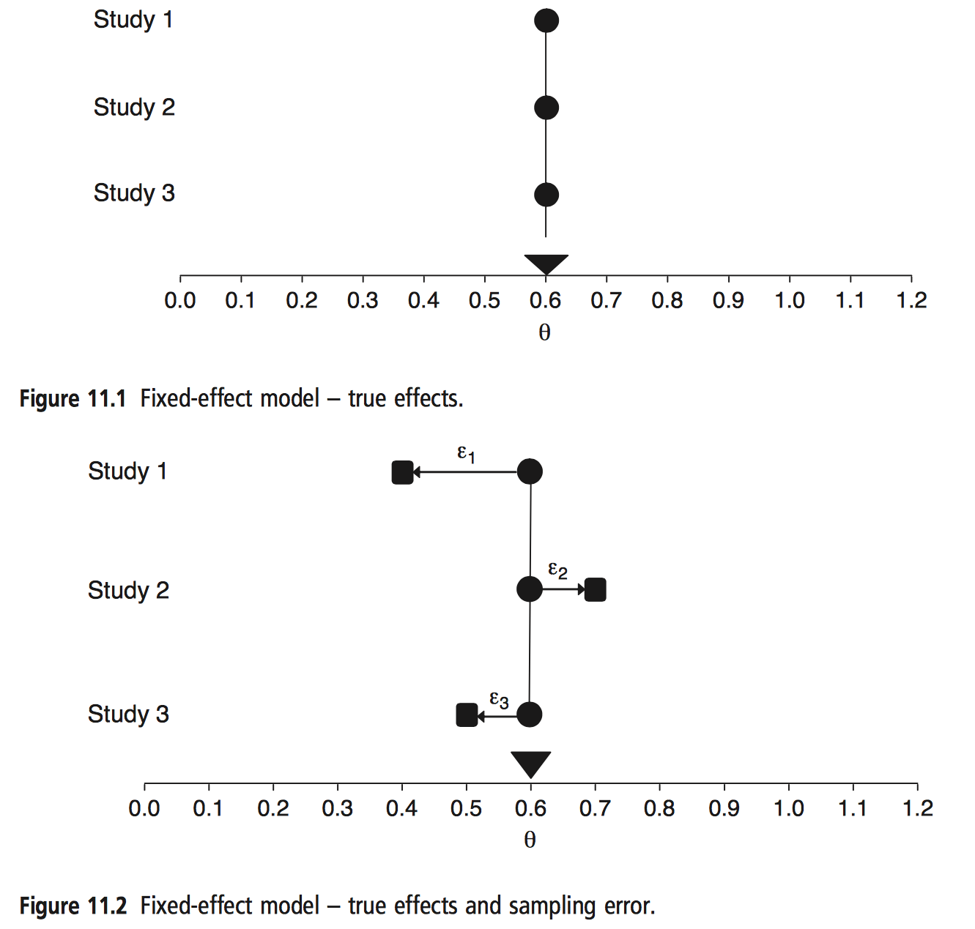
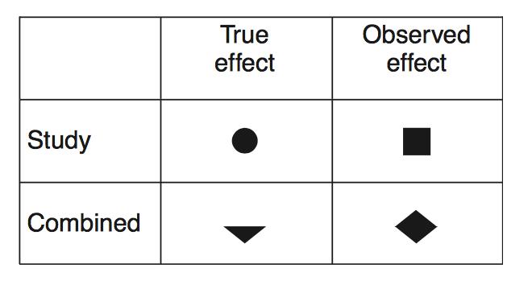
Bornstein 2009. Introduction to Meta-Analysis.

Slide 13
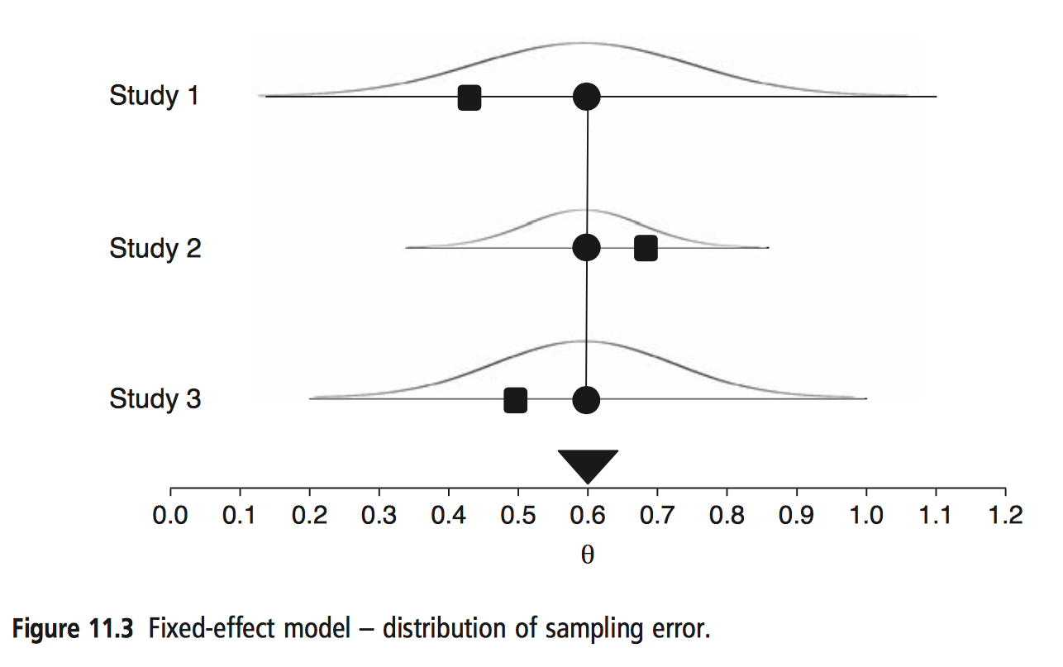
Bornstein 2009. Introduction to Meta-Analysis.

Slide 14
Random-effects Model
Assumed studies (intervention effects) are different and outcome will fluctuate around own true value
Variability due to both between patients within study and from differences between studies
Overall summary outcome is estimate of mean from which sample of outcomes was drawn
More commonly used with observational studies due to heterogeneity

Slide 15
Random vs. Fixed?
Where there is no heterogeneity, results of two methods will be similar
Decision on choice of model is informed by three issues:
  Amount of statistical heterogeneity (often misused)
  Research question
  Clinical and methodological variability

Slide 16
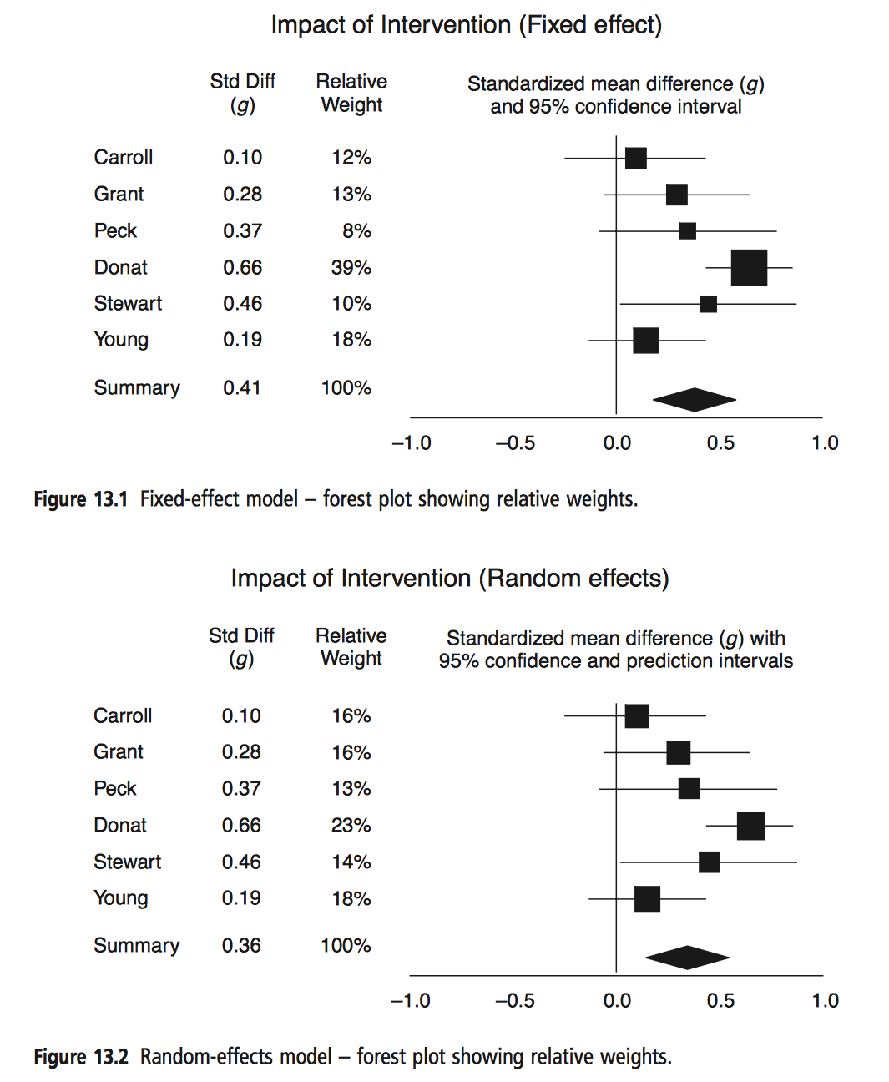
Bornstein 2009. Introduction to Meta-Analysis.

Slide 17
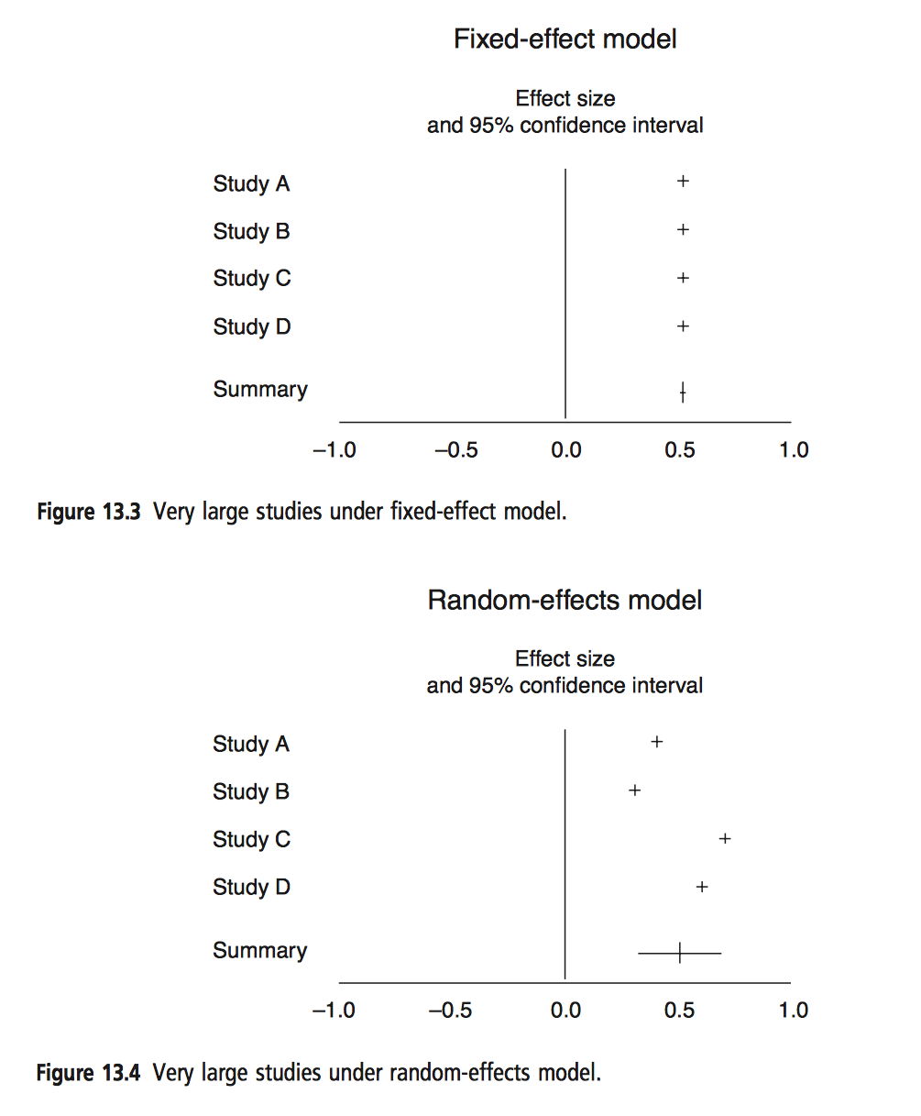
Bornstein 2009. Introduction to Meta-Analysis.

Slide 18
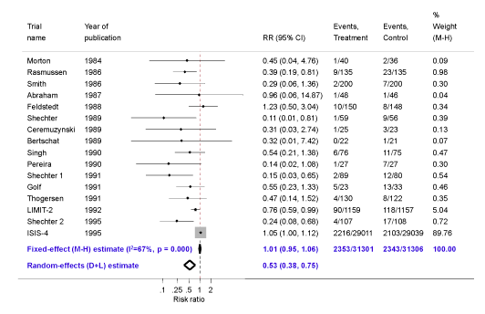
Fixed vs. Random?
The effect of intravenous magnesium on mortality following myocardial infarction (Cochrane Handbook – 10.4.c)

Slide 19
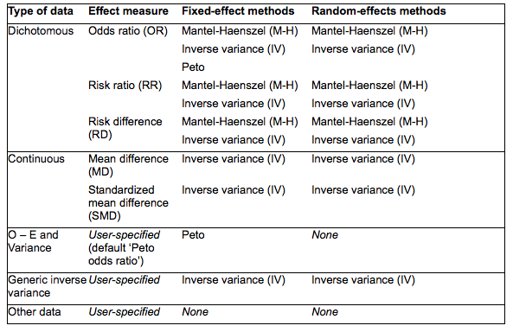
Summary of Meta-analytic Methods Available in RevMan (9.4.a)

