Slide 1
Systematic Reviews for Global Health Decision-making
(GH 213)
–Meta-Analysis subtopics
Mohsen Malekinejad, MD, DrPH

Slide 2
Meta-analysis: Other Important Topics
Subgroup analysis
Meta-regression
Sensitivity analysis
Reporting & non-publication biases
  Funnel plot: assess asymmetry in results of primary studies
Critics of meta-analysis

Slide 3
Subgroup Analysis
Effect estimates calculated for subgroups ( sex, different ethnic groups, underlying co-morbiditties)
To address anticipated heterogeneity or research question
Formal statistical comparisons made between groups
Must be pre-specified in protocol unless exploratory
70

Slide 4
Sub-group analysis - Example
Effect of knowledge of HIV + status on condom use.
Examining the impact of including data extracted directly from another review.

Slide 5
Sub-group Analysis Example: Effect of Syphilis infection on risk of HIV acquisition by statistical adjustment of RR.

Slide 6
Meta-regression
Conceptually similar to regular regression model
Outcome variable = effect size (OR, RR, …)
Explanatory variable = characteristics of study
  E.g. population type, settings, clinical practice, etc.
Regression coefficient: reflect changes in effect size with unit changes in explanatory variable
Significance of the regression coefficient is a test of whether there is a linear relationship between intervention effect and the explanatory variable

Slide 7
Sensitivity Analysis
To assess how robust the result of meta-analysis is
REPEAT the primary meta-analysis using different decision criteria. For example:
  To assess effect of each study on the overall estimate.
  To assess affect of different inclusion criteria
  Excluding unpublished studies
Better to be pre-specified

Slide 8
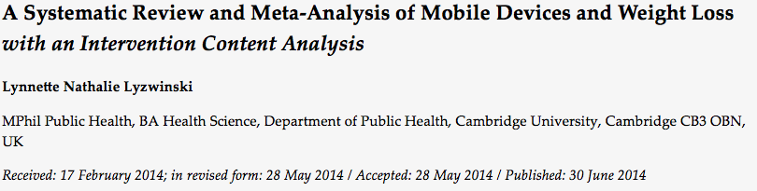
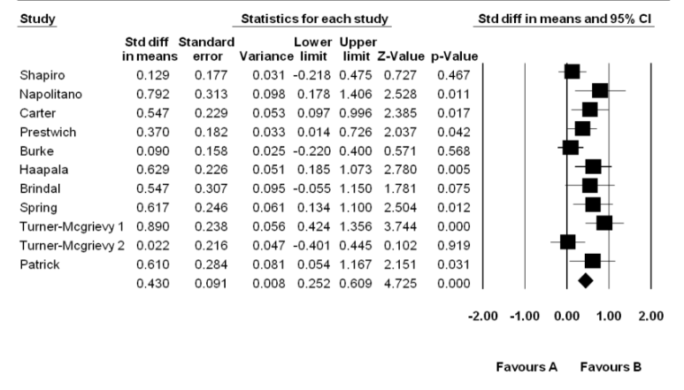

Slide 9
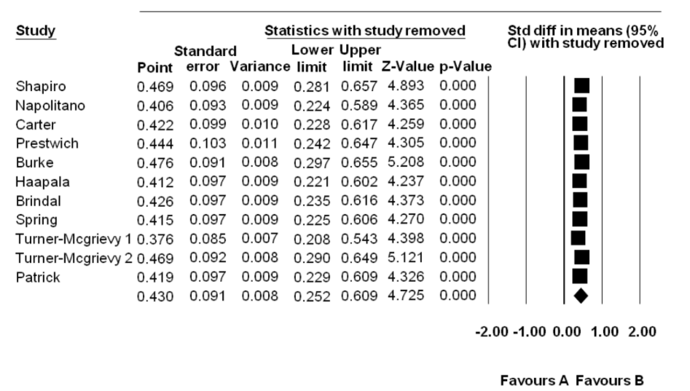
Sensitivity Analysis

Slide 10
Sensitivity Analysis Eaample: Effect of Syphilis infection on risk of HIV acquisition
Studies Omitted | RR | [95% Conf. | Interval]
Beymer 2016 | 2.21 | 1.52 | 3.22
Desai 2017 | 2.16 | 1.50 | 3.11
Giuliani 2014 | 2.56 | 1.80 | 3.63
Jia 2015 | 2.51 | 1.66 | 3.80
Jin 2010 | 2.38 | 1.64 | 3.46
Pathela 2013 | 2.43 | 1.66 | 3.56
Li 2012 | 2.30 | 1.54 | 3.42
van Griensven 2013 | 2.41 | 1.61 | 3.62
Xu 2010 | 2.22 | 1.55 | 3.17
Xu 2013 | 2.10 | 1.51 | 2.91
Yang 2010 | 2.28 | 1.55 | 3.35
Zhao 2013 | 2.26 | 1.55 | 3.28
Combined | 2.31 | 1.61 | 3.30

Slide 11
Main Critics of Meta-analysis
Cannot combine results of various studies in one number - Not intended
Combining “Apples and Oranges” – true if the goal is to always report common effect, but it is not.
Notes:
#2 – if not too hetrogiouns, we can use random-effect model to arrive on an average effect. Also, we are sometimes interested in the effect in various settings, or dispersion across studies.

Slide 12

Not Report a Single
Summary Effect when:
Too much heterogeneity among studies, there could be clearly effiect modifiers (two or more sets of studies)
High risk of bias among primary studies
The presence of serious publication and/or reporting biases

Slide 13

“…it is always appropriate and desirable to systematically review a body of data, but it may sometimes be inappropriate, or even misleading, to statistically pool results from separate studies.
Indeed, it is our impression that reviewers often find it hard to resist the temptation of combining studies even when such meta-analysis is questionable or clearly inappropriate.”
Egger et al. Systematic reviews in health care. London: BMJ Books, 2001:5

