Slide 1
Systematic Reviews (Epi 214)
Meta-Analysis Workshop

Slide 2
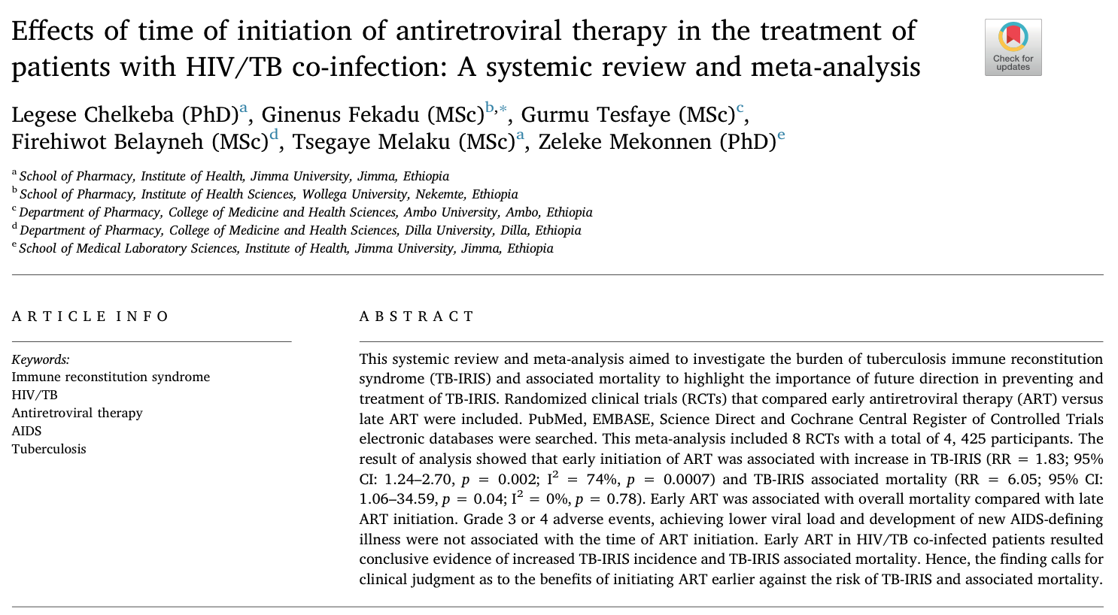
Demonstrating How to Conduct a MA
Using the Following SR:
Notes:
Citation: Legese Chelkeba, Ginenus Fekadu, Gurmu Tesfaye, Firehiwot Belayneh, Tsegaye Melaku, Zeleke Mekonnen,
Effects of time of initiation of antiretroviral therapy in the treatment of patients with HIV/TB co-infection: A systemic review and meta-analysis, Annals of Medicine and Surgery, Volume 55, 2020, Pages 148-158, ISSN 2049-0801, https://doi.org/10.1016/j.amsu.2020.05.004.
(https://www.sciencedirect.com/science/article/pii/S2049080120300911)

Slide 3
Study Objective and PICO
Objective: “ To investigate the burden of tuberculosis immune reconstitution syndrome (TB-IRIS) and associated mortality to highlight the importance of future direction in preventing and treatment of TB-IRIS”
PICO:
Population: Patients with HIV/AIDS
Exposure: Early initiation of ART
Comparator: Late initiation of ART
Outcome: 1) Incidence of TB-Immune reconstitution inflammatory syndrome (TB-IRIS), 2) all-cause mortality,3) grade 3 or 4 non-IRIS adverse events, and 4) AIDS defining illness
Notes:
Create slides of the objective/question of the SR findings, summary table, data from studies useful to answer the questions.

Slide 4
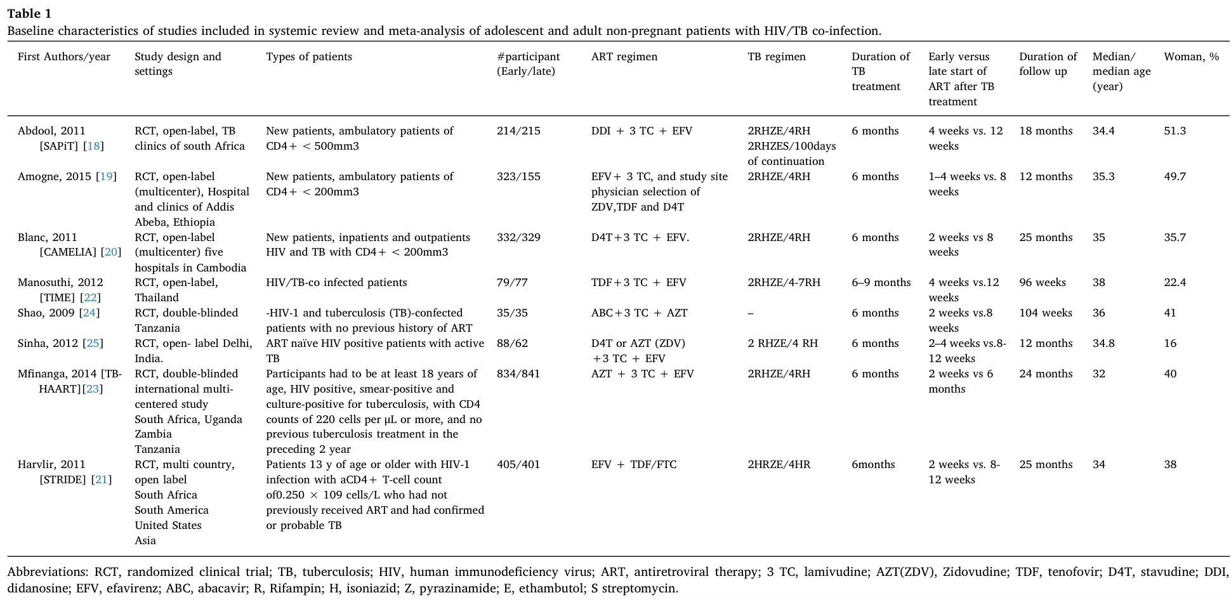
Study Characteristics
Notes:
For the purposes of the meta-analysis workshop, we will be focusing on the four studies boxed in red.

Slide 5
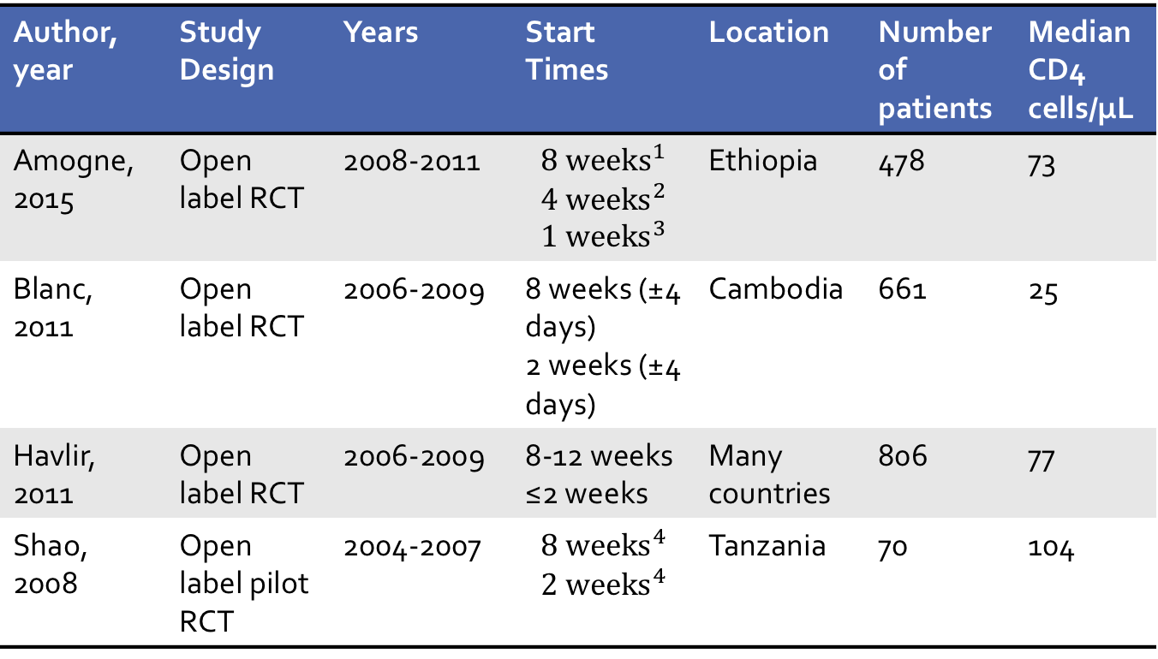
Summary Table
Author, year | Study Design | Years | Start Times | Location | Number of patients | Median CD4 cells/μL
Amogne, 2015 | Open label RCT | 2008-2011 | $${8 weeks}^{1}$$ $${4 weeks}^{2}$$ $${1 weeks}^{3}$$ | Ethiopia | 478 | 73
Blanc, 2011 | Open label RCT | 2006-2009 | 8 weeks (±4 days) 2 weeks (±4 days) | Cambodia | 661 | 25
Havlir, 2011 | Open label RCT | 2006-2009 | 8-12 weeks ≤2 weeks | Many countries | 806 | 77
Shao, 2008 | Open label pilot RCT | 2004-2007 | $${8 weeks}^{4}$$ $${2 weeks}^{4}$$ | Tanzania | 70 | 104
Median (range) days before ART initiation:
56 (48-74)
28 (21-45)
3. 7 (4-48)
4. Not reported

Slide 6
Relative risk is the risk of outcome in intervention (exposed) group compared to risk in control (unexposed)
Intervention | Outcome variable |  | Total
 | outcome + | Outcome -
Exposed | a | b | a+b
Unexposed | c | d | c+d
Total | a+c | b+d | N
Relative risk = [a/(a+b)] /[ c/(c+d)]
Risk of outcome in exposed group ÷
risk of outcome in unexposed group

Slide 7
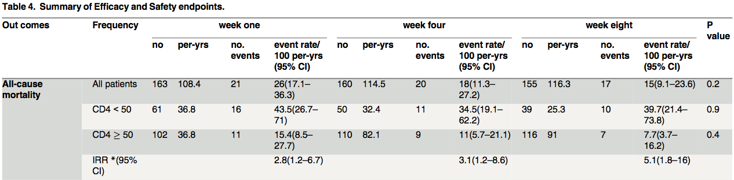
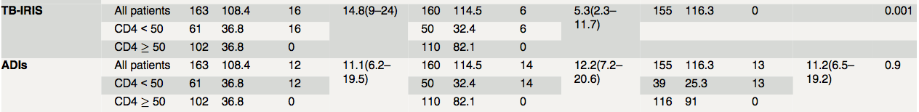
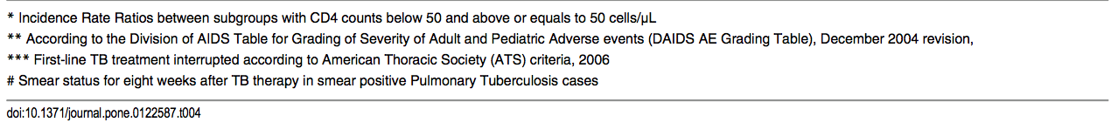
Extracting Data From Primary Study: Amogne, 2015
Early ART
Late ART
Outcomes of Interest
Notes:
Outcomes of interest from this study: All-Cause mortality, TB-IRIS, and ADIs
Early ART: Week one
Late ART: Week eight
Interested in the number of events and the total number
This table can be found in Amogne, 2015 page 10

Slide 8
Amogne, 2015: Relative risk early vs. delayed ART for all-cause mortality
Intervention / exposure | All-cause Morality |  | Total
 | Outcome + (event) | Outcome – (no event)
Early ART | 21 | 142 | 163
Delayed ART | 17 | 138 | 155
Total | 38 | 280 | 318
Relative risk = [21/(163)] /[ 17/(155)] = 1.175

Slide 9
Move to Stata Practice Set

Slide 10
RevMan Tutorial
Files on CLE to support this exercise:
Instructions for how to download Revman.pdf
Meta Analysis in RevMan - Screen Captures.pdf: Step-by-step process for how to perform meta-analysis in RevMan
Excel sheet with extracted data from those four studies for different outcomes and results of meta-analysis
RevMan file pre-populated with data from those four studies and completed meta-analysis
Notes:
Resource: https://volunteer.heart.org/apps/pico/Presentation%20Library/How%20To%20Use%20RevMan%20for%20Meta-Analysis/Meta%20Analysis%20in%20RevMan%20-%20Screen%20Captures.pdf

Slide 11
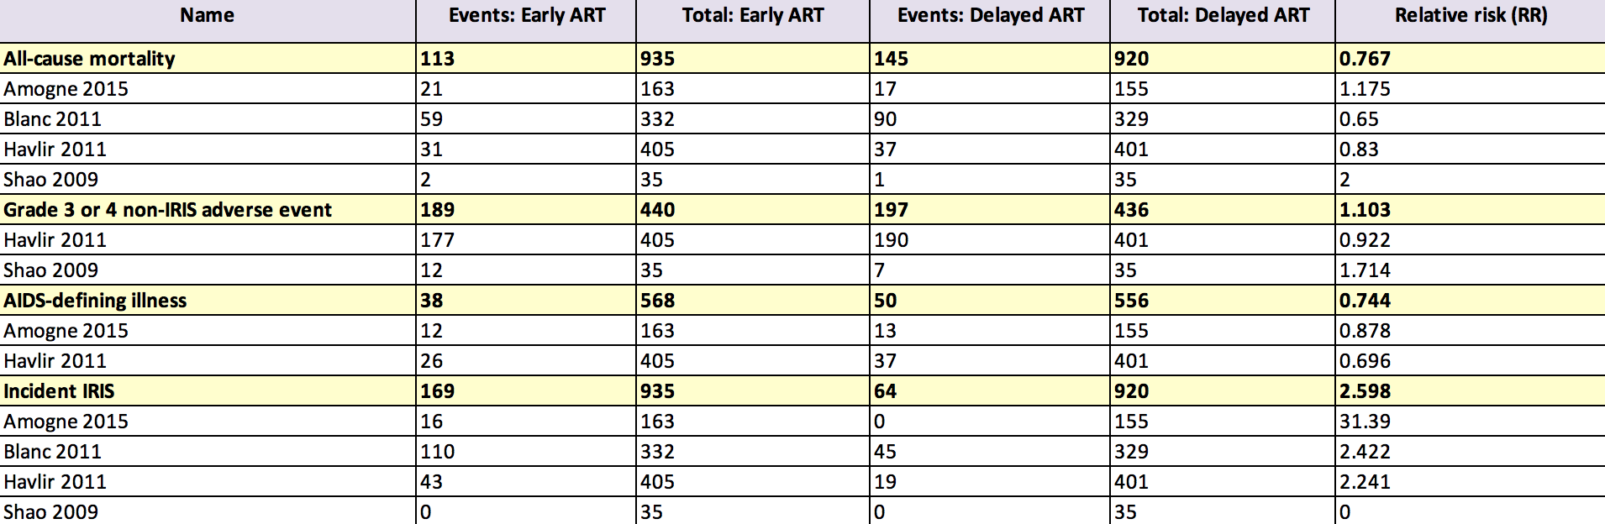
How to Prepare Data for MA
Notes:
Excel sheet available in class dashboard

