Slide 1
Identifying and Selecting Self-Report Measures for Health Disparities Research: Part II
Anita L. Stewart, Ph.D.
University of California, San Francisco
Clinical Research with Diverse Communities
EPI 222, Spring 2014
May 22, 2014

Slide 2
Brief Content of Two Measurement Lectures
Importance of good measures
Measurement terminology
Process of selecting measures
  Defining concepts
  Locating potential measures
  Critiquing measures, selecting best
Pretesting measures
Modifying measures
April 24
(class 4)

Slide 3
Brief Content of Two Measurement Lectures
Importance of good measures
Measurement terminology
Process of selecting measures
  Defining concepts
  Locating potential measures
  Critiquing measures, selecting best
Pretesting measures
Modifying measures
This
week

Slide 4
Brief Content of Two Measurement Lectures
Importance of good measures
Measurement terminology
Process of selecting measures
  Defining concepts
  Locating potential measures
  Critiquing measures, selecting best
Pretesting measures
Modifying measures
This
week

Slide 5
PROCESS of Selecting Measures for Your Studies
Describe your target population
Define concept (variable)
Identify potential measures
Review measures for:
--conceptual and psychometric adequacy
--practical considerations
Pretest best measure
If problematic:
modify and pretest again
Final measure

Slide 6
To Review Measures …
  Obtain copy of questionnaire or instrument
Review items, response choices, time frame
Review what is known about it
  Original and other publications by authors
  Subsequent studies in which it was applied

Slide 7
Conceptual and Psychometric Adequacy
Review measures to determine:
  Concept
    Matches your definition
    Appropriate for target population
  Psychometric properties
    Evidence of reliability, validity
    Evidence of responsiveness to change

Slide 8
Concept is a Match
Concept being measured “matches” the concept you defined
  Sometimes can only be determined by reviewing items
If not a perfect match
  How close is it to your concept?
  Can it be modified to get at missing components?
Notes:
HERE is where your concept definition will help you

Slide 9
Concept is Appropriate/Relevant
Concept is relevant to your population
Concept is culturally appropriate

Slide 10
Approaches to Explore Conceptual Adequacy in a Diverse Group
Literature reviews of concept in diverse groups
In-depth interviews and focus groups
  Discuss concept, obtain their views
Expert review (from diverse group)
  Review concept definitions
  Rate relevance of items

Slide 11
Conceptual Adequacy Example: Focus Groups
Patient satisfaction typically defined in terms of …
  technical care, communication, continuity, coordination, interpersonal style, access
In minority and low income groups, additional relevant domains:
  discrimination by health professionals
  sensitivity to language barriers
MN Fongwa et al., Ethnicity Dis, 2006;16:948-955.

Slide 12
A Quantitative Method to Examine Conceptual Relevance
Compiled 33 typical HRQL items
Administered to older African Americans
After each item, asked “how relevant is this question to the way you think about your health?”
  0-10 scale (0=not at all relevant, 10=extremely relevant)
Cunningham WE et al., Qual Life Res, 1999;8:749-768.

Slide 13
HRQL Relevance Results
Most relevant items:
  Spirituality, weight-related health, hopefulness
Least relevant items:
  Physical functioning, role limitations due to emotional problems

Slide 14
A Qualitative Method to Establish Relevance for Latinos
Bilingual/bicultural expert panel reviewed Spanish “Functional Assessment of Cancer Therapy” for relevance
  One item had low relevance (I worry about dying)
  One domain missing – spirituality
Developed new spirituality scale
D Cella et al. Med Care 1998; 36:1407
Notes:
Functional Assessment of Cancer Treatment - General
CHECK THIS

Slide 15
Review for Psychometric Adequacy of a Measure
Minimal standards met:
  Sufficient variability
  Adequate reliability/reproducibility
  Evidence of construct validity
  Evidence of sensitivity to change
In original population and in samples similar to your target group

Slide 16
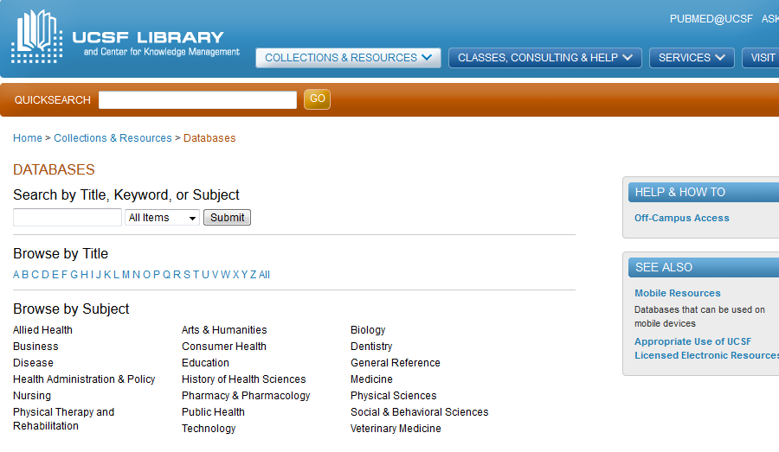
Web of Science – Find Applications of Measures
Search “W”

Slide 17
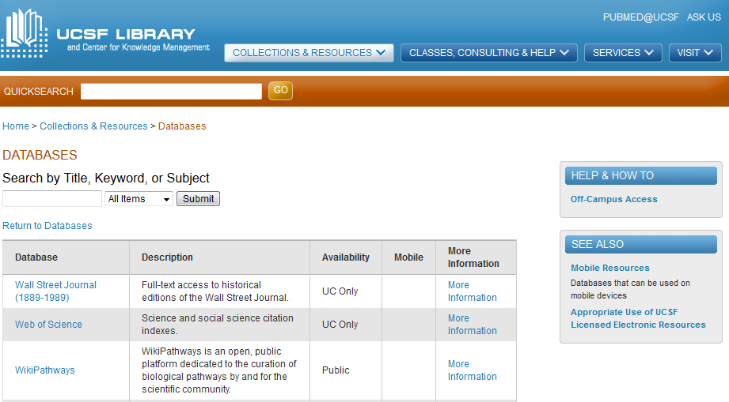
Web of Science – Find Applications of Measures

Slide 18
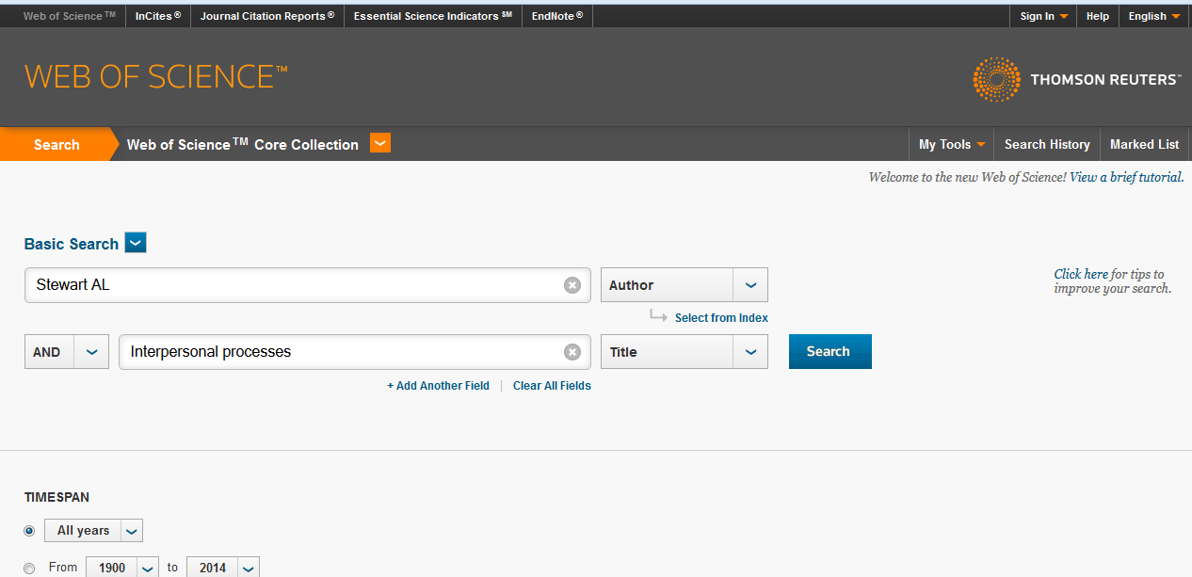
Web of Science – Find Applications of Measures

Slide 19
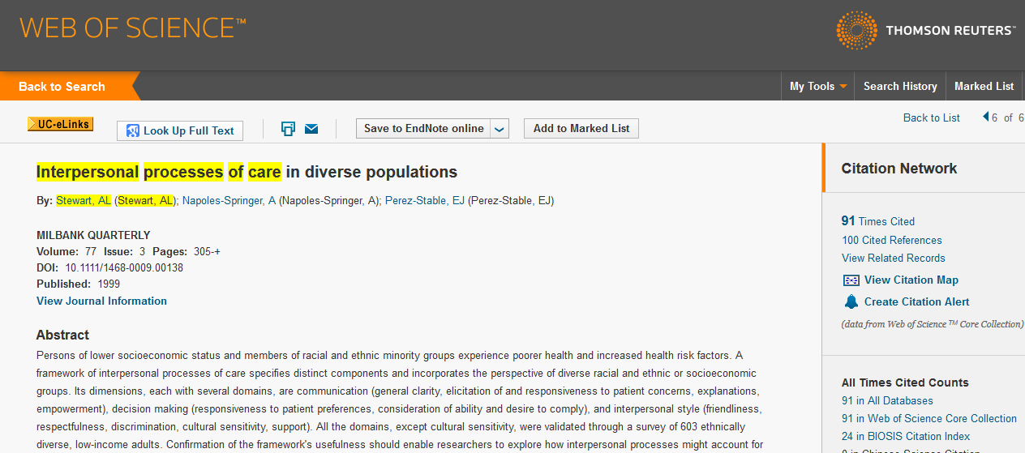
Web of Science – Find Applications of Measures

Slide 20
Review Variability of Potential Measure
All (or nearly all) scale levels are represented
  Distribution approximates normal
Observed range matches “possible” score range
Variability is a function of the sample
  Need to understand variability in sample similar to the one you are studying

Slide 21
Review Potential Measures for Evidence of Reliability
Original publication should report reliability
Subsequent publications
  Reliability in other samples
Any evidence of reliability in sample similar to yours?

Slide 22
Reliability
Extent to which an observed score is free of random error
Population-specific: reliability increases with:
  sample size
  variability in scores (dispersion)

Slide 23
Internal Consistency Reliability: Cronbach’s Alpha
Extent to which multiple items measure same construct (same latent variable)
A function of:
  Number of items
  Average correlation among items
  Variability in your sample

Slide 24
Minimum Standards for Internal Consistency Reliability
For group comparisons (e.g., regressions)
  .70 or above is minimum
  .80 is optimal
JC Nunnally, Psychometric Theory 3rd ed, McGraw-Hill, 1994
Notes:
Nunnally p. 265

Slide 25
Adequacy of Reliability of Spanish SF-36 in Argentinean Sample
SF-36 scale | Coefficient alpha
Physical functioning | .85
Role limitations - physical | .84
Bodily pain | .80
General health perceptions | .69
Vitality | .82
Social functioning | .76
Role limitations - emotional | .75
Mental health | .84
F Augustovski et al, J Clin Epid, 2008;61:1279-84.

Slide 26
Review Potential Measures for Evidence of Validity
Original publication of measure
  Preliminary evidence of validity
Subsequent applications
  Provide added evidence of validity
  Measure performs “as expected”
Focus on validity in samples similar to yours

Slide 27
Validity
Does a measure (or instrument) measure what it is supposed to measure?
And…
Does a measure NOT measure what it is NOT supposed to measure?

Slide 28
Validation of Measures is an Iterative, Lengthy Process
Validity is not a property of the measure per se
  .. but of a measure for particular purpose and sample
  Validation evidence for one purpose and sample may not serve another purpose or sample
Accumulation of evidence
  Different samples

Slide 29
Construct Validity Basics
Does measure relate to other measures in hypothesized ways?
  Do measures “behave as expected”?
3-step process
  State hypothesis: direction and magnitude
  Calculate correlations
  Do results confirm hypothesis?

Slide 30
Convergent Validity
Hypotheses stated as expected direction and magnitude of correlations
“We expect X measure of depression to be positively and moderately correlated with two measures of psychosocial problems”
  The higher the depression, the higher the level of problems on both measures

Slide 31
Testing Validity of Expectations Regarding Aging (ERA) Measure
Hypothesis 1:
  ERA-38 total score would correlate moderately with ADLS, PCS, MCS, depression, comorbidity, and age
Hypothesis 2:
  Functional independence scale would show strongest associations with ADLs, PCS, and comorbidity
Sarkisian CA et al. Gerontologist. 2002;42:534

Slide 32
Testing Validity of Expectations Regarding Aging (ERA) Measure
Hypothesis 1: Convervent validity
  ERA-38 total score would correlate moderately with ADLS, PCS, MCS, depression, comorbidity, and age
Hypothesis 2:
  Functional independence scale would show strongest associations with ADLs, PCS, and comorbidity
Sarkisian CA et al. Gerontologist. 2002;42:534

Slide 33
ERA-38 Convergent Validity Results: Hypothesis 1
 | ERA-38 | ERA Functional Independence
ADL | .19** | .20***
PCS-12 | .27** | .32***
MCS-12 | .35** | .30**
Comorbidity | - .09* | ns
Depressive symptoms | - .33** | - .28**
Age | - .24** | - .14**

Slide 34
ERA-38: Non-Supporting Convergent Validity Results
 | ERA-38 | ERA Functional Independence
ADL | .19** | .20***
PCS-12 | .27** | .32***
MCS-12 | .35** | .30**
Comorbidity | - .09* | ns
Depressive symptoms | - .33** | - .28**
Age | - .24** | - .14**

Slide 35
Discriminant Validity: Known Groups
A type of construct validity
Does the measure distinguish between groups known to differ in concept being measured?
Tests for mean differences between groups

Slide 36
PedsQL Known Groups Validity
Hypothesis: PedsQL scores would be lower in children with a chronic health condition than without
Child report: | Total score | Emotional functioning
Chron ill* | 77 (16) | 76 (22)
Healthy | 83 (15) | 81 (20)
* Different from healthy children, p < .05
JW Varni et al. PedsQL™ 4.0: Reliability and Validity of the Pediatric Quality of
Life Inventory™ …, Med Care, 2001;39:800-812.

Slide 37
Sensitivity to Change: Two Issues
Measure able to detect true changes
One knows how much change is meaningful on the measure

Slide 38
Measure Able to Detect True Change
Sensitive to true differences/changes in the attribute being measured
Sensitive enough to measure differences in outcomes that might be expected given the relative effectiveness of treatments

Slide 39
Importance of Sensitivity
Need to know measure can detect true change if planning to use it as outcome of intervention
Approaches for testing sensitivity are often simultaneous tests of
  effectiveness of an intervention
  sensitivity of measures

Slide 40
Measuring Sensitivity
Score is stable in those who are not changing
Score changes in those who are actually changing (true change)
One method
  Identify groups “known” to change
  Compare changes in measure across these groups

Slide 41
Sensitivity to Change Evidence for PHQ-9
Classified patients with major depression (DSM-IV criteria) over time as:
  Persistent depression
  Partial remission
  Full remission
Examined PHQ-9 change scores in these “known groups”
Löwe B et al. Med Care, 2004;42:1194-1201

Slide 42
Changes in PHQ-9 by Change in Depression at 6 Months
 | Mean change | Effect size
Persistent depression | -4.4 | -0.9
Partial remission | -8.8 | -1.8
Full remission | -13.0 | -2.6
Löwe et al, 2004, p. 1200

Slide 43
Review for Practical Considerations
Cost to use
Cost for scoring
Appropriateness
  Reading level
  Respondent burden
Permission to use or modify (if needed)

Slide 44
Obtaining Permission
Public domain measures
  Usually don’t need permission
Private or proprietary measures
Permission statements often found at source of measure
If not
  Need to write to author or distributor
  Allow 4-6 weeks to obtain permission

Slide 45
Cost to Use or Score Measures?
Determine early in process
Cost of administering
  Fee for each “instrument” or subject?
Cost of scoring
  Cost of scoring software?
  Cost of having it scored by source?

Slide 46
Scoring Instructions Available (Regardless of Cost)?
Are scoring instructions clearly documented?
  Is there a scoring codebook?
  Is there a computer scoring program available?

Slide 47
Reading Level
Is reading level appropriate for your target population?
  Special concern - lower SES, limited English proficiency
If reading level not known
  Make your own judgment
  Pretest with target population

Slide 48
Respondent Burden
Real burden
  Length, convenience, time to complete
Perceived burden
  Function of item difficulty, distress due to content, perceived value of survey, expected length
Some population subgroups have more difficulty, take longer to complete

Slide 49
PROCESS of Selecting Measures for Your Studies
Describe your target population
Define concept (variable)
Identify potential measures
Review measures for:
--conceptual and psychometric adequacy
--practical considerations
Pretest best measure
If problematic:
modify and pretest again
Final measure

Slide 50
Pretest Potential Measures in Your Target Population
Select best measures for all concepts in your conceptual framework
  existing instrument in its entirety
  subscales of relevant domains (e.g., only those that meet your needs)

Slide 51
Pretest in Target Population
Pretesting essential for new population group
  Especially priority measures (e.g., outcomes)
Pretest is to identify problems with:
  Procedures - method of administration, respondent burden
  Questions - item stems, response choices, and instructions
Notes:
Even if all measures have good track record, pretest

Slide 52
Types of Problems
Words/phrases not understood as intended
Some questions not answered
Some questions offensive or irrelevant
Response choices not adequate
Instructions unclear

Slide 53
In-Depth Cognitive Pretest Interviews
Explore processes respondents use to answer survey questions
Goal: understand thought processes used to answer questions
Can help write/adapt questions

Slide 54
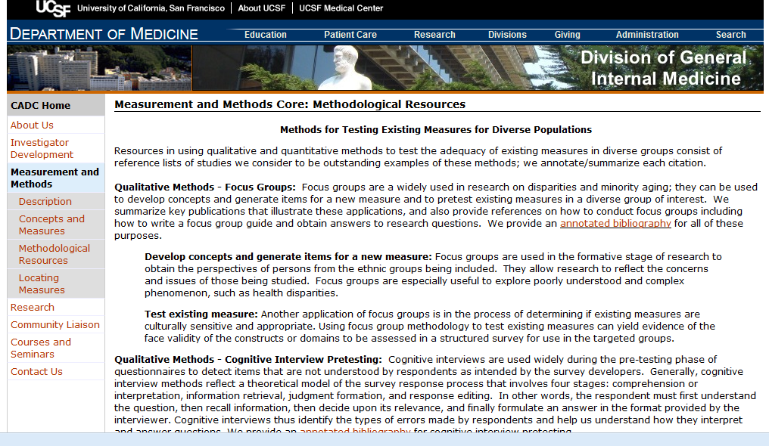
CADC Measurement/Methods Core: Resources for Pretesting Measures
http://dgim.ucsf.edu/cadc/mm/testingmethods.html

Slide 55
PROCESS of Selecting Measures for Your Studies
Describe your target population
Define concept (variable)
Identify potential measures
Review measures for:
--conceptual and psychometric adequacy
--practical considerations
Pretest best measure
If problematic:
modify and pretest again
Final measure

Slide 56
What if Measure Needs Modifying or Adapting?
If pretest indicates measure is not adequate
  May need to modify measure
What information is used to modify?
What are the types of modifications?
How should we test modified measures?

Slide 57
When Problems Found Through Pretesting… A Choice
Use existing measure “as is”
to preserve integrity of measure
OR
Modify the measure
to address problems in diverse group
Notes:
Dilemma once problems are found..

Slide 58
Argument in Favor of Using Measure “As Is”
Known psychometric properties
Allows comparison of findings to other research using the measure

Slide 59
Argument Against Using Measure
“As Is” …. (if problems are found)
Reliability and validity may be poor
Results pertaining to the measure could be erroneous
  Limited internal validity
  May not observe true associations
Notes:
Erroneous conclusions about the research questions of interest
Ability to compare to other research (external validity) is moot

Slide 60
Why Would You Consider Modifying an Existing Measure?
In health disparities research
  Sample/population differs from that in which original measure developed
    Anticipate problems in new population
More generally
  Measure developed awhile ago
  Poor format/presentation
  Study context issues
Notes:
Four basic reasons for…
Several other reasons having nothing to do with sample differences…..(GO ON)

Slide 61
Key Reason: Population Group Differences from Original
Research in a “disparity population”
  Different culture, race/ethnic group
  Lower level of socioeconomic status (SES)
  Limited English proficiency, lower literacy
Other reasons
  Different disease, health problem, patient group, age group
Notes:
In mainstream research – the bulk of the literature – modifications tend to be because of differences in the disease or health problem, or patient group differences such as age. e.g. fatigue severity measure modified for MS patients

Slide 62
Why Might a Measure Not be Suitable for New Population Group?
Concept or dimension is missing
Meaning of concepts differ from mainstream
New group may not interpret items as intended
Process of answering questions may differ
Notes:
Social support in Korean and Chinese immigrants
Missing language and financial support
Meaning may differ – Modify dietary intake questionnaires so that ethnic foods are includedj

Slide 63
What Information is Used to Decide How to Modify a Measure?
Same data identifying conceptual differences in diverse population…
  often includes information for making revisions
Notes:
To modify a measure, we need information on which to base the modifications.

Slide 64
Types of Modifications
Format or presentation
Content
  Dimensions
  Item stems
  Response options
Notes:
Most modifications can be classified into CONTENT or FORMAT
Three main types of content modifications:

Slide 65
Format/Presentation Modifications
Goal: reduce respondent burden
Improve appearance or way of responding
  Simplify instructions
  Modify format for responding
  Create more space, reduce crowded items
  Improve contrast, increase font size

Slide 66
Poor Format/Presentation = High Respondent Burden
Instructions unnecessarily wordy, unclear
Way of responding is complicated
Difficult to navigate the questionnaire
  Crowded on the page
  Hard to track across the page
Hard to read
  Poor contrast, small font
Notes:
Following to some extent on the prior era
Many measures not designed according to good survey design principles
Poorly formatted and presented on the page.

Slide 67
Example: Complex Instructions
Instructions: There are 12 statements on this form. They are statements about families. You are to decide which of these statements are true of your family and which are false. If you think the statement is TRUE or MOSTLY TRUE of your family, please mark the box in the T (TRUE) column. If you think the statement is FALSE or MOSTLY FALSE of your family, please mark the box in the F (FALSE) column.
You may feel that some of the statements are true for some family members and false for others. Mark the box in the T column if the statement is TRUE for most members. Mark the box in the F column if the statement is FALSE for most members. If the members are evenly divide, decide what is the stronger overall impression and answer accordingly.
Remember, we would like to know what your family seems like to you. So do not try to figure out how other members see your family, but do give us your general impression of your family for each statement. Do not skip any item. Please begin with the first item.
Notes:
I thought this was a perfect example of how one might need to consider simplifying the instructions. And there are many existing measures with similar problems – if not quite so extreme.
Family Environment Scale Instructions

Slide 68
Example: Burdensome Way of Responding
For each question, choose from the following
alternatives:
  0 = Never
  1 = Almost Never
  2 = Sometimes
  3 = Fairly Often
  4 = Very Often
1. In the last month, how often have you felt nervous and “stressed”? | 0 | 1 | 2 | 3 | 4
2. In the last month, how often have you felt that things were going your way? | 0 | 1 | 2 | 3 | 4
S Cohen et al. J Health Soc Beh, 1983;24:385-96.
Notes:
Many instruments in order to save paper I guess present the response choices along with the instructions, and then ask respondents to use those to answer. In this example, at least the same numbers appear beside the items, but the respondent has to remember the meaning of each number or refer back and forth. As one gets to the bottom of the page of 22 items, this is cumbersome.
I’ve also seen instruments where a blank space is provided alongside each item and respondents are supposed to write in the correct response number.

Slide 69
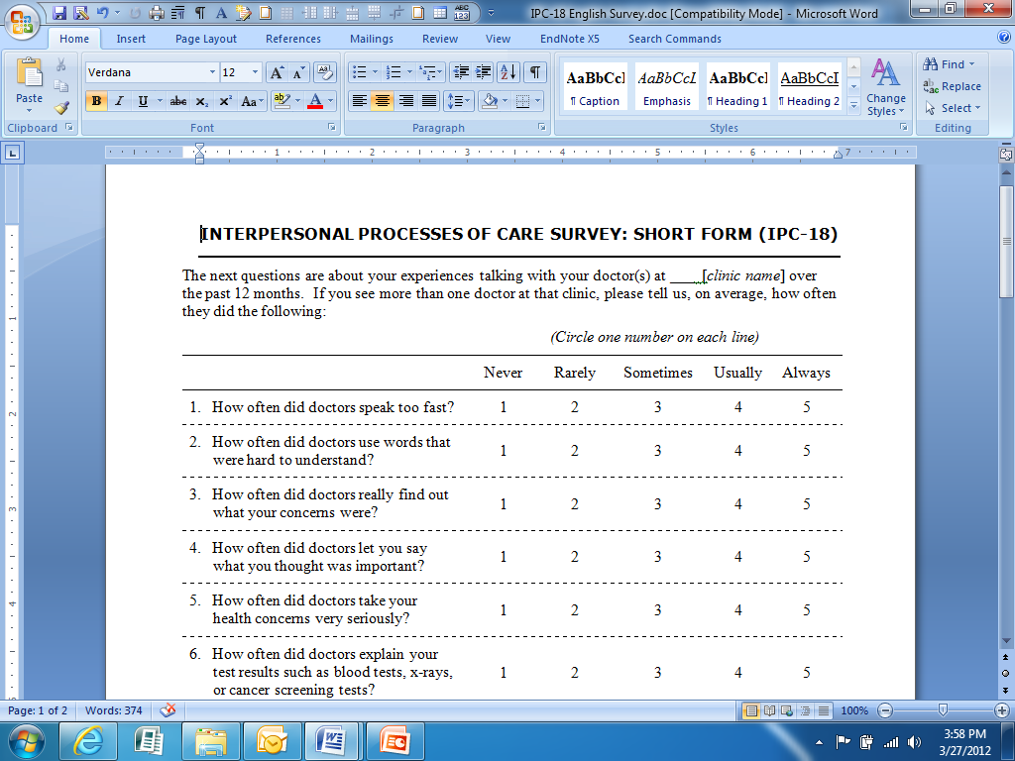
Example: Modify to Matrix Format

Slide 70
Types of Modifications
Format or presentation
Content
  Dimensions
  Item stems
  Response options
Add
Drop
Replace
Modify

Slide 71
Content Modification Example: Add Dimension
Added language support based on focus groups of older Korean/Chinese immigrants
  Help with translation at medical appointments
  Help to ask questions in English when on the phone
  Help to learn English
S Wong et al. Int J Health Human Dev, 2005;61:105-121.
Notes:
Example by some RCMAR scholars –

Slide 72
Content Modification Example: Add Dimension (cont)
New items were embedded in existing social support measure using same format
Notes:
Example by some RCMAR scholars –

Slide 73
Content Modification Example:
Too Few Response Choices and Mismatch of Choices with Question
How much is each person (or group of persons) supportive for you at this time in your life?
  Your wife, husband, or significant other person:
     - None
     - Some
     - A lot
G Parkerson et al. Fam Med; 1991;23:357-60.
Notes:
Often, for simplicity, measures were designed with only a few response choices. However, given the tendency of many to not endorse either extreme, this provides extremely limited variability. Although not done to my knowledge, this could benefit from the addition of 1-2 more levels.

Slide 74
Content Modification Example:
Replace Response Choices
How much is each person (or group of persons) supportive for you at this time in your life?
  Your wife, husband, or significant other person:
     - Not at all
     - A little
     - Moderately
     - Quite a bit
     - Extremely
Notes:
Often, for simplicity, measures were designed with only a few response choices. However, given the tendency of many to not endorse either extreme, this provides extremely limited variability. Although not done to my knowledge, this could benefit from the addition of 1-2 more levels.

Slide 75
Minor to Major Modifications?
Each type of modification can hypothetically be rated on a continuum from having minor to major impact on reliability and validity of original measure
  Minor – slight changes in format/presentation
  ……
  Major – numerous changes in dimensions, items, and response choices
Notes:
Defining the middle of the continuum is harder than one would think.

Slide 76
Need to Test Psychometric Properties of Modified Measures
All modifications, no matter how small, can affect reliability and validity of original measure
Burden is on investigator to test modified measure
Notes:
But what about several very minor modifications?
What we all agree on is that any modifications CAN affect the reliability and validity of the original measure.
We therefore suggest that at this stage in modifications research, investigators need to test the modified measures

Slide 77
Recommendations for Testing Modified Measures
Pretest modified measure extensively before fielding in new study
Build in ability to do psychometric testing when measure is fielded
  Add validity variables (e.g., similar to original measure to test comparability)
  Add follow-up to assess test-retest reliability
Notes:
Two key recommendations here
1 – PRETEST
2 – build in ability to conduct the needed analyses to justify the modifications

Slide 78
Analyze Psychometric Adequacy of Modified Measure in New Study
Modified measure should meet minimal criteria
  Internal-consistency reliability
  Validity evidence

Slide 79
Analyzing Modified Measure: Comparability to Original Measure
Compare measurement results of modified measure to original measure
  Reliability (sample dependent)
  Factor structure
  Construct validity
  Sensitivity to change
Notes:
Rather than prove that the modified measure is BETTER than original, is it COMPARABLE.
Does factor structure conform to that of the original measure?
Does the measure correlate similarly with validity variables as original measure does?
Does the modified measure detect as much change over time as the original?

Slide 80
Analyze Psychometric Adequacy of ALL Measures Administered in New Study
Test internal consistency reliability and item-scale correlations

Slide 81
Analyze Psychometric Adequacy of ALL Measures in New Study
Test internal consistency reliability and item-scale correlations
Each item should correlate substantially with the total score of all items with the item taken out (corrected for overlap)
  Typical criterion is > .30

Slide 82
Can Examine Item Convergence Using Any Statistical Software
Programs to calculate internal consistency reliability
  Provide estimated coefficient alpha
  Produce item-scale correlations corrected for overlap
  Estimate change in alpha with each item removed
SAS, SPSS, STATA

Slide 83
Interpreting Item-Scale Correlations
If any item correlates <.30 with the sum of the other items..
  May not be contributing to the scale
How to judge:
  How much lower than .30?
  How many items?
  Does omitting item increase reliability substantially?

Slide 84
SAS: Item-Scale Correlations
PROC CORR
  DATA=data-set-name
  ALPHA
  VAR (list of variables)
Output:
  Coefficient alpha
  Item correlations
  Item-scale correlations corrected for overlap
SAS Manual, Chapter 3: Assessing Scale
Reliability with Coefficient Alpha

Slide 85
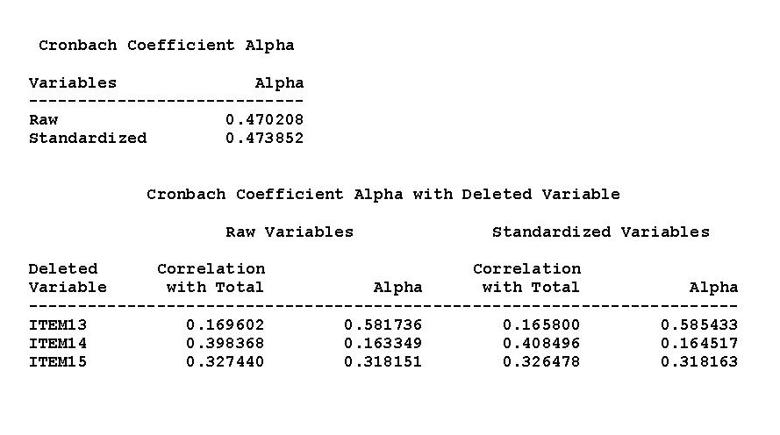
SAS Output Example: Alpha

Slide 86
SAS Output Example: Item-Scale Correlations

Slide 87
Testing Reliability in STATA
www.stata.com/help.egi?alpha
Alpha varlist [if] [in] [, options]
NOTE: item-rest correlations are those corrected for overlap

Slide 88
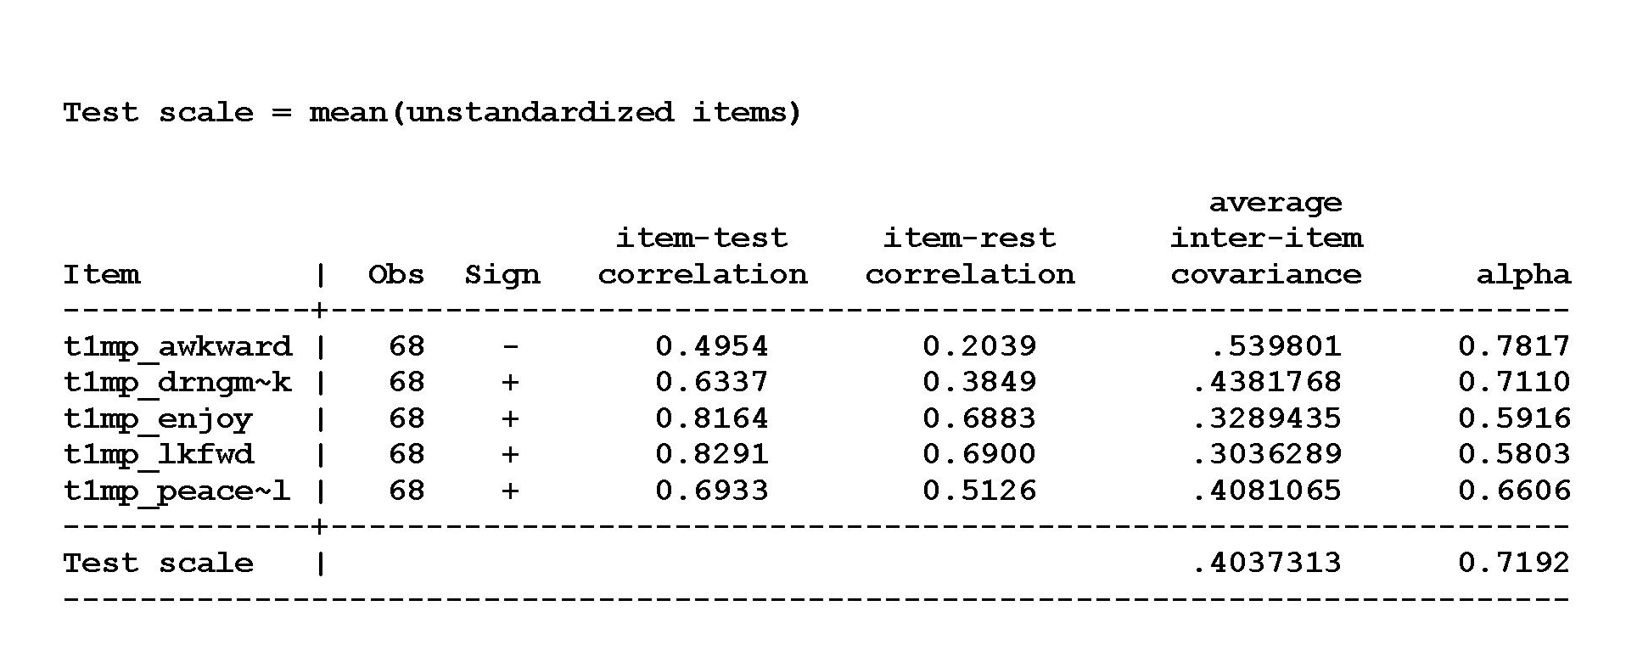
STATA Output Example: Alpha

Slide 89
STATA Output Example: Item-Scale Correlations

Slide 90
What if Reliability is Too Low?
How much lower than .70?
Does removing an item with low item-scale correlation increase alpha?
For standard scales (published)
  Report problems as caveats in your analyses
  Create a modified scale
  Report results using standard and modified scale

Slide 91
PROCESS of Selecting Measures for Your Studies
Describe your target population
Define concept (variable)
Identify potential measures
Review measures for:
--conceptual and psychometric adequacy
--practical considerations
Pretest best measure
If problematic:
modify and pretest again
Final measure

Slide 92
Overall Conclusions
Measurement in health disparities research is relatively new field
We encourage reporting on adequacy and equivalence of measures tested in any diverse population
As evidence grows, easier to find measures that work better across diverse groups

Slide 93
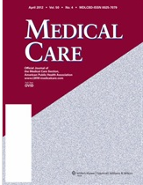
Resource: Special Journal Issue
Measurement in a Multi-ethnic Society
  Med Care, Vol 44, November 2006
  Qualitative and quantitative methods in addressing measurement in diverse populations
Notes:
The volume contains reviews of measures that have been used
cross-culturally in the areas of: acculturation, socio-economic status, social supports, cognition, health
and functional capacity, depression, health locus of control, health-related quality of life, and religiosity.

Slide 94
Homework for Class 8
Complete rows 14-28 in template
  Use form posted on the website
Include your name in the filename, e.g.,
  Smith_HW_epi222_class5
Email by Tuesday May 27 to anita.stewart@ucsf.edu

