Slide 1
The Big 6: Descriptive versus Analytic Goals
Goal of research may be “descriptive” or “analytic”
Description
  How frequent/common are risk factors/exposures/conditions/diseases? How often does Y occur?
Causation
  The science of establishing causal relationships among biological, behavioral, environmental (etc.) factors among humans
  Does X cause Y?
Attribution
  What fraction of disease Y can be eliminated if a causal exposure X is eliminated?
Mediation
  Understanding the mechanisms of causation
  How does X cause Y?
Interaction
  When and for whom does X cause Y?
Prediction
  Do A, B, and C predict occurrence of Y? (e.g., diagnosis or prognosis)
Descriptive
Analytic
Everything in this course relates to designing studies that will accomplish a descriptive or analytic goal.
Notes:
Here is the framework we set forth in the Course Introductory Video and in the first lecture (Study Design) about the kinds of questions (or objectives or purposes) that epidemiology and clinical research can answer. We call these the “Big 6”. These Big 6 can be broken into descriptive and analytic objectives. In the next two lectures, we will be discussing measures of disease occurrence, which fall under the objective of “description”. In descriptive research, our goal is to estimate the frequency or magnitude of some entity, be it an exposure, trait, disease, or some other health state. Examples include the prevalence of obesity in a population, the prevalence of smoking, the incidence of COVID-19, and the incidence of death after a diagnosis of lung cancer. We estimate these entities with what are called “measures of occurrence” or “measures of disease occurrence”.

Slide 2
Disease Occurrence I
Incidence versus prevalence
The 3 elements of measures of incidence
Cumulative incidence vs. person-time incidence
Concept of censoring
Methods (“estimators”) for calculating cumulative incidence
  Simple proportion
  Kaplan-Meier
  Life-table
  [next week] Aalen-Johansen
Underlying assumptions/warnings: losses unrelated to outcome; no (or independent) competing events; & beware of secular trends
Notes:
This is the outline for this week’s cycle.
Description is about estimating the frequency of the occurence of some entity, often a disease state, but it can refer to any exposure, state, outcome or event. In the realm of description, we will first define and contrast two fundamental aspects, incidence versus prevalence.
After a short description of prevalence, we will spend most of our time in this session on incidence, in which we will describe two fundamental expressions for incidence called cumulative incidence and person-time incidence. We will also emphasize the 3 main elements required in measuring disease incidence. Understanding those 3 elements and focusing on how they are used (or not used) can eliminate confusion about the frequently erratic use of terminology for incidence in the clinical research/epidemiologic literature. We will spend much time explaining the concept of censoring and why this presents complications for us when measuring incidence.
The bulk of this week will be spent on methods for calculating cumulative incidence, with a focus on the first three methods listed and particularly on the Kaplan-Meier technique. Formally, we call this calculating “estimation” and specific techniques are called “estimators”. Then, next week, we will discuss the Aalen-Johansen estimator, to finish the discussion of cumulative incidence, as well as a deep dive into incidence rates. Along the way we will discuss the various assumptions and warnings that are required when using these estimators to allow them to yield meaningful and interpretable answers.

Slide 3
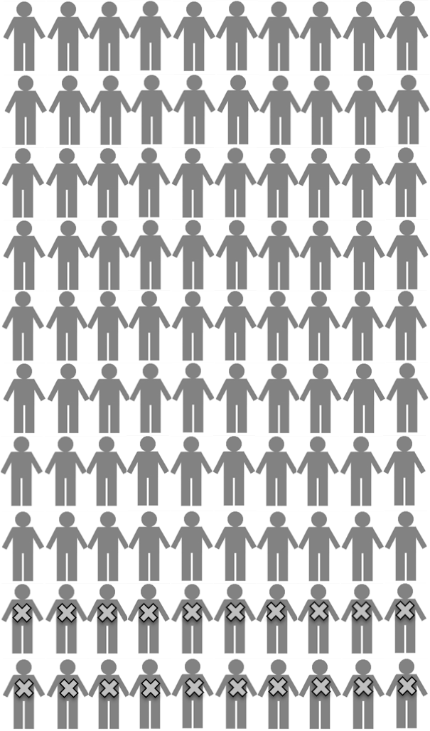
How do our study designs sample their underlying cohorts (fixed)?
= event = loss to follow-up CE = competing event
CE
CE
Cohort study
“Forward in time”
Cross-sectional Study
Observation Time
= Case-control study
“Strategically” (which limits description)
“One point in time”
Notes:
As we begin to discuss measures of disease occurrence, it is helpful to review how our common study designs sample their underlying cohorts and, consequently, how they are able to describe them (i.e., answer descriptive questions). This is a graphic that summarizes the individual-level study designs that we covered in last week’s lecture that can be performed in the context of an underlying fixed cohort. For studies with individuals as the unit of observation, we discussed 3 sampling approaches for between-subject studies: cohort, cross-sectional and case-control.
A “cohort” study design follows and describes the entire cohort or a sample of as it moves forward in time. It is the most natural and unadulterated approach. Think of it as the “forward looking” or “forward in time” approach. In the realm of description, cohort studies are unique in their ability to describe disease incidence, but they can also be used to describe prevalence.
Cross-sectional study design takes and describes a “snapshot” of the underlying cohort at a single timepoint; it is less work to perform and is more strategic than the forward-in-time cohort approach, but it also has (as we mentioned last week) more potential problems when it comes to analytic objectives. In the realm of description, cross-sectional studies are limited to describing prevalence.
Case-control designs first identify incident cases (or sometimes prevalent if need be) and then sample the underlying cohort that gave rise to the cases (the study base). This design is extremely strategic, efficient, and sophisticated. It turns out that it is so strategic that it typically is not thought of providing much in the way of pure description. Instead, the major strength of case-control studies is in their ability to address analytic objectives (i.e., relating exposure to outcome). Yet, case-control studies can provide some descriptive information. For example, case-control studies can describe prevalence of some entity in the case population. In case-cohort sampling, the random sub-cohort can measure prevalence of various entities at time 0 of a cohort, just like a cross-sectional study can. In incidence density sampling, some form of prevalence in the entire underlying cohort could, in theory, be estimated with the available participants, but its interpretation is not straightforward.

Slide 4
Sampling a Dynamic Cohort
New Members
= event
CE
= leave
CE
CE =
competing
event
Cross-sectional study
Cohort study
= Case-control study
“Strategically” (which limits description)
Time (calendar)
Notes:
As with a fixed cohort, there are 3 main ways to sample a dynamic cohort. As for underlying fixed cohorts, the sampling of underlying dynamic cohorts produces cohort studies, which can estimate prevalence and incidence, cross-sectional studies, which measure prevalence, and case-control studies, which can measure prevalence in cases (as well as in the reference group). It is important to be conscious of which type of underlying cohort (fixed vs dynamic) you are sampling and which type of study design (cohort, cross-sectional, case-control) is being utilized.
For both fixed and dynamic cohorts, because the 3 different study designs sample their underlying cohorts in different ways, the nature of the study design dictates the kind of descriptive measures the design can yield.

Slide 5
Measuring Disease Occurrence
Occurrence of disease is a fundamental measurement in epidemiology
Occurrence of disease is often a binary (yes/no; present/absent) outcome
  Note: Continuous changes in an entity, e.g., changes in blood pressure, are also relevant but are not the main focus of this course
Occurrence of disease must consider time
Note: we will talk in terms of “disease”, but concepts refer to any event/condition (be it favorable or unfavorable)
Notes:
Given that epidemiology is all about studying health and disease, it follows that description of the occurrence of disease is a fundamental measurement, or objective, of epidemiology. In this course, we are going to focus on disease in a binary respect, meaning yes or no, present or absent. This is not the only way to characterize health states in that it can sometimes be characterized in multi-state categories (e.g., no diabetes, pre-diabetes, diabetes), or as a continuous (interval-scale) variable (e.g., blood pressure). We will focus on binary states to keep things tractable. Also, note that we will use the term “disease” in our examples, but the concepts we describe can apply to any binary event or condition, be it favorable (e.g., stopping smoking) or unfavorable.
As we introduce measures of disease occurrence, we preface our comments by emphasizing that it will be important to keep track of the element of time. Even the finest distinction in measures of disease occurrence (e.g., difference between period prevalence and point prevalence) are all about time. Just like time was important in characterizing study designs (e.g., cohort studies follow people over time), it is also important in distinguishing measures of occurrence. This explains why measures of occurrence are so tightly linked to study design.

Slide 6
Prevalence versus Incidence
Prevalence counts existing diseases/conditions, usually at a single point in time
Incidence counts new (‘incident’) disease diagnoses/occurrences occurring over time
Fundamental distinction in epidemiology
Notes:
At the most basic level, disease occurrence can be split into prevalence and incidence, and the difference between incidence and prevalence is a fundamental distinction in epidemiology. Prevalence counts existing disease/conditions/states, typically at a single point in time. Incidence counts new occurrence/new entities/new diseases over time. We also call new occurrences “incident” occurrences.
In some instances, prevalence may look numerically similar to incidence and in others the two measures will be very different. They are, however, very different concepts.

Slide 7
Utility: Prevalence
Prevalence
  For public health
    burden of disease in a population & public health planning
  For science
    prioritization for research
Examples
  Prevalence of smoking among men in China in 2010 is 54%.
  Prevalence of diabetes in US adults (≥ 18 yrs) in 2015 is 12%.
  Prevalence among EPI 203 students, as of the course’s first day, of having watched the course introductory video is 73%.
Notes:
Why are both prevalence and incidence important?
The essence of prevalence is measuring current status of some entity in a population. Prevalence answers to what extent is a population affected/burdened by some trait, condition, factor or disease, regardless of when it started. Prevalence is important from the public health perspective of determining the burden of a disease or condition in a population. It could be a narrow population (e.g., prevalence of injury on a high school cross country team) or a general community population. For example, what are the most common chronic health conditions in the community? In the latter, prevalence tells the public health and medical systems what they need to prepare for and serve. For science, prevalence helps to prioritize what we should be studying in research. (Prevalence is not, however, the only factor for prioritization. The morbidity and mortality associated with different disease conditions also factor into prioritization.)
As the examples show, prevalence can pertain to causal determinants of disease (e.g., smoking), disease itself (e.g., lung cancer), or of any condition of interest be it favorable or unfavorable (e.g., having watched the EPI 203 course introduction video amongst students as of the first day of the course).

Slide 8
Utility: Incidence
Incidence
  For public health
    trends over time -> implications for disease control
  For science
    prioritization for research
    fundamental for studies of causality/etiology
      Exclude prevalent cases to focus on causes of disease, rather than causes of “survival with disease”
Examples
  Ten-year risk of stroke in 65-year-old women is 5.0%
  One-year mortality after lung cancer diagnosis is 48%
  Lifetime risk of a hip fracture is 17% for 50-year-old women
Notes:
The essence of incidence is the pace of new instances of some discrete entity over time in a population. To what extent is the population affected by new occurrences of some trait, disease, condition? How often are people transitioning from not having the trait, disease, condition to having it? This is irrespective of how long the entity lasts.
Incidence is important to public health in determining trends over time in controlling a disease, i.e., telling us how well our disease control efforts are doing. For example, changes in the incidence of heart attack tell us a lot about how public health and clinical campaigns are doing to curb its causal determinants (blood pressure, cholesterol levels, smoking, and exercise). Or, changes in the incidence of death after a cancer diagnosis tell us how the medical system is doing with cancer treatment. Like prevalence, the study of incidence also plays a role in prioritization in research in that the diseases that are more common and have a higher incidence of subsequent significant morbidity and mortality deserve highest prioritization.
The unique aspect of incidence, however, is its fundamental role for studies of causality/etiology. Causality/etiology means the study of what “causes” various diseases. We study causality because knowing the causes of diseases is the gateway to figuring out interventions to prevent diseases from occurring. To understand disease etiology, it is necessary to distinguish between causes of the disease and causes of extending disease survival. Studying only incident cases of a disease achieves this distinction by removing any differences in survival time or duration of the disease. Studying prevalent cases of disease introduces differences in survival time which could be caused by the same factors being investigated as causes of disease per se. In other words, any study evaluating factors associated with prevalence of disease will have difficulty disentangling whether a factor is associated with the onset of the disease itself or with survival after disease onset. Studying causality, of course, is an analytic objective, and it is best done with incident events.

Slide 9
Two Types of Prevalence
Point prevalence - number of persons with a specific disease/condition at one point in time divided by total number of persons in the study population
Period prevalence - number of persons with disease/condition in a prior time interval (e.g., one year) divided by number of persons in the study population
  Prevalence at beginning of interval + any incident cases
Note: Prevalence is not just for disease (outcomes).
  Exposure prevalence (sometimes called “risk factor” prevalence) is also important
    e.g., smoking prevalence
Notes:
Let us now dive deeply into the measures. There are two types of prevalence: point prevalence and period prevalence. Point prevalence is defined as the number of persons with a particular disease or condition at one point in time divided by the total number of persons of interest in the study population. It is a straightforward percentage, and it is the most common way that prevalence is used. Period prevalence is the number of persons with who have experienced or are experiencing the disease/condition at any time during some prior period of time, which includes up to the moment of inquiry. It is less commonly reported than point prevalence, it is inconsistently defined, and the time interval involved is not standardized. A way to think about period prevalence is as the point prevalence at some point in time in a group of people plus whatever instances of the condition that have occurred and resolved in some prior interval. In short, it takes a group of persons and asks what fraction of them have had the condition at any point in time in some prior time interval. The concept, however, is sometimes applied to a group of people looking forward, by counting all instances at the beginning of an interval plus all instances in the following time interval. This forward-looking approach only is valid if no one leaves the population. If people do leave, then a simple fraction is no longer valid, but, nonetheless, sometimes authors will report period prevalence in this way. Again, it is essential to examine exactly what authors have done rather than assume you know just because they use a particular term.
The distinction between point and period prevalence is often not made, but most prevalence estimates that you will encounter in the literature are point prevalences. Period prevalence has its uses, however. It is especially useful for short-lived conditions (e.g., common cold) for which point prevalence might be deceiving regarding overall burden (i.e., point prevalence would underestimate burden).
The concept of prevalence is not unique to disease. The prevalence of a risk factor (or “exposure”, as we will generically refer to this throughout the course) is also important from a public health perspective. For example, an exposure may have a modest causal relationship with a disease outcome (say, a risk ratio less than 2), but it may be very common in a population. In that instance, even a small risk ratio may have great public health importance because a large proportion of the population is exposed. A good example is the risk associated with secondhand smoking. We will cover this subject in more detail later in the course when we discuss measures of disease association and attribution, but, in general, the size of the measure of association relating an exposure to disease can be useful as a gauge of the potential role of the exposure in the etiology of a particular disease, but the prevalence of the exposure in the population will determine how large its attributable risk on the disease ⎯ and on public health ⎯ will be. We have already mentioned the concept of “exposure prevalence” last week when we noted assumptions for exposure prevalence in case-control designs.

Slide 10
Example of Point Prevalence
NHANES = National Health and Nutrition Examination Survey, a probability sample of all U.S. residents
During NHANES 2013-16, blood samples drawn and tested for presence of hepatitis C virus (HCV) using HCV RNA test.
  Prevalence of HCV infection = 0.84%
Rosenberg et al. JAMA Netw Open 2018
Notes:
In this study, the estimated national prevalence of hepatitis C virus (HCV) RNA-positivity in a period from 2013 to 2016 was 0.84% (95% CI, 0.75%-0.96%) among adults in the noninstitutionalized US population
Rosenberg ES, Rosenthal EM, Hall EW, Barker L, Hofmeister MG, Sullivan PS, Dietz P, Mermin J, Ryerson AB. Prevalence of Hepatitis C virus infection in US states and the District of Columbia, 2013 to 2016. JAMA Netw Open 1(8):e186371, 2018.
We mentioned the National Health and Nutrition Examination Survey (NHANES) during our study design session. This stage of NHANES was carried out over a long time period, 4 years from 2013 through 2016, but each person’s blood was drawn at a single point in time. Thus, this is an example of point prevalence. This illustrates how point prevalence is not a function of the length of time it takes to conduct the study. Point prevalence represents a single slice of time in a given person’s life. A single blood sample represents one point in time. Most prevalence studies, of course, do not take 4 years to make their cross-sectional measurements; NHANES is an outlier.
The period of time it took to complete the study does influence the interpretation of the results. That is, if we knew (for some reason external to the study at hand) that the prevalence of HCV was rapidly changing during the period of 2013 to 2016, then the finding of 0.84% HCV prevalence would just be the average value over that period. It would not be a steady state value, i.e., a value that was present over the entire calendar period. Indeed, HCV prevalence was likely changing (declining) during that period of time because of the introduction of curative therapy.
HCV notwithstanding, the prevalence of most common chronic conditions does not change rapidly in a population as large as the U.S.

Slide 11
Example: Point and Period Prevalences of CVD Risk Factors in U.S.
38%
Point
Point
Period
Point
Point
29%
24%
^{d} Use within 30 days before interview
11%
8.7%
Sources: ^{b} National Health and Nutrition Examination Survey (NHANES), 2013-2014; ^{c} NHANES, 2011-2014; ^{d} National Survey on Drug Use and Health 2013-2014; ^{e} NHANES 2013-2014; ^{f} National Health Information Survey (NHIS), 2015.
Notes:
These values represent estimates of the prevalence of some of the known causal determinants of cardiovascular disease among U.S. adults. These prevalences were collected during different examinations from 2011-2015 as part of several different U.S. federal government projects to gather health-related data. Although the examinations and interviews took place over several years, that information alone does not help us distinguish which factors are point prevalence and which ones are period prevalence. With some searching in the references, it becomes clear that obesity, blood pressure, and high cholesterol were all based on a one-time measurement and are therefore examples of point prevalence. Diabetes was also based on a question identifying current status. However, participants in the National Survey on Drug Use and Health were asked about use of “combustible tobacco products” in the 30 days before the interview. This is an example of period prevalence, and the period is 30 days.
National Health and Nutrition Examination Survey (NHANES) ⎯ described last week ⎯ is carried out on a sample of the US population. NHANES includes questionnaire, physical examination measurements, and a blood draw. Measurements vary across NHANES visits. https://www.cdc.gov/nchs/nhanes/index.htm
National Survey on Drug Use and Health (NSDUH) is a nationwide study that provides information on tobacco, alcohol, and drug use, mental health and other health-related issues. https://nsduhweb.rti.org/respweb/homepage.cfm
National Health Interview Survey (NHIS) is carried out annually on a sample of the US population. It is limited to a questionnaire. https://www.cdc.gov/nchs/nhis/index.htm

Slide 12
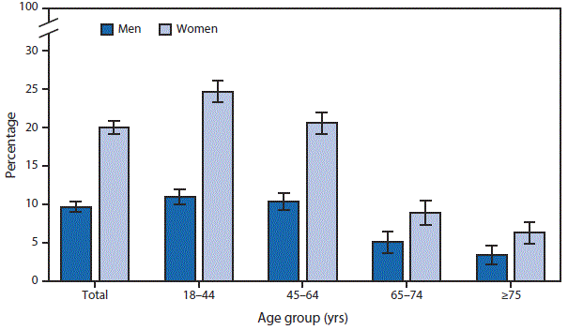
Period Prevalence: National Health Interview Survey (NHIS), 2015
Prevalence of severe headache or migraine, in past 3 months
Notes:
The prevalence of severe headache or migraine during the past 3 months was estimated based on response to interviews conducted in 2015 as part of the National Health Interview Survey (NHIS). The question asked of participants was “During the past 3 months, did you have a severe headache or migraine?” The NHIS is carried out every year (it does not take as long as the NHANES), but again the point is not how long it takes to conduct the NHIS research but the time period the measurement represents in a given participant. In this case, the measurement of disease prevalence is for a specified time period, 3 months, so it is an example of period prevalence. The same question might have been asked for the past six months and a different period prevalence estimate would have been obtained. The analogous point prevalence question would have been whether the person was experiencing severe headache or migraine at the time the interview was conducted, a proportion that could not be greater and presumably would have been lower than reported for the 3-month prior period. Here period prevalence might have also served a role in reducing bias (i.e., getting closer to truth) if persons experiencing severe headache at that moment of being asked to participate in an interview would not have been willing to take part in the interview.
One can see how short-lived conditions will have different prevalences depending on whether point or period prevalence is being examined and on the length of the time period if period prevalence is being examined.
Advanced note: One will see different definitions and derivations of the term period prevalence in textbooks and the applied literature. Besides the definition we have provided, one of the most common definitions attempts to estimate the % of persons who have the trait/condition over some calendar period (say, a calendar year) among everyone in the population during that calendar period. In these instances (e.g., Dermatol Surg 27:955–959, 2001), however, the definition of exactly what constitutes the denominator (i.e., everyone in the population in the calendar period) is quite variable, not principled, and often an approximation. For example, if a person is in the denominator for 1 day, should he/she be given the same weight as someone present for the entire year? Sometimes the term period prevalence is used for when point prevalence is clearly being measured in a group of persons (e.g., presence of hypertension at time of interview) but the study itself takes a prolonged period of time (e.g., it took all of 2020 to complete) (e.g., see https://sphweb.bumc.bu.edu/otlt/mph-modules/ep/ep713_diseasefrequency/ep713_diseasefrequency3.html). We would view this latter situation as simply point prevalence among participants who were examined sometime during 2020. In summary, one cannot assume a standard definition or study design when one hears “period prevalence”; one needs to examine the details.

Slide 13
How to report prevalence
Prevalence should always be stated as a number between 0 and 1 (e.g., 0.03) or as a percentage (e.g., 3%):
  “The prevalence of smoking was 15% (95% confidence interval: 12 to 18%) amongst teenagers in the U.S. in 2015.”
  “We found that 24% (95% CI: 20 to 28%) of adults had symptoms of fatigue at least once in the past 3 months”
Avoid statements such as:
  “Prevalence was 0.13 per 1000 persons”
  Easily confused with a report of incidence (i.e., a rate)
  Prefer: “Prevalence was 0.013% or 0.00013”
Include confidence intervals (CI): if description is primary objective, the CI is very important
Notes:
Being able to clearly communicate findings from clinical/epidemiologic research to non-scientific audiences is a major task for a researcher. We will spend a lot of time on communication in this class.
When communicating with scientific audiences, who should know prevalence means, it is best to incorporate the word “prevalence” in your narrative (“The prevalence of a diagnosis of asthma was 10% amongst neighborhood residents”). When referring to period prevalence, however, it is often better to spell out exactly what was done; very few scientists know what period prevalence is. When speaking to laypersons, it is best to explain what you mean without relying upon understanding of the word prevalence.
Avoid statements such as “Prevalence was 0.13 per 1000 persons” because this can easily be confused with an incidence metric (a rate, something we will discuss next week). Thus, we would prefer: “Prevalence was 0.013% or 0.00013”.
Finally, if description of prevalence is the primary objective in your study, it merits inclusion of the confidence interval. If a prevalence estimate is 15%, it makes a big difference in interpretation if the confidence interval is 12 to 18% as opposed to 3 to 33%. Readers need to know the precision of prevalence estimates. We will not be describing the mathematical derivation of confidence intervals in this course, but we will expect you to be able to obtain them using statistical software (e.g., Stata). We will also give heuristic interpretations of confidence intervals. For example, a confidence interval can be thought of the range of values you would obtain if you performed the study at hand, drawing the same sample size over and over again in the underlying cohort in which it was sampled. A 95% confidence interval roughly represents 95% of the values you would obtain if you did this, but please note that this is only a heuristic definition. The field of statistics has a more mathematically rigorous definition. A confidence interval is a measure of sampling error. 95% confidence intervals are conventional but more rigorous handling will often show 99% intervals.

Slide 14
Proposing prevalence objectives in a grant
Descriptive objectives are often the lead off (first specific aim) in grant proposals
Level of language sophistication in a grant should typically be higher than when reporting results
  Reviewers will expect a certain amount of scientific terms and assess your language to evaluate your know-how
Yet, best to be sufficiently clear in a grant for a general reviewer to comprehend (best to know your audience!)
  “We will estimate the prevalence of cigarette or pipe smoking amongst teenagers in the U.S. in 2018.”
  “We will determine the period prevalence, over the prior year, of self-reported symptoms of fatigue amongst adults in Ohio.”
Notes:
Likewise, researchers often need to communicate prevalence-related objectives in grant proposals. Descriptive objectives (prevalence and/or incidence) are often the initial specific aim (the lead off) in grant applications. In this situations, the word prevalence should always be used along with the population. If a period prevalence is to be estimated, the term should be mentioned by name.
The level of language sophistication in a grant should typically be higher than when reporting results because grants are typically, although not always, reviewed by other scientists. Scientific reviewers will expect a certain amount of scientific terms and assess your language to evaluate your know-how.

Slide 15
Incidence
Notes:
Prevalence is relatively straightforward, and thus we will spend most of our time focusing on a harder concept — incidence.

Slide 16
The Three Elements in Measures of Incidence
E = number of outcome events = a binary outcome
    (e.g., onset of disease) arising in population
N = number of at-risk persons in the population under study
T = time period during which the events are studied
Notes:
Turning now to incidence, understanding the three elements of incidence is essential to distinguishing the different incidence measures we will be discussing. These three elements are:
E, the number of outcome/disease events that arise in the population under study during the time period of interest;
N, the number of persons at risk for the outcome in the population under study; and
T, a time period during which the outcome events are observed.
If you pay close attention to how these 3 elements are being used (or not used), you should have no trouble in understanding what kind of incidence measure is being presented (when reviewing others’ work) or what you will need to estimate incidence (to do the work yourself). Again, the binary event we will refer to most often is the occurrence of a disease (or perhaps death), but this framework applies to measuring incidence in any study with a binary outcome (such as successfully quitting smoking).
(Note that your recommended reading (Tapia Granados 1997) presents a similar concept but labels “e” as population under study and “n” as outcome events.)
Not all reports of incidence you will encounter in the literature will explicitly identify these three elements for you. It is necessary in those cases to look closely at what is being reported and uncover any elements that are not made explicit. Sometimes it is not clear at all what investigators have done when they purport to report incidence.

Slide 17
Two Measures of Incidence
Proportion of at-risk individuals who experience the event in a defined time period (E/N during time T). This is unitless. Varies between 0 and 1.
  = cumulative incidence
  = incidence proportion
  = risk
Number of events divided by the amount of at-risk person-time observed (E/NT). Importantly, this is not a proportion. “person-time incidence” (More next week.)
= incidence rate
= incidence density
= rate
Notes:
There are two different measures of incidence. Both account for E, N, and T, but they do so in different ways. We will be exploring the properties of these two measures, the assumptions they rely on, and how they are used in research. Notably, both measures account for the element of time and the variation in individual participant observation time that often occurs in research, but they do so in different ways.
The first measure is the proportion of individuals who at time 0 start off at risk for the event of interest who subsequently experience the event in some defined duration of time. It is E/N within a specified time period T. Note that this measure of incidence does not have units because it is proportion. There are many terms for this measure, but we prefer “cumulative incidence” for this construct as it is the most descriptive and informative. We say this because “cumulative” refers to the accumulation of all incident events that arise over some period of time, T, among all person who started off at risk. The terms “incidence proportion” and “risk” are also acceptable; we will later often use the term “risk” when using this construct in measures of association. Even our preferred term “cumulative incidence” has some ambiguity. The term has also been used, for example, by Breslow and Day (1980), two famous statisticians, to describe what is more commonly known as the cumulative hazard. Once again, the reader of any research needs to dive into the details in what is being presented by the authors and not just assume a standard interpretation of these terms for incidence.
The second measure describes the number of events that arise from some person-time of at-risk observation. Sometimes, it is informally called “person-time incidence”, and we like this term, but it is not very commonly used. More commonly, one will see the terms incidence rate, incidence density, or just “rate”. The formula is informally E/NT, but we will later see that NT in the denominator is a bit more complicated than a simple multiplication. Please note that this is not a proportion. This measure does have units; it is cases per some unit of time. We will describe this in detail next week. This measure is less intuitive to most naïve observers. We prefer the term “incidence rate” to describe this construct but “incidence density” and “rate” are also fine.
Considering the relationship between these two measures, incidence rate is akin to velocity and cumulative incidence is akin to distance (e.g., miles or kilometers) traveled. That is, incidence rate represents the “force” of incidence in a population, and cumulative incidence is what results when applying that force to a fixed population, that starts off at-risk but with no cases, over time. Cumulative incidence is the proportion who develop the outcome after having experienced the force of incidence over a period of time.

Slide 18
Cumulative Incidence – Example
Definition: The proportion of at-risk individuals who experience the event in a defined time period (E/N during some time T) = cumulative incidence
Example: diabetic medications and bone fracture:
  “The cumulative incidence of a first fracture among women reached 15% at 5 years for those initiating rosiglitazone, 7.3% for those initiating metformin, and 7.7% for those initiating glyburide.”
Notes:
Cumulative incidence evaluates a group of participants who start off at time 0 and are then observed going forward. Cumulative incidence is the proportion of these persons who experience the event of interest after some duration of time has passed. The numerator is some number of people and the denominator is some number people. The people aspect of the numerator and denominator cancel out, which explains why the ensuing proportion is unitless and it must vary between 0 and 1. This proportion is the probability of developing the event by time T among all those who started off at risk at time 0. But because it is unitless, the time element T has to be explicitly added. For example, it might be the proportion of persons diagnosed during a five-year period or a ten-year period. A common error in the literature is that the time period for cumulative incidence is often missing. If the time period (which we sometimes call the “time horizon”) is missing, the reader is left guessing: Is it 6 months, 1 year, 5 years, some other time? In most contexts, the longer the time of observation, the higher the cumulative incidence of the event.
In this example from the ADOPT randomized trial, the investigators have calculated cumulative incidence over 5 years for first bone fracture in 3 different groups of the women participating in the trial: those randomly assigned to rosiglitazone, metformin and glyburide. The incidence is reported as a proportion without units. This example is a randomized trial, but cumulative incidence can, of course, be reported in a similar fashion for any fixed cohort study. Randomized experiments are simply fixed cohort studies in which the investigators assign the exposure (Kahn et al. Diabetes Care 31:845-51, 2008). This illustrates how cumulative incidence is a natural way to express incidence in a fixed cohort study.

Slide 19
Incidence Rate – Example
Definition: The number of events divided by the amount of at-risk person-time observed (E/NT) = incidence rate or density (not a proportion)
Same example, diabetic medications and fracture, now presented as incidence rates:
  “The incidence of a first fracture among women was 2.74 per 100 person-years using rosiglitazone, 1.54 per 100 person-years with metformin, and 1.29 per 100 person-years with glyburide.”
Notes:
If the measure of incidence is a number of events divided by some collective or aggregate at-risk time among individuals, it is not a proportion (not a probability). Instead, the denominator is an aggregation of time. For example, it might be 100 persons followed for 2 years, 200 persons followed for 1 year, or some other permutation of participants and observation time. In other words, the denominator is not the number of discrete people; it is something else — person-time. In addition, the value of the expression will change with the denominator, and the units of the denominator are arbitrary. That is, if an incidence is presented as events per person-years, those person-years could be converted to person-months, or person-days, or even person-minutes with corresponding changes in the incidence rate (even though they all mean the same thing because they are derived from the same raw data). And, none of those values is constrained to be between 0 and 1 — they can exceed 1. The concept of an incidence rate is not intuitive to most observers at first glance, but we will spend much more time on it next week.
The example is from the same ADOPT trial, but now the fracture results are presented as incidence rates. The incidence rates includes units, in this case it is “per 100 person-years” or “100 person-years⁻¹” (Kahn et al. Diabetes Care 31:845-51, 2008. )

Slide 20
An unfamiliar denominator
The denominator for incidence does not have to be a count of individual persons
Incidence rate, with person-time in denominator, is, in fact, the most fundamental measure of disease incidence. A few examples today but much more next week.
Notes:
We have just introduced the idea of a measure of incidence that uses a collection of aggregated time as the denominator, a concept called person-time. This is an unfamiliar concept to most readers, but as we will show later, it is, in fact, the most fundamental measure of incidence, particularly when used to describe incidence at any single moment of time (i.e., instantaneous incidence). We will give a few examples of incidence rate today, but it is next week when we explore person-time rates in more depth.

Slide 21
Incidence Rates
Numerator is number of outcomes/events in a specific time period (E)
Denominator is collective person-time that gave rise to the outcomes/events (~NxT)
e.g., cancer, we often have the number of cases in a defined geographic population over some calendar period.
  This comes from SEER
  How can we estimate the incidence rate?
Notes:
An incidence rate is formed by taking the number of events (or outcomes) of interest and dividing by the aggregation of person-time that gave rise to the events. We symbolize this as E/NxT. We say “symbolize” because it is actually the collective sum of T across all N persons, in other words the sum of each person’s duration of observation. Mathematically, this is equal to N times the mean T of all persons. We will show several ways to derive person-time next week, but let us as a preview consider how we would estimate an incidence rate for cancer. Last week, we described how the registry known as SEER scours all pathology labs and cancer clinics in given geographic areas in the U.S. to find all diagnosed cases of cancer. How can we use this to estimate an incidence rate?

Slide 22
Pancreatic Cancer Rate – SF County 2010
Pancreatic cancer cases in SF 2010 = 123 (SEER)
Population in SF 2010 = 805,340 (U.S. census)
  Assume that population is steady state for all of 2010
  Thus, person-time for 2010 is 805,340 person-years.
Incidence rate for pancreatic cancer in SF in 2010:
  123 cases/805,340 person-years
  = 15.3 cases per 100,000 person-years
Notes:
Let us consider the incidence rate of pancreatic cancer in San Francisco (SF) County, and we will consider it in the year 2010 for reasons that will be apparent in a moment. The number of pancreatic cancer diagnoses in SF County in 2010 was obtained from SEER; it was 123. The population of SF County in 2010 is available from U.S. census data; 2010 was a census year. It was 805,340 people. We assume that the size of the population was in a steady state for all of 2010. In other words, although we know people are leaving and entering SF County during the year, at any time point during the year it is safe to assume that these changes average out. We can therefore assume that the total person-time for the year is steady state population estimate, 805,340 people, x 1 year of observation = 805,340 person-years. The total number of unique people who contributed to this time is likely greater than 805,340 because we are sure that some people contributed less than a year before leaving and must have been compensated for by additional people moving in. That the total number of unique people is greater than 805,340 presents no problems for us in our incidence rate estimation. When we say 805,340 person-years, we do not literally mean 805,340 persons followed for one year. Instead, we mean a collection of observation time across people that equals 805,340 person years.
The incidence rate in 2010 is thus 123 divided by 805,340 person-years or 15.3 cases of pancreatic cancer per 100,000 person-years. 2020 was another census year in U.S. (the census occurs every 10 years), and there had been great concerns that the COVID-19 pandemic would wreak havoc on its accuracy. Thus far, the post-mortem indicates that there are more inaccuracies than the 2010 census, but the problems are not as great as feared. For the most part, the 2020 census is functional, which is reassuring given its enormous importance in informing epidemiologic understanding in the U.S. More details can be found at: https://www.pewresearch.org/fact-tank/2022/06/08/key-facts-about-the-quality-of-the-2020-census/

Slide 23
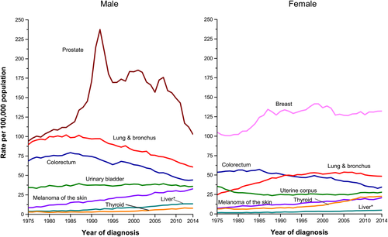
Incidence Rates for Selected Cancers by Sex, US, 1975 to 2014
Rate per 100,000 person-years
CA: A Cancer Journal for Clinicians 2018
Notes:
Here are incidence rates for several different types of cancer, estimated for the entire U.S., over the past 40 years for men and women. Again, the numerator is the number of incident cases reported in that year in the US. The denominator is person-years, calculated as we did for the pancreatic cancer example, using census data for the US. We recognize that at first glance, the magnitude of these values are still not intuitive for most observers. It is not simple to grasp what 15.3 per 100,000 person-years, although it seems small. We will return to this next week.
Advanced Note: These data have been age adjusted to the 2000 US standard population. This is also known as “standardization.” We will discuss this in a future lecture. Briefly, this adjusts the results to the age distribution of the population in 2000 to remove the effects of changes in the proportion of older/younger people in the population on the incidence rate. This makes the results more comparable across this time range of 40 years. Standardization is one way to address confounding, a topic we will cover later. Knowing what to standardize (or adjust for) always requires consideration of the research question; what do you want to show or know. Age, sex, or race/ethnicity standardization should never be rote; always ask yourself why you are adjusting for something.

Slide 24
Disease Occurrence Measures:
A Confusion of Terms
Terminology is not standardized and is used carelessly even by those who know better
Key to understanding measures is to pay attention to how the 3 elements of number of events (E), number of persons at risk (N), and time (T) are used
Even the basic difference between prevalence and incidence is often ignored
Notes:
We are presenting terms for the types of incidence that allow for precise and efficient communication amongst knowledgeable scientists; we will adhere to these terms for the rest of course. Precise use of this terminology allows us to speak to each other succinctly and unambiguously. It avoids misunderstandings.
Unfortunately, we need to warn you that in reading the clinical and epidemiologic research literature you will often find these terms used in other ways and often used without making distinctions that we think are important. This extends all the way to ignoring the basic distinction between prevalence and incidence. Thus, you cannot read a term that someone else uses and count on it meaning what you think it does. Instead, you need to understand how the 3 elements (number of events, number at risk, and time) were used by authors and decide for yourself what a given term means.

Slide 25
Incidence or Prevalence?
HIV/AIDS infection rates drop in Uganda
KAMPALA, Sept. 10 (Kyodo) - Infection rates of the HIV/AIDS epidemic among Ugandan men, women and children dropped to 6.1% this year from 6.8% a year earlier, an official report shows…
The report says the average rate of infection for urban areas fell from 10.9% to 8.7%. In rural areas, the average was 4.2%, not much different from the 4.3% average a year earlier.
All of these figures are PREVALENCES.
Notes:
Here is some language from a report from Uganda. It states that rates of HIV infection have dropped.
Use of the word “rate” should imply that incidence is being measured if proper scientific terminology is used, but this is not always the case in practice. Reports like this one are common. What is reported as an infection rate is not, in fact, incidence but prevalence. Just by looking at the numbers, it is not immediately clear that the figures of 6.1% and 6.8% are not incidence because it might be possible (although unlikely) to have incidence rates of HIV infection of this magnitude (e.g., 6 to 10 per 100 person-years) in Africa.
Since this is a news service report, it is not clear whether the original researchers used the language of infection rates or whether that was introduced by the reporters. In any case, you will commonly see this same inappropriate use of the word rate in clinical and epidemiologic research literature. Rates have a specific meaning in epidemiologic research but are used in many ways in the lay press.

Slide 26
“Rate” should not be used to describe prevalence
Although you may encounter “prevalence rate,” including in S+N text, rate should be reserved for measuring incidence.
In general, a rate is a change in one measure with respect to change in a second
From Szklo & Nieto text:
Notes:
We want to re-iterate: Avoid the term “rate” to describe prevalence. Unfortunately, you will see others do this, including the Szklo and Nieto text, but it is technically wrong and only serves to cause confusion.
Rate is a mathematical concept that has broad application in many fields of science. Most generally, a rate is a change in one measure with respect to a change in a second measure. Although we are using rate for reporting the change in a measure of disease occurrence with respect to a change in time, it can be change in one measure with respect to a second measure which is not necessarily time. For example, traffic fatalities per passenger-mile traveled is a rate. Mathematically, a rate is the first derivative of a specific function, and it is also called the hazard of a function.

Slide 27
Measures that are sometimes loosely called incidence
Count of number of events (E) in an ill-defined time period
  e.g., there were 84 traffic fatalities during “the holidays” in California
Count of the number of events during some specific time period (E/T)
  e.g., traffic accidents have averaged 50 per week during the past year in San Francisco
Neither explicitly includes the number of persons (N at risk) giving rise to the events
  Both would suffer if one had to compare them to another measure, say in another city or state.
Notes:
A comprehensive measure of incidence requires that we know how many events occurred (E) in the context of a measure of those at risk, by taking into account the elements of the time (T) that was observed and the number of persons (N) at risk. Some other measures are sometimes loosely called incidence by some users/authors, but they fall short of being unambiguous and useful. In the first example, the “holidays” may refer to a specific 3-day holiday weekend, thus giving the implied time period but this is not made explicit (maybe it also includes an extra day that many people took off work). Furthermore, we do not know exactly how many people were at risk. Thus, it would not make much sense, if your goal was to understand which state is more dangerous to drive in, to compare this value in California to another state in the U.S. that had another population size.
Traffic accidents per week in San Francisco has a specific time element (week) and also has an implied number of persons (those in the specific community), but again we are not told what that number is. Making guesses about N and T can be sometimes reasonable depending upon the context, but the point we are making is that all three (E, N, and T) need to be accounted for, explicitly, in order to have a true epidemiologic measure of incidence. Having all three would be essential if we wanted to make an intelligent comparison of any of these measures to another city or state that had a different population size.

Slide 28
CDC: Chickenpox rates drop in four states as inoculations become common
SF Chronicle
The number of chickenpox cases in four states dropped more than 75 percent as inoculations became more common in the last decade, according to a federal study released Thursday.
The total number of cases in Illinois, Michigan, Texas and West Virginia dropped from about 102,200 ten years ago to about 24,500 last year, the Centers for Disease Control and Prevention said. At the same time, the percentage of infants receiving chickenpox shots rose from less than 9 percent to as much as 83 percent, the CDC said.
What additional data would provide more useful estimate of incidence?
Notes:
In this example, the number of events (E) is given, the time period (T) is described (two one-year periods – 10 years apart ), and a geographic area is specified (four states). The story says that the number of chickenpox cases dropped more than 75% (which we have no doubt is accurate), but the headline says that rates dropped. What is missing in order to compare rates between these two one-year time periods is the number of persons living in those four states in the two time periods (the at-risk population). Since the two one-year incidence periods are 10 years apart, it is a reasonable bet that the population of the four states changed. A demographer might off-hand know how much the child population changed and could do the necessary math him/herself, but anyone else would not know how the relevant population changed and would need to look it up. If the child population increased a lot, then the difference in incidence rates between the two years will be different than is stated here.
This press release is likely not qualitatively incorrect (unless those 4 states lost most of their population, which we know is not the case), but it would have been even more informative if incidence rates rather than the counts had been reported. This is information knowable from U.S. census data — and a good use of census data.
This type of reporting might be OK for newspapers, but it is not good enough for science.

Slide 29
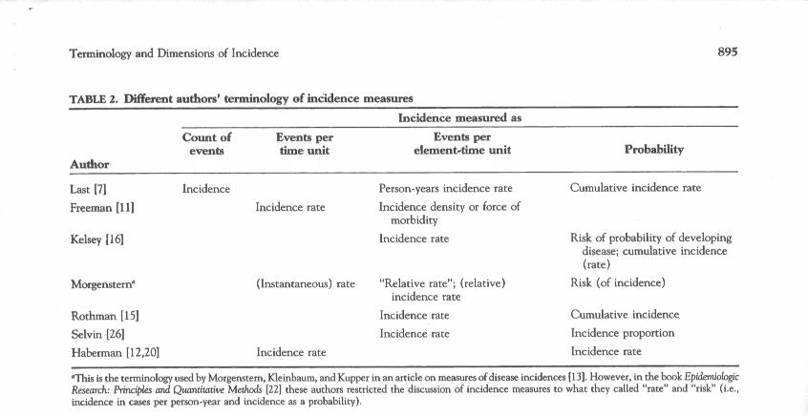
E
E/T
E/NT
E/N in time T
Tapia Granados J Clin Epi 1997
Notes:
Here is a summary of the confusion in terminology, which is modified from Tapia Granados (1997). We have added the E’s, N’s, and T’s to this table in order to give it some order and put it into the context we are using in class.
The two measures of incidence that dutifully include E, N and T are identified in the last two columns.
What is true is that E/NT is being referred to by most authors as a rate or density. We suspect that because a rate is a sophisticated concept, anyone who can actually calculate it will be sophisticated enough to give it the correct name. On the other hand, the construct of E/N over time T is called many different things by authors, including rate.
We favor the terminology used here by Rothman, who calls E/NT incidence rate and E/N cumulative incidence.

Slide 30
Two Measures of Incidence:
Our Preferred Terms
Cumulative incidence
Incidence rate
Notes:
To be clear, we prefer these two terms when focusing on incidence — cumulative incidence and incidence rate. Later, when we discuss measures of association, and get into analytic objectives, we will use more compact termsand call these risk and rate, respectively. We will refer to risk ratios and rate ratios, as well as risk differences and rate differences.

Slide 31
Disease Incidence Key Concept
Numerator is number of new events (E) (aka “incident events”) in a time period (either a fixed duration or an aggregation of time) in both incidence measures
Examine the denominator (persons or person-time) to determine the type of incidence measure
Notes:
In both measures of incidence, the numerator is E, the number of new events in the time period of interest. These new events are termed “incident” events, which explains why the entire construct is called incidence. To distinguish cumulative incidence from incidence rate, examine whether the denominator is a number of discrete persons assembled at some time 0 and then followed for some period of time or whether it is this entity we have referred to as person-time, which is an aggregation of time contributed by all persons. If the value is a cumulative incidence, the authors should have provided the duration of time for which it was calculated (e.g., 43% at 3 years). If the estimate is described as events “per person-years” (or person-any time period), then an incidence rate is being reported.

Slide 32
Cumulative Incidence
Perhaps most intuitive measure of incidence since it is just proportion of those observed who got the disease over a specific time period
Also known as incidence proportion or risk
Favored by causal inference methodologists
Estimated, typically, in a fixed cohort study design (including experimental trials)
Estimated with 1 of 4 techniques
  directly, as a simple proportion
  or, more typically, using one of these “estimators”:
    Kaplan-Meier
    Life table
    Aalen-Johansen [next week]
See Additional Slides for definition of “estimator”
Notes:
Both measures of incidence, cumulative incidence and incidence rate, are valid. Depending upon how they are estimated, they make some different assumptions and are calculated with different mathematical techniques, but both are very useful. Cumulative incidence is probably the most intuitive because it is just the proportion of persons who who got the outcome in question in some specific time period among all persons who started off the time period at risk. It is easy to understand but, again, it only has meaning when a time period is attached to it and applies only to a fixed cohort. For example, the probability of cancer in a one-year period is quite different from the lifetime probability of cancer. For reasons we will describe later, cumulative incidence is the favored metric by methodologists in the causal inference. (Advanced note: one of reasons for this is because contrasts of cumulative incidence (e.g., risk ratios), as opposed to rates, are “collapsible”.) Finally, in terms of utility, cumulative incidence, as we will show, is inherently best suited to describe incidence in a fixed cohort study. Cumulative incidence is a fixed cohort phenomenon.
Incidence based on a person-time denominator is less intuitive, but it is actually the more fundamental measure of disease occurrence. We will return to incidence estimation using person-time next week. For now, we will spend the rest of this session on understanding the cumulative incidence measure and the methods used to estimate it.
Although cumulative incidence is a proportion, it is rarely the case in practice that we can calculate it directly by dividing one number by another number. This is because studying humans is not like studying mice, a point we will explain in a moment. In practice, there are 3 techniques which we use most often to estimate cumulative incidence: the Kaplan-Meier estimator, the life table estimator, and the Aalen-Johansen estimator.
Note that we are calling these entities “estimators” because we are estimating incidence in some underlying cohort/study base by working with a sample of people from the underlying population. See the Additional Slides for more on this terminology.

Slide 33
Calculating Cumulative Incidence:
Simple Proportion
With complete and equal follow-up of each participant, cumulative incidence is just number of events (E) divided by the number of persons (N) = E/N (i.e., a simple proportion) in the given time period
Prototypic example
  Outbreak investigations (e.g., of a gastrointestinal illness) with complete follow-up among a fixed cohort of persons who were identified because of some point exposure at a certain place and time
  (Unfortunately, this is often called an “attack rate”!)
Notes:
The simplest situation in which to calculate cumulative incidence is if all persons at risk for the outcome in question are followed for the same length of time. We call this “complete and equal follow-up”. In such instances, the cumulative incidence is simply the total number of events divided by the total number of persons who were followed with complete and equal follow-up. In long-term cohort studies this virtually never happens for reasons we will explain. The prototypical example for this simple and ideal situation is an infectious diseases outbreak investigation, such as a Centers for Disease Control (CDC) investigation of an outbreak of gastroenteritis (e.g., diarrheal symptoms), where time zero is identified in a fixed cohort of persons and period of observation is short. This may start, for example, with several people in a community developing diarrhea at about the same time, and then someone discovers that they all attended the same event recently. The prototypic example is diarrhea after attending a community lunch or picnic. If the number of people and symptoms are severe enough, some group of investigators (e.g., the local or state health department or perhaps at the national level, such as the US CDC) may decide to study this to understand what food is the culprit (and, ultimately, which causative microorganism or toxin). If attendance at the picnic is a strong enough suspicion, then the investigators will choose a fixed cohort study design by trying to enroll and follow everyone who attended. In this context, the period of follow-up is typically so short that no one has a chance to become lost to follow-up or have a competing event. In the universe of cohort studies, these types of situations in which everyone has complete follow-up are in the minority.
Unfortunately and paradoxically, the term “attack rate” has traditionally been used to describe the proportion of persons who develop illness in these type of short-term complete follow-up studies (e.g., such as the investigation of gastroenteritis after picnic attendance). Household attack rate has recently become popularized in the context of COVID-19, but it is simply the proportion of household contacts who become infected with SARS-CoV-2in period of time (e.g., two weeks) after one household member is known to be infected. As we have been arguing, this is an incorrect use of “rate,” since the denominator is just the number of persons investigated; it is not a rate. This is another example of how terminology in the literature can be confusing.

Slide 34
Calculating incidence with a simple proportion:
Fixed cohort with complete and equal follow-up
On Oct 27, 2017, 115 people attended a reception at Facility A. 33 reported symptoms of diarrheal illness. The attack rate was 29%.
MMWR 2019
29% (33/115) is a cumulative incidence, not a rate
Optimal terminology: The cumulative incidence of diarrheal illness by XX days after event attendance was 29%.
Notes:
Here is an example of such a CDC outbreak investigation. What happened was that a group of people developed diarrheal illness within a tightly bunched time period. It was determined that those who because ill had attended a reception at Facility A in Nebraska on October 27, 2017. Thus, the cohort of all persons who attended the event (N=115) was the study base when researchers from the CDC decided to study the problem. It is a fixed cohort because it is defined by the one-time event of attending a reception of a particular facility. There will not be the opportunity for others to later join. We also seek to understand what happens to these individuals regardless if they move out of the geographic area. A total of 33 (29%) developed diarrheal illnesses meeting the case definition; 29% is a cumulative incidence. (Further outbreaks were investigated after subsequent events at the facility. For simplicity, we only report the first outbreak here.)
Stated most optimally, the cumulative incidence of diarrheal illness by XX days following the reception was 29% . No time period is explicitly mentioned in the report unfortunately, but we know from other sources this is cumulative incidence over a few days following the reception. Complete follow-up was possible in this context because the time period is very short.
The authors described the proportion (29%) who developed disease as an “attack rate”. This is not a rate, but a proportion. This is an example of confusing terminology.
Free RJ, Buss BF, Koirala S, et al. Successive Norovirus Outbreaks at an Event Center — Nebraska, October–November, 2017. MMWR Morb Mortal Wkly Rep 68:627–630, 2019. The MMWR is a weekly publication from the U.S. CDC which allows for rapid publication and dissemination of research deemed to be of public health importance. The initial cases reports of persons with AIDS, for example, were published in the MMWR.
A similar situation could be found in an experimental study (clinical trial) where all participants are followed for the same length of time and there are no losses to follow-up. A very well conducted clinical trial with short follow-up time could achieve this, but it is not common. Most of the time we do not have complete follow-up on everyone and hence other estimators for cumulative incidence are needed.

Slide 35
Complete and equal follow-up in a fixed cohort study
= event cumulative incidence (7 days) = 4/13 = 0.31
Observation time (e.g., 7 days )
Each horizontal line represents the experience over time of a participant
Notes:
This is what complete and equal follow-up looks like schematically in a fixed cohort study. Each participant is depicted with a horizontal line. Out of 13 participants in this fixed cohort study, 4 developed the event of interest. The cumulative incidence by 7 days, calculated with a simple proportion, is 0.31.
Although it might look like that those who had the event do not have the same observation times as the others, this is not what is referred to when we say “complete and equal follow-up”. Complete follow-up refers to no losses to follow-up. Equal follow-up time refers to only those who do not experience the event. Once someone has the event, he/she is counted in the numerator and his/her follow-up is complete. If you have had an event, you no longer need to be followed any longer; your observation is done.
Advanced note: What about if competing events (e.g., death by a lightening strike in a study of the incidence of diarrhea) were present in the fixed cohort study shown? Can you still use a simple proportion to depict cumulative incidence? If there were competing events and you wanted to “accommodate” them, then a simple proportion would still work but you would also need to report the percentage pertaining to the incidence of the competing event. Reporting just the simple proportion of the event of interest would only tell half the story. So, more than one simple percentage would be needed. If you wanted to “eliminate” the competing event, then a simple proportion could not work; some other estimator would be needed. We will later define what it means to accommodate or eliminate.

Slide 36
Cumulative incidence with differing follow-up times
In most fixed cohort studies (or experimental trials), participants have different follow-up times — for a variety of reasons.
Therefore, use of simple proportions to estimate incidence does not work
Notes:
36
Having complete and equal follow-up on all participants is the exception rather than the norm. When complete and equal follow-up does not exist, a simple proportion can no longer be used to estimate cumulative incidence. We will next show the different reasons for differing follow-up times.

Slide 37
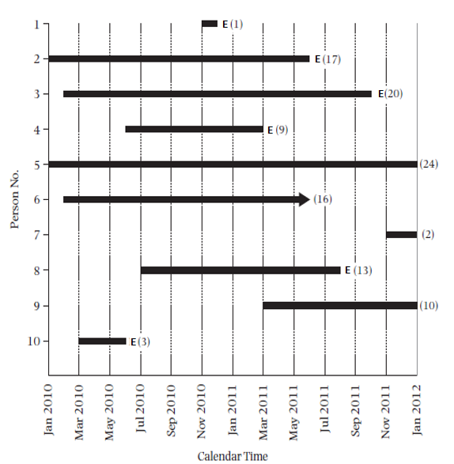
Follow-up times differ: Staggered entry in the face of uniform calendar time of study closure
= loss to follow-up
E = event
Notes:
This is a hypothetical example of a 10-person fixed cohort study given in the S & N textbook. It illustrates one of the ways that follow-up time can differ among individual participants in a cohort study. The mechanism is via “staggered entry” in the face of fixed calendar time of study closure.
The times that persons enter and leave the cohort are shown on a calendar time scale. The solid black bars represent the length of time each person was followed in the study. E denotes the event of interest. This example show that the study ends on a specific calendar date, January 2012. This is what is meant by fixed calendar time of study closure.
As is the case here, many fixed cohort studies take months to years to recruit all of the participants. This is what is meant by “staggered entry”. Since many observational studies have a single ending date in calendar time (fixed time of study closure), participants enrolled at the end of the recruiting process are going to have less follow-up time than those enrolled at the beginning. Staggered entry plus fixed time of closure will necessarily result in differing follow-up times.
37

Slide 38
Follow-up times differ: Lost to follow-up
= loss to follow-up
E = event
Notes:
Another mechanism for differing follow-up times is the occurrence of losses to follow-up, or “drop-out”. We introduced this occurrence last week. Persons in a fixed cohort study who have not developed the outcome under study and who are no longer able to be ascertained/evaluated for the event of interest are said to be “lost to follow-up” or to have “dropped out” or to have experienced “drop out”. This is regardless of why they can no longer be followed. Here, participant #6 (in a green circle) is termed lost to follow-up, which might be active or passive in terms of his/her notification of the study. In other words, he/she may have notified the research study that he/she will no longer participate, or he/she may simply no longer participate without any prior communication. He/she will not have the same follow-up as many of the other participants. Persons who have dropped out of the study are nonetheless typically still at risk for developing the event of interest. This differs from the next reason for differences in follow-up, which is known as a competing event.
38

Slide 39
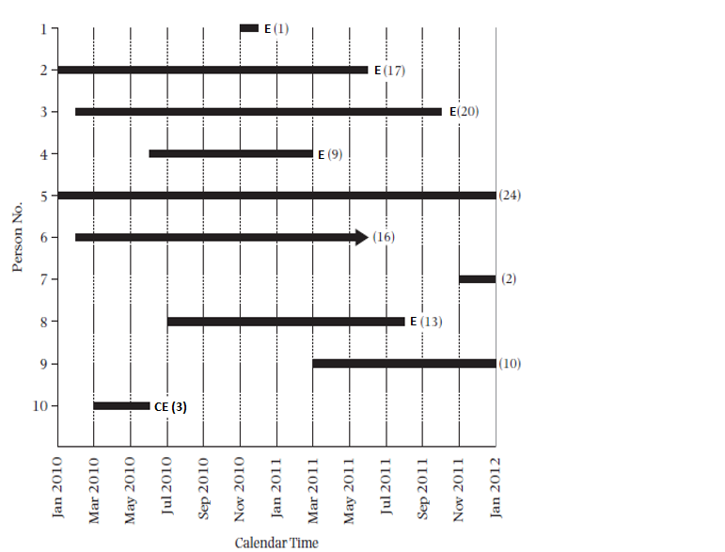
Follow-up times differ: Competing events
= loss to follow-up
E = event
CE = competing event
Notes:
Competing events are another reason for incomplete and unequal follow-up times. Let us assume that in this version of the example of a fixed cohort study, participant #10 has developed a “competing event,” identified with a blue circle. A competing event precludes (or substantially reduces the probability) development of the outcome of interest. For example, in a study of breast cancer incidence, death due to a heart attach is a competing event. The only outcome that does not have the possibility of competing events is all-cause mortality (death by any reason). We will discuss competing events at length and implications for measuring incidence in the next lecture. For now, remember that it is a reason for differing follow-up times. After this example, we will revert to participant 10 having experienced the event of interest.
39

Slide 40
Cumulative incidence with differing follow-up times
In most fixed cohort studies, participants have different follow-up times because of at least one of these reasons:
Staggered entry with uniform calendar time ending
Loss to follow-up (aka “drop-out”)
Competing events (more on this later)
Notes:
40
To summarize, these are several ways that participants can have different follow-up times in a fixed cohort study. Participants may start at different calendar times in the accrual process of the study. If the calendar end date for all participants is the same, those who start later will have less follow-up time. Or, some participants may have less follow-up time because they drop out before the end of the study. The final mechanism is the occurrence of a competing event.

Slide 41
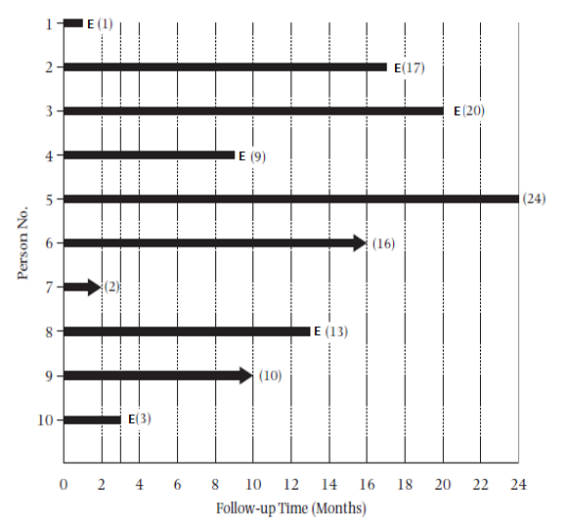
Staggered entry: Change time scale from calendar time to “follow-up” time (“shifting to the left”)
Notes:
You might infer that one way to deal with staggered entry is to simply begin everyone’s observation in the cohort at the time they actually start. This is referred to as “shifting to the left”. Note that the time axis is now follow-up time (time since enrollment; or observation time) rather than calendar time. This approach of shifting all starting time to the left, i.e., use of follow-up time as the scale, rather than calendar time, is generally how fixed cohorts are analyzed. This is used for both the Kaplan-Meier and life table methods of estimating cumulative incidence, as we will explain presently.
When shifting to the left, you might be, depending upon the study, combining persons who started in very different calendar time periods. If the incidence of the outcome under study varies according to calendar time, this is called a “secular” trend. Whether or not it is a wise thing to be combining persons who are experiencing their observation in such different calendar time periods will depend upon the research question, but keep in mind that unless there are no secular trends the final answer cannot be said to pertain to any individual in the cohort, from any calendar period. The final answer is simply an average of the different calendar time periods.
41

Slide 42
Cohort Study Design: Fixed Cohort
= event = loss to follow-up CE = competing event
CE
CE
Initial Cohort at Time Zero
(e.g., N = 1000)
Cohort at the end
of Follow-Up
(e.g., N = 987)
Time since enrollment
Notes:
Indeed, shifting everyone to the left is how a fixed cohort study is typically depicted and analyzed. Shown is our depiction of a fixed cohort study from our last session. “Time since enrollment” is the x-axis; it is time from time zero, i.e., time since entry into the cohort for each participant. All cohort participants are depicted as starting follow-up together at time zero, regardless if this was the same calendar time.

Slide 43
“Shifted to the left” with differing follow-up times
= loss to follow-up
Can we use E/N to calculate cumulative incidence in this situation?
Notes:
After we have shifted everyone to the left, we are left with different amounts of follow-up time in this cohort study. Can we use a simple proportion of E/N to describe cumulative incidence? No, this is because of 3 participants who were lost to follow-up. If we naively attempted to calculate cumulative incidence, it would be 6/10 = 0.6 at 24 months for this example, but this is not a valid estimate of 24-month cumulative incidence simply because we do not know what happened to 3 of the participants. It is not correct to say that they did not develop the event over a 24-month period of observation; we simply do not know. In short, each of these only contributed a fraction of the observation that the person who contributed 24 months. It would be wrong to give each of these 3 the same weight in the denominator as the person who contributed all 24 months.
43

Slide 44
“Shifted to the left” with differing follow-up times
Can we use E/N to calculate cumulative incidence in this situation?
E/N = 0.60 would be misleading as an incidence, since 3 people without an event have <24 mos. of follow-up time. Later, we will estimate that the cumulative incidence is 0.82 over 2 years, not 0.60.
Notes:
In more detail: at 24 months of follow-up time, we do know that 6 people had the event, and we know that 1 person (#5) did not. But we are not certain about the status of #6, 7, and 9 who did not have 24 months of follow-up. We cannot count them as having or not having the event during our specified time period (24 months) for our cumulative incidence estimate. This is why 6/10 is not a valid estimate of 24 month cumulative incidence. We can say that 6 out of 10 had the event; this is factual but it does not have much meaning or relevant interpretation. We cannot say that the cumulative incidence at 24 months is 0.6.
Today, we are going to discuss how to properly account for these different amounts of follow-up time when estimating incidence in a fixed cohort study. We will go into greater detail for the differing follow-up, distinguishing administrative censoring from losses to follow-up. Regarding losses to follow-up, the methods we will discuss can give valid answers only if we assume that losses are random, i.e., not related to the outcome. In other words, we have to assume that the rate of the event under study in those with less follow-up time is the same as the rate as those who have full follow-up. As we will see in upcoming slides, participants can have less follow-up time because they started late but finished the study (administrative censoring) OR because they dropped out before the study ended (lost to follow-up). This assumption regarding rates of events if we could continue to observe these participants is credible (in the eyes of most observers) for those who are “administratively censored” but may not be credible for those who are lost to follow-up. The methods that we will describe cannot overcome when losses to follow-up are not random; the methods will produce numbers in such situations but the answers are not correct. Having individuals who are lost to follow-up is a major threat to the validity of conclusions about incidence, thus making us realize why we stressed last session that losses to follow-up are a major threat to validity in cohort studies. This threat extends to the validity of randomized trials which can be viewed as cohort studies in which investigators have assigned exposure.
44

Slide 45
Example: Problem with Simple Proportion to Estimate Cumulative Incidence in Study with Differing Follow-up
“Among the 1,840 women at 5 yrs, 111 reported a first fracture: 60 (9.3%) of those treated with rosiglitazone, 30 (5.1%) of those treated with metformin, and 21 (3.5%) of those treated with glyburide.”
  60 fractures/645 women assigned to rosiglitazone = 9.3%.
  Avoid reporting a simple % if there are differing follow-up times; the % has no meaningful epidemiologic interpretation. No. of fractures (e.g., 60) is somewhat useful, but % is not.
“The cumulative incidence of a first fracture reached 15.1% at 5 years with rosiglitazone, 7.3% with metformin, and 7.7% with glyburide.”
  There were different follow-up times and these %’s take this into account. We’ll see how to do this in the next slides
Notes:
In this study, the ADOPT trial, the investigators reported both a simple proportion of those who experienced a fracture in each treatment group and a properly estimated cumulative incidence of fracture for each group, calculated in a way we will explain in a moment (the Kaplan-Meier approach). Because follow-up times differed among participants in this trial, these two percentages are not identical.
The first bullet is the description from the paper on the occurrence of fracture in each of the treatment groups. Providing the number of cases is informative (mostly to tell readers how much statistical precision to expect), but adding the simple proportion (e.g., 9.3% of the rosiglitazone group) is not informative if follow-up is not complete and equal on everyone. The % has no meaningful epidemiologic interpretation because it is not referring to a group of individuals all followed for the same duration. Note that this proportion is different from the cumulative incidence (15.1%) for this treatment group in the second paragraph, which is calculated in a correct manner. The simple proportion does not take differing follow-up times into account and hence can be very different than the properly estimated cumulative incidence. Avoid reporting such raw %’s if there is not complete follow-up among all participants. Unfortunately, this incorrect practice is common in the literature.
In the second bullet, we show the cumulative incidence estimates properly accounting for unequal follow-up times for participants in the trial. We will describe how to do this presently.

Slide 46
Cumulative incidence with differing follow-up times
With differing follow-up times, use of simple proportions to estimate incidence does not work
That simple proportions cannot be used is the basis of the field called survival analysis
  Pertains not just to survival after a diagnosis but rather to the occurrence of any incident event
  We will learn the basics of survival analysis
Notes:
46
To summarize, when we do not have complete and equal follow-up, we cannot use a simple proportion to estimate cumulative incidence. Furthermore, having identical and complete follow-up on all particpants is the exception to the norm.
When follow-up times are different, other methods are needed, and this is the basis of the field called “survival analysis”. It is also called failure-time analysis or time-to-event analysis. Time-to-event analysis is perhaps the most informative name because indeed this form of analysis is not just for survival after a disease diagnosis. It can be used for the occurrence of any discrete event, be it a favorable or unfavorable occurrence. The basic aspects of survival analysis need to be understood by any epidemiologist or clinical researcher. The more advanced aspects are in the purview of statisticians.

Slide 47
Calculating cumulative incidence with differing follow-up times
The Problem: Since rarely have equal follow-up on everyone, we can’t just divide number of events by the number who were initially at risk
The Solution: Kaplan-Meier and life table estimation are two common methods devised to calculate cumulative incidence among persons with differing amounts of follow-up time
Notes:
The problem is how to calculate cumulative incidence when persons are followed for different times.
The two most common methods of solving this problem of estimating the cumulative incidence in the face of differing amounts of follow-up are called the Kaplan-Meier and the life table method. The life table approach is older and is now uncommonly seen in the medical literature. It has become supplanted by the Kaplan-Meier method. The main difference is that life tables use uniform time periods in which to estimate the proportion who experience the outcome whereas the Kaplan-Meier method looks at time periods defined by when an outcome event occurs in the study sample. For large data sets, these two approaches give virtually identical answers. We will spend the majority of our discussion on the Kaplan-Meier method although for large datasets life tables give the same answer. The S & N textbook illustration of life tables is a bit misleading because, for the sake of showing the computations, the authors use a small number of observations that results in quite different estimates from the Kaplan-Meier method.

Slide 48
In survival analysis, those without event are “censored”
Notes:
The Kaplan-Meier and life table methods allow for two possible outcomes for participants: they either experience the event of interest or they are “censored.” In this example, 6 participants had the event of interest, death, during follow-up and 4 participants, identified with the circles, were censored. It is referred to as censoring because whatever happens after this date is suppressed from the investigator; the rest of the story on this participant is censored from the investigator’s view. The epidemiologic and statistical use of the term “censoring” and “censored” is borrowed straight from the lay definition of censor which is to suppress information. In epidemiologic and clinical research, we say that persons who become lost to follow-up or we no longer follow because the study has ended have their observation censored from the perspective of the researchers. The researcher does not know what has happened to these people.
A participant may be censored for one of two reasons:
because s/he became “lost to follow-up”; or
because the study’s follow-up time ended before s/he experienced the outcome.
In this particular study, no competing events occurred.
To understand this better, let’s go back to our calendar time representation in the next slide.
48

Slide 49
Censoring: lost to follow-up and administrative
= loss to follow-up
E = event
Notes:
This example shows the concept of censoring. Here the times persons enter and leave the cohort are being shown on a calendar time scale. The solid black bars represent the length of time each person was followed in the study. E = event, i.e. the outcome of interest. All participants who not develop the outcome under study are termed “censored”. Censoring occurs because of one of two reasons. One reason is becoming lost to follow-up (or “drop out”). For example, participant #6 (in green) is termed lost to follow-up (which might be active or passive in terms of his/her notification of the study). This person is sometimes called a “censored observation.”
Participants #5, #7, and #9 (circled in red) continued without experiencing the event until the study ended. Their experience is called administrative censoring. Administrative means that the reason follow-up ended was that the study was ended by the investigators (typically because funding ended). In terms of the statistical handling of the data for analysis (i.e., doing the math to estimate cumulative incidence), it doesn’t matter why a person is censored. Both types of censoring are handled the same computationally. Each person in a cohort is considered to either have the event or be censored. The reason for censoring will matter, however, when considering threats to validity in the incidence estimate (in other words, in considering whether the estimate of incidence is accurate).
49

Slide 50
Two Ways Censoring Occurs
Loss to follow-up
  Also known as “drop-out”
  Participants might inform investigators of intentions
    no longer interested in participating, or
    moving away and can no longer practically participate
  Or, they may not inform investigators
    Simply stop coming to study visits and cannot be found
  Or, in some real-world underlying cohorts, people just leave the context and no more data about them are available
  Although all above mechanisms are handled the same analytically, it is important to record the mechanism
2) Administrative Censoring = Study ends (e.g., funding is over) and participant has not yet experienced outcome
Notes:
In summary, there are two ways that censoring can occur.
The first is called lost to follow-up or drop-out. In dedicated prospective research efforts, participants might volitionally inform investigators of their intent to drop out (e.g., they lose interest or they move out of the area and cannot practically continue in the study) or they may not (they just stop showing up and do not respond to contact efforts). In settings in which researchers are using previously collected administrative data, such as electronic medical records, sometimes the trail of data simply ends, when, for example, people leave the context (e.g., leave the Kaiser Health Insurance Plan).
The second is called administrative censoring. Follow-up ends when the investigators call it quits, and the people who are still being followed at that time but have not developed the outcome of interest are said to be administratively censored as of the last date of follow-up. They therefore contribute the entire amount of their time in the study as disease-free follow-up time. This time may not be exactly the same for all administratively censored participants because they may not all have been enrolled on the same date. In the previous figure, there are 3 persons who are administratively censored, participant 5, 7, and 9. Participant 7 only has 1 month of follow-up because he or she was enrolled late in the cohort.

Slide 51

Kaplan-Meier estimator of cumulative incidence
Also called “product limit estimator”. Original article is in the optional reading.
Key innovation: Calculates the cumulative probability of not having the event (i.e., of “survival”) across consecutive discrete time periods
Analysis is performed by dividing the follow-up time into discrete periods
  calculate conditional probability of “survival” at each event time
Requires date that event (outcome) occurred on each individual or date last observed (i.e., date censored)
Notes:
The Kaplan-Meier (K-M) estimator is also called the “product limit estimator.” It was first described in 1958 as a solution to estimating cumulative incidence in the face of censoring or what the authors called “incomplete observations”. We already saw that we cannot calculate simple proportions if we have censoring. It also would be incorrect to exclude entirely from the dataset such persons who were censored. In other words, it would be invalid to just eliminate such persons from the cumulative incidence calculation. In fact, you never want to eliminate people entirely from your analysis because of something that happens after time 0. This is because you know they have at least some observation time that gave rise to NO events. Ignoring that observation time is essentially artificially reducing the denominator and falsely increasing the cumulative incidence estimate. The K-M approach to cumulative incidence estimation provides the solution. It does, however, require the assumption of non-informative censoring to yield valid estimates. We will discuss this at greater length later. The original article is included in the optional reading. It is one of the most cited biomedical articles of all time (No. 11 most cited according to 2014 Thomson Reuters). Kaplan EL, Meier P. Nonparametric estimation from incomplete observations. J Am Stat Assoc 53:457-81, 1958. Kaplan died in 2006 and Meier in 2011. That these methodologic innovators only recently died is evidence of how just young the field of epidemiology and biostatistics is. Compare with other fields such as mathematics or physics which go back many many centuries.
The essence and key innovation of the K-M method is breaking up the period of observation into little discrete pieces. The little pieces are defined by the dates in which the outcomes under study occurred in the study sample. The proportion not developing the outcome (which is called “survival” in the parlance of survival analysis) is calculated for each discrete piece and the overall cumulative probability of not developing the outcome (i.e. “surviving the occurrence of the outcome”) at any point during follow-up is calculated by multiplying together the individual probabilities of not developing the outcome in the consecutive discrete time periods. It seems like a simple concept today, but it was innovative in 1958 and became the most common method in human-based research to estimate disease/outcome incidence.
The process starts by assigning each participant a start time (a time zero) and an end date, which can either be the date in which he/she developed the event of interest or the last known date he/she was without the event of interest (i.e., the date he/she was censored). Every member of the fixed cohort needs to have these dates in order to be included in the analysis. Note: the date last seen without the event can simply be the end of the study, in the case of administrative censoring.

Slide 52
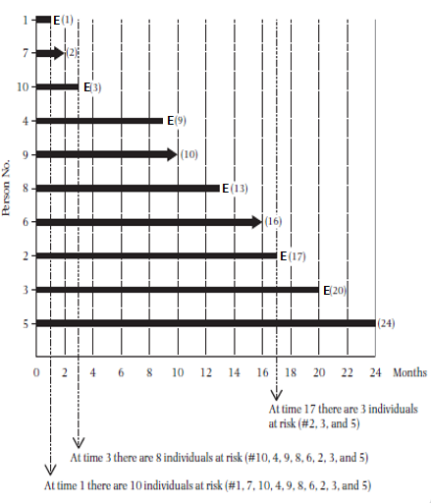
To start:
Sort the follow-up times from shortest to longest
Notes:
To perform K-M estimation, conceptually think of all participants as “shifted to the left,” sorted by order of follow-up time.
52

Slide 53
Calculating Cumulative Probability of the Event
Probability theory: Probability of 2 independent events occurring is the product of the probabilities for each occurring alone
  e.g., If event 1 occurs with probability 1/6 and event 2 with probability 1/2, then the probability of both event 1 and 2 occurring = 1/6 x 1/2 = 1/12
Kaplan-Meier estimator takes advantage of this theory to get what we want, which is cumulative incidence of an event:
  Achieves this by casting the problem as determining the probability of not having the event over a period of time
Notes:
In order to calculate cumulative incidence using the K-M estimator, you first need to understand, or at least accept on faith, the following aspect of probability therapy. It is a fundamental theorem in the probability field that the probability of having two independent events is the product of their individual probabilities. For example, the probability of flipping two heads in a row with a fair coin is ½ x ½ = ¼ . Or, if the probability of an event 1 is 1/6 and the probability of event 2 is ½, then the probability of event 1 and 2 both occurring is 1/6 x ½ = 1/12.
How can we take advantage of this theory to get what we want in survival analysis, which is the cumulative incidence of some event? The Kaplan-Meier estimator does it by casting the incidence problem as determining the probability of not having the event over a period of time.

Slide 54
Calculating Cumulative Incidence with Kaplan-Meier Approach
Time (mos) | Individuals at Risk at Start of Interval | Number of Events | Conditional Probability of the Event | Conditional Probability of Survival | Cumulative Probability of Survival
 | n | d | q = d/n | p = 1-q | S(t)
1 | 10 | 1 | 1/10=0.10 | 0.90 | 0.90
Notes:
Let us see how this determination of cumulative probability is applied in the K-M technique. This uses the example in the S + N textbook. The key is keeping straight the event and the complement, not having the event. In our example, the event, death, occurred at 6 different times during follow-up, so there are 6 discrete pieces/durations of time (remember, the event could be death or a disease diagnosis or some other binary outcome). The probability of the event is the number of deaths during each time period in time (just 1 here, but it is possible to have more than 1 at the same time) divided by the number at risk in the cohort at the beginning of the time interval in question. Thus, between time 0 and 1 month of follow-up there was one event, and at the beginning of that time interval all 10 original members of the cohort were at risk for the event. The probability of the event is thus 1/10 and the probability of not having the event, which is called “survival” in the parlance of survival analysis, is 1 – 1/10 = 9/10.
Of note, although we show just the interval from time 0 to 1 month here, we can also think of many small intervals leading up to 1 month. For example, one could conceive of the interval from time 0 to the end of day 1; day 1 to day 2, etc. Because no events have occurred prior to 1 month, the probability of the event during all of these intervals is 0% and thus the probability of not having the event is 100%. Because the probability of not having the event at time 0 is 100%, this illustrates how there is no change in the probability of not having the event (100%) until the first event occurs. That is, the curve is flat until the very moment of the first event. This same concept explains why the entire K-M curve is a series of steps, also known as a “step function”. With every passing moment in time in which no events occur, the probability of an event = 0 and, hence, the probability of not having the event is 1. The cumulative probability of not having the event (called “cumulative survival”) is unchanged because it is multiplied by 1. Hence, the line stays flat until the next event occurs, at which time there is an abrupt change in the cumulative survival (and its complement cumulative failure).
54

Slide 55
Calculating Cumulative Incidence with Kaplan-Meier Approach
Time (mos) | Individuals at Risk at Start of Interval | Number of Events | Conditional Probability of the Event | Conditional Probability of Survival | Cumulative Probability of Survival
 | n | d | q = d/n | p = 1-q | S(t)
1 | 10 | 1 | 1/10=0.10 | 0.90 | 0.90
2 | 9 | 0 | 0/9=0 | 1 | 0.90
3 | 8 | 1 | 1/8=0.125 | 0.875 | 0.788
S(2) = 0.9 x 1 = 0.9
From 1 to 2 months is an interval with a censored individual but no event. Conditional probability of survival in this interval is 1.
S(2), cumulative probability of survival at 2 months, is the same as S(1)=0.9.
Illustrates why we do not have to calculate conditional probability of survival at time of censoring.
Notes:
These additional lines in the table illustrate why it is not necessary to calculate a probability of survival when a person is censored. Here, 1 person was censored at 2 months. The probability of having the event during the interval from month 1 to month 2 is 0, and the probability of survival (not having the event) for the 9 individuals is 1. We calculate the cumulative probability of survival by multiplying all of the conditional probabilities of survival up until that moment. In this case, it is 0.9 x 1, which still equals 0.9. In other words, cumulative probability of survival (no event) at 2 months did not change from 1 month, despite someone being censored. In the next slides, we will only calculate conditional probabilities when an event occurs, ignoring the times when someone is censored. Those censored, however, still need to be kept track of, because their loss is reflected in the second column from the right “individuals at risk”. All censored persons become subtracted from the individuals at risk when the next interval starts.
55

Slide 56
Calculating Cumulative Incidence with Kaplan-Meier Approach
Time (mos) | Individuals at Risk at Start of Interval | Number of Events | Conditional Probability of the Event | Conditional Probability of Survival | Cumulative Probability of Survival
 | n | d | q = d/n | p = 1-q | S(t)
1 | 10 | 1 | 1/10=0.10 | 0.90 | 0.90
3 | 8 | 1 | 1/8=0.125 | 0.875 | 0.788
S(3) = 0.90 x 0.875 = 0.788
Notes:
When the second death occurs at 3 months of follow-up, only 8 persons are still in follow-up at the beginning of the interval because 1 person was lost to follow-up at 2 months of follow-up. Therefore, the probability of death in the time period from month 2 until the second event was 1/8=0.125, the probability of survival (not having the event) was 1-0.125 = 0.875, and the cumulative probability of survival (i.e., not having the event) through 3 months is the probability of not having the event in the first time period times the probability of not having the event in the second time period. It is 0.9 x 0.875 = 0.788.
56

Slide 57
Calculating Cumulative Incidence with Kaplan-Meier Approach
Time (mos) | Individuals at Risk at Start of Interval | Number of Events | Conditional Probability of the Event | Conditional Probability of Survival | Cumulative Probability of Survival
 | n | d | q = d/n | p = 1-q | S(t)
1 | 10 | 1 | 1/10=0.100 | 0.900 | 0.900
3 | 8 | 1 | 1/8=0.125 | 0.875 | 0.788
9 | 7 | 1 | 1/7 = 0.143 | 0.857 | 0.675
13 | 5 | 1 | 1/5 = 0.200 | 0.800 | 0.540
17 | 3 | 1 | 1/3 = 0.333 | 0.667 | 0.360
20 | 2 | 1 | 1/2 = 0.500 | 0.500 | 0.180
24 | 1 | 0 | 0 | 1 | 0.180
Cumulative probability of survival until month 24 = S(24) =
0.9 x 0.875 x 0.857 x 0.8 x 0.667 x 0.500 x 1 = 0.180
But, we want cumulative incidence, the cumulative probability of the event = 1- S(24) = 1 – 0.180 = 0.820
Notes:
We continue this process, calculating conditional probability of event and of not having the event (which we call “survival”) at each time an event occurs until we have included all events (6 in this example) and included the last person observed, who in this case was censored. We include the time period at the end, despite it not changing the cumulative probability of survival, because it reminds us how far in observation time the cumulative probability of survival pertains to. In this case, it pertains to 24 months. This means we can draw the plot (on the following slides) up through 24 months. If we did not include this last line, we would have only drawn the plot to 20 months. The cumulative probability of survival at 24 months (0.180) is the product of the individual conditional probabilities of survival up through 24 months.
Now, we have the cumulative probability of survival, but what we really want is the cumulative probability of the outcome. We obtain that by subtracting S(t) from 1. In this example, 1 – 0.180 = 0.820 is the cumulative probability of the event by 24 months. This is the cumulative incidence at 24 months.
57

Slide 58
Kaplan-Meier:
Cumulative Incidence of the Outcome
Common error: Cannot calculate this by multiplying together all of the event probabilities (that would be the probability of repeating the event -- illogical)
  (in our example, 0.100 x 0.125 x 0.143 x 0.200 x 0.333 x 0.500 = 0.0000595)
The “answer” is a proportion, so time is not intrinsic to the units. Time period has to be specified for number to be interpretable.
In this example, 0.82 is the 2-year cumulative incidence.
Notes:
The cumulative probability of the event is calculated using the survival (i.e., of not getting the event) probabilities because it is only survival (not having the event) that can happen repeatedly. To use the probability of the event per se in the calculation you would be calculating a probability of repeated diagnoses, which is not what you want because it makes no sense. You do not want to estimate the probability of repeatedly having death, for example! Instead, to get the cumulative probability of the event, do the following. At the end of multiplying together all of the individual survival probabilities to get the cumulative probability of 0.18, the cumulative probability of death by 24 months can be obtained by subtracting from 1. 1 – 0.18 = 0.82.
As we now stated many times, cumulative incidence cannot be interpreted without specifying the time period. The cumulative incidence of death for the whole U.S. population at 1 year of life is about 0.8% but at 100 years it is greater than 99.9%. In our example, the cumulative incidence of the event by 2 years is 0.82 (or 82%).

Slide 59
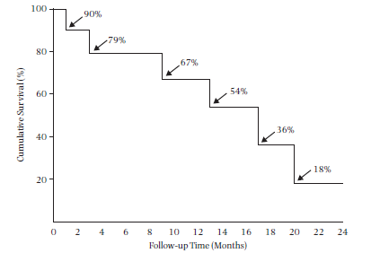
The Iconic “Kaplan-Meier Plot” (or “Curve”):
Typically shows cumulative survival
Step Function
Notes:
The results of these calculations for the S +N textbook example can be displayed in what is known as a Kaplan-Meier plot or Kaplan-Meier curve. Everyone in biomedicine has surely seen such a plot, which is why we call it iconic. What we show here is probably the most typical plot, showing the cumulative survival (i.e., of not having the event).
Note that the K-M plot is a step function. It is not correct to connect the dots with straight lines. Properly constructed K-M curves that appear smoother are, in fact, still step functions, just like this one, but with events occurring more frequently relative to the time scale so the curve appears smooth.
While, classically, K-M plots show survival (i.e., falling curve), they can just as easily show incidence (i.e., climbing curve). In fact, we prefer the climbing curves in that they are more intuitive to most observers. In other words, K-M natively estimates probability of no event, but we are typically interested in probability of event. We can estimate and plot either the probability of the event or of not having the event.
59

Slide 60
Kaplan-Meier plot of cumulative incidence
Notes:
This is the complement of the Kaplan-Meier survival plot in the previous slide. This is showing the same data but now presented as cumulative incidence.
As noted before, we prefer the incident (“climbing”) curves since we are typically interested in the probability of the event. Historically, plotting of survival (not having the event) has been more common, probably because this is what is directly calculated in the Kaplan-Meier approach. In some fields, such as evaluation of death after cancer diagnosis, the concept of “survival” has become firmly entrenched and falling plots are conventional. However, plotting of the cumulative probability of the incident event is becoming increasing popular in the literature in other fields. We prefer climbing plots in most applications.
60

Slide 61
K-M curve:
Development of tolerance to cow’s milk
Suh et al. J Korean Med Sci 2011
Notes:
This study was conducted to determine the natural course of cow’s milk allergy in Korean children. There were 115 children with cow’s milk allergy who were followed for at least 24 months for the development of resolution of this allergy, which is known as “tolerance”.
A few things to note for this example.
1) Many small steps during months 20-40 as many children have resolution of allergy. There are larger steps in subsequent time period as fewer children are left to study (i.e., the denominator is small and only a few events result in small probability of not having the event, which results in a large decrement in the cumulative probability of not having the event.
2) The time scale on the x-axis is age, which is different than the time of observation that we showed before. However, using age as the x-axis is a perfectly acceptable approach, because it again focuses on some fixed cohort of persons at a certain age (most typically either 1st day of birth or first day of adulthood (18 years old)) and follows them forward for an event.
We again think this would be easier to interpret if this plot showed the incidence of development of tolerance.

Slide 62
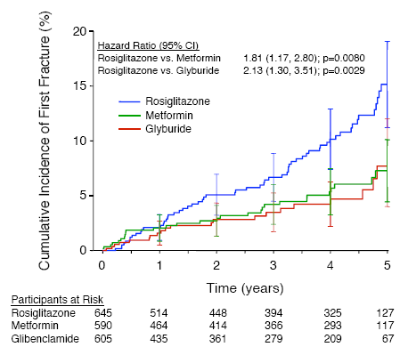
“The cumulative incidence of a first fracture reached 15.1% at 5 years for those using rosiglitazone, 7.3% with metformin, and 7.7% with glyburide.”
Standard error bars
At risk table
Notes:
We now return to the earlier example of the incidence of fractures amongst participants with diabetes being treated with different anti-diabetes agents. This is a figure from the publication. It shows Kaplan-Meier estimates of the cumulative incidence of fractures over 5 years in women. Vertical bars represent plus or minus one standard error. (Kahn et al. Diabetes Care 31:348-51, 2008)
This Kaplan-Meier curve in this example depicts incidence of the outcome, rather than survival without the outcome. The cumulative incidence was calculated by first calculating “survival without fracture,” and then determining the complement in order to show fracture incidence.
In addition to the estimates directly calculated from the data and plotted on the graph, which are called “point estimates”, this plot also includes a depiction of the potential for sampling error by showing standard error bars at each year. The point estimate represents the best guess from the data and the standard error depicts the precision of the estimate (which accounts for the fact that we only have a sample of a larger population). 95% confidence bands can also be calculated for Kaplan-Meier curves. We discussed sampling error and confidence intervals earlier when we discussed prevalence.
The numbers below the graph indicate the number of participants that were still being followed, by treatment group, at each of the time points. This is a nice way to give the reader a sense of how many participants are contributing to the different estimates and hence the statistical precision of the estimates. However, with the standard error bars shown, there is no additional information provided by the number at risk. The standard error bars tell you all you need to know. It is not wrong to show both, but the standard error bars (or a 95% confidence band) is sufficient to tell us the precision of the estimate (i.e., the range of estimates compatible with the observed data).

Slide 63
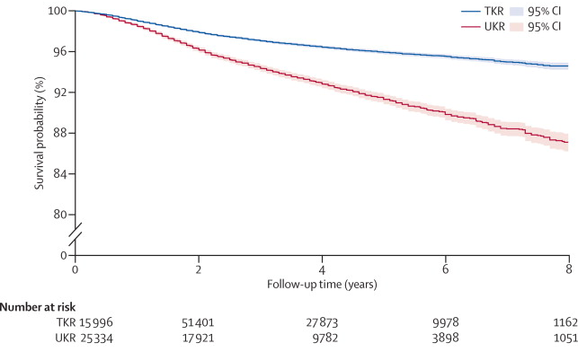
Need for Revision after Knee Replacement:
National Joint Registry for England and Wales
Figure 1. Kaplan-Meier curve of revision to 8 years in matched patients.
UKR = unicompartmental knee replacement. TKR = total knee replacement.
Liddle et al. Lancet 2014
Notes:
This example of a K-M survival curve shows probability of not having a revision after total (TKR) or unicompartmental (UKR) knee replacement. A revision refers to another surgical replacement of the knee after the initial replacement. Hence, the plot shows the percentage who do NOT need a second surgical procedure. Note the use of shaded bands to identify the 95% confidence interval. The confidence bands are narrow because the sample size is very large, which can be seen in the “number at risk” at the bottom of the plot.
Note also the nice use of the break in the y axis. Although the y axis is a probability, there is no reason why you have to show the entire range of 0 to 100%. If you did show the entire range from 0% to 100%, it might be difficult to show differences between groups if they are small and absolute incidence in both groups are small (as this example).
Finally, note the slavish adherence to the term “survival probability” on the y axis. This is what generically gets printed by statistical software, but it should be modified to one’s specific context. In this case, the y axis should be “Probability of not undergoing revision of knee replacement”.
We maintain that showing the complement of this, incidence of revision, is a more intuitive way of showing the data.

Slide 64
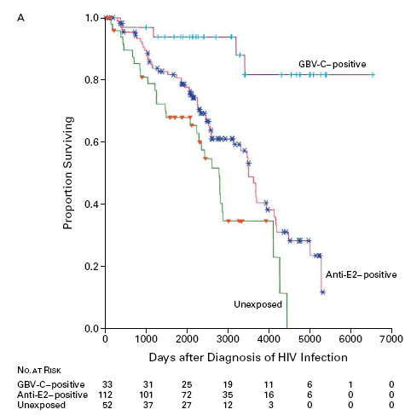
Cumulative survival after diagnosis of HIV infection in three groups of patients
“Tick mark” when participant is censored (lost to follow-up or administrative)
Large “steps” and low number at risk: Tail of curve less precise.
Tillmann et al. NEJM 2001
Notes:
Here is a graph showing a Kaplan-Meier analysis of cumulative survival after diagnosis of HIV infection in three groups of patients according to co-infection with a particular hepatitis virus: the top line represents patients positive on an assay for GBV-C RNA (evidence of active infection; GBV-C has also been designated hepatitis G virus); the middle group are positive on an assay for antibodies to a surface protein of GBV-C (designated E2; evidence of prior infection); and the third group was negative on both GBV-C assays (no evidence of infection).
As usual, notice that the lines have a step function. This is because there is a discrete jump in the cumulative incidence each time a death occurred. Very large steps can occur because very small numbers of person are at risk, and when one event occurs, the probability of no event is not so large, which then influences the cumulative probability of survival. This is illustrated by the last three large downward steps of the unexposed group. This small fraction as a multiplier will produce a large jump in the cumulative probability of having no event. A look back at the table which we created for Kaplan-Meier estimation will allow you to prove this to yourself.
The numbers below the x-axis are useful as they show the reader how many persons were observed in each group as time progressed. Only 3 were left in the unexposed during that last portion of the K-M function, each drop representing 1 person dying. No standard errors or confidence intervals are shown in this plot, but the small numbers at risk and large drops indicate that the survival estimate is quite imprecise for those latter time points. Hence, the tail of the curve does not give precise information. While the numbers at risk are nice to see for many observers, a more direct way to show statistical precision would be to show confidence bands. Again, showing both would not be wrong.
The tick marks on each survival curve represent times at which a person was censored, so they provide useful information on the amount and pattern of follow-up time in each group. They do not, however, necessarily represent losses to follow-up (i.e., drop outs). This is because participants may have started at different points in calendar time and would have different follow-up times even if they all continued to the end of the study. Thus, the tick marks represent both drop-out and administrative censoring. We do not find that combining these together is very insightful, but most software does not give the user anyway to distinguish them.
To read cumulative survival for a group from the graph, pick a time point, such as 3000 days, draw a line straight up to intersect the survival curve and then a horizontal line that intersects the y-axis. Where it intersects the y-axis is the estimate of the proportion surviving (not having the event under study) at that time of follow-up (about 60% in these data for the anti-E2-antibody positive group and less than 40% for the unexposed group at 3000 days).
If the cumulative incidence of death had been plotted instead of the cumulative incidence of survival (always an option), the graph would have started in the lower left-hand corner at 0 and moved up toward 1 (inverting the curve pictured).

Slide 65
K-M Plots of Cumulative Incidence
We have shown a variety of options to give you a sense of what you will encounter in the literature and how you might report your results.
Our preferences for K-M plot:
  Show cumulative incidence (i.e., of the event)
    Unless your field uniformly and sensibly shows survival
  Provide indication of sampling error (either confidence bands or pointwise confidence intervals)
  Number at risk table under the plot is a nice touch
    But not requisite
Notes:
You will see many different styles for Kaplan-Meier presentation in the literature. Our recommendations are to show cumulative incidence of the event (as opposed to cumulative probability of no event), show the precision of your estimates (i.e., potential for sampling error) with confidence bands and confidence intervals, and the at-risk table under the plot is nice but not requisite if you have shown confidence intervals or bands. As for drop out, we prefer to show it directly in a separate plot, as we will illustrate later.
We will not in this course focus on the methodologic theory behind the generation of the metric to show the potential for sampling error (i.e., standard error, confidence bands or pointwise confidence intervals), but we will, in the Problem Sets, guide you how to calculate them in Stata.

Slide 66
Time Element in Cumulative Incidence
K-M plot shows cumulative incidence for every time point the population was observed
  This plot is full disclosure on incidence.
  “A picture is worth a thousand words”
  Show the plot whenever you can, including abstracts
However, if you cannot show a plot and you must say cumulative incidence in words (such as in an abstract), then YOU MUST ADD A TIME ELEMENT.
For example, “20% over 1 year” or “5% by 6 months”
Notes:
If you can, show the entire Kaplan-Meier plot. This includes in abstracts for conference presentations. It allows reader to view cumulative incidence at a variety of time points. A picture is worth a thousand words. In this case, the Kaplan-Meier plot show a family of cumulative incidence estimates. However, if you cannot show the entire plot and can only describe one cumulative incidence estimate, then you must include the time horizon. Regrettably, authors often forget to do this or do not realize how important it is. Failure to add a time element is one of the most common problems in reporting cumulative incidence.

Slide 67
Cumulative Incidence:
Underlying Assumption #1
For cumulative incidence to be unbiased (i.e., valid), censoring must be unrelated to the probability of experiencing the outcome.
  Censoring must be “non-informative”
i.e., the outcome experience of those who are censored (particularly those who are lost to follow-up/drop out) must be the same as those who remain in the study.
Notes:
This concept takes us back to the point made in the first lecture on study design about a major threat to validity of a cohort study coming from losses to follow-up. (There are other threats to validity in a cohort study such as measurement bias and confounding, which we will cover later, but losses to follow-up are a substantial concern. This is not a surprise since longitudinal observation is the essence of cohort studies.) As we set forth to perform survival analysis on a fixed cohort study, those persons lost to follow-up are said to be censored. If members of the cohort who are lost to follow-up are either more or less likely to experience the outcome than those remaining, the resulting incidence estimate (which can only be calculated using the persons who remain) will be either too high or too low relative to the entire study population who began at time zero. This is why for our estimate (which can only come from those who remain) to be valid, those who are lost to follow-up (i.e., those who are censored) must have the same incidence of the event as those who remain. This is why we state that we assume that those who are lost have the same incidence of the event as those who remain in order for our estimate to be valid. When the incidence of the event is the same in those who are censored as those who remain, we state that censoring is “non-informative”. Another way of looking at this is that for cumulative incidence to be unbiased in the face of losses to follow-up, the censoring must be unrelated to the probability of experiencing the event. This means that the incidence of the event in those who become censored is the same as those not censored. It also means that the incidence of becoming lost to follow-up should be the same among those who experienced the event and those who did not.
We will give formal definitions for “valid” and “unbiased” later in the course, but for now it is clear that we seek unbiased and valid answers for our cumulative incidence estimation.
The use of the term “assumption” in this example illustrates a common type of reasoning in epidemiology and biostatistics, which we will encounter repeatedly. That is, if you are willing to accept that one or more assumptions (which, in some cases, may never by provable or whose proof must come from external sources, apart from the data at hand) are true, then you can do some interesting things with the data at hand — you can learn something new. Thus, it all comes down to how credible the assumption is.

Slide 68
Informative vs Non-informative Censoring
When the goal is estimation of incidence (“descriptive”):
Informative censoring (aka “non-ignorable”) means that those censored have different incidence of the outcome than participants who remain in the study, and therefore introduce bias in the incidence measure
Non-informative censoring (aka “ignorable”) means that those censored have the same incidence of the outcome as participants who remain in the study, and therefore do not result in bias
Notes:
Statisticians and epidemiologists characterize censoring with the terms “informative” and “non-informative”. Whether censoring is informative or non-informative depends upon several factors, but, to start, it depends upon what you want to estimate. In cohort studies, you may wish to just measure incidence (i.e., a descriptive objective) or you may also wish to evaluate causal determinants of incidence (i.e., an analytic objective). So far today, we are just discussing descriptive objectives. When the goal is estimation of incidence (i.e., descriptive), informative censoring means that those who are censored have a different incidence of the outcome under study than those who remain in the study. To lose these types of people from full observation is considered “informative” (i.e., you would want to know about their full follow-up, if you could) and you cannot ignore it if your goal is to get the right answer (hence another term is “non-ignorable”). Non-informative censoring means that those who are censored have the same incidence of the outcome as those who remain in the study. Knowing what happened to these people does not add anything, hence the term “non-informative”. You can ignore what happened after these people were censored (and hence the term “ignorable”). Not being able to observe these people and include their follow-up experience does not introduce bias in the incidence estimates. As noted earlier, however, even non-informative censoring does lead to a loss of statistical precision. This is because those who remain are fewer in number than the original study sample and fewer participants, as a general rule, yields less precision.
Another way to think about this is by looking at the table of calculations that is used to derive the Kaplan-Meier estimates. As we go longer and farther past time zero and the censored participants begin to no longer contribute anything to the analysis, all we have left to create our estimates are the participants who remain. Keep in mind, however, that the estimates are being calculated for the survival probabilities in these latter time periods are being applied to the entire group of participants who started at time 0. In other words, cumulative incidence is a fixed cohort concept, applying to the group of people who were present at time 0. That said, in the later time periods, in order for the persons who are left in the analysis to be contributing data that represents the entire population (if you had the chance to observe it) they must be a representative sample of everyone who truly is remaining without the outcome, including those censored. To assume that those who are left are a representative (or random) sample of everyone means that those who are left must have the outcome experience as those who are lost. This is because those who are lost plus those who stay make up the total population. That is, if those who stay are a representative sample of the entire population, then those who are lost must also be a representative sample of the entire population, and those who stay must have the same experience as those who are lost.
Although we won’t cover this now, it is the case that censoring that is informative in the context of incidence estimation may not be informative in analytic work. In other words, certain things we do in analytic work (such as adjustment) may negate the informativeness of the losses.

Slide 69
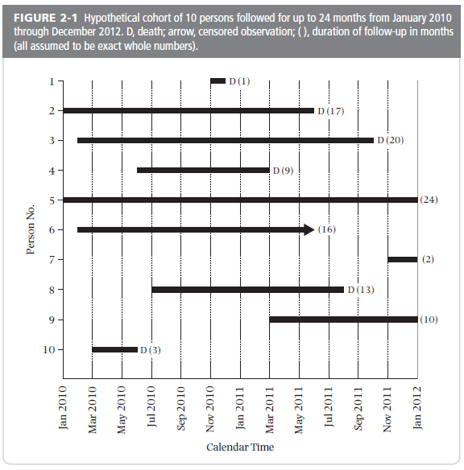
Follow-up times differ: Censoring (lost to follow-up and administrative)
= loss to follow-up
D = death
= loss to follow-up – may be informative
= Administrative – typically
non-informative
Notes:
Here is a slide we showed earlier, with a diagram from the S + N textbook showing different follow-up times. In the previous slide we stated: “For cumulative incidence to be unbiased (i.e., valid), censoring must be unrelated to the probability of experiencing the outcome.” This assumption is usually credible for participants who are administratively censored. The reason for their reduced follow-up time is an administrative decision by the investigators, not the participant’s choice. (This is unless there is something very unusual happening in the study such as massive drop out because of some systematic reason, which then causes the researcher to stop follow-up. Hopefully, authors would disclose this if it occurred.)
However, for those who are “lost to follow-up” (drop out) during the study, this non-informative assumption may not be met. Participants who decide to “drop out” of follow-up may be systematically different from those who remain in follow-up, and these differences may include a different incidence of the outcome of interest. Persons who are lost to follow-up may be informatively censored. For example, they may be dropping out because they begin to feel poorly because of early symptoms of the event under study. Or, they may have developed the event under study, and it was not reported to the investigators. We say that the assumptions “may not be met “ because unless we know what happens to them, the informativeness or non-informativeness is only speculation.
The major point is that the researcher must understand the context of the censoring in his/her cohort study (i.e., what are the explanations). In a dedicated prospective study, this is sometimes very well understood, but with datasets that researchers acquire for populations that they did not assemble themselves, the reasons and explanations behind the censoring often become lost. In such instances, it may not even be possible to decipher drop-out from administrative censoring.
69

Slide 70
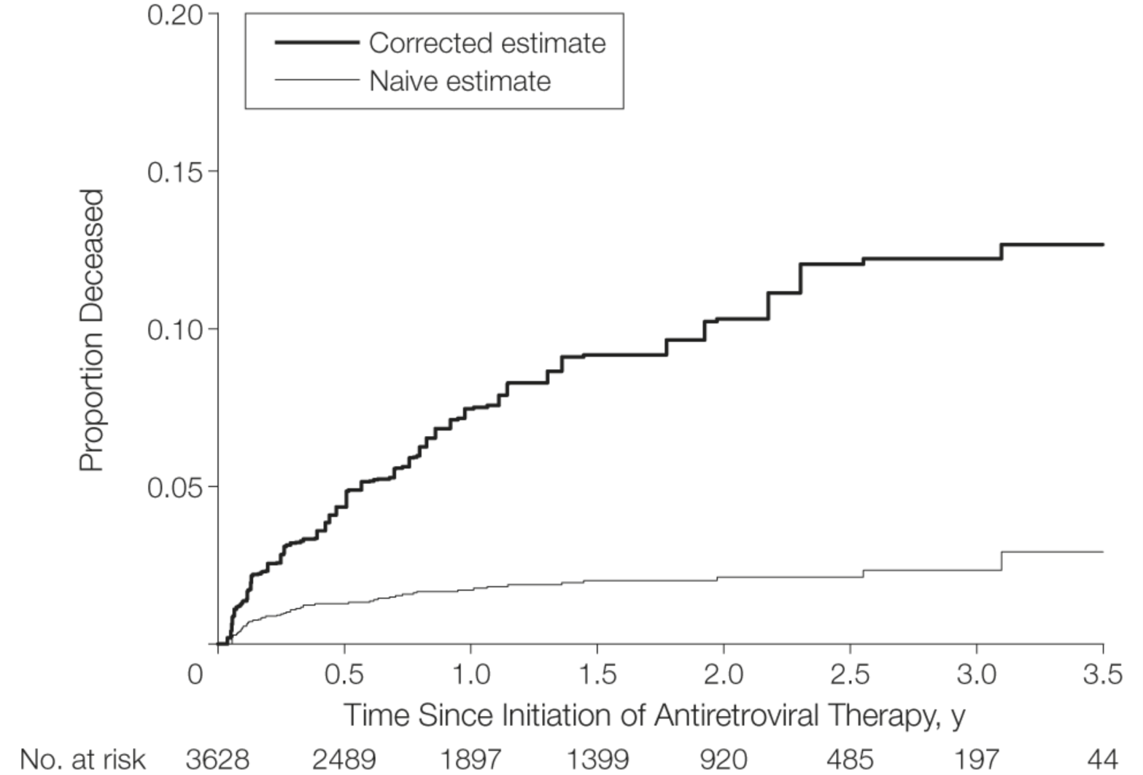
Mortality after initiation of antiretroviral therapy in resource-limited countries: Differences according to intensity of follow-up
Corrected estimate represents vital status outcomes in lost patients obtained by tracking down the lost in the community
Here, losses were informative
Naive estimate is determined using only deaths passively reported during routine clinical care. Blithely accepts the losses to follow-up and makes no attempt to decipher losses.
Geng et al. JAMA 2008
Notes:
It is interesting to look at examples where we have some data about what happened to the lost. This study is an example where we know informative censoring had occurred. This is an example of just how different results can be in some contexts when losses to follow-up are present and are informative. In this study from Uganda, the proportion of HIV-infected patients initiating antiretroviral therapy who had died was 2.3% at 3 years by passive follow-up. We call this the naïve estimate because it just uses the readily available data from the health care setting. In other words, passive means that when patients stop showing up at clinic, they are called lost to follow-up and nothing else happens. It blithely accepts the presence of losses to follow-up and makes no attempt to decipher these losses.
There were a significant number of drop-outs in this study (829 out of a total of 3628 patients). A sample of these patients who were lost to follow-up was actively tracked in their communities by the investigators to determine their vital status. The experience of this tracked group was used to correct the results for the full cohort. This is the basis of the “corrected” estimate. With correction based on the tracked patients, the investigators found that cumulative mortality after 3 years was 12.2%. The difference between 2% incidence of death and 12% is sizeable. This is a situation where the losses to follow-up are definitely informative.
It is rare that we know what happens to the lost (as was the case in this example), but informative losses of follow-up are likely common, especially in studies of morbid or fatal conditions in which the sickest persons in the cohort are the least likely to return for study visits. This may because of either a) the presence of the outcome may occur, unrecognized by the investigators (such as a death at home), and directly cause the person not to return; or b) presence of factors that are responsible for both persons to develop the outcome of interest as well as to not return for a study visit (e.g., a “common cause” of the outcome and some other state which would keep participants away from attending a study visit).
Advanced note: Whether these losses to follow-up would also bias a measure of association between an exposure variable and the outcome (i.e., an analytic objective) depends on a number of issues. These include whether the losses are also related to the exposure; “other factors” that are causally related to the outcome and to becoming lost to follow-up; whether these “other factors” are measured and able to controlled for; presence of multiplicative interaction between these “other factors” and exposure on the occurrence of becoming lost; whether or not the exposure is causally related to the outcome (“under the null or non-null context”); and the nature of the measure of association (ratio or additive) being investigated. This is essentially an expression of interaction. In most general terms, as we pointed out in the lecture on study design, bias in the measure of association will occur when the measure of association between exposure and outcome among the lost is different than those who remain under observation. All of this will be more easily understood when we introduce directed acyclic graphs later in the course.

Slide 71
Informative or Non-informative Losses?
How do we know whether our losses to follow-up (drop outs) are informative or non-informative?
Without going after them (or a sample of them) to find out, you do not know. This is the problem.
It is a matter of opinion — yours and your reviewers — whether the assumption of non-informative censoring is credible, or, if not, if you believe the violation of the non-informative censoring assumption is at least minimal.
Notes:
This naturally might lead you to ask: how do know when the drop-outs in our study are informative? The answer is that unless you try to track down all of them (or a random sample), then you cannot know. This is the problem posed by losses to follow-up. Short of assuming that losses are non-informative, it might be credible that the violation of this assumption is, at least, so small that it does not threaten your qualitative inference. That is, you and the reviewers of your work may agree that the non-informativeness is sufficiently small such that it does not invalidate your qualitative answer.

Slide 72
Cannot distinguish “lost to follow-up” from “administratively censored” in typical KM plot
Cumulative survival after diagnosis of HIV infection
“Tick mark” when participant is censored (lost to follow-up or administrative)
Tillmann et al. NEJM 2001
Notes:
All this said, what studies first need to do is to disclose the incidence of drop out (loss to follow-up) to give readers a sense of the potential problem. Conventional techniques of showing at-risk tables and tick marks for censoring on KM plots do not fully disclose the problem because they also include persons who have less than complete follow-up because of staggered entry and administrative censoring.
As we noted previously for this K-M plot, the tick marks on each survival curve represent times at which a person was censored, so they provide some useful information on the amount and pattern of follow-up time in each group. They do not, however, necessarily represent just drop outs. They may also include participants who started at later points in time and had administrative censoring at end of the study. Instead, what we want is to see the incidence of drop out per se.

Slide 73
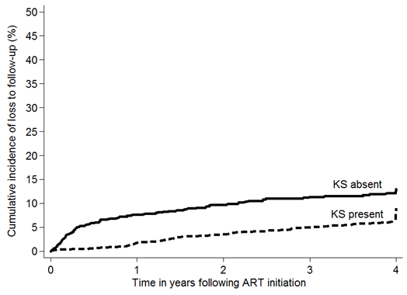
Reporting “lost to follow-up”
“Loss to follow-up” are only those who “dropped out” of the study. Does NOT include those who are administratively censored.
Notes:
This slide shows a plot of “lost to follow-up” as an outcome. In this example, person with a new diagnosis of a particular cancer (Kaposi’s sarcoma) were compared to those who do not have this cancer for the occurrence of death over 4 years. This work was led by Stephen Asiimwe. Here, the outcome is “drop out”, and those whose follow-up ended because the study ended are censored. The plot reveals a slightly higher cumulative incidence of loss to follow-up in the “KS absent” group at nearly every time in the study. This plot must then interpreted in relationship to the cumulative incidence of the main outcome. In this example, cumulative incidence of loss to follow-up at 4 years is around 5% to 10%. If cumulative incidence of the main event is much higher, say 50 to 75%, then 5% to 10% losses is small in comparison and will likely not be able to result in much bias. In contrast, if the cumulative incidence of the main event is about the same as drop out, then it is clear that drop out may indeed affect the analysis of the main event if it is informative.
This graphic is the preferred approach for telling your readers the extent of loss to follow-up, and hence a clue about the possible influence of informative censoring, in your fixed cohort. It should be done for every fixed cohort for which you desire to estimate incidence.

Slide 74
Cumulative Incidence Assumption #2
For K-M Estimation
No competing events; or
Independent competing events + a world in which you can envision preventing such competing events
Notes:
Another assumption we must make to get a valid and interpretable Kaplan-Meier estimate has to do with competing events. To get a valid K-M estimate, we must either have no competing events OR we must assume that there is a reality where competing events can be eliminated/prevented and that these competing events are independent of the outcome in question. We will now decompose what this means.

Slide 75
No Competing Events
True universally only for studies of all-cause mortality.
For all other studies, presence of competing events can be directly assessed by looking at the data
  e.g., study of adolescents for occurrence of diabetes
    In theory could have competing events (e.g., death from accident) but, in any given study, there might not be any
Notes:
Let us discuss these requirements one at a time. In an example we used earlier to calculate cumulative incidence using the Kaplan-Meier method, the outcome was all-cause mortality (death from any reason). In this situation, there are no competing events in that nothing precludes death from occurring in a given person. If this occurs, then, of course, there are no complications from competing events and no assumptions to be made.
For all other studies, it may be the case that competing events are a theoretical possibility but none occurred. For example, you might be studying a group of adolescents for an outcome of diabetes. Here, mortality (prior to diabetes) is a competing event, but it simply may not happen in your study. If this is the case, you do not need to worry about competing events in the estimation of incidence. In other words, in all other studies except for those of all-cause mortality, you must directly assess whether competing events are occurring. It is natural that you would know about competing events in a prospective study you conducted yourself, but sometimes with “found” data you will obtain a dataset in which observation time simply ended at some date and you do not know why. This is a problem in that it might be because of a competing event that simply never got recorded anywhere.
“Found” data typically refer to data that were originally collected for purposes different than research. Electronic medical record data, feeds from social media, and insurance claim data are examples.

Slide 76
Can competing events be incorporated into K-M estimation?
Only way CE can be incorporated is by assuming a reality (a target population) where they can be eliminated and they are independent
  Only way to handle CE in routine K-M estimation is to censor them
  If you censor at CE, resulting K-M estimate is unbiased (i.e., valid) only if “CE is independent of outcome”. Independence of CE means:
    Those who leave the analysis because of the CE are destined to have the same rate of the primary event as those who remain
    If you prevented the CE, you would not alter underlying rate of the outcome of interest; it would be same as rate as those without the CE
    However, hard to believe -- in most scenarios -- that both of these points are true (e.g., exception: getting struck dead by lightening)
  Therefore, K-M is typically not recommended when CE are present
  Instead, other techniques, to be covered next week, are used
Notes:
However, if competing events do occur ⎯ and they usually do in studies other than of all-cause mortality ⎯ then you will need to make some decisions if you want to calculate incidence by the K-M technique. How can competing events be managed in Kaplan-Meier estimation? If you wish to calculate incidence by the K-M technique, this means the only thing you can do (at least with routine K-M estimation) is to censor a person at the time of a competing event. (Remember, each participant in K-M estimation either is censored or gets the event.) If you censor at the time of the competing event, it means that you wish to make a statement about what would happen if competing events did not occur (i.e., were eliminated). Censoring means that you, the investigator, do not directly see what happens to the subject but that you realize that they do continue to march forward and have things happen to them. Many or most observers would believe this it is ludicrous to consider a reality where competing events are eliminated. This is not reality as we know it. That is, we live in a world of competing events.
If you nonetheless still want to go ahead and do the K-M calculation, the only way to mechanically do this in routine Kaplan-Meier estimation is to censor observation after the competing event occurs. If you do this, the underlying assumption, for the KM estimate to be valid, is that the CE is independent of the outcome of interest. Or, in other words, what this means is that if you could prevent the competing events from occurring, the rate of the outcome of interest would not be affected. The assumption is that there are no factors which are both causing the competing event and the outcome of interest. Becoming dead by being struck by lightening is one such example of an independent competing event (most people would accept this assertion) but most competing events are not obviously independent. In other words, this is an assumption that is not often realistic. The S+ N text makes this point in Table 2-4 (first item in the Table) although they do not use the term “competing event.”
In summary, to incorporate CE into KM, one needs to conduct an analysis in which you act like the CE is eliminated (the event, not the people). To do so, one needs to:
--envision a target population in which the CE does not occur. If this target population does not exist, it hardly seems worthwhile to try to perform an analysis in which CE’s are eliminated
--assume that the occurrence of the CE and the outcome of interest are independent
--assume what you have to do to eliminate the CE does not change the underlying rate of the outcome of interest
Because it is difficult to justify these three things, KM is not recommended when there is any appreciable incidence of competing events. “Appreciable” means any number which is high enough to substantively change the point estimate depending upon whether you censored the CE’s or not. There are other methods available to estimate cumulative incidence while recognizing or “accommodating” the presence of competing events (e.g., the Aalen-Johansen estimator), and we will cover these next week.

Slide 77
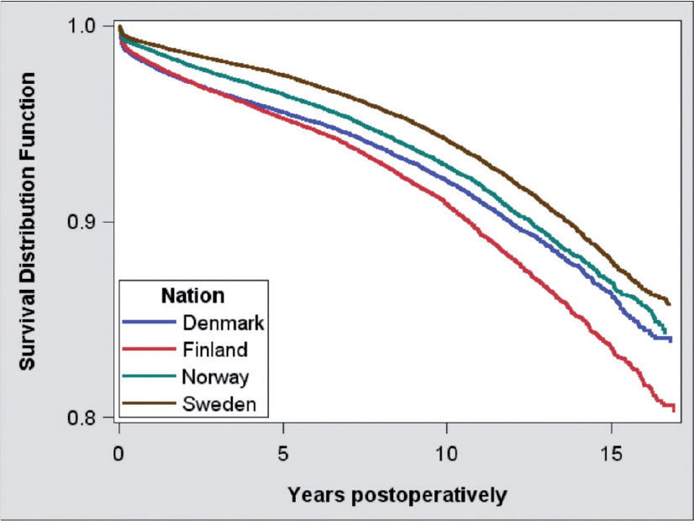
K-M often used despite competing events when looking at longevity of devices, implants, other surgical procedures
~1/3 were 75 years or older
Kaplan-Meier “survival” for all total hip replacements, by country.
Outcome is need to revise (i.e. fix) the hip replacement (for any reason).
Patients were censored at death.
Mäkelä et al. Acta Orthopaedica 2014
Notes:
The recommendation not to use conventional K-M estimation in the face of competing events does not stop researchers from doing it. Next week we will show data on just how often researchers get this wrong ⎯ usually because of ignorance of the topic ⎯ but for this week we will concentrate on a research area where we suspect people are familiar with the other approaches but still nonetheless use the K-M technique. This is the area of devices (e.g., pacemakers), implants (e.g., heart valve replacements), and surgical procedures (e.g., coronary artery bypass graft placements). The research question in these areas is “what is the biological lifespan of the device, implant, procedure, assuming that the host patients never died”. It is a bioengineering question, and it seems like a reasonable question to ask, but there are difficulties when trying to use the K-M estimator to answer it.
Indeed, this was the question addressed in this example where researchers sought to estimate how long hip replacements are lasting in 4 Scandinavian countries. As you would expect, this is an older population, and we are told that about 1/3 were 75 years or older. Thus, we fully expect to see a lot of deaths, which would be competing events in this context. Nonetheless, the investigators censored patients at death and used the K-M technique to estimate the cumulative incidence of needing a revision after a total hip replacement (i.e., needing the original hip replacement to be fixed or replaced). Is K-M the right approach to use?

Slide 78
K-M often used despite competing events when looking at longevity of devices, implants, other surgical procedures
Is K-M with censoring at death the right approach?
  Hard to say, but we believe probably not
Censoring at death assumes that if those who died had not died they would have had the same rate of hip revision as those who did not die.
  Means that you think no factors are influencing both death and hip revision (no common causes of both)
  Believable if you think state of body is not influencing device lifespan (or physicians’ decisions to do revision procedures)
  If this is the case, you may as well get the answers in animals
Use of K-M with inverse probability weighting approaches in part gets around this. Very rarely used in practice. See optional reading.
One more problem: how are you going to create a world in which no one dies? Won’t this intervention also affect risk of hip revision?
Notes:
78
Is K-M the right approach to use? By censoring patients at death, the investigators are making the assumption that if those who died had not died they would have had the same incidence of hip replacement revision (fixing or redoing the procedure) as those who did not die. Stated another way, they are assuming those who did not die and whose rate of hip revision can be observed are, in fact, representing all the patients who started in this analysis, including those who earlier died. This is akin to the assumption we made for persons who became lost to follow-up.
First, is this a reasonable question to ask? Yes, it is a bioengineering question; the focus is entirely on the device and not the human being. Note that it is slightly different than asking how long people would last without having a heart attack assuming they never died from any other competing risk (cancer). If it is a reasonable question to ask, is censoring at death with the K-M estimator the best way to do the analysis? The answer is hard to know, but we think probably not. Although we do not have the direct data available to us here, it is likely not the case that hip revision and death are independent. We do not believe that those who are experiencing death would have the same rate of hip revision (if they had stayed alive or were “revived”) as those who are not dead. The only way death and hip revision could be independent is if they shared no factors which influenced them both (i.e., if they had no common causes). This includes physicians' decisions to perform the hip revisions (physicians typically will not perform these procedures on patients who are perceived to have very short lifespans). In other words, you would have to believe that nothing about the human body is influencing the need for hip revision. If you believe this, you may as well get the answers in animals. We do not believe hip revision and death are independent.
There are, however, analytic techniques that get around some of these assumptions using the K-M approach, such as the use of inverse probability weighting to construct the population a bit differently to better reflect its risk for hip revision once the dead are revived. This is explained briefly in the optional reading (Grunkemeier et al 2007). This technique also requires some assumptions, so it is not a magic bullet. In practice, the technique is very rarely used (and we will not be describing it in the course).
There is yet one more problem, and it is one which introduces more hypothetical quandaries. That is, exactly what is the intervention that you are going to need to keep everyone from experiencing death (the competing event)? If there are shared common causes of both death and need for hip revision, then it is quite likely that anything you do to prevent deaths is also going to alter the rate of hip revision both in those destined to die (and perhaps in those not destined to die). How much it will change incidence of hip revision is hard to know.
The bottomline is that attempting to accurately describe what the incidence of hip revision would be in a world where patients did not die (i.e., eliminating death) is hard to do. It is “make believe”. It is easy to do the math (just censor at the time of the CE), but you should not feel confident that you have right answer. Some people would say it is so hard to be sure the answer is correct that it is not worth doing, and instead other approaches, where we simply accept or accommodate competing events, is a better approach. We will discuss these approaches next week.
[Technical note which will be better understood later in the course: the directed acyclic graph (DAG) for this scenario of factors influencing both death and hip revision would have a) a common cause with edges to both death and hip revision; and b) a box around death to depict selection.]

Slide 79
Cumulative Incidence:
Underlying “Warning” #3
In a fixed cohort, we “shift everyone to the left” and use follow-up time as the time scale rather than calendar time.
If the probability of the outcome is changing over calendar time, (i.e., “secular/temporal trends” affect the outcome), then this combines persons of different eras/experiences.
If there are secular trends, you can still calculate cumulative incidence and it is mathematically correct, but the result is loss of information and, typically, a less meaningful interpretation.
We call this a warning while S + N text calls it an assumption.
  We don’t have to assume no secular trends to get a valid inference
  Rather, if secular trends present, interpretation must be altered/limited
Notes:
In our example of a fixed cohort, we “shifted everyone in the left”. That is, we used follow-up time rather than calendar time as the time scale. If the probability of the outcome is changing over calendar time (a construct that is called a secular or temporal trend), then shifting everyone to the left combines persons of different eras/experiences into one lumped summary. If there are secular trends, you can still do the calculation and it is mathematically correct, but the result is loss of information and, typically, a less meaningful interpretation. In this situation, you would be sweeping a lot of interesting information under the carpet by not showing the incidences for the periods separately. Your result also has a limited interpretation in that it does not apply to any single person in your study sample, and it certainly does not apply to the next patient who presents with the condition or question. Your answer is simply the average over disparate time periods. This average may be useful to some observers, but remember that it represents none of the individual sub-eras/time periods per se.
The S+ N text calls this issue an “assumption” in that you must assume that secular trends are not present in your population, but we believe this is not the right characterization. The presence of secular trends is not a threat to validity (i.e., the inference is valid) but, rather, can affect what the estimations actually mean (how they are interpreted). Instead, we just view it is an issue that the investigator needs to be aware of. If secular trends are present, the resultant estimate is still valid for a target population that spanned all of the eras in question (but this is simply much less useful of a finding). Also, it is only valid if everyone in that wide time span is represented proportionately.
Note, “lack of secular trend” does not mean that the probability of the outcome is the same during all of the follow-up time (what we will later call a constant hazard). Moving everyone to the left has no impact, and requires no assumption, on what happens with incidence over time in a given individual. Risk could either increase or decrease over time.
Finally, a nuance here is that if the different calendar time cohorts have different lengths of follow-up (e.g., early cohort followed for 30 years and later cohort only followed by 10 years), this means that the only persons contributing data for the last 20 years are the early cohort persons. This means that the last 20 years of survival is not a random sample of everyone present at time zero. The entire curve is not a weighted average of the different calendar time cohorts. The entire curve is not representative of any tangible population, and we can see no reason to estimate this. This issue will not be a problem if all of the calendar time cohorts are followed for the same length of time (e.g., 30 years). This is another reason to be cautious about combining incidence data that has secular trends.

Slide 80
FIG. 1. Cumulative incidence of any fracture among 1,964 Rochester, MN, residents after first recognition of diabetes mellitus in 1970–1994
How long was the “enrollment” period? i.e. How many years between the start of follow-up for first & last enrolled participants?
OK to shift everyone to the left to summarize with one estimate of fracture incidence?
Melton et al. JBMR 2008
Notes:
This study was conducted at the Mayo Clinic in Rochester, Minnesota (in the U.S.), using data from Olmsted County in Minnesota. The underlying population is a dynamic cohort that receives virtually all of their medical care through the Mayo Clinic and has been used for numerous research studies. Despite it being a dynamic cohort, the goal of this research question was to determine the incidence of fracture after first recognition of diabetes. Thus, the study design was a fixed cohort study, with entry into the cohort at the time of diabetes diagnosis. Entry into this cohort took place over 24 years (1970-94). Individuals were then followed for up to 30 years.
This is an example of a K-M plot expressing cumulative incidence of fracture on the y-axis up to 30 years of follow-up time. Follow-up time for fracture starts after diagnosis of diabetes. Residents entered the fixed cohort study at calendar times that ranged across 24 years, but, as a fixed cohort, all of the participants were “shifted to the left.” The starting time for all residents in this study was the date when they entered the cohort, i.e. the date of their diabetes diagnosis.
How long were participants followed? We know that at least some were followed for 30 years. The authors report a median of 12 years of follow-up, but do not report the final date for follow-up. However, the paper was published in 2008 so the participants who were diagnosed with diabetes in 1994 had a maximum follow-up time of 14 years. Hence, not everyone was followed for 30 years.
Is there any problem introduced by shifting all of these patients to the left — for a 24-year period — and coming up with one estimate of fracture incidence? The answer depends on whether we think fracture incidence in those with diabetes was relatively stable over these years. The incidence for each follow-up year combines incidence following diabetes diagnosis for those diagnosed over a 24-year span. For example, at one year of follow-up the incidence includes the experience of those diagnosed with diabetes in 1970 through 1994. An additional problem arises as we go further out in follow-up time. At these latter follow-up times, the results are increasingly dominated by the experience of those enrolled in the 1970’s. These are the only participants with >20 years of follow-up, and therefore the only ones contributing to the incidence curve towards the end of the follow-up time.
In this particular context, in which the latter follow-up time only comes from those who were enrolled first, unless there were no secular trends, the curve cannot be applied to any tangible group of people.

Slide 81
When should you be concerned about secular trends?
1970 1980 1990 1994
Long accrual (24 years from 1970-94)
Notes:
When should you be concerned about secular trends?
You should be concerned when people are beginning observation over large periods of calendar time. When these people are “shifted to the left,” time zero for follow-up time will represent a large range of calendar years.
81

Slide 82
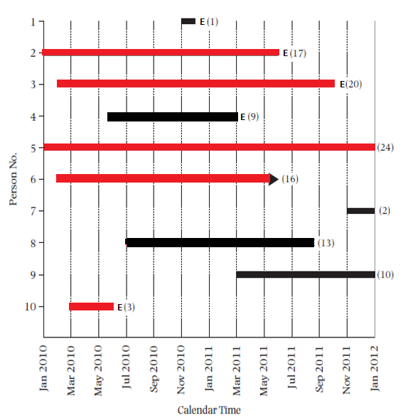
When should you be concerned about secular trends?
1970 1980 1990 1994
Same graphic but with RED bars for those who entered cohort 1970-74
Notes:
This illustrates, with red horizontal lines, which persons’ time zero occurred between 1970 and 1974.
82

Slide 83
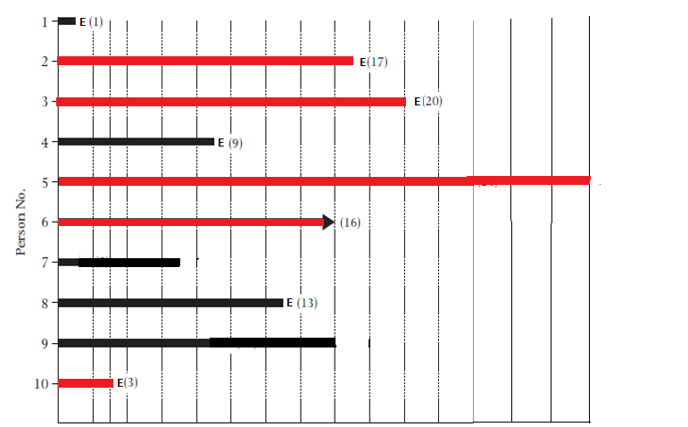
Cohort experience in later years of follow-up dominated by those recruited early
0 10 20 30
Follow-up Time (years)
Notes:
Here, we show people “shifted to the left.” Time zero ranges from 1970 to 1994 for the participants. The resulting cumulative incidence estimate thus represents an averaging of people starting in different eras.
Importantly, the participants who provide the longer follow-up times can only be those who started in the 1970’s. Thus, the experience of the total cohort towards the end of the study will only reflect the experience of the 1970’s cohort.
Thus, if we put all of these people together in our Kaplan-Meier estimate and if there are secular trends, we will have a Kaplan-Meier estimate which is made up of an average of era estimates in the first half of the observation period and then only the persons who entered the cohort in the early 1970’s during the latter portion of observation time. This estimate pertains to no one in the target population from 1970 to 1994 nor in the future. It lacks any meaningful interpretation. Thus, when follow-up is unequal between different eras and there are secular trends, we will have problems in interpreting the meaning of the estimates.
83

Slide 84
Reasons for underlying secular trends
True biological/clinical changes in incidence; e.g.,
  Rapid changes in HIV incidence at start of epidemic
  Changes in incidence of hip fracture
Changes in methods of diagnosis (measurement); e.g.,
  Adding hemoglobin A1C to diagnostic criteria for diabetes
  Widespread use of mammography for breast cancer screening
Secular trends more apt to be present in a study with longer accrual time and longer follow-up time
Notes:
There are two main ways in which secular trends can occur. The first is true biological or clinical changes in the system. In other words, something is changing in the human host or the environment that is causing true changes in incidence. The second is change in measurement, such as changes in diagnostic tests or definitions.
For many studies, it is reasonable to assume that incidence is not changing over calendar time of the study follow-up. For one thing, the difference in calendar time may be just a matter of months rather than years, so it would take a very rapidly changing trend to be important in a time frame of months. For some situations, though, this may be a dubious assumption. For example, if one were enrolling subjects to study a new infectious disease during its introductory epidemic period (HIV, Ebola, COVID-19 etc.), secular trends might affect incidence estimates significantly. Changes in methods of diagnosis can also cause a change in incidence that is essentially an artifact of the new diagnostic approach. For example, this may occur with estimates of diabetes incidence as new guidelines using hemoglobin A1C to diagnose are implemented. More widespread screening (i.e., more looking for cases without any apparent symptoms) can also cause an increase in incidence in conditions that are not clinically overt. All of these examples are known as “period effects”. Period effects impact everyone alive during that calendar period of time.

Slide 85
FIG. 1. Cumulative incidence of any fracture among 1,964 Rochester, MN, residents after first recognition of diabetes mellitus in 1970–1994
How long was the “enrollment” period? i.e. How many years between the start of follow-up for first & last enrolled participants?
OK to shift everyone to the left to summarize with one estimate of fracture incidence?
Melton et al. JBMR 2008
Notes:
Data on fracture incidence by calendar time in this specific population (with diabetes) was not made available in this study. Interestingly, the issue was not discussed by the authors. We can, however, look at fracture incidence in other populations over a similar time period. The results on the next slide, taken from a Swedish population, suggests that this might be a concern.

Slide 86
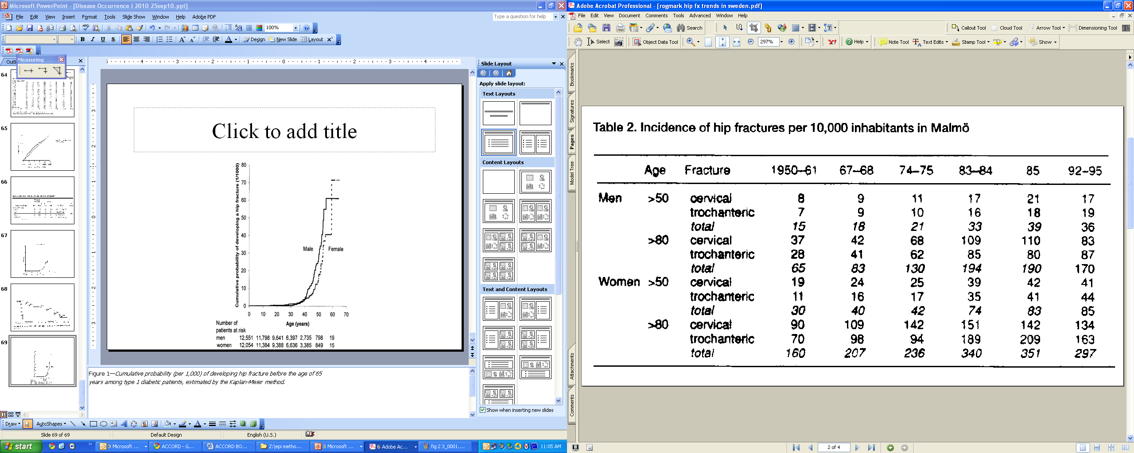
Hip fracture trends in Sweden
Rogmark et al. Acta Orthop Scand 1999
Notes:
These are results from a study of trends in hip fracture incidence during the last 60 years in Sweden. The incidences referred to here are hip fractures per 10,000 person-years, and hence these are incidence rates. (The authors actually refer to this as “… annual incidences of hip fractures per 10,000 inhabitants”, which is a typical but not pristinely clear way of saying 10,000 person-years.) The rates have increased steadily over time with some leveling off in the 1990’s. Those results were derived from a period similar to the period from the Rochester study in the prior slide. The changing rates over time can lead to a substantial loss of information and inaccurate conclusions about cumulative incidence if one simply lumps all of these time periods together and creates a single Kaplan-Meier plot. If we calculate cumulative incidence for the time period 1967-95, we would mix together periods with differing incidence of hip fracture. The resulting number would not be representative of any of the individual years. In other words, a single number summarizing those years (1967-95) does not well represent any single person in the time period. Because the same could be true in the Rochester example, we have reason to be wary about the interpretation of the Kaplan-Meier estimates of cumulative incidence.

Slide 87
Kaplan-Meier using Stata:
An Example
Cohort: Participants diagnosed with primary biliary cirrhosis in a large health maintenance organization
Goal: Determine the cumulative incidence of death (of any cause; “all cause”) — also called “cumulative mortality” — after diagnosis of primary biliary cirrhosis.
Dataset includes 184 patients with 96 deaths. Median follow-up time was 3.6 years.
Notes:
Let us now turn to the computer implementation of the K-M technique. We illustrate the use of Stata to calculate cumulative incidence with the Kaplan-Meier method with a dataset containing a collection of patients with primary biliary cirrhosis, an autoimmune disease of the liver. The dataset includes 184 patients. The outcome we are interested in is death due to any cause; 96 deaths occurred during follow-up. Median follow-up was 3.6 years. We will calculate the cumulative incidence of death, also called the cumulative mortality.

Slide 88
Biliary Cirrhosis Dataset
. use "M:\biliary cirrhosis dataset.dta", clear [THIS OPENS THE DATASET]
. describe
Contains data from M:\My Documents\ATCR - Teaching\Stata datasets\biliary cirrhosis dataset.dta
obs: 184 PBC
vars: 7 17 Mar 2019 23:36
size: 5,152
-------------------------------------------------------------------------------
storage display value
variable name type format label variable label
-------------------------------------------------------------------------------
id float %9.0g Subject identifier
time float %9.0g Follow-up time in years
d float %9.0g d Failure: 1=dead, 0=alive
treat float %9.0g treat Treatment
age float %9.0g Age at entry (years)
cirrhos float %9.0g cirrhos Cirrhosis at entry
bilirub float %9.0g Bilirubin at entry (mumol/l)
-------------------------------------------------------------------------------
Sorted by: id
Notes:
This is the dataset regarding death following a diagnosis of primary biliary cirrhosis. The commands show how to open a dataset and how to obtain a description of the contents. We use the command “describe” to show the contents.

Slide 89
To calculate Kaplan-Meier estimator, we need:
A data set with one observation per participant.
Knowledge of whether each person either experiences event (death in this example) or is censored (from either drop-out or administrative). A variable must indicate this. In this dataset, this variable = d
A variable for the time from study entry to date of event or date of censoring (i.e., duration of observation). In this dataset, this variable = time
Notes:
89
To perform Kaplan-Meier estimation, we need a data set with one observation per participant. At a minimum, we need two variables. The first, which we call “d” is called the event variable. It tells us if the person experienced the outcome under study (here, death) or did not (i.e., was censored). We typically code this as 1 for having the event, and 0 for censored. The second variable, which we will call “time”, holds the observation time, either from time 0 to the event, or from time 0 to the moment of censoring.

Slide 90
Biliary Cirrhosis Dataset
First 9 observations
+--------------------+
| id time d |
1. | 51 1.582478 1 |
2. | 23 9.032169 0 |
3. | 40 2.286105 1 |
4. | 42 2.078029 1 |
5. | 45 5.31143 1 |
6. | 48 2.633812 0 |
7. | 50 3.931554 0 |
8. | 52 4.843258 0 |
9. | 54 2.105407 0 |
Variables required for Kaplan-Meier estimate
Notes:
To illustrate how survival data look in Stata, this slide shows the first 9 observations in the biliary cirrhosis dataset.
The 3 essential variables are Id (the unique patient identifier), observation time, and event (or outcome). In this study, the outcome is death.
Id = Participant identification number
Time = Follow-up time (in years)
d = death (1=dead, 0=alive)

Slide 91
Survival Analysis in Stata
Notes:
We already opened our dataset (biliary cirrhosis dataset.dta) with the use command. Next, we need to tell Stata that our dataset contains survival data. If you are using the command line, use the stset command. Once Stata understands that the dataset contains survival data, Stata will then provide the user some summary information on the dataset.
The stset command has as its syntax “stset <observation_time_variable>, fail(<event_variable>). Thus, we would type:
stset time, fail(d)
This produces a useful summary of the dataset that is worth perusing for face validity to make sure no errors have been make. Face validity refers to whether everything makes sense according to your pre-existing understanding of the system.

Slide 92
Cumulative incidence of death at 11.64 years = 1 – 0.2375 = 0.7625
Notes:
After “stsetting” the data, the command “sts list” provides the survivor function (i.e., the Kaplan-Meier estimate of cumulative survival) at each time a participant fails or is censored (“net lost”). This is what we did with our small dataset in the example from the S+N text, except we did not show the work for each time a participant was censored since the survivor function does not change.
Stata output shows the survivor function when a participant is censored, and we can see in this example that it does not change. The last line at time 11.64 indicates 1 participant censored and the survivor function remains the same (0.2375) as in the line just above at time 11.25.
Stata also provides 95% confidence intervals [95% CI] for the survivor function at each point.
Note that 2 participants can fail at the same time, shown in the output on this slide.
This listing only shows the beginning and end of the actual output. We have omitted the middle part of save space. To obtain the cumulative incidence at, say, 5 years, you could identify this from the sts list output, but those lines of output are not shown on this slide. You can also use the “,at” option.
You will have a chance to calculate cumulative incidence using the Kaplan-Meier method in Stata in the Problem Set for this week.

Slide 93
Follow-up time (in years)
Notes:
This is called the Kaplan-Meier plot, Kaplan-Meier graph, survival curve/plot, or survivor curve/plot. The command for above graph that specifies the axis titles is : sts graph, ytitle (“Proportion surviving”) xtitle (“Follow-up time (in years)”). This graph shows the Kaplan-Meier survival estimate at a variety of times after time zero.

Slide 94
Follow-up time (in years)
Notes:
As we noted earlier, we prefer to show the direct plot of incidence (with the curve climbing). The option “, failure” will accomplish this.

Slide 95
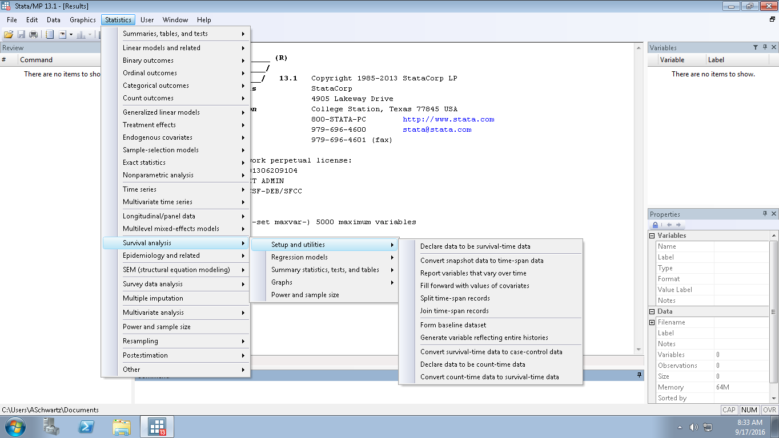
All of preceding can be done in Stata using
its drop-down menus -- and these lead to dialogue
boxes showing many other relevant options
Notes:
These are the menu pathways.
Statistics
Survival Analysis
Setup & Utilities
Use Declare data to be survival-time data
to identify time and censoring variables and specify value
that indicates failure (e.g., 1)
Statistics
Survival Analysis
Summary statistics, tests, & tables
Use List survivor and cumulative hazard functions to get
values of survival function
Use Graphs to get K-M graph

Slide 96

Life table method of estimating cumulative incidence
Life tables predate Kaplan-Meier. Their original use has been credited to Edmund Halley (of comet fame) in 1693.
  Halley E. An estimate of the degrees of the mortality of mankind, drawn from curious tables of the births and funerals at the city of Breslaw; with an attempt to ascertain the price of annuities upon lives. Philosophical Transactions 17: 596–610, 1693.
Developed to assess life span and set life insurance costs
Key difference from Kaplan-Meier
  probabilities are calculated for pre-specified fixed time intervals, not at the exact time of each event
Notes:
Life tables, as the name implies, were first constructed to look at the cumulative survival (mortality) of large populations over a lifetime.
Historical note: Life tables go back to the 17th century. Their original use has been credited to Edmund Halley.
Halley, E. An estimate of the degrees of the mortality of mankind, drawn from curious tables of the births and funerals at the city of Breslaw; with an attempt to ascertain the price of annuities upon lives. Philosophical Transactions 17: 596–610, 1693.
A life table calculation proceeds by dividing time up into discrete pre-specified pieces, calculating survival probabilities for each piece, and obtaining a cumulative probability of non-event by multiplying the individual probabilities of non-events together. But, unlike Kaplan-Meier, the time period pieces are arbitrary and not determined by the time of each event. Hence, one does not need to know the exact time of each event. The time intervals are set by the investigator. For a lifetime life table (i.e., across the spectrum of an entire human’s life), they are typically 5-year intervals. For a cohort study where participants are typically followed for 5-10 years, 1-year or 6-month intervals might be more typical.
Although the investigator does not need to know the exact time of each “event”, there is a price we pay in order to do the calculation. The price is that we must make assumptions about the timing of these. There is no free lunch. We must assume that in a given interval, the events are occurring at a constant rate and that those censored are becoming censored at a constant rate. To the extent these assumptions are wrong, the life table-derived estimates are biased. In contrast, the K-M approach uses exact times and is not influenced by this.

Slide 97
Life table method of estimating cumulative incidence
Don’t need to know exact date of each event or each censoring (this is the chief advantage of life table)
  e.g., acquisition of hepatitis C virus is typically clinically silent, only identified by repeated blood tests
But, must assume that, in a given interval, constant rate for events and constant rate for censoring. To the extent these assumptions are wrong, the life table estimates are biased.
  In contrast, the K-M approach uses exact times and is not threatened by this potential bias
For large data sets, the life table and the Kaplan-Meier methods produce nearly the same results
Notes:
Life tables differ from a Kaplan-Meier estimation in that they do not require knowing the exact time of each event (e.g., event) or the exact occurrence of censoring; this is the chief advantage of the life table approach to cumulative incidence estimation.
This can be an advantage when an event is known to have occurred in a certain time interval, but the exact date of occurrence is not known. An example is acquisition of hepatitis C virus. Acquisition can be identified with blood tests at repeated visits but an exact time of acquisition is usually not known. The life table approach would be an appropriate method for calculation of cumulative incidence of hepatitis C virus acquisition in a fixed cohort.
However, the price we pay in order to do the calculation is that we must make some assumptions about the timing of the outcome of interest during a given interval. There is no free lunch. We must assume that in a given interval, the events are occurring at a constant rate and that those censored are becoming censored at a constant rate. To the extent these assumptions are wrong, the estimates are biased. In contrast, the K-M approach uses exact times and is not biased in this respect (although other threats, that we have discussed, could make it biased).
For large data sets, these assumptions for the life table are often credible, and there is little difference between cumulative incidence calculated with K-M and the life table approach.

Slide 98
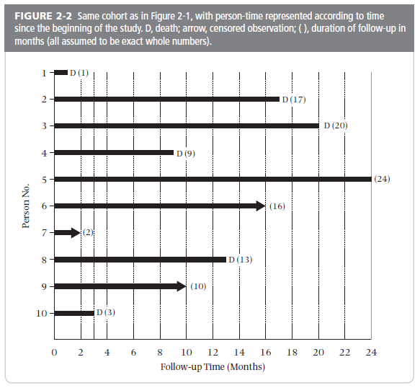
For Life Table method:
As in K-M, shift everyone to the left
Notes:
This is the same set of data that we used earlier to illustrate the calculation of cumulative incidence with the Kaplan-Meier method. We will use this same set of data to illustrate calculation of cumulative incidence using the life table method. As with the Kaplan-Meier method, to resolve the problem of different starting times, the analyst “shifts all the starting time to the left.” For the analysis, each person is going to be started at the same time zero. Note that the time axis is now follow-up time rather than calendar time. When you do this, you need to be cognizant, as was the case with Kaplan-Meier estimation, whether you are combining the experience of persons who might have been in very different calendar time periods.
Life table calculations are based on distinct time periods after the starting point. In this teaching example, we will divide this into 2 periods, each 12 months long, but it’s not necessary to have time periods of equal length. Periods should be chosen based on the assumption that events occur at a uniform rate during the interval. For this example, if we were concerned a priori that event distribution might be different towards the beginning of follow-up, we could divide the follow-up time into the first 6 months and the second 18 months.
98

Slide 99
Calculating Cumulative Incidence with a Life Table
Time interval (mos) | Alive at start of interval | Effective number at risk during interval | Number of events | Conditional probability of the event | Conditional probability of survival | Cumulative probability of survival
 | n | n* | d | q = d/n* | p = 1-q | S(t)
0-12 | 10 | 9 | 3 | 3/9=0.33 | 0.67 | 0.67
13-24
Effective number at risk for 1st year (n*)
10 alive at start
2 were censored. Assume constant rate of censoring through the interval. This means that each censored person effectively contributes 0.5 of a person. Thus, effective number of persons at risk during interval:
  10-(1/2)(2) = 10-1 = 9
Notes:
This table demonstrates the calculations involved with the life table approach. After you have established the time intervals you will use, the first order of business is to state the effective number of persons at during each interval. We derive this by determining the number censored at any point in the interval and then assuming a constant rate of censoring throughout the interval. A constant rate of censoring means that on average each censored person gave 0.5 of the length of the interval or each censored person was the equivalent to 0.5 of a person at risk. We then subtract one 0.5 of a person for each censored person to yield the effective number at risk during the interval. The rest of the calculation is just like we did in the Kaplan-Meier estimation. In our example, in the first interval (0 to 12 months), there were 10 persons at risk at the start of the interval and 2 persons who become censored. We assume that these two persons each contributed 0.5 of the observation period, thus collectively they contribute one full observation period. This means that of the starting 10 persons, we effectively have 9 persons who were at risk for the entire interval.
99

Slide 100
Calculating Cumulative Incidence with a Life Table
Time interval (mos) | Alive at start of interval | Effective number at risk during interval | Number of events | Conditional probability of the event | Conditional probability of survival | Cumulative probability of survival
 | n | n* | d | q = d/n* | p = 1-q | S(t)
0-12 | 10 | 9 | 3 | 3/9=0.33 | 0.67 | 0.67
13-24 | 5 | 4.5 | 3 | 3/4.5=0.67 | 0.33
Effective number at risk for 2nd year:
5 alive at start
1 censored. Assume constant rate of censoring. Effective number at risk:
  5-(1/2)(1) = 5-0.5 = 4.5
Notes:
The same logic is used in the second interval of calculation from month 13 to 24.
100

Slide 101
Calculating Cumulative Incidence with a Life Table
Time interval (mos) | Alive at start of interval | Effective number at risk during interval | Number of events | Conditional probability of the event | Conditional probability of survival | Cumulative probability of survival
 | n | n* | d | q = d/n* | p = 1-q | S(t)
0-12 | 10 | 9 | 3 | 3/9=0.33 | 0.67 | 0.67
13-24 | 5 | 4.5 | 3 | 3/4.5=0.67 | 0.33 | 0.22
Cumulative probability of survival thru 24 months =
0.67 x 0.33 = 0.22
We want cumulative probability of event =
1-0.22 = 0.78 (over 2 years)
Recall that the K-M estimate was 0.82
Notes:
The cumulative probability of survival through 24 months is 0.67 x 0.33 = 0.22. Because we are ultimately interested in the cumulative incidence of the event, we subtract the cumulative survival from 1.0 to get 0.78. This is very close, although not identical, to the Kaplan-Meier estimate.
101

Slide 102
Life table in Stata
Using same dataset – mortality after diagnosis of primary biliary cirrhosis
. ltable time (d)
Beg. Std.
Interval Total Deaths Lost Survival Error [95% Conf. Int.]
-------------------------------------------------------------------------------
0 1 184 18 7 0.9003 0.0223 0.8464 0.9360
1 2 159 19 9 0.7896 0.0308 0.7214 0.8429
2 3 131 13 9 0.7084 0.0349 0.6337 0.7707
3 4 109 9 12 0.6465 0.0375 0.5679 0.7145
4 5 88 14 7 0.5394 0.0407 0.4563 0.6153
5 6 67 7 14 0.4765 0.0424 0.3915 0.5565
6 7 46 10 12 0.3574 0.0455 0.2694 0.4461
7 8 24 3 4 0.3086 0.0472 0.2193 0.4022
8 9 17 2 3 0.2688 0.0488 0.1786 0.3671
9 10 12 1 6 0.2389 0.0517 0.1458 0.3449
10 11 5 0 3 0.2389 0.0517 0.1458 0.3449
11 12 2 0 2 0.2389 0.0517 0.1458 0.3449
-------------------------------------------------------------------------------
How do we report cumulative incidence of death at 10 years from this output?
1-0.2389 = 0.7611
KM estimate was 0.7625
Notes:
This slide illustrates the life table method performed in Stata We are using the same dataset ⎯ survival after diagnosis of primary biliary cirrhosis — as we used before for the Kaplan-Meier calculation in Stata.
By default, Stata has assigned an interval of 1 time unit for the life table. Since our time variable is in years, this is a time interval of 1 year. A different interval (or intervals) can be specified by the user, if desired.
How would we report cumulative incidence of death at 10 years from this output? The “survival” column gives us the cumulative survival (0.2389), but we want cumulative incidence of death (failure). That is 1-0.2389 = 0.7611. Compare this result with the estimate we obtained with the Kaplan-Meier method: cumulative incidence of 0.7625. You can see with this larger dataset that the K-M and life table estimates are very similar.
The graph produced with this command is shown on the next slide.

Slide 103
Life Table Estimator
Survival after diagnosis of primary biliary cirrhosis
Kaplan-Meier Estimator
Follow-up time (in years)
Follow-up time (in years)
Notes:
Here we see the life table and K-M survival curve for the same set of data (time to death after diagnosis of primary biliary cirrhosis). Note that the life table is not a step function; instead, the points are simply directly connected by a straight line. This is consistent with the underlying assumption that the rate of the event is constant within each interval. The K-M plot is a step function although it is difficult to appreciate in this graph because there are many events. It is easier to see this step function in the small n example that we showed earlier today.

Slide 104
More Common Use of Life Table Approach
Time interval (mos) | Alive at start of interval | Effective number at risk during interval | Number of events | Conditional probability of the event | Conditional probability of survival | Cumulative probability of survival
 | n | n* | d | q = d/n* | p = 1-q | S(t)
0-12 | 10 | 9 | 3 | 3/9=0.33 | 0.67 | 0.67
13-24 | 5 | 4.5 | 3 | 3/4.5=0.67 | 0.33 | 0.22
Conditional probability of the event data do not have to come from the same group of persons followed over time
Instead, probabilities could be obtained by changing the time scale to age and using age-specific probabilities of the event obtained from different groups of people (of different ages)
Notes:
What we have explained thus far in both the Kaplan-Meier approach and the life table approach has used data from a fixed cohort followed forward. This is not the only way these approaches, particularly the life table method, can be used. Specifically, the conditional probability of event data do not need to come from the same group of people. Instead, we could change the time scale to age and then use age-specific probabilities of the event obtained from different groups of people of different ages. In this way, we can piece together a hypothetical cohort as it ages and experiences the age-specific probabilities that are present at the current moment in time.
104

Slide 105
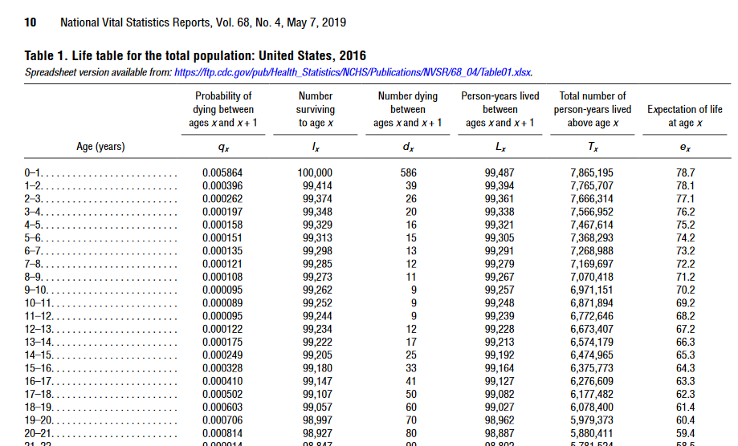
More Common Use of Life Table Approach
Probabilities could be obtained by changing time scale to age and using age-specific probabilities of the event
Yields the experience of a hypothetical population living in a particular period of time
  “Period life table” (as opposed to cohort life table)
Basis for life expectancy estimates (actuarial science, demography)
  People born in a particular period (e.g., 2016) and experiencing the incidence of death of that particular period.
Notes:
Working with age-specific probabilities of the event of interest during a particular period of time yields incidence estimates for a hypothetical population living in the particular period of time. Performing such an approach yields what is called an “period life table”. Formally, what we were using before, when we were analyzing a fixed cohort over its observation time, is called a “cohort life table”.
This approach is the basis of life expectancy estimates that you have probably encountered. These estimates essentially consider people born in a particular period (say, 2016 in the U.S.) and then look at what would happen to them as they age and they experience the incidence of death that is present in the specified time period. We call this a hypothetical population, because no single group of people live their entire lifetimes during a particular period. Shown is a snapshot of a life table for the U.S. in 2016, showing the mean life expectancy of 78.7 years.
This approach is not a common focus of epidemiology/clinical research, which more typically works with actual cohorts followed for their experience, but it is useful to know about. This approach is the main focus of actuarial science and demography.

Slide 106
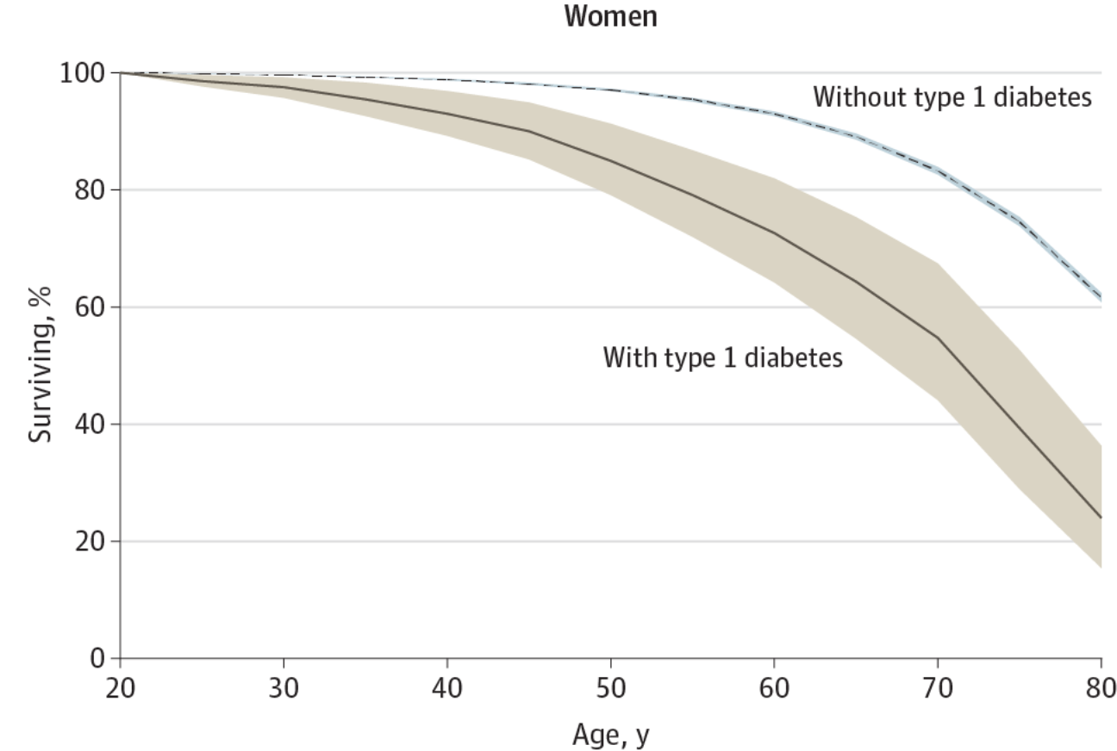
Life table approach to evaluate impact of a disease state:
Life Expectancy in a Scottish Cohort With Type 1 Diabetes
Age, years
Percentage Surviving Among Those With Type 1 Diabetes Compared With the General Population Without Type 1 Diabetes.
Livingstone et al. JAMA 2015
Notes:
A period life table approach can be used to show the impact of a particular disease state. This example compares life expectancy of persons diagnosed with type 1 diabetes to those without type 1 diabetes. It comes from Scotland where there is a nationwide registry of diabetes. It shows survival by age, starting from 20 years, in women with and without type 1 diabetes. Notice how the x axis is age (and not observation time or calendar time). This plot was constructed using age-specific incidences of death from 2008 to 2010. Note that this is not a fixed cohort of persons starting at age 20 and followed until age 80. Instead, it creates a scenario whereby we hypothetically envision 20 year olds and pretend that their future has the same rates of deaths as persons living from 2008 to 2010.
Notice how there are not steps in the plot. This is characteristic of life tables.

Slide 107
 | Kaplan-Meier | Life Table
Calculation | Based on product of conditional probabilities of survival | Same
Interval | Defined by event | Defined by investigator depending upon context
Dating of event | Need date of event | Don’t need exact date of each event. Must place within time interval.
Rate of events within interval | No assumptions | Constant
Rate of censoring in interval | No assumptions | Constant
Censoring | Unrelated to probability of outcome | Same
Competing events | No CE or independent | Same
Assumptions/Requirements:
Notes:
Here is a review of the similarities and differences in the Kaplan-Meier and life table approaches to estimation of cumulative incidence. The major difference is in the dating of the event. The exact date is needed for Kaplan-Meier estimation, but for the life table the exact date is not needed. Instead, it is sufficient to simply know what interval of time the event occurred. There is, however, the need to assume that events occur at a constant rate during an interval in the life table approach and that any censoring is also constant across an interval. For the life table approach, unless the assumptions are strictly met, the results are biased. The assumptions are less credible in small datasets. In large datasets, the two approaches will typically be equivalent.
In practice, the Kaplan-Meier approach is used much more commonly in biomedicine, but knowledge of the life table approach is useful to reinforce the underlying principle behind both approaches, which is the way that cumulative probability of survival is calculated in the face of censoring (unequal follow-up times).

Slide 108

Advanced Topics
Instead of using follow-up time after “shifting everyone to the left,” you can have different scales of time, such as age
Can also accommodate gaps in follow-up
For more, recommend:
Notes:
We will not have time to dive into some advanced topics in cumulative incidence estimation, but the Stata book on survival analysis is a great way to learn these in addition to their software implementation.
One advanced topic is on the use of age as the metric of the x-axis, something we have mentioned in today’s session.

Slide 109
Disease occurrence
Prevalence
Point
Period
Incidence
Cumulative incidence
Incidence rate
Simple proportion
Kaplan-Meier
Life table
Aalen-Johansen
Average incidence rate
Instantaneous (hazard) rate
Notes:
Here is a flowchart of the material covered in our two lectures on measures of disease occurrence, including topics that we covered today in red. Next week, we will cover the topics in black.

Slide 110
Summary
Prevalence counts existing disease/conditions and incidence counts new instances of disease/condition
Prevalence is a proportion
  Point prevalence
  Period prevalence
Terminology is not standardized
  “Rate” is often used incorrectly to describe prevalence
  You will need to examine details of what others have done rather than accept their nominal terminology
Notes:
Here is a summary of what we have discussed today.

Slide 111
Summary: continued
Incidence: consider E, N, and T
  Cumulative incidence: a proportion
  Incidence rate: based on person-time (next week)
Cumulative incidence:
  % of persons who have event within a specific time
  Estimated with simple proportion, Kaplan-Meier or life table. Kaplan-Meier most frequently used.
  Unequal follow-up times are the source of complications which are addressed with Kaplan-Meier and life table approaches
  Main assumptions/requirements of Kaplan-Meier and life table:
    Losses unrelated to outcome (non-informative censoring)
    No (or independent) competing events
  Be aware when observations spanning long calendar periods are combined and everyone is “shifted to the left”
Notes:
In the next lecture, we will finish our discussion of cumulative incidence by presenting the Aalen-Johansen estimator that does not require the assumption of independent (or no) competing events. And, we will take up the measure of incidence based on person-time, which are known as incidence rates.

Slide 112
Additional Slides

Slide 113
A note on estimation
Because we are working with a sample of subjects (from the target population), we formally can only estimate any target population parameter
  e.g., “In our study, we seek to estimate cumulative incidence.”
Mathematical formulae/techniques which accomplish this estimation are often called “estimators”
  e.g., “We used the Kaplan-Meier estimator.”
The target quantity of the estimator is sometimes called the estimand.
Notes:
113
All of our research studies are sampling populations, and thus our results are merely estimates. The points describe the scientific terminology related to estimation. A short primer on these terms can be found at:
Little RJ and Lewis RJ. Estimands, estimators, and estimates. JAMA 326:967-968, 2021

Slide 114
The Key Probability Aspect of Kaplan-Meier
Probability theory: Probability of 2 independent events occurring is the product of the probabilities for each occurring alone
  If event 1 occurs with probability 1/6 and event 2 with probability 1/2, then the probability of both event 1 and 2 occurring = 1/6 x 1/2 = 1/12
Kaplan-Meier technique assumes independence in the sequences of probabilities of not experiencing the event in question:
  Probability of no event in time 2 given no event in time 1 (i.e. conditional on no event in time 1) is independent of the probability of no event in time 1
Notes:
Some learners balk at treating two or more time periods for a given person as independent. They say, “How can they be considered independent when many of the same persons are in each time period”? The answer is that the probability in the second time period is conditional on a given person already having lived through the first time. In other words, in each time period, the clock is reset. Therefore, the probability of the outcome in the second period is the probability conditional on not having experienced the outcome up until that point in time. A similar mistake is made by gamblers who think that because a coin has come up tails four times in row the probability of heads on the next toss is better than ½. It isn’t.

