Slide 1
Epidemiologic Methods (EPI 203)
Unifying theme of study design: all study designs are samples of an underlying cohort
Design begets measures of occurrence and measures of association
Notes:
Let us take a moment to review where we have been so far in this course, now that we are nearly halfway through. We have spent the first 5 lectures discussing study designs, measuring disease (or other outcome) occurrence in these designs, and evaluating associations between exposures and outcomes. We talked about how the ultimate goal of these measures of association is either causation (Big 6 Objective #1) or prediction (Big 6 Objective #2). We also discussed measures of disease attribution, which is one of many research objectives that can be accomplished once causation has been established.
We have stressed the unifying theme that all study designs are simply a means of sampling human populations as they are moving through time, i.e., sampling underlying cohorts, either fixed or dynamic. Usually, these underlying populations are very real and tangible, and other times they are hypothetical (e.g., secondary bases in the context of case-control studies). In particular, we have emphasized how case-control studies, historically the most misunderstood and variably implemented design, should be viewed as an efficient means of sampling an underlying cohort.
The types of measures of disease occurrence that we can get from these studies depends upon the exact design. With measures of occurrence in hand, we then explained how we can compare/contrast measures of occurrence across levels of exposure with either ratio or difference comparisons; we call these comparisons measures of association. Again, the study design dictates what kinds of measures of association can be derived. We also discussed how there is continued methodologic development in both study design and measures of disease association, better ways to express the magnitude of the contrast between exposure levels. The self-controlled case series and restricted mean survival time difference are such example.
We expect that by this point in the course you are moving from being accepting consumers of this material to active and scrutinizing critics and, hopefully, creators of top-flight research. As we pointed out in the course introduction, our aim is for you to develop a deep understanding of the fundamental concepts such that they become second nature to you.

Slide 2
Notes:
Here is where we are going. Now that we have laid out the basics of study design and analysis, we need to discuss the various threats we face in getting the right answer in our research, in other words, what we formally call “threats to validity”. We will start today by discussing selection bias, then devote two sessions to properties of measurement and measurement bias, and then devote three sessions to probably the biggest threat we face in observational research — confounding.
We will also have several more Journal Clubs along the way, which will help to solidify the concepts learned in lecture by applying them to real-world studies. The reason we have the Journal Clubs is because there is often a very big gap between learning the theory in didactic settings and recognizing and applying it in the real-world. We are therefore reading these articles to facilitate your learning how methodologic theory applies in the real world. The jump from theory to real-world practice is not easy, but it can be mastered with practice.

Slide 3
Error in Clinical and Epidemiologic Research:
General Aspects and Focus on Selection Bias
Framework for understanding error in clinical research
  systematic error, aka threats to internal validity, or bias
  random error, aka sampling error, or chance
Types of bias: Selection bias, Measurement bias, and Confounding
Selection bias
  according to study objective: descriptive or analytic
  mechanisms by study design:
    cross-sectional
    case-control
    longitudinal studies (cohort: observational or experimental)
Notes:
Here is our roadmap for this session. We are going to start with a general framework about error in clinical and epidemiologic research, one you can use when thinking about your own work or critiquing others’ work. In particular, we will distinguish between the two types of error: systematic error and random error. Systematic error, also known as bias, poses a threat to internal validity (and ultimately external validity). Random error is the chance result of sampling error.
We will then spend the rest of the time on bias and explain that there are three main forms of bias: selection bias, measurement bias, and confounding bias. Among the different forms of bias, we will focus today on selection bias. We will discuss selection bias according to the research objective, meaning descriptive or analytic, and by study design. We will describe how ― i.e., the mechanisms ― selection bias may occur in different study designs. As we have emphasized, a descriptive objective means where the goal is to estimate measures of disease occurrence, and analytic means estimating measures of disease association (is some exposure a cause of some outcome?) and or causation-related objectives such as interaction, mediation, and attribution. We will discuss selection bias in cross-sectional, case-control, and longitudinal studies (i.e., a cohort study, which can be observational or an experimental trial).
We hope that by now everyone is convinced that randomized experimental trials or even non-randomized experimental trials (experimental designs are also known as interventional designs) are just like cohort studies except that the exposure is assigned by the investigator instead of naturally occurring. Thus, given that we think everyone here is doing either observational or experimental work, this discussion is pertinent to everyone.

Slide 4
WARNING: SHIFTING GEARS
Today (and much of the remainder): A lot of theory
  Few equations or cook-book algorithms
  Instead, frameworks to guide thinking
Why?
  Identifying (or preventing) bias not a formulaic process
  Requires deft human intelligence
    sound mastery of methodologic framework, your subject matter, and experience (1:1:1)
We will often depart considerably from S & N textbook
Notes:
Before we get too far, we need to caution that we are shifting gears in the course. That is, for today and the remainder of the course, we will feature more theory. We will not have many equations or cook-book algorithms, such as had for calculating prevalence or incidence. Instead, we will present frameworks to guide your thinking. Why is this? It is because identifying, or importantly in the design of your studies, preventing, bias is not a “plug and play” or formulaic process. In other words, there is nothing automatic you can do, no software that you will do it for you. Identifying and preventing bias (i.e., “minimization of inferential bias”) requires deft human intelligence and that means it requires sound knowledge of methodologic theory (and a framework to apply the theory), deep subject matter expertise, and experience. Indeed, high-quality research is usually the result of a three-part recipe: one part subject matter knowledge; one part methodologic knowledge; and one part experience.
Finally, we will often depart considerably from the S & N textbook, attempting to give a clearer view of the material, and, in some cases, a more modern view. When our lectures differ from the S&N textbook, our material will trump the textbook.

Slide 5
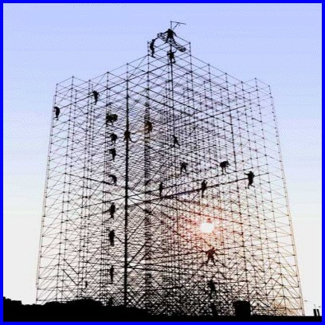
A Framework for Classifying Error
Notes:
Let us start by establishing a framework for understanding and classifying error.

Slide 6
Clinical and Epidemiologic Research:
Sample
Measure
(Intervene and make more measurements)
Analyze relationship between measurements
Infer (i.e., make an inference)
Inference
  Webster’s: act of passing from sample data to generalizations, with unknown degree of certainty
  All we can do is make educated guesses about the soundness of our inferences
  Those who are more educated will make better guesses
Notes:
To understand this framework, we recall the basic elements or processes of clinical and epidemiologic research. We sample humans from underlying cohorts, make measurements on them, sometimes perform an intervention (and perform more measurements), analyze the relationships between the measurements, and then make inferences.
Just to make sure we are all on the same page, what do we mean by an “inference”? If you look up inference in Webster’s dictionary, you will find that it is the “act of passing from sample data to generalizations, usually with calculated degrees of certainty”.
In other words, when we make inferences from our samples to larger populations we always do so with a certain amount of trepidation. What makes clinical and epidemiologic research a challenging and interesting profession is that there is no way for us to really know just how accurate our inferences are. All we can do is to make educated guesses about how accurate our inferences are. The premise for this course is that those who are more educated will make better guesses than others who are less educated.

Slide 7
Theme for Rest of Course
Anyone can get a numeric answer in research
The challenge is to tell if it is correct
Notes:
Stated another way, the theme for the rest of the course is that anyone can derive a numeric answer in a research study (i.e., push the buttons in Stata to get an output).
The challenge is to tell if the number is correct. This is the highest art form in our field.
It turns out that getting the right answer in clinical/epidemiologic research is often difficult, and, as a consequence, many research results are wrong. This is important and sobering for everyone. If you are a knowledge generator, you obviously want to learn how to decrease frequency of being wrong. If you are a consumer of research, either as a clinical practitioner or as a patient, you will need to be able to make some judgement on your own regarding whether a particular research finding is right or wrong. This is why learning epidemiology and biostatistics is relevant for everyone.

Slide 8
Two types of inferences
Inference
OTHER EXT. PPTLN.
TARGET POPULATION
Inference
Diseased
SOURCE POPULATION
(aka
ACCESSIBLE
POPULATION,
STUDY BASE,
“UNDERLYING COHORT”)
+ -
+
-
INTENDED SAMPLE
Exposed
STUDY SAMPLE
OTHER EXTERNAL POPTLN.
Conception of Study Design yields
Notes:
Here is what the process of inference looks like schematically in our hierarchy of populations. Recall that all we ever have in our studies is our study sample, here in the right bottom corner. Recall that the study sample may not be identical to the intended sample because sometimes reality gets in the way. For example, sampled persons may refuse to participate. The intended sample is the manifestation of our study design (e.g., cohort, cross-sectional, or case-control). The intended sample is what we hope to achieve when we sample some underlying source population, also known as the accessible population, study base, or underlying cohort. That is, the process of conception of a study design yields an intended sample, which because it is “intended”, it is theoretical.
The study sample is a therefore a tool that we use to form an inference about the source population that gave rise to it. This is the first of two inferences we can make. In other words, to understand something about our source population, we are typically forced to sample it ― i.e., only study a fraction of the source population.
The target population, in the upper left-hand corner, is the largest population to which the findings of our study might “reasonably” apply. We say “reasonably” because there are persons in the target population who never had a chance to be included in the study sample, and thus we cannot definitely state the findings from our study sample apply to the target population. To the extent that the target population is, to some extent, different than the source population, we call it an external population. Thus, our second inference is from our study sample to the target population. In truth, in addition to making inferences about the target population, we are usually interested in making inferences outside of our target population. There are usually many “other external populations”, shown here in the two boxes next to the target population about which we are interested in making this second type of inference. The newly evolving field of “transportability” focuses on making inferences about these other external populations.
Sometimes our study sample comes directly from the target population as shown. The NHANES study is an example of this, being directly sampled from the U.S. general population, which is the target population. Usually, however, we are sampling from source populations which are not identical to our target population. The Physicians Health Study or Nurses Health Study are examples of this at a national level in the U.S.. A local example is the California Teachers study. In these examples, we seek to make inferences about the general adult population in the U.S. (target population), and, to do so, we sample a source population that is a non-random sample of the general adult population. This is important to keep in mind in that the source population is sometimes where problems can reside that lead to bias. The firefighter example in the Hernan 2004 Selection Bias paper (Optional Reading) gives a nice example of this.
Note: there is tremendous variability in the methodologic and applied literature as to what these populations are called. A discussion of the variability in the terminology can be found in Schwartz et al. Toward a clarification of the taxonomy of “Bias” in Epidemiology textbooks. Epidemiology 26: 216-222, 2015.

Slide 9
U.S. urban residents,
20 to 65 yo
Europeans, 20 to 65 yo
Inference
San Franciscans, 20 to 65 yo
Inference
Random X-S sample of San Franciscans, 20 to 65 yo
U.S residents, > 65 yo
Random X-S sample of San Franciscans, 20 to 65 yo, who participate
SOURCE POPULATION
(aka
ACCESSIBLE
POPULATION,
STUDY BASE,
“UNDERLYING COHORT”)
+
-
INTENDED SAMPLE
Exposed
STUDY SAMPLE
Notes:
As an example, let us say we desired to draw a cross-sectional (X-S) random sample of San Franciscans, age 20 to 65 years. The random sample is the intended sample of the source population, which is all San Franciscans 20 to 65 years old. The target population could reasonably be said to be all U.S. residents living in urban areas who are age 20 to 65 years. However, this might be debated depending upon what we desired to study in this population. Other external populations, for example, include U.S. residents over age 65 and Europeans age 20 to 65.

Slide 10
Inference
? EXTERNAL VALIDITY (generalizability; transportability)
OTHER EXT. PPTLN.
TARGET POPULATION
Inference
? INTERNAL VALIDITY
Diseased
SOURCE POPULATION
(aka
ACCESSIBLE
POPULATION,
STUDY BASE,
“UNDERLYING COHORT”)
+ -
+
-
INTENDED SAMPLE
Exposed
OTHER EXT PPTLN.
2 Types of Inferences
Correspond to 2 Types of Validity
STUDY SAMPLE
Conception of Study Design yields
Notes:
The two types of inferences correspond to two types of validity: internal validity and external validity. Here is what internal and external validity look like schematically. Internal validity (in the red) is a measure of how well the estimate to a particular question derived from our study sample matches truth in our source population. External validity (in the blue), which is also known as generalizability or transportability, refers to how well the estimate to a particular question derived from our study sample matches truth in some population larger than the source population. It could be either be the target population or some other external population.
Earlier we noted there is not uniformity in the literature as to what these different populations are called. Similarly, the terms external validity, generalizability, and transportability also have varying definitions. Some writers refer to them synonymously while others use the term generalizability to refer how well the study sample depicts what we show as the target population (with the study sample being a subset of the target population) and transportability to how well the study sample refers to populations external to the target population. Regardless of the terminology, it is important to note that when speaking about external validity, the external population in question need to be specified. Formal assessment of external validity requires a statement of which other external populations one seeks to make the inference. It is very unlikely that the inference from one study sample is going to be applicable in all other external populations. Thus, to say that an inference is externally valid or externally invalid, in general terms, makes no sense; we must specify which external population we are interested in. External validity is often incorrectly used in an abstract manner (the “our results are externally valid”), but it should not be.
Instead of having different names for the different types of validity, Daniel Westreich at the University of North Carolina has offered a unifying solution which he calls “target validity”. In other words, the goal of this process is to determine if the findings from a study sample pertain to some larger population. Westreich believes we should simply be clear about which larger population we want to make an inference. How well the study sample makes an unbiased inference is “target validity”. This is explained in Westreich et al. Target validity and the hierarchy of study designs. American Journal of Epidemiology 188: 438–443, 2019.

Slide 11
Two Types of Inferences
Correspond to Two Types of Validity
1. Internal validity
  Do results for a particular question obtained from the actual study participants accurately match truth in the source population?
  Epidemiologic theory guides assessment
2. External validity (generalizability; transportability)
  Do results for a particular question obtained from study participants accurately match truth in some external population?
  Internal validity is a building block/prerequisite for external validity
  Assessment traditionally qualitative and vague
  More recently, cutting edge of new quantitative methods
“Validity” used alone typically means internal validity
  “Threat to validity” typically means threat to internal validity
  Identifying threats to validity is a critical aspect of research
Notes:
Once again, the two types of inferences correspond to two types of validity.
Internal validity asks the question “do the results for a particular research question obtained from the actual study participants accurately match truth in the source population?” It is the various threats to this type of validity that we will discuss over the rest of the course, starting today with selection bias. We use epidemiologic theory to guide this assessment, and we are going to learn this theory in the rest of the course. This is the inference to concentrate on first.
External validity — also called generalizability or transportability — asks the question “do the results for a particular research question obtained from the actual study participants accurately match truth in some external population”? In particular, it asks whether the results pertain to some particular external population, not any and every external population. Internal validity is a component of or a prerequisite to external validity. It makes no sense to think that a study result that is not internally valid will be valid in some external population. (The only way this could occur would need to be some stroke of coincidence.)
Whether or not a finding from a study population generalizes to one or more external populations has traditionally been a much more vague, speculative and qualitative process compared to the assessment of internal validity. Up until recently, making this assessment was just a guess and it still is for most researchers. It is, however, an area of active methodologic development in which researchers attempt to formally estimate effects in external populations. We will not cover this process in this course, although aspects of effect modification (to be covered later in the course) are important in the process. Judea Pearl at UCLA is one of the leaders in this area, as he is in many aspects of causal inference. Advanced note: this will be easier to understand by the end of the course: One important way that one population can be different than another is the presence (or magnitude of prevalence) of one or more factors that are causally related to the outcome under study (other than potential causal determinant under investigation). For example, this other factor could be some form of behavior. These other factors can influence both descriptive parameters and analytic parameters. In the realm of analytic parameters, we refer to this as effect-measure modification. If a measure of association was estimated in a study sample without that factor (or a different prevalence of the factor), then it will not transport exactly on both the additive and multiplicative scales to a population that does have the factor (or a different distribution of that factor).
Although we should be more specific, when we (and many others) refer to “validity” alone, we are typically referring to internal validity. When we say “threat to validity”, we are usually talking about threats to internal validity, which refer to processes that will lead to less than perfect internal validity. A big part of research is looking for threats to validity. As researchers, we are in constant surveillance for threats to validity in both our own work and the work of others.

Slide 12
Attempts in study design to enhance the 2nd inference are often in conflict with goal of making a valid 1st inference. Finding compromise = art of research.
Optimizing validity starts with 1st inference. Rest of course focused here.
If 1st inference is wildly inaccurate, there is little point considering the 2nd inference
Inference
? INTERNAL VALIDITY
Diseased
SOURCE POPULATION
(aka
ACCESSIBLE
POPULATION,
STUDY BASE,
“UNDERLYING COHORT”)
+ -
+
-
INTENDED SAMPLE
Exposed
STUDY SAMPLE
Notes:
Although there are two types of inferences, it is important to note that the whole process of inference starts with using the study sample (remember this is all you have) and making an inference about the source population. This is what we call the first inference, and its soundness is described as the internal validity of the inference. The goal is to optimize the validity of the first inference, and we will spend the rest of the course focused on this. If the first inference is wildly inaccurate, there is no point considering the second inference. Attempts in study design to enhance the second inference, typically by including more diverse groups of individuals/patients/participants, are often in conflict with goal of making a sound first inference. Finding a compromise to this conflict is part of the art of research.

Slide 13
Error in Clinical and Epidemiologic Research
The goal of any study is to make an accurate (true) inference, i.e.:
  measure of disease occurrence in a descriptive study
  measure of association between exposure and disease in an analytic study
Ways of getting the wrong answer:
  systematic error; aka “threat to validity” or “bias”
    any systematic process in nature or in the conduct of a study that causes a distortion from the truth in a predictable direction
    captured in the validity of the inference
  random error; aka “chance” or “sampling error”
    occurs because we cannot study everyone (we must sample)
    related to sample size; direction is random and not predictable
    captured in the precision of the inference (e.g., SE and CI)
Notes:
If the goal of any study sample is to estimate the truth about the source population (for a descriptive study, this would be the measure of disease occurrence (or exposure occurrence), and for an analytic study this would be the measure of association between the exposure and disease), then what are the ways of missing the truth (i.e., getting the wrong answer)? There are two ways.
One is systematic error and the other is random error. Systematic error is also known by the terms “threat to validity” or “bias”. Bias is the most common term used. It is any systematic process in nature (i.e., occurring naturally, not created by the investigators) or in the conduct of a study (some of which are in the control of the investigator and some are not) that results in the incorrect estimate (relative to truth in some stated population) of a measure of disease occurrence or measure of association. Because it is a systematic process, it will cause a distortion from the truth in a predictable (not random) direction. We say that the amount of systematic error is captured in the validity of the inference. Systematic error is not influenced or ameliorated by sample size. In other words, large sample sizes will not reduce systematic error. Note that this is a common misconception of the “Big Data” error. All of the big data in the world is not going to overcome systematic error. Also, just because the error occurs in a predictable direction does not mean it is easy to mitigate or fix. This is because we typically cannot know the quantitative degree of error; errors may occur in opposite directions and tend to cancel each other out; some of the errors occur unbeknownst to us (we simply do not recognize them); and, finally, there is also the background of random error (as explained next).
In contrast to systematic error, random error occurs because we typically cannot study everyone in our source population studies; we are typically forced to just sample a fraction of the source population. Just by chance alone we might draw a sample that is not representative of the source population (remember the source population is not monolithic; there is a distribution of characteristics among persons within it) and get an answer that is different than the truth in the source population. Even a random sample from the source population is not a guarantee to be strictly representative in every feature. This will always be the case unless there becomes a day when humans are cloned and live in identical conditions. This is why random error is synonymous with the term “chance”, and the direction of the error is random and not predictable. We say that random error is captured in the precision of the estimate and is usually numerically described in the standard error or confidence interval of our estimate. Random error is in the realm of biostatistics, and we will not in this course be describing the theory about how to generate standard errors or confidence intervals for the various point estimates we will derive. We will essentially just be pointing out how to generate estimates of the effects of random errors by describing how to generate confidence intervals in Stata. Random error can cause either over- or underestimation in descriptive studies and can cause you to either declare an association in an analytic study when one does not really occur (this is a type I error) or miss an association when one truly does occur (this is a type II error). Increasing sample size will, on average, decrease the amount of random error that is present.

Slide 14
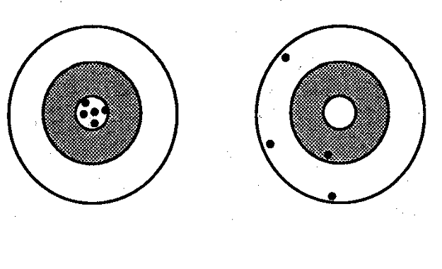
Validity and Precision of an Inference:
Each Shot at Target Represents the ‘Inference’ from a Study Sample of the Same Sample Size of a Given Study Design
Center of target = truth
Good Validity
Good Precision
Poor Validity
Poor Precision
Notes:
Let us graphically illustrate these concepts of validity and precision of an inference. These figures should be familiar to you from the Designing Clinical Research textbook used in the Summer Designing Clinical Research course. They graphically show the difference between validity and precision. Consider that at the center of the target is the truth and that each shot at the target represents the inference from a study you conduct — a sample of participants whom you select. Here we show five different studies (samples) of the same sample size of the same study design, i.e., 5 different samples of the source population. Of course, what you want is on the left — good validity and good precision. We say that this is good validity because the average or central tendency of the different attempts (different samples) gives you an answer that is right on the truth. We say that this is good precision because the differences between the individual samples is very close; there is very little random error.
Contrast this situation to the target on the right where the average of the different studies would be somewhere around the left lower quadrant of target, which is far off from the center of the target; this is poor validity. Each of the different estimates is also fairly far away from each other — this is poor precision.

Slide 15
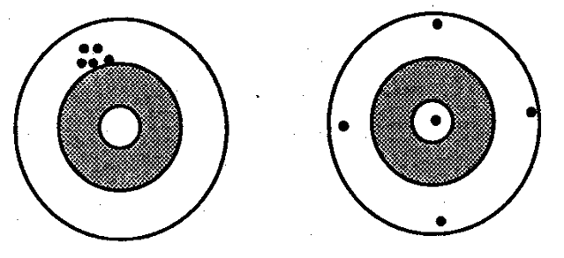
Validity and Precision of an Inference
Poor Validity
Good Precision
Notes:
How about here? We have good precision, the different shots are tightly bunched, but their average (central tendency) is far away from the center of the target. This is poor validity.

Slide 16
Validity and Precision of an Inference
Validity? Precision?
Good validity; Good precision - A
Good validity; Poor precision - B
Poor validity; Good Precision - C
Poor validity; Poor precision - D
Notes:
16
Here is perhaps a harder example. How about this scenario? Is it A, B, C, or D?

Slide 17
Validity and Precision of an Inference
Validity? Precision?
Good validity; Poor precision - B
Good validity; Good precision - A
Poor validity; Good Precision - C
Poor validity; Poor precision - D
Notes:
17
Precision is not good. Validity, however, is good in that the average of the different attempts is right on the center of the target. There is nothing systematically wrong with the inferences of these studies.

Slide 18
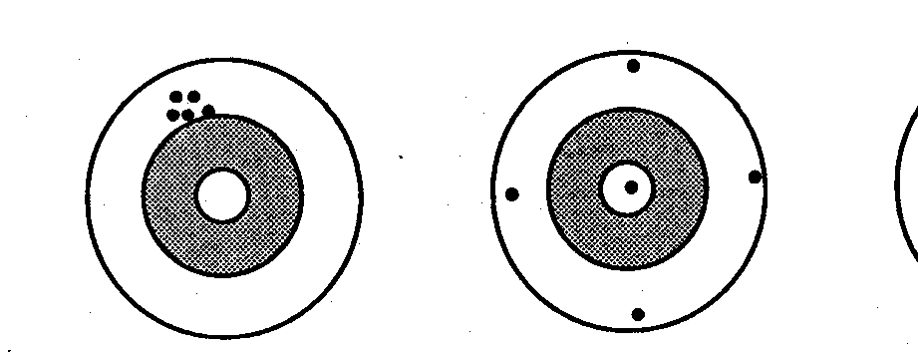
Validity and Precision
Random error (chance)
Random error (chance)
No
Systematic error
Systematic error (bias)
Poor Validity
Good Precision
Good Validity
Poor Precision
Notes:
In summary, the difference between the average of different attempts (which is shown in the red dot) and the truth (at the center of the target) is the measure of validity; it is known as the systematic error or bias. The difference we see between any two of the different estimates is random error. In the panel on the right, there is no systematic error. In other words, there is no systematic process that is leading to a systematic deviation from the truth. Do not let the disparate replicate attempts deceive you; there is poor precision but not systematic error.

Slide 19
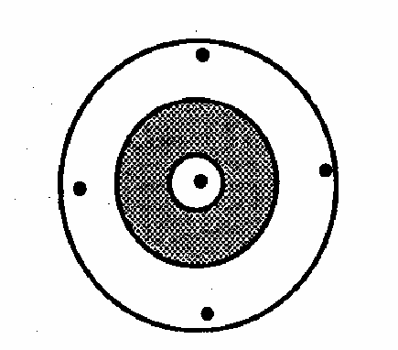
So Far, Just Theory. When Performing an Actual Study:
You Only Have One Shot
Only judgment can tell you about systematic error (validity)
Field of “statistics” can tell you the random error (precision) with formulae for confidence intervals
Judgment requires subject matter knowledge, methodologic knowledge, and experience
(i.e., you)
Notes:
The past several slides represented theory; in other words, we talked about would happen if you had many attempts at performing a study. In reality, when you perform a study you almost always have just have one shot, as shown here in red, and you don’t know where the center of the target is. The field of statistics, remarkably, can tell you the random error of your one shot, with formulae for standard errors and confidence intervals, but it cannot tell you anything about how close you are to the center.
It is only your judgment and the judgment of other scientists who review your work that can help you guess about systematic error. It is only the person who has subject matter knowledge of the clinical, biological, or behavioral problem, methodological knowledge of clinical and epidemiologic research, and experience applying all three who can make the best guess about systematic error. This illustration is also the basis of one of the course’s mantras which is that “relevant and valid research requires 33% subject matter knowledge, 33% methodologic knowledge, and 33% experience in applying this knowledge …one part of each”. Without all 3 parts, each individual component is insufficient.
The person who has the joint requisite knowledge in both subject matter and methodologic realms is the clinical researcher or epidemiologist, which is what most students in this course are training to be. Recall the overlapping circles shown during the Course Introduction video of how the clinical researcher/epidemiologist is a person who understands both subject matter and research methods.

Slide 20
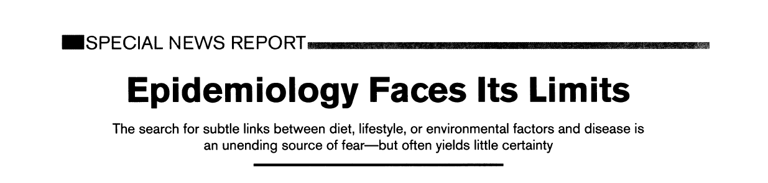


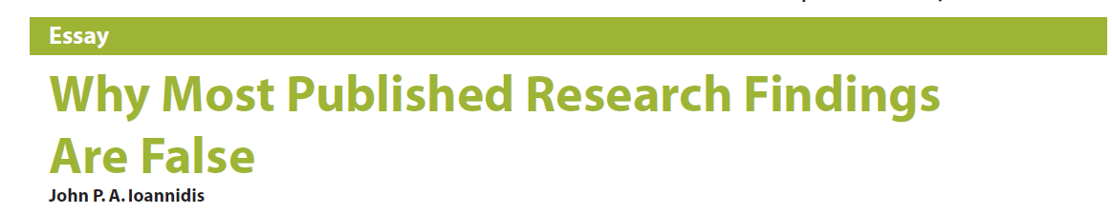
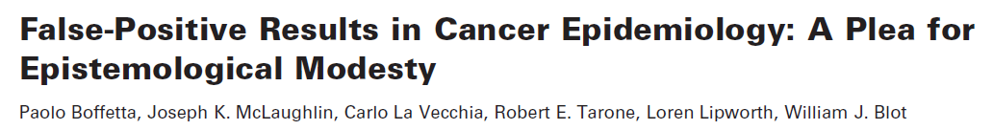

Why Do We Need Valid Studies?
Notes:
This need for validity is not just an academic issue but instead a very practical one. This is because clinical and epidemiologic research is under constant attack for its veracity by fellow researchers, scientific writers and the public. The articles shown are some of the most prominent examples. Taubes and Ioannidis are amongst the most well-known critics.
This is not just friendly academic banter. The NIH, the single largest funder of research in the world, also has grave concerns about the getting valid answers in the research that it sponsors. This is reflected in its recent “rigor and reproducibility” campaign. https://www.nih.gov/research-training/rigor-reproducibility

Slide 21
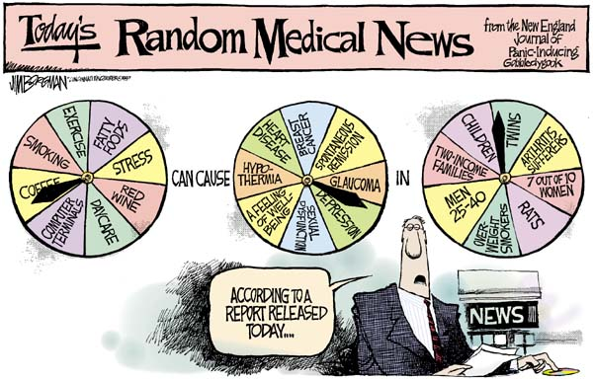
Why Do We Need Valid Studies?
Notes:
The criticism is not limited to academic discourse between professionals but instead extends to the general public, as exemplified in this cartoon. Here we have a news broadcaster with three pinwheels — one for exposure, one for outcome, and one for population — and the broadcaster is randomly spinning these wheels.
Obviously, this cartoon reflects how at least some portion of the public feels about what we do in clinical and epidemiologic research. Having a given exposure cause a given disease one day but not the next causes the public to lose faith in our work. Since it is the public, by in large, who funds our work, it is incumbent upon us to conduct valid work. Public distrust in science in large part has multi-fold origins, but some of it is because clinical and epidemiologic research has had some notable wrong answers which then needed to be corrected.
The COVID-19 pandemic has shown an example of the catastrophic manifestations of public distrust in science. Public distrust in science had a substantial causal role in the slow uptake of COVID-19 vaccination, which ultimately led to hundred of thousands of deaths which could have been prevented.
The comic is by Jim Borgman, a well-known editorial cartoonist. This has been viewed millions of times around the world.

Slide 22
Error in Clinical Research: Our Focus on Bias
The goal of any study is make an accurate (true) inference, i.e.:
  measure of disease occurrence in a descriptive study
  measure of association between exposure and disease in an analytic study
Ways of getting the wrong answer:
  Our focus: systematic error = threats to validity = bias
    any systematic process in nature or in the conduct of a study that causes a distortion from the truth in a predictable direction
    captured in the validity of the inference
  random error; aka chance or sampling error
    occurs because we cannot study everyone (we must sample)
    direction is random and not predictable
    captured in the precision of the inference (e.g., SE and CI)
Notes:
Getting back to the two ways that error can occur, among systematic error (or bias) and random error (chance), we are going to focus on systematic error in this course. We will leave discussion of chance to the excellent courses on biostatistics.
Remember, there are 3 terms meaning the same thing. Systematic error = threat to (internal) validity = bias. Typically, we are going to use the shorthand word bias because this is what you will most typically see elsewhere.

Slide 23

What do we mean by bias?
MetLife Is Settling Bias Lawsuit
BUSINESS/FINANCIAL DESK
MetLife said yesterday that it had reached a preliminary settlement of a class-action lawsuit accusing it of charging blacks more than whites for life insurance from 1901 to 1972.
MetLife, based in New York, did not say how much the settlement was worth but said it should be covered by the $250 million, before tax, that it set aside for the case in February.
We don’t mean prejudice
Notes:
When we say bias in clinical and epidemiologic research, what do we mean? We do not mean the popular use of the word bias, as shown here in the New York Times “MetLife is Settling Bias Lawsuit”, where bias is referring to some sort of prejudice. This is not what we mean in formal scientific language.

Slide 24
“Bias” in Webster’s Dictionary
1 : a line diagonal to the grain of a fabric; especially : a line at a 45° angle to the selvage often utilized in the cutting of garments for smoother fit
2 a : a peculiarity in the shape of a bowl that causes it to swerve when rolled on the green b : the tendency of a bowl to swerve; also : the impulse causing this tendency c : the swerve of the bowl
3 a : bent or tendency b : an inclination of temperament or outlook; especially : a personal and sometimes unreasoned judgment : prejudice
c : an instance of such prejudice
d (1) : deviation of the expected value of a statistical estimate from the quantity it estimates
(2) : systematic error introduced into sampling or testing
4 a : a voltage applied to a device (as a transistor control electrode) to establish a reference level for operation b : a high-frequency voltage combined with an audio signal to reduce distortion in tape recording
Notes:
We mean another definition of bias. Indeed, if we refer back to Webster’s, we find many definitions for the word bias and if we look hard enough we can find the scientific definition we are looking for . . . a systematic error introduced into sampling or testing.

Slide 25
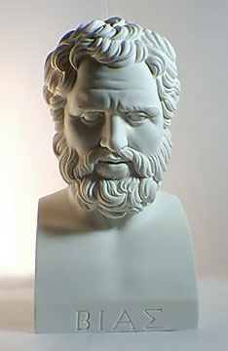
Bias of Priene (600 - 540 BC)
One of the 7 sages of classical antiquity
Consulted by Croesus, King of Lydia, about the best way to deploy warships against the Ionians
Bias wished to avoid bloodshed, so he misled Croesus, falsely advising him that the Ionians were buying horses
Bias later confessed to Croesus that he had lied.
Croesus was pleased with the way that he had been deceived by Bias and made peace with the Ionians.
Bias = deviation from truth
BMJ 324:1071, 2002
Notes:
The definition for bias that we are looking for is in the dictionary, but nonetheless it is a peculiar word, and I’ve always been interested in its origins. It appears to come from the scholar Bias, of the region called Priene (which today is in Turkey), who was one of the 7 sages of classical antiquity. Legend has it that Bias was once consulted by King Croesus (KREE sus) about the best way to deploy warships against the Ionians. Because Bias wanted to avoid a war, he falsely advised the king that the Ionians were planning to use horses. Bias later confessed to the King that he had lied, but the King was so pleased about his motives that he made peace with the Ionians. Subsequently, a deviation from truth became known as bias.

Slide 26
In the language of bias
Center of target = truth in the source population
Unbiased
Precise
Biased
Imprecise
Notes:
Here are the same target diagrams from before, but now we use the language of “bias”.

Slide 27
Bias = difference between answer in the study sample and truth in the source population
Unbiased
Imprecise
Biased
Precise
Notes:
27
Again, a study design that is wildly imprecise can still be unbiased. A precise study design can nonetheless be biased.

Slide 28
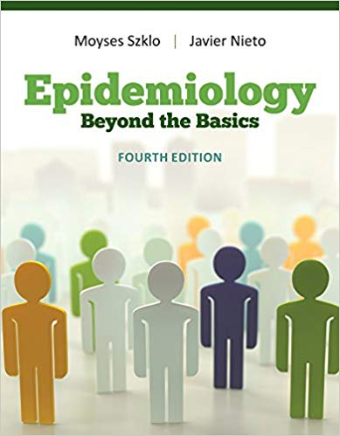
One More Big Picture Framework Item:
Classification Schemes for Overall Error and Bias
Common Approach (which we will use)
  Bias (Systematic error)
    Selection Bias
    Measurement (Information) Bias
    Confounding Bias
  Chance (Random error)
Szklo and Nieto (and some others)
  Bias (Systematic error)
    Selection Bias
    Measurement (Information) Bias
  Confounding
  Chance (Random error)
Think of the “BIG 4” in all of your work
Rationale: confounded associations are not erroneous; they are just not causal
Retort: The only time confounding actually comes up is causation-related research, where we do seek to eliminate it
Notes:
Before we go on, there is one more big picture framework item to describe, and this is the major classification schemes for overall error and bias.
We have already stated that the two main forms of error are systematic (bias) and random. In what is the most common classification approach, bias is split into 3 types: selection bias, measurement (or information) bias, and confounding bias (usually referred to simply as “confounding”). We had noted this previously. We are discussing selection bias today, measurement bias for the next 2 weeks, and then confounding for the 3 weeks after that. These three forms of bias can be distinguished by their causes (or origins), consequences, and solutions (aka cures or fixes). There is, however, not absolute clarity about the distinctions between these three by different investigators, normative bodies, and textbooks. This ambiguity is explained well in Schwartz et al. Towards clarification in the taxonomy of bias…Epidemiology 26:216, 2015. In practice, it is not critical that all forms of bias be reproducibly classified into one of these three bins. Instead, it is more important that they are all recognized and acted upon.
Every time you think about your own work or read someone else’s work, you should run down this list and ask yourself: is there selection bias present, measurement bias present, or confounding present and what is the role of chance? If you can remember these four things, you have covered all of the bases. These are what we call the BIG 4. Think of the BIG 4 in all of your work. (Note: The BIG 4 are different than the BIG 6.)
We should point out, however, that the Szklo and Nieto textbook considers selection bias and measurement/information bias to be the major forms of bias and considers confounding to be a separate process. We do not agree with this approach, but in any case, it is semantics, and we simply want to point this out to you to avoid confusion. The rationale for Szklo and Nieto’s approach is that confounded associations are technically not numerically wrong; they are simply not causal. The rebuttal to this, however, is that the only time confounding ever comes up is during research that is related to figuring out causation. In causation-related research, confounding is always a source of bias. This is why we consider confounding as one of the 3 forms of bias: selection bias, measurement bias, and confounding.
Note: The “Big 4” is a comprehensive classification, but not all components are relevant in each of the “Big 6” objectives of clinical research/epidemiology. Confounding, for example, is not relevant to description or prediction.
Historical note: The origin of the simplifying scheme of three forms of bias (selection, measurement, and confounding) was attributed by Kleinbaum (in his 1982 textbook) to the methodologist Olli Miettinen who developed the classification while teaching at Harvard in the early to mid-1970’s. Kleinbaum referred to Miettinen’s work as an unpublished manuscript (written in 1976), and, indeed, many of Miettinen teachings did not get published until nearly 40 years later, when he co-authored a textbook with a junior colleague: Miettinen OS, Karp i. Epidemiological Research: An Introduction. Dordrecht: Springer; 2012. Miettinen is considered one the leading scholars to usher in the modern era of epidemiology. Miettinen’s three-part scheme has withstood the test of time and is remarkably close to the structural forms of bias that have arose in the modern era of causal inference in which graphic depictions of systems are prominent. We will cover this in our description of directed acyclic graphs (DAGs) in a few weeks. Finally, we call this scheme simplifying because other approaches of the era were considerably more complicated (e.g., that of Feinstein in his 1977 Clinical Biostatistics textbook) or Sacket (in the Additional Slides), featuring long lists of seemingly unrelated biases with exotic names whose content was difficult to remember. The brilliance of Miettinen was that he recognized that virtually all forms of bias fell into one of the three categories.

Slide 29
“Causal Inference”
Goal: Identify causal relationships
6 ways a statistical association can occur
  Chance
  Selection bias
  Measurement bias
  Confounding bias
  Reverse causation
  True causal relationship
Process of causal inference: rule out/refute first 5
Notes:
This classification scheme now allows us to define the process of causal inference. Causal inference refers to the identification of causal relationships (objective number 2 on our Big 6 list). This is one of the central goals of epidemiology and clinical research. When assessment of causation is the goal, what we do initially is to determine a statistical (or “numerical”) association between a given exposure/treatment and disease/outcome. We know that there are 6 different ways (or explanations) that a statistical association can occur. If we can find evidence that any of alternative mechanisms 1 through 5 can explain the statistical association, then we cannot accept #6. If we try to find evidence for alternative explanations 1 through 5 but cannot find such evidence, then we can conclude that 6 is true. In other words, if we can refute the alternative explanations, then we feel comfortable accepting the causal explanation as being true. This is acceptance of causality by means of refutation.
Advanced note: There is one additional explanation that must be excluded in certain situations, and that is called “model misspecification” bias. Most generally, this refers to some problem in the formulation of the statistical mathematical model that you use to analyze your data. The “error” could come from a variety of sources including, for example, the naïve use of a model that does not fit the data or the incorrect specification of a continuous variable. This alternative explanation for a causal explanation does not necessarily pertain in every project/research question, especially those which do not require any sophisticated model to analyze the data. Because this course does not cover any sophisticated biostatistical analytic techniques, we will not dwell much on this source of bias. There is one other requirement for one entity to be called causal of another, and this is called “consistency”. We will discuss this towards the end of the course.
Another common approach to gathering the evidence for causal inference is essentially the converse of ruling out the three common forms of bias. In this approach, the analyst is asked to argue for the presence of “exchangeability”, “positivity”, and consistency before she/he can conclude causality. We will describe these terms at the end of the course, but the essence is what we have already described: excluding selection bias, measurement bias, and confounding as an explanation for an apparent association between exposure and outcome.

Slide 30
Summary: Framework and Classification for Error
We use our study samples to make inferences about the source population and other external populations
Our inferences are characterized by their validity and precision
  Degree of validity (systematic error or bias) guided by substantive and methodologic knowledge (epidemiologic theory)
  Precision (random error or chance) expressed via formulae (SE and CI)
Our inferences can be wrong in 4 main ways
  Systematic error aka threat to validity or bias
    Selection bias, Measurement bias, and Confounding
  Random error aka sampling error or chance
Using the vocabulary accurately will assist and hasten your work
Notes:
This is a summary of the first part of this session. We have introduced important vocabulary in the language of clinical and epidemiologic research. Using this language accurately will be expected in formal scientific writing, such as in grant applications and scientific papers. It may be unjust, but if you use the vocabulary incorrectly, some reviewers may form unfavorable opinions of your ability to perform good science. Equally as important: using the vocabulary accurately will allow you to very efficiently converse with advanced methodologists who can help you improve your work. This is not surprising. If two people can understand the same language, they can work more efficiently and accurately.

Slide 31
Error in Clinical and Epidemiologic Research:
General Aspects and Focus on Selection Bias
Framework for understanding error in clinical research
  systematic error, aka threats to internal validity, or bias
  random error, aka sampling error, or chance
Types of bias: Selection bias, Measurement bias, and Confounding
Selection bias
  according to study objective: descriptive or analytic
  mechanisms by study design:
    cross-sectional
    case-control
    longitudinal studies (cohort: observational or experimental)
Notes:
Back to our roadmap for today. Now that we have discussed a general framework for error, and split bias up into three types (selection, measurement, and confounding), we will spend the rest of the session on selection bias. In particular, we will describe how selection bias may occur. We will discuss selection bias according to the research objective, meaning descriptive or analytic, and also by study design.

Slide 32
Selection Bias
Definition: Bias resulting when study sample (the people/person-time) is systematically not representative of source population
In a Descriptive Study
  Bias caused when persons in source population have different (unequal) probabilities of being selected for/retained in study sample
  Occurs when the participants/follow-up in the study sample are not representative of the persons/follow-up in the source population
In an Analytic Study (Where most of the attention goes)
  Bias caused when persons in source population have different (unequal) probabilities of being selected for/retained in study sample
    Specifically, but not exclusively, when differing (unequal) probabilities are influenced by (or associated with) both exposure and outcome of interest
  Occurs when participants in study sample have different relationship between exposure & outcome than persons in source population
Notes:
With that introduction, let us move on to discussing selection bias, which is defined as the bias that occurs when the study sample (either the people per se or the person-time) is not representative of the source population. We will return again and again to this basic definition.
The more nuanced definition of selection bias depends upon whether you are referring to a descriptive or analytic study. In a descriptive study, selection bias is the bias that is caused when persons in the source population have different (unequal) probabilities of being selected for initially (“in-selection”) or, subsequently, retained in the study sample (“out-selection”). If persons in the source population do not all have the same chance of landing in the study population, then most likely what will happen is the study sample will not reflect the source population. (We say “most likely” because chance could compensate for this non-representativeness and still end up yielding the correct answer.) In other words, this bias occurs because the participants or their follow-up that we observe in the study sample are NOT representative of the persons/follow-up in the source population. What we mean by not representative is in terms of the entity under descriptive study, be it of an exposure or an outcome.
In an analytic study — and I will say that this is where most of the attention is paid for selection bias because it is considerably more complicated than descriptive studies — the definition is that selection bias is the bias that is caused when persons in the source population have different (unequal) probabilities of being selected for/retained in the study sample. A critical aspect of these different probabilities of being selected for study inclusion that results in bias is especially apparent when the probabilities are influenced by both the person’s exposure and outcome of interest. By influence, we mean either that selection is caused by the exposure and outcome or caused by something that also influences exposure and outcome (and thus exposure and outcome are associated with being selected for the study). Selection bias occurs when people in the source population do not all have the same chance of landing in the study sample or, in a longitudinal study, being retained in the study sample. It occurs when the people who do land in the study sample have a different relationship between exposure and outcome than people in the source population.
Hence, the overarching issue in selection bias is that it occurs when we are not able to get a study sample that is representative of our source population. It is important to point out that the reason for a non-representative sample is not chance; it is some systematic process either caused by the investigators or volitionally chosen by the participants.
Foreshadowing note: When we say “especially, but not exclusively, when differing (unequal) probabilities are influenced by (associated with) both the person’s exposure and outcome of interest”, we mean that selection probabilities do not always have to be influenced by both exposure or outcome of interest in order for selection bias to occur. Influence by exposure and outcome is needed for selection bias to occur under what are called “null conditions”. Influence by outcome alone is sufficient under the non-null (“off the null”).

Slide 33
Selection Bias: Mechanisms
What can cause the study sample to not be representative of the source population?
Answer: any systematic problem in process of selecting persons initially (“in-selection”) or — in a longitudinal study — in process that determines which persons fall out of observation (“out-selection”)
  Problems caused by:
    Investigators: Faulty study design or processes
    Human behavior: People, by choosing not to participate/ending participation
    Normal life: Competing events
    (or all of the above)
Unique to human-based research
Notes:
If selection bias is the result of the study sample not being representative of the source population, how might this happen? In other words, what are the mechanisms that cause selection bias?
The answer is any systematic problem in the process of selecting persons initially (“in-selection”) or — in a longitudinal study — in the process that determines which persons fall out of observation (“out-selection”). We can classify the problems into 3 categories. First, there are the problems caused by the investigators via faulty study design processes; i.e., bad methodologic decisions. The second stems from human behavior of the participants (or rather, sometimes, the non-participants), by the act of refusing to participate in the first place or declining to continue to participate. As soon as we have some people who should be participating but choose not to, we have the potential for selection bias. Interestingly, this problem is unique to human-based research. The drosophila or mice researchers do not have this problem. Our field is not called human-based research for nothing; humans will be humans and when they are, it causes challenges for valid inference. The third issue is just that normal life often gets in the way of science in the form of competing events. Or, you might have all of these 3 operating at the same time.
Advanced note: Later in the course, we will describe even a more expansive definition of selection bias in which there are other mechanisms beyond problems in selecting people initially or retaining them. For example, ill-informed conditioning on a “collider” during data analysis can also produce selection bias under this more comprehensive definition.

Slide 34
Error in Clinical and Epidemiologic Research:
General Aspects and Focus on Selection Bias
Framework for understanding error in clinical research
  systematic error, aka threats to internal validity, or bias
  random error, aka sampling error, or chance
Types of bias: Selection bias, Measurement bias, and Confounding
Selection bias
  according to study objective: descriptive or analytic
  mechanisms by study design:
    cross-sectional
    case-control
    longitudinal studies (cohort: observational or experimental)
Notes:
Let us now talk about selection bias in the different major study designs we have discussed in the course to date.

Slide 35
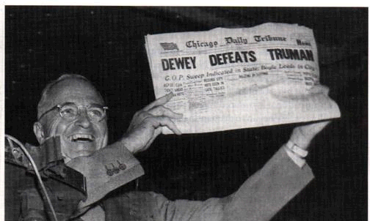
Selection Bias in a Descriptive Study
Fulminant example: Surveys for 1948 President election
  various cross-sectional studies used to find participants
  most favored Thomas Dewey
Election results
  Harry Truman beat Dewey
Explanation: Poor Study Design
Although from social science, ushered in realization of the importance of representative (random) sampling in all fields
Notes:
We will talk first about a descriptive study, and although this is outside of our biomedical realm, one of the most fulminant examples of selection bias in a descriptive study occurred in the pre-election surveys (polls) for the 1948 Presidential election in the U.S. The pre-election surveys used various cross-sectional survey methods to find participants and most of these surveys found that the largest percentage of survey respondents favored the candidate Thomas Dewey. Newspapers were even printing headlines stating that Dewey had won (shown is Harry Truman holding up such a newspaper; he was later vindicated).
However, as those of you who follow U.S. history know, the truth was seen in the general election results in which Truman beat Dewey. What was the problem here? Who or what was at fault for the erroneous pre-election study inference? In retrospect, these polls used unprincipled study designs featuring non-representative samples. They simply surveyed people who were the most expedient to find. Although this was in the field of social science, the errors made in the pre-election polls in this election (and others like the 1936 President election of Roosevelt vs Landon) really turned the entire science of sampling on its head and ushered in the era in which we live today where we recognize the importance of representative (or random) sampling in all fields. In short, if you wish to learn about the source population, the only way to be sure is to implement a process in which you obtain a representative sample.

Slide 36
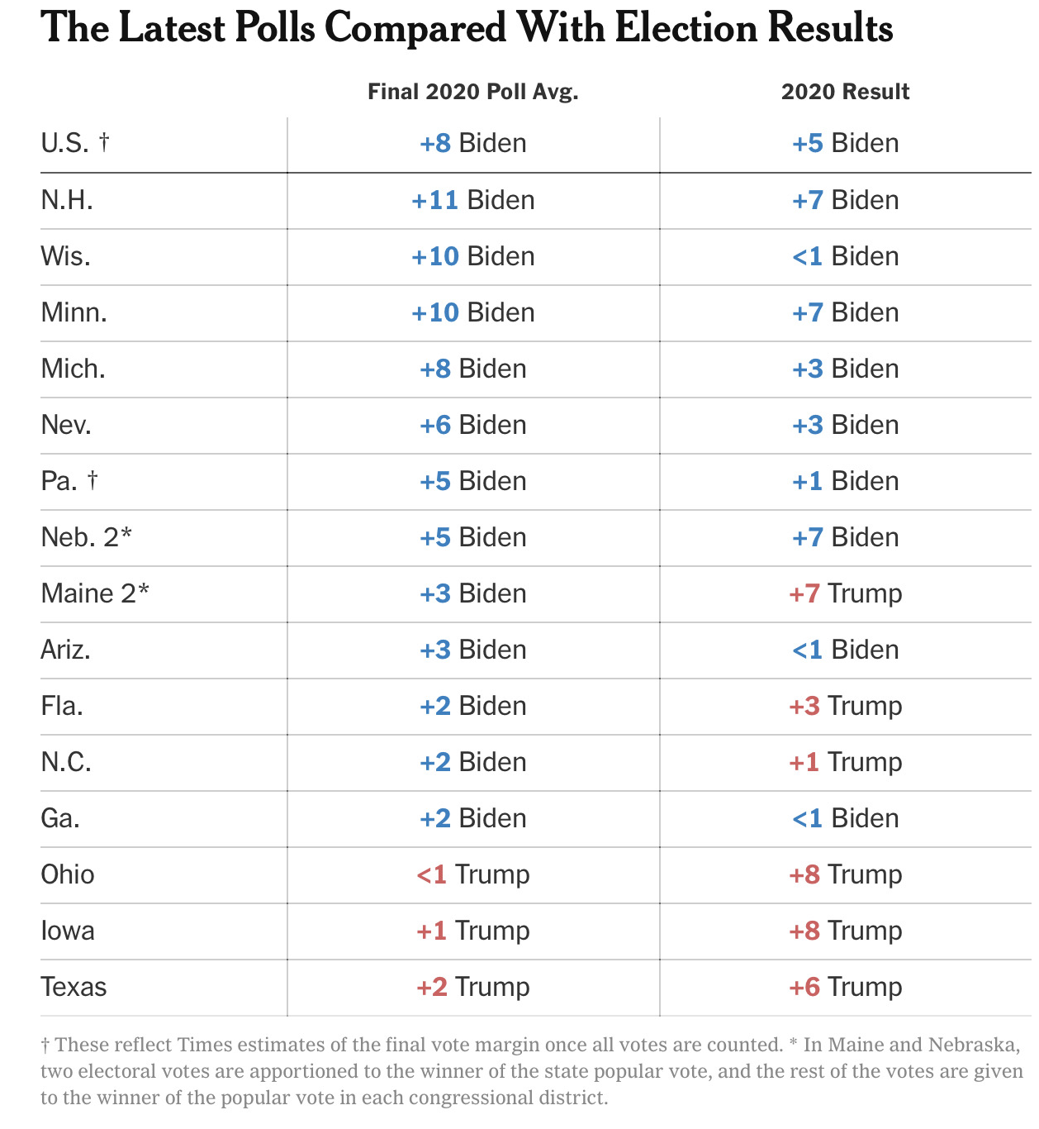
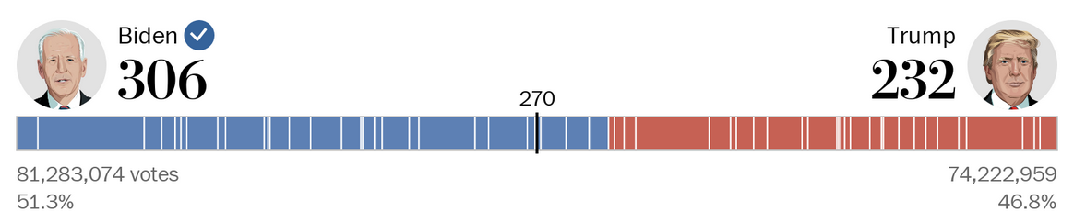
2020 U.S. Presidential Election
Pre-election poll – a cross-sectional sample (N = ~1000’s)
Final election results (N = 158,383,403)
Election polls provide opportunity to later look at truth and evaluate bias in poll study design
Luxury rarely occurs in clinical/epidemiologic research
Leonhardt NY Times 2020
Notes:
Are we still making this kind of mistake in political science? The validity of the inferences from contemporary pre-election polling is much better, but they are still not perfect. In the U.S. Presidential election of 2020, this is what various pre-election polls/surveys showed overall in the U.S. and for several select states. These data were presented in an article by David Leonhardt in the New York Times in November 2020. These polls were the latest taken prior to the election. These surveys were samples of a few thousand persons, and they represented what where ultimately over 158 million voters. Qualitatively, the national poll was correct. For the individual states, the polls were mostly correct, with the exception of 3 states. Quantitatively, the national polls had Biden winning by an absolute 8% difference. This compares to the actual difference of 5%. In many ways, it is remarkable how a sample of a few 1000 can some close to the truth in 158 million. In other ways, it shows the imperfection of these polls despite over 100 years of working on them in the U.S.
Why are these election polls such a great way to learn about sampling and descriptive estimates in cross-sectional study designs? Because they are one of the few situations where we actually get to learn the truth about the source population, on election day, and can thus get a handle on whether there was bias in the survey (the study sample). Unfortunately, we do not get this luxury in clinical/epidemiologic research. Note: if the poll differs from the election result, we cannot, in truth, be certain if the difference is because of chance or bias. If the poll result is very far away from the election result, outside of the 95% confidence interval (what the pollsters call “sampling error”), then we are less likely to believe that this difference is due to chance and more likely to believe that the poll result was biased. If the poll result was close to the election result but not exactly the same, we have a harder time distinguishing chance from bias.
Political science note: There was a general perception was that the 2016 polls had been wrong about the U.S. presidential election — very wrong. Yet, the most rigorous polls, such as that done by New York Times/CBS News and 538.com, were actually very close to truth (the final election results), and not that different in their margin of error (pre-election estimate minus truth) than any other presidential election since 1968. Despite winning more overall votes (the popular vote), Clinton lost in the electoral college. A nice summary of the 2016 polling can be found at: http://fivethirtyeight.com/features/the-real-story-of-2016.
The David Leonhardt article provides an interesting history of presidential election polling in the U.S.

Slide 37
Descriptive Study:
“Box and Arrows” Depiction of No Selection Bias (Unbiased Sampling)
Arrow (or stick) is the probability of someone in source population participating in study sample
Equal weighting of arrows = Equal selection probabilities
SOURCE POPULATION
STUDY SAMPLE
Notes:
Here is a schematic representation, with boxes and arrows (or we might call them sticks), that depicts what we hope to do when sampling in a descriptive study in terms of having no selection bias. The arrows depict the probability that a given person in the source population ends up in the study sample. This probability is known as a “selection probability”. In the upper left, we depict the source population and on the lower right is our study sample. Our goal is to have the study sample validly represent the source population; we show this here by an equal weighting of arrows stemming from the source population to the study sample. Everyone in the source population has the same chance as ending up in the study sample. Everyone has the same selection probability.

Slide 38
Descriptive Study:
Depiction of Selection Bias (Biased Sampling)
Unequal weighting of arrows = Unequal selection probabilities
SOURCE POPULATION
e.g., Dewey backers were over-represented
See Additional Material Slides for Biomedical Example
STUDY SAMPLE
Notes:
This is an example of what selection bias looks like in a descriptive study. The study sample has an over-representation of a specific portion of the source population (in the upper right portion of the box) as you can see depicted by the unequal weighting of arrows. People in the source population have unequal selection probabilities; this is what is being depicted by the unequal weighting of arrows. This is what happened in the 1948 U.S. pre-election survey. Those persons who favored Dewey were over-represented in the study sample, the pre-election polls.

Slide 39
Longitudinal descriptive study
Geng et al. JAMA 2008
Mortality following initiation of antiretroviral therapy among HIV-infected adults in Uganda
In the presence of 39% loss to follow-up (drop out) at 3 years (n ~ 800 lost)
Notes:
Here is another example from a study with a descriptive objective; this time, it is a longitudinal study and in the biomedical arena. This study evaluated mortality after initiation of antiretroviral therapy among HIV-infected adults in Uganda and was conducted by a former instructor in the course, Elvin Geng, who was working with the course director as well as David Glidden. These patients were identified at clinics in Uganda which administered antiretroviral therapy. Elvin had to contend with substantial losses to follow-up, 39% at three years after starting therapy in this fixed cohort study. This amounted to over 800 lost patients. In his initial estimate, Elvin did what most researchers would do. He censored observation at the time of drop out. Doing so, he made the assumption that the losses to follow-up were non-informative, in other words, that patients who became lost had the same incidence of mortality as those who remained in the analysis. When we censor patients and then use the Kaplan-Meier estimator to derive cumulative incidence, the analyst is effectively stating that the lost experience the same incidence of the outcome as those who remain. After all, if you do not know what happened to these patients, you do not have many options, and this is what researchers have done for time immemorial.

Slide 40
There was, however, some discomfort about merely censoring …
Mortality following initiation of
antiretroviral therapy in Uganda
In the presence of 39% loss to follow-up (drop out) at 3 yrs
What else to do at this point?
Assume all lost are dead - A
Match losses to nat’l death index - B
Consult a biostatistician - C
Hopeless; choose another project - D
Some other idea - E
Notes:
40
There was, however, some discomfort about merely censoring the lost and performing Kaplan-Meier estimation.
What would you do at this point? Assume all of the lost are dead? Try to figure out what happened to the lost by matching the names of the lost to a death registry? Consult a biostatistician? Given up entirely because this is a hopeless situation; there is no way to get an unbiased answer? Or, is there is some other idea?

Slide 41
Mortality following initiation of
antiretroviral therapy in Uganda
In the presence of 39% loss to follow-up at 3 yrs
What else to do at this point?
Some other idea - E
Assume all lost are dead - A
Match losses to nat’l death index - B
Consult a biostatistician - C
Hopeless; choose another project - D
Notes:
41
Answer: Some other idea.
Assuming all of the lost are dead would be a form of sensitivity analysis, but with 39% lost this is going to yield a very high estimate of death. It is not realistic to believe that they are all dead.
It is a nice thought to consider matching these patients to some external data source, like a national death index, but there is not a national death registry in Uganda. There is one in the U.S. but not in Uganda. This is the case in many resource-limited countries — no national collection of deaths.
A biostatistician is not going to get you out of this mess. There is no magic that they can do with just the data at hand.
You might indeed consider that this is a hopeless situation, for which no estimate of mortality should be attempted. Sometimes one needs to conclude that the available data simply are not adequate to address the question at hand.
However, it turns out that there was a feasible solution.

Slide 42
Mortality following initiation of antiretroviral therapy in Uganda
Accounting for losses to follow-up by tracking down vital status of a sample of the lost in the community
Sample-Corrected estimate
Selection bias
(5-fold change)
Naive estimate
Notes:
The innovative solution is to track down a random sample of the lost and determine their vital status. Elvin looked high and low in the community for these patients to determine if they were dead or alive. In this case, a 15% sample of the lost was sought after in the community, and for about 85% of them, an updated vital status was documented. When Elvin did this and incorporated the new outcomes he found into the analysis, the new estimate of mortality, which is called the corrected estimate, was considerably higher than the original estimate (which we call the naïve estimate), five-fold higher (or nearly +10% on the absolute difference scale). The difference between the original, or naïve, estimate, which we now know is wrong, and the corrected estimate is the result of selection bias. We rarely get this direct measure of selection bias in clinical and epidemiologic research.
In summary, the other idea was to obtain a random sample of the drop outs and try very hard to find out what happened to them by searching for them in the community. If you can identify the vital status in a high percentage of this sample, then you can safely state that it is representative of all those who were lost to follow-up. You can then use this sample to stand for all 800 who dropped out. This practice of searching for a random sample of lost to follow-up has subsequently become a best practice in research in this field in sub-Saharan Africa.

Slide 43
Selection Bias (It is not just selection)
Definition: When study sample not representative of source population
In a Descriptive Study
  Bias caused when persons in source population have different (unequal) probabilities of being selected for/retained in study sample
  Occurs when the participants/follow-up in the study sample are not representative of the persons/follow-up in the source population
  “in-selection” or “out-selection”
In an Analytic Study (Where most of the attention goes)
  Bias caused when persons in source population have different (unequal) probabilities of being selected for/retained in study sample
    And these differing (unequal) probabilities are influenced by (or associated with) both exposure and outcome of interest
  Occurs when persons in study sample have different relationship between exposure & outcome than persons in source population
Notes:
This example takes us back and reminds us of the basic definition of selection bias in a descriptive study. Selection bias is not just about who gets selected for a study, which is sometimes call the front end or “in-selection”. It is also about who gets retained and is available for analysis during the follow-up period. This is sometimes called the back end or “out-selection”. When the participants who remain during follow-up in study sample ARE NOT representative of the source population’s follow-up, selection bias will ensue.

Slide 44
Descriptive Study:
Depiction of Selection Bias (Biased Sampling)
Unequal weighting of arrows = Unequal selection probabilities
e.g., patients who had died in follow-up and did not return to clinic became under-represented in study sample
SOURCE POPULATION
Informative censoring leads to selection bias
STUDY SAMPLE
Notes:
This is what the Uganda example looks like in a box and arrows diagram. Some patients who had died during follow-up and did not return to clinic became underrepresented in the study sample as it was followed over time. Because death was indeed why the patients were not returning to clinic, these patients who were lost had a greater incidence of death than those whose vital status was known to the study. Earlier, we referred to this as informative censoring. Now, we can see how informative censoring leads to selection bias.

Slide 45
Selection Bias: Analytic Objectives
Definition: When study sample not representative of source population
In an Analytic Study
  Bias caused when persons in source population have different (unequal) probabilities of being selected for/retained in study sample
    Specifically, when the differing (unequal) probabilities are influenced by (or associated with) both exposure and outcome of interest
  Occurs when persons in study sample have different relationship between exposure & outcome than persons in source population
  Manifestations:
    When there truly is not an association between exposure and disease, selection bias can result in an erroneous association (positive or negative)
    When there truly is an association between exposure and disease, selection bias can yield a distortion in that value (smaller or larger)
      Including erroneous appearance of no association
Notes:
Now let us shift our attention to selection bias in analytic studies. We have already said selection bias in analytic studies is the bias that occurs when people in the source population have unequal probabilities of being selected for/retained in the study sample. This is specifically the case when the unequal probabilities are influenced by both the person’s exposure status and outcome status. By influence, we mean either directly cause or be associated with.
Selection bias can create a number of problems. In a study where there is truly not an association between exposure and disease (we call this “under the null” or “the null context”), selection bias can result in an apparent association, an erroneous one. In a study where there truly is an association between exposure and disease (we call this “under the non-null” or “off the null”), selection bias can yield a distortion in that value (either a smaller or larger value, depending upon context). We will commonly refer to these contexts “under the null” and “under the non-null” in the slides to follow. They are theoretical in that we can never know whether, in truth, there is or is not a relationship between exposure and outcome. Despite the theoretical nature of these constructs, they are very useful to understand the origins and manifestations of selection bias.
Advanced note: We say that selection bias occurs, specifically, when the differing (unequal) probabilities are influenced by (or associated with) both exposure and outcome of interest. We will later describe how this constellation is neither sufficient nor necessary for selection bias to occur. That is, there are some situations in which this constellation does not cause selection bias (because another important condition is missing) and some scenarios in which even fewer conditions are needed.

Slide 46
Analytic Study:
Depiction of No Selection Bias (Unbiased Sampling)
Disease
+ -
Given that a person resides in one of the 4 cells in the source population, the selection probability is the probability he/she will be represented in that cell in the study sample.
+
-
Exposure
Selection probability includes process of selection and, in cohort studies, process of retention
SOURCE POPULATION
Equal weighted arrows = Equal selection probability = No selection bias
STUDY SAMPLE
Notes:
In analytic studies, we aim to estimate the association between exposures (or interventions/treatments in the case of experimental studies) and diseases (more generally, outcomes). We depict an analytic study by the presence of the familiar 2 x 2 table with exposure (present or absent) along the rows and disease (present or absent) over the columns. This is what the schematic looks like in the presence of unbiased sampling and, thus, no selection bias. The arrows represent the selection probabilities, which for each cell is the percentage of persons in the cell in the source population that is found in the study sample. Here, the arrows all have the same weight, and therefore there is an equal probability of being selected into the study no matter which of the 4 cells you reside in the source population. In such a situation, no selection bias will ensue. Equal selection probability results in no selection bias.
These selection probabilities include both the process of selection of participants into the study (“in-selection”), and, in cohort studies, the process of retention in the study (“out-selection”). In other words, the arrows are meant to depict everything about whether someone in the source population ends up in your study sample and evaluable throughout the study.

Slide 47
Analytic Study:
Depiction of No Selection Bias (Unbiased Sampling)
Disease
+ -
PR = (10,000/50,000)/(10,000/50,000) = 1
+
-
10000
40000
Rule -- Equal selection probability in all 4 cells:
No Selection Bias
Exposure
1%
10000
40000
1%
SOURCE POPULATION
1%
1%
100
400
PR = (100/500)/ (100/500) = 1
Corollary: Unequal selection probabilities give potential for selection bias
100
400
STUDY SAMPLE
Notes:
Here is a numeric example from a cross-sectional study which lacks selection bias because it was performed with representative sampling. Let us say we have 10,000 persons in the source population who are exposed and diseased, 40,000 exposed and non-diseased, 10,000 unexposed and diseased, and 40,000 unexposed and non-diseased. This equates to a prevalence ratio in the source population of 1.0.
Now, let us conduct our actual study and obtain our study sample. Let us say that the selection probability is 1%, and that it is equal in all cells. This results in the prevalence ratio that is shown for the study sample. To no surprise, the prevalence ratio is 1.0.
This, therefore, defines one rule regarding selection bias: If there is an equal probability of being selected into the study no matter which of the 4 cells you reside in in the source population, no selection bias can result. Formally, the weight of the arrows is equal to the selection probability for each of the cells, which is sometimes called the sampling fraction. If the sampling fraction is the same regardless of the cell you are in the source population, then no selection bias will ensue.
As an important corollary to this, the presence of unequal selection probabilities gives potential for selection bias. Specifically, for selection bias to result in the appearance of an association where one truly does not exist, selection probabilities must differ according to (i.e., related to) both exposure and disease (outcome). We call this situation in which an association between exposure and disease does not truly exist “under the null’. In other words, the null hypothesis is operative. In short hand, we call it “under the null”.

Slide 48
Analytic Study:
Depiction of Selection Bias (Biased Sampling)
Disease
PR = (10,000/50,000)/(10,000/50,000) = 1
+ -
Unequal selection probabilities gives potential for selection bias:
+
-
10000
40000
In this case, spurious protective effect of being exposed
Exposure
10000
40000
0.5%
1%
SOURCE
POPULATION
PR = (50/450)/ (100/500) = 0.55
1%
1%
50
400
450
“Under the null”, selection probabilities must differ according to both exposure and disease for selection bias to occur
500
100
400
150
800
STUDY SAMPLE
Notes:
Let us look at an example in which the selection probabilities are not equal. Here again is the schematic of an analytic study. I like these box and arrow diagrams because they help us keep straight what is going on and help us predict the direction of the bias. Here we depict with a lighter shaded arrow among those persons who are exposed and diseased; they are undersampled relative to the other 3 cells.
Numerically, let us say that 3 of the cells have a selection probability of 1% but that the exposed and diseased cell has a selection probability of 0.5%. Unequal selection probabilities across cells give the potential for selection bias. What would you predict is the manifestation (i.e., direction) of this pattern of selection probabilities? Any process that artificially lowers the number of persons in this upper left hand corner cell will falsely underestimate the effect of any association between the presence of the exposure and the disease. In this example, it serves to indicate that an exposure with no effect is spuriously protective. Here the prevalence ratio is biased downward to 0.55.
In this example, the unequal selection probability is not just affecting exposed persons or diseased persons. It is affecting exposed and diseased persons. Thus, this example illustrates how when “under the null”, selection probabilities must be influenced by/related to both exposure and outcome in order to result in selection bias. “Under the null” means that there is no association in the source population, i.e., no effect of exposure on outcome.

Slide 49
Analytic Study:
Depiction of Selection Bias (Biased Sampling)
Disease
+ -
Unequal selection probabilities:
Overestimate of Effect
+
-
Exposure
SOURCE POPULATION
STUDY SAMPLE
Notes:
What if we have this situation where exposed and diseased persons, the cell in the upper left-hand corner, have a higher probability of being in the study sample. This is another situation with unequal selection probabilities, a potential for selection bias. If exposed and diseased are overrepresented relative to the other cells, then, to no surprise, this will result in an overestimate of effect of the exposure.
Selection here is related to exposure (exposed persons have a higher selection probability than unexposed) and also to outcome (diseased persons have a higher selection probability than non-diseased). For selection bias to result in the appearance of association where one truly does not exist (“under the null”), selection probabilities must differ according/related to both exposure and disease

Slide 50
Analytic Study:
Depiction of Selection Bias (Biased Sampling)
Disease
+ -
Unequal selection probabilities:
Underestimate of Effect
+
-
Exposure
SOURCE
POPULATION
STUDY SAMPLE
Notes:
What if we have this situation where exposed and diseased persons, the cell in the upper left-hand corner, have a lower probability of being in the study sample? This is another situation with unequal selection probabilities, a potential for selection bias. If exposed and diseased are underrepresented relative to the other cells, then, to no surprise, this will result in an underestimate of effect of the exposure. We saw this in the numerical example two slides prior to this.
Again, selection is related to exposure and to outcome. For selection bias to occur in the estimation of the association between exposure and outcome in which one truly does not exist (“under the null”), selection probabilities must differ according/related to both exposure and disease

Slide 51
Analytic Study:
Depiction of Selection Bias (Biased Sampling)
Disease
+ -
Unequal selection probability:
Underestimate of Effect
+
-
Exposure
SOURCE POPULATION
STUDY SAMPLE
Notes:
How about here where the exposed but non-diseased are overrepresented? Too many exposed and non-diseased would appear to indicate that exposure does not cause disease and hence there is underestimation of the effect of the exposure.

Slide 52
Analytic Study:
Depiction of Selection Bias (Biased Sampling)
Disease
+ -
Unequal selection probabilities:
Overestimate of Effect
+
-
Exposure
SOURCE POPULATION
Artificial excess of unexposed/non-diseased gives false impression of greater effect of exposure
STUDY SAMPLE
Notes:
Here, unexposed/non-diseased are overrepresented. This results in an overestimate of the effect of the exposure. A way to think about this is that in the unexposed group (the reference group), it spuriously appears that most persons are non-diseased (diseased are rarely unexposed). The more this occurs in the unexposed reference population, the more that any exposed/diseased stands out as being different and hence the effect of exposure is overestimated. This is just one way to explain this; there are others.

Slide 53
Analytic Study:
Depiction of Selection Bias (Biased Sampling)
Disease
+ -
Unequal selection probability:
Underestimate of Effect
+
-
Exposure
SOURCE POPULATION
STUDY SAMPLE
Notes:
What happens when the unexposed but diseased are overrepresented? Too many unexposed amongst the diseased would appear to indicate that exposure does not cause disease and hence there is underestimation of the effect of the exposure.

Slide 54
What Do Each of These Scenarios Have in Common?
Disease
Disease
+ -
+ -
+
-
+
-
Exposure
Exposure
SOURCE
POPULATION
SOURCE
POPULATION
STUDY SAMPLE
STUDY SAMPLE
Disease
Disease
+ -
+ -
+
-
+
-
Exposure
Exposure
SOURCE
POPULATION
SOURCE
POPULATION
STUDY SAMPLE
STUDY SAMPLE
Notes:
What do each of these scenarios have in common that resulted in their having selection bias? One obvious visual difference is that one cell appears to be different than the rest. This is true, but the answer is a bit deeper than that.

Slide 55
Analytic Study:
Depiction of No Selection Bias (Unbiased Sampling)
Disease
+ -
Unequal selection probabilities but only according to exposure
+
-
Exposure
SOURCE POPULATION
“Under the null”, selection probabilities must differ according to both exposure and disease for selection bias to occur
STUDY SAMPLE
Notes:
To help answer the question, consider this scenario. Here, the selection probabilities are unequal, and thus we have to be thinking about the potential for selection bias. These two cells (all of the exposed persons) are underrepresented relative to these two (the unexposed persons), and thus we say that selection is related to exposure. However, selection appears to be unrelated to disease; diseased and non-diseased appear to be selected at an equal probability. Is this scenario a problem for our analytic objective of asking whether exposure is related to disease?
No, it just means you enrolled fewer exposed persons, but this had nothing to do with disease status. This is unequal selection according just to exposure only, not to disease. We earlier called this exposure-selective sampling, and it is perfectly acceptable in cross-sectional or cohort studies without concern for causing bias. Remember, the rule is that for selection bias to occur “under the null”, selection probabilities must differ according to both exposure and disease. So, no selection bias ensues in this scenario.

Slide 56
Analytic Study:
Depiction of No Selection Bias (Unbiased Sampling)
Disease
PR = (10,000/50,000)/(10,000/50,000) = 1
+ -
+
-
10000
40000
Unequal selection probabilities but only according to exposure:
No Selection Bias
Exposure
0.1%
10000
40000
0.1%
SOURCE POPULATION
1%
1%
10
40
PR = (10/50)/ (100/500) = 1
“Under the null”, selection probabilities must differ according to both exposure and disease for selection bias to occur
100
400
STUDY SAMPLE
Notes:
Here is a numeric example. Let us say that both exposed diseased and exposed non-diseased are sampled with a 0.1% selection probability. This compares to 1% in the unexposed group. If we work through the math, the prevalence ratio in the study sample is unchanged at 1 compared to the source population. This is not surprising. Cross-sectional studies or cohort studies are commonly assembled with what is known as “exposure-selective” or “stratified sampling” based on exposure status; this does not inherently cause selection bias.
This reminds us of the rule: For selection bias to occur “under the null”, selection probabilities must differ according to both exposure and disease.

Slide 57
Analytic Study:
Depiction of No Selection Bias (Unbiased Sampling)
Disease
Unequal selection probability but only according to disease
+ -
+
-
Exposure
What type of (intentional) study design might this be?
SOURCE
POPULATION
“Under the null”, selection probabilities must differ according to both exposure and disease for selection bias to occur
STUDY SAMPLE
Notes:
How about here? Same thing. Unequal selection occurs only according to disease but not according to exposure. The non-diseased have a lower selection probability than the diseased. There is no influence of exposure on selection probabilities. Therefore, no selection bias ensues under null contexts.
This selection pattern depicts a familiar study design. It is a case-control study. We know this because the non-diseased have a much lower selection probability than the diseased. In fact, in many case-control studies there is 100% probability of selection of the cases but only a small fraction of the rest of the underlying study base is sampled.
As explained in the Additional Material Slides, in situations in which there is an underlying association between exposure and diseases (“a non-null” context), selection probabilities do not have to be influenced by both exposure and outcome. It will suffice for just outcome to influence selection probability for selection bias to ensue. Hence, the rules for selection bias are slightly different depending upon where truly is or is not an association between exposure and outcome. Case-control studies, despite having outcome influence selection, are immune to resultant selection bias due to their design because of the particular measure of association they use — odds ratios.

Slide 58
Analytic Study:
Depiction of No Selection Bias (Unbiased Sampling)
Disease
PR = (10,000/50,000)/(10,000/50,000) = 1
+ -
+
-
10000
40000
Unequal selection probabilities but only according to disease:
No Selection Bias
Under the Null
Exposure
0.1%
10000
40000
1%
SOURCE POPULATION
0.1%
1%
100
40
PR = (100/140)/ (100/140) = 1
“Under the null”, selection probabilities must differ according to both exposure and disease for selection bias to occur
100
40
STUDY SAMPLE
Notes:
Here is a numeric example. Let us say that both exposed diseased and unexposed diseased are sampled with a 1% selection probability. This compares to 0.1% in the exposed non-diseased and unexposed non-diseased groups. If we work through the math, the prevalence ratio in the study sample is unchanged at 1 from the source population.
This follows our rule: For selection bias to occur “under the null”, selection probabilities must differ according to both exposure and disease.

Slide 59
What Do Each of These Scenarios Have in Common?
Disease
Disease
+ -
+ -
+
-
+
-
For selection bias to result in the appearance of association where one truly does not exist (“under the null”), selection probabilities must differ according/related to both exposure and disease selection
Exposure
Exposure
SOURCE
POPULATION
SOURCE
POPULATION
Will occur when:
Influence on selection by exposure status; and
Influence on selection by disease status; and
Some special influence on selection conferred by joint exposure & disease status
  We will later formally define “special influence” as multiplicative interaction between exposure & disease on occurrence of selection
STUDY SAMPLE
STUDY SAMPLE
Disease
Disease
+ -
+ -
+
-
+
-
Exposure
Exposure
SOURCE
POPULATION
SOURCE
POPULATION
STUDY SAMPLE
STUDY SAMPLE
Notes:
Back to our question: What do each of these four scenarios have in common that resulted in their having selection bias? We mentioned this earlier. What they have in common is that the selection probabilities must differ in some way that is related to both exposure and disease. In other words, different selection probabilities will result in selection bias when they have some influence by exposure status, some influence by disease status, and some special influence conferred by the joint exposure and disease status. We will later formally define “special influence” as there being “multiplicative interaction” between exposure and disease on the occurrence of selection.
Advanced note: To understand what we mean by “special influence”, let us concentrate on a cross-sectional study for simplicity, because both exposure and outcome are present at the outset. Special influence will be clearer when we discuss interaction in a few weeks., but, for now, this can be understood by returning to 2x2 tables we used to depict selection bias in an analytic study. Assume that being exposed and being diseased increase selection probability. If these two forces are operating independently and are directly related to being selected, then the exposed/diseased will have the highest probability of selection (which will tend to overestimate an association if one is truly not present). However, this is going to be cancelled out by the fact that the unexposed/non-diseased are going to relatively undersampled (tends to underestimate association). The overall result is no selection bias. It is only when the combination of being exposed and having the outcome results in a different selection probability than you would expect by combining two independent probabilities that selection bias will occur. In other words, for selection bias to occur, the selection probabilities for each of the 4 cells cannot just be influenced by the independent selection forces related to exposure and outcome. There needs to also be some special influence on selection conferred by joint exposure and disease status. This can only be accomplished when the effects of exposure and outcome on selection probability are not independent — they need to be synergistic or antagonistic. More on this can be found in the Appendix of the Hernan 2004 paper on selection bias in the optional reading.

Slide 60
Typically, in practice, you don’t know all of the selection probabilities
You usually select study sample without firm enumeration of source population
Usually, best we can do regarding evaluation of presence of selection bias is make educated guesses based upon context and theory
Disease
+ -
+
-
Exposure
?
?
SOURCE POPULATION
?
?
STUDY SAMPLE
Notes:
This is all interesting theory, but, of course, as most of you have recognized, the problem is that unless you have enumerated the entire underlying source population, then you do not know the selection probabilities in the various 4 cells of your study sample. And, if you had enumerated the entire underlying source population, you might have also made all of the measurements and hence there would be no reason to draw a study sample. You would just analyze the entire source population and not have to worry about selection bias.
We depict our lack of knowledge about the selection probabilities here by placing question marks by the arrows. We do not, in practice, know their intensity or weight. We do not, in practice, know the selection probabilities. The best we can do is make educated guesses, based upon the context, if the selection probabilities are equal or unequal.

Slide 61
Guesses are informed by remembering basic rules for selection bias
For selection bias to occur “under the null”: A person’s selection/retention must be influenced/associated with BOTH his/her exposure and outcome
Selection/retention
Exposure
Disease
Other factors
Other factors
Selection/ retention
Selection/ retention
Exposure
Disease
Exposure
Disease
Other factors
Other factors
Selection/retention
Exposure
Disease
Notes:
These guesses can be made keeping the requirements for selection bias in mind. To summarize, for selection bias to occur under the null (when there truly is no association), we need to know that people’s selection into a study or retention in the study must be influenced by (or associated with) both his/her exposure and outcomes.
This top figure is a way to remember what is needed. It shows how both exposure status and disease status are directly influencing selection and/or retention.
Exposure need not be directly responsible for selection. Exposure might just be associated with selection. This means that another factor is responsible for exposure and for selection/retention. And, disease status need not be directly associated but rather it can just be associated with selection. These are shown in the second row of figures.
Or, as shown in the bottom panel, both exposure and disease may only be associated with selection/retention via another “other factors”; exposure and disease are not directly responsible for selection/retention into the study.
As we mentioned, there is one other condition that must be met regarding the influence of exposure and disease on selection or retention probability. This is called multiplicative interaction, and it means that there must be “something special” about a person’s joint exposure and disease status that influences selection. This will be explained in much more detail later in our sessions on interaction.
We are going to return to these diagrams, which we will later call directed acyclic graphs (DAGs), later in the course. They turn out to be very handy in identifying the potential for selection bias. You can also read about them in the optional reading for this week (Hernan et al., 2004) if you want to get started now.

Slide 62
Why does selection that is influenced by exposure and outcome induce bias?
Example
Study: Does family wealth affect academic performance in young adults?
Study sample: Undergraduates at Harvard
Widely rumored/appreciated that admission to Harvard is related to:
  Academic performance
  Family wealth
Participant | Family wealth | Academic Performance
1 | Rich | Low
2 | Poor | High
3 | Rich | Low-medium
4 | Poor | Very high
Data not surprising because the more a participant has of one attribute that got him into the sample, the less he will need of the another
Or, if participant has none of one attribute, he/she must have a lot of the other
Data, in aggregate, will show family wealth and acad. performance to be inversely related.
This is not the case in source population (all young adults); the problem is selection bias
Notes:
Why does selection that is influenced by both exposure and outcome induce bias?
As an example, let us say that we want to study the relationship between family wealth (the exposure) and academic performance (let’s say GPA; the outcome) in young adults.
And, let us say that we are going to do this study among undergraduates at Harvard, a university where it is widely rumored/appreciated (at least in the past) that admission is related to academic performance and family wealth.
Here are a portion of the data. In Participant 1, family wealth is rich and academic performance is low. In Participant 2, family wealth is poor and academic performance is high. (Two other participants’ data are shown.)
These data are not surprising because, among these undergraduates at Harvard, the more a participant has of one attribute that got him into the study sample (which is based at Harvard), the less he/she will need of the another. If you do not believe that, you will certainly believe that if a participant has none of one attribute, he/she must have a lot of the other. Otherwise, he/she would not be at Harvard.
In the end, the data, when viewed in aggregate (as in a 2 x 2 table) will show a relationship between academic performance and family wealth in the study sample. This will be an inverse or indirect relationship. Higher family wealth will be related to lower academic performance. We know, of course, that this is not true in the true source population of all young adults. If a relationship does exist, it is not an inverse one. This wrong inference is the result/manifestation of selection bias. (Note: These are fictitious data and are not meant to reflect on any particular university in any way.)
The example illustrates that anytime you investigate whether or not two factors are related to each other in a study sample whose existence was influenced by these two factors (at least in part), you will often obtain a biased measure of association.
Historical note: While this logic may today seem like common sense to us, it took some time for it to become formalized. Recognition of the phenomenon is believed to have been first made by Sewall Wright in the early 1920’s. Wright was inventor of what we today call causal diagrams (directed acyclic graphs). He urged caution regarding the use of partial correlation, a dominant method of variable control at that time. He wrote “If an effect of a number of causes is made constant, spurious negative correlations appear among the causes and their other effects”. Working independently, Barbara Burks, a graduate student at the time at Stanford, was even more forceful in 1926 in her “On the Inadequacy of the Partial and Multiple Correlation Technique”. She wrote “the true measure of contribution of a cause to an effect is mutilated if we have rendered constant variables which may in part or in whole be caused by either of the two factors whose true relationship is to be measured, or by still other unmeasured remote causes which also affect either of the two isolated factors.” Unfortunately, the work of Wright and Burks was either vilified or ignored for decades. For example, Berkson in 1946 — the first to recognize an example of selection bias in human health-related research — did not describe the more general conditions that lead to the bias or recognize that it had been already described by Wright and Burks. While both Wright and Burks used graphical diagrams to illustrate their work, neither emphasized the generic graphical structure that led to the bias they were cautioning to avoid. As the work of Wright and Burk was slowly revived in the 1950’s and the years that followed, several names appeared for the graphical circumstances underlying the bias such as “configuration [<]”, “head-to-head arrows”, “inverted fork”, “v structure” and “converging arrows”. None gained traction until “collider” emerged in the 1980’s, an action-packed compact term that conjures the graphical image and subsequently became entrenched in most disciplines. Later, we will refer to this form of selection bias as “collider-conditioning bias”.

Slide 63
Error in Clinical and Epidemiologic Research:
General Aspects and Focus on Selection Bias
Framework for understanding error in clinical research
  systematic error, aka threats to internal validity, or bias
  random error, aka sampling error, or chance
Types of bias: Selection bias, Measurement bias, and Confounding
Selection bias
  according to study objective: descriptive or analytic
  mechanisms by study design:
    cross-sectional
    case-control
    longitudinal studies (cohort: observational or experimental)
Many of the examples that follow are unusual situations where investigators went the extra mile to illustrate selection bias
Notes:
Now that we understand the basics about selection bias, let us discuss it specifically by analytic study design. To do this, most of the examples that follow are unusual situations where the investigators went the extra mile, in one shape or form, to illustrate selection bias.

Slide 64
Selection Bias in a Cross-sectional Study:
Presence of exposure and outcome at study outset raises potential for selection bias
Disease
+ -
+
-
Exposure
?
?
SOURCE POPULATION
?
?
Selection
?
?
Exposure
Disease
STUDY SAMPLE
Notes:
Let us start with cross-sectional studies, and the one thing that should cross your mind immediately with cross-sectional studies is that the presence of exposure AND outcome at the time you select participants raises the potential for selection bias. Of course, exposure is always present in observational studies at the beginning, but outcome may not be. Consider fixed cohort studies (which we will discuss momentarily) in which outcome is not present at the time of study sample assembly.
In cross-sectional studies, the presence of known exposure status and known outcome status at the time of sampling do not guarantee that selection bias will occur, but they do raise our concern. This is why we place the question marks on all of the arrows in the figures.

Slide 65
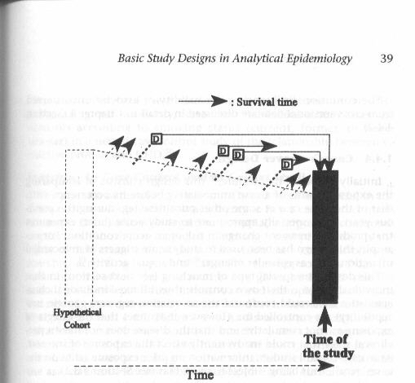
Mechanisms of Unequal Selection Probabilities in Cross-Sectional Studies
Assuming that the goal is to identify causal determinants of disease development (causation research)
CE
Unwise choice of a study sample as representative of source population.
  Study sample influenced by both exposure and outcome (e.g., Harvard study)
Non-participation amongst eligibles whom you have approached
  “Non-response” (eligible persons in intended sample decline participation according to exposure & outcome); actual study sample not equal to intended sample
Some people whom you would like to sample never become available to ask
  Drop out, competing events, and/or death from disease influenced by/associated with both exposure & outcome
Notes:
That said, let us think about the general mechanisms that can lead to unequal selection probabilities in cross-sectional studies. Let us do this by remembering our schematic which is that all cross-sectional studies are sampled from an underlying cohort. In this instance, we have depicted a fixed cohort, but it could also be a dynamic one. With this in mind, and assuming that the goal is to identify causal determinants of disease development (etiologic/causal research and not survival after disease), what are the mechanisms of how unequal selection probabilities — which must be related to both to exposure and disease — might occur in cross-sectional studies? In other words, how does selection bias occur? (Note: Our careful preface regarding the goal of the research question is because bias always needs to be defined relative to some desired truth in a source population. In other words, there can be no discussion of bias unless we are all clear what the true parameter is that we are trying to estimate. In this example, we are interested in causation of disease. In other research questions, we might be interested in survival after disease development.)
There are three basic mechanisms, and they can be inferred by looking at the figure. The first is making an unwise choice of a study sample. For example, if it was your goal to study the relationship between family wealth and academic performance in the general population of young adults, it would be an unwise choice by the investigators to choose a study sample of Harvard students for the reasons we explained earlier.
The second mechanism is because of non-participation among those who are appropriately eligible and that you attempted to enroll. This non-participation is also called “non-response” or “refusal”, which means that of the persons who are eligible to be in the study (i.e., they are alive and accessible at the time you conduct the study), some refuse to participate. If they do refuse according to their exposure and outcome status, then unequal selection probabilities and selection bias may ensue. Recalling our “hierarchy of populations” schematic, non-participation here is one reason why actual study samples do not equal intended samples
The third mechanism comes from recalling that there is a lot going on in cross-sectional studies that influences if people are around at the time of your study. In other words, in the underlying cohort, some people may never become accessible to ask to see if they want to participate. This is because of drop out, a competing event, or death. If these mechanisms of leaving the available study population are influenced by/associated with both exposure and outcome, then selection bias may ensue. This is a mechanism where one can readily appreciate the need for a special influence on selection conferred by joint exposure & disease status. That is, it is easy to see how having a particular disease (compared to not) can influence survival and hence availability to be sampled, but if this premature demise due to disease occurs Berks on in the same way among exposed and unexposed, then no bias will ensue. However, if the premature demise of those with the outcome is more or less marked in the exposed (compared to the unexposed), then bias may ensue.
Note: these scenarios are all assumed to be “under the null” (i.e., there truly is no association between exposure and outcome).

Slide 66
Selection Bias in a Cross-sectional Study:
Effect of Non-Responders
History of Heart Attack
+ -
+
-
Hyper-lipidemia
?
?
SOURCE POPULATION
?
A seemingly good overall 83% response
25
347
?
Austin, AJE 1981
Population-based survey of Southern California adults
45
2312
OR observed = 3.6
STUDY SAMPLE
Notes:
Are there any empiric examples of these mechanisms? What we just listed are the theoretical mechanisms, and typically we cannot be sure if they are occurring. This is unless researchers go the extra mile to investigate. In this example (Austin AJE 1981), a cross-sectional population-based study of cardiovascular disease in adults in southern California, the researchers tracked down the participants who initially refused to participate. In one of the analyses, the authors were studying the association between hyperlipidemia (high levels of fat in the blood) and presence of cardiovascular disease, as evidenced by history of heart attack. In this 2 x 2 table are the results using the participants who agreed to participate (the study sample). Overall, 83% of approached people agreed to participate. You might think this is very good participation, but you actually do not know the individual selection probabilities into the 4 cells.
The observed association was an odds ratio of 3.6. (Note: we are NOT promoting the use of an odds ratio in a cross-sectional study, but, instead, we are being faithful to the authors’ original depiction.)

Slide 67
Selection Bias in a Cross-sectional Study:
Effect of Non-Responders
History of Heart Attack
Investigators made the extra effort to track down and question the initial non-responders
+ -
+
-
30
401
Hyper-lipidemia
63
2807
CORRECTED
STUDY SAMPLE
SOURCE POPULATION
Response now nearly complete; selection probabilities now believed to be equal
OR true = 3.3
Austin, AJE 1981
Population-based survey of Southern California adults
Notes:
As I mentioned, the authors went the extra mile and tracked down those individuals who initially declined to participate. This is similar to what Elvin Geng did in his Ugandan work regarding mortality after initiation of antiretroviral therapy. In going this extra mile, the investigators called the non-responders again to try to convince them to participate, and they were able to convince a large percentage of the initial non-responders to answer the questions (or at least some of the questions). Here is what they found when they added in the responses from the initial non-responders. Because the authors now have nearly a complete response to the survey, we can say that the selection probabilities are essentially identical, and we show this with equal probabilities (equally weighted arrows). Hence, this 2 x 2 table therefore can be considered truth (assuming no other threats from measurement bias, confounding or sampling error). The odds ratio is now 3.3, in what we call the corrected study sample (which is very close to the intended sample).

Slide 68
Agreement to participate
Selection Bias in a Cross-sectional Study:
Effect of Non-Responders
Hyper-lipidemia
Hx of MI
History of Heart Attack
Investigators made the extra effort to track down and question the initial non-responders
+ -
+
-
30
401
Hyper-lipidemia
63
2807
CORRECTED
STUDY SAMPLE
SOURCE POPULATION
OR true = 3.3
25
347
83%
87%
Response %
Austin, AJE 1981
Population-based survey of Southern California adults
45
2312
72%
83%
OR biased = 3.6
Selection bias
STUDY SAMPLE
Notes:
Remember, the odds ratio of 3.6 is what the authors derived solely from the participants who responded. If we consider the numbers in the cells in the upper right as being representative of the source population, then we can use these as the denominator to derive the selection probabilities in the study sample. For example, among the exposed/diseased, if we divide 25 by 30, we get 83%. You can now see that the selection probabilities are not equal in the 4 cells, and they do differ according to both exposure and disease. This cell (exposed/non-diseased) is slightly overrepresented but the cell in the lower left hand corner (unexposed/diseased) is most underrepresented (72%). When unexposed/diseased are underrepresented, this means that the association between exposure and disease will be overestimated. Thus, the net result is that this is going to tend to overerestimate the association between hyperlipidemia and heart attack. The observed odds of 3.6 was greater than the odds ratio depicted as truth, 3.3. The difference between 3.6 and 3.3, about 10%, is from selection bias.
It can also be shown that a simple mathematical formulation/combination of the response probabilities represents what we will call “selection bias interaction factor” by which the observed odds ratio is biased in relation to the truth. In this case, the formulation is: (0.83)(0.83)/(0.87)(0.72) = 1.10. The original authors of this work (Austin et al.) called this an “error term”. The true odds ratio, 3.3, times the response probability “selection bias interaction factor”, 1.1, is equal to the observed odds ratio of 3.6. Later in the course, we will show how this “selection bias interaction factor” is the same as the metric we use to evaluate for multiplicative interaction. When exposure and disease are independently related to the occurrence of selection into a study (i.e., when there is not “something special” conferred by joint exposure and outcome status on the occurrence of selection into a study), this means there is no interaction between exposure and disease on the occurrence of selection (the selection bias interaction factor would be “1”).
It is hard to explain what human behavior or motivation would lead to this result. Sometimes, a “worried well” pattern occurs when persons who possess causal determinants but not actual disease have the highest response percentages, but when this occurs there is an underestimate in the observed data between the risk factor and disease. A higher response probability in the worried well did occur here (87%), but this was overshadowed by a low response percentage among those with disease but no risk factor. The study’s authors were not able to explain this, which illustrates how the direction and magnitude of non-response is often difficult to predict.
The graphic in the upper left-hand corner is a rudimentary DAG, which we will discuss formally in a few weeks. It depicts how both exposure and outcome causally influence decision to participate.

Slide 69
Effect of unequal response probabilities in a cross-sectional study
Group | Exposure | Outcome | Bias in OR due to non-response
Men | Family h/o MI | Heart failure | +63%
 | Hypertension | Stroke | -32%
Women | Family h/o stroke | Stroke | +59%
 | Family h/o diabetes | Stroke | -34%
Mechanism: Non-participation among some eligible in intended sample
(Study design was fine)
Austin, AJE 1981
Population-based survey of Southern California adults
Notes:
The analysis on the prior slide was the best worked out example in the Austin paper. A 10% difference between the true odds ratio and the observed odds ratio is not too bad, but these authors went on to show much greater differences when looking at a variety of other analyses. For example, among men, when looking at the association between family history of myocardial infarction (MI) and the presence of heart failure, the observed odds ratio was inflated by 63% relative to the presumed truth. Some other examples featured underestimation by 32%, overestimation by 59%, and underestimation by 34%.
What was the mechanism of selection bias in this study? The study design was fine (a population-based study). The explanation rests with the humans who did not want to participate. They were in the intended sample but not in the actual sample. This is sometimes called “non-response bias”. Remembering all of the individual colorful names for the individual biases is hard. It is easier to categorize bias into 3 forms: selection, measurement, or confounding. Non-response bias is a form of selection bias.

Slide 70
Mechanisms of Unequal Selection Probabilities in Cross-Sectional Studies
Assuming that the goal is to identify determinants of disease development (etiologic research)
CE
Unwise choice of a study sample as representative of source population.
  Study sample influenced by both exposure and outcome (e.g., Harvard study)
Non-participation amongst eligibles whom you have approached
  “Non-response” (eligible persons in intended sample decline participation according to exposure & outcome); actual study sample ≠ intended sample
Some people whom you would like to sample never become available to ask
  Drop out, competing events, and/or death from disease influenced by/associated with both exposure and disease
Notes:
Again, the mechanism at play here is called “non-response” or “refusal”, which means that of the persons who are appropriately eligible to be in the study (i.e., they are alive and accessible at the time you conduct the study), some refuse to participate. When they refuse according to exposure and outcome, selection bias may ensue under the null. Here, the actual study sample is not equal to the intended sample. We call this a problem in “in-selection”.

Slide 71
Mechanisms of Unequal Selection Probabilities in Cross-Sectional Studies
Assuming that the goal is to identify determinants of disease development (etiologic research)
CE
Unwise choice of a study sample as representative of source population.
  Study sample influenced by both exposure and outcome (e.g., Harvard study)
Non-participation amongst eligibles whom you have approached
  “Non-response” (eligible persons in intended sample decline participation according to exposure & outcome)
Some people whom you would like to sample never become available to ask
  Drop out, competing events, and/or death from disease influenced by/associated with both exposure and disease
      See Additional Material Slides
Notes:
For an example of the 3rd mechanism of unequal selection probabilities in a cross-sectional study, please see the Additional Material Slides

Slide 72
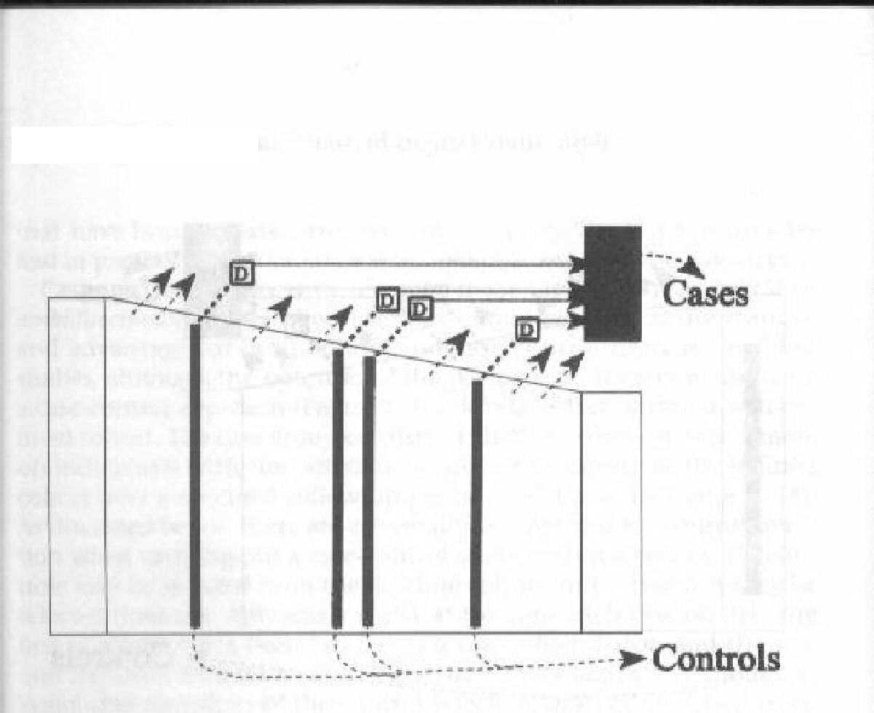
Mechanisms of Unequal Selection Probabilities in Case-Control Studies
controls
  1. Violation of the study base principle (choosing the wrong controls)
  PLUS, because exposure and disease present at the outset, all the same mechanisms seen in cross-sectional study:
CE
controls
controls
controls
Controls
Non-participation amongst eligibles whom you have approached
  “Non-response” (eligible persons in intended sample decline participation according to exposure & outcome).
Some people never become available to select
  Drop out and/or competing events influenced by/associated with both exposure and disease
Notes:
Let us turn now to case-control studies. Here is an incidence density sampling design — a principled approach to choosing controls — within a fixed cohort; incidence density sampling could also be done within a dynamic cohort. What are the mechanisms of unequal selection probability in case-control studies? There are also 3 main mechanisms, and this diagram enumerates them. Probably the biggest problem, the most common mechanism, one we have already covered in the course, is choosing the wrong group of controls because you did not follow the study base principle. This violation of the study base principle is analogous to choosing a non-representative group in the cross-sectional study design that we just covered.
However, this is not the only mechanism of generating unequal selection probabilities because you still have all of the other mechanisms that were present in cross-sectional studies. That these two other mechanisms can and do occur in case-control studies is because exposure and disease are already present at the outset of case-control studies, just like in cross-sectional studies. A case-control study can suffer bias from non-response even when the proper control group is identified (i.e., study base principle is followed); this is mechanism #2. Or, in mechanism #3, bias will occur when drop out and/or competing events in the underlying cohort are influenced by/associated with both exposure and disease.
As with the cross-sectional study discussion, these scenarios are all assumed to be under the null.

Slide 73

Selection Bias in Case-Control Studies: Presence of Exposure & Disease at Outset Also Invites Selection Bias
Coffee and cancer of the pancreas. MacMahon et al. NEJM 1981
Cases: patients with histologic diagnosis of pancreatic cancer in any of 11 large hospitals in Boston and Rhode Island between October 1974 and August 1979
Exposure under study: coffee consumption
What type of study base is this?
Notes:
73
One of the most famous case-control studies evaluated the association between coffee consumption and pancreatic cancer.
In this study, the cases were defined as all patients with histologically confirmed pancreatic cancer in any of 11 hospitals in Boston (a city in the U.S.) or Rhode Island (a small state in the U.S.).
What is the study base that gave rise to the cases? Is it primary or secondary? Answer: secondary. This is because there is no tangible defined (meaning something you could get your hands around and enumerate) underlying cohort that gave rise to the cases. Our might be tempted to say all of the people of Boston or Rhode Island, but persons outside of Boston and Rhode Island use these hospitals if they had developed pancreatic cancer. Furthermore, not all new cases of pancreatic cancer in these geographic regions would necessarily use these specific hospitals. Some cases may have gone to smaller hospitals in Boston or traveled to other medical meccas (e.g., Mayo Clinic in Minnesota or John Hopkins in Baltimore) seeking therapy.

Slide 74
Selection Bias in Case-Control Studies: Presence of Exposure & Disease at Outset Also Invites Selection Bias
Cases: patients with histologic diagnosis of pancreatic cancer in any of 11 large hospitals in Boston and Rhode Island between October 1974 and August 1979
Given these cases, how should controls be chosen?
Random digit dialing in area - A
Neighbors of the cases - B
Appendicitis admissions to hospitals - C
Hopeless; choose another project - D
Notes:
74
Given these cases as described, what is the best way of selecting the controls? What would you do?
Is it:
-- random digit dialing in the Boston and Rhode Island communities
-- neighbors of the cases
-- admissions for appendicitis
-- don’t bother at all; it is hopeless to find controls in a secondary study base

Slide 75
Selection Bias in Case-Control Studies: Presence of Exposure & Disease at Outset Also Invites Selection Bias
Choosing controls in face of a secondary study base not easy.
Random digit dialing probably best of available answers, although Hopeless is also acceptable.
Cases: patients with histologic diagnosis of pancreatic cancer in any of 11 large hospitals in Boston and Rhode Island between October 1974 and August 1979
How should controls be chosen?
Random digit dialing in area - A
Neighbors of the cases - B
Appendicitis admissions to hospitals - C
Hopeless; choose another project - D
Notes:
75
Answer: Choosing controls in the face of a secondary study base is not easy. Random digit dialing is probably the best answer of these choices, although it is not clear what population boundary to use. Such an approach is far from perfect. Hopeless is also acceptable. In truth, we would have never gathered cases in this way and hence would not have put ourselves in this position.

Slide 76
Selection Bias in a Case-Control Study
Coffee and cancer of the pancreas
MacMahon et al. NEJM 1981
What did the authors do? Controls:
Other patients without pancreatic cancer under the care of the same physician of the cases with pancreatic cancer
Patients with diseases known to be associated with smoking or alcohol consumption were excluded
Notes:
What did the authors do? For controls, they choose patients under the care of the same physician of a case patient at the same time the case patient was diagnosed.
They also excluded patients with diseases known to be associated with smoking or alcohol consumption.

Slide 77
Coffee and cancer of the pancreas
MacMahon et al., NEJM 1981
Case Control
Coffee:
> 1 cup day
No coffee
207 | 275
9 | 32
216 307
OR= (207/9) / (275/32) = 2.7 (95% CI: 1.2-6.5)
Biased or Unbiased?
Notes:
Here is what they found. In both the cases and controls, they determined the odds of drinking at least one cup of coffee per day.
How was the odds ratio calculated? Answer: the odds ratio is the exposure odds in the cases (207/9) divided by the exposure odds in the controls (275/32).
What does the odds ratio mean?
Answer: what was measured was the exposure odds: cases had a 2.7 fold greater odds of being coffee drinkers than non-cases. We are not told exactly what the method of control sampling was, but it appears to be cumulative sampling (controls found all at once after all cases gathered). In this setting, the exposure odds ratio is equal to the disease odds ratio. Thus, we have: coffee drinkers have a 2.7-fold greater odds of getting pancreatic cancer than non-coffee drinkers.
Do you believe this is a valid point estimate — a valid inference ― for the association between coffee use and pancreatic cancer? Is it biased or unbiased?

Slide 78
Relative to the hypothetical secondary study base that gave rise to the cases, selected controls were depleted of coffee users
Selected controls were:
Other patients under the care of the same physician at the time of an interview with a patient with pancreatic cancer
  Many of the MDs were gastroenterologists whose other patients were likely advised to stop using coffee
Patients with diseases known to be associated with smoking or alcohol consumption were excluded
  Smoking and alcohol use are correlated with coffee use; therefore, sample is relatively depleted of coffee users
  Conclusion: Controls were depleted of coffee users compared to true secondary study base
Notes:
There are many reasons to believe that this odds ratio is biased.
When we think about the hypothetical secondary study base that gave rise to the cases, we have a strong belief that the control group that was selected was relatively depleted of coffee users.
Let us look at the controls that were used:
-other patients of the same physicians of the cases: many of these MDs were gastroenterologists whose other patients were enriched for having gastrointestinal diseases who were likely advised to stop using coffee because, at the time, excess coffee use was felt to cause a variety of gastrointestinal complaints. Hence, these individuals are not representative of the study base that gave to the pancreatic cancer cases. They have been depleted of coffee users.
-equally important: what about excluding patients with diseases known to be associated with smoking or alcohol consumption? By excluding conditions known to be related to smoking and alcohol, the authors also depleted coffee users compared to the true study base that gave rise to the cases. This is because smoking and alcohol use is statistically related to coffee use.
What is the result of this in terms of biasing the odds ratio? [Answer: bias away from the null; an overestimate of the odds ratio]

Slide 79
Mechanisms of Unequal Selection Probabilities in Case-Control Studies
  1. Violation of the study base principle (choosing the wrong controls)
  PLUS, since exposure and disease present at the outset, all the same mechanisms seen in cross-sectional study:
CE
Non-participation amongst eligibles whom you have approached
  “Non-response” (eligible persons in intended sample decline participation according to exposure & outcome).
Some people never become available to select
  Drop out, competing events, and/or death from disease influenced by/associated with both exposure and disease
Notes:
What mechanism of selection bias is this? It is violation of the study base principle. The authors simply chose an inappropriate control group. This was commonplace in that era, in which researchers performed case-control studies without theory. This is less common today, but it still occurs in case-control studies that are attempted with secondary study bases.

Slide 80
Coffee and cancer of the pancreas:
Use of population-based controls
Gold et al. Cancer 1985
Case Control
Coffee:
> 1 cup day
No coffee
84
82
10
14
OR = (84/10) / (82/14) = 1.4 (95% CI, 0.55 - 3.8)
It wasn’t until 2016 that coffee was removed from WHO carcinogen list.
Reputation of case-control studies has never recovered.
Notes:
What happened when a better case-control study was done? Another set of investigators instead used population-based controls as obtained from random digit-dialing in the community. When doing so, the odds ratio was now roughly half what the first study showed, and it was also compatible with a chance occurrence. Several other subsequent studies also failed to show an association. The findings of MacMahon et al. were incorrect.
Studies like the McMahon case-control work all contributed to coffee being classified as a carcinogen by the WHO. It was not until 2016 that coffee was removed for that carcinogen list. The link between coffee use and pancreatic is now officially discredited. How many other mistakes are on that carcinogen list?
Coffee no longer viewed as a carcinogen. Loomis et al. Lancet Oncology 2016. http://www.thelancet.com/journals/lanonc/article/PIIS1470-2045(16)30239-X/fulltext
Of note, Brian MacMahon was the chairman of the Department of Epidemiology at the Harvard School of Public Health from 1958 to 1988. The study serves as a lesson of how anyone can get the wrong answer. Erroneous case-control studies like this one have contributed to case-control studies earning a reputation as a weak study design. For example, on many formal scales of grading evidence (e.g., from Oxford), case-control studies are a step down than cohort studies. This generalizing about case-control studies cannot be condoned as sound thinking, but it nevertheless represents how many scientists view case-control studies.
OCEBM Levels of Evidence Working Group. "The Oxford 2011 Levels of Evidence".
Oxford Centre for Evidence-Based Medicine. http://www.cebm.net/index.aspx?o=5653

Slide 81
Case-control Study of Coffee and Pancreatic Cancer:
Depiction of Selection Bias
Cancer No cancer
coffee
no coffee
Bias: overestimate effect of coffee in causing cancer
SOURCE POPULATION
Other GI condition
Selection into study
Coffee use
Pancreatic cancer
STUDY SAMPLE
Notes:
Schematically, what happened? We now know in truth that there is no association between coffee use and pancreatic cancer. What could lead to a spurious overestimation of the effect of coffee use? We know that over-representation of the upper left and lower right cells or under-representation of the upper right or lower left cells can result in overestimation of the effect of coffee use.
In this case-control study, coffee users in the control group are being undersampled. The result of this is to overestimate the effect of coffee in pancreatic cancer.
The graphic in the lower left-hand corner is a rudimentary DAG, which we will discuss formally in a few weeks.

Slide 82
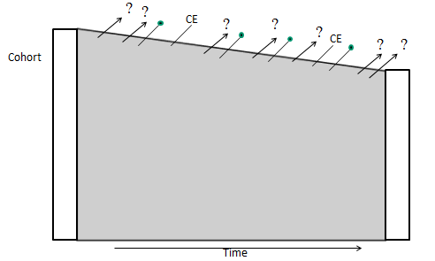
Mechanisms of Unequal Selection Probabilities in Cohort Studies: Mechanism #1: Selection at the Front End (“In-Selection”)
  At the beginning of a cohort (time zero), outcome has not yet occurred.
  Hence, outcome per se cannot be direct driving force in selection probability
  However, other pre-existing causes of outcome (“other factors”), can serve as a driving force of selection probability into cohort.
    These “other factors” are what link outcome to selection probability
Notes:
Let us now turn our attention to cohort studies. At the beginning of a cohort (i.e., time zero), the outcome has not yet occurred. Hence, outcome per se cannot be the direct driving force in anyone’s selection probability at the beginning of a cohort study (i.e., starting in the cohort). Yet, selection bias can still occur at the outset of cohort studies, what we call the “front end” (or “in-selection”), and this is via the existence of “other factors”, namely other causes of outcome, that are themselves also causally related to being selected into the study. It is these “other factors” that link outcome (that has not yet occurred) to selection probability and result in unequal selection probabilities that are related to both exposure and outcome.

Slide 83
For Selection Bias to Occur at Cohort Front End
For selection bias “under the null” at front end: Person’s selection must be influenced/associated with BOTH his/her exposure and outcome
Selection
Cannot occur because outcome not present at time of cohort selection
Exposure
Disease
Other factors
Other factors
Selection
Selection
Cannot occur because outcome not present at time of cohort selection
Exposure
Disease
Exposure
Disease
Other factors
Other factors
Selection
Exposure
Disease
Notes:
Recall that when we schematically showed this earlier, we said that not only could exposure and disease directly influence selection in order to result in selection bias, but we also said that “other factors” — specifically causes of exposure and causes of disease — could also result in selection bias if these factors were responsible for influencing either selection or retention in the study. These other factors are known as “common causes” of selection/retention and exposure; or as common causes of selection/retention and disease. This is what we meant by “associated with” exposure and disease in the definition of the criteria for selection bias to occur.
In the slide, we only show selection because we are focused on the front end of the cohort at this time — enrollment of the cohort. Later, we will discuss the retention aspect (“out-selection”).

Slide 84
Cohort Study of Sleep Duration and Heart Disease:
Depiction of Selection Bias
Volunteers tend to select persons with:
-- organized lifestyles (they have time to volunteer and time to sleep)
-- family history of heart disease (they have motivation to volunteer for this research and are at risk for heart disease)
Heart Dis No Heart Dis
Sleep >8 hrs
Sleep <8 hrs
These, in particular, will be rare
Bias: underestimation of effect of longer sleep; will make longer sleep appear protective even if it is not
SOURCE POPULATION
Recruitment:
Volunteers from community
STUDY SAMPLE
Notes:
Here is an example of this. Let us say we are interested in studying whether sleep duration is a cause of heart disease, and we seek to assemble a fixed cohort study. There is much interest in the effects of sleep duration on health. The source population for this work is the general population in a community. However, to keep the study feasible, we decide to simply open recruitment to volunteers from the community to form the cohort. The moment we stray from the general population with the use of volunteers, we need to be concerned about the possibility of selection bias. This method of recruitment will tend to select persons with organized lifestyles who have time to volunteer, but these persons also tend to have more time to sleep. The recruitment method will also select persons who have a family history of heart disease because they have a motivation to assist with this type of research. These individuals will also tend to have a higher risk of heart disease. The arrows show the selection probabilities, in relative comparison. The short sleepers with no heart disease are going to be particularly rare. The result of this constellation of selection probabilities will be to underestimate the effect of longer sleeping. Even if there is no effect of sleep duration on heart disease (under the null), this constellation of selection probabilities will spuriously make it appear that longer sleep duration is protective.

Slide 85
For Selection Bias to Occur at the Cohort Front End
For selection bias “under the null” at front end: Person’s selection must be influenced/associated with BOTH his/her exposure and outcome
Organized lifestyle
Family history of heart disease
Self-selection into study
Sleep duration
Heart disease
This might have been called confounding in the past, but greater clarity between selection bias and confounding has recently emerged.
Notes:
Here is the schematic to remind us why selection bias will occur. Neither the exposure (sleep duration) nor the outcome (heart disease) are directly influencing selection into the study, but exposure and outcome are associated with selection by these other factors (organized lifestyle and family history of heart disease, respectively).
In this structure, even if there were truly no association between sleep duration and heart disease, selection bias would result (sampling error notwithstanding) in an apparent erroneous association.
Note that in the past this scenario might have been called confounding, but more there is now greater clarity between selection bias and confounding. This is explained in Hernan et al. 2004 in the optional reading. We will come back to this in greater detail in a few weeks.

Slide 86
Mechanisms of Unequal Selection Probabilities in Cohort Studies: Mechanism #2: Retention During Follow-up (“Out-Selection”)
  Forces that determine length of participation (i.e., who ultimately stays in the analysis) are another cause of selection bias in cohorts
  Failure to complete participation comes in one of two ways:
    Drop-outs (loss to follow-up)
    Competing events (if relevant to your outcome)
Notes:
The other major mechanism of selection bias in cohort studies comes in the form of retention during follow-up. We have already spoken a lot about this in the course. This is a common mechanism of selection bias; it can create substantial bias and it may be very hard to remedy. The mechanisms for this are the forces that determine length of participation (i.e., who ultimately stays in the analysis). The failure to complete participation comes in two possible ways, either drop-outs (also known as losses to follow-up) or competing events (which may or may not be relevant depending upon the outcome in a particular study).
In this mechanism of selection bias, it is not whom you start with (also called “in-selection”); it is whom you end up with (“out-selection”).

Slide 87
For Selection Bias to Occur During Cohort Follow-up
Need: For selection bias to occur “under the null”: A person’s retention must be influenced/associated with BOTH his/her exposure and outcome
Retention (i.e., drop out vs non-drop out)
Exposure
Disease
Other factors
Other factors
Retention
Retention
Exposure
Disease
Exposure
Disease
Other factors
Other factors
Retention
Exposure
Disease
Notes:
Here is the schematic that we showed a few slides ago, when talking about selection bias at cohort initiation. Here, we just replace selection with retention. Again, for selection bias to occur under the null (when there is truly no association between exposure and disease), retention must be related to (i.e., influenced by) or associated with (via another factor) both exposure and disease. One of these four structures must be present for selection bias to occur.
This is the basis of the popular (if not vague) adage: “selection bias will occur when losses are related to exposure and outcome”.
One more condition that must be present (which is explained in the Additional Material Slides) is that there must be multiplicative interaction between exposure and outcome on the selection probability of retention.

Slide 88
Selection Bias Due to Losses to Follow-up
e.g., Cohort study of progression to cirrhosis (liver dysfunction) in hepatitis C virus (HCV) carriers. Exposure = HCV via IDU vs via blood transfusion
All the ingredients are present for selection bias:
Outcome directly influences drop out (& may be linked by “other factors”)
  becoming sick with undiagnosed cirrhosis is a reason for loss to follow-up
  persons who are lost to follow-up have greater cirrhosis incidence than those who remain (i.e., informative censoring)
Exposure directly influences drop out
  IDU (compared to transfusion) are more likely to become lost to follow-up because of more life distractions and perhaps less social support
Result: Selection bias
  IDU group becomes more depleted of sickest persons than transfusion group
  Those who remain in IDU group are less sick than those remaining in transfusion
  Underestimates the incidence of cirrhosis in IDU relative to transfusion group
Notes:
As an example, consider a cohort study looking at progression to cirrhosis (which is dysfunction of the liver) among hepatitis C virus (HCV)-infected individuals. The study compares two groups which are defined by their means of HCV acquisition: those who acquired HCV via injection drug use (IDU) versus those who acquired HCV via blood transfusion. Hence, acquisition route is the exposure under study. This research question is relevant because there has been interest in whether the way one acquires HCV influences one’s initial inoculum of virus (and host immune response) and ultimately one’s liver disease progression.
In a study like this, all the ingredients are present for selection bias due to losses to follow-up; it is the perfect storm.
This is because it is easy to see that the outcome under study may directly influence retention. Specifically, getting sick from not yet officially diagnosed cirrhosis (not yet diagnosed by the health care system) is a reason for becoming lost to follow-up; you just do not feel well enough to come back for study visits. Therefore, you can see how it is likely that persons who are lost to follow up have a different cirrhosis incidence than those that remain; those who remain will have a lower incidence than those who drop-out. This is a mechanism of informative censoring. It may also be the case that other factors that contribute both to cirrhosis and drop out, such as alcohol use, may be in play here as well to link outcome to drop-out.
Assume also that persons who practice injection drug are more likely to become lost to follow up compared to transfusion recipients. This is because of additional distractions that make it difficult for them to attend appointments and perhaps because of less social support. Therefore, this means that the frequency of losses differs across the exposure groups (IDU vs transfusion recipients), and it is more common in the IDU group.
The result of all of this is selection bias. The IDU group becomes more depleted of its sickest participants than the transfusion group. Those who remain in the IDU group are less sick than those who remain in the transfusion group. This results in more underestimation of incidence of cirrhosis in IDU group than compared with the transfusion group. The IDU group looks like it has a more favorable outcome.

Slide 89
Effect of Selection Bias in a Cohort Study:
Assume no true difference in cirrhosis incidence between IDU and transfusion recipients (“under the null”)
Effect of informative censoring in transfusion recipients
Assuming no informative censoring and no difference in cirrhosis incidence between IDU and transfusion recipients (superimposed lines; the null)
Probability of developing cirrhosis
Selection bias
Effect of informative censoring in IDU group
Time
Assume no competing events
Notes:
This is what a Kaplan-Meier curve would look like for the study. Or, more specifically 1-KM. The dark curve is what we would see if there was no informative censoring AND assuming there was no difference between IDU and transfusion recipients in the incidence of cirrhosis (i.e., “under then null”). In other words, the top dark curve assumes that there is no effect of the route of HCV acquisition on the occurrence of cirrhosis and also no drop-out. There would be superimposable curves.
However, now enter reality: there is loss to follow-up, and it is informative. The effect of this informative censoring is to deplete those with the highest incidence of cirrhosis, such that those who remain have a lower rate of cirrhosis than those who drop-out. The second curve from the top is the effect of drop out in the transfusion recipients. It turns out that the effect of being sick with undiagnosed cirrhosis (or the effect of alcohol use) on drop out is greater in the IDU group than the transfusion group. This is because the IDU group has more distractions which prevent appointment attendance and perhaps less social support. The joint effect of being in the IDU group and also being sick from undiagnosed cirrhosis (or having alcohol abuse) is more than just the two effects operating independently. This is what we referred to earlier as “some special influence on selection conferred by joint exposure & disease status”. The experience of the IDU group is shown in the third plot from the bottom. More sick patients are being depleted from observation in the IDU group than the transfusion group, leaving the IDU group with more well patients who have lower incidence of progression to cirrhosis.
The result is the appearance that the IDU group appears to have lower incidence of cirrhosis than the transfusion group — all because of selection bias. In this scenario, we assumed that in truth that was no effect of exposure. Hence, the apparent difference we see between IDU and transfusion groups is because of selection bias.
See Greenland AJE 106:184, 1977 for further examples.

Slide 90
Cohort Study of HCV Acquisition Type & Cirrhosis Progression:
Depiction of Selection Bias
Selection bias will lead to spurious underestimation of cirrhosis incidence in both exposure groups, more so in IDU group; end result: underestimate of IDU effect
Cirrhosis No Cirrhosis
IDU
Transfusion recipients
Mechanism: Sick participants stopped coming (more so in IDU group)
SOURCE POPULATION
Ability to attend study visits
Alcohol use
STUDY SAMPLE
IDU
Cirrhosis
Notes:
Here is the effect of selection bias schematically. The result is spurious underestimation of cirrhosis incidence in the IDU group relative to the transfusion recipients.
The figure in the lower left-hand corner depicts how both exposure and disease are affecting retention; it is a rudimentary DAG.

Slide 91
Competing Events and Selection Bias
All of the prior comments regarding losses to follow-up also apply to competing events
Rationale: Losses to follow-up and competing events are the ways that people fall out of observation
  For selection bias to occur “under the null”: A competing event must be influenced/associated with BOTH his/her exposure and outcome
Generic structure
Specific example
Pathophysiologic state
Genetic background
Competing event
Cancer death
Exposure
Smoking
Disease
Alzheimer’s
Notes:
Everything we just said about losses to follow-up (drop-out) as a mechanism for altered probabilities of retention also apply to competing events. The rationale is that losses to follow-up and competing events are the two ways that people fall out of observation. When drop-out or competing events are influenced by both exposure and disease, selection bias will ensue.
Here is the generic schematic. During follow-up, some pathophysiologic state is the “other factor” we defined earlier. This state is associated with our disease of interest and the competing event. Exposure is causally related to the competing event. Having the competing event then affects whether a participant will continue to come back to study visits. For example, dead persons can no longer be studied.
An example of this is the association between smoking and Alzheimer’s dementia. Death is the competing event. When this is studied in older populations, who are prone to the development of competing events (e.g., death via cardiovascular heart disease and cancer-related deaths), the data shows that smoking (vs. no smoking) is associated with a decreased incidence of dementia. This is not seen in younger populations, who have very low risk of competing events. The inverse relationship in the older population is felt to be because of selection bias. Among older patients, those who remain alive have an inverse relationship between smoking and high-risk genetic background. Among those alive, exposed are less likely to have high-risk genetic backgrounds than unexposed persons. This is because if they were exposed and had the high-risk genetic background they would likely be dead. This is explained in Hernan et al. Epidemiology 2008.

Slide 92
Selection Bias in a Randomized Trial
Randomization prevents selection bias at the front end
  This is because “exposure” (an intervention) is:
    randomly assigned
    comes after decision to participate
  Therefore, exposure cannot be related to study participation
Instead, factors related to retention (i.e., the back end) are the major potential cause of selection bias in RCTs
  Drop outs and competing events
See Additional Slides for examples
Other Factor
Selection
Disease
Exposure (Intervention)
Notes:
Finally, how about selection bias in a randomized experiment? At the outset of a randomized experiment, selection bias cannot occur because exposure (which is an intervention) is randomly assigned after the decision of a participate to be in the trial. Hence, exposure status cannot directly influence selection into the study. Because exposure status is randomly assigned, no other factor causes it or is associated with it. So, both mechanisms of how exposure might influence selection are precluded. We show this with the red X’s on the diagram.
Instead of problems at the front end, where randomized trials can be threatened by selection bias is during follow-up (i.e., the back end, or “out-selection”). These are the same issues that occur during follow-up in cohort studies, namely drop out and competing events. This is another reason we equate experimental studies with cohorts, except that the investigator allocates the exposure. The Additional Slides have examples.

Slide 93
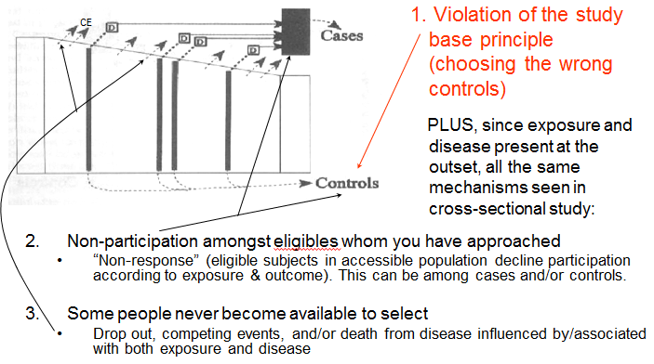
Summary: Selection Bias
Definition: When study sample does not represent/reflect source population
In a Descriptive Study
  Bias caused when persons in source population have different (unequal) probabilities of being selected for/retained in study sample
In an Analytic Study
  Bias caused when persons in source population have different (unequal) probabilities of being selected for/retained in study sample
    Specifically, when these differing (unequal) probabilities are influenced by (or associated with) both exposure and outcome of interest
Checklist of mechanisms per study design
Disease
Selection/ Retention
Other factors
+ -
Other factors
+
-
Exposure
Exposure
Disease
SOURCE POPULATION
STUDY SAMPLE
Two frameworks to guide your thinking
Notes:
In summary, selection bias occurs when the study sample (the people or the person-time) does not represent (i.e., accurately reflect) the source population. In a descriptive study, this is the bias caused when persons in the source population have different probabilities for being selected in the first place (“in-selection”) or being retained (‘out-selection”). In an analytic study, this is the bias caused when persons in the source population have different probabilities of being selected in the study or being retained and these probabilities are influenced by directly (or are associated with) both exposure and outcome under study. In the Additional Slides section, we show how one exception to this in the context of a “non-null” relationship, a situation in which only influence by outcome is needed.
We also showed the requirements for selection bias diagrammatically. We provided two frameworks. We showed this both with “box and arrow” diagrams and with figures that emphasized how exposure and outcome must be directly related to (or associated with) either selection or retention in order for selection bias to occur under the null. We also gave checklists regarding the practical mechanisms, by study design, that result in selection bias.
These two frameworks should help you guide your thinking about the presence of selection bias in any study, either your own or others. Frameworks are unfortunately not well appreciated by many/most researchers which has led to a lot of ad hoc thinking about selection bias. The paucity of pages in epidemiology textbooks regarding selection bias is indicative of how underdeveloped this topic is in the education process. The S+N text, for example, has only a few pages on selection bias. Selection bias is among the most occult and poorly understood among the biases. Its methodologic development is far behind confounding, for example.

Slide 94
Summary: Conditions for, Direct Evidence of, and Manifestations of Selection Bias
Conditions that could give rise to selection bias
Front: Any time your study sample is anything other than a random sample of the general population (i.e., anything other than everyone in general population having same selection probability); and/or
Back: Any time original study sample loses people from drop out/competing events
Direct evidence for selection bias: We rarely have it
Because we typically don’t have our hands on those outside of our study sample
  cannot prove (with our data) if our sample is representative of source population
  best we can do is speculate based on subject matter considerations and the rules for what is needed to create selection bias
    Rules differ depending upon whether there is (“under the non-null”) or is not (“under the null”) a true association between exposure and outcome
Manifestations
Selection Bias can result in:
  “Under the null”: specious numerical association between exposure & outcome when one truly is not present
  “Under non-null”: distortion of the association between exposure & outcome
Notes:
This is a summary of the conditions needed for, direct evidence of, and manifestations of selection bias.
Regarding the conditions that could give rise to selection bias, at study outset (what we have called the “front end” or “in-selection”), any time your study sample is anything other than a random sample of the general population, there is the possibility of selection bias. In other words, if you do not have a random sample of the general population, it is important to consider the selection forces that influenced who was chosen to or decided to participate. Even with a random sample of the general population, you need to be concerned, especially in cross-sectional studies, with reasons why people may have left the underlying cohort. On the back end (“out-selection”), any time the original study sample loses participants via drop out or competing events, there needs to be a concern about the possibility of selection bias.
Selection bias is the least obvious amongst the biases. This is primarily because we typically do not have any direct data we can evaluate. This is especially the case for selection bias on the front end. On the back end, at least the presence of drop out and competing events triggers a concern about selection bias. On the front end, the investigator needs to think hard about the possible selection forces. The best we can do in these situations is to think about what may influence selection and remember the rules regarding what is needed for selection bias. These rules differ according to whether there is truly no association between exposure and outcome (“under the null”) or whether there is (“off the null”). Remember, when under the null, the presence of selection bias can create a specious numerical association between exposure and outcome. Under the non-null, the presence of selection bias can cause a distortion between exposure and outcome; selection bias could cause the spurious appearance of no association as well.
There has been a surge of methodologic development around selection bias in the 15 years, and this will become even more apparent when we explain directed acyclic graphs in a few weeks. Interestingly, a better understanding of selection bias has now allowed for selection bias to be recognized as the cause of many long standing “paradoxical” findings/associations in the clinical and epidemiologic literature. These include the obesity paradox (Banack and Kaufman Epidemiology 2013) and the low birthweight paradox (Whitcomb et al. Pediatric and Perinatal Epidemiology 2009).

Slide 95
Summary: Managing Selection Bias
Prevention in design stage is critical
  Fixes in the analysis of data stage may not be possible
  General advice: Strive for study samples that are representative of source populations; high participation %’s; and low rates of losses to follow-up
In cross-sectional studies:
  Presence of exposure and outcome at outset: potential for selection bias
In case-control studies:
  Follow the study base principle
In longitudinal studies (cohorts/experimental studies):
  Be mindful of occult selection forces at cohort outset (cohort only; not RCT)
  Competing events cannot be prevented but need to be acknowledged
  Consider approaches to tracking down the drop outs (or at least a sample)
    See Additional Slides for what to collect at study entry
Notes:
And, finally, a summary about how to manage selection bias.
The first message is that prevention and avoidance, through proper decisions in the design stage by you, the investigator, are critical. Although there are sometimes fixes in the analysis phase, they depend upon having some detailed measurements. If you have not made these measurements, then there is no fix. We will discuss this more later in the course.
In this regard, there are three main general messages: strive for representative study populations (in all study designs by avoiding convenience samples); high participation %’s (in all study designs by thorough explanation and incentives to participate), and low rates of loss to follow-up (in longitudinal studies by keeping participants engaged).
A few special tips by study design.
In cross-sectional studies, remember that the presence of both exposure and outcome at outset is a recipe for selection bias. If having the outcome in question has any influence on survival, then any factor found to be associated with outcome may be so because of relationship with incident disease or survival after disease.
For case-control studies, it is critical to follow the study base principle when selecting controls.
In longitudinal studies, be mindful of occult selection forces at cohort outset that are related to both exposure and outcome. There is a lot of misperception in the scientific community that non-representative samples for cohort studies will only influence descriptive objectives but not analytic objectives. We have shown today how this is not true (see also Munafo et al. International Journal of Epidemiology 2017). Of course, this applies only to cohort studies and not to randomized trials (RCTs) where randomization essentially guarantees no selection bias at the outset. In both observational studies and RCTs, the critical advice is to prevent losses to follow-up. When the study is over, you can consider performing worst case scenario sensitivity analyses regarding persons who were lost and if your finding is robust to even to the most extreme cases, then your qualitative inference is on safe ground. These worst-case scenarios, however, can be extreme and result in finding that one’s nominal estimates are not robust. Thus, consider also approaches where you track down the lost or a sample of them. To prepare for this, make sure to learn as much about your participants when they enter the cohort and keep this information updated. Finally, be aware of and measure competing events. They cannot be prevented (they are part of nature), but you do need to account for them in your analysis. And, if you can understand the common causes of the competing event and your outcome of interest, you can perform some sophisticated analyses that allow you to overcome the bias. This is an example of some of the remedies that can be done in the analysis stage for selection. We will learn about this in the weeks to come as we begin to discuss directed acyclic graphs.

Slide 96
Additional Material Slides

Slide 97
selection bias
measurement bias
confounding bias
vs.
bias
Notes:
The kind of classification scheme that we are promoting, with just four things to remember (selection bias, measurement bias, confounding, and chance), is much easier to remember than what some others have propagated. For example, Sackett, cataloged, in a famous paper in 1979, a lengthy list of biases, some of which have interesting and colorful names, such as “apprehension” bias or “obsequiousness” bias. We find these impossible to remember, and, indeed, because they all fall under one of our 3 biases (selection, measurement, and confounding), we simply just remember these three.
Naming different biases was very common in the past and continues to be popular, but it is increasingly recognized that a 3-category approach (selection, measurement, and confounding) is cleaner and more intuitive.

Slide 98
Leukemia Among Observers of a Nuclear Bomb Test
Caldwell et al. JAMA 1980
Smoky Atomic Test in Nevada
Outcome of 76% of observing troops at site was later found; occurrence of leukemia determined
82% contacted by the investigators
18% contacted the investigators on their own
4.4-fold greater prevalence of leukemia than those contacted by the investigators
Explanation: Human nature (affected humans like to come forward)
Notes:
Here is a biomedical example of a study with a descriptive objective.
There was interest in past regarding the risk for cancer among the military observers of the various nuclear bomb tests that have been performed over the years in the U.S.. In one such study, there was an attempt to find all observers of the Smoky Atomic test in Nevada. In this study, 76% of the total troops were later identified and the occurrence of leukemia was determined.
On the surface, 76% seems very good. But how representative were these 76%? The authors were clever enough to empirically look at this. They did so by separating the troops into those who were contacted by the investigators (82% of the participants) and those who contacted the investigators on their own — 18% of the participants. And, as you might have predicted, those who contacted the investigators on their own, i.e., self-selection, had a much higher leukemia prevalence, over 4 times higher. Hence, at the end of the day we really don’t know how representative these 76% were, and we have to be concerned that they are enriched, by self selection, by those who developed leukemia. The only way you could know the truth is if you contacted all 100% or if you got close to 100% and did sensitivity analyses on the remainder.
What is the explanation or mechanism for this? The study design looks fine. They had a list of troops and they set out to find them all. It is just human nature that is the problem here. Affected humans like to come forward, and it appears they did in this case.

Slide 99
Mechanisms of Unequal Selection Probabilities in Cross-Sectional Studies
Assuming that the goal is to identify determinants of disease development (etiologic research)
CE
Unwise choice of a study sample as representative of source population.
  Study sample influenced by both exposure and outcome (e.g., Harvard study)
Non-participation amongst eligibles whom you have approached
  “Non-response” (eligible persons in intended sample decline participation according to exposure & outcome)
Some people whom you would like to sample never become available to ask
  Drop out, competing events, and/or death from disease influenced by/associated with both exposure and disease
Notes:
The following is an example of mechanism #3 of unequal selection probabilities in a cross-sectional study.

Slide 100
Selection Bias in a Cross-Sectional Study
Is glutathione S-transferase class μ deletion (GSTM1-null) polymorphism associated with increased risk of breast cancer?
With prevalent breast cancer in cross-sectional study, an association with GSTM1-null is seen depending upon the no. of years since diagnosis
But not with brand new incident diagnoses (via a case-control study)
GSTM1 (exposure) is associated with survival after breast cancer, but not with cancer development per se
Kelsey et al. Canc Epi Bio Prev 1997
Notes:
Based on evidence from other cancers, there has been interest in whether a particular polymorphism of glutathione S-transferase class mu (a deletion known as GSTM1-null) is causally related to the development of breast cancer.
These investigators evaluated this using both prevalent breast cancer cases (i.e., in a cross-sectional study) and with incident breast cancer cases (via a case-control study). In the cross-sectional study, using prevalent breast cancer cases, the magnitude of the association depended upon the number of years since diagnosis of the breast cancer cases. On the left, when limiting the analysis to breast cancer cases who had been diagnosed in the past 4 years, the odds ratio was 0.97. In other words, no evidence of an association. When using breast cancer cases who had been diagnosed between 4 and 8 years ago, there was a hint of an association with an OR of 1.3. Interestingly, when using prevalent breast cancer cases who had been diagnosed 8 or more years ago, this brought out an association with an odds ratio of 2.0.
Similar to what was seen with the prevalent cases who were diagnosed less than 4 years ago, when the researchers used true incident cases (i.e., very recently diagnosed) they also saw no evidence of an association, odds ratio 1.08.
An explanation for this is that there is something about having this polymorphism that is associated with longer survival after a breast cancer diagnosis, but not with getting breast cancer per se. The authors speculated that it may be something to do with metabolism of the chemotherapy used to treat cancer. In any case, this illustrates the very different conclusions you would draw in a cross-sectional study with prevalent breast cancer versus a study using incident diagnoses, and this is all because of selection bias.

Slide 101
Cross-sectional study of GSTM1 polymorphism and breast cancer
Breast Cancer
+ -
null
Bias: overestimate effect of GSTM-1 null polymorphism in causing breast cancer
GSTM1
pos.
SOURCE POPULATION
Death from Breast Ca
GSTM1
Breast Ca
STUDY SAMPLE
Selection into Study
Notes:
Here is what this looks like schematically. You perform a cross sectional study with prevalent breast cancer, and you end up preferentially sampling those with the null mutation because of their survival advantage. The result is an overestimate of the association between the null mutation and incident breast cancer.

Slide 102
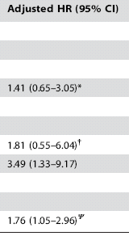
Effect of losses to follow-up in a cohort study
Determinants of mortality after initiation of antiretroviral therapy in Africa
Naively Ignoring Losses
Tracking Down Vital Status on Losses
1.0
1.0
1.0
1.0
1.0
1.0
Bisson PLOS ONE 2008
Selection bias
Notes:
Because we rarely know happens to those participants who become lost in a longitudinal, we rarely have anything but theoretical examples of this bias in analytic work. One group of investigators, however, went the extra mile and tracked down patients who had become lost to follow-up. This is a study of the determinants of mortality after the initiation of antiretroviral therapy among adults in Africa. As in the earlier studies, there was substantial loss to follow-up after baseline. When the authors simply assumed that the losses were non-informative, i.e., they naively ignored the losses by censoring, the second column is what they found. These are hazard ratios. Then, the authors went the extra mile and tracked down the vital status on patients who were lost to follow-up. They found who was dead and alive among the patients who had not returned to their parent clinic. When they incorporated this new information about the lost into the overall analysis, the third column shows what they found. The differences compared to the middle column are notable. Sex, which was not significant in the naïve analysis, became significant. So did CD4 count. However, the effect of hemoglobin lost its statistical significance. The differences between ignoring losses and tracking them down is selection bias.

Slide 103
Selection Bias in a Case-Control Study:
Including all cases at study outset is “half” of what is needed for selection bias: Diseased more likely than non-diseased to be selected
Disease
+ -
+
-
Exposure
?
?
SOURCE POPULATION
?
?
Selection
?
Exposure
Disease
STUDY SAMPLE
Notes:
In a case-control study, it should be immediately apparent that the design guarantees half of what is needed for selection bias is present. That is, disease status is known at the time of selection in case-control studies and diseased persons are more likely than non-diseased to be selected. This does not guarantee that selection bias will occur, but it does raise our concern and make it important to consider how exposure status influences selection.

Slide 104
Selection Bias in a Randomized Trial
Losses to follow-up are a major potential cause of selection bias in randomized experiments
e.g., Randomized trial of a drug vs a placebo; outcome=death; assume truly no effect of drug (“under the null”); and
  the drug can cause a side effect which causes symptoms
  underlying disease causes symptoms
  symptoms cause people to drop out of the study
  side effect of a drug only occurs in persons “sick” from the disease under study
Selection bias will ensue:
  Compared to placebo, drug group will be selectively depleted of the sickest persons
  Will make drug treatment group appear to fare better
Notes:
We already stated that selection bias at the front end of randomized experiments is precluded because of the nature of the design, Instead, the main cause of selection bias in randomized trials is from losses-to-follow-up.
How could this happen? Consider an example of a randomized trial of a drug vs a placebo. Assume that a symptomatic side effect of a drug occurs more commonly in persons who are sickest and more prone to develop the ultimate study outcome and that the occurrence of this side effect is associated with more losses to follow up. In other words, the participants with this side effect drop out of the study. This would mean that the drug treatment group would be selectively depleted of the sickest patients. This would make the drug look spuriously better than it really is.

Slide 105
Selection Bias in a Randomized Trial:
Assume no true difference in death between drug and placebo (“under the null”)
Effect of informative censoring in placebo group
Assuming no informative censoring and no difference in death incidence between drug and placebo (superimposed lines; the null)
Probability of Death
Selection bias
Effect of informative censoring in drug group
Time since randomization
Notes:
This is what a Kaplan-Meier curve would look like for the study. Or, more specifically 1-KM. The dark curve is what we would see if there was drop out AND assuming there was no difference between drug and placebo recipients in the incidence of death (i.e., “under then null”). There would be superimposable curves.
In reality, let us say that we cannot keep track of everyone in the study and some persons do drop out, and we are not able to track their vital status. Those persons who drop out have a higher incidence of death than those who remain, thus resulting in those who remain showing a lower incidence of death than the entire starting group. There will be an apparent diminution of incidence in both the drug and placebo group, but this will be larger in the drug group. This is because of the joint effects of the drug and the disease cause more symptoms that cause people to drop out. The end result is the spurious appearance that the drug group has a lower incidence of death than the placebo group — all because of selection bias.

Slide 106
Selection Bias in a Randomized Trial:
Assume no true difference in death between drug and placebo (“under the null”)
Death No Death
Selection bias will lead to spurious appearance of lower incidence of death in drug group
Drug
Placebo
Mechanism: Sick participants stopped coming (more so in drug group)
SOURCE POPULATION
Retention
Disease severity
Symptom
STUDY SAMPLE
Drug
Death
Notes:
Here is the effect of selection bias schematically. The result is a spurious appearance that the drug resulted in a lower incidence of death relative to the placebo group.
The figure in the lower left-hand corner depicts how both exposure and disease are affecting retention; it is a rudimentary DAG.

Slide 107
Competing Events in Randomized Trials
Competing events: other mechanism of selection bias in RCTs
Competing events are typically explicitly accounted for and reported on in RCTs
  They are part of adverse event monitoring/reporting
  This allows for a balanced view of the outcomes of interventions
  Nonetheless, presence of the competing event complicates attempts at quantifying causal relationship between intervention & main outcome
Competing events are often swept under the carpet (i.e., ignored) in cohort studies
  This is unfortunate
  Fuller disclosure of competing events is more complicated but give us a more comprehensive accounting of the effects of exposures
Notes:
Competing events are the other mechanism of selection bias in randomized trials. Fortunately, competing events are typically fully described in experimental studies as part of general adverse event reporting. That is, assuming the whereabouts of participants are known, then a competing event will typically be reported in a randomized study. However, just describing competing events is not sufficient in analytic work. The proper management of competing events in analytic research is complicated and the subject of very recent methodologic development. Managing competing events in analytic work is a sophisticated topic beyond the scope of this course.
Unfortunately, competing events are often ignored and unreported in cohort studies (i.e., observational research). Reviewers and editors often do not demand full disclosure on competing events. Competing events are often simply censored in Kaplan-Meier survival analyses, which we earlier showed is a biased approach. Without reporting competing events, readers have no idea as to whether they may be influencing any of the reported measures of association. Full disclosure of competing event in cohort studies is just as important as in randomized trials.

Slide 108
Under Non-Null Conditions,
Even Less is Needed for Selection Bias
Earlier, for selection bias to occur under the null (i.e., for selection bias to cause an apparent association when one truly does not exist):
  Selection/retention probabilities must differ according/related to both exposure and disease
But what about when there truly is an association between exposure and disease (which is called “non-null conditions”)?
  Selection bias in this context can result in estimates that are larger or smaller than truth. Bias could also result in no apparent effect.
  Even fewer influences on selection/retention needed for selection bias. Influence from outcome alone on selection/retention suffices.
    e.g., informative censoring across exposure groups will alter difference measures
Selection/retention
Exposure
Disease
Notes:
We earlier stated exactly what conditions will produce selection bias to occur “under the null”, in other words when there was truly no association between exposure and disease. We said that selection bias will occur when selection probabilities for the 4 cells were unequal and when selection was influenced by/associated with both exposure and outcome. We summarized these criteria with this shorthand graphic.
But what about when there truly is an association between exposure and outcome? We call this a “non-null condition”, or “under the non-null” context, or “off the null”. If this is the case, it turns out that even fewer influences on selection/retention (i.e., fewer rules) are needed to induce selection bias. Specifically, we only need selection/retention probabilities to be influenced by outcome status. There does not have to be an influence from exposure. As a simple example, consider any cohort study in which persons who are the most ill drop out. This means that those who remain will have a lower incidence of the outcome than those who dropped out. If this happens with the same force (on a multiplicative scale) in all exposure groups, then we would expect that the incidence of the outcome in those who remained with be reduced by some factor. Any ratio measure of association relating exposure to outcome would not be influenced because each exposure group would have its incidence reduced by the same factor, which cancels out. Additive measures of association, however, would be biased. For example, consider if, in truth, incidence of death among exposed was 0.2 (in say 5 years) and 0.1 in unexposed; the risk ratio would be 2.0 and the risk difference would be +0.1. If losses to follow-up occurred and they were informative, let us say that the incidence of death in the exposed was 0.16 (a diminution of 20%) and the incidence of death in the unexposed was 0.08 (a diminution of 20%). The resultant risk ratio (0.16/0.08) would be unchanged at 2.0; the resultant risk difference would be (0.16-0.08) = + 0.08, which is biased.

Slide 109
Summary of Criteria Needed for Selection Bias to Occur
“Under the null” (i.e., truly NO association between exposure & outcome)
Selection bias will occur when a person’s selection/retention is:
influenced by (or associated with) his/her exposure; and
influenced by (or associated with) his/her outcome; and
exposure & outcome must influence selection/retention more than just independently
  i.e., there must be multiplicative interaction between exposure and outcome on occurrence of selection/retention
“Under non-null” (i.e., truly IS an association between exposure & outcome)
For selection bias, any 1 of 3 scenarios suffices:
The “under the null” scenario above
Other factors
Selection/retention
Other factors
Exposure
Outcome
Selection/retention
Other factors
Selection/retention associated with outcome; interaction between “other factors” & exposure on outcome)
Selection/retention caused by outcome
Exposure
Outcome
Selection/retention
Exposure
Outcome
Notes:
This is a summary of the criteria needed for selection bias to occur. Under the null, selection bias will occur when a person’s selection/retention is:
-influenced by (or associated with) his/her exposure; and
-influenced by (or associated with) his/her outcome; and
-exposure and outcome must influence selection/retention more than just independently; i.e., there must be multiplicative interaction between exposure and outcome on occurrence of selection/retention.
Under the non-null situation, selection bias will occur under and one of three possible scenarios. The first is the scenario (i.e., the conditions) that we described for “under the null” conditions. That is, everything that we said “under the null” also pertains to “non-null” conditions. The second is when a person’s selection/retention is influenced by factors which are also causally related to outcome and there is no association between exposure and selection/retention. This can be looked at a manifestation of interaction between these factors and exposure on the occurrence of outcome. In fact, there will always be interaction on at least the additive or multiplicative scale of measures of association when both exposure and some other factors cause the outcome, as we will learn later in the course. If there is multiplicative interaction, there will be bias in the risk ratio. If there is additive interaction, there will be bias in the risk difference. See Hernan AJE 2017 Selection bias without colliders for more detail. The third scenario, which is less appreciated, is when selection/retention is only influenced by outcome (i.e., when outcome itself directly influences selection/retention.) This will be easier to understand when we formally introduce DAGs later in the course. We will see that we can envision other causes of our outcome (above and beyond the exposure under study) such that conditioning on selection/retention is equivalent to conditioning on a descendent of a collider.

Slide 110
Practical Value of the “Under the Null” and “Non-Null” Distinction
 | Scenario #1 | Scenario #2 | Scenario #3 | Scenario #4
Association between exposure and retention | Absent | Absent | Present | Present
Association between exposure and outcome | Present | Absent | Present | Absent
Information gained regarding association between exposure and outcome | Association was not created because of selection bias regarding retention under the null. This is because recipe components for selection bias under null are not present. Assuming no other bias or chance, association is real. | None. You cannot tell if absent association is real or if caused by bias towards the null. | None. You cannot tell if association is real or if caused by bias away from the null. | None. You cannot tell if absent association is real or if caused by bias towards the null.
Notes:
What is the practical value of this “under the null” vs “non-null” distinction?
One can, in one’s data, look at the association between exposure and retention. When one performs a study and sees an association between exposure and outcome and one does not see an association between exposure and retention, then one knows the effect of exposure on outcome could not have been created from selection bias under the null. If there is selection bias at all, then it must be under non-null. One can conclude that the effect is real qualitatively although it may still be biased in magnitude. However, when one does not see an effect between exposure and outcome, this logic does not help you. This is because the effect may be biased towards the null from bias in a true off-the null context. The other three scenarios also do not provide any practical value. In summary, there is only some practical relevance.
Later in the course, we will learn how the “non-null” context is the only one in which selection bias can occur without conditioning on a collider. This is an important in understanding how selection bias is not exactly synonymous with collider-conditioning bias.

Slide 111
Preventing and Managing Losses to Follow-up
Prevention
Obtain comprehensive contact information under informed consent
  SSN (critical for death index searches), DOB, legal name
  State of birth
  Middle initial, father’s surname
  Address and many phone numbers
  Friends and family members
Engage participants while in follow-up (frequent communication; incentives)
Decrease burden of participation
Management
When losses occur, contact:
  postal service for change of address
  DMV
  National death index
Search for a sample of those lost
Notes:
In any longitudinal study, be it cohort or experimental, there are things that a researcher can do prevent and manage losses to follow-up. Regarding prevention, the most important task is to maintain the interest of the participants. This include frequent communication and sometimes incentives. Decreasing burden participation is also critical. Make it easy for participants to continue contributing.
Related to prevention, the researcher can also prepare for tracking down lost participants by obtaining a comprehensive list of contact data. Upon informed consent of participants, collect as much as you can that will help you track down them if they come out of contact. When losses do occur, use this contact information to try to bring participants back or to at least track their vital status. If there are too many lost participants to track down, then consider looking for a random sample.

