Slide 1
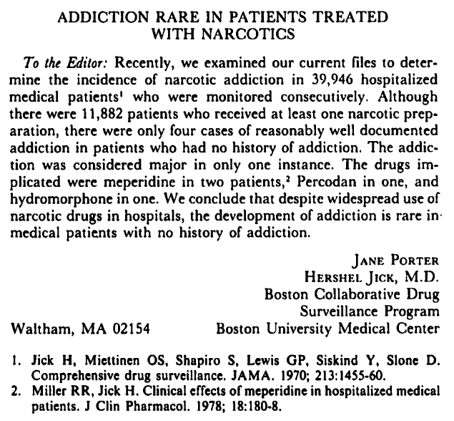
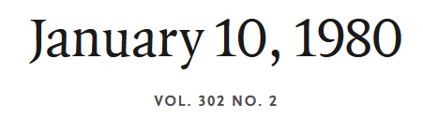

Notes:
Here is the first of the two pieces for this Journal Club. It is very short.

Slide 2
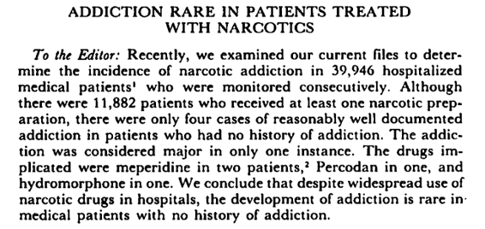
Research Question?
Notes:
What is the research question?

Slide 3
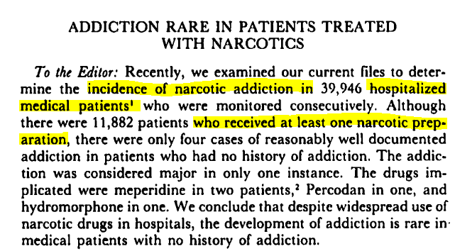
Research Question?
Notes:
Correct. The key phrases are:
--incidence of narcotic addiction
… in
--consecutive
--hospitalized patients who received at least one narcotic preparation

Slide 4
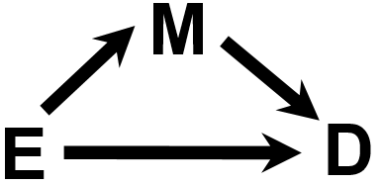
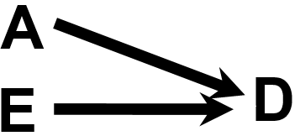
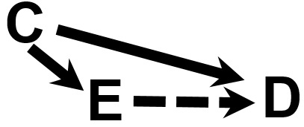
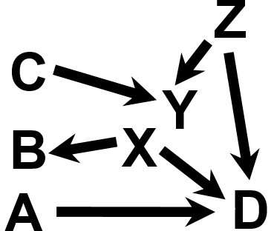
Which of the “Big 6”?
A
S=1
Description
  How frequent/common are traits/exposures/conditions/diseases?
Mediation
  Understanding the mechanisms of causation. How does E cause D?
D
Causation (“Causal inference”)
D
  The science of establishing causal relationships among biological, behavioral, environmental (etc.) factors within humans. Does E cause (or prevent) D?
  Will intervening upon E change occurrence of D?
Interaction
  When and for whom does E cause/predict D?
B
Prediction
  Do A, B, and C predict concurrent presence/future occurrence of D?
  e.g., diagnosis or prognosis
Attribution
  What fraction or how many cases of disease D can be eliminated if causal exposure E is eliminated/reduced?
A
D
E
Notes:
Which of the “Big 6” is this research question? We have now described 5 of them: description, causation, attribution, mediation, and interaction. We can now draw DAGs that depict each of these. (Notice how the edge goes away, with animation, in the DAG to depict attribution). DAGs are very efficient compact notation that remind us what we need to do to address these different objectives.
We have not and will not formally say much about prediction in this course although we talked about sensitivity and specificity (which are important metrics of prediction) as well as measures of association, which, in general, can be interpreted in a prediction context. Measures of association that are not causal do depict prediction. We typically do not use DAGs to describe prediction objectives, but we can use DAGs to show the variety of ways that one variable can predict another, either through a true causal relationship or a variety of non-causal relationships (e.g., via confounding or via collider-conditioning). DAGs also help us think of features that promise to have good predictive accuracy. That is, proximal direct causes will tend to be stronger predictors than most distant variables connected to outcome via a series of confounding paths. (Note: DAGs can also sometimes be helpful in prediction problems to remind us about downstream mediating steps which may be intervened upon in different contexts and hence be a source of poor prediction in other populations.)
The research question in Jick and Porter is one of description.
As review, one way to think about clinical research and epidemiology is to think about the different kinds of questions that clinical researchers and epidemiologists answer. We call these the “Big 6”. Most of what clinical research and epidemiology answer can be placed into one of these 6 categories or objectives, and each is highly relevant. A major use of this scheme is for practitioners to be able to encounter any given research question or problem and instantly classify the work into one or more of these categories/objectives. Then, once the category/objective is recognized, this should invoke a mental checklist of what is needed methodologically to fulfill the objective. For example, if description is the objective, is the parameter of interest prevalence, incidence, or something else? If incidence, is the parameter risk or rate and have all of pitfalls with risks and rates been addressed? Then, is the sample representative, and is the measurement accurate. This type of pattern recognition will instantly help practitioners focus on key threats to validity.

Slide 5
S = Hospitalized medical patients in any hospital in the Boston Collaborative Drug Surveillance Program (BCDSP) who receive ≥1 narcotic preparation
Narcotic addiction
Notes:
Here is the DAG for our question. We did not spend much time discussing DAGs for descriptive questions, but this is now being written about by methodologists, and it is straightforward. For more detail, see
Smith L. Selection mechanisms and their consequences: Understanding and addressing selection bias. Current Epidemiology Reports 2020.

Slide 6
Two types of inferences
Hierarchy of Populations
Inference
OTHER EXT. PPTLN.
TARGET POPULATION
Inference
Diseased
SOURCE POPULATION
(aka
ACCESSIBLE
POPULATION,
STUDY BASE,
“UNDERLYING COHORT”)
+ -
+
-
INTENDED SAMPLE
Exposed
STUDY SAMPLE
OTHER EXTERNAL POPTLN.
Conception of Study Design yields
Notes:
Here is what the process of inference looks like schematically in our hierarchy of populations. Recall that all we ever have in our studies is our study sample, here in the right bottom corner. Recall that the study sample may not be identical to the intended sample because sometimes reality gets in the way. For example, sampled persons may refuse to participate or they may drop out. The intended sample is the manifestation of our study design (e.g., cohort, cross-sectional, or case-control). The intended sample is what we hope to achieve when we sample some underlying source population, also known as the accessible population, study base, or underlying cohort. That is, the process of conception of a study design yields an intended sample, which because it is “intended”, it is theoretical.
The study sample is a therefore a tool that we use to form an inference about the source population that gave rise to it. This is the first of two inferences we make. In other words, to understand something about our source population, we are typically forced to sample it ― i.e., only study a fraction of the source population.
The target population, in the upper left-hand corner, is the largest population to which the findings of our study might “reasonably” apply. We say “reasonably” because there are persons in the target population who never had a chance to be included in the study sample, and thus we cannot definitely state the findings from our study sample apply to the target population. To the extent that the target population is, to some extent, different than the source population, we call it an external population. Thus, our second inference is from our study sample to the target population. In addition to making inferences about the target population, we are usually also interested in making inferences outside of our target population. There are usually many “other external populations”, shown here in the two boxes next to the target population about which we are interested in making this second type of inference. The newly evolving field of “transportability” focuses on making inferences about these other external populations.
Sometimes our study sample comes directly from the target population as shown. The NHANES study is an example of this, being directly sampled from the U.S. general population, which is the target population. Usually, however, we are sampling from source populations which are not identical to our target population. The Physicians Health Study or Nurses Health Study are examples of this at a national level in the U.S.. A local example is the California Teachers Study. In these examples, we seek to make inferences about the general adult population in the U.S. (target population), and, to do so, we sample a source population that is a non-random sample of the general adult population. This is important to keep in mind in that the source population is sometimes where problems can reside that lead to bias. The firefighter example in the Hernan 2004 Selection Bias paper (Optional Reading) gives a nice example of this.
Note: there is tremendous variability in the methodologic and applied literature as to what these populations are called. A discussion of the variability in the terminology can be found in Schwartz et al. Toward a clarification of the taxonomy of “Bias” in Epidemiology textbooks. Epidemiology 26: 216-222, 2015.

Slide 7
Research question: What is the incidence of narcotic addiction in hospitalized medical patients who receive at least one narcotic medication?
Descriptive
Objective
Real-world dynamic cohort: Patients admitted to medical wards in any of 8 hospitals participating in BCDSP who received at least one narcotic medication administration
Fixed cohort study: Consecutive sample of patients admitted to medical wards in any of 8 hospitals participating in BCDSP (during ?? time period) who received at least one narcotic medication administration
?
Fixed cohort study: Consecutive sample of patients admitted to medical wards in any of 8 hospitals participating in BCDSP (during ?? time period) who received at least one narcotic medication administration
TARGET POPULATION
Fixed research cohort sampling of an underlying real-world dynamic cohort
SOURCE POPULATION
(aka
ACCESSIBLE
POPULATION,
STUDY BASE,
“UNDERLYING COHORT”)
INTENDED SAMPLE
STUDY SAMPLE

Slide 8

= Case-control
study
Sampling a Dynamic Cohort
= event
New Members
= leave
CE
CE = competing
event
M
CE
M = mortality
Cross-sectional study
Cohort study (dynamic or fixed)
Observation begins
Observation ends
Time (calendar)
Notes:
Remember the ways we can sample underlying dynamic cohorts for purposes of research. Analogous to the sampling of a fixed cohort, there are 3 main ways to sample a dynamic cohort. There is cohort sampling (dynamic or fixed), cross-sectional sampling, shown in the blue vertical line and case-control sampling, shown with the black circles (for the cases) and the red squares for the reference populations.

Slide 9
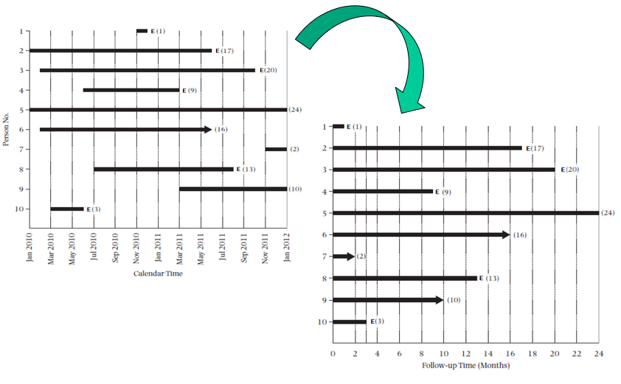
Notes:
Recall that sampling a dynamic cohort as a fixed cohort involves shifting people to a common starting point. We called this shifting to the left.

Slide 10
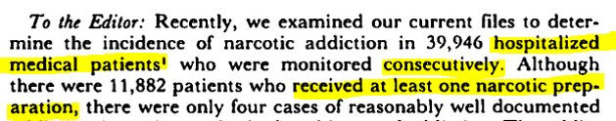
Boston Collaborative Drug Surveillance Program (BCDSP)
Patients
Persons admitted to inpatient medical or psychiatric wards at any of 8 participating hospitals in the BCDSP
Present analysis
  Medical wards only
  Treated with at least 1 narcotic (pain relief) medication
Boston, Massachusetts
  Lemuel Shattuck Hospital
  Peter Bent Brigham Hospital
  Boston Veterans Administration Hospital
  Boston City Hospital (Tufts Service)
Providence, Rhode Island
  Roger Williams General Hospital
London, Ontario
  St. Joseph’s Hospital
  Westminister Hospital
Jerusalem, Israel
  Hadassah Hebrew University Hospital
Notes:
So, what is this BCDSP? It is a research program that started in the 1960’s that was one of the first to systematically look at large number of inpatient medical records to address clinical and epidemiologic questions. A closer look at reference 1 tells us that the BCDSP consists of persons who are admitted to inpatient medical or psychiatric wards at any of the 8 participating hospitals. These 8 are listed here. For this present analysis, the study sample was limited to medical wards and patients treated with at least 1 narcotic (pain relief) medication.

Slide 11
Boston Collaborative Drug Surveillance Program (BCDSP)
Patients (What we are told)
Hospitalized medical patients
Treated with at least 1 narcotic (pain relief) medication
Questions? (What else to know?)
What were the initial reasons for admission?
Sociodemographic/economic characteristics?
Indication for narcotic?
Type and duration of narcotic?
Notes:
Here is what the authors told us. These were:
--hospitalized medical patients
--treated with at least 1 narcotic (pain relief) medication
What else might we want to know?

Slide 12
We were not told enough about study sample (their characteristics; med description) to declare the target popltn.
Descriptive
Objective
Real-world dynamic cohort: Patients admitted to medical wards in any of 8 hospitals participating in BCDSP who received at least one narcotic medication administration
Fixed cohort study: Consecutive sample of patients admitted to medical wards in any of 8 hospitals participating in BCDSP (during ?? time period) who received at least one narcotic medication administration
Target Population?
Fixed cohort study: Consecutive sample of patients admitted to medical wards in any of 8 hospitals participating in BCDSP (during ?? time period) who received at least one narcotic medication administration
If we knew more, could say: patients hospitalized for conditions x, y and z, receiving on average X days but no more than Y days of narcotic medications a, b, or c.
TARGET POPULATION
Fixed research cohort sampling of an underlying real-world dynamic cohort
SOURCE POPULATION
(aka
ACCESSIBLE
POPULATION,
STUDY BASE,
“UNDERLYING COHORT”)
INTENDED SAMPLE
STUDY SAMPLE
Notes:
You will notice that earlier we had a question mark for the target population, which is the broadest population to which our study inferences may be applied. This question mark was because we were not told enough about the study sample, both in terms of their host characteristics and in terms of the exogenous agents (i.e., the narcotics) they were given.

Slide 13
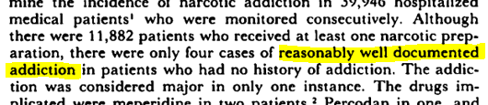
Measurements
Questions? (What else?)
Manual review, by research nurse, of all medical charts from admission to discharge
  Focus on start date, dosage, and indication for all drugs prescribed
Interview of patient (at least at admission)
Interview of attending physician
  any time a drug was discontinued, to determine reason
  at discharge, regarding for any adverse events and discharge diagnoses
How was “addiction” defined?
What information was used to ascertain addiction?
Were patients interviewed post-discharge?
Notes:
What about the measurements? The main measurement is the occurrence of addiction to narcotics. All that we are told in the text about addiction is that it was “reasonably well documented”. If we take a deeper look into the references provided by the authors, we learn that that there was a manual review, by a research nurse, of all medical charts from admission to discharge. This review focused on the medications prescribed.
There was also an interview, by the research nurse, of the patient and attending physician. The details and timing on these interviews are vague. Patients may have only been interviewed at admission. Attending physicians appear to have been interviewed at discharge, but we don’t know exactly what they were asked about.

Slide 14
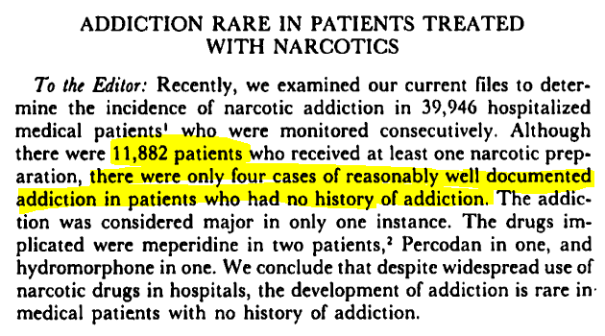
Results
Of 39,946 hospitalized patients, 11,882 received at least 1 narcotic medication
What estimand would we like to see to address research question?
Cumulative incidence of addiction via Aalen-Johansen estimator
What did we get?
Can we estimate valid cumulative incidence from this?
No mention of deaths
No time horizon
Proper denominator is pts with no history of addiction
Notes:
Let us look at the findings. Of 39,946 hospitalized patients, 11,882 received at least 1 narcotic medication. What estimand would we like to see to address the research question?
What did we get from the authors? We were told: 4 instances of addiction out of 11,882 patients.
Can we estimate valid cumulative incidence from these data? No. We do not know the time horizon, and we do not know competing events such as death (as inpatients). This is not a fatal flaw. We do know that incidence is low.

Slide 15
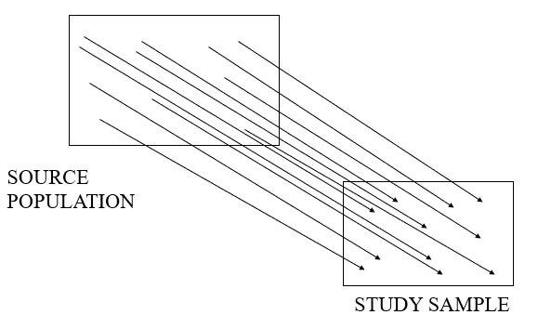
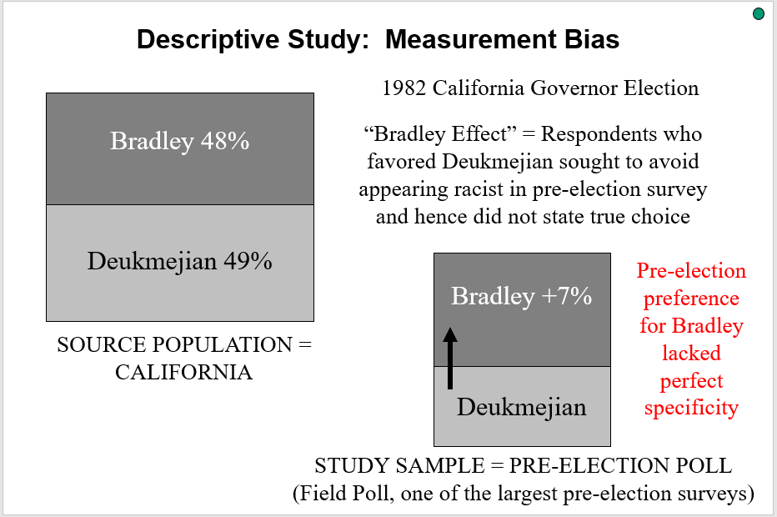
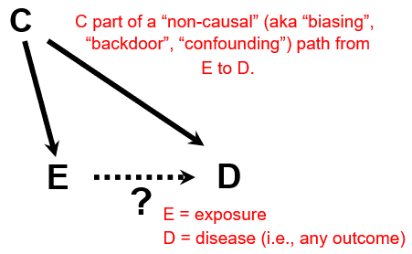
Threats to Validity
If the RQ is:
  What is the incidence of narcotic addiction in hospitalized medical patients who receive at least one narcotic medication?
S=1
D
Selection bias?
Measurement bias?
Confounding?
Sampling error?
No
Perhaps insensitive measurement of addiction; ?specificity
Not relevant in descriptive work
No strong evidence;
sample size is large
Notes:
How about the threats to validity? If the research question is: “What is the incidence of narcotic addiction in hospitalized medical patients who receive at least one narcotic medication?” then we can through our standard framework for error?
How about selection bias? We learned two frameworks to think about selection bias, one with box and arrows and the other with DAGs. We do not see any evidence of selection bias here.
Measurement bias? Hard to know given how little we are told about the ascertainment of addiction. From what we are told, we could imagine that the measurement might be insensitive. Specificity? Hard to know but with only 4 instances, even if they are all false positives, specificity is still very high.
Confounding? Confounding is not relevant in descriptive work.
Sampling error? Given the large sample size, we do not feel that sampling error is an issue.

Slide 16
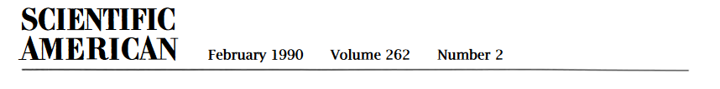
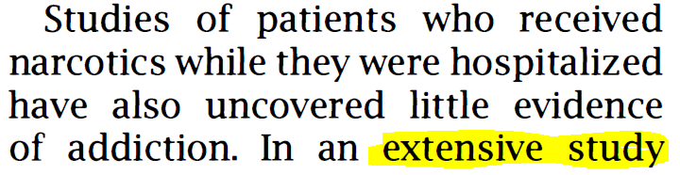
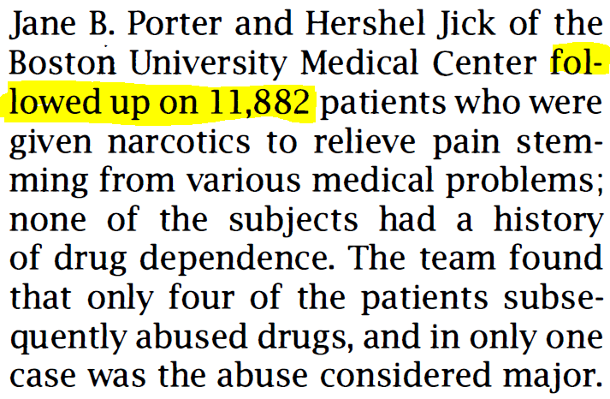
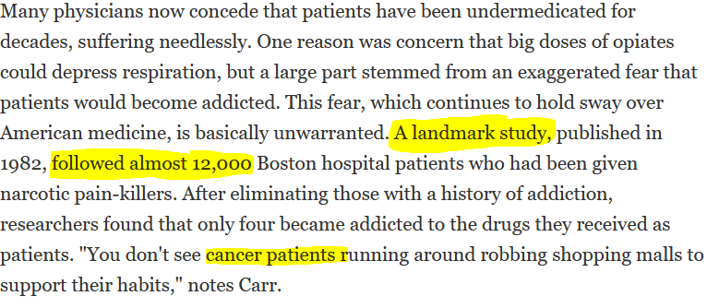
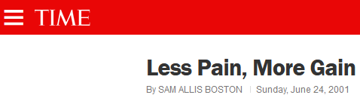
Little was made of this report until …
Notes:
Little was made of this report until it began to be picked up by the popular press, like this work in Scientific American, in which the Porter/Jick work was called an “extensive study” and that 11,882 patients were followed up on. Note: I do not believe we have any evidence that the patients were followed after they left the hospital.
And, this work in Time magazine, in which Porter and Jick was called a “landmark” study and again some suggestion of extensive longitudinal follow-up. And, there is some reference to cancer patients, despite our not knowing anything about whether cancer patients were represented in the 11,882.

Slide 17
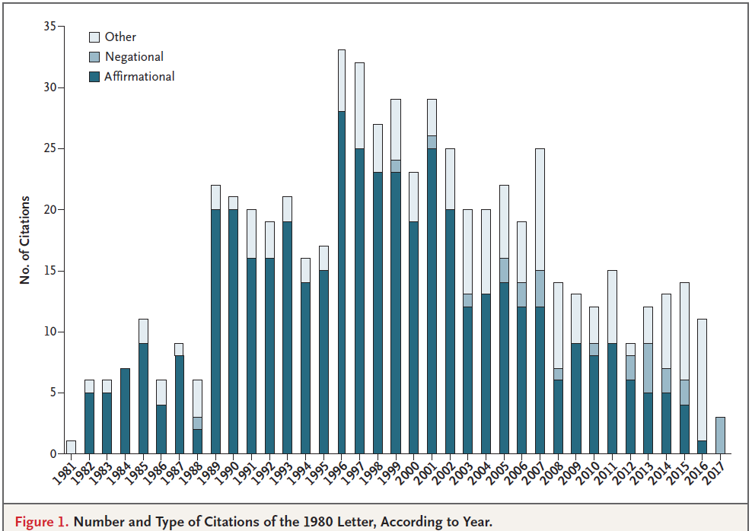
Bibliometric Analysis of Porter & Jick
Leung et al. NEJM 2017
608 citations through 2017 (cf median 11 citations)
72% cited Porter/Jick as evidence that addiction was rare in patients treated with opioids (“affirmational” citations)
81% failed to note that Porter/Jick patients were hospitalized
Notes:
And, then, momentum began to grow in the frequency of citations of this piece in the scientific literature. Through 2017, there were 608 citations of this piece, compared to a median of 11 for other letters to the NEJM. Remember, this was a letter. Among those referring to Porter/Jick, 72% cited Porter/Jick as providing evidence that addiction was rare among patients given opioids. Most of the referring papers (81%) failed to mention that the patients in Porter/Jick were hospitalized and may have had acute onset and time-limited pain.

Slide 18
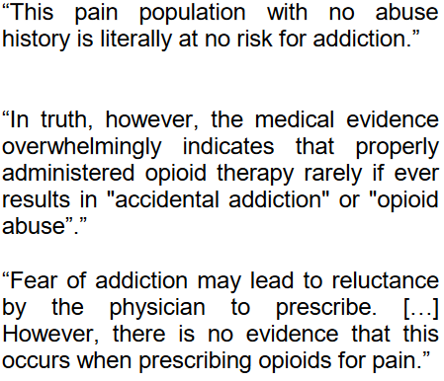
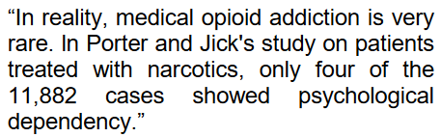

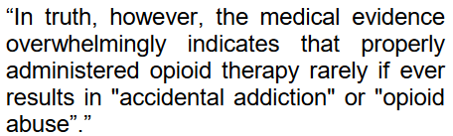
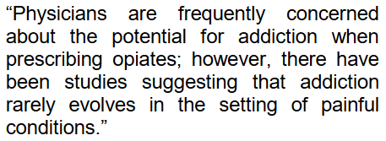
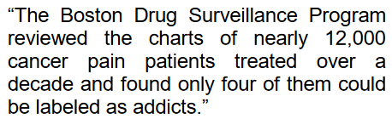
References to Porter & Jick
Notes:
Here are some excerpts.

Slide 19
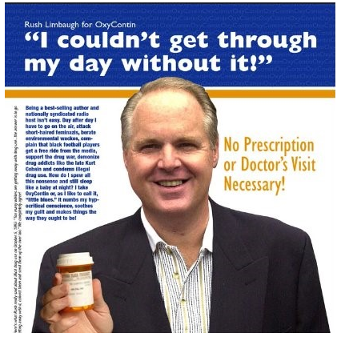
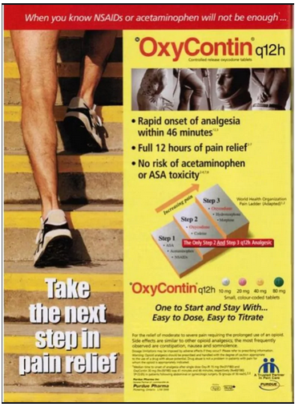
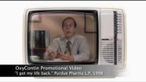

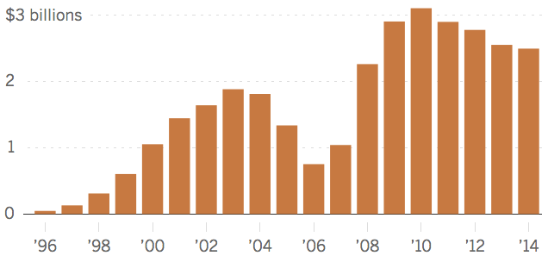
Oxycontin sales
Pharmaceutical Industry Was Also Interested
1996: Purdue Pharma began to market a sustained release formulation of oxycodone, called Oxycontin
Extensive promotion to doctors: lavish conferences, profiling
Lucrative bonus system to sales representatives
Promotion to public: anti-pain campaigns, coupons
Heart of promotion: “much less than 1%” risk of addiction
Notes:
The pharmaceutical industry also became interested in this report.
In 1996, Purdue Pharma, which was owned by the Sackler family
Extensive promotion of this drug to doctors and directly to the public. At the heart of the promotion was the quote that “much less than 1%” of patients who take opioids develop addiction, an estimate they got from Porter and Jick.
Video available at: https://wp.wwu.edu/hled151/tag/oxycontin/

Slide 20
Opioid Crisis, aka Opioid Epidemic in the U.S.
Incidence of addiction in patients with chronic pain treated for prolonged periods (outside hospitals) is not “<1%”
Prototypic scenarios
  Otherwise healthy outpatients
  Oxy prescribed for
    chronic pain syndromes (e.g., musculoskeletal)
    or even (less commonly), self-limited mild/moderate pain syndromes (e.g., dental problem)
  Medication initially used as directed
  Results in addiction
Beginning late 1990’s, rising incidence of …
Addiction to opioid drugs
  Prescription, particularly Oxycontin
  Illicit (e.g., street-purchased prescription drugs; heroin; illegally synthesized fentanyl)
Opioid drug-related overdose
Opioid drug-related deaths
  ~500,000 deaths from 1999 to 2018
Significant social, psychological, and economic consequences for affected persons, families, and communities
Notes:
What ultimately happened, as many of you know, is the “opioid crisis”, also known as as the opiod epidemic in the U.S.
It turns out that the incidence of addiction to pain medications in persons treated for chronic pain for prolonged periods of time is not less than 1%; it is much greater than this. The prototypic scenario, repeated over and over in the U.S. communities are otherwise healthy persons prescribed oxycontin for chronic pain syndromes (e.g., back pain) or even typically self-limited pain syndromes (dental problems). Even with the medications used as prescribed, addiction develops.
In the late 1990’s, there began to be a rising incidence of ….
Deaths from opioid – quite problematic how to assign opioids as cause of death. Unlikely each was assessed with SCC. Who knows if this number is correct.

Slide 21
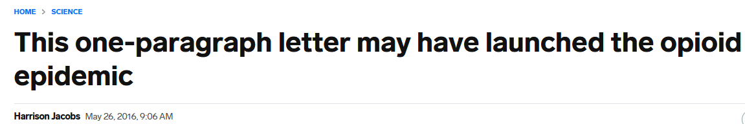
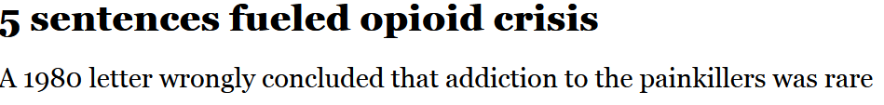




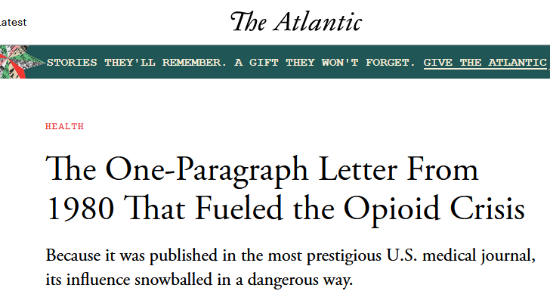
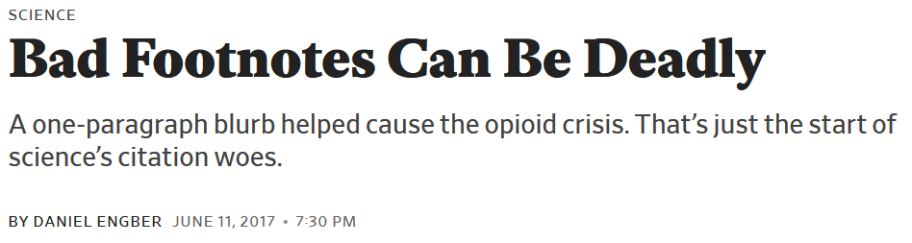

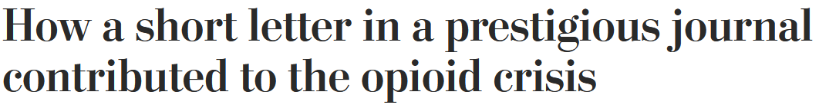


Popular press has vilified Porter and Jick
Notes:
The same popular press that initially amplified the message of Porter and Jick now has vilified them. Here are a few deadlines.

Slide 22
Opioid Crisis: Causal Pie
Porter/Jick
Socioeconomic despair
Uncritical scientific interpretation by other scientists
Pain
Uncritical scientific interpretation by physicians
Inattentive regulatory bodies
Commercial profit-seeking
Notes:
Is the opioid crisis all the fault of Porter and Jick? No, we have learned in this course that virtually everything is multi-factorial and all occurrences can be thought in the context of the sufficient-component cause model. The Porter/Jick letter played a role but a number of other factors such as … also played an equally important role.

Slide 23
What Happened to Purdue Pharma?
2007: Prosecuted by U.S. federal govt and several states, paid $600 million
Additional lawsuits from state and local governments
2021/2022: Bankruptcy after agreeing to pay $6 billion; company restructured
Sackler family removed but achieved legal immunity

Slide 24
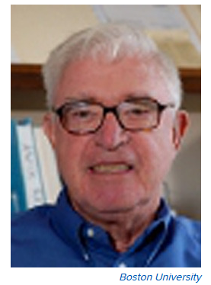

Reaction from the Author
NPR Interview 2017
Hershel Jick (undated)
Notes:
https://www.npr.org/sections/health-shots/2017/06/16/533060031/doctor-who-wrote-1980-letter-on-painkillers-regrets-that-it-fed-the-opioid-crisi

Slide 25
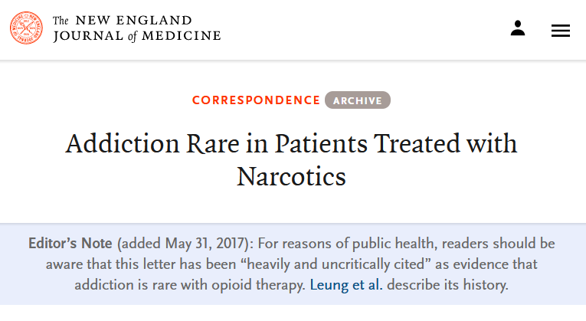
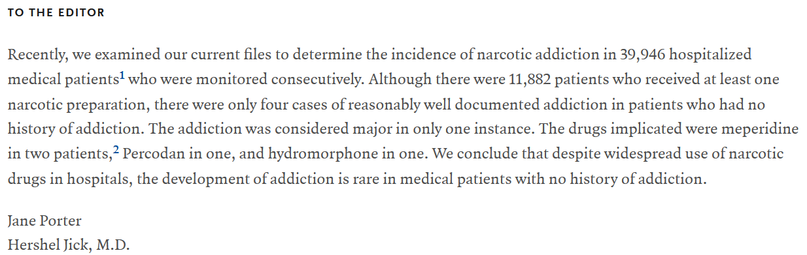
Notes:
This is such an unusual situation that the editors of the New England Journal have placed a disclaimer on the 1980 letter, basically saying not to take it as evidence that addiction is rare. In short, they are telling readers not to believe this letter.

Slide 26
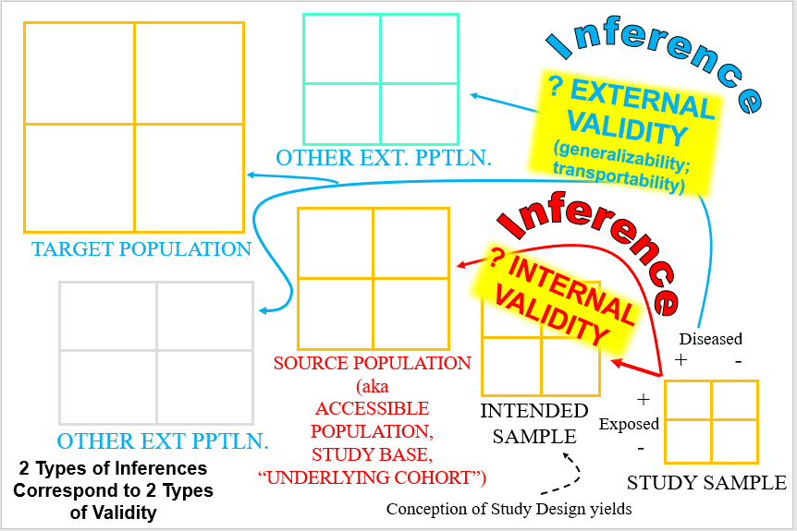
In our Epidemiologic Inference Framework, What Went Wrong?
Underlying pain condition
Narcotic duration
Narcotic type
Narcotic use
Addiction
Lack of external validity
- results from study sample did not apply in other ext. pops.
… a result of interaction

Slide 27

Worthwhile Viewing
Notes:
Although our course rarely endorses external commercial entities (other than Stata, that is), this multi-part docu-drama called “Dopesick” is well worth viewing.

Slide 28
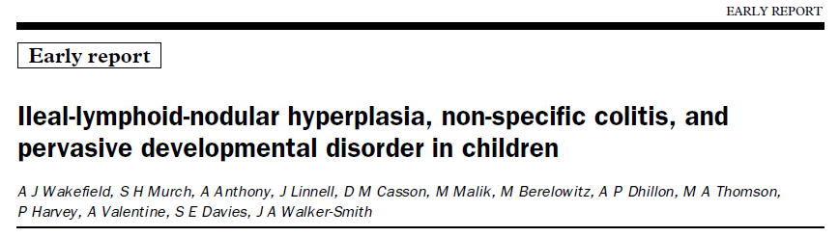
Notes:
The second article for today is this piece by Andrew Wakefield on development disorders in children, published in the Lancet in 1998.

Slide 29
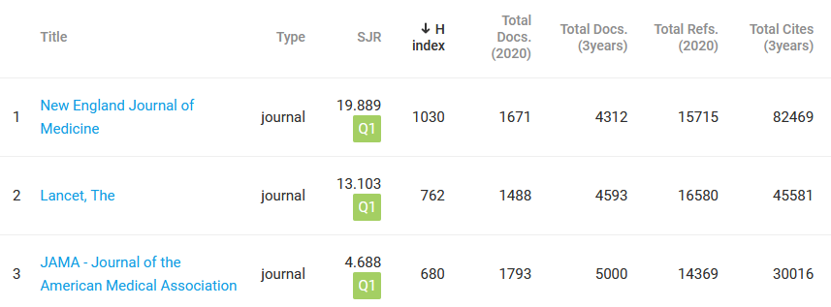
Notes:
Please note that these articles today are not from International Urology and Nephrology, the source of the first Journal Club we had on testicular cancer. The NEJM and Lancet are widely considered the most prestigious and impactful journals in biomedicine. Most people expect what they read in these journals to be true.

Slide 30
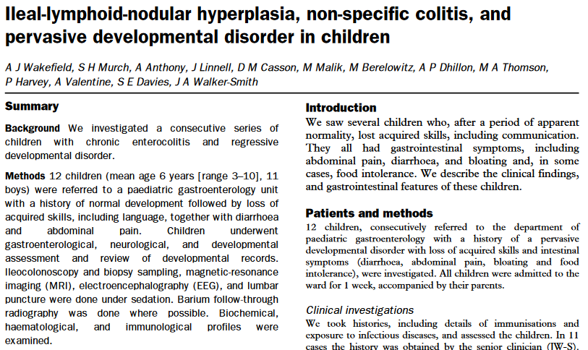
Research Question?
Among children, what are the causes of a syndrome of chronic enterocolitis and regressive behavioral development?
Notes:
What is the research question posed by this article?

Slide 31
Research question: Among children, what are the causes of a syndrome of chronic enterocolitis and regressive behavioral development?
?
Real-world dynamic cohort: children with chronic enterocolitis and regressive behavioral development residing in ?London/UK/Europe
Cross-sectional study: Consecutive sample of children with chronic enterocolitis and regressive behavioral development presenting to Pediatric Gastroenterology Clinic at Royal Free Hospital
Cross-sectional study: Consecutive sample of children with chronic enterocolitis and regressive behavioral development presenting to Pediatric Gastroenterology Clinic at Royal Free Hospital who agree to be admitted to hospital for testing
TARGET POPULATION
Cross-sectional sampling of an underlying real-world dynamic cohort
SOURCE POPULATION
(aka
ACCESSIBLE
POPULATION,
STUDY BASE,
“UNDERLYING COHORT”)
INTENDED SAMPLE
STUDY SAMPLE
Notes:
Let us go through our hierarchy of populations.
What is the study design here? It is a cross-sectional study. Children were evaluated at one slice in time. Who were they?

Slide 32
Cross-Sectional Design with Outcome-Selective Sampling
New Members
Survival Time
CE
CE
aka stratified cross-sectional sampling
Cross-sectional: Controls
Cross-sectional: Cases
Calendar Time
Time of the Study
Notes:
Schematically, this can be thought of as a cross-sectional design with outcome-selective sampling.

Slide 33
Case Series
Variably defined
“A collection of subjects (usually patients) with common characteristics used to describe some clinical, pathophysiologic or operational aspect of a disease, treatment, exposure or diagnostic procedure. . . . A case series does not include a comparison group and is often based on prevalent cases and on a sample of convenience.”
One constant: no comparator group
Equivalent to
  Cross-sectional study with exposure-selective (exposed only) or outcome-selective (cases only) sampling
  Cohort study with exposure-selective sampling (exposed only)
  Case-control study without the controls. Prevalent or incident cases
Thus, also fine to call this a case series (but we do not favor it – we have terms)
Porta M. A Dictionary of Epidemiology
Notes:
Is this a case series? You will notice that this is not a term we used in the course, mainly because it is variably defined and we really do not need the term. We already have language.
If you look in the Dictionary of Epidemiology, you will see case series defined as “….”.
We feel that this is equivalent to:
--
--
Or
---
In summary, it is fine to call this a case series but we do not favor it because we already have terminology to describe it.

Slide 34
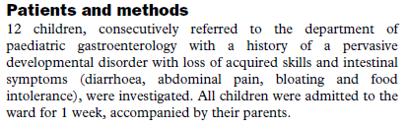
Participants
Each eligible child who appeared at the clinic, in order, one after the other with no break
Pervasive developmental disorders
  Group of disorders characterized by delays in the development of socialization and communication skills.
  Symptoms include problems with language; difficulty relating to people, objects, and events; unusual play; and repetitive body movements
  Autism is the most characteristic and best studied PDD
  Now called autism spectrum disorder (ASD)
Notes:
Who were the participants? We were told that they were children who were consecutively referred to the department of pediatric gastroenterology with a history of two things:
--a pervasive developmental disorder
..and
--some intestinal symptoms.
What does consecutively mean?

Slide 35
Participants
What was the motivation of investigating joint presence of PDD and intestinal symptoms?
This was a GI clinic. How long did authors have to wait to find 12 children with both PDD & intestinal symptoms?
Were all listed intestinal symptoms needed, or just 1?
Did 12 consecutive (one after another) families really consent to join study that needed a 1-week admission?
Questions?
Notes:
What kinds of questions do you have about the participants?

Slide 36
Measurements
Questionnaire-based
  Medical history
Endoscopic
  Ileocolonoscopy with biopsy
Imaging
  Head MRI
Biochemical
  Many analytes (a comparator group was available for many of these)
Other
  Lumbar puncture, EEG, evoked potentials
Notes:
The children were admitted to the inpatient unit and then had a number of measurements performed.

Slide 37
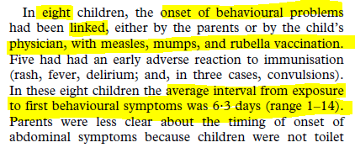
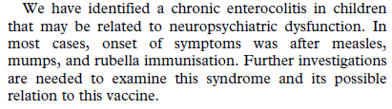
Results
Main finding?
Notes:
What was the authors’ main finding? It was that in eight children, the behavioral problems was said to be linked, either by parents or family physician, to a recent measles/mump/rubella vaccination. In these eight, the mean time from vaccination to behavioral symptoms was just 6 days.
The authors concluded that they have identified a chronic enterocolitis that may be related to neuropsychiatric dysfunction and that this unique constellation of symptoms occurred very shortly after the MMR vaccine.

Slide 38
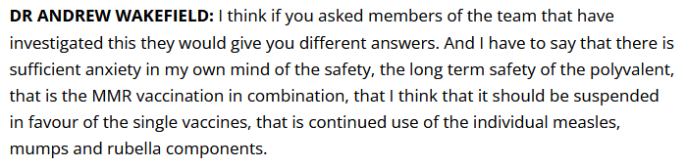
A Press Conference Accompanied the Lancet Publication
Notes:
A press conference accompanied the publication in Lancet. At this conference, the first author Andrew Wakefield said that, on the basis of these eight patients, sufficient anxiety in this mind of the safety of the MMR vaccine.

Slide 39
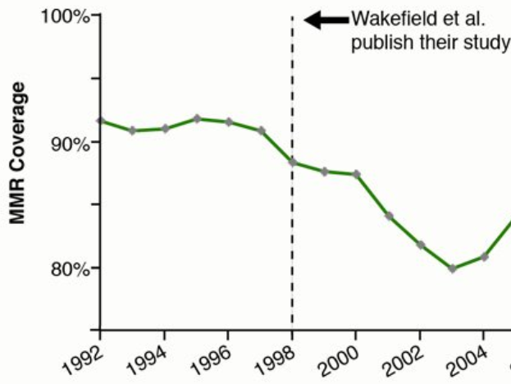
Anti-Vaccination Sentiment Accelerates
Europe
National Health Service of the United Kingdom
Notes:
Many of you know what followed regarding public opinion of childhood vaccination. There may been anti-vaccination sentiment brewing before the Wakefield paper, but it certainly accelerated after the paper was published. These data are MMR coverage throughout Europe.

Slide 40
If participant selection and data described in paper truly reflect what occurred, what is main threat to validity regarding a causation objective?
PDD
Yes
No
8
MMR within 2 weeks prior to PDD onset
Exposure
No MMR within 2 weeks prior to PDD onset
4
>90% of all children receive MMR (i.e., no comparator group)
Timing of MMR in relationship to PDD may be subject to differential misclassification of exposure (parents seeking a reason for the PDD)
Notes:
Let us say that all of the data contained in the paper regarding participant selection and the measurements are true. If so, what is the main threat to validity. Well, first, in our 2 x 2 table, we only have cases. Wakefield seeks to make the cases that MMR is very common among the cases. However, at the time these data were being collected, over 90% of children were getting vaccinated. Furthermore, the timing of MMR ..

Slide 41

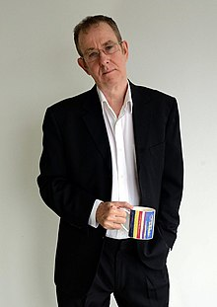
Participant selection was NOT as described in paper
February 22, 2004
Brian Deer
Notes:
What I just described was if the data were valid. It turns out that they were not. In work performed by an investigative reporter, Brian Deer, in the UK, it was found that:
First, the participant selection was not as described in the paper.

Slide 42
Conflict of Interest
Wakefield was being paid by a lawyer who was preparing lawsuits vs MMR
  But Wakefield did not disclose this in Lancet paper
Participants
  Not an unselected consecutive sample from the community
  Instead, many families involved with legal action against MMR manufacturers
  Were told to go to Royal Free clinic because of their belief that MMR was culprit for child’s behavioral issues

Slide 43
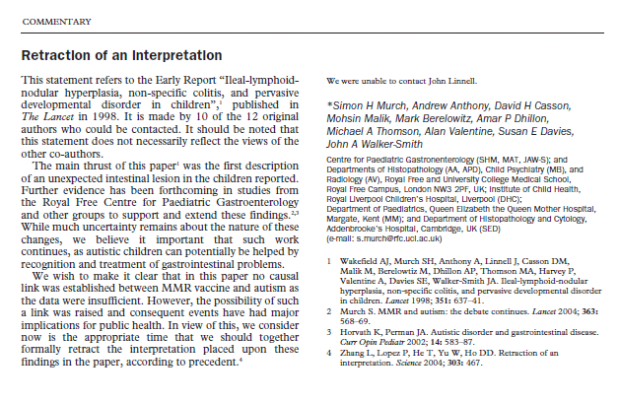
Partial Retraction – March 2004

Slide 44
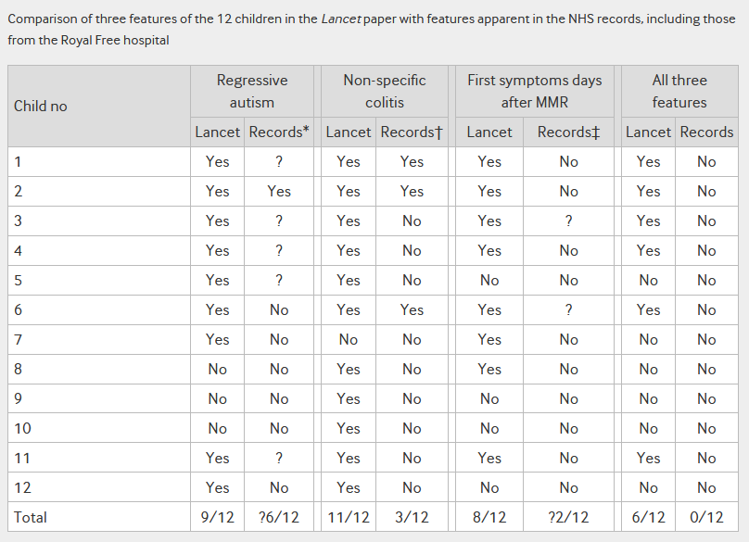
Fraud
Measurements -- Fabricated

Slide 45

Full Retraction Feb. 2010

Slide 46


Jan. 2011
Brian Deer, Investigative Reporter:
“Wakefield’s work was indeed fraudulent, motivated by desire to make $ in lawsuits, a new diagnostic test, and alternative vaccines.”
Fiona Godlee, editor of the BMJ:
  "The original paper has received so much media attention, with such potential to damage public health, that it is hard to find a parallel in the history of medical science. Many other medical frauds have been exposed but usually more quickly after publication and on less important health issues.”
Notes:
This story all came to a head in January of 2011 when the BMJ published a series of 3 articles by Brian Deer in which he concluded the Wakefield’s work was indeed fraudulent, all motivated by, he claims, a desire to make money in lawsuits, by developing new a diagnostic test, and by developing an alternative vaccine.
The BMJ editor, Fiona Godlee, called this one of the most damaging frauds in the history of medical science.

Slide 47



Wakefield is still active
2017 - Available on Amazon Prime
Wakefield speaking at Life Chiropractic College in Hayward, CA in August 2015
2016 - Available on Amazon Prime
Notes:
You might have thought that the original author of all of this, Andrew Wakefield, has quietly disappeared, but, in fact, he has not. After he lost his medical license in the UK, he moved to Austin, Texas. Here he is lecturing to a chiropractic school in Hayward, in the East Bay, in August 2015. You can read more about it at:
http://www.sfgate.com/health/article/Former-doc-who-linked-vaccines-to-autism-tells-6222613.php
He has created a film documentary, called “Vaxxed”, in Spring 2016 about how he believes the CDC has fraudulently covered up data (from one study) that showed an association between MMR and autism. He claims the cover up went to the highest level of the CDC and other members of the US government, as well as the popular media. This caused quite a stir at the Tribeca Film Festival, where it was initially scheduled to show but then was pulled back. You can watch it on Amazon Prime. Wakefield claims to have a CDC whistleblower who is willing to tell all. The documentary unfortunately does not tell us enough about the culprit study for us to make our own decisions about what is going on.
In 2017, he created another documentary called “The Pathological Optimist”, where he denies being fraudulent and instead claims that he was the victim of a malicious smear campaign to discredit any work that went against the party line for vaccination. Please see this film for yourself to form your own opinion.

Slide 48


2018 data
Whatever the population percentage attributable risk of Wakefield’s paper, the anti-vaccine movement that existed before Wakefield was undeniably accelerated
Notes:
Whatever Wakefield’s intentions, the anti-vaccine movement that surely existed before Wakefield’s paper, was undeniably accelerated by Wakefield’s work. Everyone has surely heard about measles outbreaks occurring over the past decade. On Dec. 5, 2019, the WHO published a report citing 140,000 measles deaths worldwide in 2018.

Slide 49

Beyond MMR
Notes:
The relevance to our current situation is obvious. The full book on the legacy of Wakefield’s work may not yet have been written.

Slide 50
Societal Ramifications of Clinical and Epidemiologic Research
Two short reports
  One (Porter/Jick): innocent but negligent lack of detail regarding study sample and target population
  The other (Wakefield et al.), we are forced to conclude: malignant deceit
Both with enormous implications that society continues to feel today
Reminder that stakes are high in clinical and epidemiologic research
Even if you are doing great work, your co-authors may not
An otherwise stellar reputation can be shattered in an instant
It takes 20 years to build a reputation and five minutes to ruin it.
  Warren Buffett

Slide 51
Questions and Comments?

Slide 52
Prize Winners
Systematic Performance
  Highest % score on Problem Sets to date
Notes:
This year’s prize winners. The first prize is for systematic performance goes to the course participant who had the highest % score on the Problem Sets. This goes to < >.
Sometimes it is just as good to be lucky as it is to be good and to show you that we respect the role of chance, we also are awarding a prize on the basis of chance. We picked a name out of hat and drew < > who also happened to have a very high % on the Problem Sets.

Slide 53

Prize Winners
Systematic Performance
  Highest % score on Problem Sets
    Leslie Seijo
    Ashley Martinez
Notes:
This year’s prize winners. The first prize is for systematic performance to the course participant who had the highest % score on the Problem Sets. This goes to < >.
Sometimes it is just as good to be lucky as it is to be good and to show you that we respect the role of chance, we also are awarding a prize on the basis of chance. We picked a name out of hat and drew < > who also happened to have a very high % on the Problem Sets.

Slide 54
Prize Winners
Systematic Performance
  Highest % score on Problem Sets
    Leslie Seijo
    Ashley Martinez
Chance
  Pick name out of a hat
    Masayuki Teramoto (who also had a very high % !!)
Notes:
This year’s prize winners. The first prize is for systematic performance to the course participant who had the highest % score on the Problem Sets. This goes to < >.
Sometimes it is just as good to be lucky as it is to be good and to show you that we respect the role of chance, we also are awarding a prize on the basis of chance. We picked a name out of hat and drew < > who also happened to have a very high % on the Problem Sets.

Slide 55
Experimental design is actually NOT the place that needs the most help…
Notes:
In the Optional Reading for this week, we have included published guidelines for reporting observational research. Who has heard of the CONSORT statement for reporting randomized trials, shown here?
Interestingly, it is not the trials researchers who really need these guidelines. The beauty of the randomized study design is that it is typically very robust to making mistakes.

Slide 56
Instead, where more help is needed is in the wild west of observational studies.
Notes:
Instead, where more help is needed is in the wild wild west of observational studies. Who remembers our first Journal Club?

Slide 57
Optional Reading for this week
Notes:
To tame the massive heterogeneity that is currently the case in observational research, the STROBE guidelines for reporting observational studies were published a few years ago. These are slowly catching on and will likely become the standard within the next 5 to 10 years. Who has heard of the STROBE guidelines?

Slide 58
What Kinds of Questions Does Clinical Research/Epidemiology Answer?
“Big 6”
Description
  How frequent/common are risk factors/exposures/conditions/diseases?
Causation (“Causal inference”)
  The science of establishing causal relationships among biological, behavioral, environmental (etc.) factors within humans. Does X cause (or prevent) Y?
  Will intervening upon X change occurrence of Y?
Attribution
  What fraction or how many cases of disease Y can be eliminated if a causal exposure X is eliminated or reduced?
Mediation
  Understanding the mechanisms of causation
  How does X cause Y?
Interaction
  When and for whom does X cause/predict Y?
Prediction
  Do A, B, and C predict concurrent presence/future occurrence of Y?
As we come to a close, what have we learned in this class?
How often does Y occur?
e.g., diagnosis or prognosis
Notes:
As we draw to a close, we want to remind everyone about what and how much you have learned. By now, everyone remembers the Big 6. It lists the different types of questions or objectives/purposes that epidemiology and clinical research answers. In our course, we have covered description, causation, attribution, and interaction (and we are sure that interaction is fresh in everyone’s minds today). We have mentioned mediation although we really did not cover it in any depth. Finally, we did not cover prediction other than to talk about measures of association, which are used to some extent in prediction.

Slide 59








Where We Stand on the Ladder of Methodologic Sophistication
End of EPI 203
Beginning of EPI 203
Notes:
The prior slide was the topics, but where does this course leave you in terms of your depth of methodologic knowledge? This is what we call the ladder of methodological sophistication. It begins with knowledge covered in introductory textbooks like the one by Gordis. It then goes to intermediate level, and as a reminder, we do view this course as an intermediate level course in epidemiologic methods. Our semi-accompanying text, by Szklo and Nieto, is indeed pitched as such and distinguishes itself from other introductory texts, like that by Gordis, the prototype introductory text. As an intermediate level course, we had a lot to cover and everyone should feel a great sense of accomplishment for getting this far. We did want to mention to everyone, however, that there is a world beyond our course in the form of advanced specialized material. Our discussion of DAG’s, interaction, and non-conditioning approaches for confounding adjustment, for example, began to take us a bit into this world. You can see what the world is like in the Rothman, Greenland, and Lash text (the blue text), the soon-to-be-released text on causal inference by the Harvard faculty, and a text on mediation and interaction by Tyler VanderWeele, also at Harvard.
Finally, because there is always something at the top of the ladder, there is a very sophisticated text on causality by Judea Pearl.

Slide 60
Epidemiologic Methods II (EPI 207)
Winter Quarter
Course Director: June Chan
Notes:
For those of you who want more formal instruction, we encourage you to take our Epi Methods II course in the Winter quarter.
It goes without saying that we would encourage everyone to take more coursework. Our concise advice is that if you seek to practice clinical research at the highest level, you will need more training in epidemiology.

Slide 61

Observational Research
Getting valid inferences can be a challenge
Replete with uncertainty
  Occult selection forces
  Unbeknownst colliders
  Unclear degree of misclassification
  Unmeasured confounders
  Uncertain effect modifiers when attempting to generalize
We need the most skillful researchers performing observational research
Notes:
I am sure that we have convinced you that observational research is not simple. Getting it right can be a challenge. It is replete with uncertainty from occult forces of differential selection and retention, unknown degree of misclassification, unmeasured confounders, and unbeknownst colliders. Finally, even if we get internal validity correct, there is the issue of uncertain effect modifiers when we thinking about transporting the inference to another population.
Given this degree of difficulty and degree of uncertainty, we hope that we have convinced you that we need the most skillful and most knowledgeable people to be doing observational research.

Slide 62

  1:30 to 3:00 pm: Last Section
    Web-based course evaluation for first 10 minutes
  Later today: Distribute Final Exam (on CLE syllabus)
    Due: 11:59 pm (California time) on Dec. 13 for U.S. small groups; Dec. 14 at 11:59 pm (California time) for Brazil/Uganda
    Upload two files (MS Word and .pdf) on the CLE website. Label file with your name (e.g., Smith_Joe.pdf)
    Contact Agnes.Ng@ucsf.edu if problems
    Please work independently (i.e., by yourself)
    The hard work for this has already been done!
Notes:
Here is the rest of the day’s schedule.
Unlike many courses where you relax all term and cram at the end to do a project or take an exam, for virtually all of you, the hard work for our course has already been done. The active learning that all of you have done each week during the term means that you have already done the hard work for this exam. So, again, congratulations to everyone for learning all of this important material.

