Slide 1
Systematic Reviews
(Epi-214)
Module 5-A: Assessment of Risk of Bias
Mohsen Malekinejad, MD, DrPH

Slide 2
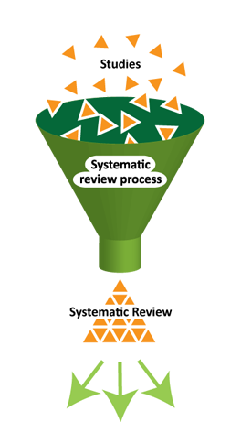
Main steps for Conducting SR
Structured and transparent
process involving:
  Formulate research question & PICO
  Plan the review (via a protocol)
  Comprehensive search
  Selection of studies
  Data extraction
  Standardization of data
  Assess risk of bias
  Data synthesis (may include meta-analysis)
  Interpretation of results
  Reporting
Notes:
In terms of the process:
Yellow – steps that are somewhat different
Red – varies ALOT

Slide 3
Terminology
Bias: systematic error in results or inferences
  Replications of a biased study would lead, on average, to the same wrong answer
Precision: likelihood of random error due to sampling variation
  replications would produce different effect estimates, but they would give the right answer on average if repeated a lot
Different biases can lead to underestimation or overestimation of a true value: intervention effect, disease rate, prevalence,…

Slide 4
Assessment of Risk of Bias
Objective: to ascertain the validity of results of primary studies ~ how much can you trust findings
How: identifying flaws in design and execution of PS
Risk of bias assessment depends on the quality of reporting, but can be done regardless
For interventional studies, Cochrane’s risk of bias widely used

Slide 5
Two Distinct Sources of Bias
Bias in the results of the primary studies included in the systematic reviews -> should be dealt with during the data extraction
Bias due to exclusion/inclusion of results of studies that should/shouldn’t be included -> affect results of the meta-analysis

Slide 6
Risk of bias vs. “Study Quality”
Study quality: extent to which study authors conducted their research to highest standards
Problem with this? A study may be performed to the highest possible standards yet still have an important risk of bias
  e.g. impractical or impossible to blind participants or study personnel
What really matters? the extent to which we should believe the results of studies
  Thus, instead of “study quality” use “risk of bias”

Slide 7
Risk of Bias vs. Evidence Quality
Risk of bias is assessed at the level of each data point (PICO level) and DURING data extraction
Evidence quality is assessed AFTER data analysis completed, for each outcome across all included data points
  RoB assessment informs evidence quality assessment
  Obviously: “evidence quality ” ≠ “study quality”
Notes:
More on quality of evidence in a few weeks

Slide 8
Internal vs. External Validity
Internal validity: the extent to which study’s results are trustworthy (how biased they are)
  Reflect rigors in study design and execution
External validity: the extent to which the results of a study are generalizable or applicable to a broader population and settings
  Reflect how participants were selected and the context of study

Slide 9
Key Bias Types | Description
Selection bias | Systematic differences between baseline characteristics of the groups that are compared
Performance bias | Systematic differences between groups in the care that is provided, or in exposure to factors other than the interventions of interest
Detection bias | Systematic differences between groups in how outcomes are determined
Attrition bias | Systematic differences between groups in withdrawals from a study
Reporting bias | Systematic differences between reported and unreported findings

Slide 10
How to Assess risk of bias?
Over hundred tools proposed for assessing study “quality” or “rigor” or “bias”
For randomized controlled trials (RCTs): dozens of “scales” and “checklists” exist

Slide 11
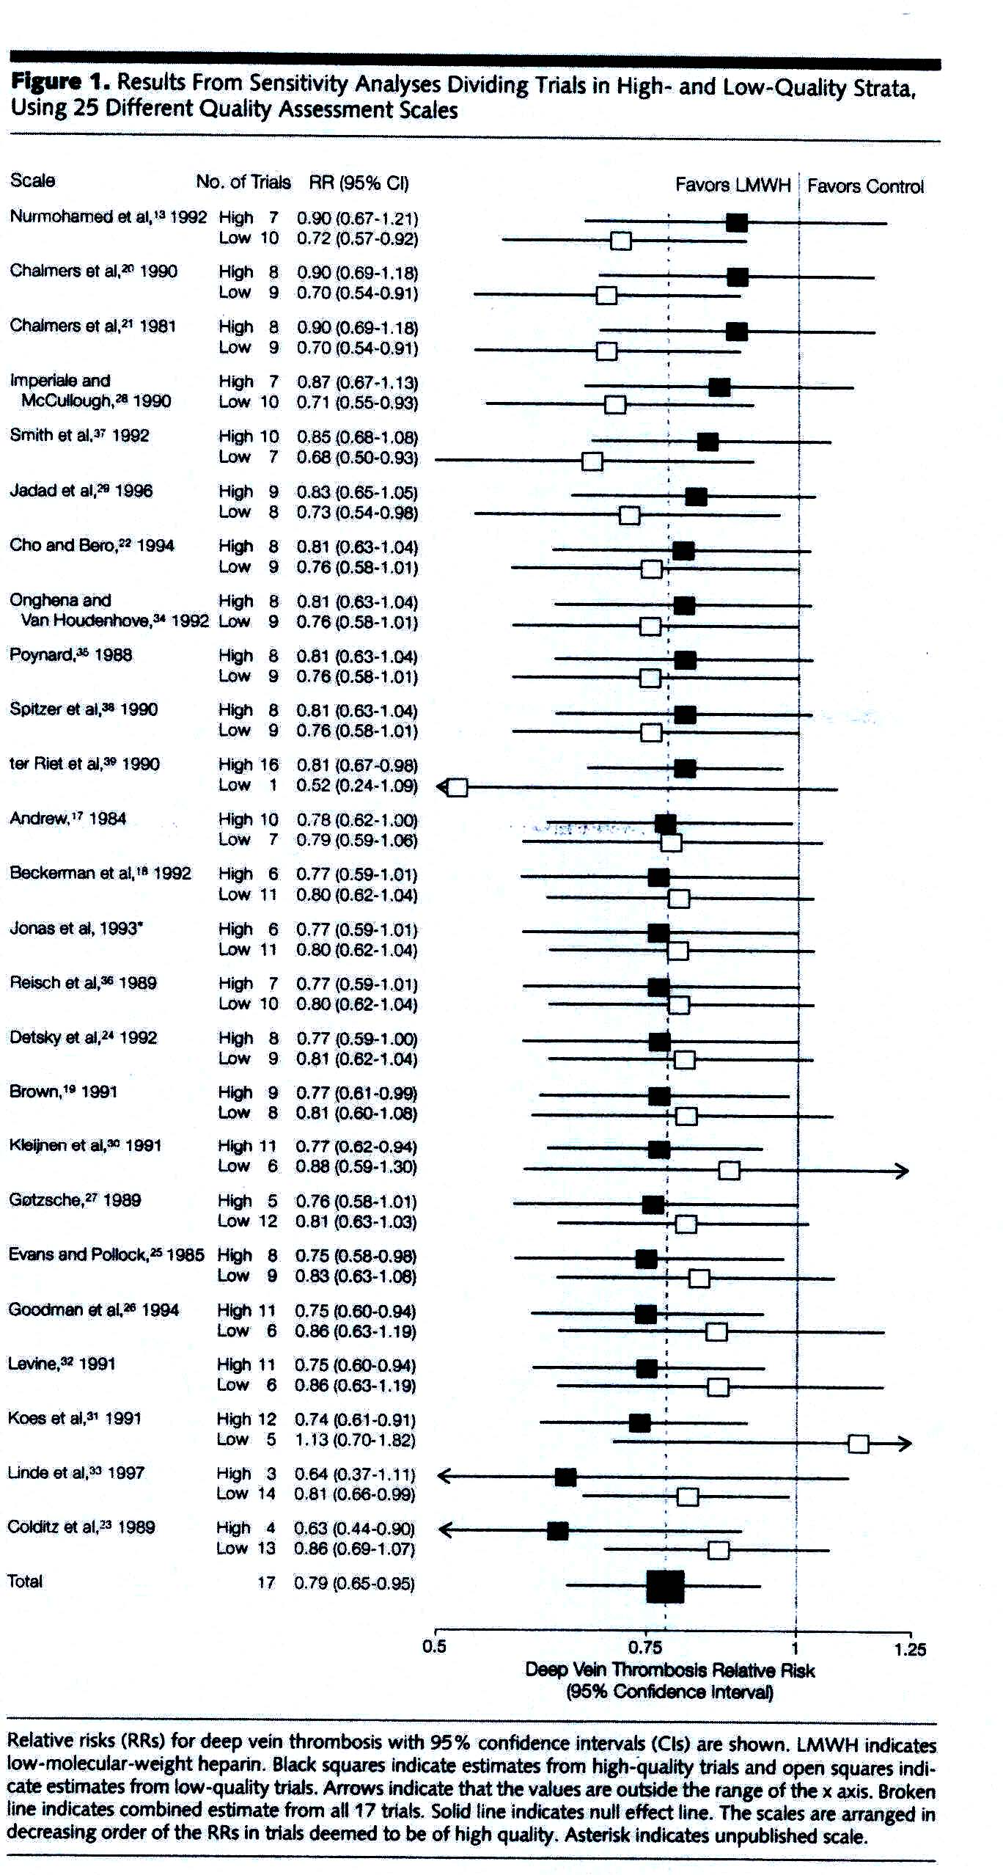
Juni (1999, JAMA)
Notes:
June & colleagues (1999) used several scales to assess “quality” of 17 trials for meta-analysis. Conflicting results; Seemingly dramatic differences between high-quality and low-quality scores, but no statistically significant associations between individual quality scores and treatment effect
Jüni P, Witschi A, Bloch R, Egger M. The hazards of scoring the quality of clinical trials for meta-analysis. JAMA. 1999 Sep 15;282(11):1054-60.

Slide 12
Assessment of risk of bias – Caveats
All instruments are imperfect
Highly subjective
Require both contextual and methodological expertise
What to assess varies by study design
  Consolidating risk of bias across studies
Inadequate reporting is a problem
What to do if all studies high risk of bias?
  Not combine results
  Exclude?

Slide 13
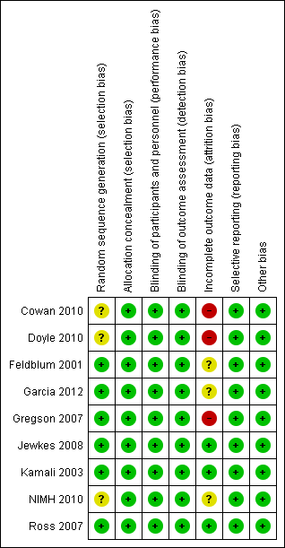
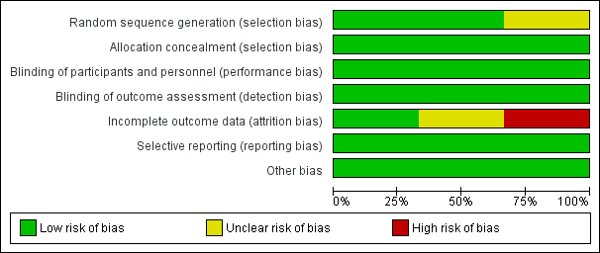
Cochrane risk of bias tool

Slide 14
Cochrane ROB 2 Assessment Tool (New)
For RCTs, assessments made separately and transparently for 5 different bias domains
Select which result to focus on for RoB (PICO level)

Slide 15
Risk of Bias Domains
bias arising from the randomization process
bias due to deviations from intended interventions
bias due to missing outcome data
bias in measurement of the outcome
bias in selection of the reported result

Slide 16
RoB Assessment Implemented
Signaling questions to help make a judgement about risk of bias for the domain – with potential answers:
  Yes, Probably yes, Probably no, No; and No information.
A place to justify responses to the signaling questions and risk-of-bias judgements
Option to predict (and explain) the likely direction of bias.
Notes:
Ask questions like:
Did the study author properly describe the randomization process?

Slide 17
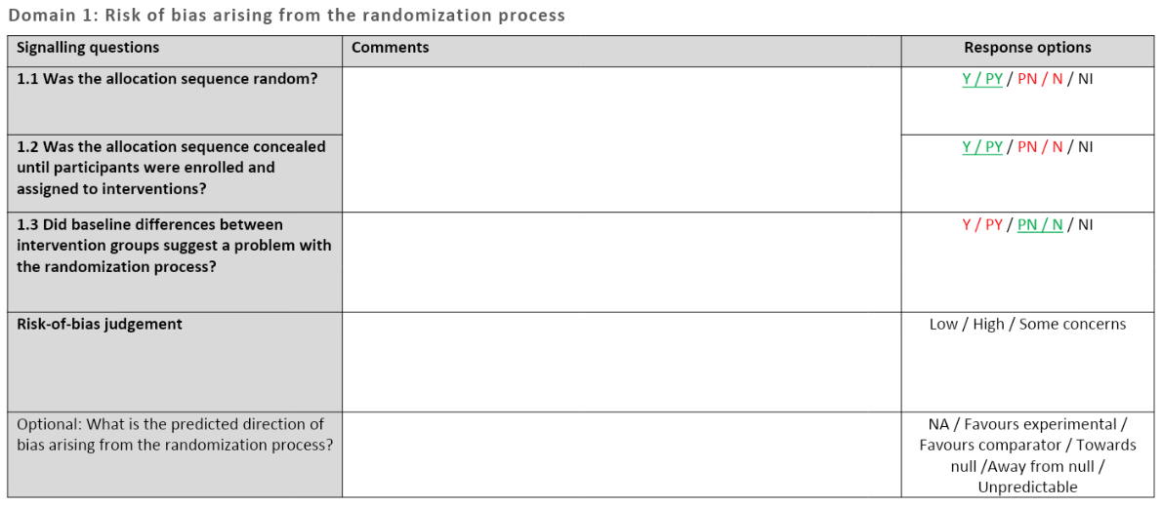
Revised RoB 2 Tool
https://drive.google.com/file/d/18Zks7k4kxhbUUlbZ51Ya5xYa3p3ECQV0/view

Slide 18
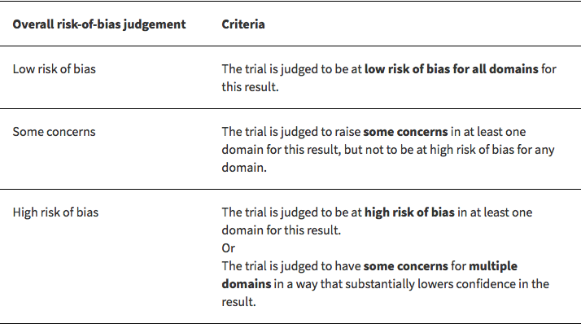
Reaching Overall Risk of Bias at Domain Level

Slide 19
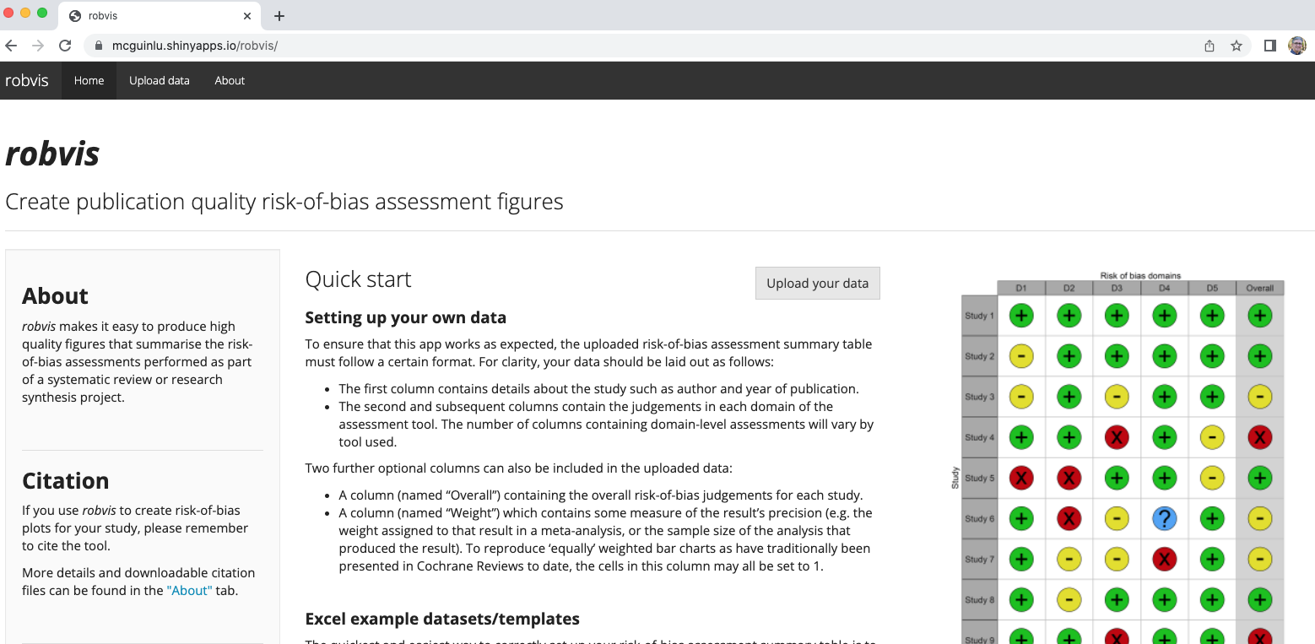
Tool to visualize ROB 2.0 https://mcguinlu.shinyapps.io/robvis/

Slide 20
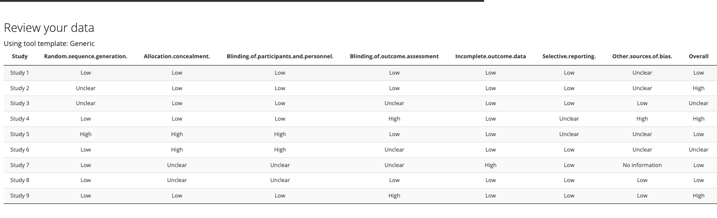
Data can be uploaded from a CSV or Excel file to the website

Slide 21
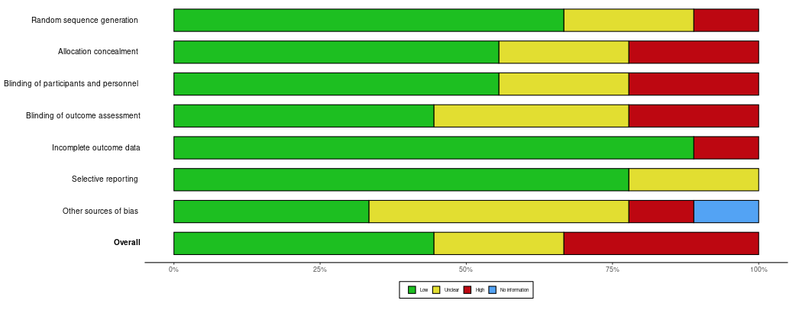
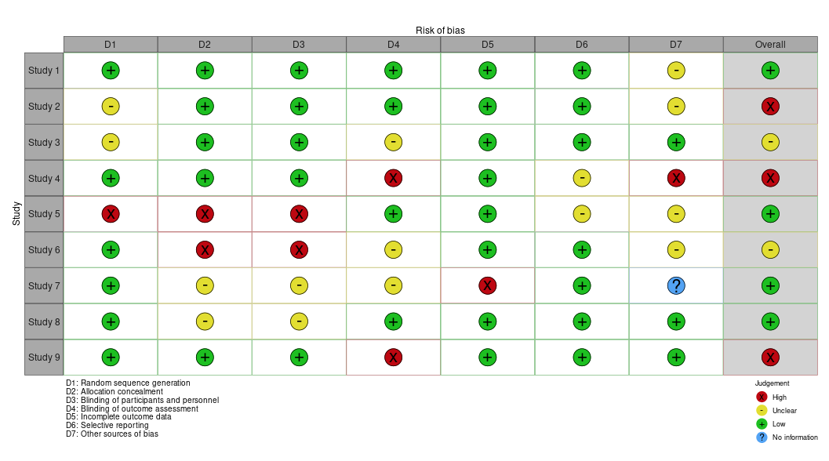

Slide 22
“Other bias”?
For example:
Early stopping for benefit
Contamination bias
Changes to study protocol during study
Number of participants in each arm not reported
Randomized drop-outs replaced by non-randomized participants
Industry-funded authors apparently making “too strong a case”
  Some Cochrane reviews note industry funding in that section every time and mark it (at minimum) as “unclear”

Slide 23
What about observational studies?
SR of instruments for assessing quality/rigor/risk of bias in non-randomized studies identified ~200 tools (Deeks et al, 2003)
  None deemed particularly good as generic instruments
Notes:
Deeks JJ, Dinnes J, D'Amico R, et al. Evaluating non-randomised intervention studies. Health Technol Assess. 2003;7(27):iii-x, 1-173.

Slide 24
Tools for Observational Studies
ROBINS-I tool (Risk Of Bias in Non-randomized Studies - of Interventions)
  https://www.riskofbias.info/welcome
Making GRADE the irresistible Choice (MAGIC)
  http://help.magicapp.org/knowledgebase/articles/327941-tool-to-assess-risk-of-bias-in-cohort-studies
Notes:
MAGIC tool is easy to adopt

Slide 25
ROBINS-I Domains
Pre-intervention
Post-intervention
Domain 1: Confounding
Domain 4: Deviation from intended interventions
Domain 2: Selection of participants into the study
Domain 5: Missing data
Domain 3: Classification of interventions
Domain 6: Measurement of outcomes
Domain 7: Selection of reported result
Notes:
Sterne JAC, Higgins JPT, Elbers RG, Reeves BC and the development group for ROBINS-I. Risk Of Bias In Non-randomized Studies of Interventions (ROBINS-I): detailed guidance, updated 12 October 2016. Available from https://www.riskofbias.info

