Slide 1
Systematic Reviews
(PI-214)
Module 5-B: Reporting and interpreting systematic review findings

Slide 2
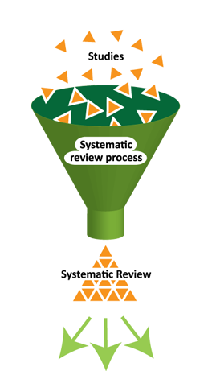
Main steps for Conducting SR
Structured and transparent
process involving:
  Formulate research question & PICO
  Plan the review (via a protocol)
  Comprehensive search
  Selection of studies
  Data extraction
  Standardization of data
  Assess risk of bias**
  Data synthesis (may include meta-analysis)
  Interpretation of results
  Reporting
Notes:
In terms of the process:
Yellow – steps that are somewhat different
Red – varies ALOT

Slide 3
Reporting
When you complete your protocol, you complete your Introduction and Background.

Slide 4
Results
Should summarize review findings in a clear and logical way
Should explicitly address review objectives
Should describe analyses and findings narratively and use tables & figures to help tell the story
Follow the Preferred Reporting Items for Systematic Reviews and Meta-analyses (PRISMA) checklist
Notes:
I will focus now on results for intervention reviews, but most of this will generally hold true for other types

Slide 5
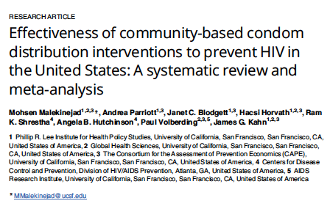

Slide 6
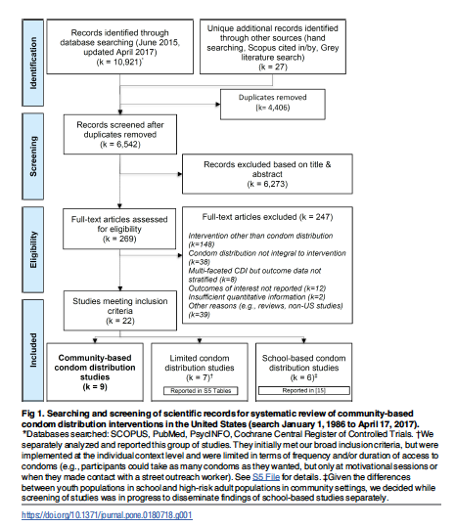

Slide 7
Descriptive analysis:
Results of screening
Narrative should describe the numbers of studies screened, assessed and excluded at each stage
  PRISMA flow diagram (usually will be Figure 1)
Brief reasons for excluding studies after full-text review
  i.e. only for those studies whose full-text articles you have examined in an effort to determine eligibility

Slide 8
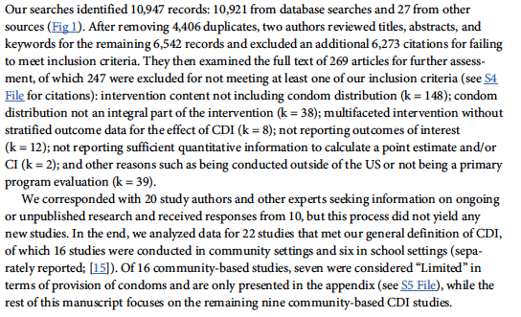
Example 1: Results of screening

Slide 9
Example 2: Results of screening
Searches on 16 March 2016 yielded 492 records (bibliographic databases, n=408; conference abstracts, n=16; registered trials, n=62). After removing 172 duplicate records and 161 clearly irrelevant records, we reviewed 159 records by examining titles, abstracts and keywords. We selected 20 records for full-text review. Applying the inclusion criteria, we then excluded 14 studies reporting results of other background regimens, second-line therapy, pharmacokinetics and other topics. We had no disagreements in screening. See Appendix 2 for bibliography of excluded studies with specific reasons for exclusion. Figure 1 depicts our screening process.

Slide 10
Descriptive analysis : Characteristic of included studies
Brief listing of all included studies and their respective settings
Succinctly describe each study’s population, intervention, setting , follow-up period, other key extracted data
  “Characteristics of included studies” table

Slide 11
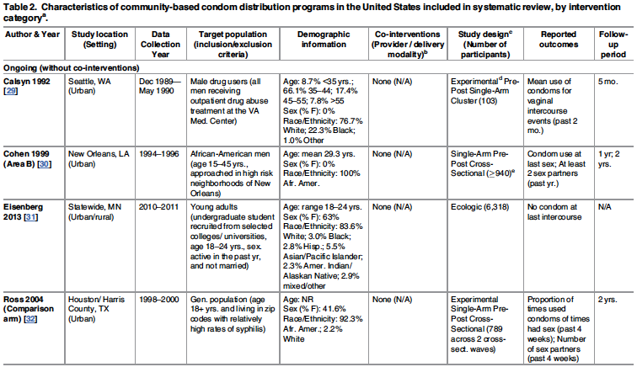

Slide 12
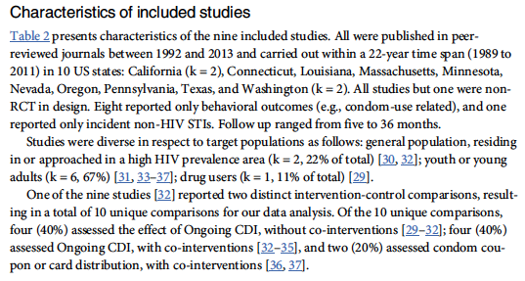
Example: Study characteristics

Slide 13
Example 2: Study characteristics
The trials were conducted in Australia, Belgium, Canada, France, Germany, Hungary, Italy, The Netherlands, Romania, Spain, Russia, the United Kingdom and the United States. Overall, there were 934 participants.
The first trial (SPRING-1) was a four-arm Phase IIb trial that compared DTG + ABC + 3TC (N=17) or DTG + TDF + FTC (N=34) with EFV + either ABC + 3TC (N=16) or TDF + FTC (N=34) [9, 20]. The other was a Phase III multicenter trial (SINGLE) that compared DTG + ABC + 3TC with EFV + ABC + 3TC in 833 ART- naïve patients [11,21-23]. SPRING-1 contributed 51 patients to the DTG arm and 50 to the EFV arm; SINGLE contributed 414 to the DTG arm and 419 to the EFV arm.
The primary endpoint of these two studies was viral suppression to <50 copies/mL at 48, 96 and 144 weeks.

Slide 14
Results of individual primary studies
In addition to tabular form, reviews sometimes report (narratively) the key results of individual primary studies , before moving on to meta-analysis (if any) and narrative synthesis of the evidence.
Given word count constraints in many journals, it may be preferable to present individual study results within the context of the evidence synthesis or when data can not be combined.

Slide 15
Evidence synthesis
Narratively synthesize and summarize results in sufficient detail to give readers a clear sense of findings
Effect estimates with confidence intervals (CI) for all primary outcomes
Meta-analyses
  Effect estimates, CIs and measures of heterogeneity
  Forest plots help to illustrate
  Results of any sensitivity or subgroup analyses

Slide 16
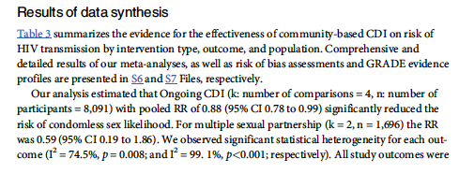

Slide 17
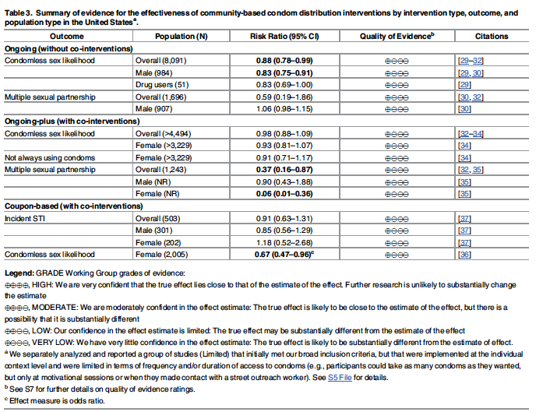

Slide 18
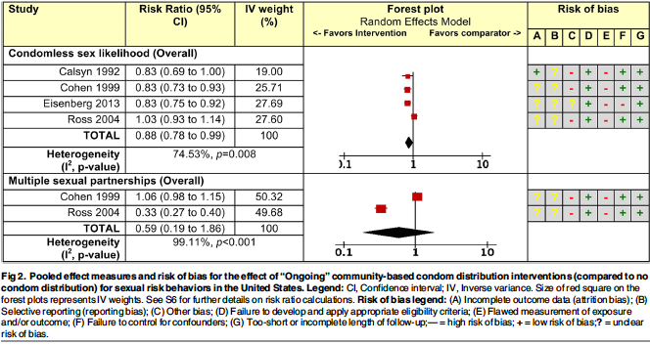

Slide 19
Confidence Interval & P Value
A 95% confidence interval is often interpreted as indicating a range within which we can be 95% certain that the true effect lies.
A P value is the standard result of a statistical test, and is the probability of obtaining the observed effect (or larger) under a ‘null hypothesis’.
Notes:
Cochrane handbook 15.3

Slide 20
Interpreting P values and statistical significance
P values less than 0.05 are often reported as ‘statistically significant’, and interpreted as being small enough to justify rejection of the null hypothesis.
Moderate or large P value doesn’t mean no effect, and small p-value doesn’t mean important benefit. P value only speaks to the precision of the estimate and not the magnitude of the effect.
Avoid describing results as ‘statistically significant’, ‘not statistically significant’ or ‘non-significant’ - instead report the confidence interval together with the exact P value.
Notes:
Cochrane handbook 15.3

Slide 21
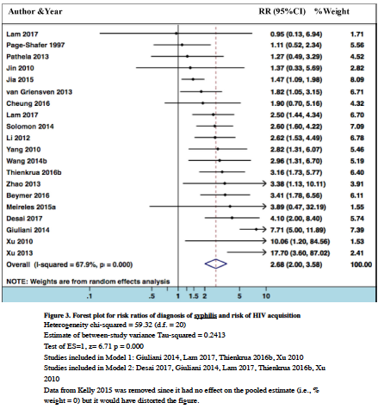

Slide 23
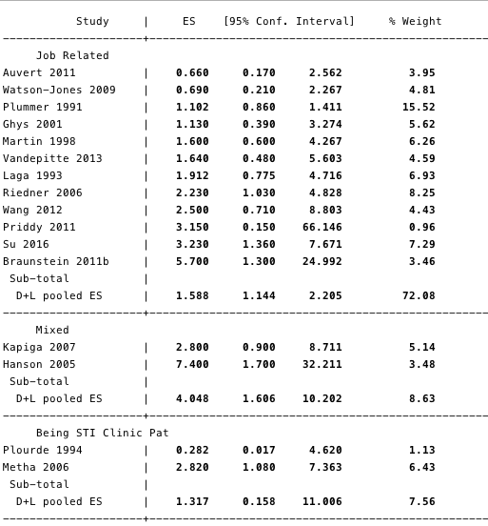
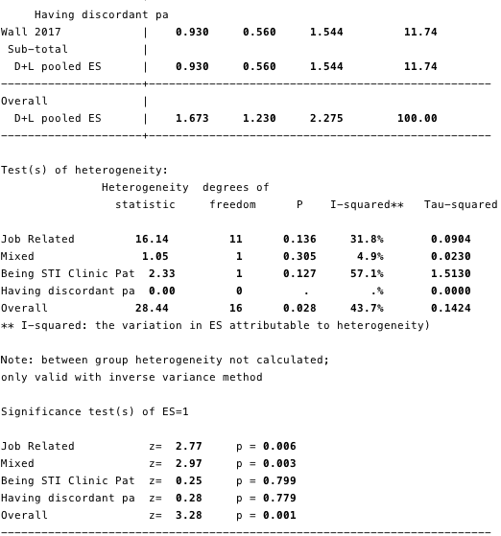

Slide 24
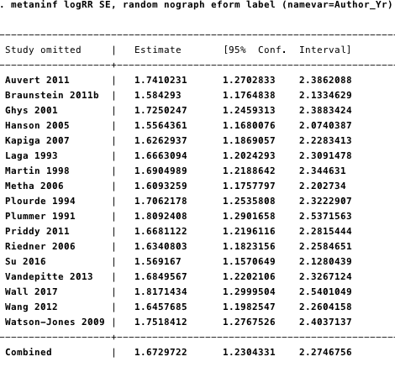

Slide 25
Results: dichotomous outcomes
Examples: RR, OR, RRR, RD, ARD.
RR and RRR tend to be substantially more stable across risk groups than absolute effects.
Choice of metrics used may influence end users' understanding of evidence
“Clinicians may be more inclined to prescribe an intervention that reduces the relative risk of death by 25% than one that reduces the risk of death by 1 percentage point, although both presentations of the evidence may relate to the same benefit (i.e. a reduction in risk from 4% to 3%)”
Relative risk reduction (RRR) is a convenient way of re-expressing a risk ratio as a percentage reduction:
A risk ratio of 0.75 translates to a relative risk reduction of 25%.
Notes:
Cochrane handbook 15.4

Slide 26
Results: dichotomous outcomes – relative vs. absolute risk
Example: “nine randomized controlled trials in almost 6000 cancer patients indicated that the administration of heparin reduces the risk of venous thromboembolism (VTE), with a risk ratio of 43% (95% CI 19% to 60%). For patients with a plausible baseline risk of approximately 4.6% per year, this relative effect suggests that heparin leads to an absolute risk reduction of 20 fewer VTEs (95% CI 9 fewer to 27 fewer) per 1000 people per year (Akl et al 2011a).”

Slide 27
Results: continuous outcomes (MD)
Mean Difference
When all studies have used the same familiar units (e.g., durations of events such as diarrhea symptoms or duration of hospitalization), you may report summary estimate in those units, as a difference in mean response between two interventions.
When units of outcomes are difficult to interpret (e.g. rating scales), include min and max of the scale of measurement, and the direction.
Include the smallest change in instrument score that patients perceive is important – the minimal important difference (MID)
Example: the chronic respiratory questionnaire has possible scores in health-related quality of life ranging from 1 to 7 and 0.5 represents a well-established MID
Notes:
Cochrane handbook 15.5

Slide 28
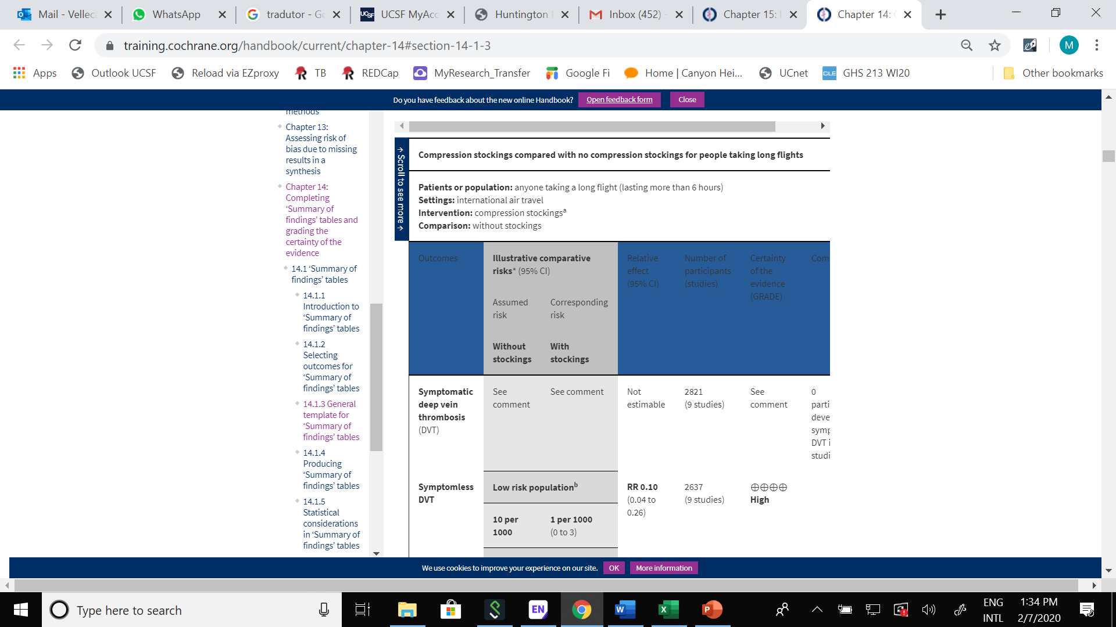
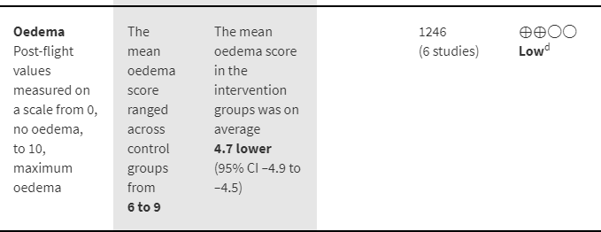
Results: continuous outcomes
Example of when reporting a the ‘Summary of findings’ table how to include a difference of means between the two interventions.
Notes:
Cochrane handbook 15.5

Slide 29
Results: continuous outcomes (SMD)
Standard Mean Differences
Express effect size in standard units rather than the original units of measurement.
The SMD: difference in mean effects between two arms divided by the pooled standard deviation of participants’ outcomes (or external SDs when studies are very small)
SMD value: depends on both the size of the effect and SD of the outcomes (the inherent variability among participants).
  Example of a guideline for how to interpret them: 0.2 represents a small effect, 0.5 a moderate effect and 0.8 a large effect (Cohen 1988).

Slide 30
Results: Continuous outcome SMD (Con’t)
Usually not useful to directly report SMD because studies have used different measurement instruments with different units.
Can express it in the units of one or more of the specific measurement instruments used by the included studies
  Should calculate an absolute difference in means by multiplying the SMD by an estimate of the SD associated with the most familiar instrument.

Slide 31
Results (example)
In meta-analysis at each time point, DTG-containing regimens were superior to EFV-containing regimens (RR=1.10, 95% CI 1.04-1.16 at 48 weeks; RR=1.12, 95% CI 1.04-1.21 at 96 weeks and RR=1.13, 95% CI 1.02-1.24 at 144 weeks) . See Figures 2-4 . Only SINGLE contributed data to the 144-week outcome.
There were only two deaths overall (both in the EFV arm in SINGLE) and no difference in risk of death between the two treatment regimens (RR=0.26, 95% CI 0.01-4.20). SINGLE also reported a primary outcome of discontinuation of initial ART regimen because of adverse events or death at 96 and 144 weeks. At both time points, the DTG-containing regimens were superior to those containing EFV (RR=0.27, 95% CI 0.15-0.50 at 96 weeks and RR=0.28, 95% CI 0.16-0.48 at 144 weeks). Risk of serious adverse events was similar in each regimen at 96 weeks (RR=1.15, 95% CI 0.80-1.63) and 144 weeks (RR=0.93, 95% CI 0.68-1.29).

Slide 32
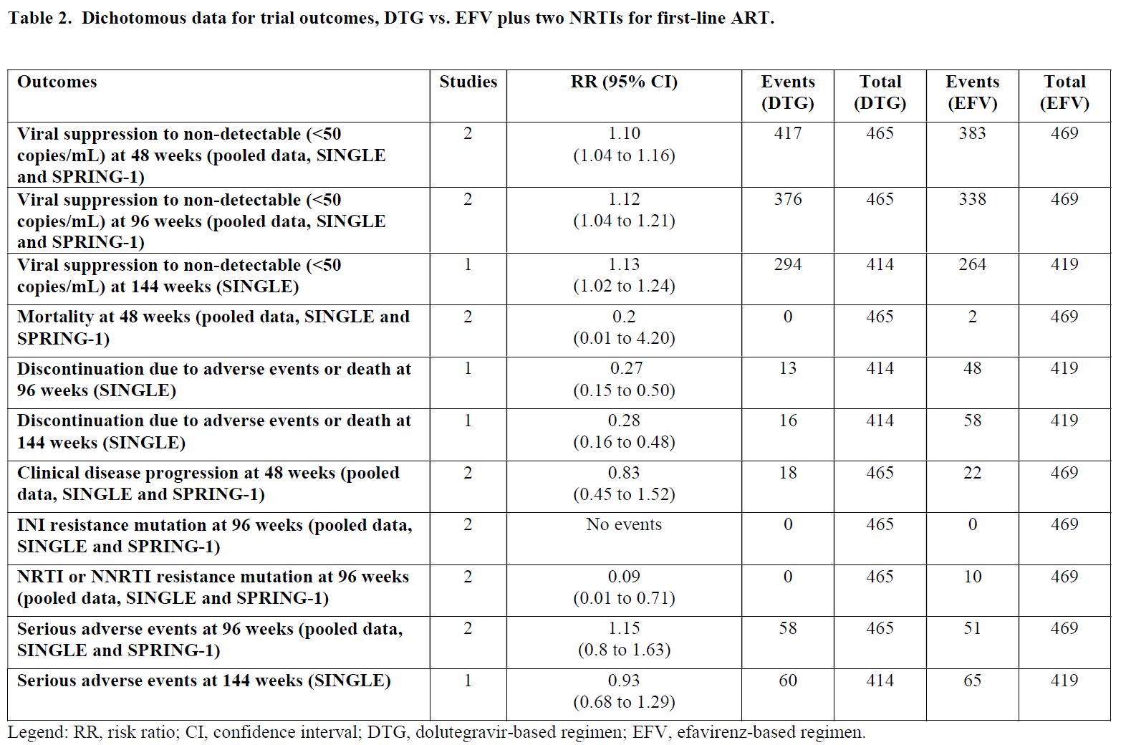

Slide 34
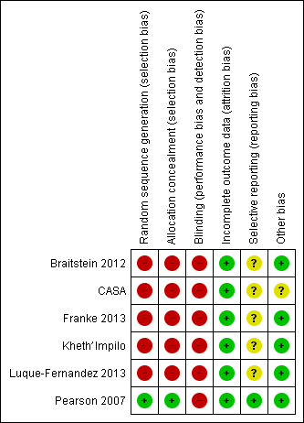
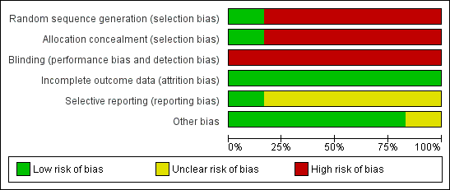
Risk of bias
Briefly describe the bias risk within individual studies and across all studies
  Figures can help

Slide 35
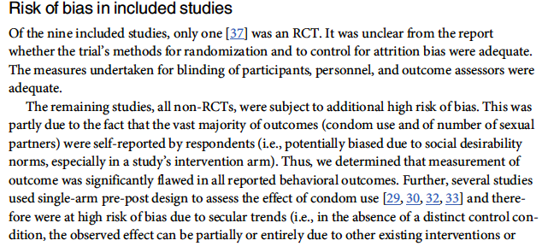
Description of bias risk (Example)

Slide 36
Description of bias risk (Example2)
Overall, the risk of bias across both trials was moderate. In both trials, methods for sequence generation were adequate, with centralized, computer-based procedures used to randomize patients within baseline CD4 and viral load strata in SINGLE and within viral load strata and NRTI selection in SPRING-1. Allocation concealment and blinding of patients and personnel was adequate in SINGLE, although at week 96 patients and personnel were unblinded. Outcome assessors were unblinded at week 48. In SPRING-1, however, allocation to drug was not concealed; only drug dose was concealed. Similarly, participants and personnel were blinded only to drug dose. Outcome assessors were blinded to both drug and dose. With all outcomes biologically measured in both trials, the risk of bias from unconcealed allocation or lack of blinding is unclear, though it is likely low.
There was a high risk of attrition bias in SINGLE, with 18% of DTG arm participants and 26% of EFV arm participants leaving the trial by week 96. While clinical reasons for withdrawal up to week 96 are described well, other types of reasons are not clearly described. Withdrawals after week 96 were described even less clearly. In SPRING-1, attrition was low (6% in DTG arm, 10% in EFV arm), and investigators described it adequately. With regard to selective outcome reporting, both trials conformed well to their respective protocols, though one outcome in SINGLE (“Change from baseline in CD4+ cells at week 48”) was reported only the clinicaltrials.gov web site and not in any published report.

Slide 37
Discussion
Summarize the review’s main findings in the context of the evidence quality
  If you have not assessed evidence quality, just summarize the main findings
Consider relevance of findings to policy-makers, healthcare providers, researchers, patients
Discuss limitations at study level (e.g. risk of bias) and at review level (e.g. publication bias or inability to obtain papers)

Slide 38
Conclusions
Provide a final summary statement of review findings in the context of evidence quality and related evidence beyond the review’s scope, noting implications for clinical or public health practice and for future research.

Slide 39
Conclusion Compoents
Implications for practice
Implications for research
Reaching conclusions

Slide 40
Example: Conclusions
We found two RCTs that directly compared DTG- and EFV-containing three-drug regimens for initial treatment of HIV infection in adults and adolescents. DTG appears to be superior to EFV in terms of durable viral suppression, absence of resistance and immunologic recovery. DTG-containing regimens should be considered in future international guidelines for initial therapy of HIV infection.

Slide 41
A few closing words today
Effect estimates: When possible, if an intervention shows possible benefit or harm for a given outcome, provide both relative and absolute effect estimates
  Expressing only in relative terms may lead e.g. providers overestimating magnitude of treatment effect (e.g. RR 0.50 may only mean 2%>1%)
  A good metric for this is number needed to treat (or screen or harm)
Report harms (also in absolute terms) as well as benefits
Report results data for all primary outcomes – don’t cherry-pick the significant ones
Be mindful of a tendency to “want” interventions to work – Be conservative, nuanced and highly accurate in your writing – Avoid “spin”!

