Slide 1
Systematic Reviews
(EPI214)
Module 6-A: Quality (Certainty) of Body of Evidence
Mohsen Malekinejad, MD, DrPH

Slide 2
How confident can we be that our estimates are true?
Can we believe these results?
Many systems developed over the years to assess “quality” or “strength” of evidence, but often conflicting, methodologically unsound and hard to understand

Slide 3
In patients with acute HCV, should antiviral treatment (compared to no treatment) be used to achieve viral clearance?
Evidence
Recommendation
Organization
B
Class I
AASLD (2009)
II-1
“Should be initiated…”
VA (2006)
1+
A
SIGN (2006)
-/-
“Most authorities…”
AGA (2006)
-/-
B “It works…”
AWMF(2004)

Slide 4
GRADE
Grading of Recommendations Assessment, Development and Evaluation (GRADE)
  Assesses the quality f the body of evidence, not a single study
  Has become the global standard in past 10 years
  Required for use in developing WHO guidelines
  “Quality of evidence” is better considered as CERTAINTY of evidence.
Relies on judgment, but great virtues are simplicity and transparency
  All important judgments are described

Slide 5
Grading evidence quality
How does it work?
Quality of evidence
Study design
Lower if…
Higher if…
High
Randomized trial
Study limitations (bias)
Large effect (e.g., RR 0.5)
Very large effect (e.g., RR 0.2)
Moderate
Inconsistency
Evidence of dose-response gradient
Low
Non-RCT
Indirectness
All plausible confounding would not reduce a demonstrated effect OR properly adjusted
Very low
Imprecision
Publication bias
Notes:
Can go down 1 or two levels, and can go up maximum of 3 levels.
Observational studies can start at high too = but if there is inherent risk of selection bias, graded down to low.

Slide 6
Quality of evidence in GRADE
HIGH: We are very confident that the true effect lies close to that of the effect estimate.
MODERATE: We are moderately confident in the estimate of effect: The true effect is likely to be close to the effect estimate, but possibility to be substantially different.
LOW: Our confidence in the effect is limited: The true effect may be substantially different from the effect estimate.
VERY LOW: We have very little confidence in the effect estimate: Any estimate of effect is very uncertain.
6
Notes:
6

Slide 7
Domains that can lead to decreasing the certainty level of a body of evidence
Risk of bias or limitations in the detailed design and implementation: Our confidence in an estimate of effect decreases if studies suffer from major limitations that are likely to result in a biased assessment of the intervention effect.
Unexplained heterogeneity or inconsistency of results: When heterogeneity exists and affects the interpretation of results, but review authors are unable to identify a plausible explanation with the data available, the certainty of the evidence decreases.
Notes:
Cochrane handbook – descriptions section 14.2

Slide 8
Domains that can lead to decreasing the certainty level of a body of evidence
Indirectness of evidence:
  When the evidence is restricted to indirect comparisons between A and B (e.g. randomized trials are available, but they have compared A with placebo and B with placebo) ;
  When the evidence comes from a restricted version of the main review question in terms of population, intervention, comparator or outcomes (e.g. in a review addressing an intervention for secondary prevention of coronary heart disease, most identified studies happened to be in people who also had diabetes).
Notes:
Cochrane handbook – descriptions section 14.2

Slide 9
Domains that can lead to decreasing the certainty level of a body of evidence
Imprecision of results: When studies include few participants or few events, and thus have wide confidence intervals, review authors can lower their rating of the certainty of the evidence.
High probability of publication bias: The certainty of evidence level may be downgraded if there is evidence of publication bias (non-reporting bias)
Notes:
Cochrane handbook – descriptions section 14.2

Slide 10
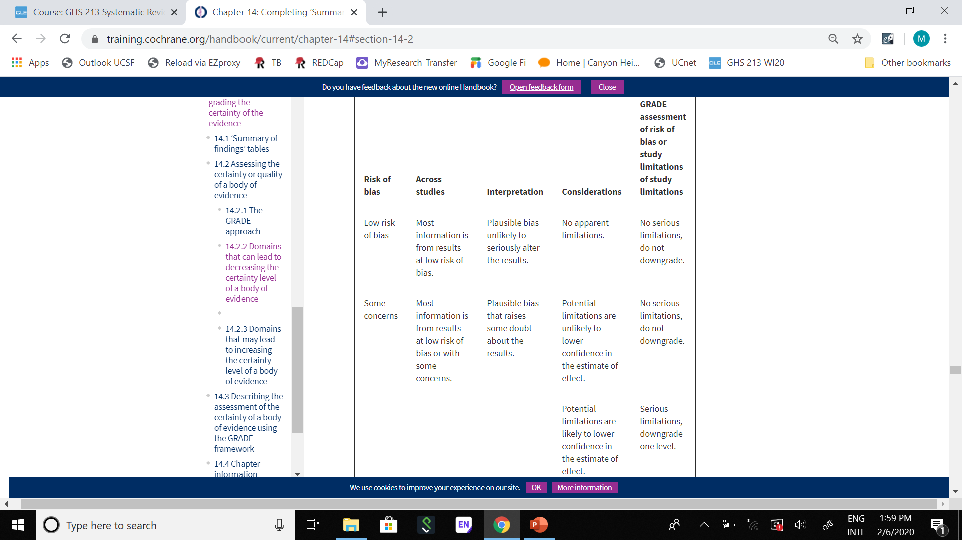
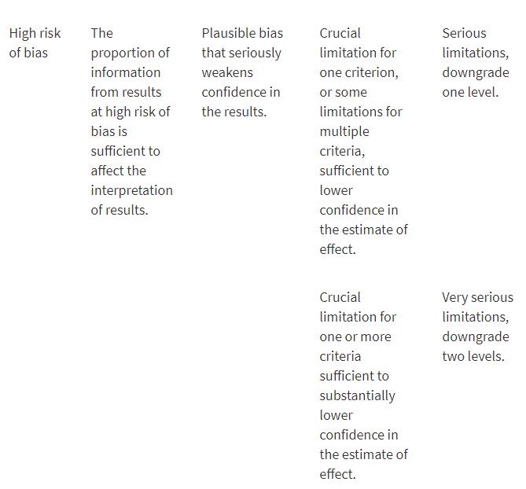
Further guidelines for domain 1 (of 5) in a GRADE assessment: going from assessments of risk of bias in studies to judgements about study limitations for main outcomes across studies
Notes:
Cochrane handbook – table 14.2.A

Slide 11
Domains that may lead to increasing the certainty level of a body of evidence
(Usually for observational studies)
Large effects (e.g., RR < 0.5)
Dose-response: as intervention increase so does outcome
Lack of plausible confounding / opposing residual bias (likely pulling effect size in favorable direction)
Notes:
Cochrane handbook – main subheadings section 14.2.3

Slide 12
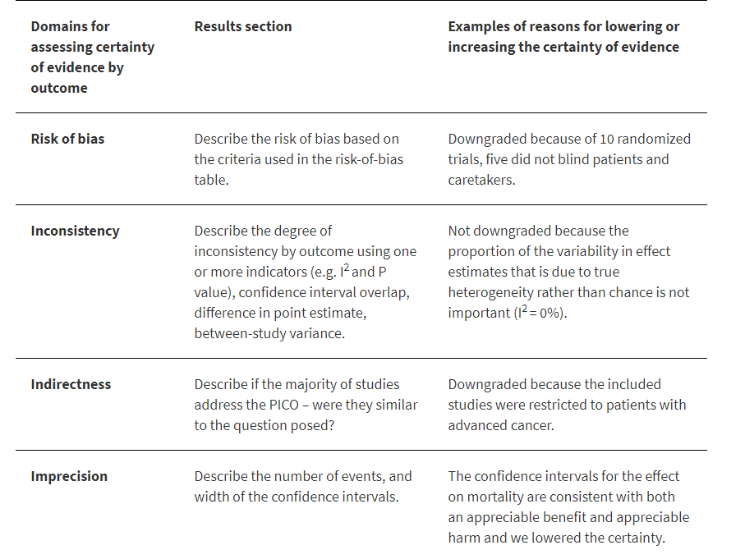
Framework for describing the certainty of evidence and justifying downgrading or upgrading
Notes:
Cochrane handbook chapter 15, table 15.5.A

Slide 13
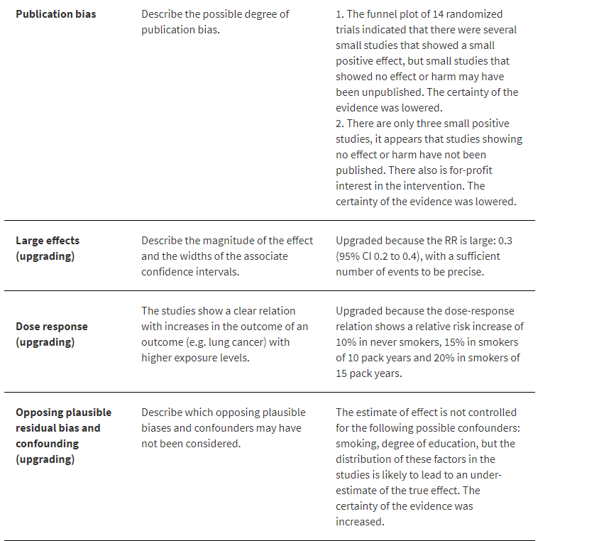
Framework for describing the certainty of evidence and justifying downgrading or upgrading
Notes:
Cochrane handbook chapter 15, table 15.5.A

Slide 14
