Slide 1
Systematic Reviews
(EPI214)
Module 6-B:Assessment of Non-Reporting Bias
Mohsen Malekinejad, MD, DrPH

Slide 2

“Non”-Reporting Bias
Reporting biases: arise when dissemination of research findings is influenced by the nature and direction of results
Studies with significant, positive findings are more likely to be:
  Published
  Published in English
  Published rapidly
  Published in a non-obscure journal
  Published more than once or one form
  Cited by others

Slide 3
Non-Reporting Bias: Common Types
  Publication bias: Publication or non-publication
  Time-lag bias: Rapid or delayed publication
  Language bias: Publication in a particular language(usually not English)
  Location Bias: research findings in journals with different ease of access or indexing
  Outcome reporting bias: Selective reporting of
some study outcomes
    This one is done in the risk of bias assessment

Slide 4
Minimizing risk of non-reporting bias?
Restriction of syntheses to inception cohorts (i.e., known to have initiated)
  Include only if registered prospectively.
  Conduct prospective reviews / meta-analysis
  Caveats:
    still there can be missing results and only works for regulated interventions (e.g., dugs, medical devices)
    Potentially lower precision (fewer studies) and low applicability (narrower question)
Inclusion of results from sources other than published reports
  Inclusion of results from trial results registry
  Inclusion of results from clinical study reports and other regulatory documents

Slide 5
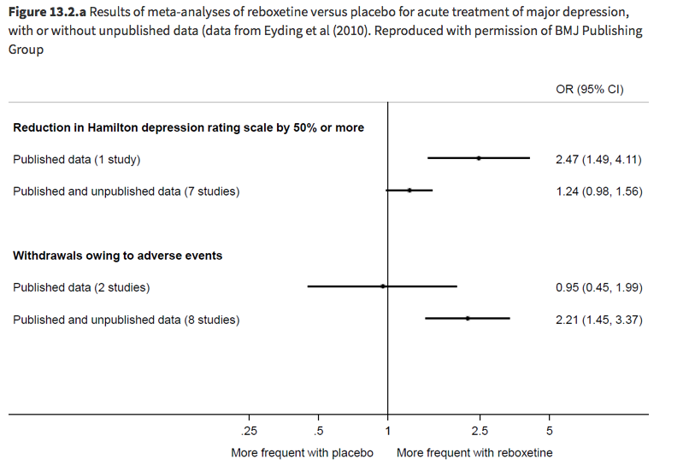

Slide 6
Assessing risk of missing results
Why? Unlikely to get all unpublished results even if we try to find all studies.
Applies to quantitative effect estimates of interventions / more work on other areas and qualitative data needed

Slide 7
Framework for assessing risk of bias due to missing results
Select syntheses to assess for risk of bias due to missing results
Define which results are eligible for inclusion in each synthesis
Record whether any of the studies identified are missing from each synthesis because results known (or presumed) to have been generated by study investigators are unavailable: the ‘known unknowns’
Consider whether each synthesis is likely to be biased because of the missing results in the studies identified
Consider whether results from additional studies are likely to be missing from each synthesis: the ‘unknown unknowns’
Reach an overall judgement about risk of bias due to missing results in each synthesis

Slide 8
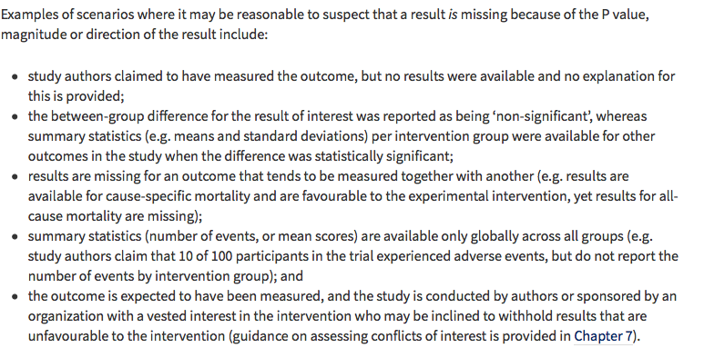

Slide 9
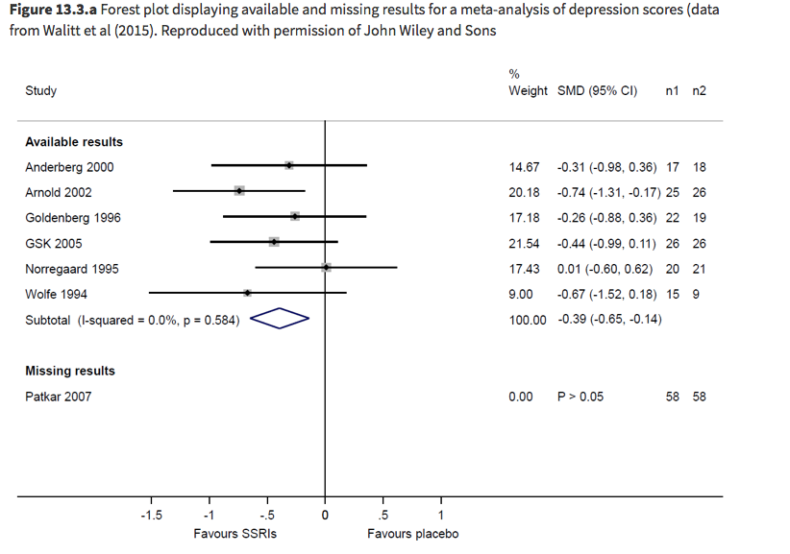

Slide 10
Clues for “Unknown” Missing Results
Single data base searched
Specialized database not searched
Databases of specific countries where some studies would take place not searched
If fast-moving field, positive results get out sooner (time-lag)

Slide 11
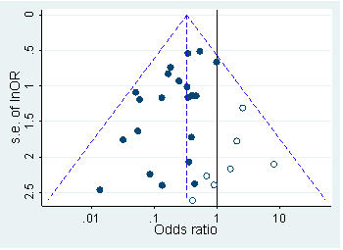
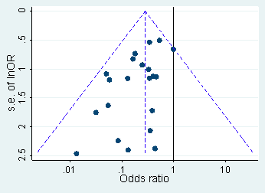



Reporting Bias: Funnel Plots -1
Symmetrical
Asymmetrical
Effect size vs. sample size or some indicator of sample size
Symmetrical inverted funnel: suggests no publication bias
Asymmetrical: gap in bottom corner of graph
  Publication bias: smaller studies without statistically significant effects or “negative” effect remain unpublished
Notes:
If symmetrical you get favorable and ___ results
Asymmetrical is not deterministic, shows small studies with negative effect are missing
Funnel plot is just effect size and is subjective

Slide 12
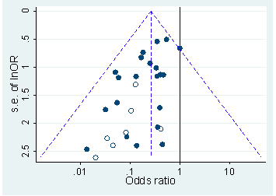
Reporting Bias: Funnel Plot -2
Reasons other than reporting bias for Asymmetrical funnel plot:
  Poor methodological quality of studies
  True heterogeneity
  Artefactual
  Random
Asymmetrical because some smaller studies (open circles) are of lower methodological quality and therefore produce exaggerated intervention effect estimates.

Slide 13
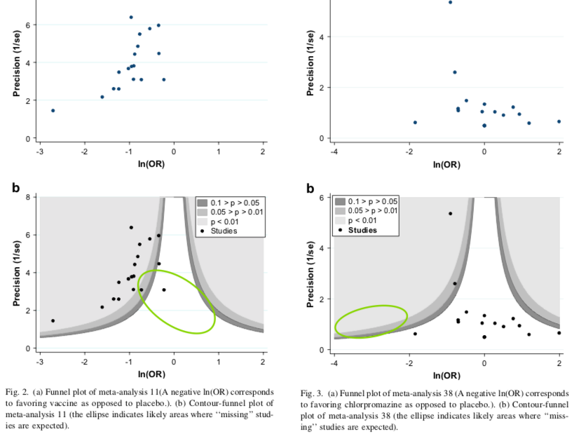
Peters 2009

Slide 14
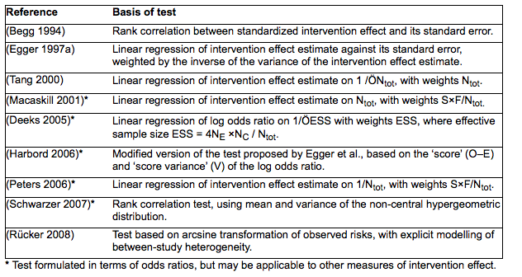
Tests for Funnel Plot Asymmetry
Notes:
Earlier tests by Egger had limitations for odds ratio
N_{tot} is the total sample size, N_{E} and N_{C} are the sizes of the experimental and control intervention groups, S is the total number of events across both groups and F = N_{tot} – S. Note that only the first three of these tests (Begg 1994, Egger 1997a, Tang 2000) can be used for continuous outcomes.

Slide 15
Funnel Plot Asymmetry:
Statistical Tests
Examines whether the association between intervention effects and a measure of study size (standard error) > expected by chance alone
  At least 10 studies in the meta-analysis - power is too low with fewer studies
  Lack of evidence of asymmetry does not preclude chance of publication bias (Low power test)
  When there is evidence of asymmetry, publication bias is one of the possible explanations
Statistical test does not replace visual inspection
  Eg. do small studies tend to lead to more or less beneficial intervention effect estimates?

