Slide 1
Systematic Reviews
(EPI214)
Module 6-C: Critical appraisal of systematic reviews
Mohsen Malekinejad, MD, DrPH

Slide 2
AMSTAR and PRISMA
A Measurement Tool to Assess Systematic Reviews (AMSTAR)
Preferred Reporting Items for Systematic Reviews and Meta-analyses (PRISMA)

Slide 3
AMSTAR | PRISMA
Complementary (though they seem to overlap a bit)
Assesses methodological quality of SRs: “how well it was conducted”. | Assesses the completeness of reporting SR methods: “how well it was reported”.
16-item checklist | 27-item checklist
Designed to improve the quality and conduct of SR methods | Designed to improve transparency and consistency of reporting SR methods
e.g.: Provides criteria for assessing a literature search as adequate or inadequate | e.g.: Requires details of the literature search terms and sources used, but does not distinguish between adequate and inadequate searches

Slide 4
Links to AMSTAR 2 checklist:
https://www.bmj.com/content/358/bmj.j4008 (under data supplement)
https://amstar.ca/mascripts/Calc_Checklist.php

Slide 5
AMSTAR
Just because it’s a systematic review doesn’t mean it is actually an unbiased, comprehensive, systematic assessment of the literature.
Systematic reviews may have been done quite poorly.
  Not uncommon to see reviews with ad hoc methods, or that have “cut corners”.
AMSTAR can help to characterize a review’s methodologic quality.

Slide 6
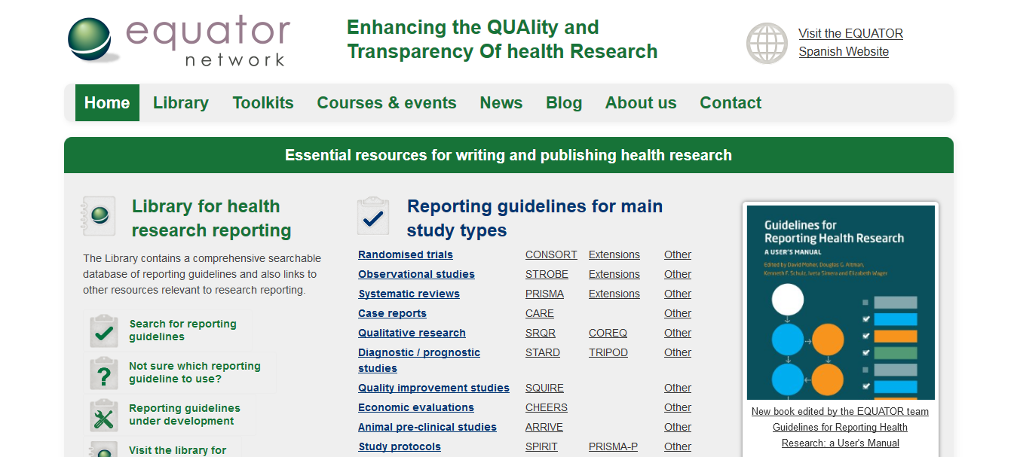
REPORTING

Slide 7
PRISMA check-list
Two functions:
Helps readers know exactly what was done in the review process.
Helps reviewers report everything they should report in the review.

Slide 8
http://prisma-statement.org/PRISMAStatement/

Slide 9
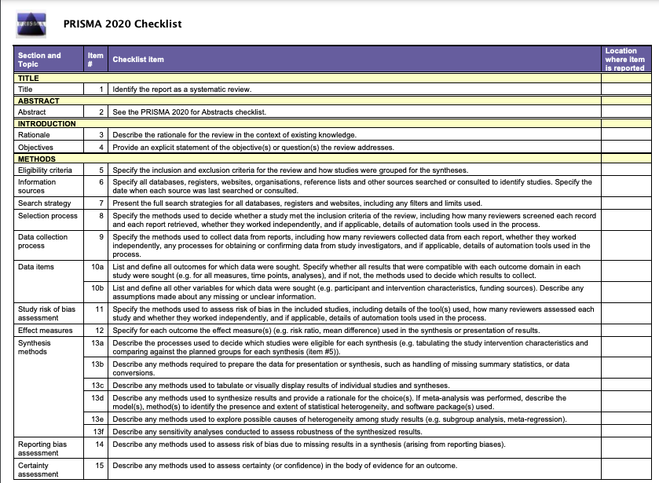

Slide 10
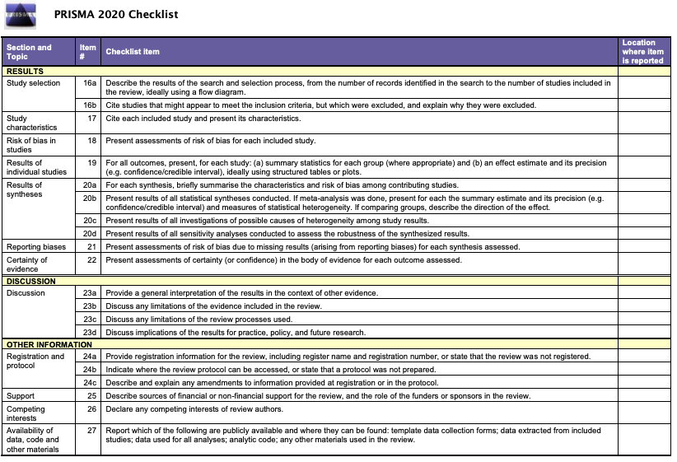

Slide 11
PRISMA check-list
PRISMA can help to characterize the quality of a review’s reporting.
Compliance with PRISMA reporting guidance provides transparency in review methods.

Slide 12
PRISMA - Limitations
A given systematic review may actually be an unbiased, comprehensive, systematic assessment of the literature, but if it’s reported poorly we can’t be sure.
Makes it difficult to know the extent to which we can believe its findings.
Notes:
If poor reporting we cannot be sure that findings are accurate. Not good writers but good methodology

Slide 13
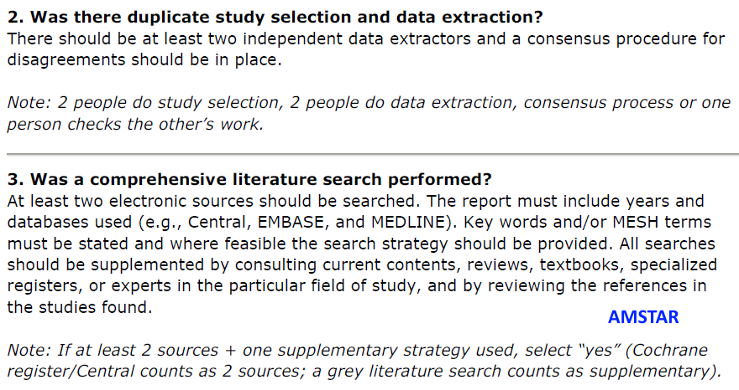
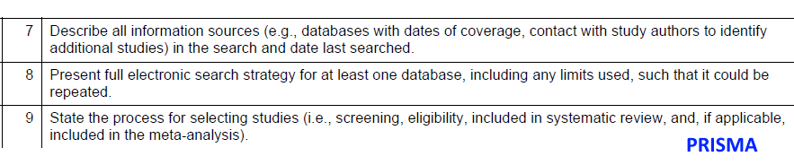
How AMSTAR & PRISMA complement each other
Notes:
Prisma about the quality of reporting
Assess how well it was reported (PRISMA) and how well it was conducted (AMSTAR)

Slide 14
PRISMA-P for SR protocols
A 17-item checklist intended to facilitate the preparation and reporting of a robust protocol for the systematic review.
Items have been derived largely from the PRISMA checklist and items of the PROSPERO register.
Notes:
Several extensions of the PRISMA Statement have been developed to facilitate the reporting of different types or aspects of systematic reviews.
Prisma-P for protocols: http://prisma-statement.org/Extensions/

Slide 15
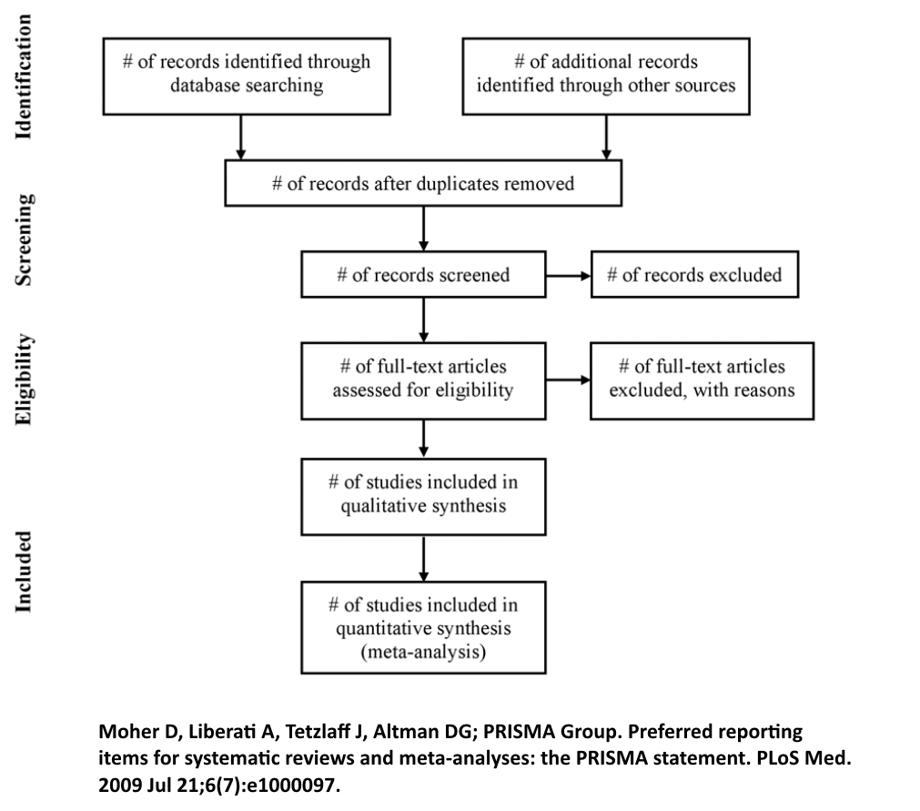
PRISMA flow-chart
Flow-chart: Illustration and description of study screening process
Notes:
You should cite the person who made the guidelines

