Slide 1
Engaging minority populations in research
Have We Done Enough?
Anna Nápoles, PhD
Professor
EPI 222
May 29, 2014

Slide 2
Outline
lack of attention by health researchers to issues of engagement of diverse communities
what we know about R&R methods for diverse populations
recommendations to advance R&R science in diverse populations

Slide 3
Lack of Attention to the Issues

Slide 4
NIH Mandate to Recruit Minorities
1993 NIH Revitalization Act: women and minorities must be included in clinical research supported by NIH
Sufficient numbers to allow valid evaluation of ethnic differences for major ethnic groups
Notes:
Need to describe composition of study pop, rationale and recruitment plan; targeted pop
For clinical trials need to have sufficient power to test for subgroup analyses if prior evidence exists of such differences

Slide 5
Dismal Representation
75% of public has little or no knowledge of clinical research enterprise
2% of U.S. pop participates in clinical research
3% of cancer patients participate in clinical trials
Of those, only 10% are minorities, while they make up almost 40% of U.S. population
www2.mdanderson.org/cancerwise/2010/03/minority-participation-in-clinical-trials.html;
Harris PA 2012
Notes:
Very significant room for improvement!
By 2042, whites will be the minority in the U.S., especially in Hawaii, D.C., California, New Mexico and Texas
52 million Latinos (16.4%)
15 million Asians/API (5%)
38 million (12.6%)

Slide 6

WHY

Slide 7


Notes:
Under-representation of minorities in research has been largely attributable to defacto exclusion.
It is a stark realty owing to years of neglect and lack of attention to these issues.

Slide 8
Percent of Phase III Cancer Trials that Used Age, Gender or Race Targets,
1990-2000
Swanson GM. 2002 Cancer;95(5):950-9.
Notes:
In these graphs, age is represented by the dark green, gender by the light green and race by the white columns.
This review of over 260 phase III cancer trials between 1990-2000, shows that for treatment trials, while age was an explicit eligibility criteria in almost 30% of trials and gender in over 40% of trials, there were 0 trials that specified race/ethnicity targets
For prevention trials, results are better for age with about 70% of trials specifying age criteria, but pretty similar to treatment trials with almost 40% of trials specifying gender criteria and 9% race/ethnicity criteria.

Slide 9
Percent of Phase III Cancer Trials that Used Age, Gender or Race Targets,
2001-2010
Kwiatkowski K. 2013 Cancer;119(16):2956-63.
Notes:
Not much change in the 10 years after as demonstrated by this review which replicated the earlier systematic review
For treatment trials, Looking at the white columns, you can see that race/ethnicity targets were specified in 1% of Phase II treatment trials and 19% of prevention trials so we still have a ways to go

Slide 10
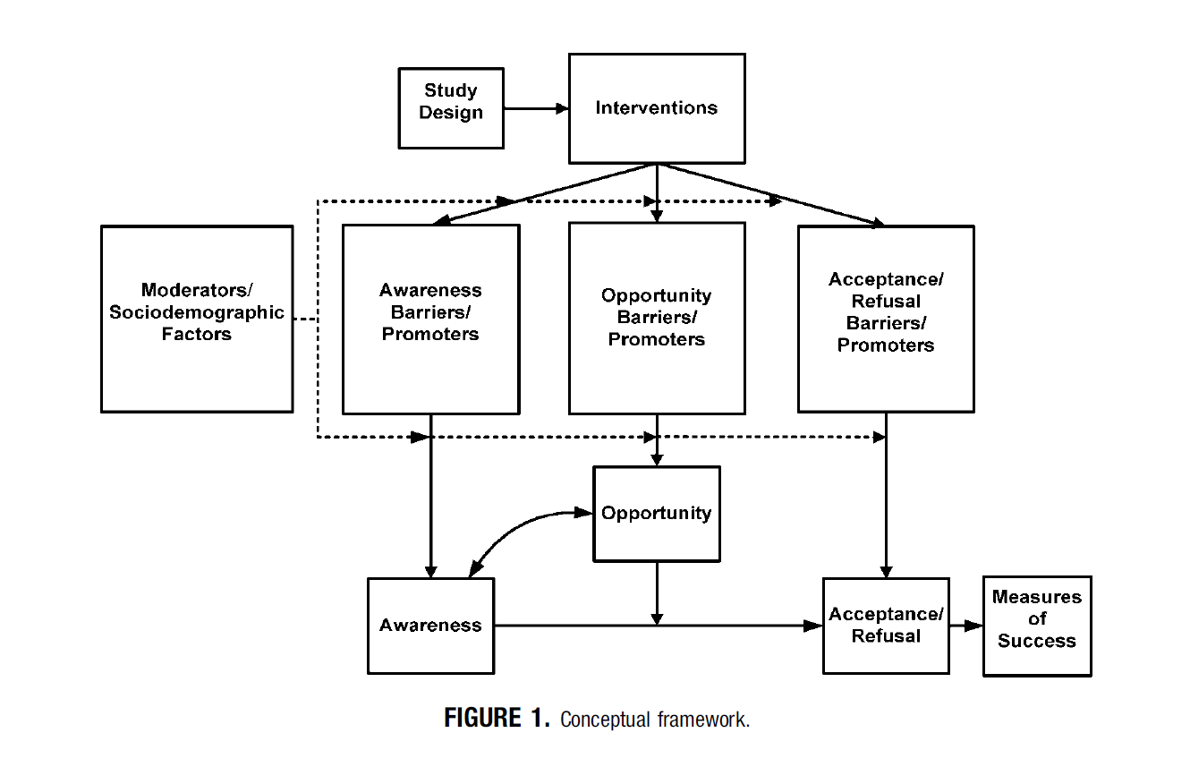
Conceptual Framework
Jean Ford et al. 2007
Notes:
This lack of attention to enrollment of minorities in clinical trials can be seen at multiple stages including the design of studies and recruitment plans, as well as, failure to report recruitment and retention results by race/ethnicity.
This limits awareness, opportunities and acceptance of clinical trials among diverse pops
Furthermore, we don’t know how race/ethnicity act to moderate participation in research. That is, does participation in trials differ by race and ethnicity for particular types of studies?
10

Slide 11
Failure to Attend to Barriers & Enhancers of Participation
History Distrust
Attitudes
Lack of Information
Notes:
There is also widespread lack of attention to barriers that have been well-documented in the literature with respect to enrollment of diverse populations in research, e.g., distrust, fear, lack of information, history of discrimination in the U.S.
African Americans more likely than whites to be ineligible due to perceived noncompliance (Penberthy L, 2012; review of therapeutic cancer RCTs)
African Ams more likely than whites to refuse due to family pressures, being overwhelemed (Penberthy L 2012)
Views that minority pts are risky-drop out (Joseph G 2012)
Enhancers of engagement in research are largely unknown

Slide 12
Trust in Researchers (%)
Neither
Agree A nor D Disagree
L and AA do not take part due to distrust 65 29 6
L and AA afraid due to discrimination 43 39 18
Studies guard health of participants 41 45 14
Participants treated as guinea pigs 30 46 24
Researchers are condescending to minorities 25 62 13
Nápoles-Springer. Research on Aging. 2000;22(6):668-691.
Notes:
In a survey of San Francisco Bay Area representatives from 117 CBOs that served Latino and African American older adults, they felt that these groups did not participate in research because of negative perceptions of research and researchers
Issues of inferior treatment of Latinos and African Americans by researchers were prevalent, such as distrust, discrimination, lack of safequards, being treated as guinea pigs, and being condescending

Slide 13
Unmet Needs of Older
African Americans and Latinos (%)
Percent Needing
Lots/Huge
Rank Unmet Need Amount of Help
1 Affordable housing 71
2 Enough money to meet needs 70
3 Transportation 60
4 Safer neighborhoods 60
5 Medical care 53
Nápoles-Springer. Research on Aging. 2000;22(6):668-691.
Notes:
When we asked key community informants n=117 (CBOs) how much help they felt older ethnically diverse adults needed on specific topics (none, a little, a lot or a huge amount of help) they ranked concerns over basic needs as being of highest priority. Medical was ranked 5th on the list.

Slide 14
How Do We Address Barriers?
Improve fit between the priorities of researchers and those of the community
AA & L community members value knowledge and desire to participate, especially if improves their own or communities’ health
AA & L are willing to participate if:
  we openly address their concerns
  we reduce barriers to participating
Nápoles-Springer. Research on Aging. 2000;22(6):668-691.
Notes:
We conducted focus groups with 34 low income African American and Latino older adults in San Francisco Bay Area
Want researchers to work with communities to address limited availability to quality health care in their communities
Want access to newest scientific advances

Slide 15
What Do We Know?

Slide 16
Current Status of R & R Science
4 Systematic reviews concluded:
Need for more systematic research
To test efficacy of specific methods
With greater methodological rigor
In specific groups
Ford JG, et al. Cancer 2007;112:228-42.
Lai G, et al. Clinical Trials 2006;3:133-141.
UyBico SJ, et al. JGIM 2007;22(6):852-63.
Yancey A, et al. Annu Rev Pub Hlth 2006;27:9.1-9.28

Slide 17

Minorities are
less willing to participate

Slide 18
When Awareness &
Opportunity Exist (N=70,000+)
  WTP compared to Whites OR 95% CI
  3 interview studies
  AA .92 (.84 – 1.02)
  Latinos 1.37 (.94 – 1.98)
  10 clinical interventions
  AA 1.06 (.78 – 1.45)
  Latinos 1.33 (1.08 – 1.65)
  Wendler D, et al., 2006. PLoS Med;3(2):e19
Notes:
Systematic review to identify all published health research
studies that report consent rates by race or ethnicity, including NHIS and NHANES
20 health research studies that reported consent rates by race or ethnicity which involved enrollment decisions of over 70,000 individuals
Dispels myth that minorities are unwilling to participate
No race/ethnic difference in WTP for interview studies
Af Ams just as WTP as Whites, and Latinos more likely to participate than Whites in clinical interventions, possibly to increased access to state-of-the art treatments.

Slide 19
What We Know about Barriers/Enhancers
Observational Data
Extensive time, expense, effort
Community is key
Culturally sensitive methods
Multiple methods = higher yield
Notes:
It has been shown repeatedly that recruiting minorities requires more effort and expense than whites. For example, the National Lung Screening Trial, a multi-center RCT used targeted strategies/additional funding in select cities, which accounted for 78% of enrolled minorities overall.

Slide 20
What We Know about What Works
Observational Data
Mass mailing is effective in African Ams, esp. mid-higher SES; referral by friend for all r/e
Personal contact is key, but expensive
Bus ads work in metro areas
Incentives – modest increase in survey response rates; timing is not important

Slide 21

Experimental RCTs of Recruitment Methods
Special issue in Community Genetics 2008; 11

Slide 22
Asians – Cancer Genetics Networks
UCI & Fred Hutchinson
RCT of 4 methods targeting Asians:
  Traditional intro letter/packet
  Trad + $20 international phone card
  Trad + pan-Asian greeting (cover sheet)
  Combo (all 3 components)
  Wenzel L, et al. Community Genetics 2008;11:234-240.

Slide 23

Personalized Greeting in 5 Asian Languages

Slide 24
Results
Site differences:
  No incentive effect for UCI site
  Fred Hutchinson – Seattle
    Greeting 4.5 x
    Phone card 3x more likely than trad only
    Combo 3x

Slide 25
Latinos – South Texas
RCT of 3 methods targeting Latinos:
  Traditional intro letter/packet
  Trad + culturally tailored magazine
  Combo (Trad + magazine + f/u call)
  Ramirez A, et al. Community Genetics 2008;11:215-223.

Slide 26

Culturally Tailored Magazine

Slide 27
Results
Traditional only: (31%)
Traditional + mag: (30%)
Combo (trad+mag+ph call) did best (43% response rate)
28% of combo group indicated they would not have joined without the call

Slide 28
Costs?
Limited cost info by method & R/E
Oncology nurse navigator at USC enrolled 86% of eligible African American patients in RCTs at cost/enrolled of $5,677
Costs/minority enrolled for NLST from $146-$749 (mail, face-to-face outreach, media)
$ for higher incentives to participants, organizational service fees, transportation, childcare, dissemination of results
Community screening sites cost more

Slide 29


Slide 30
Recruitment Planning
Multiple strategies
Cultural similarity of personnel
Make participation desirable
Nurture relationships
Anticipate losses by group & stage (awareness, opportunity, participation)
Notes:
Especially for genetics /genomics study, cultural similarity and personal approaches are essential for successful minority enrollment (Johnson VA 2011-systematic review of 6 genetics studies in African Americans)

Slide 31
Practical Recruitment Steps
Budget for varied recruitment strategies
Pretest recruitment messages and strategies
  ethnically tailored flyers, contact letters, envelopes, logos
Monitor recruitment and relationships; adjust as necessary
Report results by ethnicity to build evidence base
MAKE IT PERSONAL!

Slide 32
Academic Institution Challenges
Build credibility of research institution through community service
Increase awareness of resources available at the research institution for the community
Increase access to research info/results

Slide 33
Recommendations to Advance R & R Science

Slide 34

Recommendation 1: Include Communities

Slide 35
greater resources and effort should be directed toward researching AND INVOLVING societal groups that have the greatest capacity to benefit
(Sheikh A 2006;PLoS Med 3(2): e49.)

Slide 36
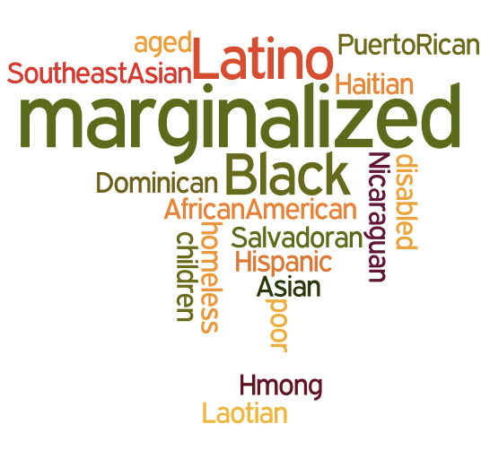
Notes:
Requires a paradigm shift from focusing on how to recruit minorities to having minority communities involved as partners in research
With shared learning and solving of health issues

Slide 37
Clinical Trials with CBPR Approaches
Systematic review of 19 studies; 14 since 2007; (n=18,818)
17 (90%) reported participants’ r/e
Minorities were majority in 13/17 studies
Recruited adequate # of minorities
89% of interventions were effective
De Las Nueces D. HSR.DOI: 10:.1111/j.1475-6773.2012.01386.x
Notes:
37

Slide 38
Recommendation 2: Increase Funding

Slide 39
Inadequate Funding
Searches of funding opps (1992-2010: search terms “recruitment or retention research”
  NIH Office of Extramural Research
  Federal Business Opportunities
    Yield = 1 contract award to generate representative sample for an NIA cohort study in diverse populations
FOAs can include a R & R subcomponent
Nápoles AM, Chadiha L; Gerontologist. 2011 Jun;51 Suppl 1:S142-6.

Slide 40
Recommendation 3: Increase Comparative Effectiveness Research (CER)

Slide 41
Interim Strategy-Nested Studies
Embed studies of the effectiveness of various R & R methods within larger studies, e.g., test supplemental materials or f/u
Examine moderators associated with R&R, e.g., individual, community or study characteristics
Conduct formative research prior to or after studies to examine enhancers/barriers

Slide 42
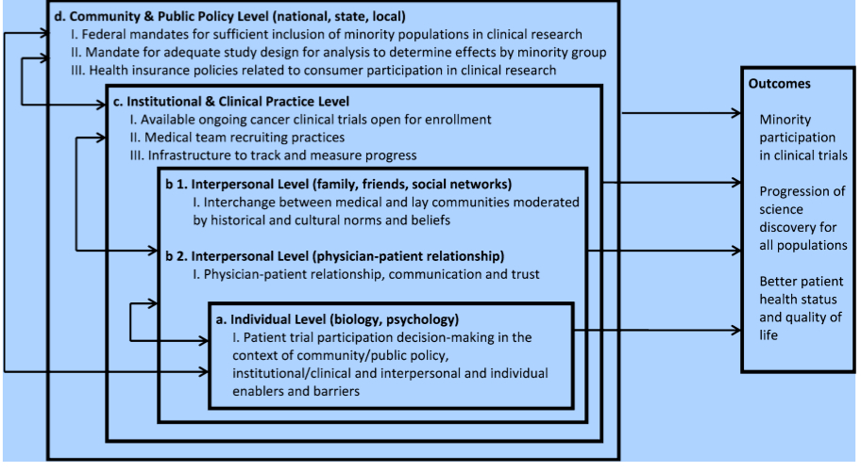
Multilevel Framework to Increase Minority Accrual
Anwuri VV. Cancer Causes Control; published online 12 July 2013
Notes:
Most R&R research and efforts have focused on individual level factors, e.g. attitudes, awareness of patients
Implemented structural changes at the institutional level , which resulted in increase from 12% minority accrual to therapeutic trials in 2005 to 14% in 2010 in a comprehensive cancer center.
Changes included:
Leadership support
Center-wide policy to require investigators define disease-specific accrual targets by race and gender based on incidence rates seen at the center
On-going monitoring and feedback policies
Baquet CR 2008 at Univ of Maryland use multi-pronged appraoches that included 1)intensive outreach, MD/Nurse education; community RCT infrastructure for 20-fold increase in CT enrollment

Slide 43

Use of Volunteer Registries
Minorities continue to be underrepresented, esp. Latinos
Will require strategic outreach
Effectiveness not yet assessed
Ex: CTSAs’ ResearchMatch has enrolled > 16,000 volunteers in 50 states; 751 researchers; 540 active studies
Harris PA, et al. 2012 Acad Med;87:66-73.
Notes:
Harris PA 2012
Research Match whites over represented relative to U.S. Census (81.2% vs. 75.1%);
African Americans underrepresented (9.9% vs. 12.3%)
Latinos underrepresented 4.7% vs. 12.5%
Harris PA 2005
Need to be careful of healthy volunteer bias; Vanderbilt University registry: volunteers are younger and more likely to be normal weight compared to census data

Slide 44
Implications
Need CER on more intensive R&R methods for underrepresented
Requires increased funding
Nesting R&R studies within studies is an interim solution for low intensity methods
Notes:
44

Slide 45

Conclusions
Recruitment of diverse groups is an equity issue
Working closely with minority communities in all phases of research can facilitate
  research that is relevant to their perspectives
  participation
  effectiveness
  translation/sustainability

Slide 46
APPLY RESULTS/
ID NEXT STEPS
AWARENESS
DISSEMINATE
INVITATION
FEEDBACK
RESULTS
OPPORTUNITY
PARTICIPATION
Notes:
WHAT WOULD HAPPEN IF WE INVOLVED END-USERS OF RESEARCH FINDINGS THROUGHOUT THE PROCESS?
HAVE WE DONE ENOUGH? WE HAVE BARELY SKIMMED THE SURFACE WITH RESPECT TO THE RIGHT SIDE OF THE CIRCLE.
WE HAVE A LONG WAY TO GO TO ACT ON THE LEFT SIDE WHICH INCLUDES DISSEMINATING THE RESULTS AND APPLYING THEM TO ADDRESS CANCER HEALTH DISPARITIES IN PARTNERSHIP WITH THE COMMUNITIES THAT EXPERIENCE THOSE DISPARITIES AND THEIR CLINICIANS.

Slide 47

What’s in it for My Community?

Slide 48
Resources
Community-Campus Partnerships for Health
http://depts.washington.edu/ccph
National Institute of Mental Health
http://www.nimh.nih.gov/funding/grant-writing-and-application-process/recruitment-points-to-consider-6-1-05.pdf

