Slide 1
Epi 150.03: Designing Clinical Research
Introduction to the Course &
The Research Question
Peter Chin-Hong MD
Professor of Medicine
UCSF
August 4, 2014

Slide 2
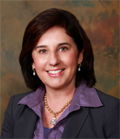
Miriam Kuppermann
Department of Obstetrics and Gynecology

Slide 3
Outline
About this course
The research question

Slide 4
Outline
About this course
The research question

Slide 5
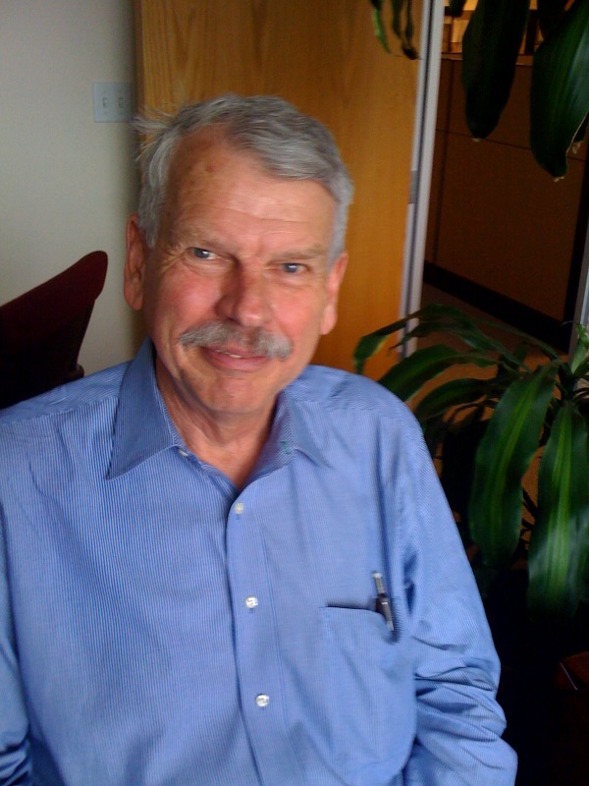
About the course
Began > 30 years ago
Also known as the “Hulley Course”
Steve was the leader for the text (DCR) and designed the course, homework, and instructions to section leaders
Steve Hulley

Slide 6
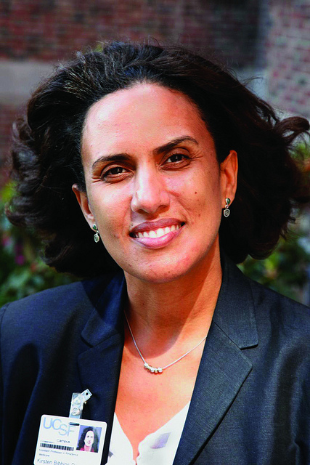
About This Course
Kirsten Bibbins-Domingo
  Director until 2011

Slide 7
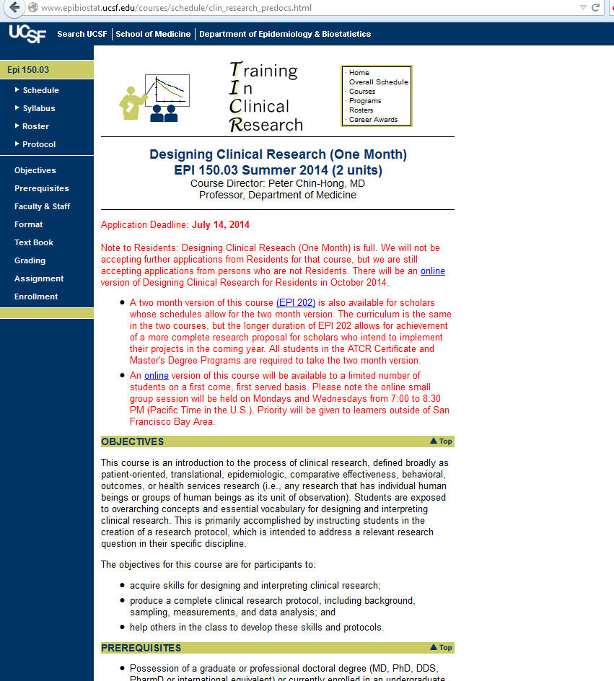
Website
Google “Epi 150.03” or “DCR UCSF” or find from TICR home page
Course roster, schedule, rooms, readings, PowerPoint files (when available)
Links to recordings of lectures

Slide 8
Website
Google “Epi 150.03” or “DCR UCSF” or find from TICR home page
Course roster, schedule, rooms, readings, PowerPoint files (when available)
Links to recordings of lectures

Slide 9
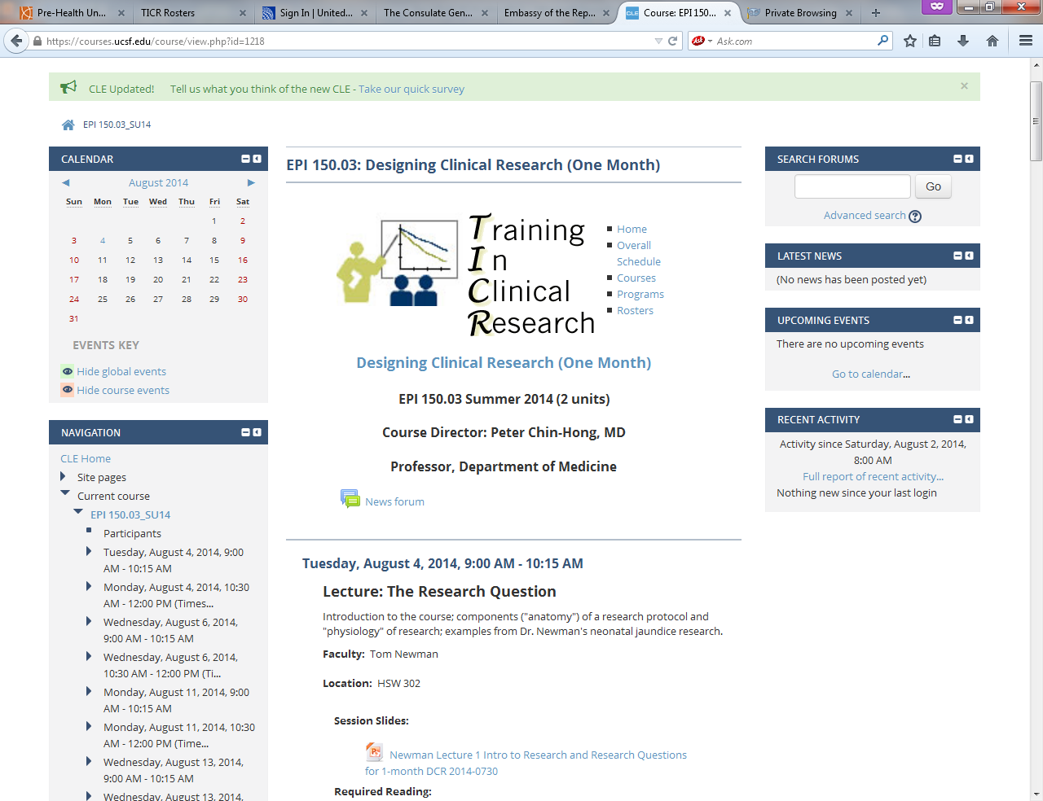

Slide 10

About the reading
DCR-4 includes exercises and answers at the end of the book
  We recommend jotting down answers before reading ours
  Can discuss in section but usually won’ t be turned in
Try Inkling®
Let us know your suggestions for improving the book
Notes:
Survival Guide for Generalist Physicians in Academic Fellowships.

Slide 11

About the reading
Recommended reading this week
Evidence-Based Diagnosis (EBD) text also recommended; you’ll need it for Epi 204
Notes:
Survival Guide for Generalist Physicians in Academic Fellowships.

Slide 12
Course objectives
    1. Learn about how to design and do clinical research
    2. Produce a protocol for a study
    3. Help others in the workshop
    4. Provide feedback on the workshop
    5. Have a multiplier effect

Slide 13
Course ingredients
      Aug 4 − Lectures (9:00 – 10:15)
      Aug 27 * Selected issues from DCR 4 text and examples
      Sections (10:30 – 12:00)
      * Protocol components
      * More issues from the text
      * Helping and getting to know your classmates
      Aug 25 5-page protocols due
      Aug 27, tba Protocol review sessions
      * In pairs and trios, new faculty

Slide 14
Grades, attendance, interruptions
5-page protocol must be turned in to pass
  Protocol review sessions on August 27
Gold star sticker:
  No unexcused absences
  No more than 1 missing or late homework
  Help your colleagues with their protocols
Class time is sacred
  Do not answer cell phones or pages except emergencies
  If clinical responsibilities will interfere, please arrange coverage or take this class another time

Slide 15
Faculty for sections 2014
Name | Field
Andrew Avins | Medicine
Dejana Braithwaite | Epidemiology
Helen Kim | Anesthesia
Kala Mehta | Medicine/Geriatrics
Diana Naranjo | Pediatrics
Eleni Linos* | Dermatology
Amy Hsu | Medicine/Geriatrics
Sara Kalkhoran | Medicine
Nicole Ling | Pediatrics/Rheumatology
Jonathan Singer | Medicine/Pulmonary
Betty Smoot | Physical Therapy
*E-section

Slide 16
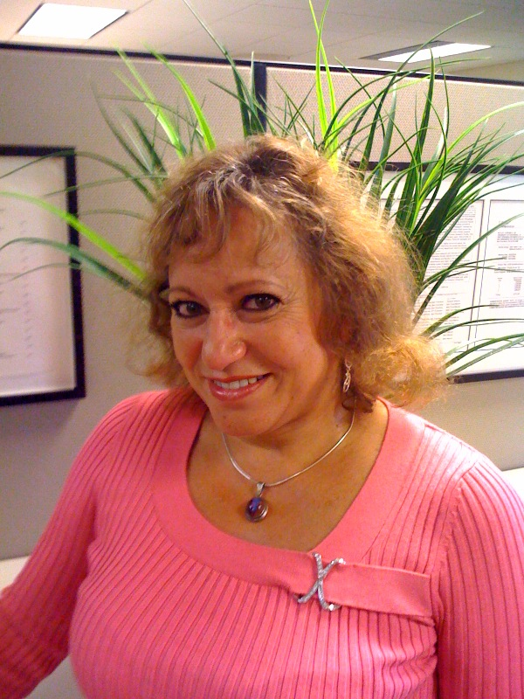
Course coordinator
    Olivia De Leon
      Olivia@epi.ucsf.edu
      514-8231 (tel)
      514-8150 (fax)
    (Please let her know if your email address changes by sending her an email from the new address)
Olivia De Leon

Slide 17
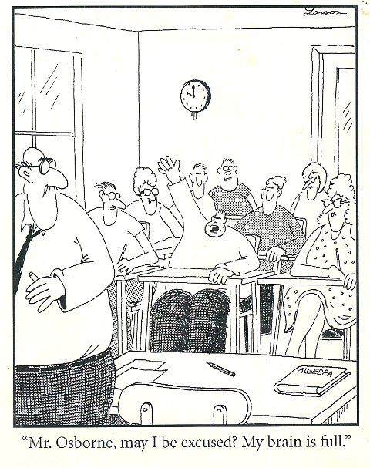
Questions?
Notes:
12.5 min to this point if few or no questions

Slide 18
Outline
About this course
The research question

