Slide 1
Sample Size and Power
Steven R. Cummings, MD
Director, S.F. Coordinating Center

Slide 2

The Key to Long Life?
Resveratrol
In the skin of red grapes
Makes mice
  Run faster
  Live longer

Slide 3
The Key to Long Life?
Resveratrol
In the skin of red grapes
Makes mice
  Run faster
  Live longer
Mimics ‘sirtuin:’
senses energy; controls DNA transcription; produces more
mitochondria.

Slide 4
What I want to show
Consuming resveratrol prolongs healthy life

Slide 5
What I need to know:
Ingredients for Estimating Sample Size
Testable hypothesis
Type of study
Statistical test
  Type of variables
Effect size (and its variance)
Power and alpha

Slide 6
Sample Size Ingredients
Testable hypothesis
Type of study
Statistical test
  Type of variables
Effect size (and its variance)
Power and alpha

Slide 7
My research question
Does consuming resveratrol lead to a long and healthy life?

Slide 8
What’s wrong?
Does consuming resveratrol lead to a long and healthy life?
Vague
To estimate sample size, it must be a testable hypothesis

Slide 9
“Consuming resveratrol”
I could measure resveratrol intake in a cohort, then follow-up for survival free of disease…

Slide 10


“Consuming resveratrol”
The most rigorous design: randomized placebo-controlled trial
Comparing red wine to placebo would be difficult
But resveratrol supplements are widely available

Slide 11
A specific predictor
“Consuming resveratrol”
Resveratrol supplements vs. placebo

Slide 12
I need a measureable outcome
“Prolongs healthy life”
Lower mortality rate

Slide 13
The question is becoming a hypothesis
Do people randomized to get a resveratrol supplement have a lower mortality rate than those who get a placebo?

Slide 14
I must specify the population
Do people randomized to get a resveratrol supplement have a lower mortality rate than those who get a placebo?

Slide 15
In whom?
Elderly men and women (≥70 years)
  Because the question applies to both genders
  Because they have a relatively high mortality rate
    I’ll have enough ‘events’ within a feasible period of study

Slide 16
The research hypothesis
(AKA the‘alternative’ hypothesis)
Men and women > age 70 years randomized to get a resveratrol supplement have a lower mortality rate than those who get a placebo.
However, it cannot be tested statistically
Statistical tests only reject null hypothesis - that there is no effect

Slide 17
The Null Hypothesis
Men and women > age 70 years randomized to receive a resveratrol supplement do not have lower mortality rate than those who receive placebo
Can be rejected by statistical testing

Slide 18
Ingredients for Sample Size
 Testable hypothesis
Type of study: Descriptive or Analytical

Slide 19
Descriptive studies
Only one variable
Sample size is based on the desired width of the confidence interval
What proportion of centenarians (≥100 years old) take resveratrol supplements?
  Confidence interval for proportions
What is the mean red wine intake of centenarians?
  Confidence interval for the mean

Slide 20
Descriptive studies
Only one variable
Sample size is based on the desired width of the confidence interval
What proportion of centenarians (≥100 years old) take resveratrol supplements?
  Confidence interval for proportions
What is the mean red wine intake of centenarians?
  Confidence interval for the mean
Not covered today

Slide 21
Analytical studies
Predictor and outcome variable(s)
Comparisons
  For example:
  Compare the mean red wine intake in centenarians vs. 60-80 year olds
  People who get resveratrol have lower mortality than those who get placebo

Slide 22
Ingredients for Sample Size
 Testable hypothesis
 Type of study: analytical (RCT)
Statistical test
  Type of variables
Effect size (and its variance)
Power and alpha

Slide 23
Type of statistical tests
Depends on the types of variables
This works for
most study planning

Slide 24
The types of variables?
Men and women > age 70 years randomized to receive a resveratrol supplement do not have lower mortality rate than those who receive placebo
Dichotomous: resveratrol or placebo
Continuous: mortality rate

Slide 25
The types of variables?
Men and women > age 70 years randomized to receive a resveratrol supplement do not have lower mortality rate than those who receive placebo
Dichotomous: resveratrol or placebo
Continuous: mortality rate
What’s wrong?

Slide 26
The types of variables?
Men and women > age 70 years randomized to receive a resveratrol supplement do not have lower mortality rate than those who receive placebo
Dichotomous: resveratrol or placebo
Continuous: mortality rate
  It is a proportion at certain times
  For example, 3% at 1 year

Slide 27
The appropriate test for this randomized trial for mortality

Slide 28
Ingredients for Sample Size
 Testable hypothesis
 Type of study: analytical (RCT)
 Statistical test
   Type of variables
Effect size
Power and alpha

Slide 29
Estimating the effect size
For randomized trials,
Start with the expected rate in the placebo
Usually available from population or cohort studies
In this case, we know the mortality rates by age:
3-4% per year*; for a 3 year study: 10%
* ~ mean annual female/males @ 78 yrs

Slide 30
Effect size the hardest part
What should I assume for the effect of resveratrol on mortality?

Slide 31
Effect size the hardest part
Ways to choose an effect size:
What is likely, based on other data?
Do a pilot study
Estimate based on effect on biomarkers
What difference is important to detect?
  “We don’t want to miss a __%_ difference”
What can we afford?

Slide 32
The effect of resveratrol on mortality rate?
What is likely, based on other data?
  No data in humans!

Slide 33
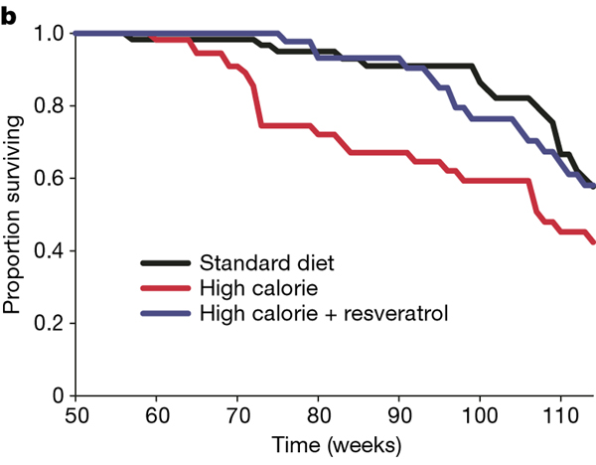
Resveratrol pronged survival of mice fed high calorie diet
~ 25%
Baur, Nature 2006

Slide 34
The effect of resveratrol on mortality rate?
What is likely, based on other data?
Pilot study??
  Small pilot studies generally produce unstable estimates of effects and variance

Slide 35
The effect of resveratrol on mortality rate?
What is likely, based on other data?
Do a pilot study
Estimate based on effect on biomarkers
  Biomarkers for mortality and effect of resveratrol?

Slide 36
The effect of resveratrol on mortality rate?
What is likely, based on other data?
Do a pilot study
Estimate based on effect on biomarkers
What difference is important to detect?
  I don’t want to miss a 1% decrease!
What can we afford?
  1%: the trial will be too big & expensive
  5%: the study will be smaller and cheaper

Slide 37
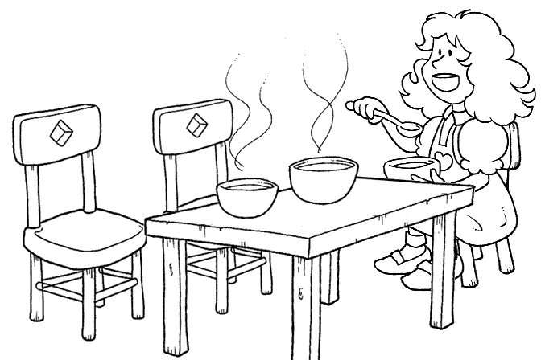
The Science of Effect Sizes
Too large!
Smaller effect is important to health
Larger effect is important for your budget
5%

Slide 38
The Science of Effect Sizes
Too large! Too small!
Smaller effect is important to health
Larger effect is important for your budget
5%
1%

Slide 39
The Science of Effect Sizes
Too large! Too small! Just right!
It requires
good judgment,
balancing science
and feasibility
Smaller effect is important to health
Larger effect is important for your budget
2%
5%
1%

Slide 40
Effect size
Men and women > age 70 years randomized to receive a resveratrol supplement do not have lower mortality rate than those who receive placebo
It would be important to find (I don’t want to miss) a 20% decrease
Placebo rate: 10%
Resveratrol rate: 8%

Slide 41
Ingredients for Sample Size
 Testable hypothesis
 Type of study: analytical (RCT)
 Statistical test
   Type of variables
 Effect size (and its variance)
Power and alpha

Slide 42
α (alpha)
The probability of finding a ‘significant’result if nothing is going on
“Type 1 error”

Slide 43
To convince people that an effect is not due to chance
Customarily, a result is ‘statistically significant’ if P<0.05
In other words,
Probability of a type I error = 5%
α (alpha) = 0.05

Slide 44
I will need to convince skeptics
Very small chance that a positive result is an error
α (alpha) = 0.01
P<0.01
A smaller α means larger sample size

Slide 45
Two-sided vs. one-sided α
A 2-sided α assumes that the result could go either way
  Recognizes that you have two chances of finding something that isn’t really there
    Resveratrol decreases mortality
    Resveratrol increases mortality
A 1-sided hypothesis assumes that the result could, plausibly, go only one way

Slide 46
One-sided α
You may believe that your effect could only go one way!
  Resveratrol is‘natural.’ It could not increase mortality!
Be humble.
  The history of research is filled with results that contradicted expectations

Slide 47
One-sided α?
There is a universal consensus: vitamin D is good for muscle and bone!
Vitamin D trial (Sanders et al, JAMA 2010):
  ~1500 IU of vitamin D/d
  Significantly increased the risk of falls and fractures in elderly women and men
A 1-sided test is almost never the best choice

Slide 48
β (beta)
The probability of missing this effect size in this sample, if it is really true in the populations
AKA Type 2 error

Slide 49
Power (1- β)
The probability of finding this effect size in this sample, if it is really true in the population

Slide 50
If it’s true, I don’t want to miss it
The chance of missing the effect (β)
is “customarily” 20%
In other words
Probability of a type II error = 0.20
β (beta) = 0.20
Power = 1- β : 0.80
“80% power”

Slide 51
I really don’t want to miss it
β = .10
Power (1- β) = 0.90
Greater power requires a larger sample size

Slide 52
We have all of the ingredients
 Testable hypothesis
 Type of study: analytical (RCT)
 Statistical test: Chi-squared
 Effect size 10% vs 8%
 Power: 0.90; alpha: 2-sided 0.05

Slide 53
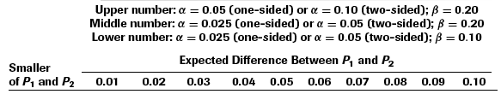
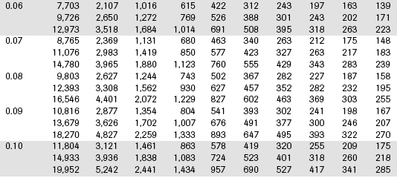
From Table 6B.2
Comparing two proportions
2-sided α = 0.05
Power = 0.90
Treatment
rate

Slide 54
From Table 6B.2
Sample size: 4,401
Per group!
Total: 8,802
Does not include drop-outs
  20% drop-out: 11,002 total sample size!

Slide 55
Appropriate responses
Shock and awe
Depression
Anxiety
Consider alternative approaches

Slide 56
Alternatives
Tweak α: one-sided
  Almost never appropriate
Tweak the power: 0.80

Slide 57
From Table 6B.2
Comparing two proportions
2-sided α = 0.05
Power = 0.80
Treatment
rate

Slide 58
Alternatives
Tweak α: one-sided
  Almost never appropriate
Tweak the power: 0.80
  Modest effect: 3,308 (6,616 total)
  (not including loss to follow-up)

Slide 59
Alternatives
Increase the effect size
  10% vs. 6% (4% difference)
  40% reduction

Slide 60
From Table 6B.2
Comparing two proportions
Treatment
rate

Slide 61
Increasing the effect size
10% vs. 6%
Makes a big difference!
769 / group; 1,538 total (no dropouts)
However, still large (and not affordable)
Not believable

Slide 62
Alternatives: a new hypothesis
Change the outcome measure
  Continuous measurement
  A precise measurement
A‘surrogate’for mortality rate:
  Strongly associated with mortality rate
    and
  Influenced by resveratrol
Walking speed

Slide 63
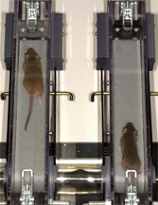
Mice on resveratrol
Mice fed resveratrol
  Live 25% longer
  Run faster
  Have greater endurance

Slide 64
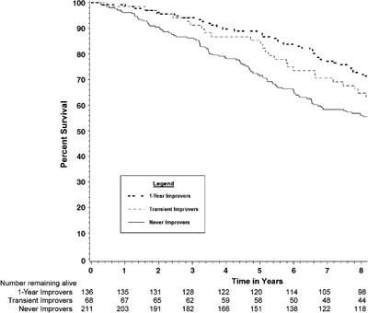
People who walk faster live longer
Faster by ≥0.1 m/s
Slower
~20% decreased
mortality rate

Slide 65
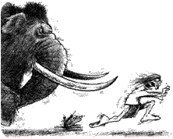
Fast walkers have lower mortality
An evolutionary perspective

Slide 66
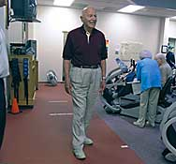
Walking speed
Easy and cheap!
Measure time over a 6 meter course

Slide 67
New endpoint needs a new hypothesis
Among 70 year old men and women, those randomized to resveratrol will not have a greater change in walking speed than those assigned to placebo.

Slide 68
The new ingredients
 New testable hypothesis
 Type of study: analytical (RCT)
 Statistical test?
  Continuous variable
  Difference between means

Slide 69
Type of statistical tests
Depends on the types of variables

Slide 70
The new ingredients
 New testable hypothesis
 Type of study: RCT
Statistical test: t-test
Effect size: “standardized effect size” E/S

Slide 71
Standardized effect size: E/S
Sample size depends on the ratio of E/S
  E: Effect size (difference in means)
  S: Standard deviation for measurement
You need smaller sample size if
  Greater effect (E)
  More precise measurement (lower SD)

Slide 72
Effect size for change in walk speed?
Faster by ≥0.1 m/s
Slower
~20% decreased
mortality rate

Slide 73
Human cohort studies
0.1 m/s corresponds to a 20% decreased mortality rate
Faster by ≥0.1 m/s
Slower
~20% decreased
mortality rate

Slide 74
What we need to determine E/S for our trial
Effect size (E) for change in walking speed
  Decline in the placebo group = -0.1 m/s
  Prevented by resveratrol = 0 m/s
  Difference (effect size) = 0.1 m/s

Slide 75
What we need to determine E/S for our trial
Effect size (E) for change in walking speed
+0.1 m/s
I need S: Standard deviation
Standard deviation of the change

Slide 76
S
Standard deviation for the measurement
  Cross-sectional data: 0.25 m / sec
However, we are interested in change
Standard deviation of change in speed?
  Often more difficult to find because cross-sectional surveys are more common than longitudinal studies

Slide 77
What if you don’t know the SD?
Standard deviation of change in speed?
If you cannot find data from other studies
Alternatives
  Pilot study: measure change in gait speed over 6 mos?
  A well educated guess

Slide 78
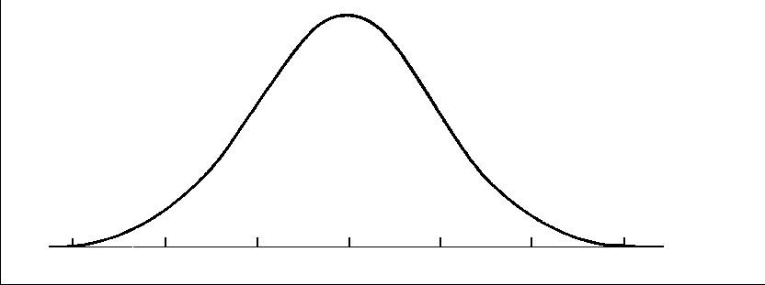
Estimating an S.D.
The 1/4 rule
~ 4 S.D.s across a ‘usual’ range of values
So, 1 S.D. will = about 1/4 of the range
Number
of
people

Slide 79
Estimating an S.D.
The 1/4 rule
~ 4 S.D.s across a ‘usual’ range of values
Number
of
people
Change in walking speed

Slide 80
Estimating S.D. for change in walking speed using the 1/4 rule
Range of changes over 3 years*
+0.2 m/sec to -0.6 m/sec
  Based on ‘experience’ or informed guess
Range = 0.8 m/sec
1/4 of the range = 0.2 m/sec

Slide 81
E/S
E: Effect size: 0.1 m/sec difference in change
S: Standard deviation: 0.2 m/sec
E/S = 0.5

Slide 82
The new ingredients
 New testable hypothesis
 Type of study: analytical (RCT)
 Statistical test: t-test
  Continuous variable
  Difference between means
Effect size: 0 vs. 0.1 m/sec change
  E/S = 0.5
 Power: 0.80; 2-sided alpha: 0.05

Slide 83
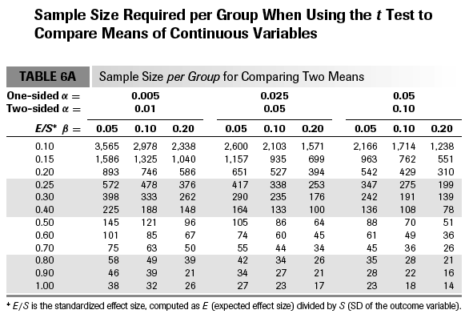

Slide 84
The new ingredients
 New testable hypothesis
 Type of study: analytical (RCT)
 T-test
 Effect size: E/S = 0.5
 Power: 0.80; alpha: 0.20
Sample size: 64 per group; 128 total
With 20% drop out: 160 total

Slide 85
Improving precision
Increased precision (decreased SD) will decrease the sample size
Ways to increase precision:
  Take the mean of repeated 6m walks
  S.D. improves from 0.2 to 0.15 m/sec
E/S improves from 0.5 to 0.1÷ 0.15 = 0.7

Slide 86
A modest improvement in precision
reduced sample size by 1/2

Slide 87
Summary
Estimate sample size early
Systematically collect the ingredients
Effect size is the most difficult - and important - judgement
Alternatives that reduce sample size
  Compromise power
  Increase effect size
  Use precise continuous outcomes

Slide 88
Thank you

