Slide 1


EndNote for Research and Collaboration
Evans Whitaker, MD, MLIS
evans.whitaker@ucsf.edu
Downloaded from UCSF Library Box 7/2/21
https://creativecommons.org/licenses/by-nc/4.0/

Slide 2
Preliminaries
This is a hybrid class
  In-person, please ask questions so that those online can hear
  On-line, I will keep you muted, use Chat to ask questions
Links to class materials
  PowerPoint: http://tiny.ucsf.edu/4pfmFH*
  Handout: https://ucsf.box.com/s/z8axagvo8yua7s6h4srq1dcp6h3y90t4
  EndNote Basic (online account): http://endnote.com/product-details/basic

Slide 3
Buying a copy
UCSF does not purchase access to EndNote
  Your lab, PI, grant might
EN X9 is available on OnTheHub
  $114 for students
  $219 for faculty/staff (list price is $249)
  $99 for the upgrade to X9
  As of 2/20/19, price to UCSF folks is in flux
  https://onthehub.com/download/software-discounts/endnote )
There is a free, underpowered online version

Slide 4
Goal for today
I would like you to leave with a working version of EndNote
-- OR –
At least to understand how to set up and use EndNote
How will we do this?
The handout provides an approach to learning EndNote with a lot of hands-on time

Slide 5
Outline
Set up
  Orientation to key pieces
    Set preferences
  Desktop version
  Online version
Use
  Adding information
    From databases, websites
      Adding PDFs
        Those on your computer
        By having EndNote retrieve them for you
  Organizing information
  Removing duplicates
  Adding in-text citations and a reference list to a Word document

Slide 6


Access to UCSF Resources
Use UCSFwpa on campus
MyAccess vs. VPN
  Only applies when
  you are off-campus (= not on wpa)
Bookmark
  library.ucsf.edu
  pubmed.ucsf.edu
  uptodate.ucsf.edu
Bookmarklet – Install on your computer
Notes:
Before we go furtther

Slide 7
Context
EndNote is one of several reference managers. All do the same thing: store and organize your information material and help you cite and add references to a paper.
Pros:
  Industry standard
  Powerful
  Spun off from parent company recently
  Fetch PDFs of articles as a batch
Cons:
Costs money
Steeper learning curve
Lag in development for last several years with previous parent company
Competitors:
  RefWorks (free to UCSF) // F1000 (free to UCSF), Zotero (free, open source), Mendeley (free*), Read Cube and Papers have merged ($3/mo students, $5/mo academic), PaperPile ($2.99/mo), and others

Slide 8
Set Up

Slide 9
The Parts of the Installation
EndNote desktop – Mac and/or Windows
EndNote Basic AKA EN Online, EN Web
CiteWhileYouWrite (for Word and Pages(Mac))
Capture Reference
  Adds website
  information to EndNote
To install:
Google→EndNote online
Create account and log-in
Under Options:
Download Installers
Drag Capture Reference to Bookmark toolbar of browser

Slide 10
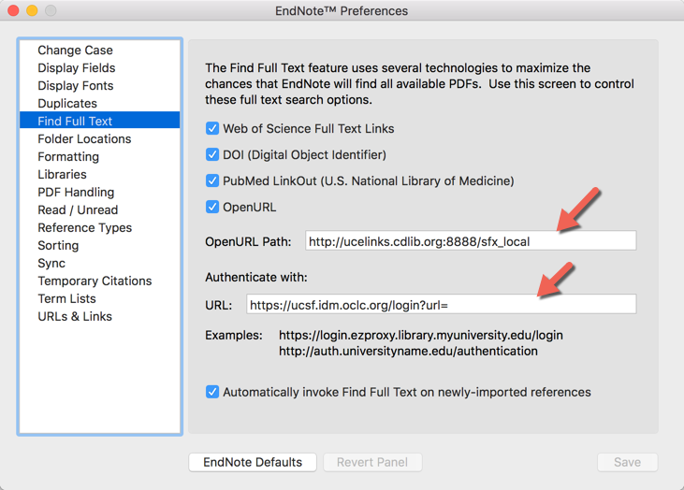
Set Preferences

Slide 11
Using EndNote

Slide 12
Use
Importing Articles into EndNote
Most frequent problem with importing information to EndNote:
  You did not “tell” EndNote where the material is coming from
  Import will fail…

Slide 13
Use
Importing Articles into EndNote
From PubMed – a 3 step process
From other databases
  Embase – multistep, like PubMed
  Web of Science
  PsycINFO
From GoogleScholar – set Scholar preferences for EndNote
From webpages – use Capture Reference bookmarklet
  (warning: widely variable quality of information)
From UCSF Library “Single Search”
PDFs on your computer

Slide 14
Use
Organizing your library
Two layers of organization possible
Use Groups and drag-and-drop
Create Group Sets

Slide 15
Removing Duplicates

Slide 16
Retrieving Full Text
A strength of EndNote
In our environment EN successfully finds about 2/3 of articles.

Slide 17
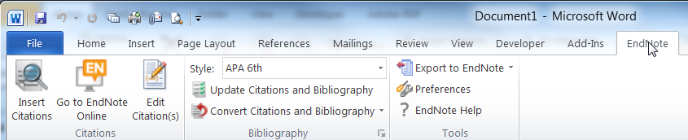

Use
Formatting a Word Document
In EndNote for Windows
In EndNote for Mac with Word 2008, 2012
In EndNote for Mac with Word 2016
    There is a tab like on a Windows machine

Slide 18

That’s it! Contact me with ?s

