Slide 1

A to with Zotero
Evans Whitaker, MD, MLIS
UCSF Library
evans.whitaker@ucsf.edu
Downloaded from UCSF Library Box 7/2/21
https://creativecommons.org/licenses/by-nc/4.0/

Slide 2
Materials
Link to handout:
  http://tiny.ucsf.edu/ts9dTT
Link to PowerPoint (you likely won’t need it)
  http://tiny.ucsf.edu/tTXbgs

Slide 3
Why Zotero? Why not?
Pros
  It is like an “A-minus” student, pretty good at everything
  Reference managers are not graded on a curve; there are no “straight-A students” in the class
  Free
  Open source
  Sharing with collaborators
  Easy to use
Cons
  Sluggish with very large libraries (>5000-10,000)
  Not designed to attach a PDF to everything in your library
  Set up is a bit tricky

Slide 4
Today’s Session
Goal:
Leave class with your computer set up to use Zotero
AND with some practice in using Z to store and organize information and add citations and references to a Word document.
Objectives:
Create Zotero account
Install Zotero 5.0, Word plugin, and browser plugins
Configure Zotero
Use Zotero to save information from websites, article databases and more
Format references in a Word document in AMA/APA style using Zotero

Slide 5
Context
Full reference manager software
  Store
  Organize
  Format Word
Why Zotero?
  Free (for all but heavy users)
  Open source
  Large, active user group – estimated 1–1.5 M July ’14
  Established – Version 1 dates from 2006
Why haven’t I heard of it?
  Z comes from the Social Sciences
  what you find

Slide 6
Can you install it?
Windows machine
  OS XP SP2 and later
  Word 2003 and later, except Word 2010 Starter
Mac
  MacOS has 10.9 or higher
  Word processor:
    Word for Mac 2004 and later
    Also works with LibreOffice and OpenOffice
    Does not work with Pages, G Docs
Linux

Slide 7




Cloud presence
You synchronize
the two
Local computer presence

Slide 8
Preliminaries
Shut down all applications
Reopen your favorite browser
  Z only works with Firefox, Chrome, Safari

Slide 9
Go to Zotero.org
Register for an account
Download Zotero 5.0
Acknowledge email from Zotero
Log in to online Zotero
Install Zotero on your computer

Slide 10
Set Preferences
In desktop Zotero
Open Preferences
  PC → Tools menu (called Options)
  Mac → Zotero menu

Slide 11
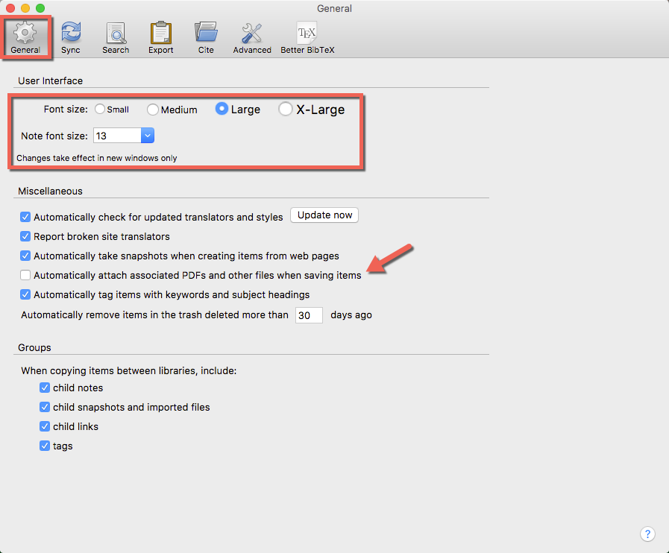

Slide 12
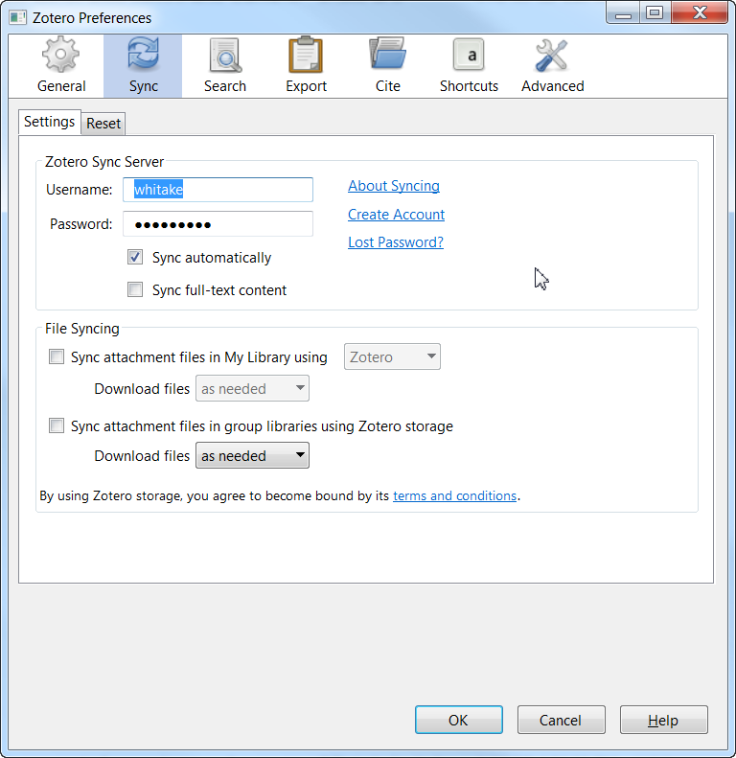

Slide 13
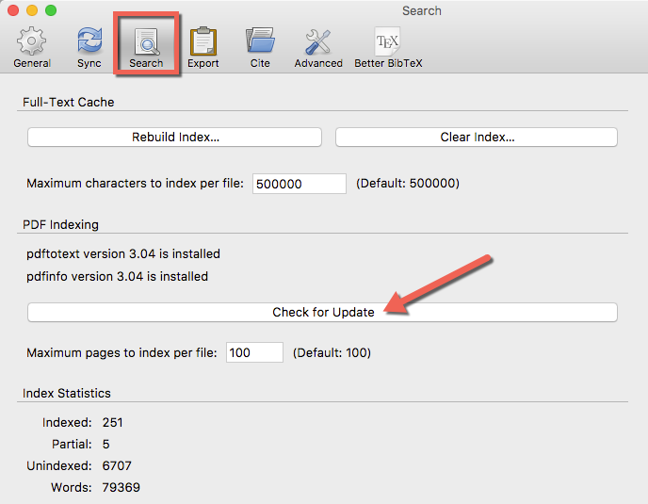

Slide 14
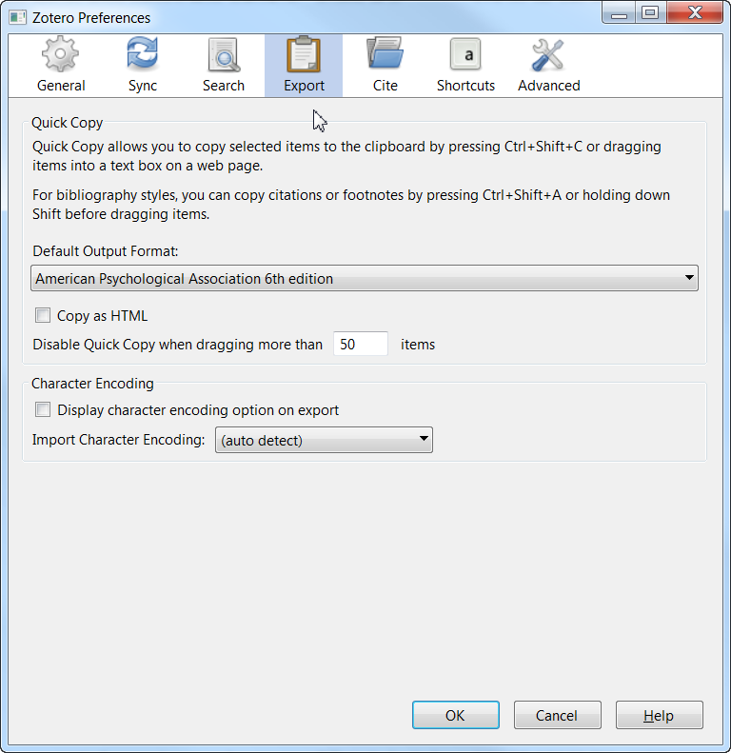

Slide 15
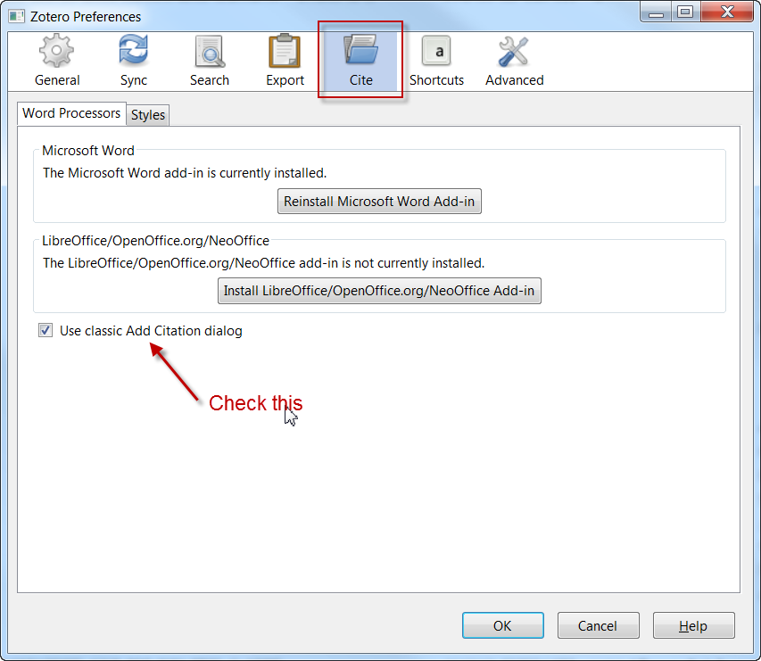
Under this tab, find the installed styles available to you. Need something else? Go to “Get additional styles” at bottom of page, find what you want double click to download, double click downloaded file to install, and then close preferences to finish

Slide 16
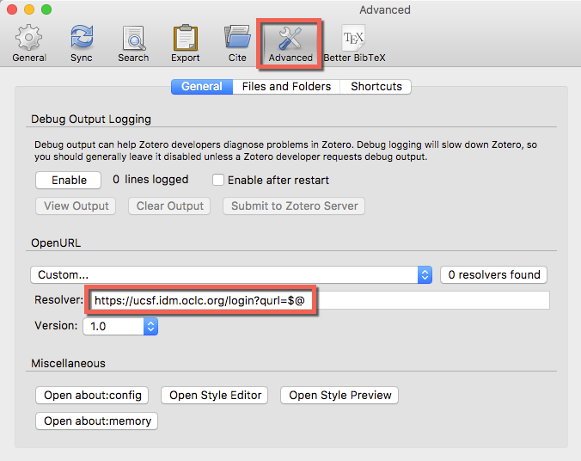
http://ucelinks.cdlib.org:8888/sfx_local

Slide 17
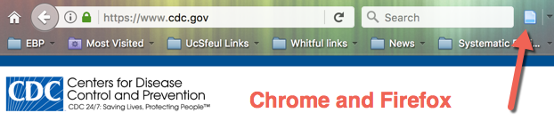

Test Zotero
Go to CDC.gov in browser
  Use you default browser …
Look for icon from Zotero
Looks like:
Looks like:

Slide 18
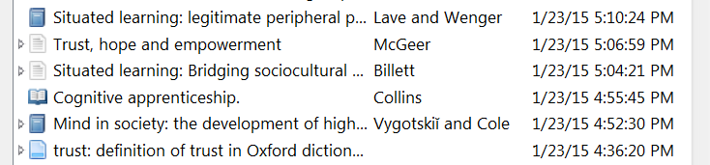
Zotero icons
Book
Journal Article
Book chapter
Webpage
And yes, this one as well…
The folder means there are several articles on one page

Slide 19
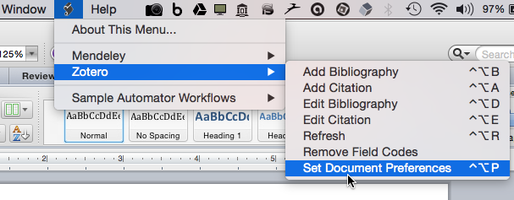
Test Zotero ⬅➔Word Mac 2008
Open Word:
Set APA 6th

Slide 20
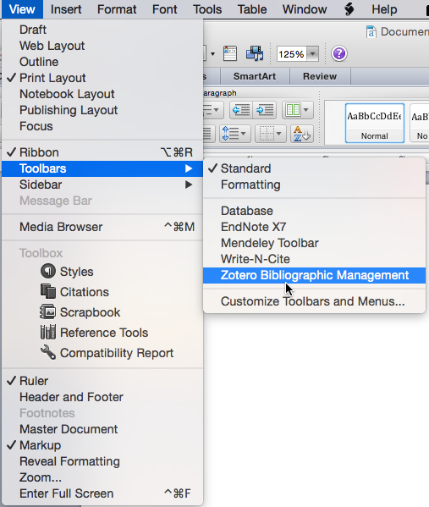

Test Zotero ⬅➔Word Mac 2011
Only looks like this in Word for Mac 2011
Make sure this is checked to show tool bar
The first is insert citation
The third is insert bibliography

Slide 21
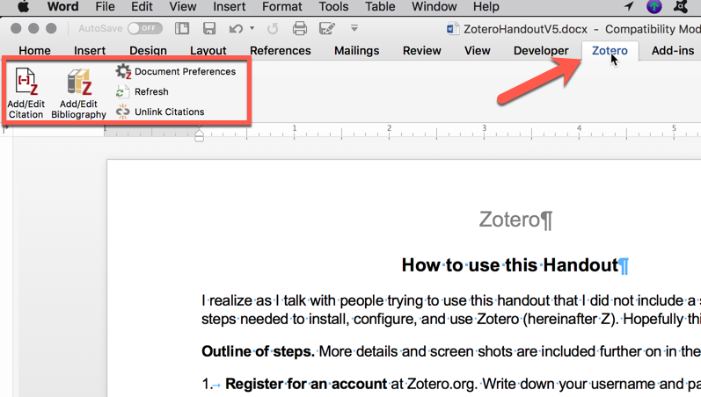
Test Word for Mac 2016

Slide 22
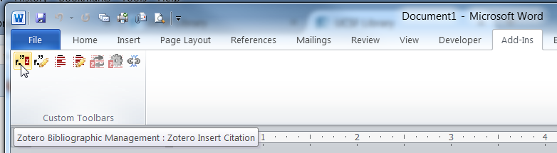
Test Word on Windows 2007
Zotero tool bar
Click Add-Ins tab to see the tool bar

Slide 23
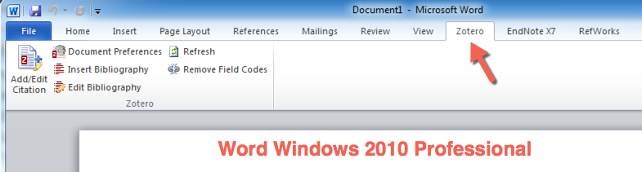
Test Word for Windows 2010

Slide 24
Working with Zotero
PubMed (same in Web of Science, PsycINFO, ERIC, Sociological Abstracts)
Embase
Scholar
Webpage
PDFs

Slide 25
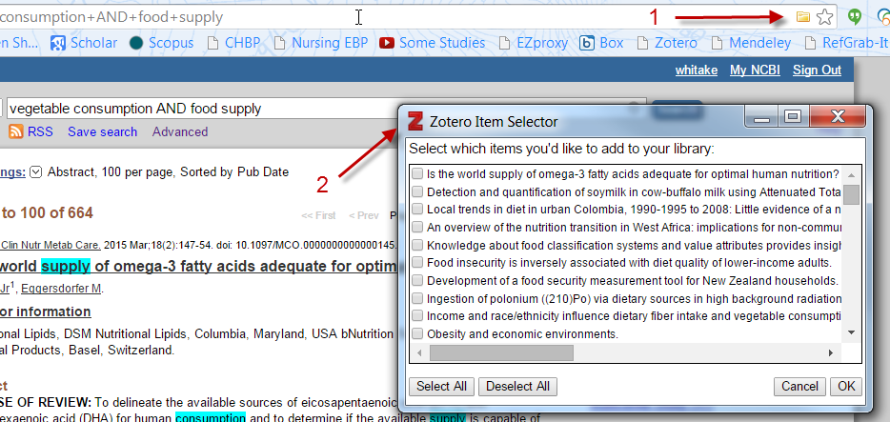
PubMed
Search
Click Folder icon (1)
Select articles you want from Zotero Item Selector (2)
Click OK

Slide 26
Working with Zotero
PubMed
Embase (browser plug in does not work, export RIS file from Embase→ import that into Zotero
Scholar
Webpage
PDFs

Slide 27
Working with Zotero
PubMed
Embase
Scholar (my advice, add one by one) from the page linked to by Scholar
Webpage
PDFs

Slide 28
Working with Zotero
PubMed
Scopus
Scholar
Webpage
PDFs
Just as in our CDC.gov test (caveat, double check accuracy)

Slide 29
Working with Zotero
PubMed
Embase
Web of Science
Scholar
Webpage
PDFs

Slide 30
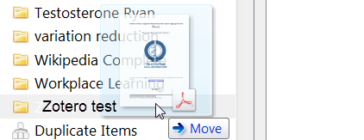
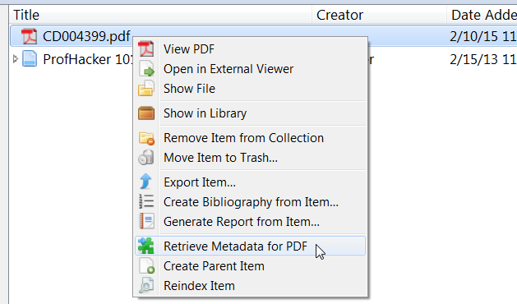
PDFs
Add a PDF to your Zotero library
Drag the file name to Zotero
2. Right click (two finger click on Mac trackpad)
Select Retrieve…
Z looks for information about the PDF
Works >90% of the time.

Slide 31
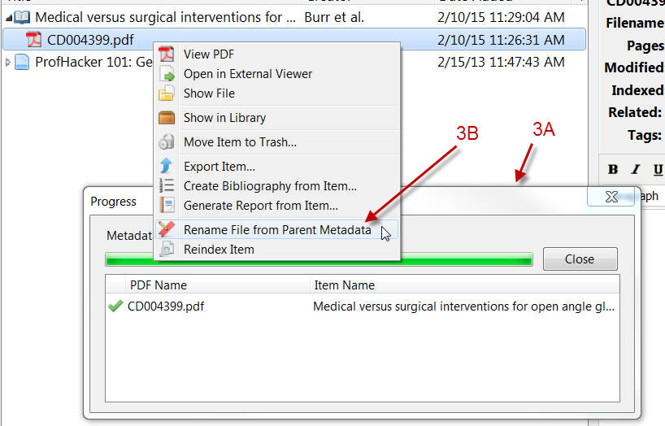
3A. Box showing that Z found the information about the article
3B. Finish by renaming PDF something useful

Slide 32
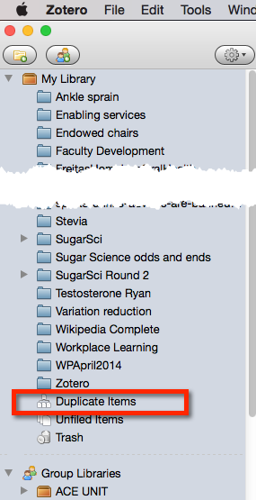
Duplicates
More than one source?
Likely to have duplicates
To manage duplicates:
  Merge identicals
  For non-identical items
    Choose the best one to be the template for the item

Slide 33
Working with Word
Open a Word document
Find tool bar or Zotero tab (Mac) or Add-in or Zotero tab (Windows)
  Macs with Word 2008 → No tool bar or tab, use scroll icon!
    “control-option-A” to add citation
    “control-option-B” to add reference list
  Word Mac 2011 is the only one with a tool bar
Start typing your article
Put in a reference
Put in more than one reference
Add your reference list

Slide 34
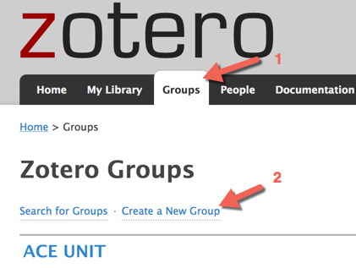

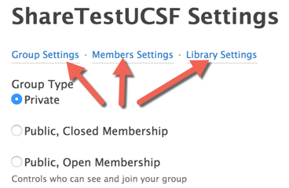
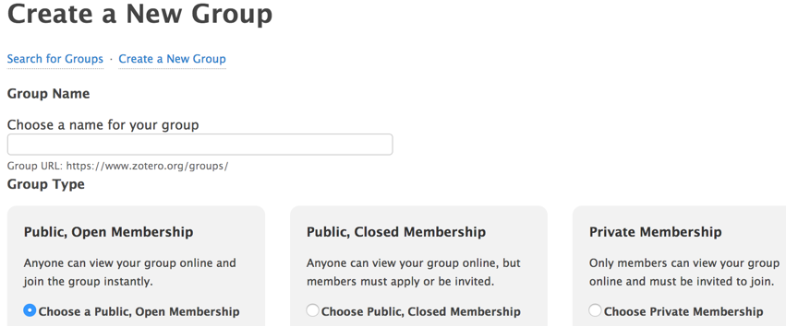
Sharing with others
Start from Zotero online
Create a New Group (see left)
OR Zotero desktop (see right)
Select name and type of group (see below left)
See above, change settings in each of 3 areas. Invite others in Members.

Slide 35
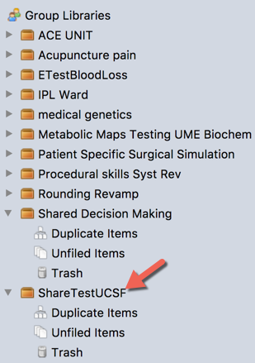
Share 2
Once your new shared library appears in Zotero desk top, drag and drop articles you want to share into the shared folder.

Slide 36
That’s it!
Questions?
Contact us as needed at the library
evans.whitaker@ucsf.edu

