Slide 1
Inhalations
By John Horner
Student Pharmacist: Class of 2015

Slide 2
Learning Objectives
At the completion of this module students will be able to:
List 4 advantages and 4 disadvantages of the pulmonary and nasal routes
Recognize types of inhaled devices and explain the mechanism of administration and appropriate use
Explain the significance of drug particle sizes, describe their fate depending on their size, and list two methods in which to generate an efficient number of “respirable” particles

Slide 3
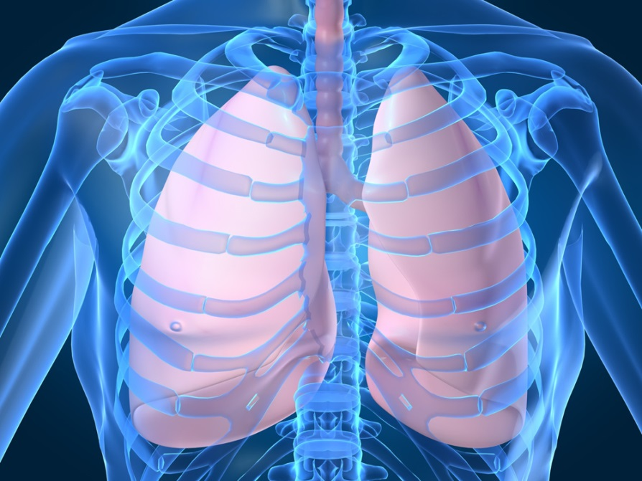
Pulmonary (Lungs) Route
Delivers drugs effectively to the airways and lungs
Primary treatment for asthma, COPD, and others
Mostly local
Potential to deliver systemically
  Insulin, and plasmids for gene therapy may develop

Slide 4
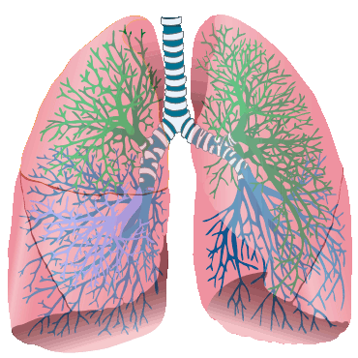
Advantages of Pulmonary Delivery
Large surface area (~80 m2)
Good permeability of lung membrane (very thin)
  provides rapid drug absorption and fast onset of action
Directly enters systemic circulation
  less hostile environment than oral route (peptides, proteins)

Slide 5
Advantages of Pulmonary Delivery
(Local Effect)
  high concentration of targeted drug delivery to pulmonary tissues
  minimizes systemic side effects
  use less drug than by oral route
  used for disease of the lungs, such as asthma and COPD
(Systemic effect)
  non-invasive, needle-free system that delivers drug directly to the systemic circulation
  suitable for many drugs, from small molecules to large proteins
  inhaled insulin promising substitute for injections

Slide 6
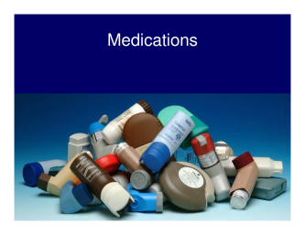
Disadvantages of Pulmonary Delivery
Complex delivery devices (many types)
Difficult to administer
  improper technique observed in many patients AND health-care providers
Less convenient/socially acceptable
Difficult to keep track of doses remaining in device (especially with no dose counter)

Slide 7
Pulmonary Delivery
Formulation Development
Route and drug are not the only things to consider when choosing this or any other route
Includes the drug, formulation (which includes many excipients), and the device
All of these can impact the delivery of the medication and must put into consideration

Slide 8
Disposition of Particles in Airways
Aerosol: suspension of fine solid particles or liquid droplets in a gas
Particles must be the right size and deposit in the right area
The drug particle size is important, as it determines the deposit location
  the smaller the particle, the farther down the lung it will travel, which increases the effect of the inhaler
What will generate an efficient number of “respirable” particles (1-5 μm)?
  a slow inspiratory flow rate (for pMDIs)
  long particle residence time in airway ~10 seconds (breath hold)

Slide 9
Formulations and Devices
Formulations:
  solutions, suspensions, or dry powders
  each can influence the deposition of particles in the airways, and will determine the type of device used
Devices:
  5 main types of devices used in pulmonary delivery
    nebulizers
    pressurized metered-dose inhalers (pMDIs)
    dry powder inhalers (DPIs)
    the newly released soft mist inhaler (SMI)
    devices used to administer inhaled gasses
  Each device has its own advantages, disadvantages, and administration techniques that are important be aware about as a pharmacist

Slide 10
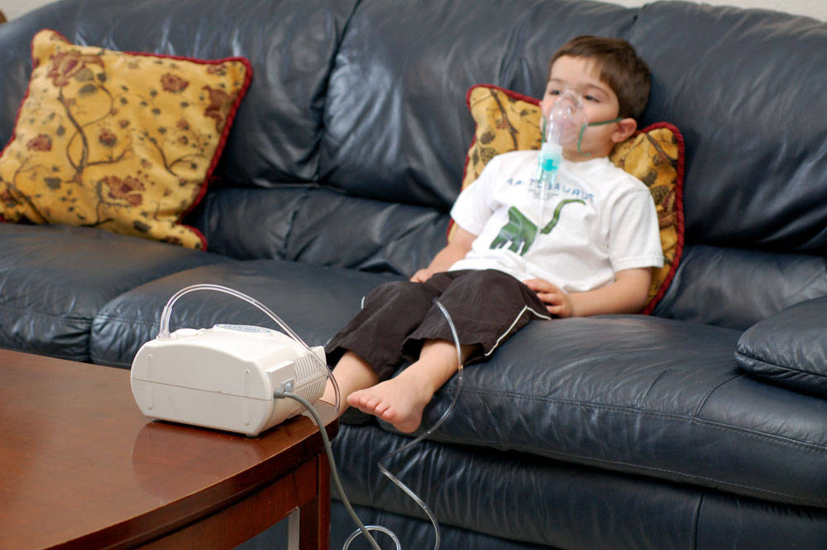
Nebulizers
Used in pediatric, geriatric, and emergency departments
Converts a drug solution into a mist of small droplets
Advantages:
  provide large doses with little patient skill
  can aerosolize most drug solutions
  Disadvantages:
    inefficient and erratic performance
    not portable, time consuming, and requires external power source
    high cost, high risk of contamination
    not good for proteins because of high shear degradation

Slide 11
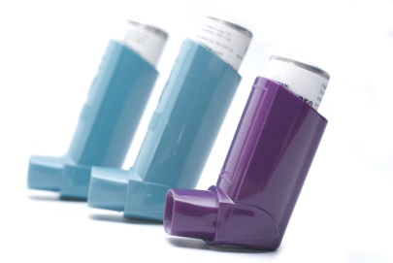
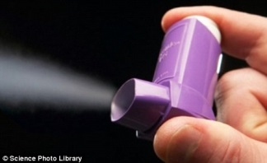
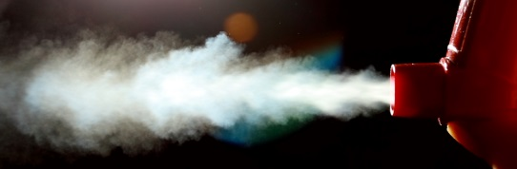
Pressurized Metered-Dose
Inhalaers (pMDIs)
Most common portable inhalation device that delivers a drug aerosol driven by propellants at a high velocity
Examples of Clinical use of pMDIs: ProAir® (albuterol), Flovent (fluticasone), and Xopenex (levalbuterol)

Slide 12
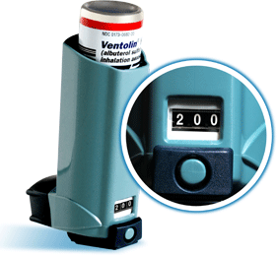
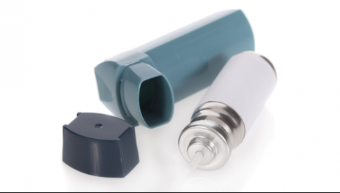
pMDI Components
Container
Drug formulation
  Drug
  Surfactants: stabilize suspensions
  Lubricants: stabilize solutions
  Co-solvents: formulation aids for solutions
Propellants
  hydrofluoroalkane (HFA) compounds
    achieve desired vapor pressure & spray characteristics
Metering valve
Actuator (Trigger)
Dose counter

Slide 13
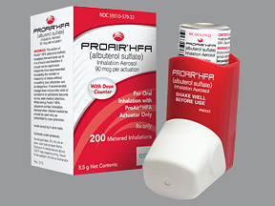
Advantages/Disadvantages of pMDIs
Advantages:
  gold standard
  well-tolerated
  portable
  relatively inexpensive
  tamper proof, protect product, no contamination
  accurate multiple-dose metering, reproducible
Disadvantages:
  technique precise and many do not follow
    there is a high incidence of incorrect use among patients and providers
  throat deposition from high velocity particles
  size of dose is limited
  cannot be used for proteins or peptides because of degradation from propellants

Slide 14
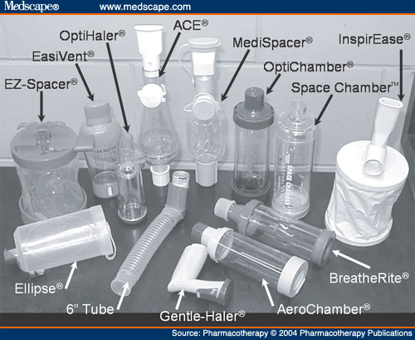
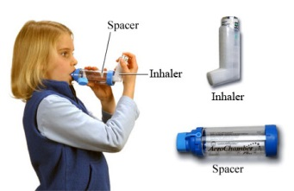

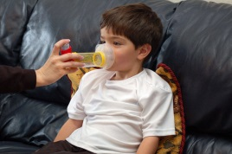
pMDIs: Spacers
Holding chamber that connects to the end of the pMDI to allow for the following benefits:
  less difficult to coordinate actuation of MDI
  ↓ oropharyngeal deposition
  ↑ pulmonary deposition
  Especially good for children or others that experience difficulty demonstrating proper technique

Slide 15
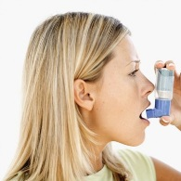
Administration of pMDI
The following video demonstrates the correct administration technique with a spacer (open-mouth technique)
Key points
  inhale deeply and slowly
  hold breath (10 sec.)

Slide 16
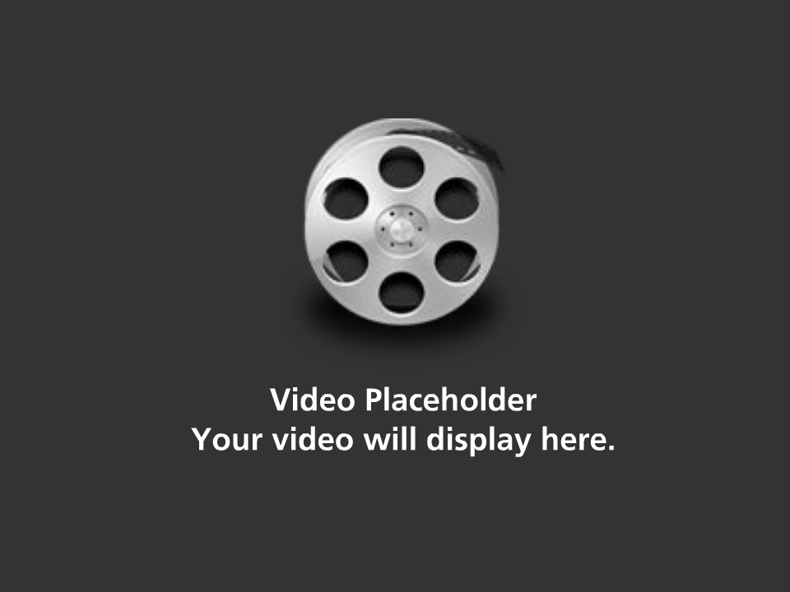
Video: How to Use an MDI (open-mouth technique) With a Spacer

Slide 17
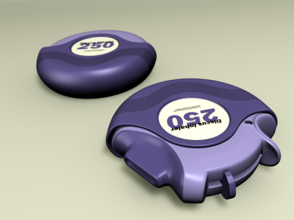
Dry Powder Inhalers (DPIs)
Deliver a dry powder formulation of medication to the lungs
There are several devices including, but not limited to:
  Diskus, HandiHaler, Aerolizer, Flexhaler, and Twisthaler
Multi-dose or unit-dose
No propellants: breath-actuated
Lactose common carrier
Spacer not used
Require rapid inspiratory rates
  breath in forcefully

Slide 18
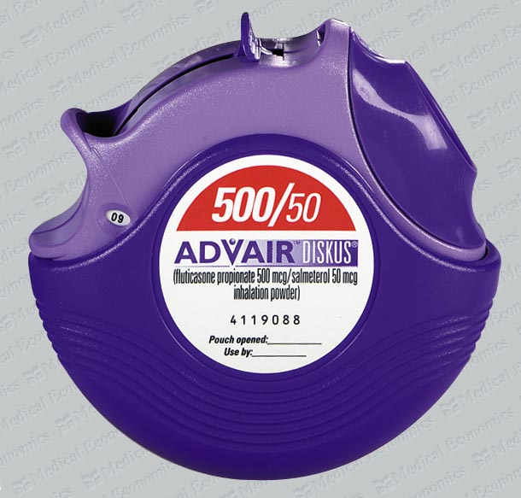
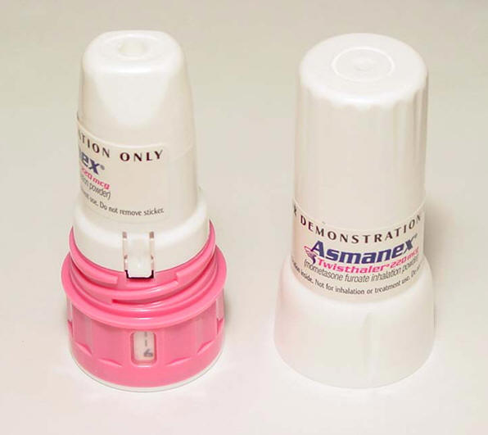
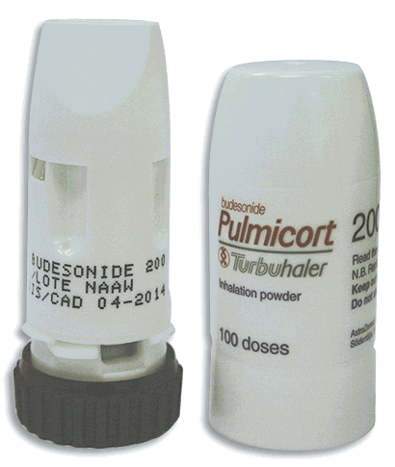
Types of DPIs: Multi-Dose
Diskus
Twisthaler
Flexhaler
Advair (salmeterol/fluticasone)
Flovent (fluticasone)
Serevent (salmeterol)
Asmanex (mometasone)
Pulmicort (budesonide)

Slide 19
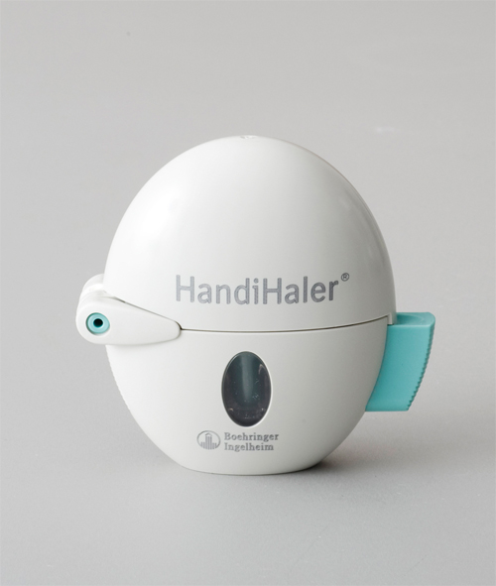
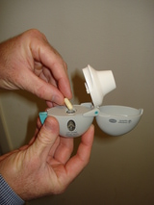
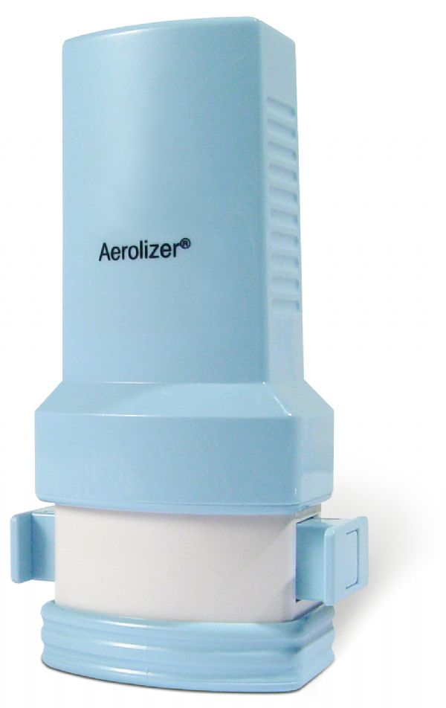
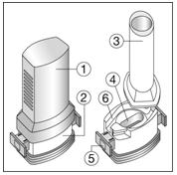
Types of DPIs: Unit-Dose
HandiHaler
Aerolizer
Example: Spiriva (tiotropium)
Unit dose gelatin capsule that is pierced by device
Example: Foradil (formoterol)

Slide 20
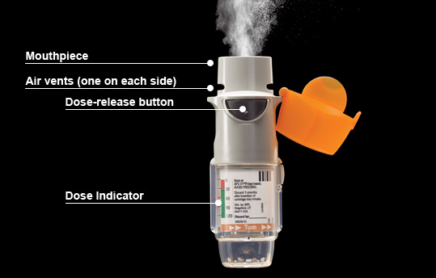
Soft Mist Inhalers (SMIs)
Example: Combivent Respimat (Ipratropium and Albuterol)
  Multidose, propellant-free, soft-mist inhaler (produces a fine mist of droplets)
  Dose-indicator

Slide 21
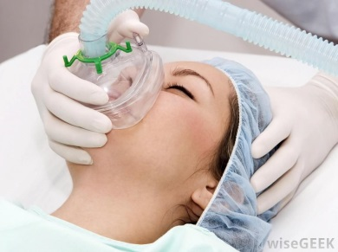
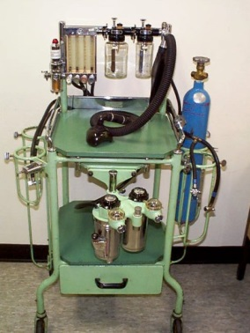
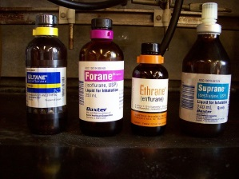
Inhaled Gasses
Commonly used in the hospital to administer medications, as well as oxygen and nitrogen
A very important example is anesthetic gasses
administered by anaesthetists through a mask connected to a vaporizer and delivery system
they are often prepared by pharmacists

Slide 22
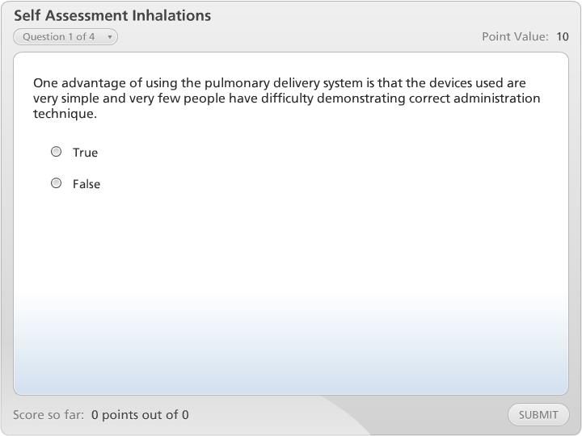



Self Assessment Inhalations

Slide 23

Intranasal Route
Convenient and widely used
Most drugs used for local effects treatment of many disease states such as
  nasal allergies, inflammation, congestion, and infections
They can also be used systemically for certain indications such as
  immunizations and many other promising treatments
Formulations come in drops, aerosols, ointments and powders
Although this route offers some great benefits, there are many limitations you should consider before making this your choice delivery system

Slide 24
Advantages of Nasal Delivery
Good for local treatment
Advantages for systemic delivery
  more permeable and less metabolism than gut
    Some proteins and peptides may be delivered
  rapid absorption (if drug is delivered and remains at its target site)
  greater adherence than parenteral route
  direct route into brain?
    direct access to the CSF
    low molecular weight peptides

Slide 25
Disadvantages of Nasal Delivery
Low residence time and thus low absorption (this pertains to amount of drug absorbed, not the speed)
  increased by using solvents to increase viscosity
Mucociliary clearance hinders large or slowly absorbed drugs
Solubility requirements strict
  drug must not be too hydrophilic or too hydrophobic
Drugs must have the right pH, tonicity
Poor reproducibility
Local irritation by some drugs
Allergic rhinitis (inflammation of the nasal mucosa), sneezing, and congestion decrease performance
  avoid nasal route when patient has these symptoms

Slide 26
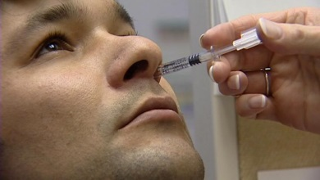
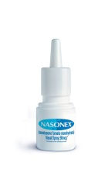
Available Formulations for
Nasal Delivery
Drops
  solutions or suspensions
  controlling dose and site of
  application is difficult
Aerosols
  Deliver to anterior section, which increases residence time and absorption
  Less irritating
  Devices include nebulizers, MDIs, and DPIs
Ointments, and powders
  not used as much due to irritation and discomfort

Slide 27

Conclusion: Choice of Route and Form
What is the drug in question?
Where is the drug target?
Urgency?
Patient’s Condition?
  Can they breath, are they able to use correct pMDI technique (children), can they produce a high enough respiratory flow rate for DPIs, can they afford it, are they sneezing?

Slide 28
Make Your Choice
Thinking of the major advantages, disadvantages, and physical properties of each drug route and form and applying this information to your patient’s specific needs will help you make this decision
Hopefully, as you go back to review these modules later on, you will start to be able to see the bigger picture

Slide 29
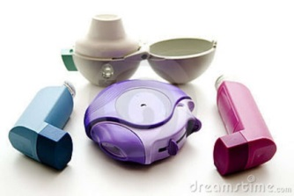
The End

