Slide 1
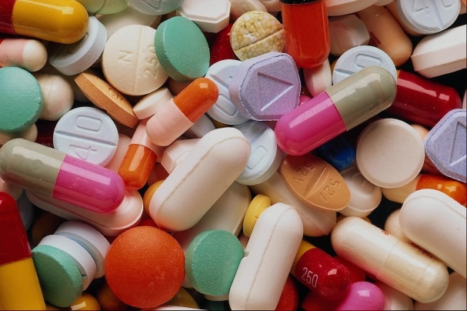
Oral Delivery
By John Horner
Student Pharmacist: Class of 2015

Slide 2
Learning Objectives
At the completion of this module, students will be able to:
List 2 main clinical or physicochemical advantages and disadvantages of each of the medication forms and routes discussed in this module and discuss when they are appropriate to use in the health care setting for specific patient populations
Visually differentiate between the types of oral formulations, including tablets, capsules, liquids, and all their variations
Explain generally the following key concepts: sites of absorption in oral delivery, coatings, modified release mechanisms, and capsule function

Slide 3
Oral Delivery Overview
Most widely used and accepted dosage form in the US
It’s safe, convenient, and easy
Includes a variety of formulations, each with subtle, unique differences
Routes to cover
  oral gastrointestinal tract (GIT)
  sublingual (under tongue)
  buccal (inside cheek)
MAIN QUESTION: In what situations would these dosage forms be preferred?

Slide 4
Oral (GIT) Route
Accessed through the mouth and down the digestive or GIT
Drugs absorbed anywhere along the GIT
Although very common, oral delivery may not be suitable
Advantages
↑ Ease of use
Short and long-acting forms
↓ Relative cost
Disadvantages
Delayed onset
Hostile environment
Lost fraction possible
  chemical breakdown
  incomplete absorption
  gut metabolism
  hepatic metabolism
Disclaimer: these are general characteristics for this route and exceptions do exist (there are oral drugs that have a quick onset and experience no lost fraction)

Slide 5
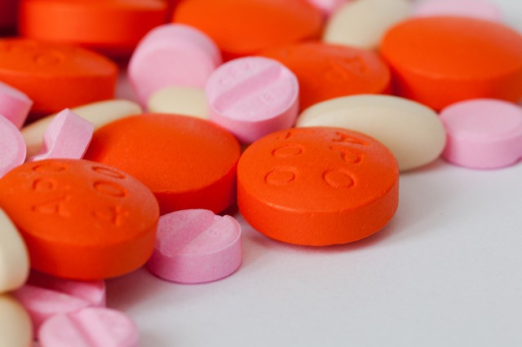
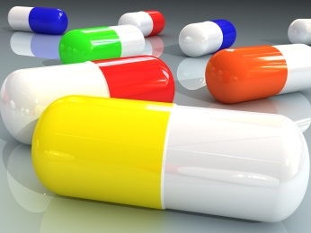
Description of available solid forms
Tablets
Capsules
Less common, but still important:
Caplets
Thin Films

Slide 6
Tablets
Compressed products (API+ excipients)
Many shapes, colors, and sizes
Some forms can be divided (w/score)
They are disintegrated then dissolve
More stable than bulk powders or liquids
Coated tablets offer additional benefits
Very common

Slide 7
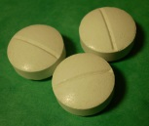
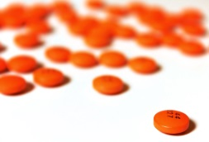
Types of Tablets
  Conventional
  Coated
Can be divided if score present
Can also be crushed if needed
Several types of coatings: film, sugar, or enteric
Cannot to be divided/crushed

Slide 8
Why Coat Tablets?
Protect from environmental damage
Mask unpleasant taste or smell (increases adherence)
Facilitate swallowing
Avoid early release of API (controlled delivery)
Ensure drug stability (protect from stomach acid)

Slide 9

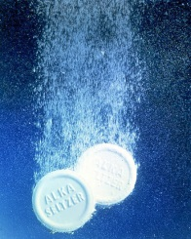
Types of Tablets
Effervescent
Tablets are dropped in water and CO2 is released
Administered as a solution
Rapid drug action
Stored in dry environment
Examples:
  Alka Seltzer
  Airebourne
  Prevacid Solutabs
  Pain Medications

Slide 10
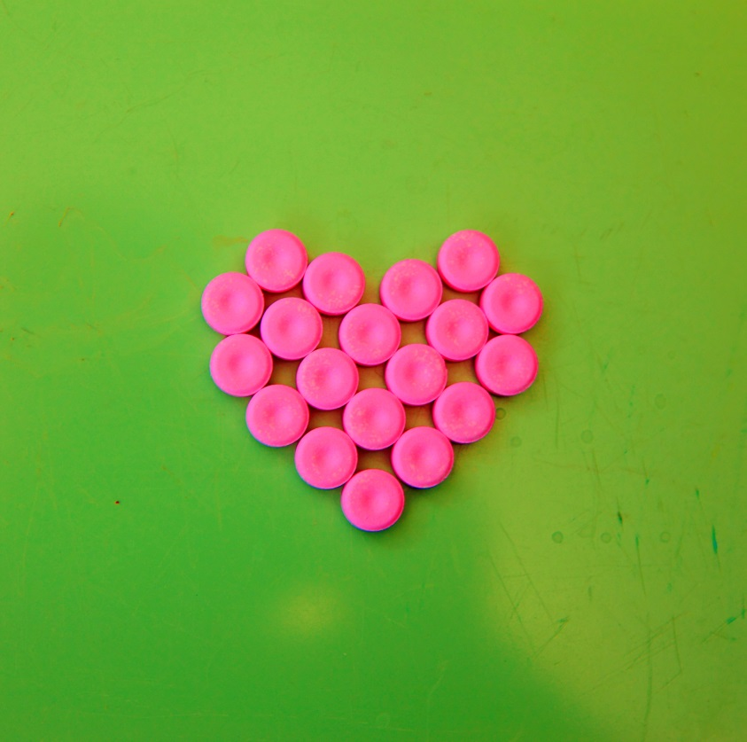
Types of Tablets
Chewable
Special Tablets
Disintegrating “Wafers”
Quickly disintegrates
Examples:
    Klonopin Oral Wafer
    Gliadel Wafer Implant (not an oral medication)
(Discussed later)
  Sublingual
  Buccal
  Vaginal
Broken in mouth, dissolved further down GI Tract

Slide 11
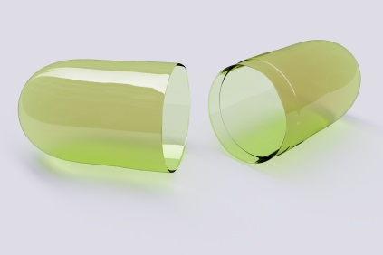
Capsules
API + excipients enclosed in gelatin container
Cannot be divided, but some can be opened and their contents can be removed to be compounded into other formulations (like liquids), or to be sprinkled on food
Like tablets, they can be engineered to more accurately control the speed and location of API release
Not as common as tablets, but may be easier to take

Slide 12
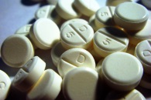
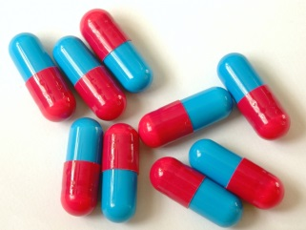
Caplets
= Caplet
+
Hybrid of tablet and capsule
It is a tablet that is oblong and has a gelatin-like texture
Increasingly popular

Slide 13
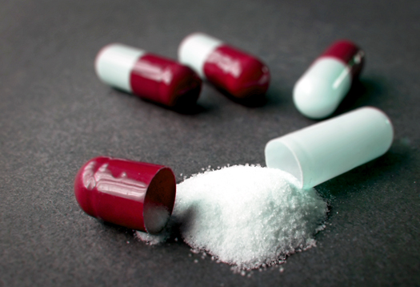
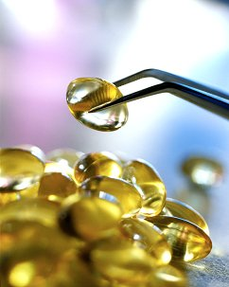
Types of Capsules
Hard Gelatin
Soft Gelatin
Body and cap of gelatin with tamper-proof seal
Contain powders, pellets, and/or granules, which are released
“Soft” gelatin surrounding liquid formulation
Can also be filled with pastes or powders
Must be swallowed whole

Slide 14
Thin Films
Thin strips placed in the mouth
Instantly dissolve or “melt” on the tongue
They are convenient and can be taken without any water
Good for children

Slide 15
Types of Release Formulations
(Made for Tablets or Capsules)
Immediate release (IR) | Extended release (ER/XL/XR) | Delayed release
Standard form Often not indicated on label | Drug released slowly at a nearly constant rate Prolonged drug levels Less frequent dosing (Better adherence) | Enteric coated (EC) most common Used to help bypass the stomach and release API in upper small intestine.
Other common acronyms:
CD - controlled delivery
CR - controlled release
LA - long acting
SR - sustained release
TR - timed release

Slide 16
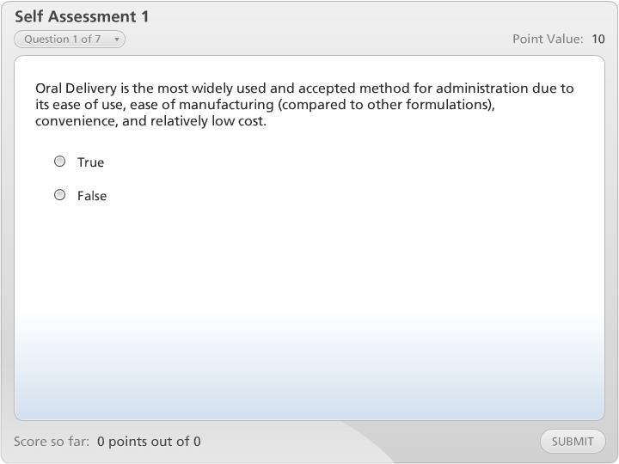



Self Assessment 1

Slide 17
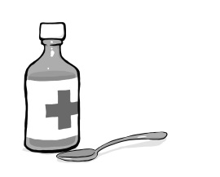
Description of Available Liquid Forms
Forms
Solutions
  syrups
  elixirs
  tinctures
  drops
Suspensions
Emulsions
Oral Liquid Advantages
  Easier for administration (children, elderly people)
  Rapid absorption
  Flexible dosing
Oral Liquid Disadvantages
  Stability challenges
  Accurate dosing
  Harder to mask taste (flavouring helps)

Slide 18
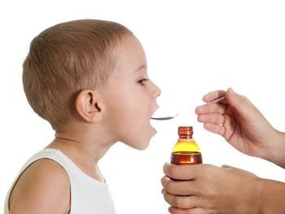
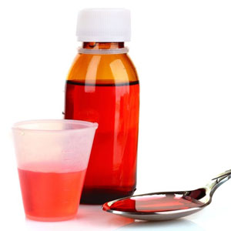
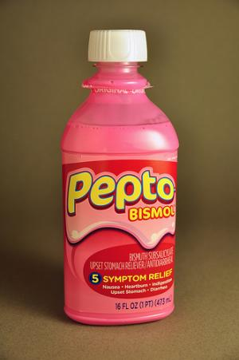
Types of Liquids
Solutions
Homogenous
Clear liquid preparations that contain one or more substances dissolved in water or co-solvent (e.g. alcohol)
Come ready to administer, concentrated to dilute, or may come in a soluble solid form (powders) to be dissolved
Includes also syrups, elixirs, tinctures, and drops

Slide 19
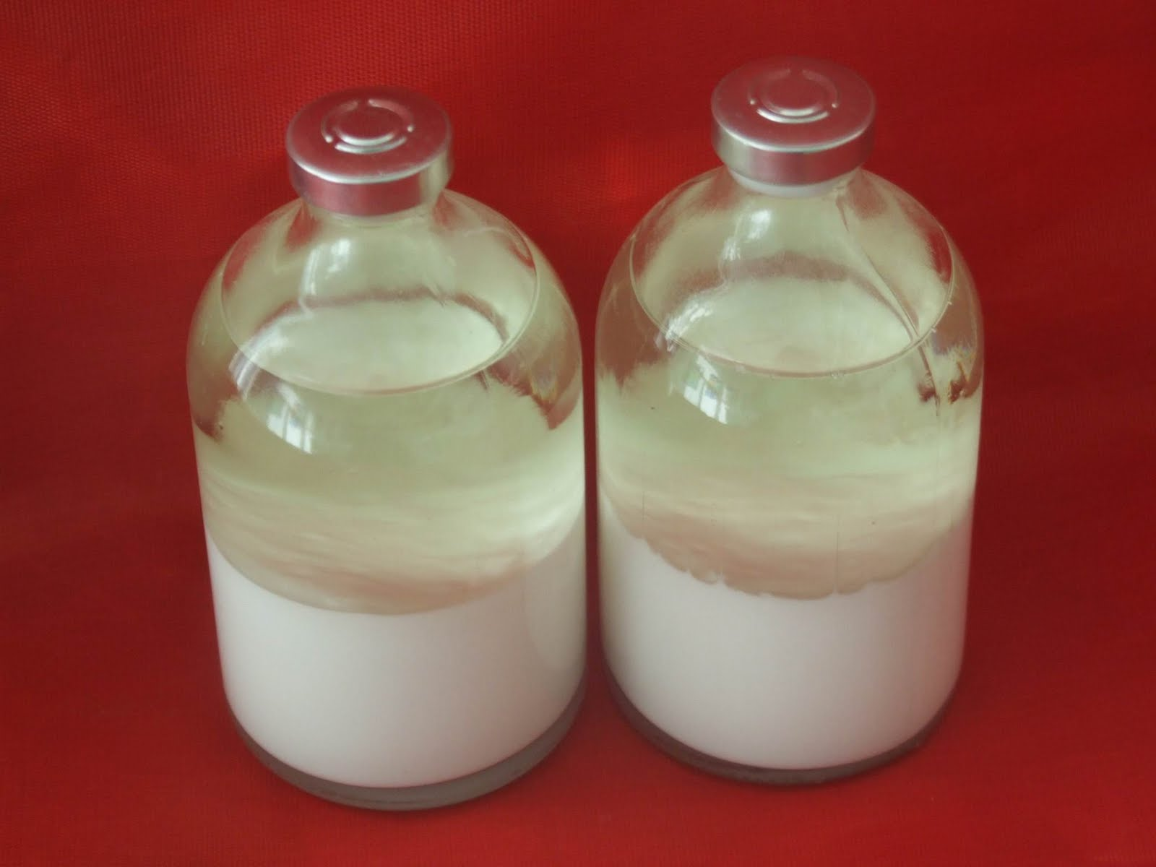
Types of Liquids
Suspensions
Heterogeneous
Solid particles are dispersed upon shaking to give a uniform liquid distribution
Example: liquid antibiotics
Emulsions
Two-phase systems
  emulsifying agents
  consistency varies

Slide 20
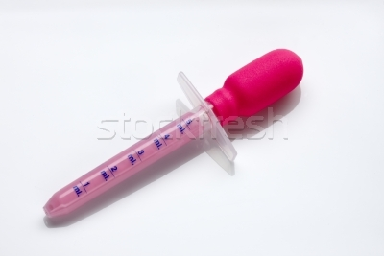
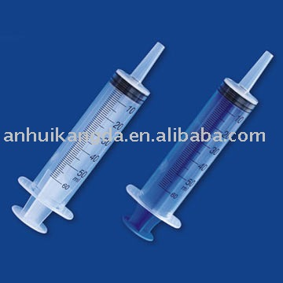
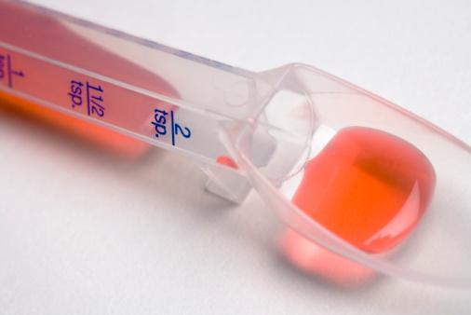
Oral Administration Tips
Solid oral formulations
  in general, take with plenty of water
  tablets: tilt head back
  capsules: tilt head forward
  with or without food varies from drug to drug
Liquid oral formulations
  Remember to shake suspensions
  Be careful of expiration dates

Slide 21
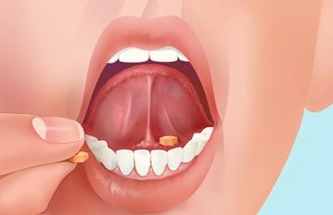
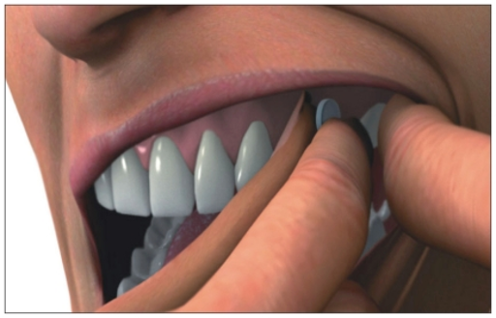
Sublingual (SL) and Buccal Routes
Sublingual
(under tongue)
Buccal
(inside cheek)
Routes accessed when a drug is dissolved and passes through the membrane of the bottom or side of mouth
Good for faster action and when parenteral administration is not practical

Slide 22
SL and Buccal Routes
Advantages
  more rapid systemic drug effect
  less drug fraction lost due to break down and first pass metabolism
  very easy to use
Disadvantages
  some drugs are not well dissolved in saliva or diffuse too slowly
  may have bad taste

Slide 23
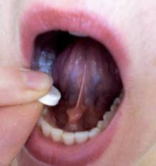
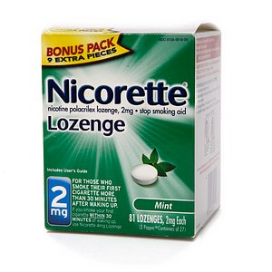
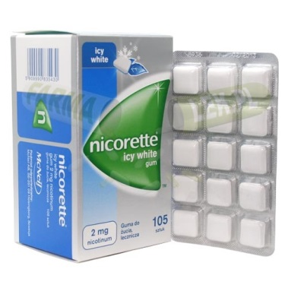
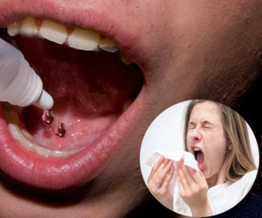
Description of Available Forms
Tablets
Lozenges
Drops/Spray
Gum

Slide 24
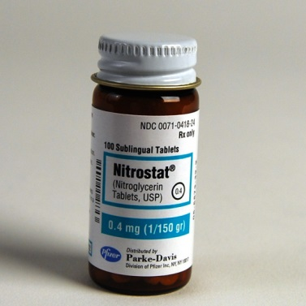
Description of Available Forms
Tablets/Lozenges
Solid preparations that are intended to dissolve or disintegrate slowly in the mouth
Examples
  Nitroglycerin SL tablets
  Nicorette Lozenges
Notes:
Rx for change videos

Slide 25
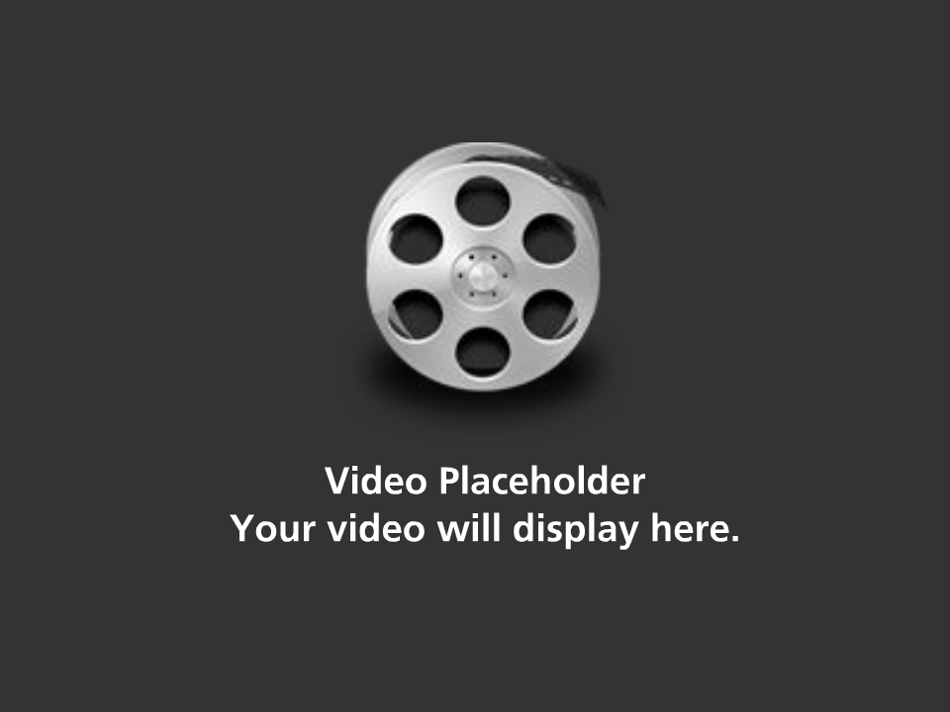
Nicorette Lozenges Video

Slide 26
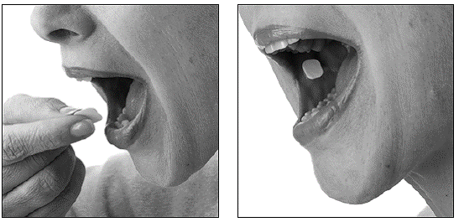
Description of Available Forms
Drops
Drops, such as sublingual immunotherapy, are also available for administration
Spray
Example: Nitroglycerin sublingual spray
Gum
Intended for the buccal route
Prominent example: Nicorette Gum

Slide 27
Nicorette Gum Video

Slide 28
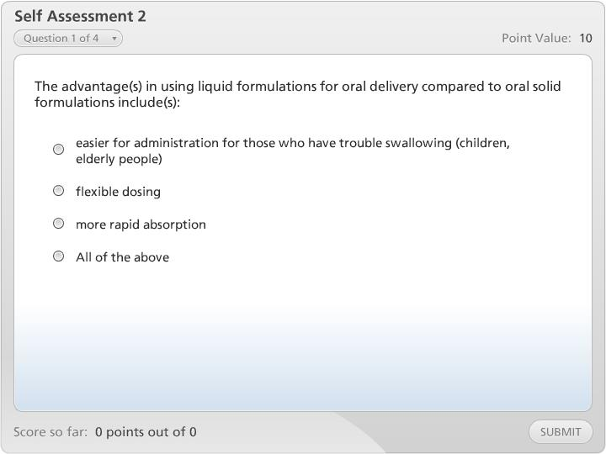
Self Assessment 2

Slide 29

Conclusion
Now let’s take what we learned today and apply it to our patient case “Peter,” that was introduced in the first module
In what situations would oral delivery be ideal for Peter?
Are there any specific routes or forms you select over others? Why?
In what situations would you not want to give Peter an oral dosage form?
To answer these questions, let’s review oral delivery and ask ourselves a few key questions

Slide 30
Oral Take Home
Advantages
↑ Ease of use
Short and long-acting forms
↓ Relative cost
Disadvantages:
Delayed Onset
Hostile environment
Potential Lost Fraction
  chemical breakdown
  incomplete absorption
  gut metabolism
  hepatic metabolism (first pass)

Slide 31

Choice of Route and Form
What is the drug in question?
Where is the drug target?
Urgency?
Patient’s Condition?
  Are they awake to take pills? Can they swallow? Adherence? Cost? Anything else that would make the oral route less ideal?

Slide 32
Make Your Choice
Thinking of the major advantages, disadvantages, and physical properties of each drug route and form and applying this information to your patient’s specific needs will help you make this decision
Hopefully, as you go back to review these modules later on, you will start to be able to see the bigger picture

Slide 33
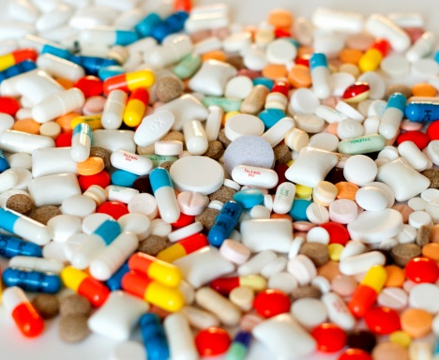
The End!

