Slide 1
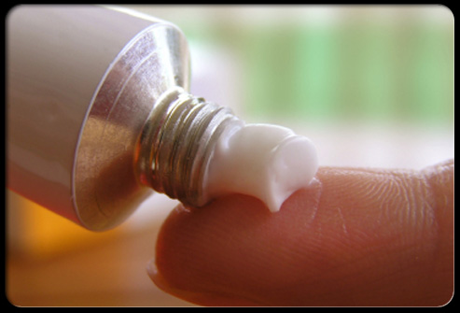
Topical Delivery
By John Horner
Student Pharmacist: Class of 2015

Slide 2
Learning Objectives
At the completion of this module, students will be able to:
List 2-3 main advantages and disadvantages of each of the topical routes of administration discussed in this module
Describe the physical properties, uses, appearance and clinical benefits of topical medication forms including ointments, creams, lotions, gels, foams, powders, and pastes
When presented with a case presentation, be able to recommend a specific topical route and form of topical medication based on patient specific needs such as target area (local vs. systemic), skin conditions, adherence, and ease of use

Slide 3
Overview of Topical Delivery
Defined as medication that is applied to body surfaces such as the skin or mucous membranes
Includes
  dermatologic, transdermal, ophthalmic, otic, rectal, and vaginal routes
Examples of forms:
  ointments, creams, gels, sprays, drops, suppositories, patches, others
Do not substitute dosage form without the physician’s approval
Each form is carefully chosen to ensure the maximum benefit for a particular patient and to address a specific indication
You should be able to recognize the differences in each form in their appearance, physical/biological properties, and unique benefits

Slide 4
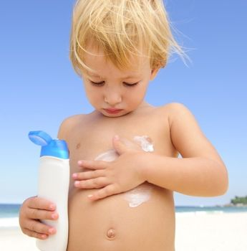
Topical Dermatologic Route
Primary goal: deliver drug to the site of application
  not for systemic absorption (generally)
These medications help hydrate, protect, and deliver medication to the skin
Some examples of clinical use for dermatologic conditions include:
  psoriasis, eczema, atopic dermatitis, athlete’s foot, sun protection, insect repellent, and burns
There are many things to consider when selecting a topical formulation, but all forms should be:
  uniform, free of grittiness, physically/ chemically/ microbiologically stable, not irritable, and aesthetically appealing

Slide 5
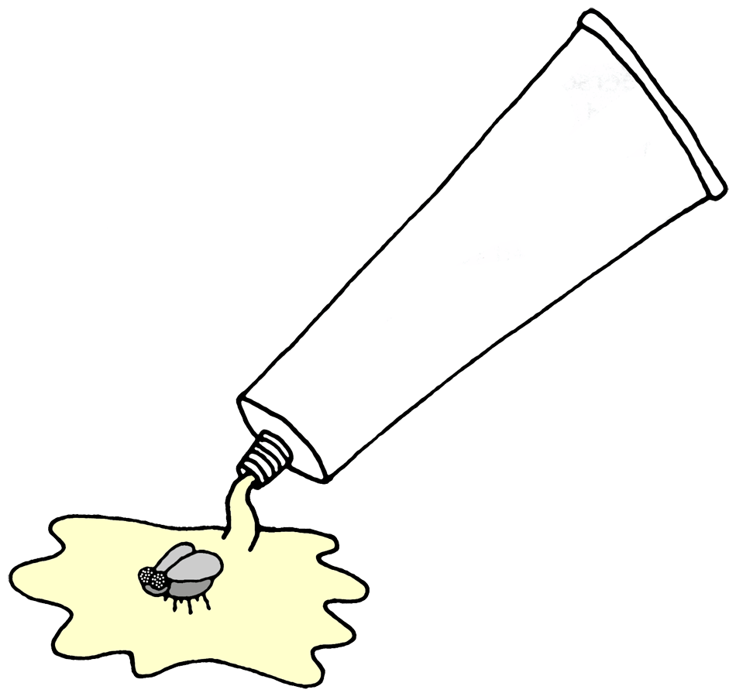
Advantages of
Topical Dermatologic Delivery
Avoidance systemic absorption (mostly)
  local action only
  reduced side effects
A relatively large area of application
Convenient, non-invasive, and easy to apply
  good adherence
  patients can self medicate

Slide 6
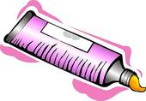
Disadvantages of
Topical Dermatologic Delivery
Skin irritation or hypersensitivity reactions may occur
Poor permeability of some drugs through the skin
  high molecular weight, and hydrophilic drugs have more difficulty
Medication could get wiped away
Ointments and creams can be messy

Slide 7
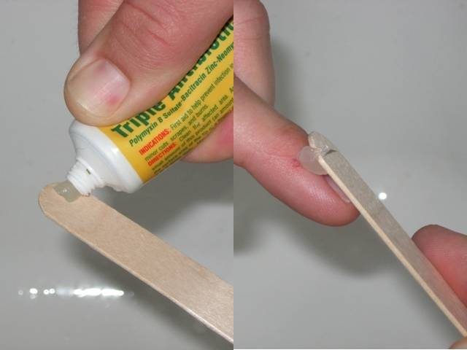
Available Forms: Ointments
Ointments
There are many different types
  Water-repellent, absorptive, water-in-oil, water soluble, etc.
Most “OCCLUSIVE” barrier forming – blocks water loss
  useful on dry cracked skin or abrasions
Not easily washed off
Can be greasy and less favored by patients

Slide 8
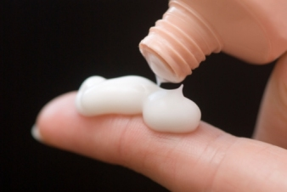
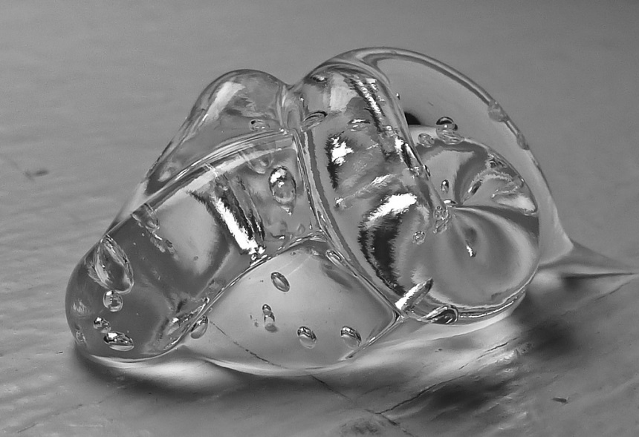
Available Forms: Creams and Gels
Creams
Gels
Preferred when occlusive effect not necessary
Cosmetically appealing, easy to apply
Liquefy on contact with the skin
Non greasy, easy to apply
Lacks emolliating (softening) and skin protective properties

Slide 9

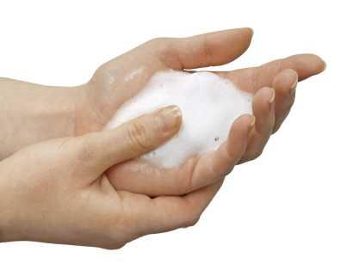
Available Forms: Lotions and Foams
Lotions
Foams
Free flowing topical product, and thicker than solutions, which are harder to wash away
Good for moist or hairy skin, spread readily
Pressurized liquids with propellant
Easily spreadable, good for hairy/non hairy areas

Slide 10
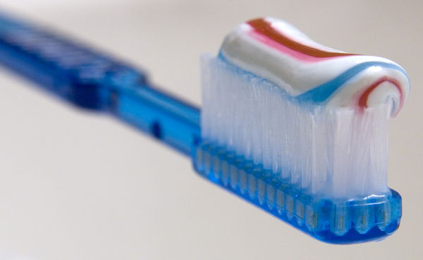
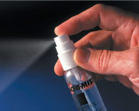
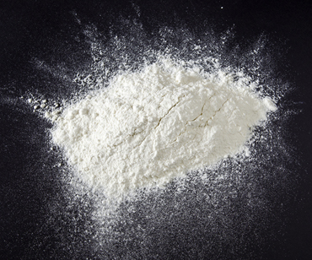
Available Forms:
Pastes, Sprays, and Powders
Pastes
Sprays
Powders
Contains high proportion of powdered solids
Pressurized or non pressurized delivery
Fine powder that can be medicated or non medicated
Good if the skin surface is wet

Slide 11

How to Administer
Topical Medication
Steps
Do not take this drug by mouth. Use on your skin only. Keep out of your mouth, nose, and eyes (may burn)
Wash your hands before and after use.
Clean affected part before use. Make sure to dry well
Put a thin layer on the affected skin and rub in gently

Slide 12
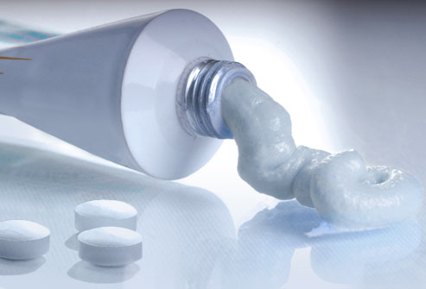
Topical Preparations:
Choosing the Right Product
Consider their conditions
Is it wet? DRY IT: solutions, gels, lotions, and creams
Is it dry? WET IT: creams, lotions, ointments
Is it abraded? AVOID: gels, lotions, and solutions
Is it hairy? USE: gels, lotions, or foams
Cosmetically appealing?

Slide 13
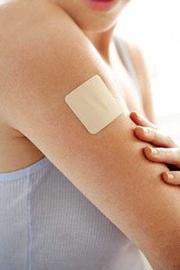
Transdermal Route
Intended to be absorbed through the skin and enter the systemic circulation
Although the most common forms for this route are transdermal patches, other conventional forms, such as creams and ointments, are used as well

Slide 14
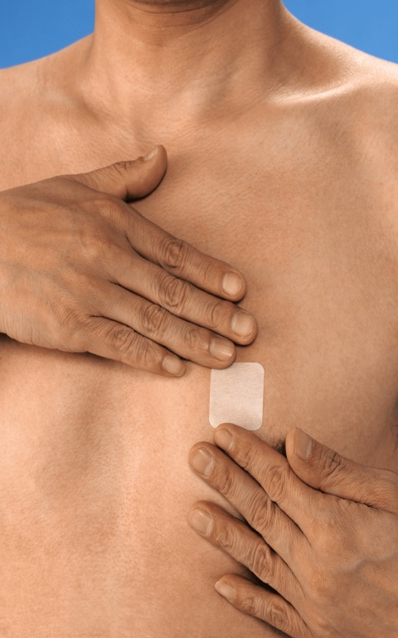
Advantages of Transdermal Delivery
Provides consistent, long lasting drug levels
Alternative to injectables
  relatively less pain and stress
  no need for trained specialist
Alternative to oral dosage forms
Easy to use and conceal
Associated with better adherence
Can be immediately discontinued

Slide 15
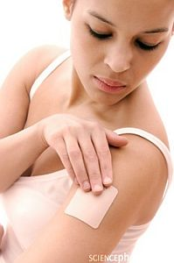
Disadvantages of
Transdermal Delivery
Allergic reactions to the adhesive or skin irritation may occur
  rotate sites to minimize
Patients with some dermatologic conditions should not use the patch
Some drugs that are large, weak, or hydrophilic are not good candidates for this delivery system
Slow onset of action
Disposal can be hazardous

Slide 16
Available Forms:
Ointments, Creams, and Gels
These are “conventional” forms that present with some problems:
  harder to apply correct dose
  easier to wipe away
  product can be transferred to another person
However
  can produce less irritation than patches

Slide 17
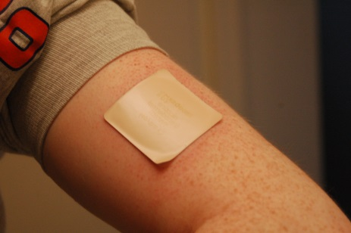
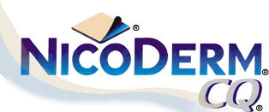
Available Forms: Patches
TTS (transdermal therapeutic system)
Controlled drug delivery into the systemic circulation
Easy and discrete
Common sites of application:
  buttocks, thighs, abdomen, chest, and upper arms

Slide 18
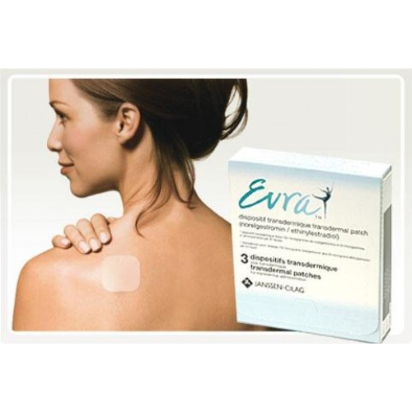
Clinical Pearls: Patches
Do not cut patches to adjust dose
Rotate cites
After patch removal, skin may appear red for 24 hours
Local skin reactions common (redness, burning, itching)
Avoid use in patients with dermatologic conditions
  e.g., psoriasis, eczema, atopic dermatitis

Slide 19
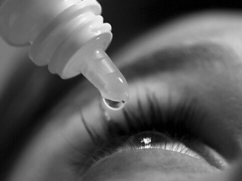
Ophthalmic (Eye) Route
The eye is easily accessible to topical drug administration
Mostly used for local action
Treats disease states such as infection, irritation, inflammation, glaucoma, and others

Slide 20

Advantages of Ophthalmic Delivery
Minimizes side effects from avoiding systemic circulation
Direct administration provides a rapid onset of action

Slide 21
Disadvantages of Ophthalmic Delivery
No systemic delivery: blood-eye barrier
Large portion of the drug is wasted from:
  loss from tear dilution
  reflex blinking
  relatively small area of absorption
Must be:
  sterile
  contain preservatives if multi-dose
  isotonic with tears
  have close pH values to that of the fluids in the eyes
  clear of particulates
Short shelf life
  most are shorter than 1 month, so check expiration date!

Slide 22
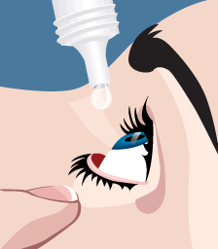
Available Forms:
Drops, Ointments, and Suspensions
Ophthalmic Solutions (eye drops)
  easy to use, prepare, filter, and sterilize
Ointments, gels, and creams
  greasy and can cause temporary blurred vision
  recommended for nighttime administration
  have enhanced drug availability, by increasing contact time, thus longer duration of action
Suspensions:
  good for poor water soluble drugs, such as prednisolone
  provide longer duration of action because of increased contact time
  may cause irritation, especially with large particle sizes

Slide 23
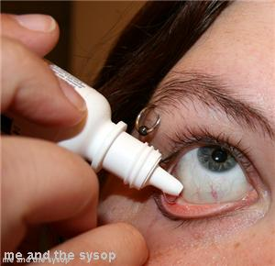
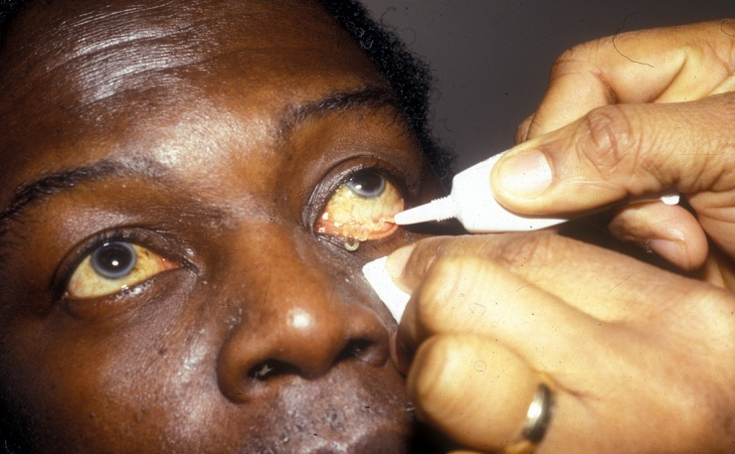
Administration of Eye Drops and Ointments
Hands should be washed with soap prior to administration
When administering drops, shake the bottle, tilt head back, pull lower eyelid down, and squeeze out drop without touching the tip of the bottle with the eye. Wait a few minutes between each drop to allow time to absorb
When administering ointments, apply a thin ribbon into the lower eyelid, then close eye for a few minutes to increase contact time

Slide 24
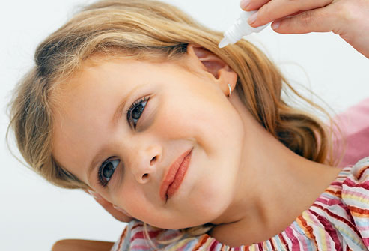
Otic (Ear) Route
Drugs applied to the ears are only for local effects such as infection, inflammation, irritation, earwax accumulation, tinnitus, and others

Slide 25
Available Forms:
Drops, Ointments, and Powders
Ear Drops
  convenient and relatively inexpensive
  low residence time
  adjust for pH, viscosity, and tonicity
  must be sterile
Ointments and powders
  not used often due to discomfort and irritation
  provide higher retention times

Slide 26
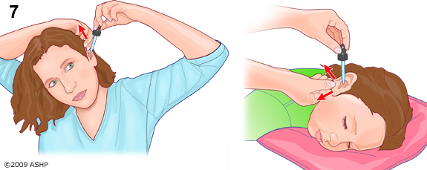
Administration of Ear Drops
To administer:
  warm product in hands, tilt head, do not touch tip of bottle to ear, insert drop, keep head tilted for several minutes, then use cotton ball to help retain extra product

Slide 27
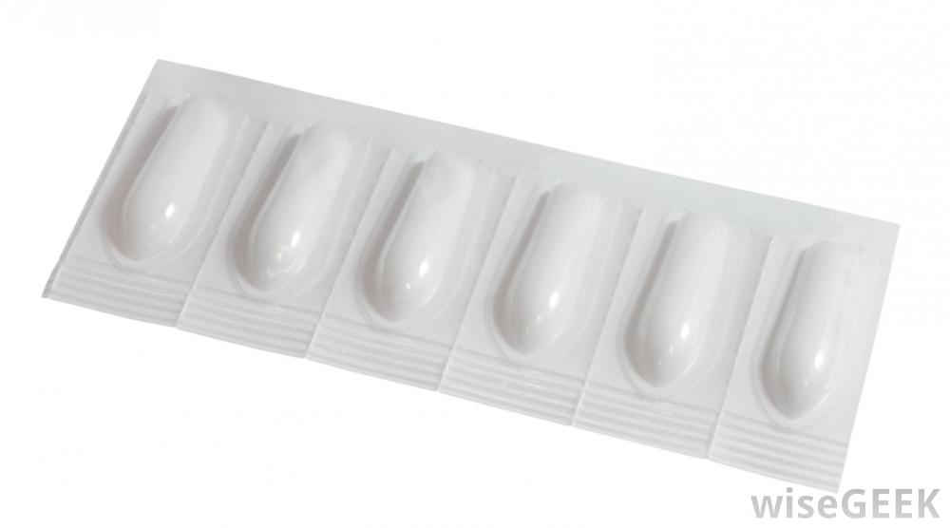
Rectal Route
Option for drugs which are irritable when given orally, and is used to deliver drugs systemically and locally
It is also the preferred route for certain rectal diseases

Slide 28
Advantages/Disadvantages of
Rectal Delivery
Advantages:
  can be used both for systemic and local therapy
  limited direct access to systemic circulation (2/3 bypasses first-pass metabolism, while 1/3 reaches liver via the superior rectal vein)
  advantage for patients who are unable to take oral medications
Disadvantages:
  insertion and retention can be difficult
  variability in absorption
  patient adherence can suffer if patients do not like rectal insertion
  some drugs can cause irritation

Slide 29
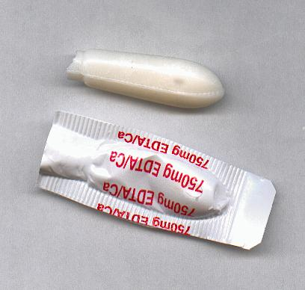
Available Forms:
Suppositories and Others
Suppositories
Solid medications for insertion into body cavities
Disintegrate and release contents by melting or dissolving
Rational treatment form for local conditions
  constipation: deliver laxatives
  hemorrhoids: treat pain and itching
Oil-soluble bases and water-soluble bases used
Enhancers boost absorption
Other Forms
Enemas
Foams
Gels, ointments, and creams
  topical use, usually with applicator

Slide 30
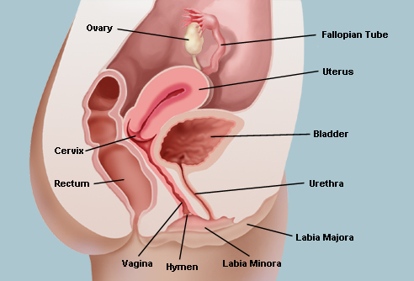
Vaginal Route

Slide 31
Advantages of Vaginal Delivery
Advantages:
Rich blood vessel network allows for direct entrance into systemic circulation
  no first-pass metabolism or gut breakdown
Less drugs can be used to produce a local effect and avoid side effects
Discrete, painless, easy to use

Slide 32
Disadvantages of Vaginal Delivery
Disadvantages:
Variable wall thickness and pH with age and hormonal cycle
  this influences the permeability of drugs to pass through the membrane
  absorption erratic and unpredictable
Formulation may slip out or leak (especially if liquid or semisolid)
Some may cause irritation
Some patients may not like to use this method, which may be uncomfortable

Slide 33
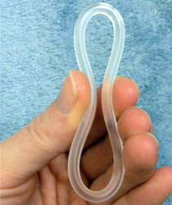
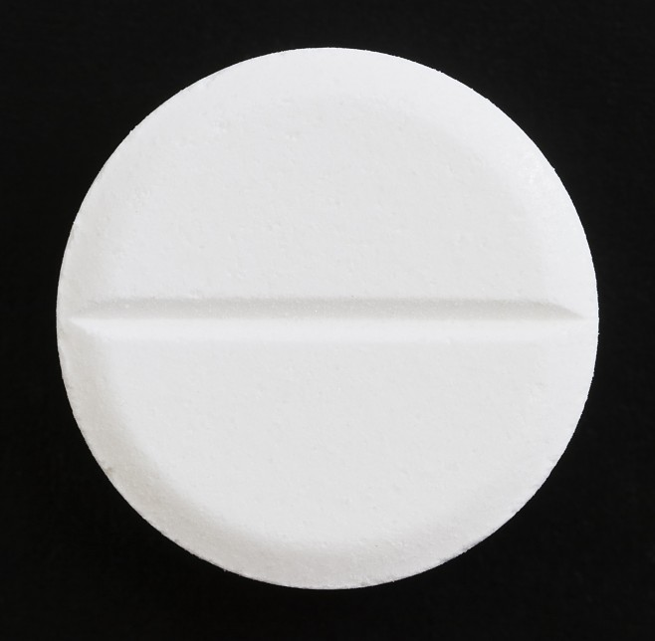
Available Forms:
Vaginal Ring and Tablets
Vaginal Ring
Tablets
Circular, flexible, nonirritating
Commonly made of silicone
Not messy, do not interfere with sex, and has an accurate extended release capability
Must be removed occasionally
Stable, not messy to handle, and easy to administer
Disintegrate in the vagina, releasing their contents
Patients seem to prefer the vaginal tablet over the cream

Slide 34
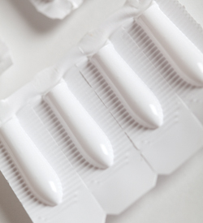
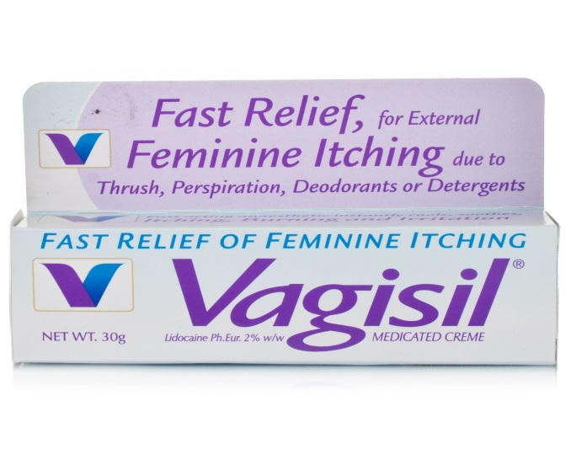
Available Forms:
Suppositories and Others
Suppositories
Creams, Ointments,
Gels, and Foams
Also called pessaries
Melts with body temperature and dissolves into body fluids
Provide local action to vagina
Administered usually with a plastic applicator
Can be messy and uncomfortable
Tend to be washed away by vaginal fluids
Need repeat administration

Slide 35
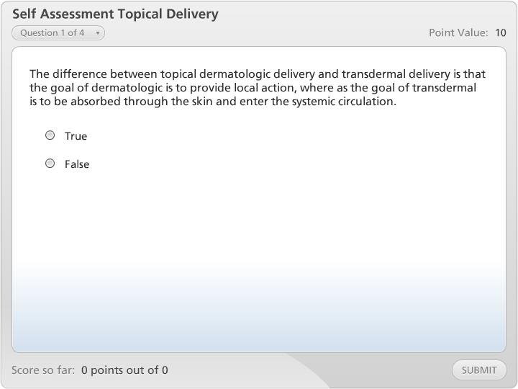



Self Assessment Topical Delivery

Slide 36

Conclusion: Choice of Route and Form
What is the drug in question?
Where is the drug target?
Urgency?
Patient’s Condition?
  What is their skin condition like? Is it dry, wet, cut, hairy? Are they concerned about aesthetic appeal? Are they allergic to adhesives? Are they willing to use a suppository? How about eye or ear drops?

Slide 37
Make Your Choice
Thinking of the major advantages, disadvantages, and physical properties of each drug route and form and applying this information to your patient’s specific needs will help you make this decision
Hopefully, as you go back to review these modules later on, you will start to be able to see the bigger picture

Slide 38
The End

